Slide 1

篮球crazy

Slide 2
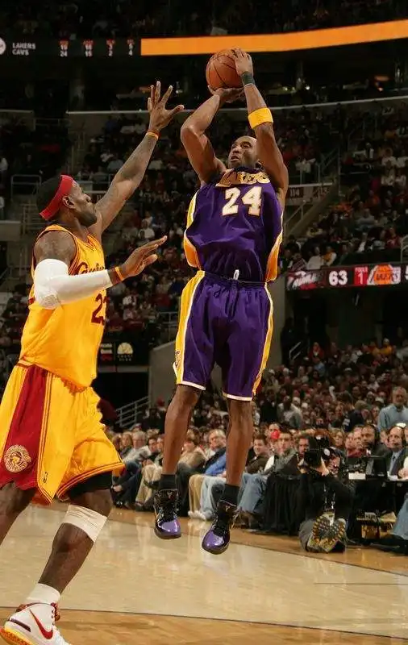
what：
the basketball game
科比 | 詹姆斯
24号 | 23号

Slide 3
how crazy:
1.in my senior high school,I tried my best to play basketball
2.we to the ball is the people to the first love

Slide 4
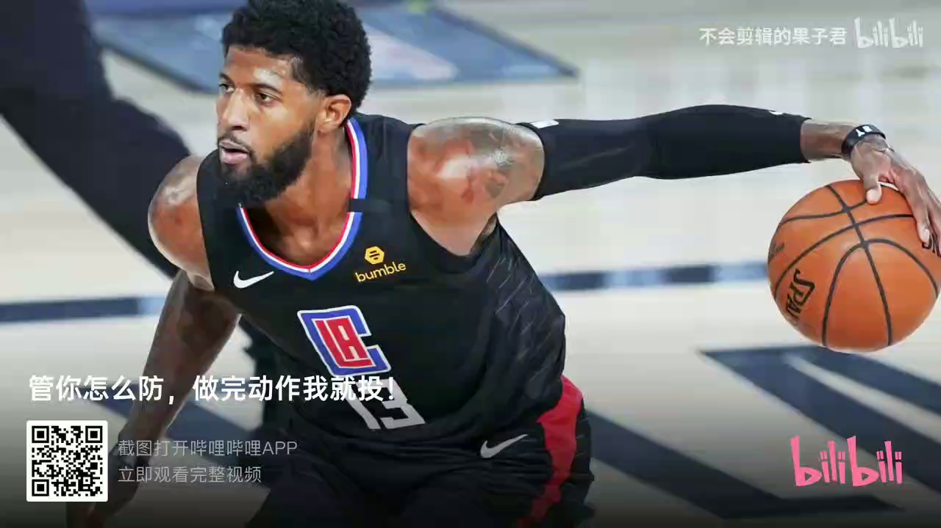

Slide 5
why:
An performance art
Release your stress deeply
Rebuild your confidence well

