Slide 1
DBMS and Data Management

Slide 2
The Classical Solution to Security.
1. Identify the user.
  access through a login sequence requiring a user identifier.
2. Authenticate the users identity.
  require the user to input a secure password.
3. Match the user identifier with a list of privileges.
4. Privileges such as:
  what type of operation can be performed?
  on what objects in the database?
5. Before a transaction is executed check objects and operations required for the transaction execution against the privileges granted to the user.

Slide 3
The above would use an authority matrix to determine which users had what rights on what objects.
User | Relation A | filed1 | filed2 | Relation B | Field a | Field b | Program a
1 | Select |  | All | None |  |  | Run
2 | Insert select |  | Select | All |  |  | None
3 |  | Select |  | Select |  |  | Run
In a relational database the above would form part of the database itself.

Slide 4
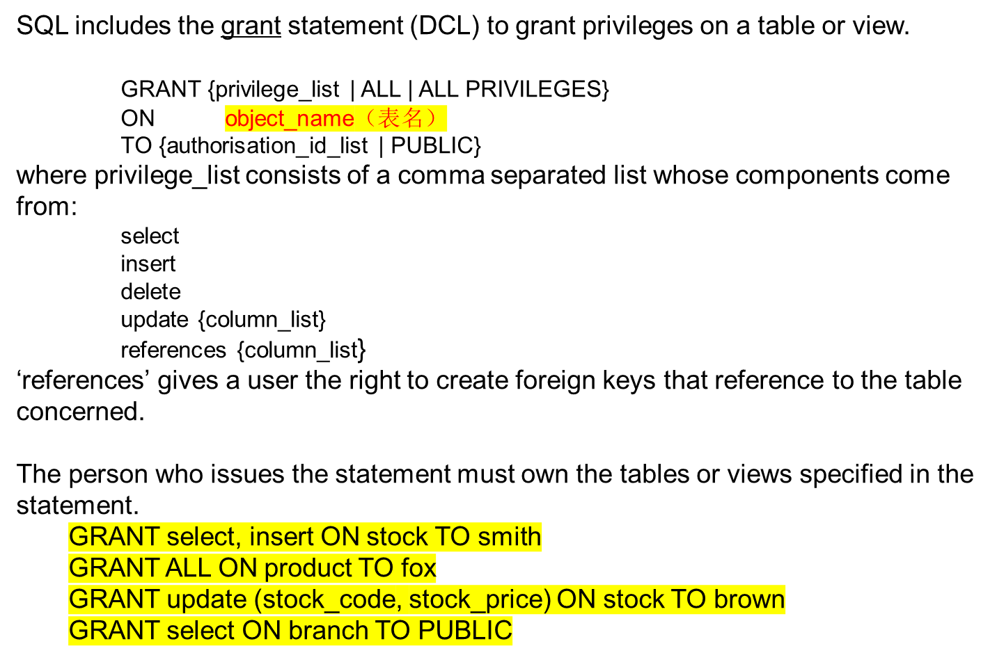
Example: Privileges

Slide 5
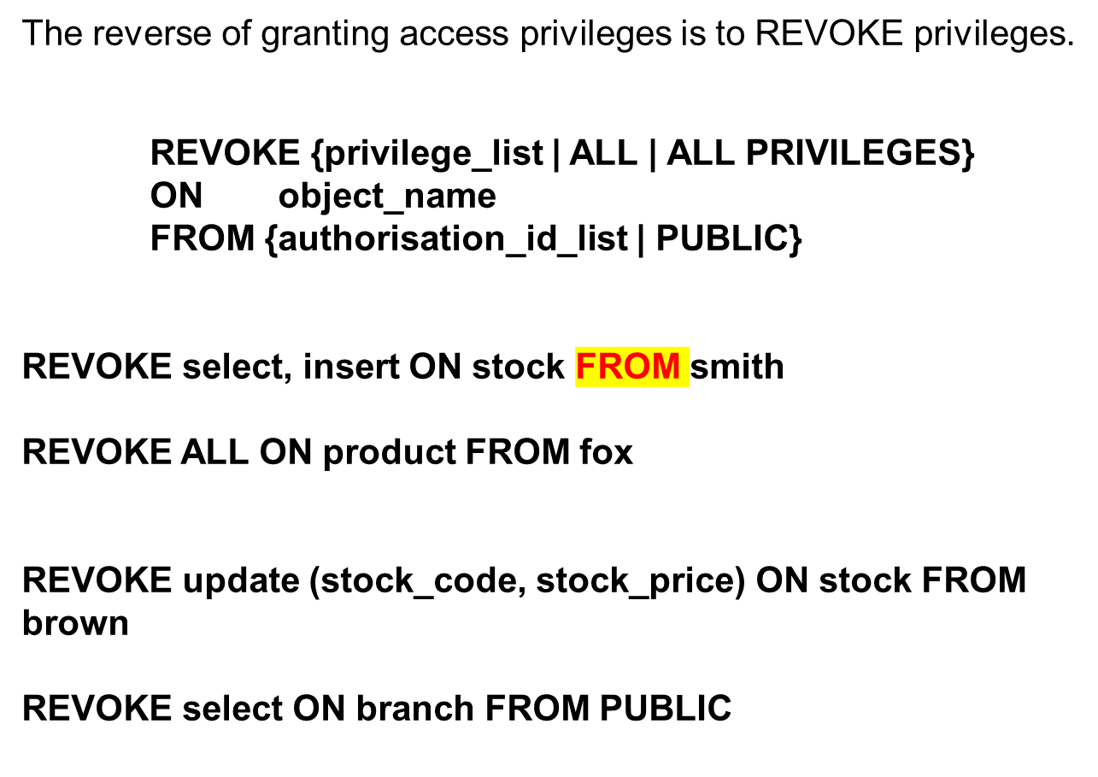

Slide 6
Security through VIEW definitions:
In order to limit a users access to data we could specify a set of views on to a relation.
The views would expose only those parts of the relation which the user is permitted to see, an abstraction of the underlying data.
No access privileges are granted on the underlying table, only on the views.
We use the External Schema to limit access to the Conceptual Data.
Consider,
A database concerned with personnel information which includes salary information, the database is used both by the payroll office which needs to see information on NI#, Salary, working hours etc. and also by the medical staff who need to see records of home address and phone numbers for emergency contacts.

Slide 7
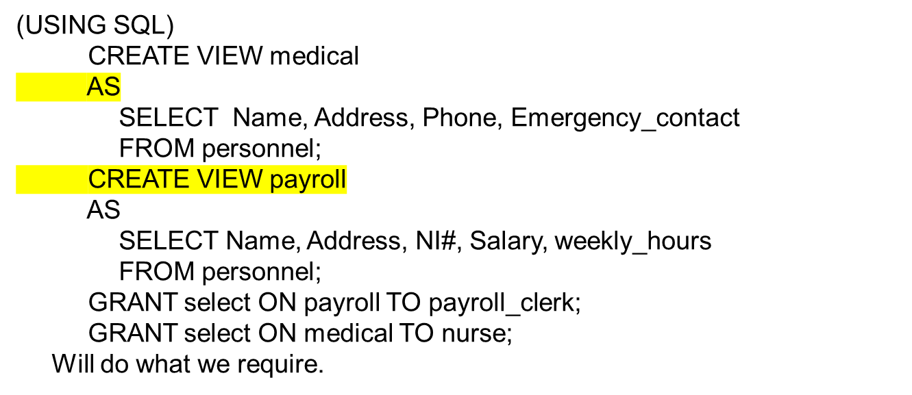
Clearly we wish to restrict the payroll view to exclude the medical information, and restrict the medical view to exclude the financial information.
personnel:
Name | Address | Phone | Emergency_contact | NI | Salary | Weekly_hours

Slide 8

Notice that the view can be quite sophisticated:
CREATE VIEW zwu (name, address, salary)
AS
SELECT Name, Address, Salary
FROM personnel
WHERE personnel.Name = "Zimin Wu";
GRANT select ON zwu TO Zimin;
Or how about summarising information in the payroll file, without making the individual salaries accessible?
CREATE VIEW salary_summary (total_salary)
AS SELECT sum(Salary)
FROM personnel;
GRANT select ON salary_summary TO bank_manager;
So, the view is a useful 'access limiting' tool.

Slide 9
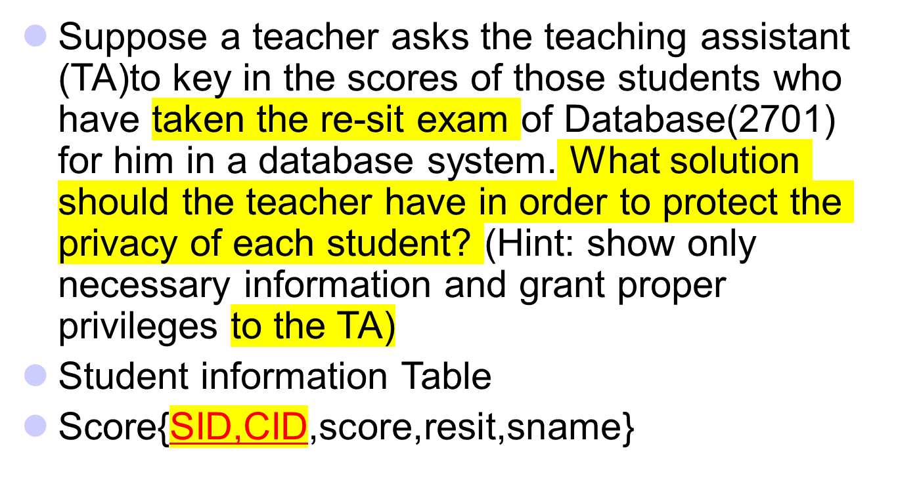
A actual scenario

Slide 10

Topics
Large Scale Data Management
Lots of Data
Lots of Users
Lots of ……
What are Transactions?
Concurrency Control
Why?
How?

Slide 11
Large Scale Data Management Systems
To put into perspective the problems of large scale database management systems consider the requirements for the implementation of an electronic cash system (e.g. smart cards)
  There are 400 Billion recorded consumer payment transactions each year.
  Person to Person transactions account for a further 400 Billion.
  There are 2 Trillion US dollars worth of sub $10 transactions world-wide per year.
  “e-cash” (Internet payment mechanisms) are expected to drop to the sub “cent” level for one-off per page access.
Banks like to keep accurate, secure records of ALL financial activities.
Credit card transactions are authorised in approx 30 secs - no matter how busy the system is (how many simultaneous attempts to authorise cards occur).

Slide 12
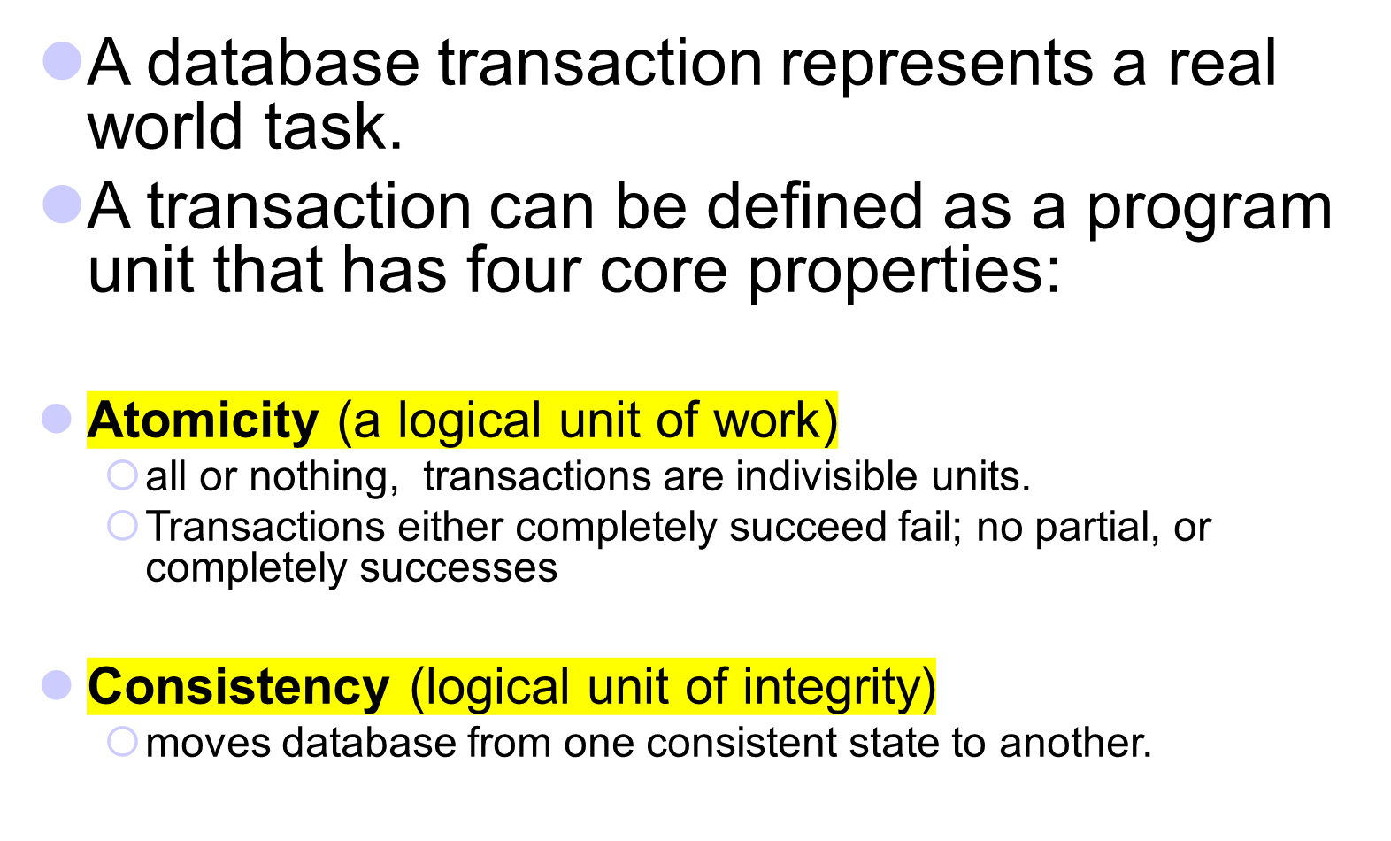
Transaction Processing

Slide 13
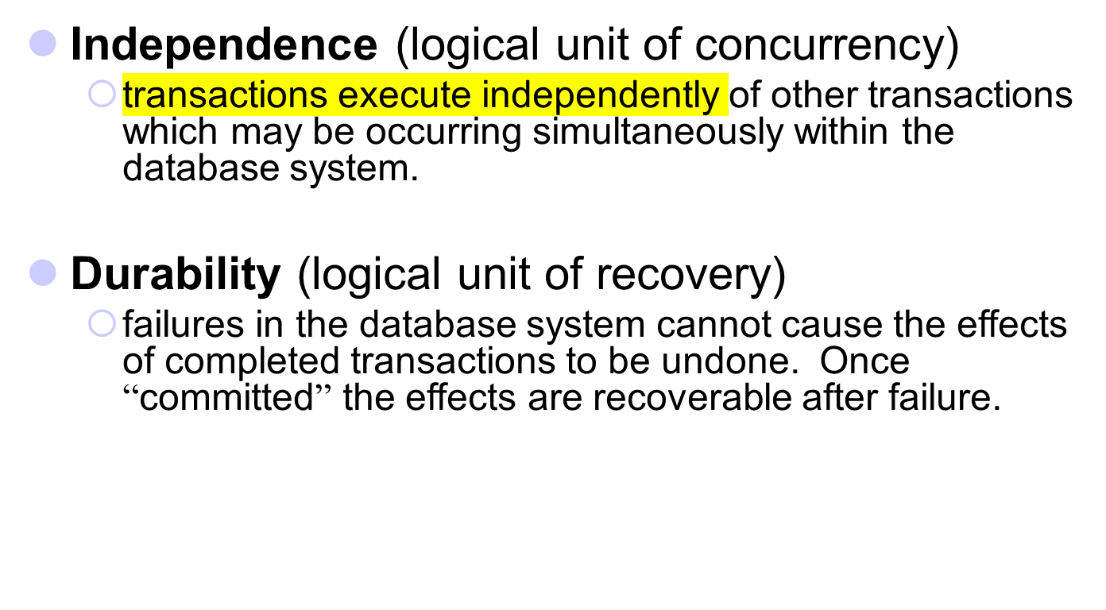

Slide 14
How to represent a Transaction.
How to represent a Transaction.
Most DBMS (or Database Languages) have mechanisms similar to the SQL description which follows (they do differ from system to system)
A program unit can be one or more statements - we talk about multi-statement transactions (MST). A DBMS needs “user” support to inform it of the boundaries of a transaction.
Marking Transaction Boundaries
A transaction begins with the user's first executable SQL statement.SQL has two simple commands in the Data Manipulation Language to allow the user to mark the end of transactions.

Slide 15
COMMIT;
  marks the end of a transaction - and is used where the effects of the transaction are to be made visible to the other transactions in the database.
ROLLBACK;
  also marks the end of a transaction - it is used where you want to “undo” the effects of the transaction (rollback the state of the database) to the state it was in just before the BEGIN TRANSACTION was executed. (undoing the whole transaction)
执行操作
撤销操作

Slide 16
The Need for Concurrency Control
Most databases are used in multi-user mode; resulting in more than one transaction occurring simultaneously in the system.
Databases frequently have lots of users.
(Airline booking, Telesales Operations, Credit Card Mgt.)
Within a collection of transactions individual statements might be interleaved as well as the underlying operating system causing processes to be interleaved.

Slide 17
Schedule (1)
Concurrency control can be achieved by scheduling the operations of concurrent transactions carefully.
Definition: A valid schedule S of n transactions T1, T2, ..., Tn is an ordering of all the operations in these transactions subject to the constraint that, for each transaction Ti, the operations of Ti in S must appear in the same order as they do in Ti.
Only valid schedule will be considered.

Slide 18

Schedule (2)
Notations:
Ri(X) – read(X) by transaction Ti
Wi(X) – write(X) by transaction Ti
Example: Given T1 = R1(X) W1(X) and
T2 = R2(X) W2(X)
A valid schedule: R1(X) R2(X) W1(X) W2(X)
An invalid schedule: W1(X) R1(X) R2(X) W2(X)
先读后写

Slide 19

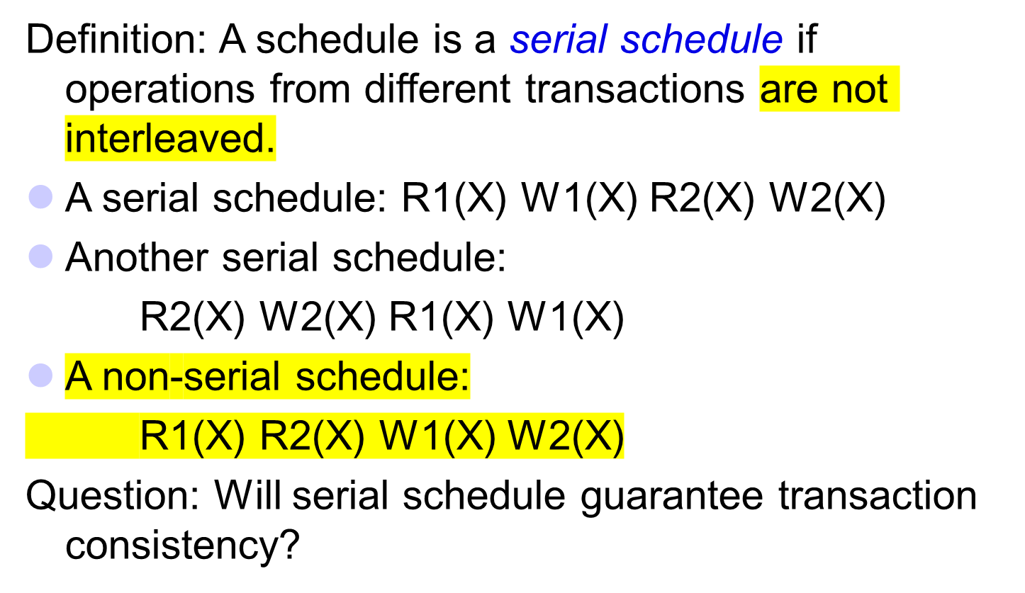

Slide 20
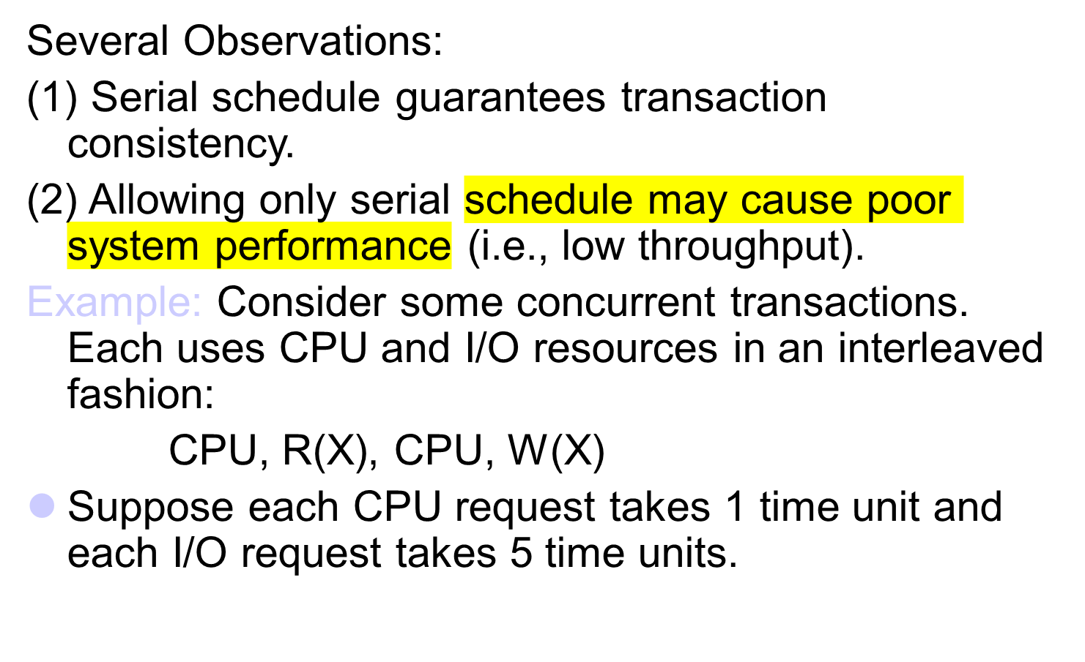
Serial Schedule (2)

Slide 21
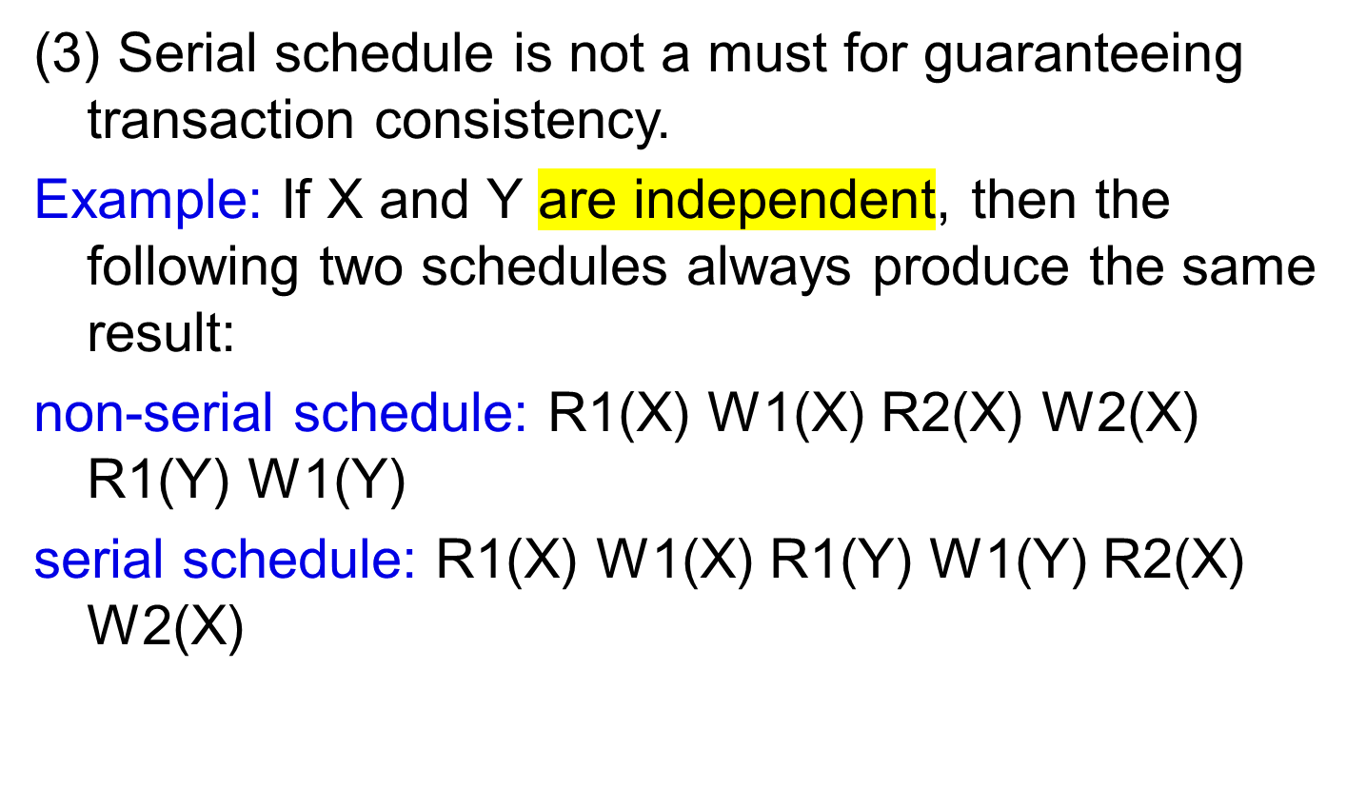
Serial Schedule (5)

Slide 22
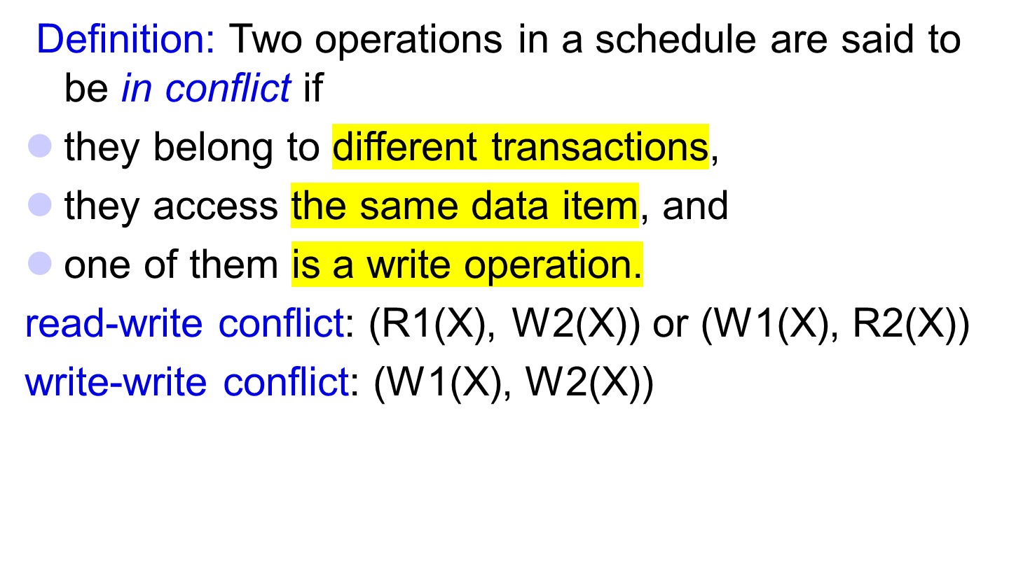
Conflict Operations
是否矛盾

Slide 23
Equivalent Schedules
Definition: Two schedules of the same set of transactions are (conflict) equivalent if the order of any two conflicting operations is the same in both schedules.
Example: Consider two transactions:
T1 = R1(X)W1(X)R1(Y)W1(Y)
T2 = R2(X)W2(X).
The following two schedules are equivalent:
S1: R1(X) W1(X) R2(X) W2(X) R1(Y) W1(Y)
S2: R1(X) W1(X) R1(Y) W1(Y) R2(X) W2(X)

Slide 24
Serializable Schedule
Definition: A schedule S of n transactions is (conflict) serializable if it is equivalent to at least one serial schedule of the n transactions.
S1 above is serializable.
Claim: A serializable schedule guarantees transaction consistency.
A non-serial but serializable schedule often permits higher degree of concurrency than a serial schedule.

Slide 25

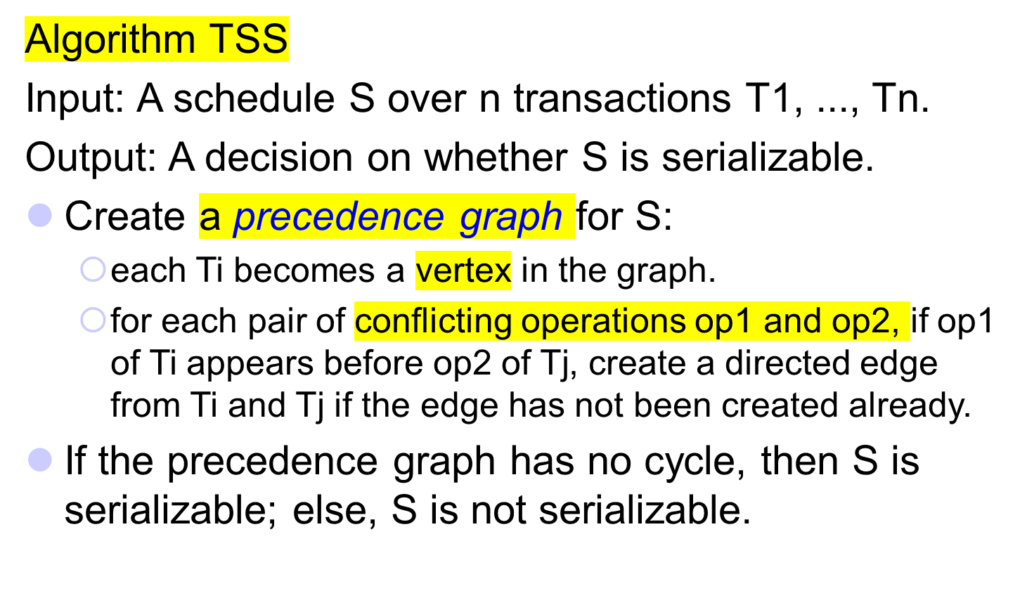

Slide 26
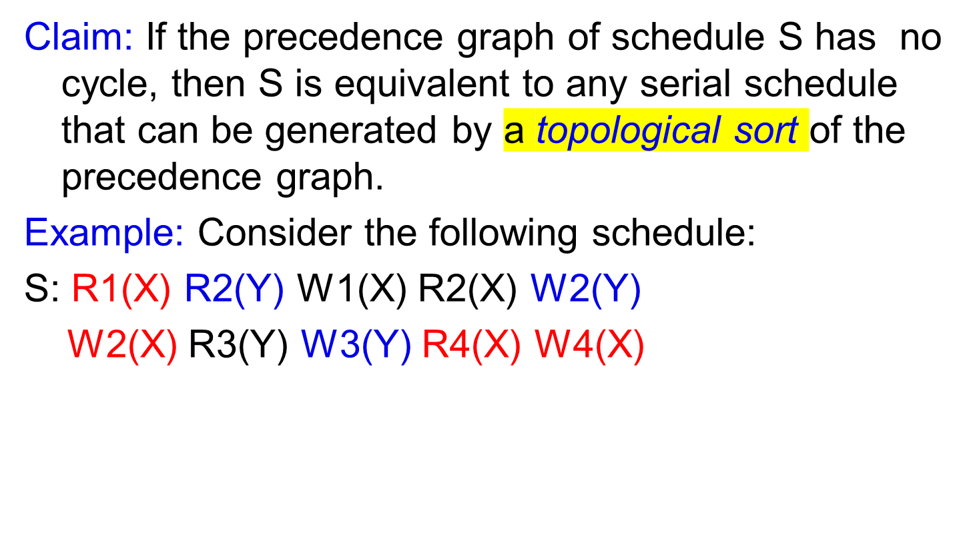
Test Schedule Serializability (3)

Slide 27
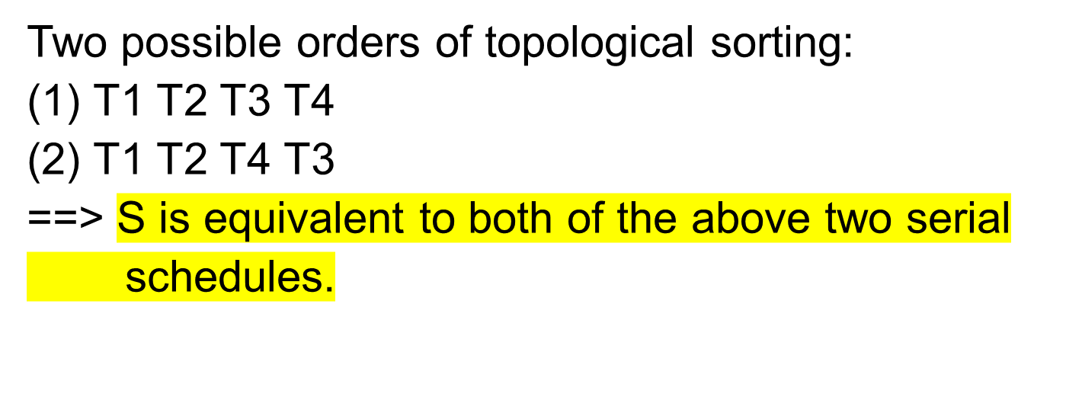
Test Schedule Serializability (4)
T1
T2
T3
T4

Slide 28
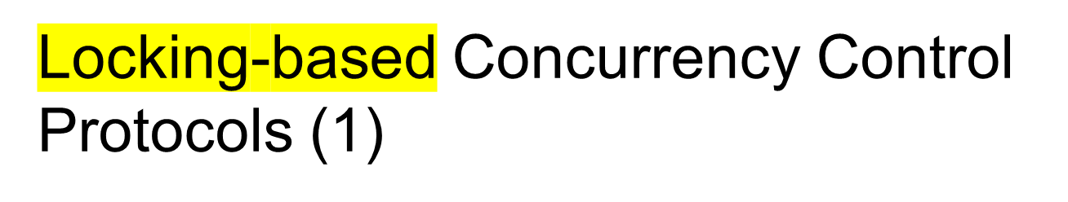
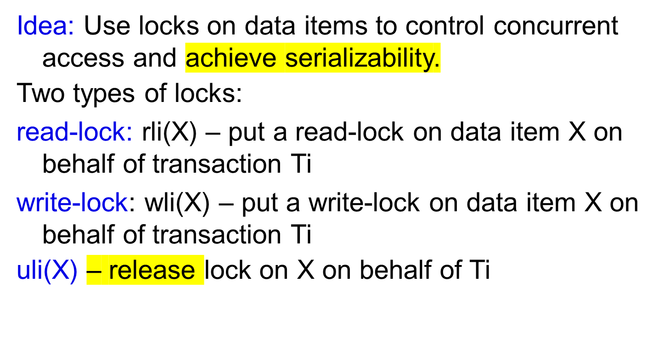
释放一个交易的所有锁

Slide 29
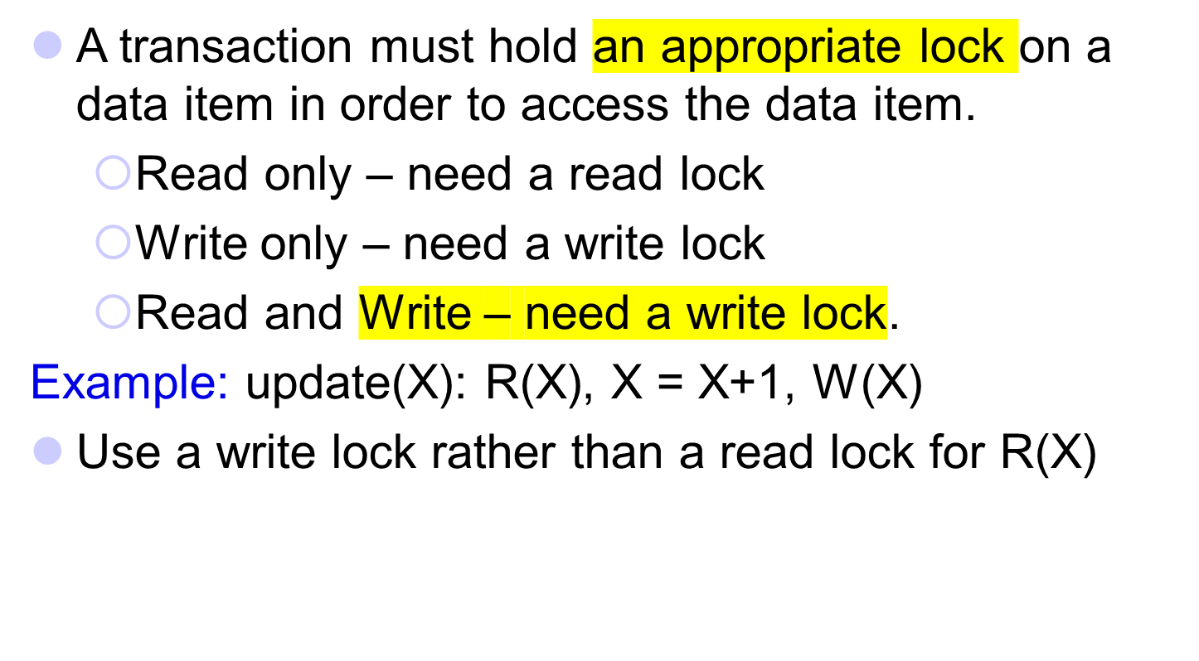
Locking-based Concurrency Control Protocols (2)
Notes:
In general, it is possible that a (R(X), W(X)) pair does not correspond to an update operation, for example, it is a select followed by a delete.
In this case, a lock can be upgraded to a write-lock from an initial read-lock.

Slide 30
Locking-based Concurrency Control Protocols (3)
Lock Compatibility table
rli(X) wli(X)
rlj(X) Yes No
wlj(X) No No
Multiple compatible locks can be put on the same data item.
Incompatible locks cannot be put on the same data item at the same time.
Some DBMSs do not follow this requirement.

Slide 31
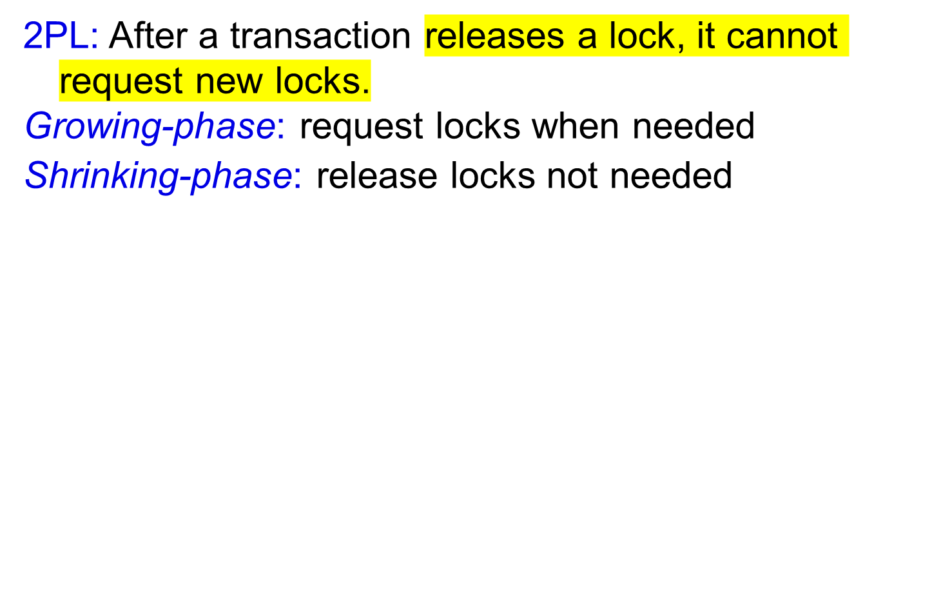
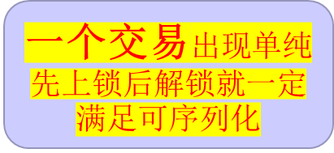

Two-phase Locking Protocol (2PL) (1)
#locks
time

Slide 32
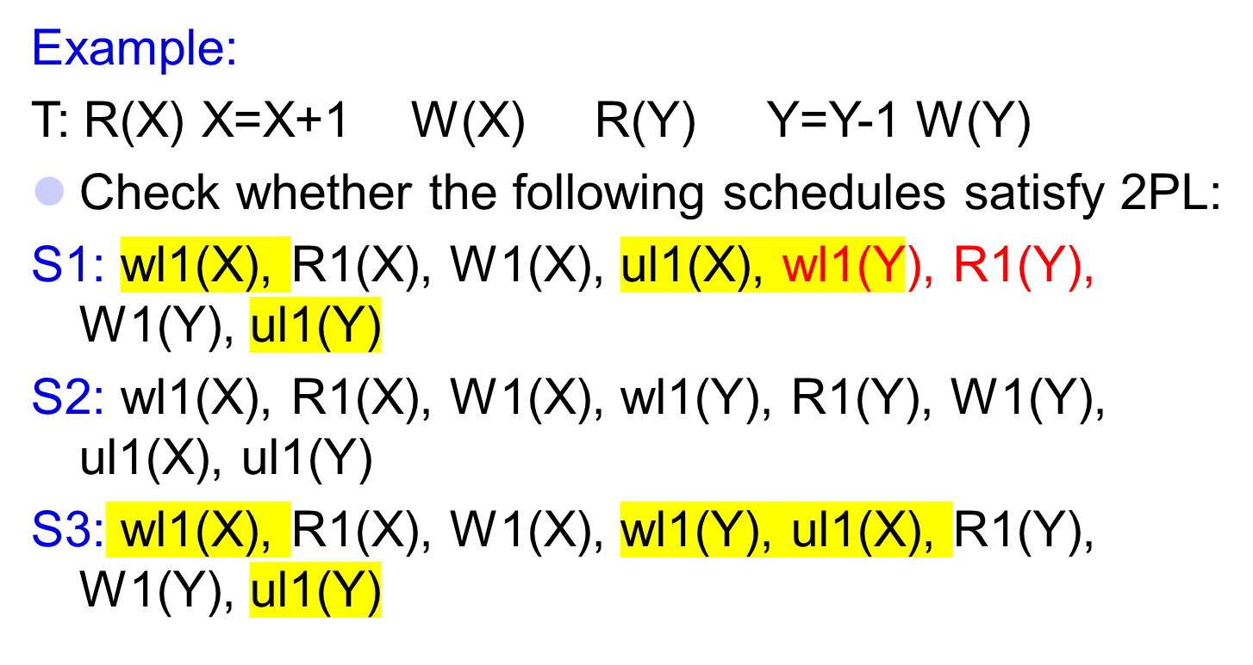
Two-phase Locking Protocol (2PL) (2)
Only S2 and S3 satisfy the 2PL protocol.

Slide 33
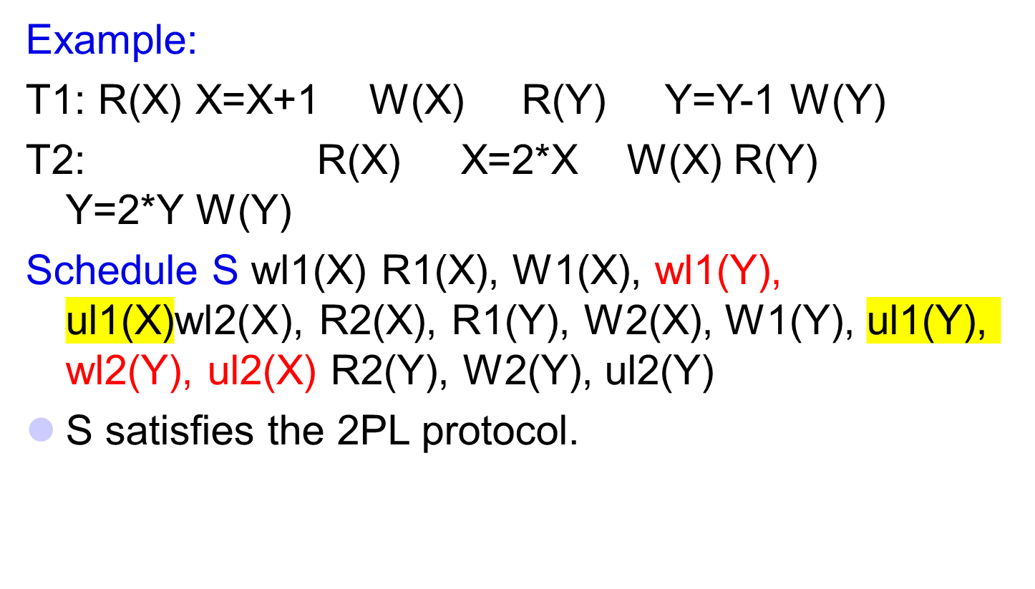
Two-phase Locking Protocol (2PL) (3)
因为是属于不同的交易

Slide 34
Two-phase Locking Protocol (2PL) (4)
For a set of transactions, there may be more than one schedule satisfying 2PL.
May add the following requirements to make the schedule unique:
  First-come-first-service whenever possible: Requests that come first should be scheduled first subject to 2PL rule.
  Release a lock as early as possible: When a lock is no longer needed by a transaction, it should be released as soon as allowed by 2PL.

Slide 35
Two-phase Locking Protocol (2PL) (5)
Theorem: Any schedule satisfying the 2PL protocol is serializable.
Problems with 2PL:
2PL may cause cascading aborts.
2PL does not prevent deadlock.

Slide 36
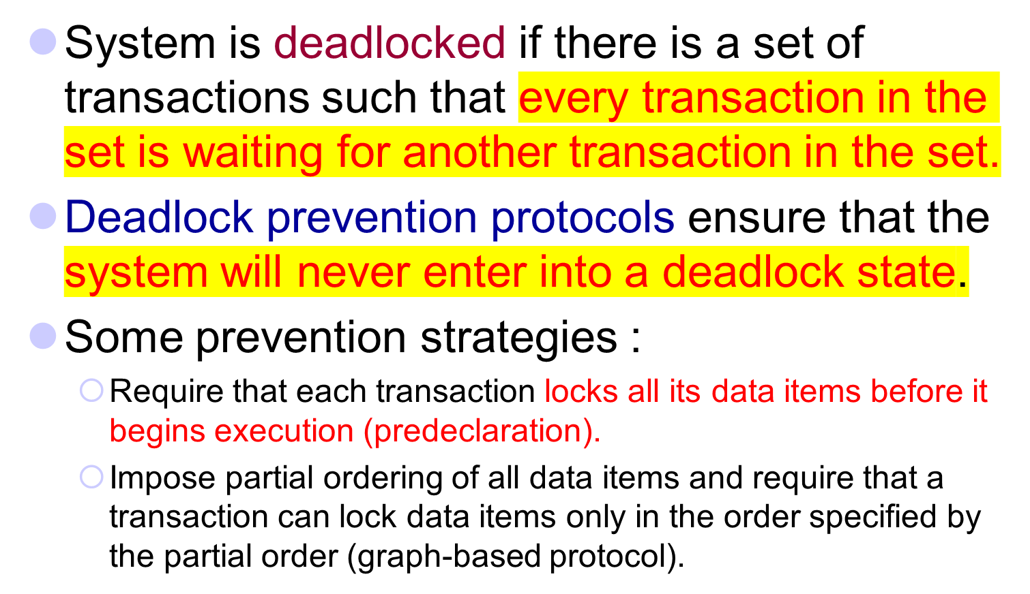
Deadlock Handling
要么直接将该事务的所有数据项全部锁起来；要么通过图的方式调整获取数据的顺序

Slide 37
More Deadlock Prevention Strategies
Following schemes use transaction timestamps for the sake of deadlock prevention alone.
wait-die scheme — non-preemptive(非抢占)
  older transaction may wait for younger one to release data item. Younger transactions never wait for older ones; they are rolled back instead.
  a transaction may die several times before acquiring needed data item
wound-wait scheme — preemptive
  older transaction wounds (forces rollback) of younger transaction instead of waiting for it. Younger transactions may wait for older ones.
  may be fewer rollbacks than wait-die scheme.

Slide 38
Deadlock prevention (Cont.)
Both in wait-die and in wound-wait schemes, a rolled back transactions is restarted with its original timestamp.
  Older transactions thus have precedence over newer ones, and starvation is hence avoided.
Timeout-Based Schemes :
  a transaction waits for a lock only for a specified amount of time. After that, the wait times out and the transaction is rolled back.
  thus deadlocks are not possible
  simple to implement; but starvation is possible.
  Also difficult to determine good value of the timeout interval.

Slide 39

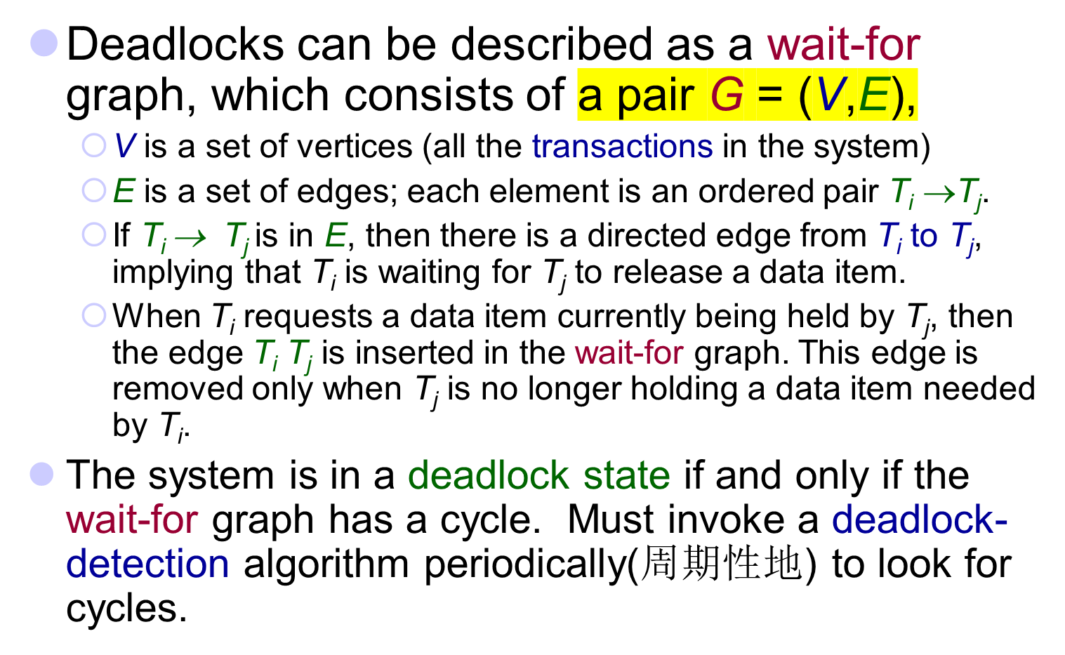

Slide 40



Deadlock Detection (Cont.)
Wait-for graph without a cycle
有环图则死锁

Slide 41
Deadlock Recovery
When deadlock is detected :
  Some transaction will have to rolled back (made a victim) to break deadlock.
    Select that transaction as victim that will incur minimum cost.
  Rollback -- determine how far to roll back transaction
    Total rollback: Abort the transaction and then restart it.
    More effective to roll back transaction only as far as necessary to break deadlock.
  Starvation happens if same transaction is always chosen as victim.
    Include the number of rollbacks in the cost factor to avoid starvation

