Slide 1
数据库系统
Database Systems

Slide 2
CHAPTER 1: INFORMATION AND DATABASE SYSTEM
Chapter Outline:
  1.1 from Information to Data
  1.2 History of Data management
  1.3 Database System
  1.4 Database Management System (DBMS)

Slide 3
1.1 Information and Data
We are living in a “world of INFORMATION”
What is Information?
  Hard to get a perfect definition.
  In a easier but informal way:
  Information can be defined as knowledge or idea that is derived from study, experience, about events or things.

Slide 4
Information media data
Information need to be represented so that it can be process by human being, which may be called media
what human can sense:
  Sound, Text, Graphics, ……
Most traditional media can be transformed into bits or symbols and therefore becomes easier to be manipulate by computer.(data)

Slide 5
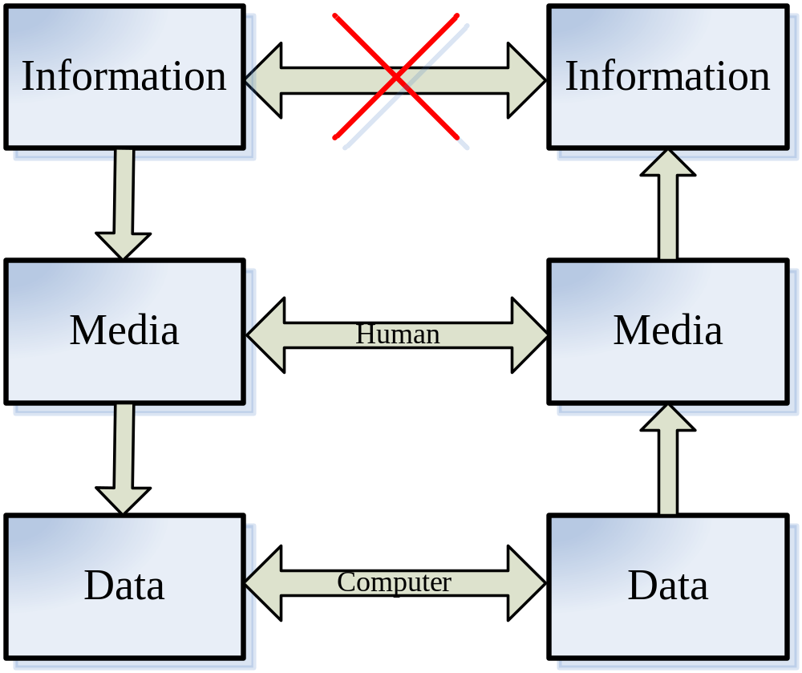
Relationships
Notes:
Sharing information directly is impractical, then the information is represented by media and data.The difference of the two is that media are comprehensible by human and data are mostly processed by computer software.

Slide 6
The characteristics of Information
Facts: (Monotonically Increasing) more and more storage devices are required to store ever growing volume of information:
  Info. is generated from almost everything daily.
Facts: (Infinitely Replicable) copy and paste:
  It can be shared with others without losing anything.
Facts: (Derivation) related information will generate new information
  With more people involved, more information is obtained and new information is generated.
Information is different from “material”, because of the three characteristics. data therefore inherits these characteristics
Notes:
Derivation: 多个学期的学生成绩，成绩是否变好了？

Slide 7
1.2 History of Data Management
In 50's -- 60's, File based system emerged to meet the need of managing data.
File based system consists of Application Programs as well as some independent files.

Slide 8
An Example File System
Example:
  A bank with several branches
  A banking system may have files for customers, saving accounts and checking accounts;
  Application Programs to deposit and withdraw money, to find balance, etc.

Slide 9
Problems of File Systems (1)
No guarantee that data is not lost if not backed up
No support to query languages
No efficient access to data items unless the location is known
Application depends on the data definitions (structures)
Change to data definition will affect the application programs
Single view of the data
Separate files for each application
Limited control to multiple accesses
Data viewed as physically stored
It is difficult to support new applications.

Slide 10
Problems of File Systems (2)
  No centralized control of data.
  Files are often created for a particular application.
  Files are created and managed independently.

Slide 11
Problems of File Systems (3)
There often exists severe data redundancy and inconsistency.
Checking-Account: Acct#, Owner-name, Owner-SSN, Owner-Addr, Balance, ...
Saving-Account: Acct#, Owner-name, Owner-SSN, Owner-Addr, Balance, Interest, …

Slide 12
Problems of File Systems (4)
It lacks concurrency control.
Concurrency control: prevent mutual interference of concurrent requests.
Example (Train ticket reservation):
Consider the situation when two customers are trying to book the only ticket left for a train through two agents at about the same time.

Slide 13
Hierarchical database systems
Hierarchical database systems (HDBS), late 60's -- early 70's
Best known HDBS: IMS (Information Management System of IBM).
One-to-many relationships between parent records and child records.
Records are connected pointers.

Slide 14
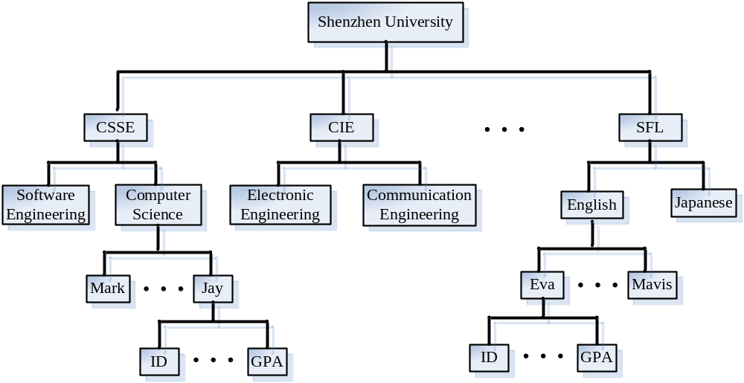
Example of Hierarchical Database

Slide 15
An IMS Query
Query: find all shenzhen University students whose major is computer science and whose GPA is higher than 3.5.
GU University (Name = `Shenzhen University')
College (Name = `CSSE')
Department (Name = `Computer Science')
Student (GPA > 3.5)
L1: GNP Student (GPA > 3.5)
Goto L1
Notes:
GET UNIQUE GU
GET NEXT GN
GET NEXT within GNU
PARENT
GET HOLD UNIQUE GHU
GET HOLD NEXT GHN
GET HOLD NEXT within GHNP
PARENT

Slide 16
History of Database (Continued)
Network database systems (NDBS), late 60's -- early 70's
In NDBS, record types are organized into an acyclic graph.
Some commercial NDBSs: IDS II (Honeywell), DMS II (UNISYS).
Main problem with HDBS and NDBS: difficult to use.

Slide 17
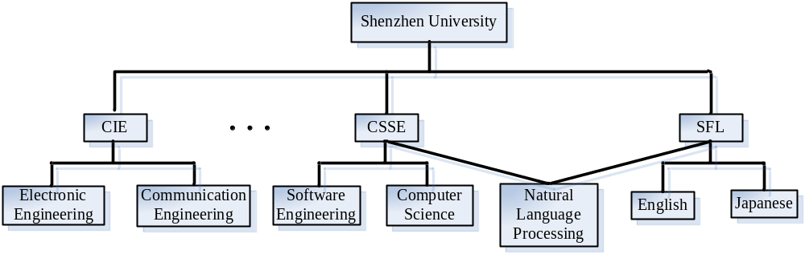
Example of Network database

Slide 18
History of Database (Continued)
Relational database systems (RDBMS), early 70's -- now
Example relational DBSs: DB2, Oracle 10g, Microsoft SQL server ...
In RDBMS, data are organized into tables (relations).

Slide 19
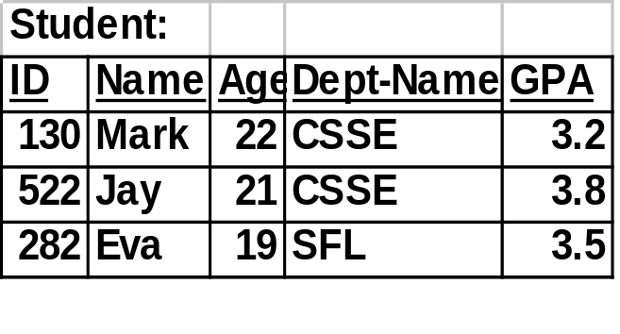
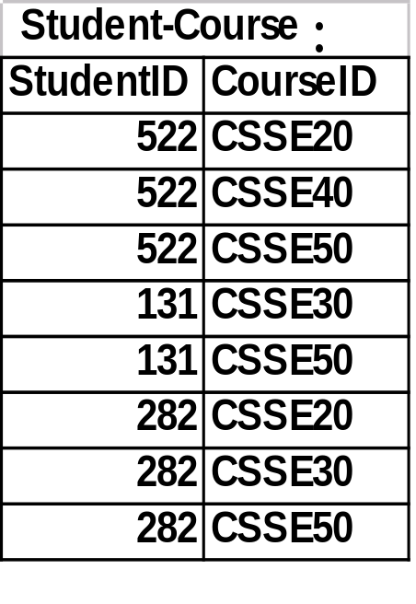
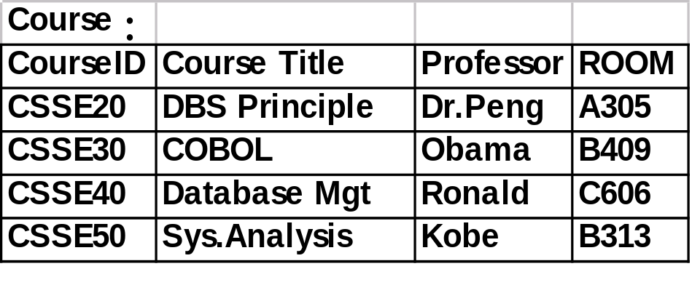
Relational database

Slide 20
History of Database (Continued)
Object-oriented and Object-Relational database systems (OODBS), 80's -- now
Example OODBSs: O2, Objectivity, ObjectStore, Versant, …
Example ORDBSs: Oracle 9, Informix, UniSQL/X.
Notes:
To satisfy the relational data model and the programming languages
computer aid design (CAD), multimedia processing, telecommunication and health care.

Slide 21
Database System
Data is increasing and need storage and processing techniques.---database system
A Database System is composed of a database,data model as well as a set of software capable of managing the database called DBMS.

Slide 22
DATABASE
Database is a collection of data with three properties:
  It matches some aspects of the real-world.
  It is created for some specific goal
  the data is related

Slide 23
DATA MODEL
The description of the data in the database system is called data model.
  the structure of the data, which describes the format or organization of data in the database.
  operations on the data. Different data structure will have different data operation mechanism.
  Constraints on the data form the third concern of the data. The constraints are limitations or rules on what the data can do.
Notes:
学生资料按学号放， 按姓名放
Operation:
Constraint: 1-100

Slide 24
DBMS
A database management system (DBMS) is a set of software that are used to define, store, manipulate and control the data in a database.
defines --- define data types, structures and constraints.
stores --- store data to support efficient access.
manipulates --- perform retrieval and update operations using a query language.
controls --- provides control access to data.

Slide 25
Database Languages
Data Definition Language (DDL): used by DBA or database designer to define database schemas.
Data Manipulation Language (DML): used by database users to retrieve, insert, delete and update data in the database.
  Query language: The part of DML that is used to retrieve data.
Data Control Language (DCL): used by database owners and DBA to control the access of data.

Slide 26
Two Types of DML
Procedural DML --- a user is required to specify WHAT data is needed as well as HOW to get it.
Example: DMLs for hierarchical and network database systems.
Non-procedural DML --- a user is required to specify ONLY WHAT data is needed but NOT HOW to get it.
Example: SQL

Slide 27
Procedural DML
Procedural DML is more difficult to use but usually has a better performance
Non-procedural DML is easier to use but usually suffers on performance
A better approach:
Non-procedural DML + query optimization

Slide 28
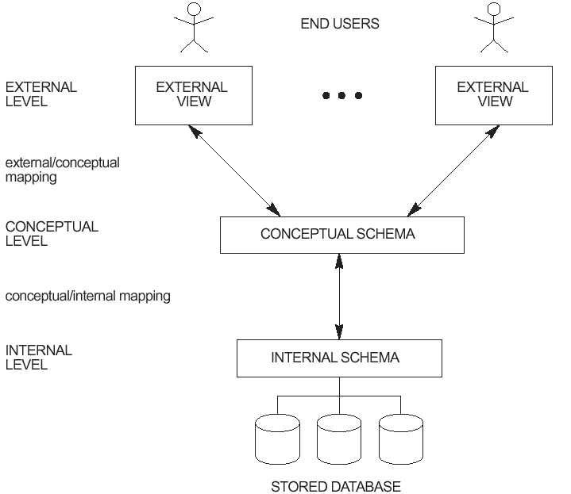
DBMS 3-Tier Architecture
Notes:
Internal: data storage structures and access paths.
describe the structure and constraints for the whole database. Uses a conceptual or an implementation data model.
External schemas: at the external level to describe the various user views. Usually uses the same data model as the conceptual level.

Slide 29
Database Schema (1)
Definition: Database schema is the description of the user data in the database.
In relational model, a database schema consists of a set of tables.
Conceptual schema: logically describes all data in the database
Notes:
以及内模式或者物理模式（internal or physical schema）

Slide 30
Database Schema (2)
Internal schema (Physical schema): describes how data in the database are actually stored
External schema (User view): Each external schema provides a description of a portion of the data in the database which are interested or can be accessed by a special group of users.
Notes:
举例

Slide 31
Characteristic of 3-tier Architecture
1. The external level : concerned with the way individual users see the data
2. The conceptual level : can be regarded as a community user view - a formal description of data of interest to the organization, independent of any storage considerations.
3. The internal level : concerned with the way in which the data is actually stored

Slide 32
Advantages of the Three-Tier Architecture
Easier for users to understand and use the database.
Provides a mechanism for access control.

Slide 33
An Example
Conceptual schema: students: student_ID char(6)
Department_number char(4)
GRADE numeric(5)
Internal schema: Stored_std: length = 20
Header Type = byte(6), offset = 0
std# Type = byte(6), offset = 6, Index = STDX
Dept# Type = byte(4), offset = 12
GRD Type = byte(4), offset = 16
External schema 1: STD_GRD: STD# char(6)
GRD integer
External schema 2: STD_Dept: STDNo char(6)
DeptNo char(4)

Slide 34
Mappings
Two mappings are needed to process a user query:
From external schema to conceptual schema
Ex: StdNo to Student_number
From conceptual schema to internal schema
Ex: Student_number to STD#

Slide 35
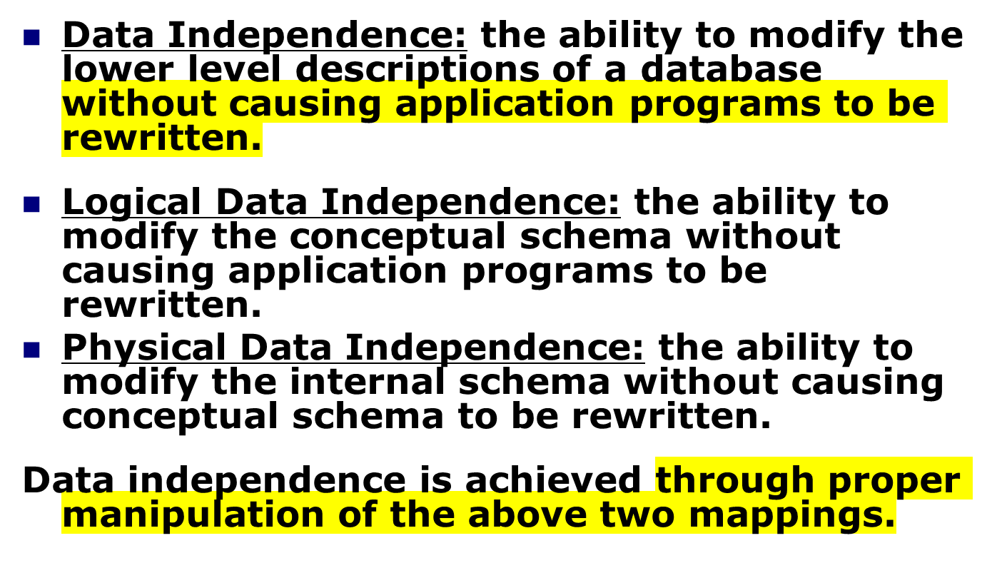
Data Independence

Slide 36
DBMS related roles
DBMS Developers: Those who design and implement DBMS software: buffer manager, query processor, transaction manager, interface, ...
Database designers: Those who are responsible for determining
  what data should be stored in the database;
  how data in the database should be organized;
  the design of customized views;
  the design of special data structures to improve the performance of the system.

Slide 37
DBMS Professionals(2)
Database administrator (DBA): Those who manage and monitor the daily operation of a database system.
  authorization for database access, e.g., who can access what data in what mode.
  routine maintenance: backup, install new tools, ...
  modification to existing database design.

Slide 38
DBMS Professionals(3)
End-user:
  Casual users: those who access the database using SQL directly.
  Naive users: those who access the database using pre-prepared packages.
Application programmers: Those who write menu applications for naive users, typically, through database calls embedded in a program.

Slide 39
Additional Benefits of Database Technology
- Controlling redundancy (不必要的重复) in data storage and in development and maintenance efforts.
- Sharing of data among multiple users.
- Restricting unauthorized (未经批准的)access to data.
- Providing multiple interfaces to different classes of users.
- Representing complex relationships among data.
- Enforcing integrity constraints (数据完整性) on the database.
- Providing backup and recovery services.
- Potential for enforcing standards.
- Flexibility (适应性) to change data structures.
- Reduced application development time.
Availability of up-to-date information.
Economies of scale (因经营规模扩大而得到的经济节约)

Slide 40
When not to use a DBMS
Main inhibitors is costs of using a DBMS:
  High initial investment and possible need for additional hardware.
  Overhead for providing generality, security, recovery, integrity, and concurrency control is very high.
When a DBMS may be unnecessary:
  If the database and applications are simple, well defined, and not expected to change.
  If there are stringent real-time requirements that may not be met because of DBMS overhead.
  If access to data by multiple users is not required.
When no DBMS may suffice :
  If the database system is not able to handle the complexity of data because of modeling limitations
  If the database users need special operations not supported by the DBMS.

Slide 41
Questions
?

