Slide 1
CHAPTER 2: THE RELATIONAL DATA MODEL
数据库系统
Database Systems

Slide 2
CHAPTER 2: THE RELATIONAL DATA MODEL
Definition: A data model is a tool that can be used to specify (describe) the
real-world objects (entities),
relationships among them,
constraints on them, and
the manipulation of them.

Slide 3
Relational Database Model
started:1970 "A Relational Model of Data for Large Shared Data Banks".
topics:
  relation and relational database,
  realworld objects and relational representation
  integrity and constraints

Slide 4
Terminologies of a Relation
relation name
Attr1 Attr2 Attr3 Attr4
v11 v12 v13 v14
v21 v22 v23 v24
v31 v32 v33 v34
Relation name
Attributes
head
Records
(tuples,rows)
columns

Slide 5
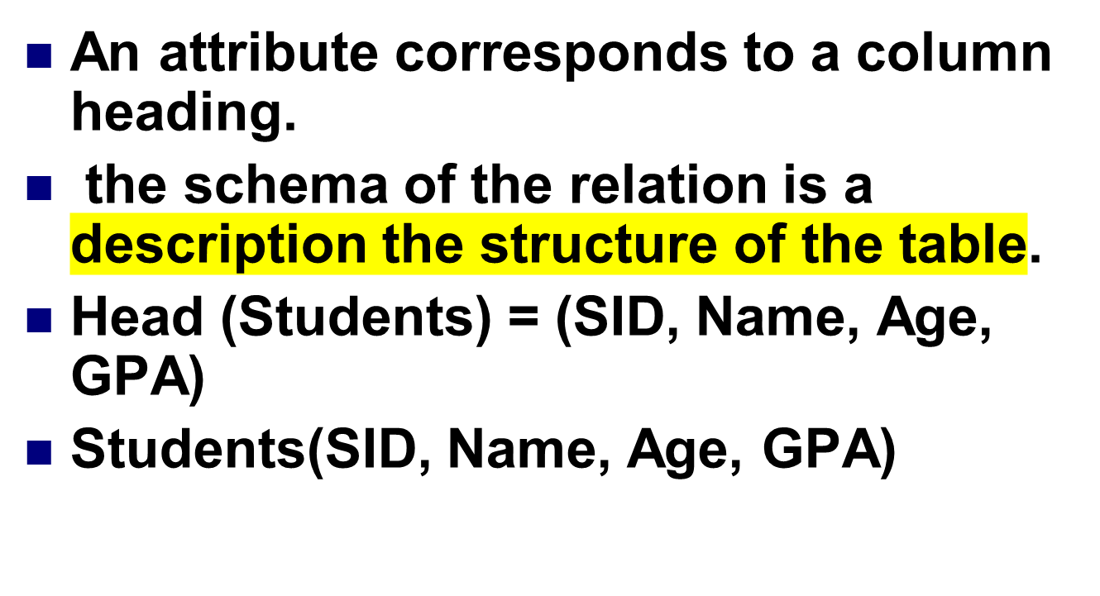
Schema

Slide 6
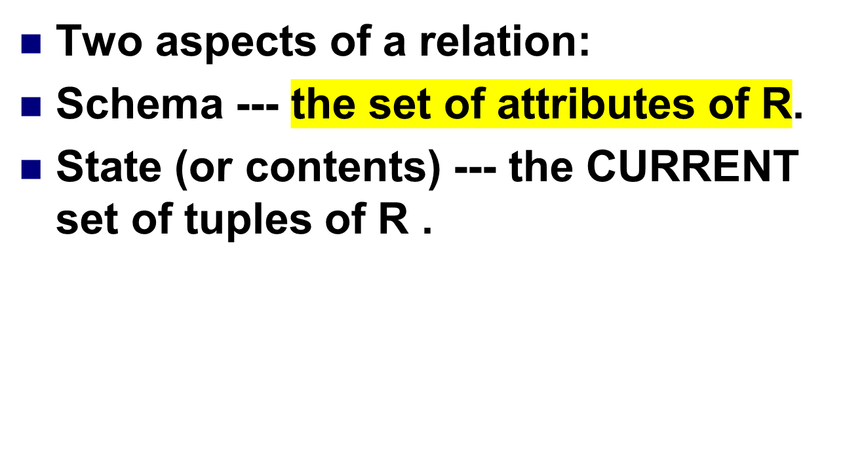
Schema and State

Slide 7

Once the schema of a relation is decided, it will be very costly to change
Some possible changes are:
delete an attribute
insert an attribute
rename an attribute
delete the schema

Slide 8
Schema and State
Whereas the state of a relation changes frequently in most relations.
Some possible changes are:
  update some attribute values
  Insert a new tuple
  Delete an existing tuple
A given schema may have different states at different times.

Slide 9
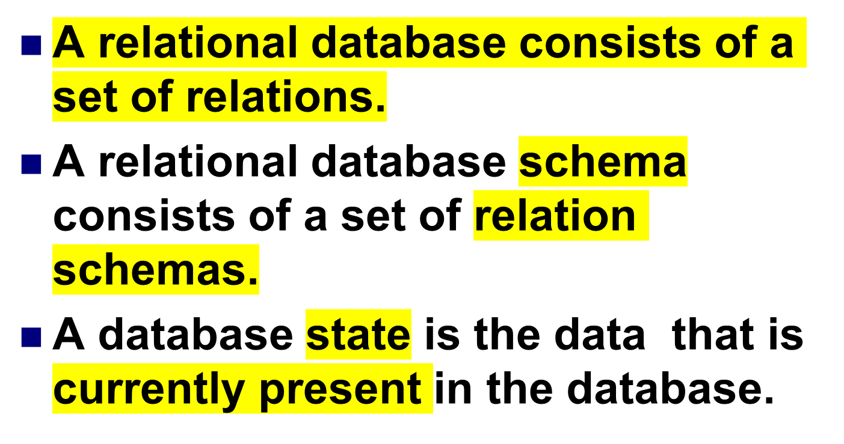
A Relational Database

Slide 10
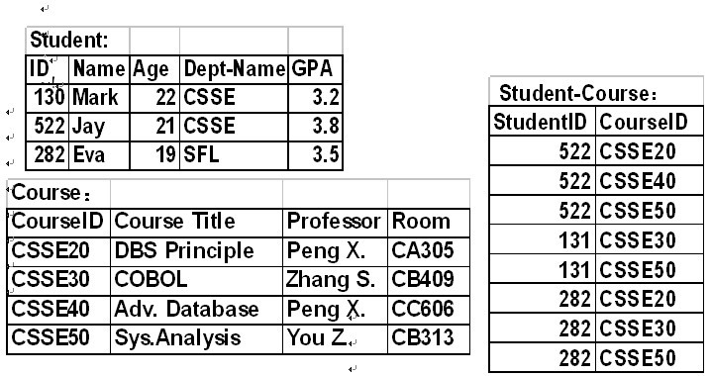
An Example Database

Slide 11
Characteristics of a Relation 1
1.Changing the order of attributes or tuples does not affect the meaning of the relation (columns and rows can be in any order)
name | age | ID | group
Smith | 34 | 45 | alpha
Patel | 29 | 88 | beta
Smith | 32 | 102 | alpha
Jones | 24 | 106 | alpha
ID | name | age | group
102 | Smith | 32 | alpha
106 | Jones | 24 | alpha
88 | Patel | 29 | beta
45 | Smith | 34 | alpha

Slide 12
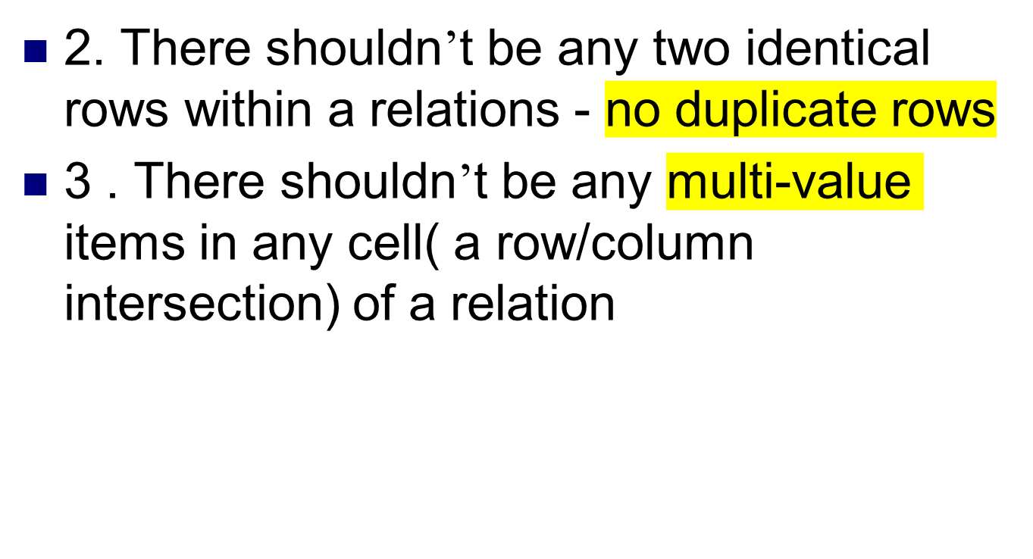
Characteristic of a relation 2

Slide 13
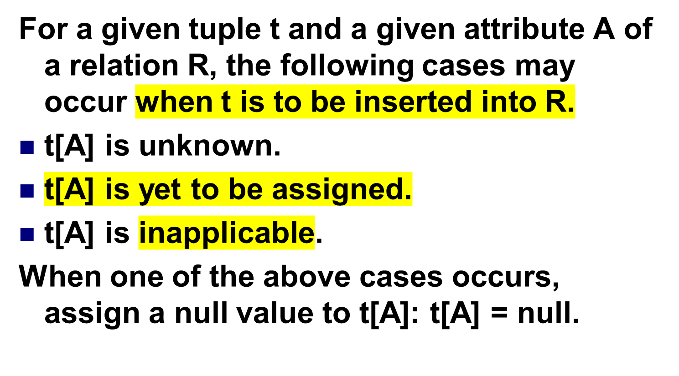
Null Value (1)

Slide 14
Null Value (2)
Note: A null value is different from either a 0 or a space!
In SQL, any arithmetic expression involving null will be evaluated to null.

Slide 15

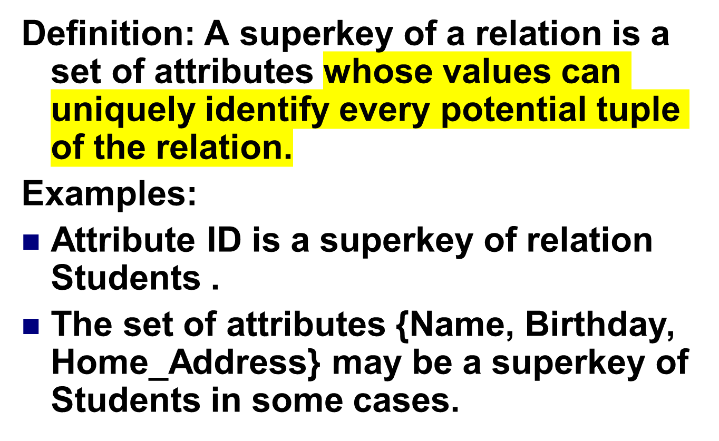
可以独立标识（无重复）一个属性的集合

Slide 16
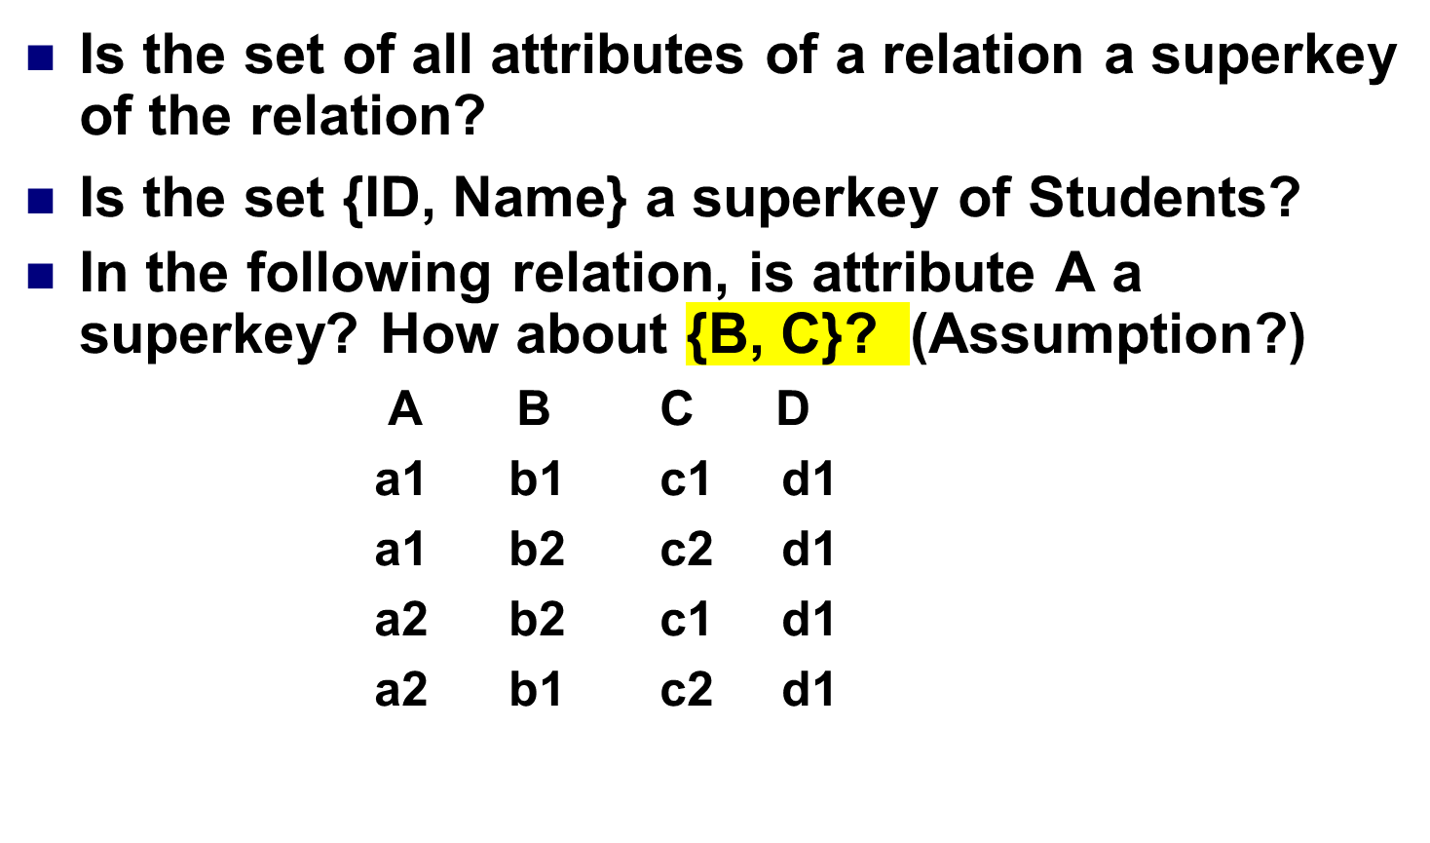
Superkey (2)

Slide 17
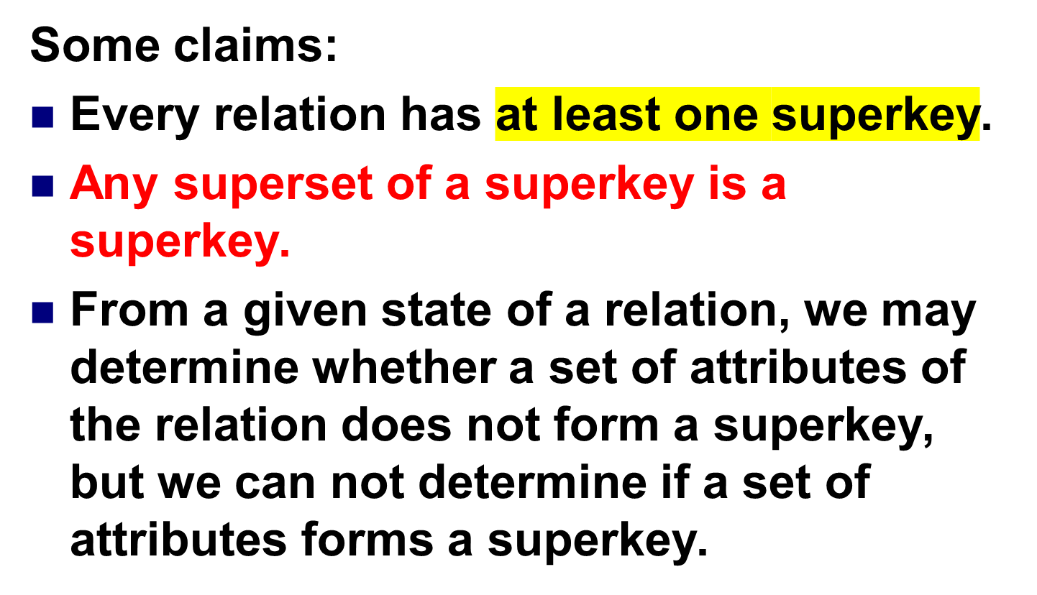
Superkey (3)
每一张表本身就可以作为Superkey

Slide 18
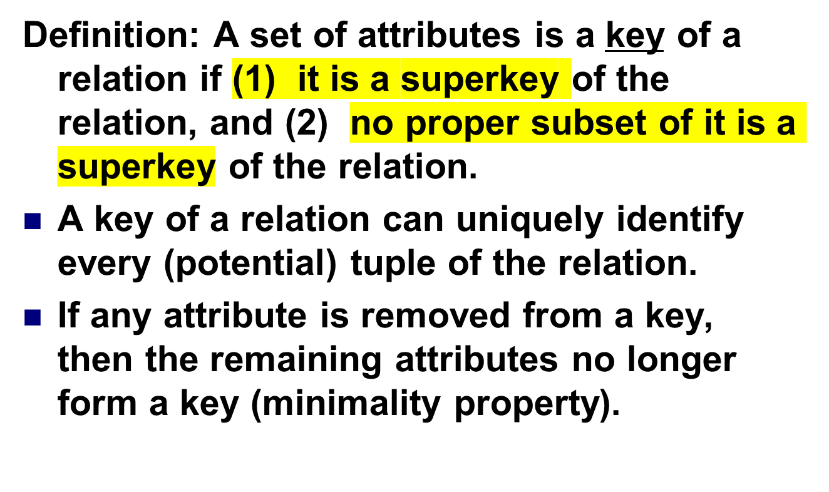
Key (1)

Slide 19
Key (2)
Example: For relation Students (ID, Name, Home_Address, Birthday, GPA),
ID is a key.
{ID, Name} is a superkey but not a key.
{Name, Home_Address, Birthdate} is also a key.

Slide 20
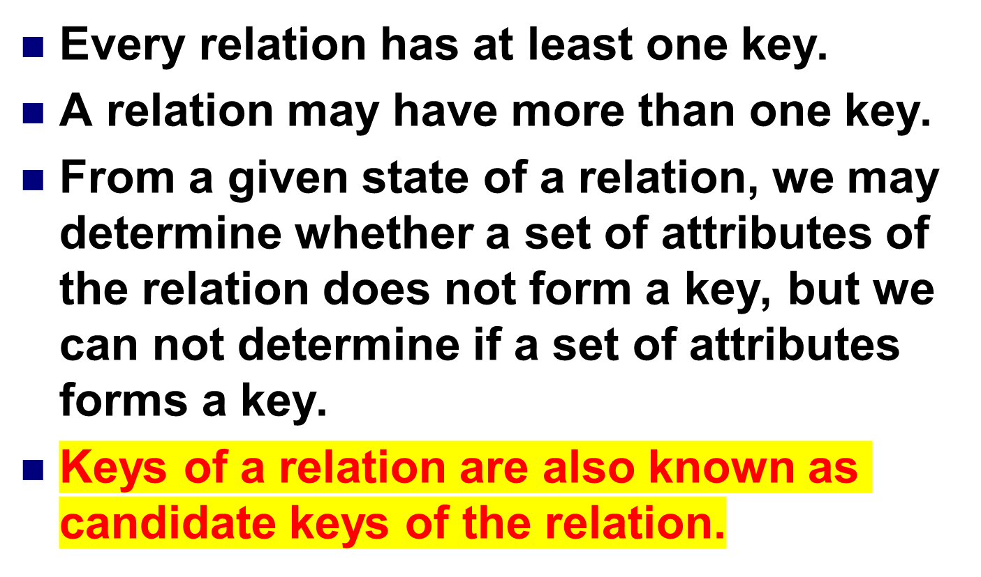
Key (3)

Slide 21
Candidate Key
Example: Find all possible candidate keys for the following relation based on its current tuples.
A B C D
a1 b1 c1 d1
a1 b2 c2 d1
a2 b2 c1 d1
a2 b1 c2 d1
Answer: {A, B}, {A, C}, {B, C}.

Slide 22
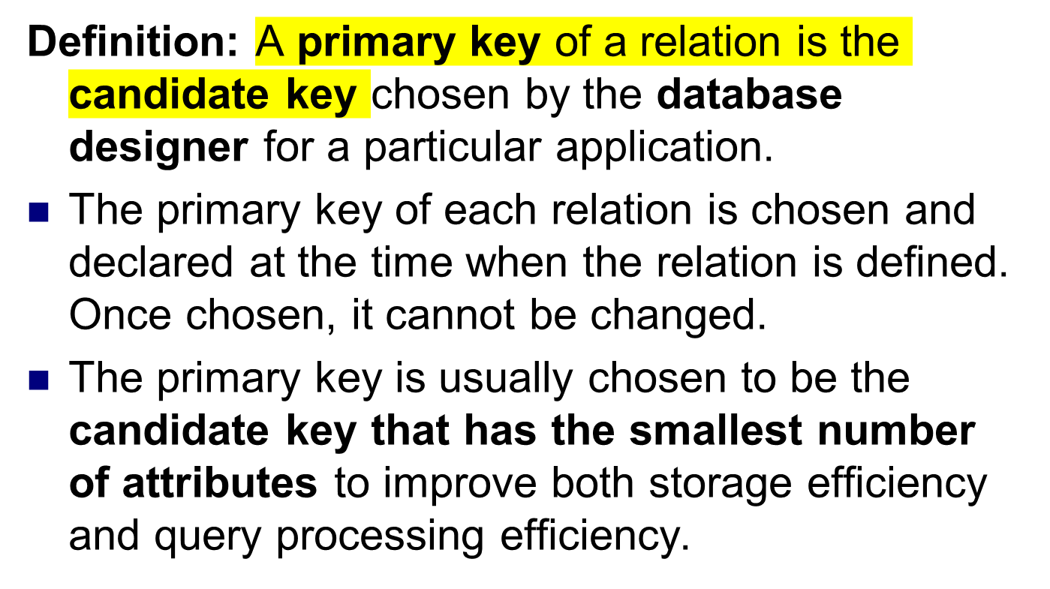
Primary Key (1)

Slide 23
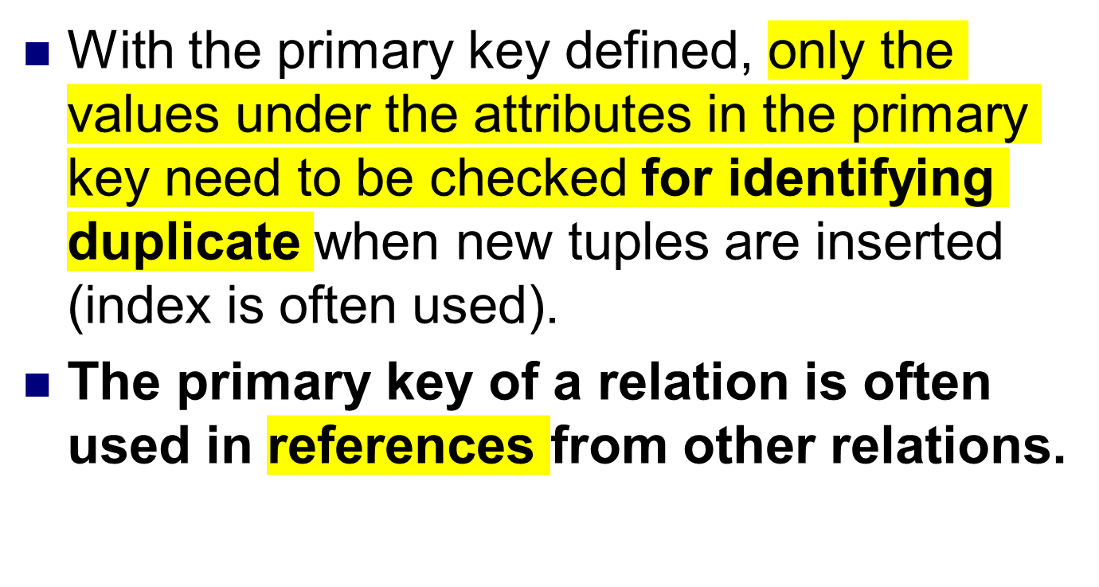
Primary Key (2)

Slide 24
Foreign Key (1)
Definition: A set of attributes FK of relation R1 is a foreign key in R1 if it satisfies the following two conditions:
There is a relation R2 with the primary key PK such that FK and PK have the same number of attributes with compatible domains.
For any tuple t1 in R1, either there exists a tuple t2 in R2 such that t1[FK] = t2[PK] or t1[FK] is null.

Slide 25
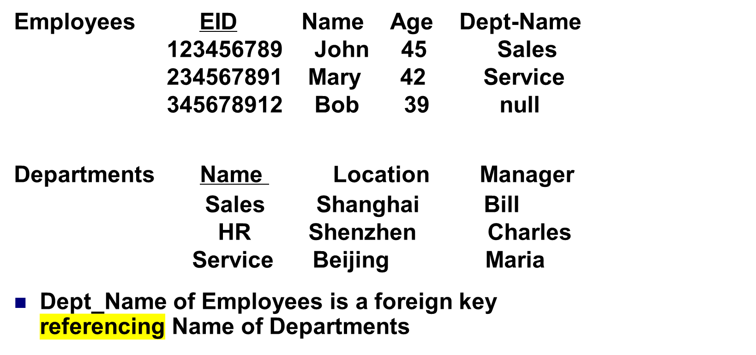
Foreign Key (2)

Slide 26
Foreign Key (4)
Using a foreign key of a relation to reference the (primary) key of another relation is THE WAY used by the relational data model to establish relationships among different relations.

Slide 27
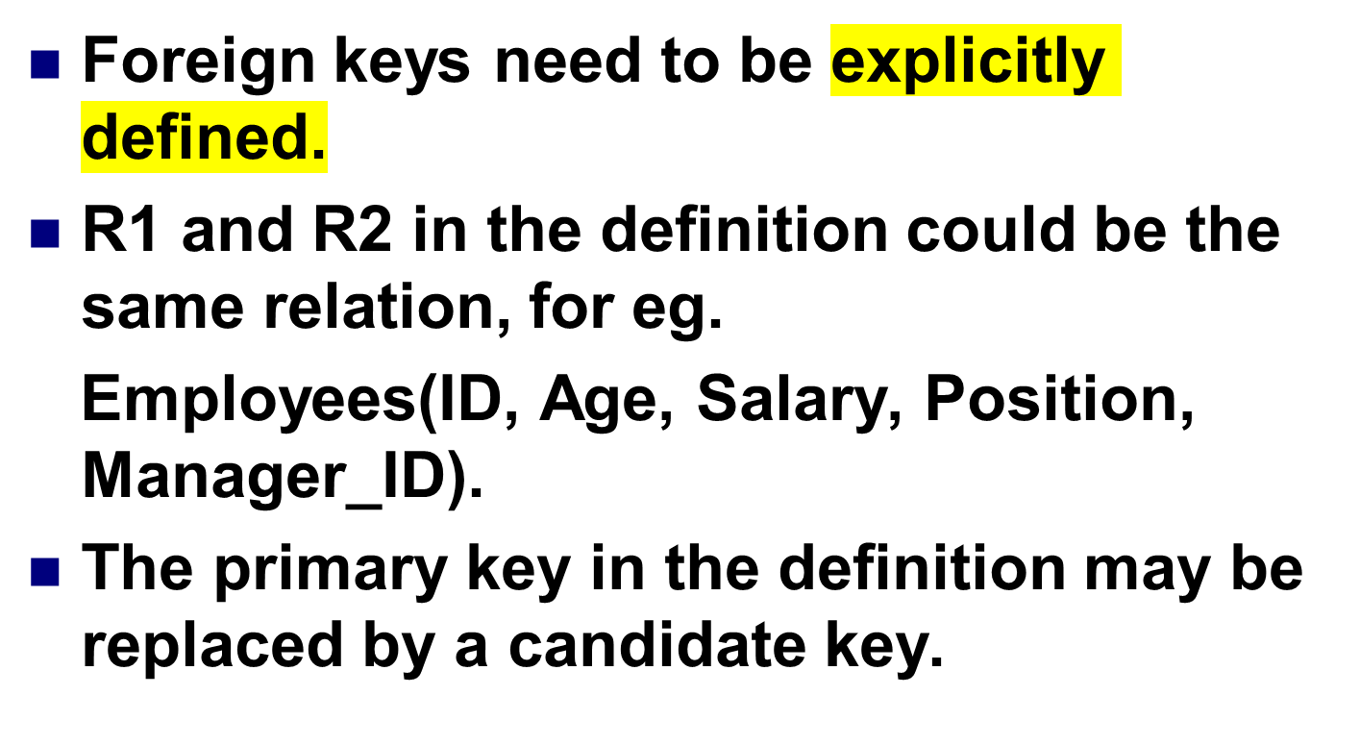
Foreign Key (3)

Slide 28
Database Integrity
Definition: | Data Integrity
 | Correctness and consistency of data against a stated set of constraints during the “normal” operation of the database.
For example: the relational model has two forms of integrity rule which must be satisfied
Entity Integrity
Referential Integrity
Notes:
unique (for a given object type)
minimal (have no spurious attributes)
That is the reason why PRIMARY KEY is NEEDED

Slide 29
主键不能为空
Justification
If the identity is missing then the object in the real world is not identifiable.
If the identity is unknown then you cannot know if the object is already in the database - therefore you cannot tell that if the identity is unique.
Notes:
That is the reason why PRIMARY KEY is NEEDED
identifiers must be
unique (for a given object type)
minimal (have no spurious attributes)

Slide 30
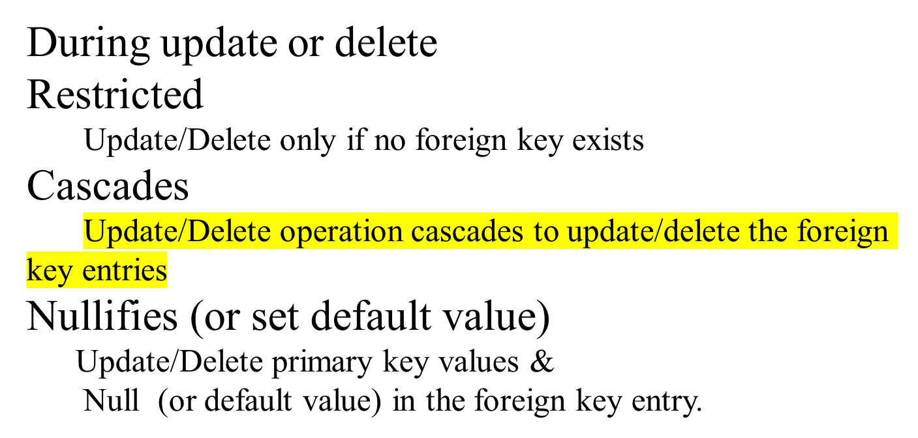

Referential integrity rule The database must not contain any unmatched foreign key values.
Notes:
使无效

Slide 31
constraints
Domain Constraints
  for one or more attributes
User specified integrity constraints
(also known as enterprise constraints, or business rules)

Slide 32
Domain Constraints
Defn: Domain a set of all possible correct values
These can be defined as
an explicit set of values:
supplier code domain = (S1, S2, S3, S4, S5)
a range of valid values:
age domain = (0 .. 120)
or a pattern which values must satisfy:
employee code domain = ( AAAA9999AAA)
(4 letters followed by 4 digits followed by 3 letters)
or (sometimes) just a datatype:
size domain = integer
or combinations of the above.

Slide 33
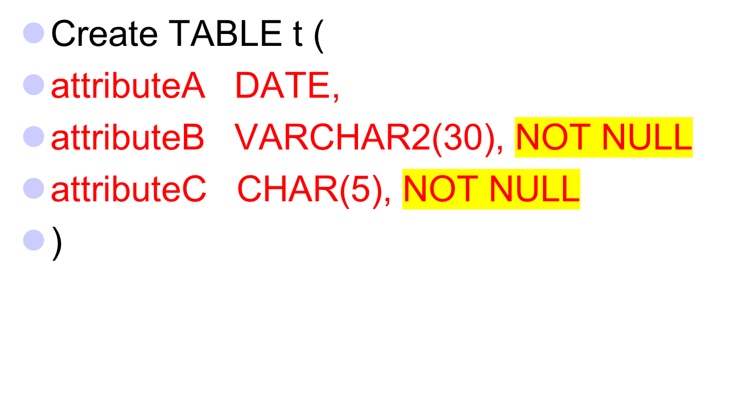
SQL for domain constraint

Slide 34
User Specified Integrity Constraints
Relation rules
  Record constraints
  Set constraints
which may be
Static
Dynamic (before and after alterations)

Slide 35

Relation Rules
What combination of attribute values are acceptable in a relation?
Record constraints
Set constraints
Vehicle.Type = CAR
then Vehicle.Wheels = (3,4)
Vehicle.Type = CYCLE
then Vehicle.Wheels = (2,3)
Vehicle.Type = HOVERCRAFT
then Vehicle.Wheels = null
SUM(employee.salary) < limit
COUNT(distinct dept.car) < 10
AVG(staff.overtime) IN [+/- 10% of 6]

Slide 36
Relation rules may be Static or Dynamic
Static constraints：must hold between data items at ALL times.
credits taken each semester of a student must be less than 24
employee.salary < manager.salary
IN employee, manager
WHERE employee.mgr# = manager.mgr#
Dynamic constraints：must hold between database states before AND after changes to the relation or relations
the total achieved credits of each student must not decrease in consecutive semesters
and the integrity constraints may relate to several tables.
Notes:
". credits taken each semester of a student must be less than 24

