Slide 1
数据库系统
Database Systems

Slide 2
Relational Algebra
Chapter Outline:
3.1 Relational Algebra(RA)
3.2 Simple and Complex Queries using RA
An Introduction to Database System

Slide 3
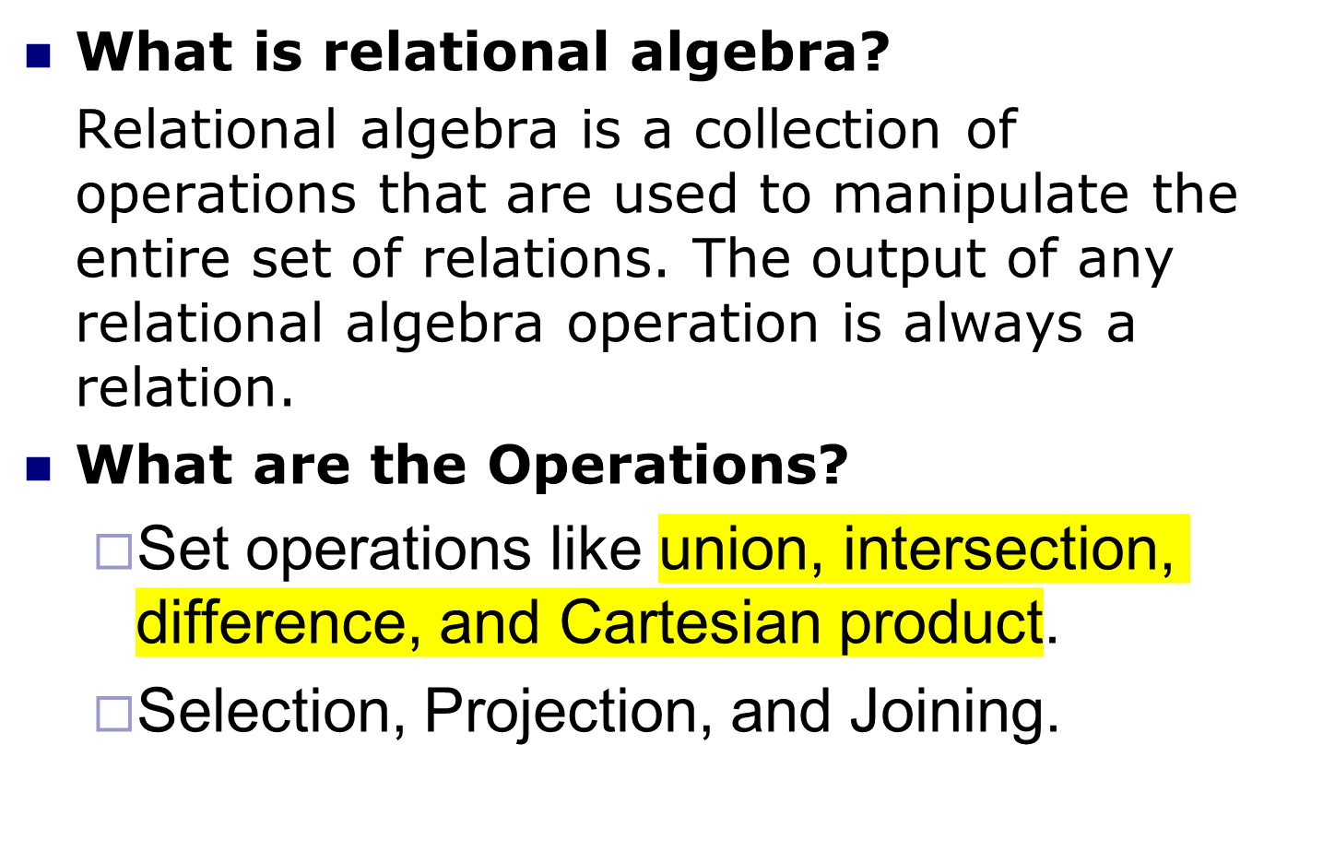
Relational Algebra
Notes:
Codd 提议这样一种代数作为数据库查询语言的基础,即使 SQL 的查询语言也松散的基于了关系代数，尽管 SQL 中的操作数(表)不完全是关系.

Slide 4
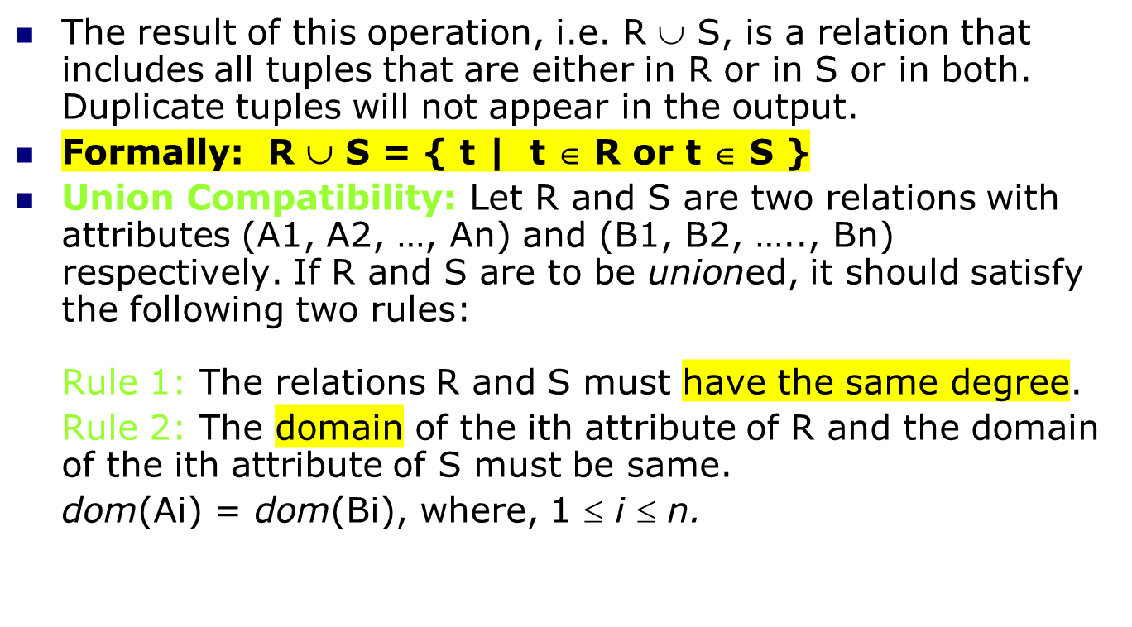
Union (∪)

Slide 5
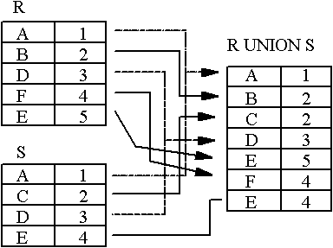
Union (∪)
An Introduction to Database System

Slide 6
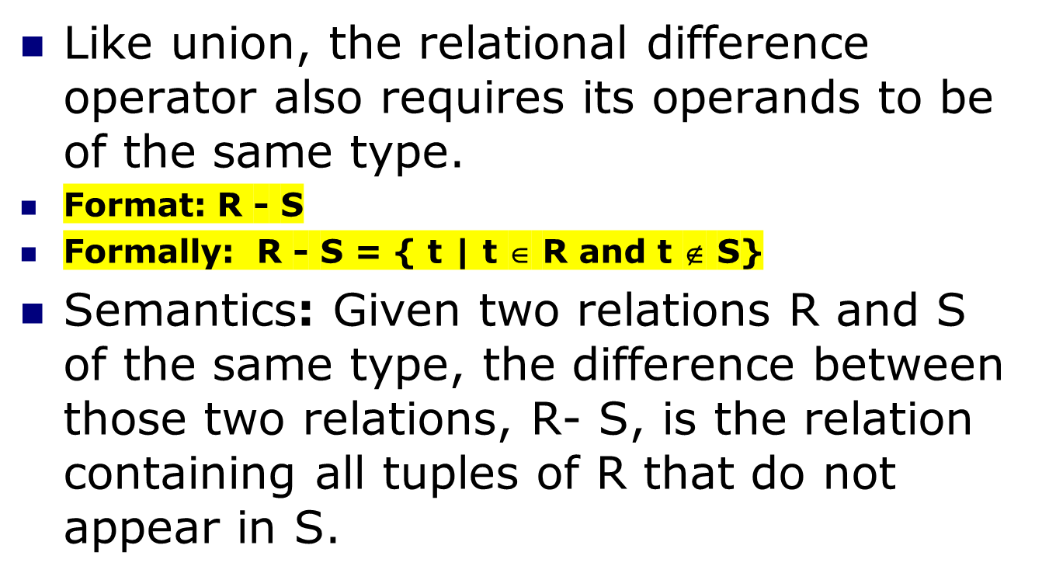
Relational Difference (-)
An Introduction to Database System

Slide 7
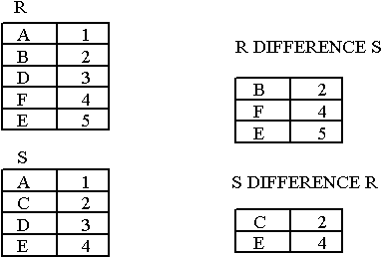
Relational Difference (-)
Notice that Difference has a directionality to it, e.g. R-S and S-R are not the same thing.
An Introduction to Database System

Slide 8
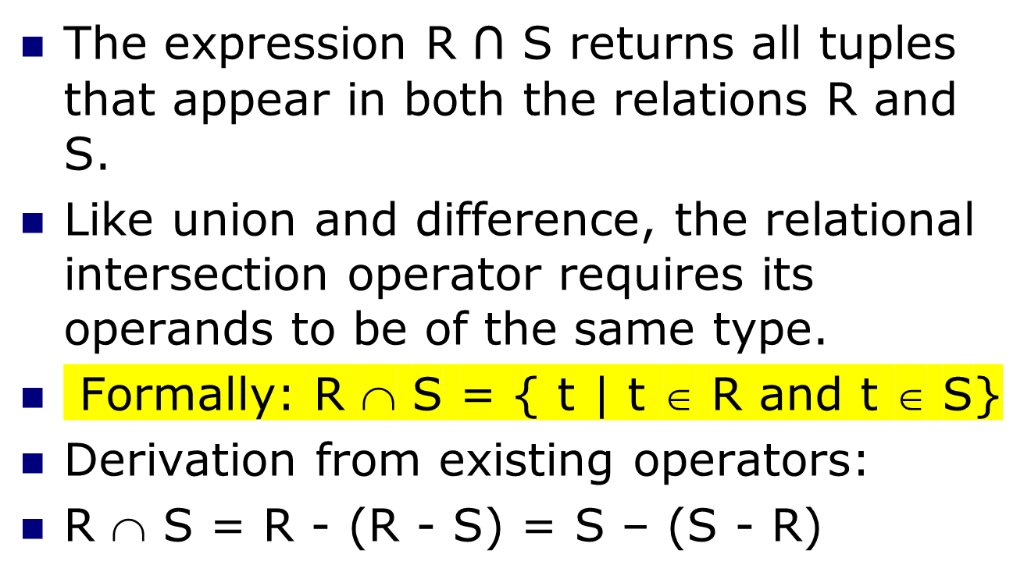
Intersection(∩)
An Introduction to Database System

Slide 9
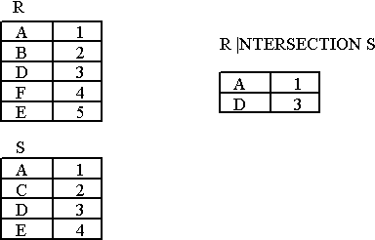
Intersection(∩)
An Introduction to Database System

Slide 10
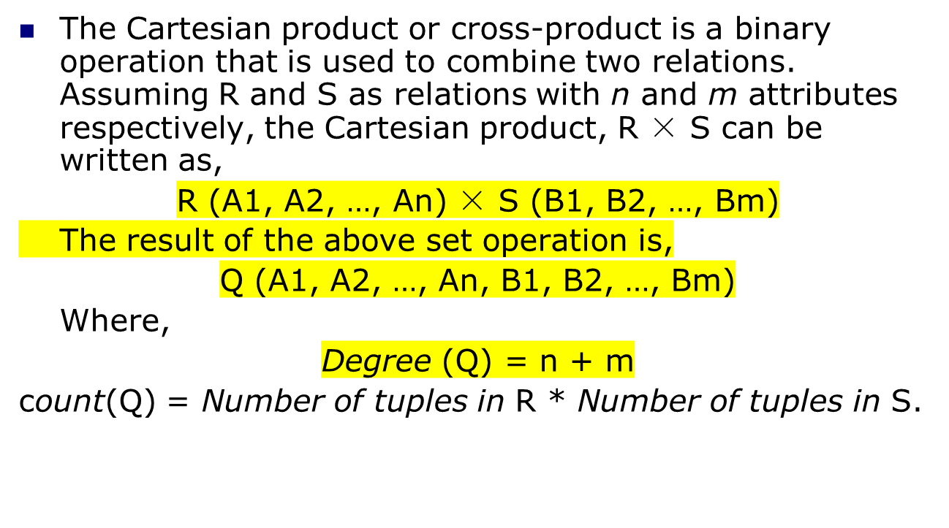
Cartesian Product (×)
Degree指的是表中的列数量（属性数目）

Slide 11
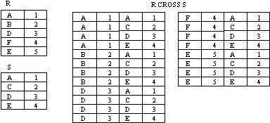
Cartesian Product (×)
R (A1, A2, …, An) × S (B1, B2, …, Bm)
An Introduction to Database System

Slide 12
Special Relational Operations-Sample Relations
Figure 3.5 Student
SSN | SNAME | GPA | AGE | DEPARTMENTID
2007001003 | CHENGLICHONG | 3.33 | 20 | 31
2007001005 | ZHONGWEILONG | 3.62 | 20 | 33
2007001006 | WUYUANLANG | 4.01 | 20 | 33
2006001001 | LUOZI | 3.12 | 20 | 34
2006001002 | GUOHUAXIAN | 3.21 | 21 | 34
2006001004 | LELINGBING | 3.75 | 21
2007002001 | ZHUJIANGUO | 3.05 | 19
An Introduction to Database System

Slide 13
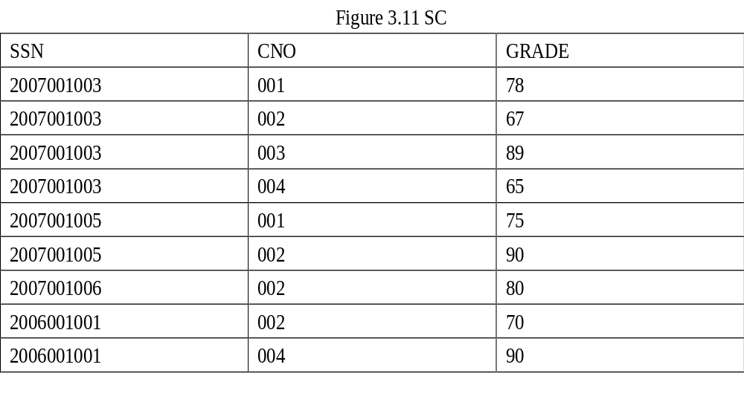
An Introduction to Database System

Slide 14
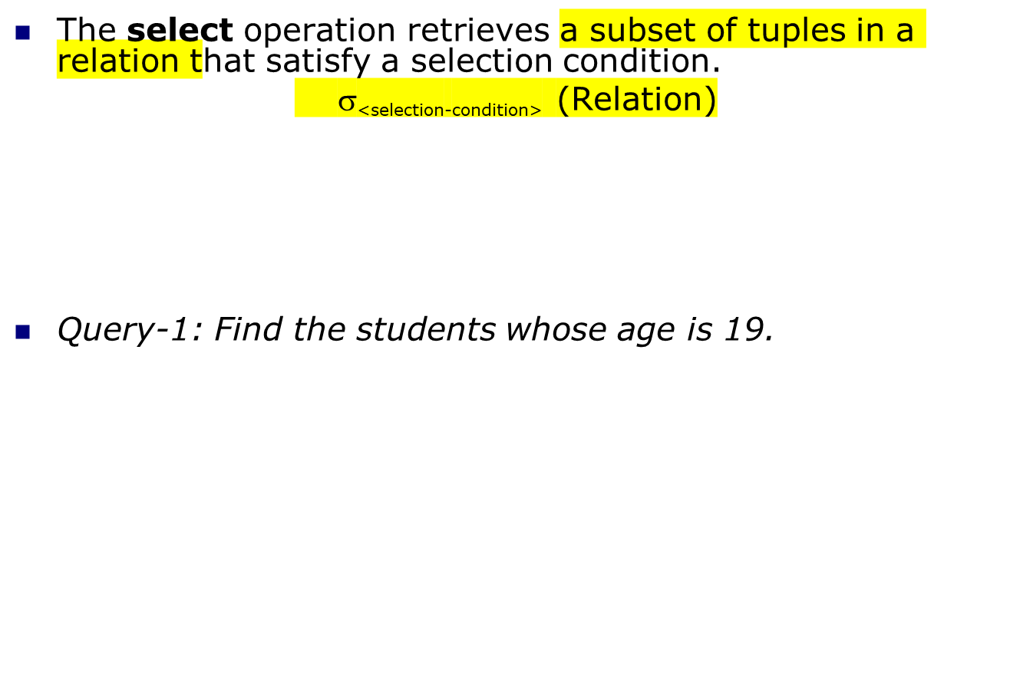
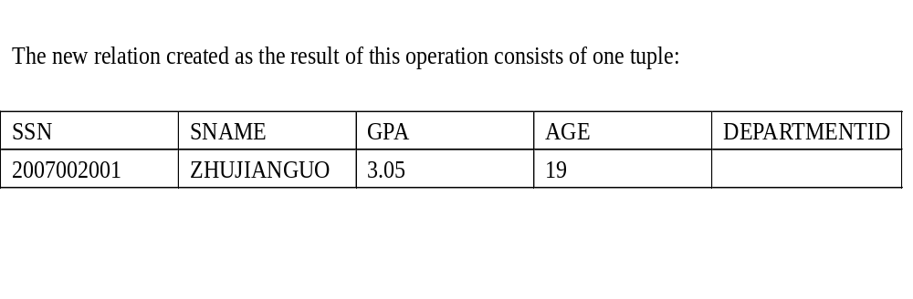
The SELECT operation (σ)
选出关系中的子集
σ

Slide 15
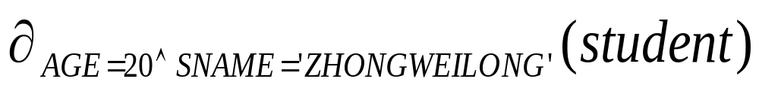
The SELECT operation (σ)
Query-2: Select tuples (rows) of the student relation where the AGE is 20 and Name is ZHONGWEILONG, we could write:
An Introduction to Database System

Slide 16
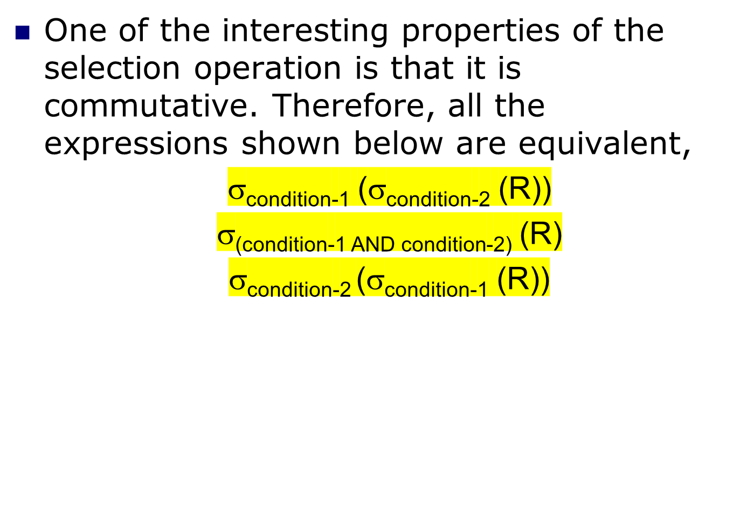

Slide 17
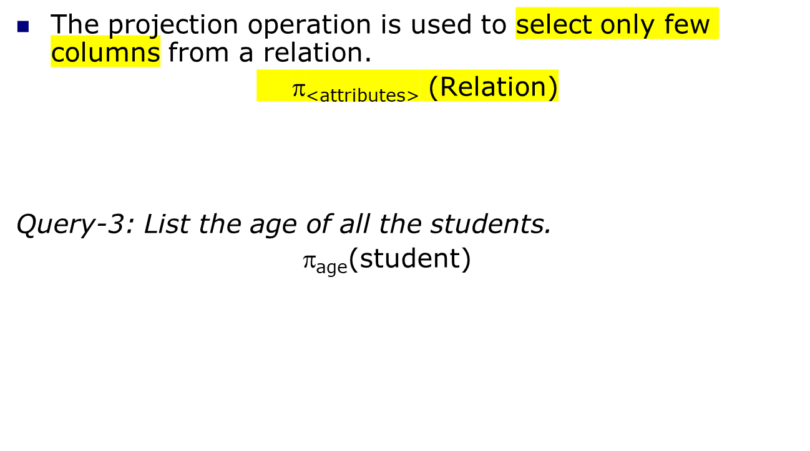

The Projection Operation (π)
π
选取关系中的某一两列

Slide 18
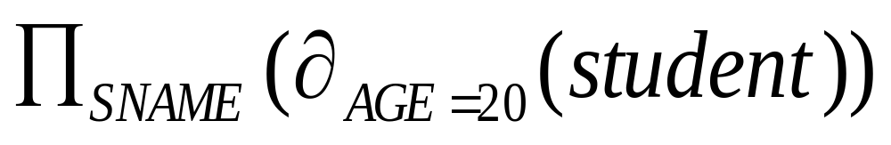
Select and Project
We can perform these operations on the relations resulting from other operations. To get the names of students having the AGE as 20, we write:
An Introduction to Database System

Slide 19
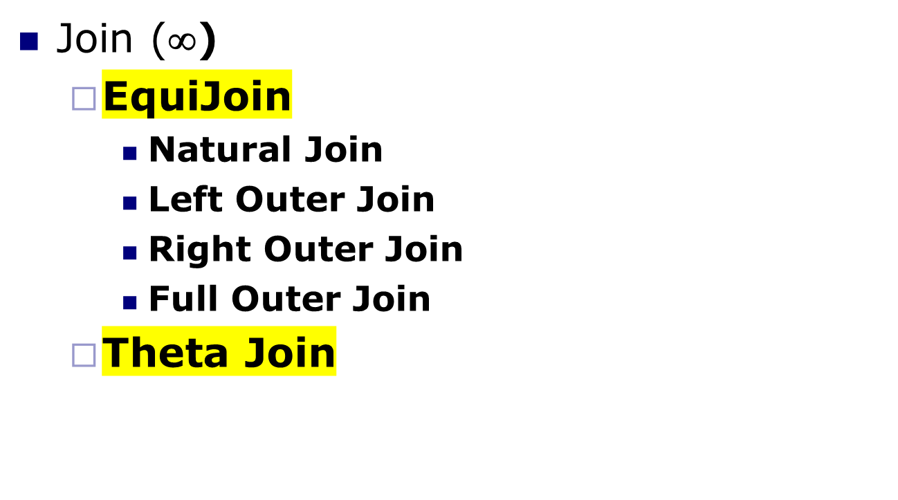
Join (∞)

Slide 20
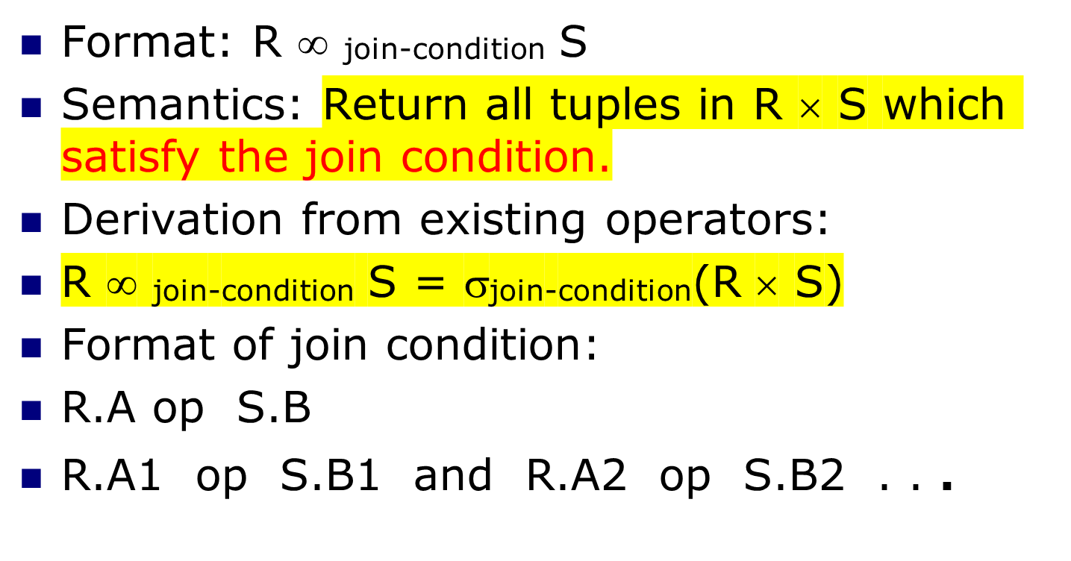
Join (∞)
等价于连接条件，用于筛选笛卡尔积后的有效数据

Slide 21
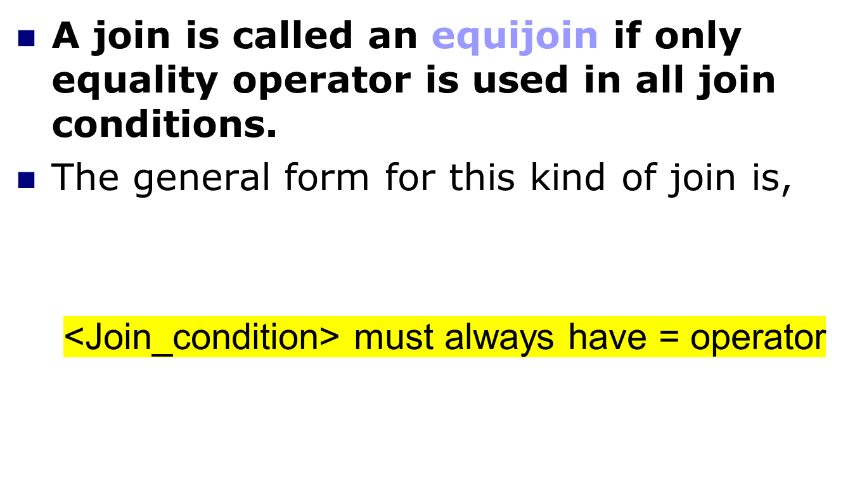
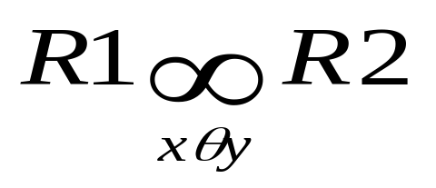
Equijoin (∞ )

Slide 22
Equijoin
R S R ∞R.B = S.B S
A B B C A R.B S.B C
a b b c a b b c
d b c d d b b c
b c a d b c c d
Most joins in practice are equijoins.

Slide 23
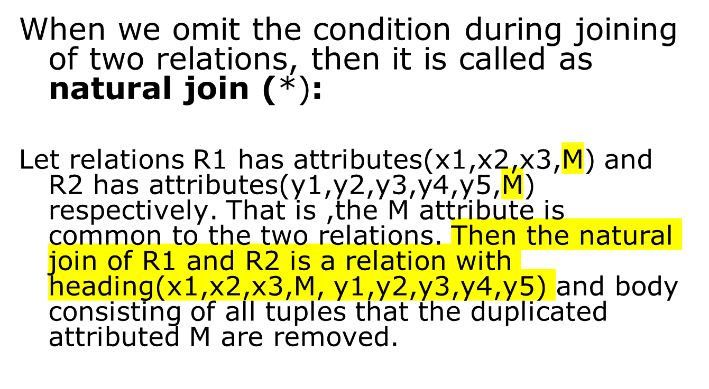
Natural Join (*)
没有写条件，直接是R ∞S
连接条件，即有相同的列，只保留一列

Slide 24

Natural Join
R1:(x1,x2,x3,M), R2:(y1,y2,y3,y4,y5,M), M is common to the two relations. Then the natural join of R1 and R2 is a relation with heading(x1,x2,x3,M, y1,y2,y3,y4,y5) and body consisting of all tuples that the duplicated attributed M are removed.
B
E
A
B
C
E
A
B
C
b₁
3
a₁
b₁
5
3
a₁
b₁
5
b₂
7
a₁
b₂
6
a₁
b₂
6
7
a₂
b₃
8
b₃
10
a₂
b₃
8
10
a₂
b₄
12
b₃
2
R
b₅
2
a₂
b₃
8
2
S

Slide 25
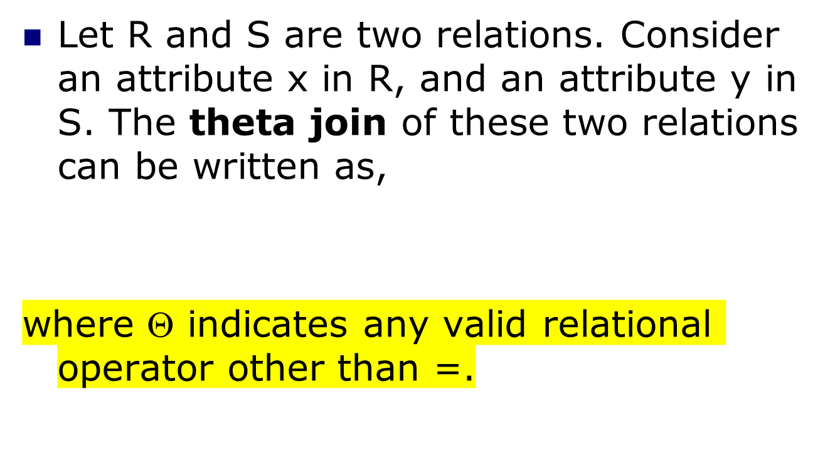
Theta Join (Θ) or NonEqui Join
增量表示连接的条件不为等号

Slide 26
Theta Join
A
B
C
B
E
A
R.B
C
S.B
E
a₁
b₁
5
b₁
3
a₁
b₁
5
b₂
7
a₁
b₂
6
b₂
7
a₁
b₁
5
b₃
10
a₂
b₃
8
b₃
10
a₁
b₂
6
b₂
7
a₂
b₄
12
a₁
b₂
6
b₃
10
b₃
2
R
a₂
b₃
8
b₃
10
b₅
2
R ∞ S
S
C＜E

Slide 27
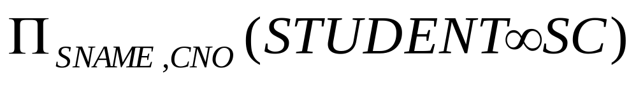
Example
To find all students name and selected courses NO, we need student and SC relations
1.
2. We can rewrite the previous query as:
An Introduction to Database System

Slide 28
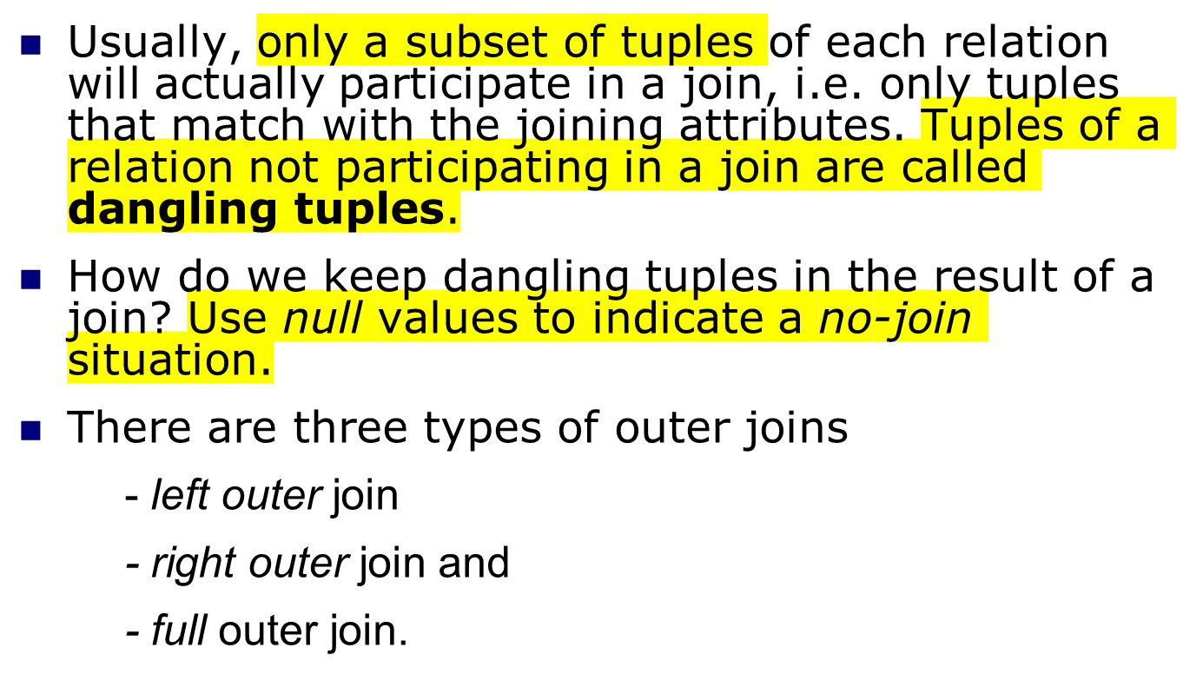
Outer Joins (Special Case of EquiJoin)
保留没有参与的记录

Slide 29
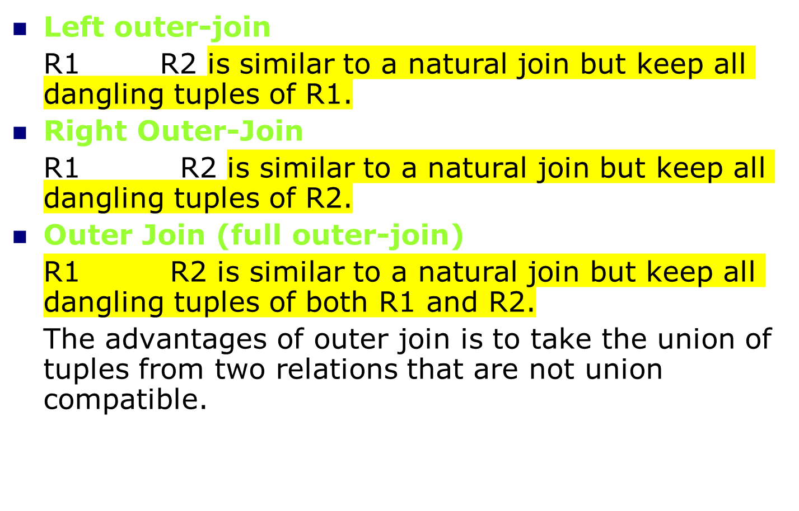

Slide 30
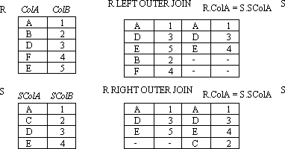

Example:LEFT OUTER JOIN, RIGHT, OUTER JOIN
An Introduction to Database System

Slide 31
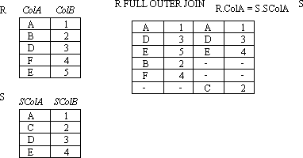

Example:FULL OUTER JOIN
An Introduction to Database System

Slide 32
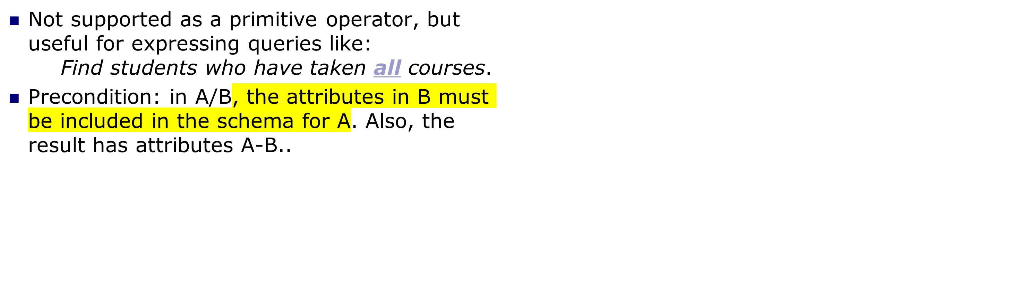
Division
A必须包含B中所有的属性
Notes:
13

Slide 33
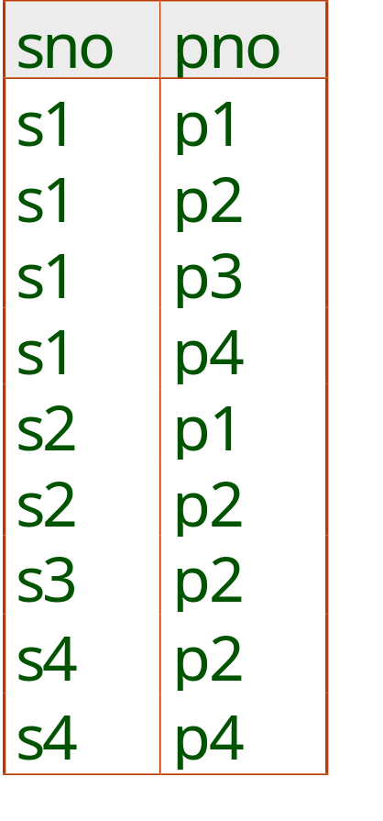
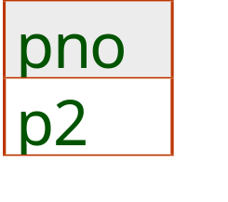
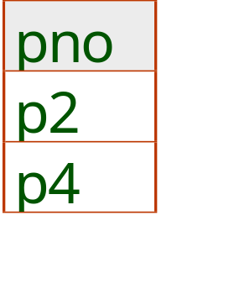
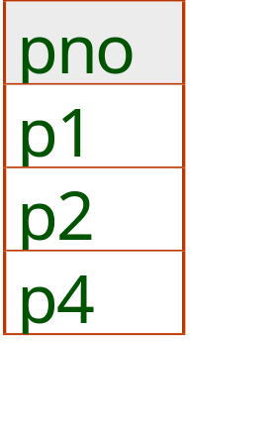
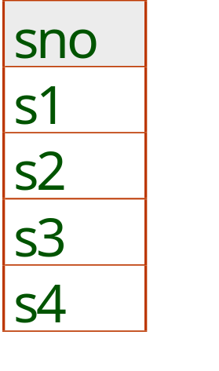
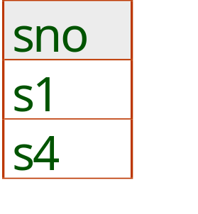
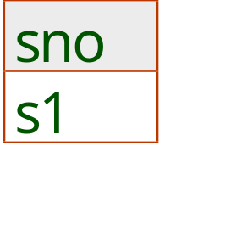
Examples of Division A/B
找出A中包含所有Bi表记录的记录
B1
B2
B3
结果不包含B中的列
A
A/B1
A/B2
A/B3
Notes:
14

Slide 34
Another Example
Another example is: Suppose we want to find all the students who have selected all courses (See Figure 3.19 Course Table ) provided by the school.
CNO | CNAME | CREDIT
001 | Math | 3
002 | Multimedia | 3
003 | Computer network | 4
004 | Software engineering | 4
005 | Bioinformatics | 3
An Introduction to Database System

Slide 35
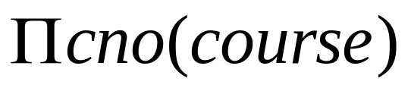

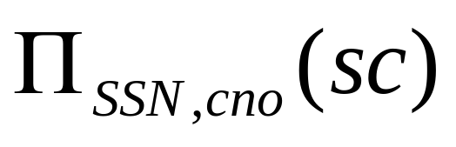
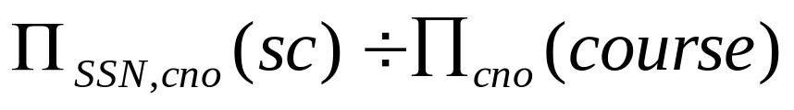
We can think of it as three steps:
1.We can obtain the NO. of all courses provided by the school by:
2.We can also find all SSN, cno pairs for which the student has selected courses by:
3.Now we need to find all students who selected all the courses. The divide operation provides exactly those students:
An Introduction to Database System

Slide 36
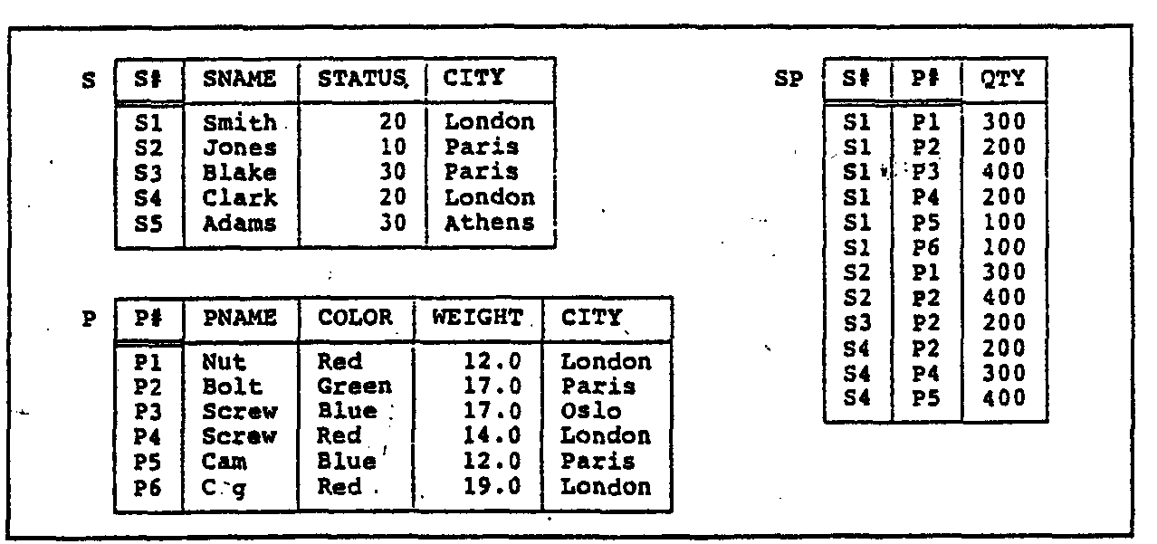
3.2 Simple and Complex queries using RA
An Introduction to Database System

Slide 37
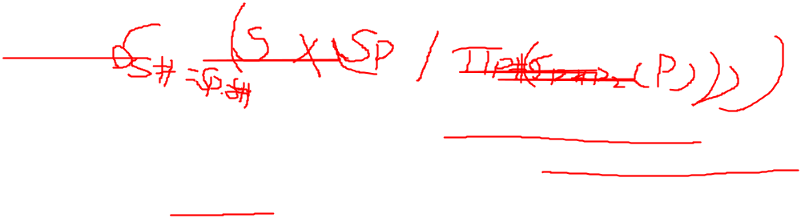
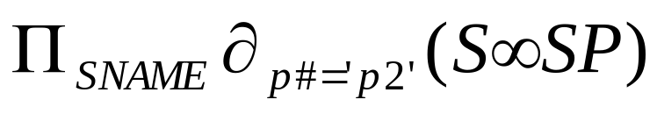
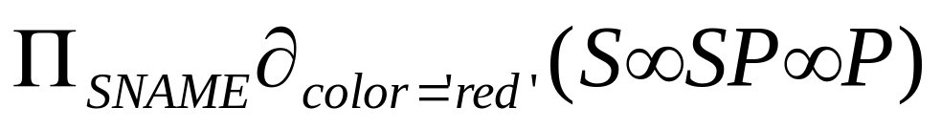
Example
Example 1: Get supplier names for suppliers who supply part P2:
Example 2:Get supplier names for suppliers who supply at least one red part:
An Introduction to Database System

Slide 38
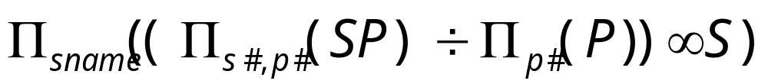
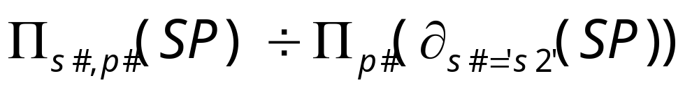
CON…
Example 3:Get supplier names for suppliers who supply all parts:
Example 4:Get supplier numbers for suppliers who supply at least all those parts supplied by supplier S2:
An Introduction to Database System

Slide 39
Example
Example 1: Get supplier names for suppliers who supply part P2:
Example 2:Get supplier names for suppliers who supply at least one red part:
An Introduction to Database System

Slide 40
CON…
Example 3:Get supplier names for suppliers who supply all red parts:
Example 4:Get supplier numbers for suppliers who supply at least all those parts supplied by supplier S2,but not supplied by S3:
An Introduction to Database System

