Slide 1
Database Design
Determinacy

Slide 2
The problem
Considering the relation:
{Sno,sdept,mn,courseNo,grade}
One student belongs to one department
One department has one manager
Students to courses are many to many
One grade for a student taking a class

Slide 3
Considering these actions:
Updating a manager……how much work we should do?
Inserting a course when a dept. is just formed and no student ….can we insert?
When all the students have graduated…and what is left??

Slide 4
Anomalies
Update anomalies - changing information in one tuple leaves the same information unchanged in another; occurs with redundancy.
Deletion anomalies - if a set of values becomes empty, we may lose other information as a side effect.
Insertion anomalies - inability to represent certain information.

Slide 5
How can we avoid these?
Remove redundant
Restructure the database schema
How?
By Normalization!
But before that, we need to know about the concept of determinancy

Slide 6
  Determinancy
Diagramming Technique
Simple Determinancy
Complex Determinancy

Slide 7

Determinancy
Consider a collection of attributes
Name, Student ID, Age, Course Name, Course Code
Certain attributes can be used to uniquely determine one value of another attribute.

Slide 8
Name | SID | CName | CCode | Age
Smith | 1345 | BSc Comp | COM217 | 33
Jones | 234 | BSc SE | COM328 | 19
Chen | 5234 | BSc Comp | COM217 | 33
Aboud | 2623 | BSc SE | COM328 | 19
Chen | 2678 | BSc Comp | COM217 | 22

Slide 9
Of these attributes:
SID determines Name. e.g. 234 -> Jones
SID determines CName. e.g. 5234 -> BSc Comp
SID determines CCode. e.g. 2678 -> COM217
SID determines Age e.g. 234 -> 19
CName determines CCode e.g.BSc Comp -> COM217
CCode determines CName e.g. COM217 -> BSc Comp

Slide 10
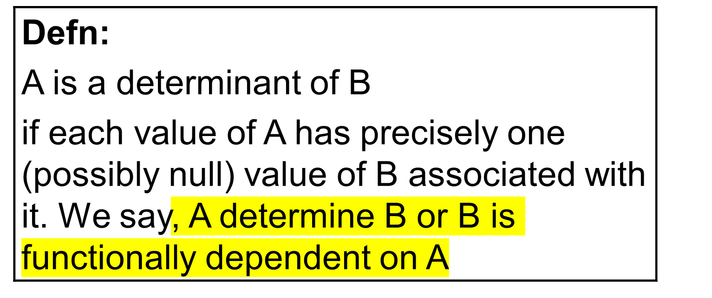
BUT
Age doesn’t determine anything
Name doesn’t determine anything

Slide 11
In fact using the earlier table we could find the determinants by inspection. BUT NOT ALWAYS!
MORE IMPORTANTLY
We can find the determinants by considering the enterprise rules for the attributes.

Slide 12
Each course name has exactly one course code.
Each course code has exactly one course name.
Each student ID is issued to one student.
Each name may be associated with several student ids.

Slide 13
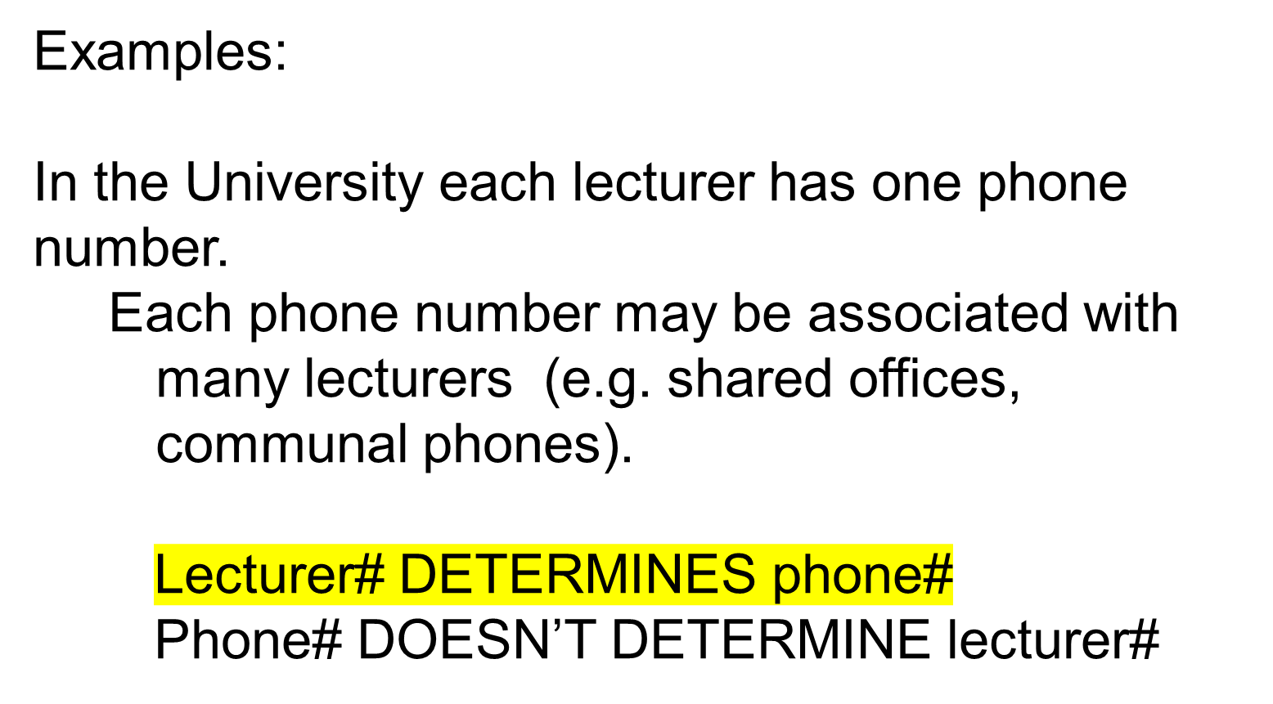

Slide 14
Each dog owner may own several dogs. Each dog is owned by one owner (assuming no group owners)
Dog# determines owner#
Owner# doesn’t determine dog#

Slide 15
Each employee has one national insurance number. Each national insurance number is allocated to exactly one employee.
Employee# determines national insurance number
National insurance number determines employee#

Slide 16
Each employee may drive several different cars from the car pool. Each car in the car pool may be driven by several drivers at different times.
Car# doesn’t determine driver#
Driver# doesn’t determine car#
In practice we don’t summarise the “doesn’t determine” lines.

Slide 17
We can produce a simple diagram which shows the determinancy. AB
A determines B :
A
B

Slide 18
Examples
Lecturer# DETERMINES phone#
Phone# DOESN’T DETERMINE lecturer#lecturer#phone#
lecturer#
phone#

Slide 19
Dog# determines owner#
Owner# doesn’t determine dog#
dog#
owner#

Slide 20
Employee# determines national insurance number
National insurance number determines employee#
employee#
national ins. number

Slide 21
Car# doesn’t determine driver#
Driver# doesn’t determine car#
car#
driver#

Slide 22
Composite Determinants.
Several attribute values taken together can determine the value of some other attribute.
Example
In the Car, Driver example earlier, include an attribute number_of_times. The number of times a specific driver has driven a specific car.

Slide 23
Enterprise rules
Driver can have several number_of_times.
Car can have several number_of_times.
Driver AND Car has one number_of_times.
Gives
(Driver, Car) determines number_of_times

Slide 24
Car#
number_of_times
driver#
Question: Try the same for student#, module# and grade. Each student has a grade for each module they take.

Slide 25
Interpreting and producing diagrams.
What does this determinancy diagram represent?
Warehouse#
quantity in stock
part#
re-order-level

Slide 26
How does it differ from this diagram?
Warehouse#
quantity in stock
part#
re-order-level

Slide 27
Exercises:
Produce a determinancy diagram for the
Name, Student ID, Course Name, Course Code and Age
attributes used earlier.

Slide 28
More exercises
a) Each student is given a unique student identifier. Each student is enrolled on exactly one course, but each course has several students. Each course consists of several modules.

Slide 29
b) A company has several cars for rent. They can be rented to any valid driver who has a driving license. The name, address and license number of each driver are to be stored along with the day and date on which they rented the car. A driver can rent any available car.

Slide 30
c) A company has several warehouses each identified by its postcode. Each warehouse has storage space allocated to several items. Each type of item has a unique location within a specific warehouse. Each item has a unique serial number, and all items of the same type are stored in the same location.

