Slide 1
Functional Dependency (1)
Definition: Let R(A1, ..., An) be a relation schema. Let X and Y be two subsets of {A1, ..., An}. X is said to functionally determine Y (or Y is functionally dependent on X) if for every legal relation instance r(R), for any two tuples t1 and t2 in r(R), we have
t1[X] = t2[X] t1[Y] = t2[Y].
满足函数映射关系

Slide 2
Functional Dependency (2)
Two notations:
X ⊂ R denotes that X is a subset of the attributes of R.
X Y denotes that X functionally determines Y.

Slide 3
Functional Dependency (3)
Several equivalent definitions:
X Y in R for any t1, t2 in r(R), if t1 and t2 have the same X-value, then t1 and t2 also have the same Y-value.
X Y in R there exist no t1, t2 in r(R) such that t1 and t2 have the same X-value but different Y-values.
X Y in R for each X-value, there corresponds to a unique Y-value.

Slide 4
Functional Dependency (4)
Theorem 1: If X is a superkey of R and Y is any subset of R, then X Y in R.
Note that X Y in R is a property that must be true for all possible legal r(R), not just for the present r(R).

Slide 5
Functional Dependency (5)
Example: which is true?
A B C D A B
a1 b1 c1 d1 A C
a1 b2 c1 d2 C A
a2 b2 c2 d2 A D
a2 b3 c2 d3 B D
a3 b3 c2 d4 AB D

Slide 6
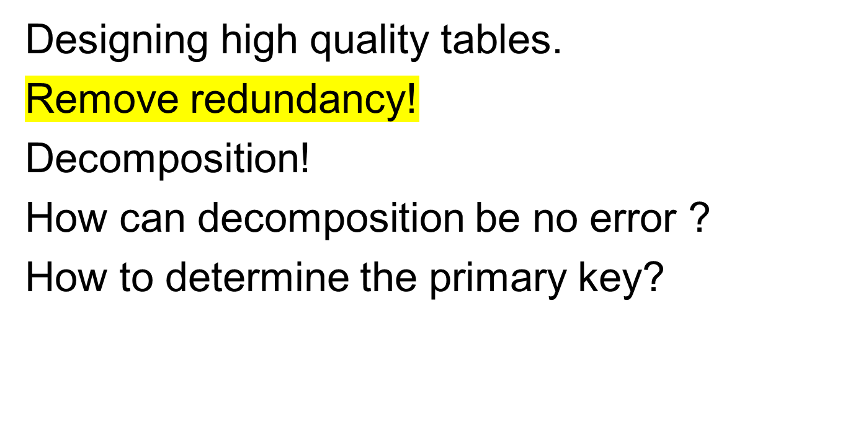
Relational Database Theory

Slide 7
Example
Consider : （动物名称，动物属性， 动物居住地）
F={动物名称→动物属性,动物属性→动物居住地,动物名称→动物居住地}
How to decomposed the table?

Slide 8
Example
SL ──────────────────
动物名称 动物属性 动物居住地
──────────────────
灰太狼 羊食 青青山
喜羊羊 草食 青青草原
食人鱼 全食 青青河
美羊羊 草食 青青草原
蛤蟆 小食 青青草原
──────────────────

Slide 9
Example
  1. Decompose it into:
  SN(动物名称)
  SD(动物属性 )
  SO(动物居住地)

Slide 10


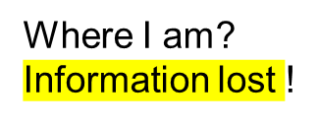
Example
SN────── SD ────── SO ──────
动物名称 动物属性 动物居住地
────── ────── ──────
灰太狼 羊食 青青山
喜羊羊 草食 青青草原
食人鱼 全食 青青河
美羊羊 小食
蛤蟆
动物名称→动物居住地

Slide 11
Example
  2. SL
  NL(动物名称,动物居住地)
  DL(动物属性,动物居住地)
  then：
  NL DL
  Sno Sloc Sdept Sloc
  灰太狼 青青山 羊食 青青山
  喜羊羊 青青草原 草食 青青草原
  食人鱼 青青河 全食 青青河
  美羊羊 青青草原 小食 青青草原
  蛤蟆 青青草原

Slide 12


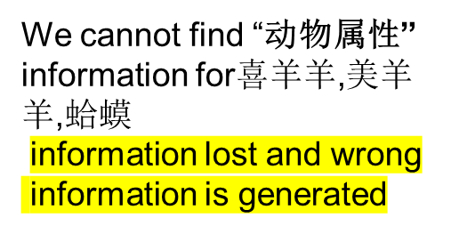
Example
NL DL
─────────────
动物名称 动物居住地动物属性
─────────────
灰太狼 青青山 羊食
喜羊羊 青青草原 草食
喜羊羊 青青草原 小食
食人鱼 青青河 全食
美羊羊 青青草原 草食
美羊羊 青青草原 小食
蛤蟆 青青草原 草食
蛤蟆 青青草原 小食
动物名称→动物属性

Slide 13
Example
  3. SL：
ND(动物名称,动物属性)
NL(动物名称,动物居住地)
Then

Slide 14
Example
ND NL
动物名称 动物属性 动物名称 动物居住地
灰太狼 羊食 灰太狼 青青山
喜羊羊 草食 喜羊羊 青青草原
食人鱼 全食 食人鱼 青青河
美羊羊 草食 美羊羊 青青草原
蛤蟆 小食 蛤蟆 青青草原
只可以根据连接条件（唯一标识）进行划分表

Slide 15
Example
ND NL
──────────────
动物名称 动物属性 动物居住地
──────────────
灰太狼 羊食 青青山
喜羊羊 草食 青青草原
食人鱼 全食 青青河
美羊羊 草食 青青草原
蛤蟆 小食 青青草原
──────────────
No information lost.

Slide 16

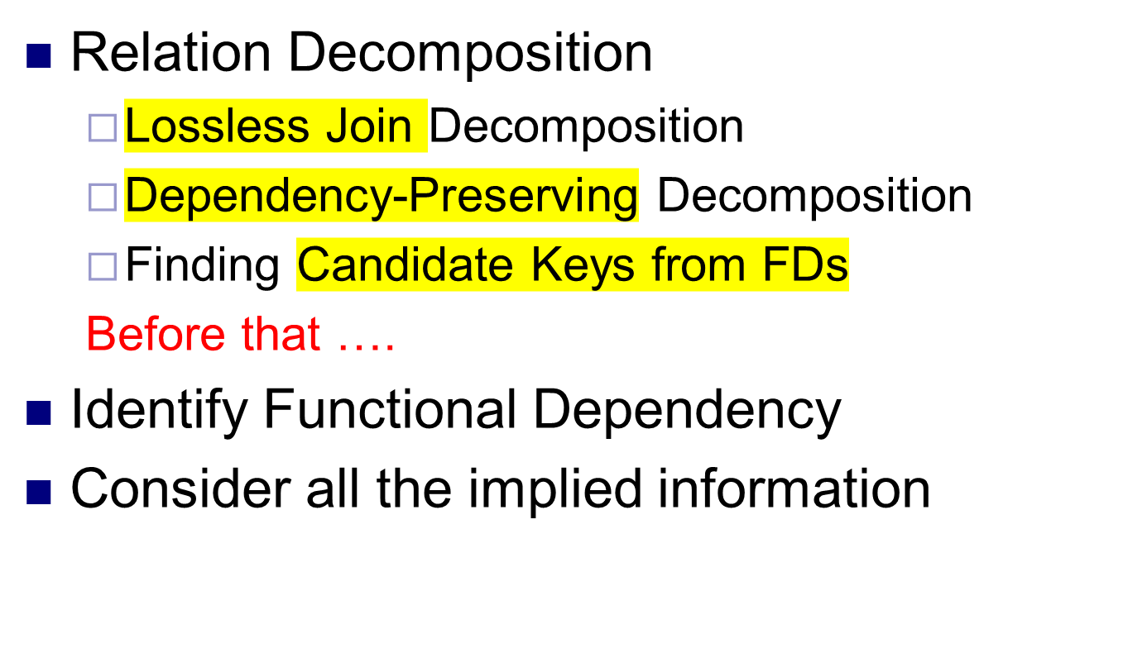
信息无损拆分
最小的Super Key

Slide 17
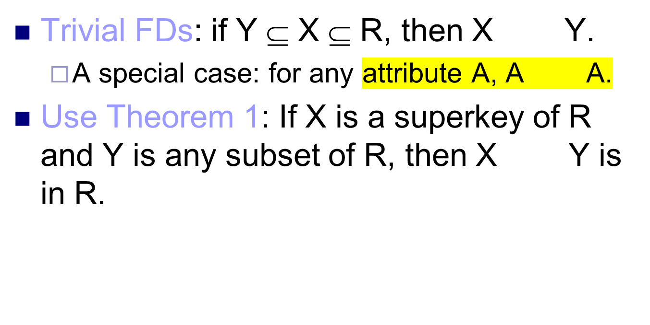
Identify Functional Dependency (1)

Slide 18
Identify Functional Dependency (2)
Created by assertions.
Employees(SSN, Name, Years_of_emp,
Salary, Bonus)
Assertion: Employees hired the same year have the same salary.
This assertion implies:
Years_of_emp Salary

Slide 19
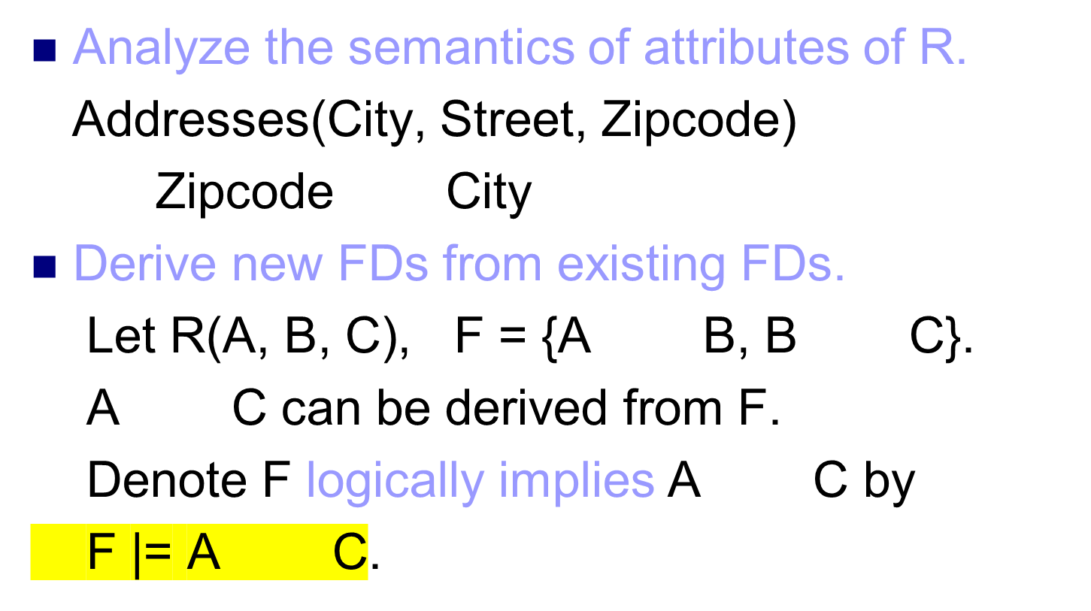
Identify Functional Dependency (3)

Slide 20
Identify Functional Dependency (4)
Definition: Let F be a set of FDs in R. The closure of F is the set of all FDs that are logically implied by F.
The closure of F is denoted by F⁺.
F⁺ = { X Y | F |= X Y}

Slide 21
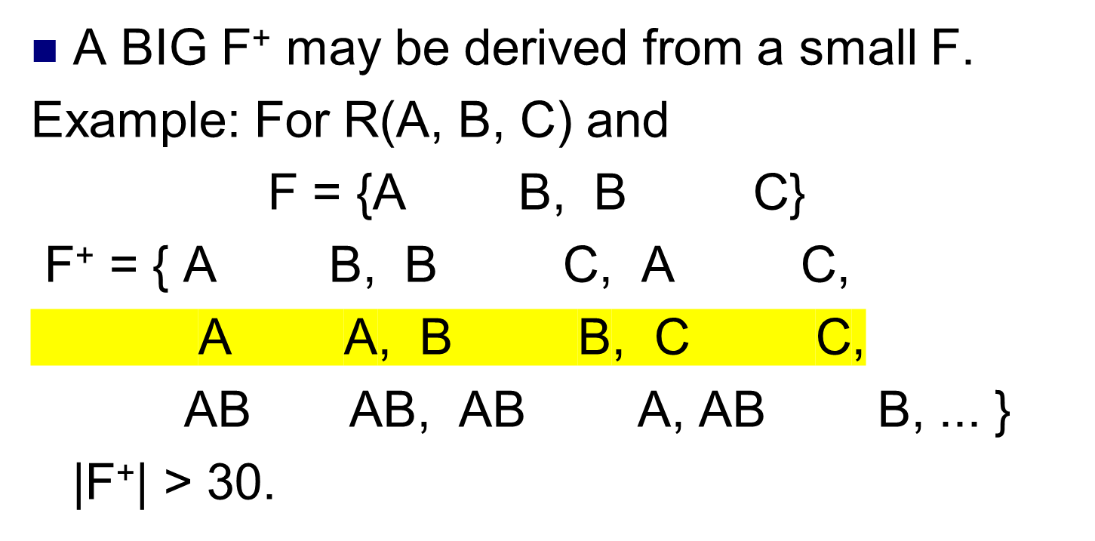
Identify Functional Dependency (5)

Slide 22

Armstrong's Axioms (1974):
(IR1) Reflexivity rule:
If X ⊇ Y, then X Y.
(IR2) Augmentation rule:
{ X Y } |= XZ YZ.
(IR3) Transitivity rule:
{ X Y, Y Z } |= X Z.

Slide 23
Computation of F⁺ (2)
Theorem: Armstrong's Axioms are sound and complete.
Sound --- no incorrect FD can be generated from F using Armstrong's Axioms.
Complete --- Given a set of FDs F, all FDs in F⁺ can be generated using Armstrong's Axioms.

Slide 24
Computation of F⁺ (3)
Additional rules derivable from Armstrong's Axioms.
(IR4) Decomposition rule:
{ X YZ } |= { X Y, X Z }
(IR5) Union rule:
{ X Y, X Z } |= X YZ
(IR6) Pseudotransitivity rule:
{ X Y, WY Z } |= WX Z

Slide 25
Computation of F⁺ (4)
(IR4): { X YZ } |= { X Y, X Z }
Proof:
by (IR1): YZ Y, YZ Z;
by X YZ, YZ Y and using (IR3):
We conclude X Y;
Similarly :
by X YZ, YZ Z and (IR3): X Z.

Slide 26
Computation of F⁺ (5)
(IR5): { X Y, X Z } |= X YZ
Proof:
by X Y and (IR2):
XX XY, i.e., X XY;
by X Z and (IR2): XY ZY;
by X XY, XY ZY and (IR3):
X YZ.

Slide 27
Computation of F⁺ (6)
(IR6): { X Y, WY Z } |= WX Z
Proof:
by X Y and (IR2): XW YW;
by WX WY, WY Z and (IR3):
WX Z.
Claim: If X ⊆ R and A, B, ..., C are
attributes in R, then X A B ... C
≡ { X A, X B, ..., X C }

Slide 28
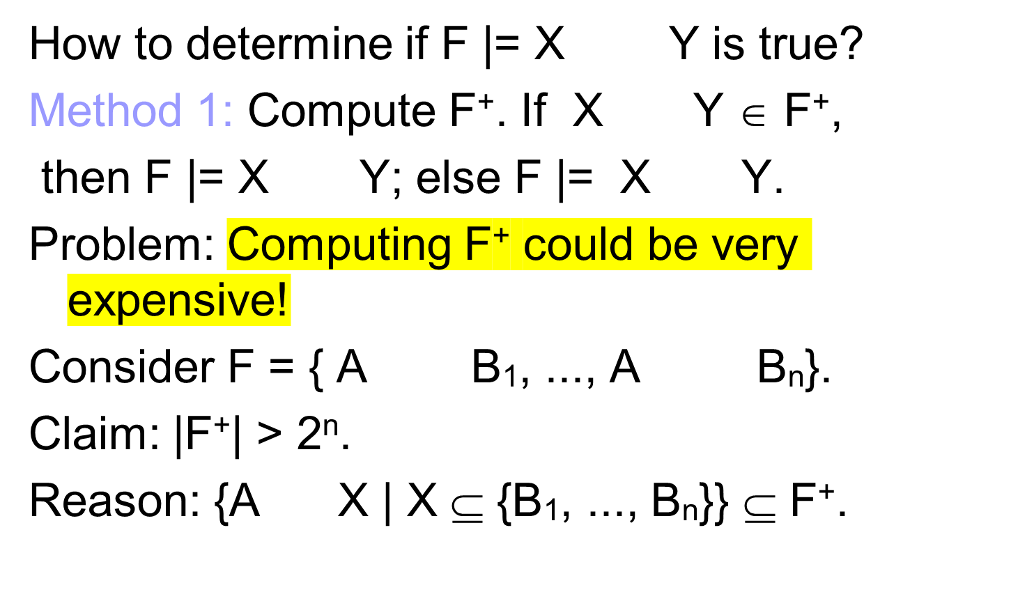
Closure of Attributes (1)

Slide 29
Closure of Attributes (2)
Method 2: Compute X⁺ : the closure of X under F.
X⁺ denotes the set of attributes that are functionally determined by X under F.
X⁺ = { A | X A ∈ F⁺ }
Theorem: X Y ∈ F⁺ if and only if Y ⊆ X⁺.
Proof: Use the decomposition rule and the union rule.

Slide 30
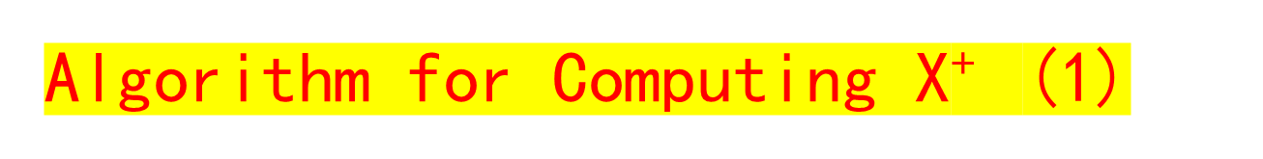
Input: a set of FDs F, a set of attributes X in R.
Output: X⁺ (= xplus).
begin xplus := X;
repeat for each FD Y Z in F do
if Y ⊆ xplus then xplus := xplus ∪ Z;
until no change to xplus;
end

Slide 31
Algorithm for Computing X⁺ (2)
Example:
R(A, B, C, G, H, I) = ABCGHI
X = AG
F = {A B, CG HI, B H, A C }
Compute (AG)+.
Initialization: xplus := AG;

Slide 32
Algorithm for Computing X⁺ (3)
1st iteration:
consider A B,
since A is a subset of xplus, xplus = ABG;
consider CG HI,
since CG is not a subset of xplus, xplus = ABG;
consider B H,
since B is a subset of xplus, xplus = ABGH;
consider A C,
since A is a subset of xplus, xplus = ABCGH;
(xplus is changed from AG to ABCGH)

Slide 33
Algorithm for Computing X⁺ (4)
2nd iteration:
consider A ---> B,
since A is a subset of xplus, xplus = ABCGH;
consider CG ---> HI,
since CG is a subset of xplus, xplus = ABCGHI;
consider B ---> H,
since B is a subset of xplus, xplus = ABCGHI;
consider A ---> C,
since A is a subset of xplus, xplus = ABCGHI;
(xplus is changed from ABCGH to ABCGHI)

Slide 34
Algorithm for Computing X⁺ (5)
3rd iteration:
(consider each FD in F again, but there is no change to xplus, exit)
Result: (AG)⁺ = ABCGHI.
The performance of the algorithm is sensitive to the order of FDs in F.

Slide 35
Algorithm for Computing X⁺ (6)
Theorem: Given R(A₁, ..., A_{n}) and a set of FDs F in R, K ⊆ R is a
superkey if K⁺ = {A₁, ..., A_{n}};
candidate key if K is a superkey and for any proper subset X of K, X⁺ ≠ {A₁, ..., A_{n}}.

Slide 36
Algorithm for Computing X⁺ (7)
Continue the above example:
AG is a superkey of R since (AG)⁺ = ABCGHI.
Since A⁺ = ABCH, G⁺ = G, neither A nor G is a superkey.
Hence, AG is a candidate key

Slide 37
Finding SuperKey
Theorem: Given R(A₁, ..., A_{n}) and a set of FDs F in R, K ⊆ R is a
superkey if K⁺ = {A₁, ..., A_{n}};
candidate key if K is a superkey and for any proper subset X of K, X⁺ ≠ {A₁, ..., A_{n}}.

Slide 38
Finding Candidate Key from FDs (1)
Continue with the same example:
R(A, B, C, G, H, I) = ABCGHI
X = AG
F = {A → B, CG → HI, B → H, A → C }
AG is a superkey of R since (AG)⁺ = ABCGHI.
Since A⁺ = ABCH, G⁺ = G, Therefore neither A nor G is a superkey.
Hence, AG is a candidate key and hence can be used as primary key

Slide 39
Worked Example 1:
Relation schema: R = (A, B, C, D, E)
F = {A->BC, CD->E, A->D, B->D, E->A}
Find A⁺, B⁺, BC⁺
Find Candidate keys of R

Slide 40
Worked Example 1 (cont’)
Compute A⁺(F = {A->BC, CD->E, A->D, B->D, E->A})
result = A
result = ABCD
result = ABCDE
Therefore A⁺= ABCDE
A->BC A->D
CD->E

Slide 41
Worked Example 1 (cont’)
Compute B⁺(F = {A->BC, CD->E, A->D, B->D, E->A})
result = B
result = BD
Therefore B⁺=BD
B->D

Slide 42
Worked Example 1 (cont’)
Compute BC⁺(F = {A->BC, CD->E, A->D, B->D, E->A})
result = BC
result = BCD
result = BCDE
result = ABCDE
Therefore BC⁺=ABCDE
Hence candidate keys are??
B->D
CD->E
E->A

Slide 43
Example 2 (cont’)
List Candidate keys of R
F = {A->BC, CD->E, B->D, E->A}
Let α be a candidate key for R
α → R, there is no γ s.t. γ ⊂ α, γ → R
A? B? C? D? E?
BC? BD? CD?
Candidate keys : A E BC CD

Slide 44
Finding Candidate Keys from FDs(2)
Let F be a set of FDs in relation schema R(A₁, ..., A_{n}).
Method 1 (can be automated)
(1) for each A_{i}, compute A_{i}⁺;
if A_{i}⁺ = A₁ A₂ ... A_{n}
then A_{i} is a candidate key;

Slide 45
Finding Candidate Keys from FDs(3)
(2) for each pair A_{i}A_{j}, i ≠ j
if A_{i} or A_{j} is a candidate key
then A_{i}A_{j} is not a candidate key;
else compute (A_{i} A_{j})⁺;
if (A_{i}A_{j})⁺ = A₁ A₂ ... A_{n}
then (A_{i} A_{j}) is a candidate key;

Slide 46
Finding Candidate Keys from FDs (4)
(3) for each triple A_{i}A_{j}A_{k}, i ≠ j, i ≠ k, j ≠ k
if any subset of A_{i}A_{j}A_{k} is a candidate key
then A_{i}A_{j}A_{k} is not a candidate key;
else compute (A_{i}A_{j}A_{k})⁺;
if (A_{i}A_{j}A_{k})⁺ = A₁ A₂ ... A_{n}
then (A_{i}A_{j}A_{k}) is a candidate key;
(4) . . . . . .

Slide 47
Finding Candidate Keys from FDs (5)
Method 2 (Graph Approach)
Step 1: Draw the dependency graph of F. Each vertex corresponds to an attribute. Edges can be defined as follows:
A B becomes A B
A BC becomes A
AB C becomes
B
C
A
C
B

Slide 48
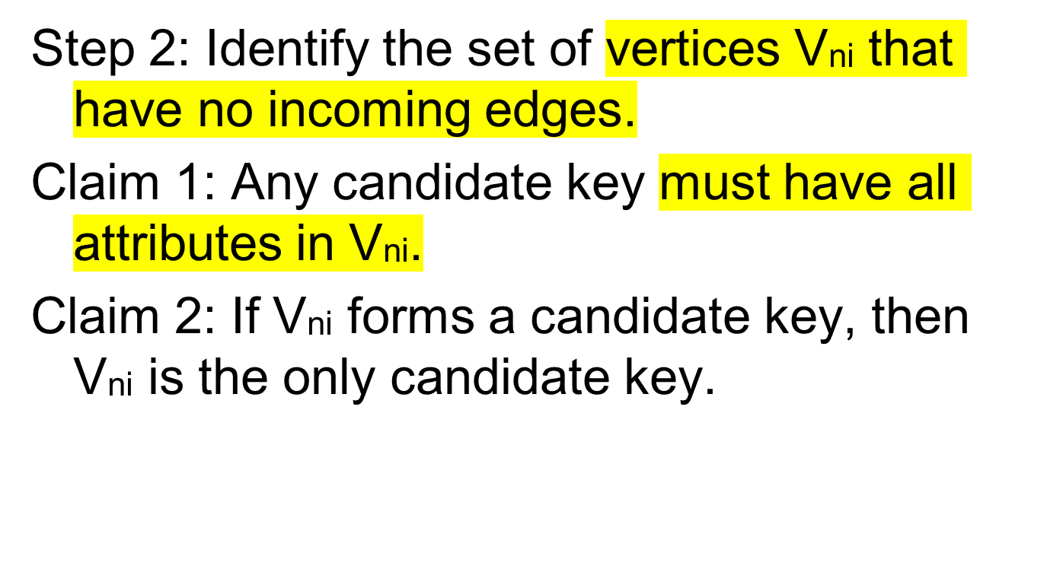
Finding Candidate Keys from FDs (6)
入度为0的节点

Slide 49
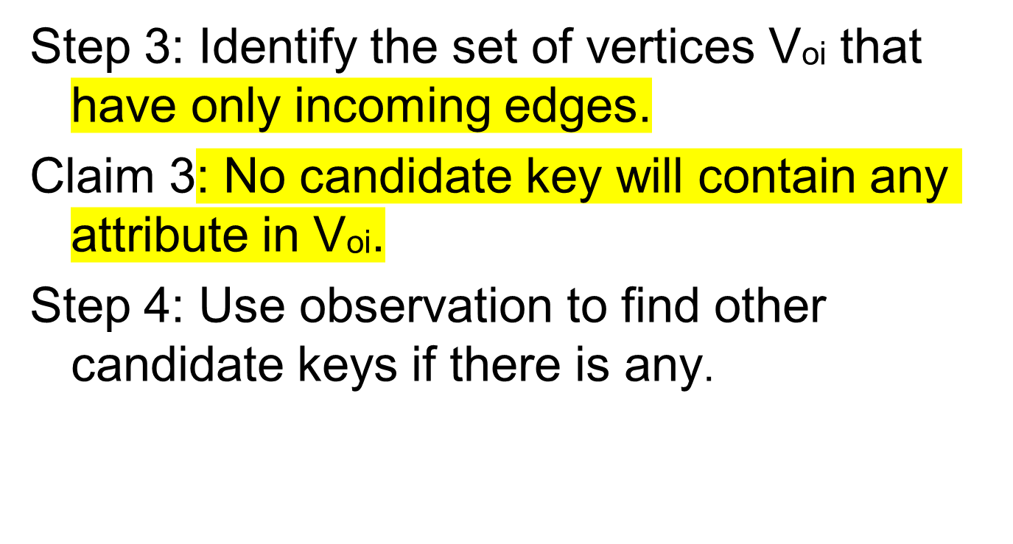
Finding Candidate Keys from FDs (7)

Slide 50
Finding Candidate Keys from FDs (8)
Example: Suppose R(A, B, C, G, H, I),
F = {A BC, CG HI, B H }
Vni = {A, G}, Voi = {H, I}.
Since (AG)⁺ = ABCGHI, AG is the only candidate key of R.
A
B
H
C
G
I

Slide 51
Finding Candidate Keys from FDs (9)
Example: Suppose R(A, B, C, D, E, H),
F = { A B, AB E, BH C,
C D, D A }
Vni = { H }, Voi = { E }.
Candidate keys: AH, BH, CH, DH.
A
B
C
D
E
H

Slide 52
Relation Decomposition
  Lossless Join Decomposition
  Dependency-Preserving Decomposition
  Finding Candidate Keys from FDs

Slide 53
Relation Decomposition (1)
Definition: Let R be a relation schema. A set of relation schemas {R₁, R₂, ..., R_{n}} is a decomposition of R if R = R₁ ∪ ... ∪ R_{n}.
Claim: If {R₁, R₂, ..., R_{n}} is a decomposition of R and r is an instance of R, then
r ⊆ π_{R1}(r) ∞ π_{R2}(r) ∞ . . . ∞ π_{Rn}(r)
Information may be lost (i.e. wrong tuples may be added) due to a decomposition.

Slide 54
Lossless Join Decomposition (1)
Definition: {R₁, R₂, ..., R_{n}} is a lossless (non-additive) join decomposition of R if for every legal instance r of R, we have
r = π_{R1}(r) ∞ π_{R2}(r) ∞ . . . ∞ π_{Rn}(r)

Slide 55
Lossless Join Decomposition (2)
Theorem: Let R be a relation schema and F be a set of FDs in R. Then a decomposition of R, {R1, R2}, is a lossless-join decomposition if and only if
R1 ∩ R2 R1 - R2; or
R1 ∩ R2 R2 - R1.

Slide 56
Lossless Join Decomposition (3)
Example
F={动物名称→动物属性,动物属性→动物居住地,动物名称→动物居住地}
  T1 (动物名称，动物属性)
  T2 (动物名称，动物居住地)
  T1 ∩T2=动物名称
  T1 -T2=动物属性
  T2 –T1=动物居住地
    动物名称 动物属性
    动物名称 动物居住地
lossless-join decomposition ！

Slide 57
Lossless Join Decomposition (4)
Example
F={动物名称→动物属性,动物属性→动物居住地,动物名称→动物居住地}
  T1 (动物名称，动物居住地)
  T2 (动物属性，动物居住地)
  T1 ∩T2=动物居住地
  T1 -T2=动物名称
  T2 –T1=动物属性
    动物居住地 动物名称
    动物居住地 动物属性
lossy-join decomposition ！

Slide 58
Lossless Join Decomposition (5)
Example
F={动物名称→动物属性,动物属性→动物居住地,动物名称→动物居住地}
  T1 (动物名称，动物属性)
  T2 (动物属性，动物居住地)
  T1 ∩T2=动物属性
  T1 -T2=动物名称
  T2 –T1=动物居住地
    动物属性 动物名称
    动物属性 动物居住地
lossless-join decomposition ！

Slide 59
Lossless Join Decomposition (6)
Example: Consider:
Prod_Manu(Prod_no, Prod_name, Price, Manu_id, Manu_name, Address)
F = { P# Pn Pr Mid, Mid Mn A },

Slide 60
Solution
Decomposition: {
Products=P# Pn Pr Mid,
Manufacturers=Mid Mn A
}
Is it a loss less join?

Slide 61
Since Products ∩ Manufacturers = Mid
Mn A = Manufacturers - Products,
it is a lossless-join decomposition.

Slide 62
Dependency-Preserving Decomposition (1)
Definition: Let R be a relation schema and F be a set of FDs in R. For any R' ⊆ R, the restriction of F to R' is a set of all FDs F' in F⁺ such that each FD in F' contains only attributes of R'.
F' = π_{R'}(F) = { X Y | F |= X Y and
XY ⊆ R' }
Note: π_{R'}(F) = π_{R'}(F⁺)!

Slide 63
Dependency-Preserving Decomposition (2)
Example: Suppose R(City, Street, Zipcode),
F = {CS Z, Z C}, R1(S, Z), R2(C, Z).
π_{R1}(F) = {S S, Z Z, S Z S,
SZ Z, SZ SZ}
π_{R2}(F) = {Z C, C C, Z Z,
CZ C, CZ Z, CZ CZ}

Slide 64
Dependency-Preserving Decomposition (3)
Definition: Given a relation schema R and a set of FDs F in R, a decomposition of R, {R₁, R₂, ..., R_{n}}, is dependency-preserving if
F⁺ = (F₁ ∪ F₂ ∪ . . . ∪ F_{n})⁺
where F_{i} = π_{Ri}(F), i = 1, ..., n.

Slide 65
Dependency-Preserving Decomposition (4)
In the above example, {R1, R2} is a decomposition of R.
Since CS Z ∈ F⁺ but
CS Z ∉ (π_{R1}(F) ∪ π_{R2}(F))⁺,
the decomposition is not dependency-preserving.

Slide 66
Dependency-Preserving Decomposition (5)
Algorithm DP
Input: A relation schema R, A set of FDs F in R, a decomposition {R₁, R₂, ..., R_{n}} of R.
Output: A decision on whether the decomposition is dependency-preserving.

Slide 67
Dependency-Preserving Decomposition (6)
for every X Y ∈ F
if ∃ R_{i} such that XY ⊆ R_{i}
then X Y is preserved;
else use Algorithm XYGP to find W;
if Y ⊆ W then X Y is preserved;
if every X Y is preserved
then {R₁, ..., R_{n}} is dependency-preserving;
else {R₁, ..., R_{n}} is not dependency-preserving;

Slide 68
Dependency-Preserving Decomposition (7)
Algorithm XYGP
W := X;
repeat for i from 1 to n do
W := W ∪ ((W ∩ R_{i})⁺ ∩ R_{i});
until there is no change to W;

Slide 69
Dependency-Preserving Decomposition (8)
Example: Suppose R(A, B, C, D),
F = {A B, B C, C D, D A },
R1(A,B), R2(B,C), R3(C,D).
Is {R1, R2, R3} dependency-preserving?
Since AB ⊆ R1, A B is preserved.
Since BC ⊆ R2, B C is preserved.
Since CD ⊆ R3, C D is preserved.

Slide 70
Dependency-Preserving Decomposition (9)
For D A, use Algorithm XYGP to compute W.
Initialization: W = D;
first iteration:
W = D ∪ ((D ∩ AB)⁺ ∩ AB) = D;
W = D ∪ ((D ∩ BC)⁺ ∩ BC) = D;
W = D ∪ ((D ∩ CD)⁺ ∩ CD)
= D ∪ (D⁺ ∩ CD)
= D ∪ (ABCD ∩ CD) = CD;

Slide 71
Dependency-Preserving Decomposition (10)
second iteration:
W = CD ∪ ((CD ∩ AB)⁺ ∩ AB) = CD;
W = CD ∪ ((CD ∩ BC)⁺ ∩ BC)
= CD ∪ (C⁺ ∩ BC) = BCD;
W = BCD ∪ ((BCD ∩ CD)⁺ ∩ CD)
= BCD;

Slide 72
Dependency-Preserving Decomposition (11)
third iteration:
W = BCD ∪ ((BCD ∩ AB)⁺ ∩ AB)
= ABCD;
Since A ⊆ W, D A is also preserved.
Hence, {R1, R2, R3} is a dependency-preserving decomposition.

Slide 73
Blackboard Example 1:
Let Relation Schema R = (A, B, C, D, E)
Let F = {A->BC, CD->E, B->D, E->A}
Let R be decomposed into R₁= (A, B, C) and R₂= (A, D, E)
  Is it a lossless-join decomposition?
  Is it a dependency-preserving decomposition?
If R_{a}= (A, B, C) R_{b}= (C, D, E)
  Is it a lossless-join decomposition?
  Is it a dependency-preserving decomposition?

Slide 74

Blackboard Example 2:
Let R = (A, B, C, D, E) and F = {A->BC, CD->E, B->D, E->A}
Let R be decomposed inot R₁= (A, B, C) and R₂= (A, D, E)
Is it a lossless-join decomposition?
{A} is superkey of R₁, so lossless-join
Is it a dependency-preserving decomposition?

Slide 75

Blackboard Example 3:
R = (A, B, C, D, E) F = {A->BC, CD->E, B->D, E->A}
R_{a}= (A, B, C) R_{b}= (C, D, E)
Is it a lossless-join decomposition?
{C} is not superkey of R_{a} and R_{b}, so lossy-join
Is it a dependency-preserving decomposition?

