Slide 1
Database Design
Normalization

Slide 2
What you learn:
Problems related to DB design (Anomalies) (不规则)
How to overcome (Normal Form)
How does it relate to last class( Functional Dependency and Relational DB theory )

Slide 3
The problem
Considering the relation:
{Sno,sdept,mn,courseNo,grade}
Some problem exists:
  Change the name of the manager in a dept.
  Insert new classes in a new course
  Delete the student information will cause the course information loss.
  Anomalies

Slide 4
Normalisation
Defn: Normalisation : is a technique for producing a set of relations with desirable properties, given the data requirements of an enterprise.

Slide 5
The purpose of “The properties” :
  Removing redundancy
  By table decomposition
Normalization Level:
  1st, 2nd, 3rd, Boyce-Codd, 4th and 5th Normal Forms
  Strictness trend: 1NF->5NF

Slide 6
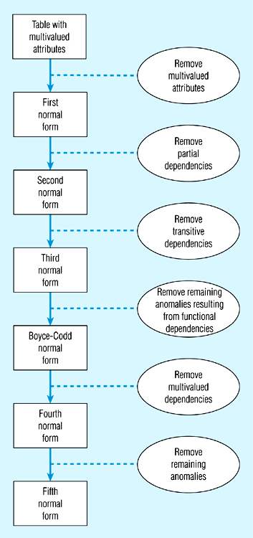
Steps in normalization

Slide 7
Data Normalization
Primarily a tool to validate and improve a logical design so that it satisfies certain constraints that avoid unnecessary duplication of data
The process of decomposing relations with anomalies to produce smaller, well-structured relations

Slide 8
What is Well-Structured Relations?
Def: A relation that contains minimal data redundancy and allows users to insert, delete, and update rows without causing data inconsistencies is called Well-Structured Relations.
Goal is to avoid anomalies such as:
  Insertion Anomaly – adding new rows forces user to create duplicate data
  Deletion Anomaly – deleting rows may cause a loss of data that would be needed for other future rows
  Modification Anomaly – changing data in a row forces changes to other rows because of duplication

Slide 9
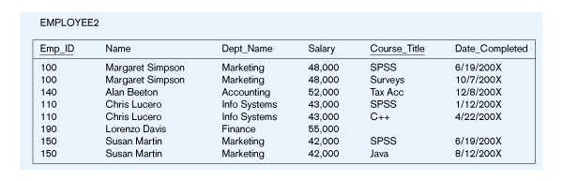
Example – Employee2
Question – Is this a relation?
Answer – Yes: unique rows and no multivalued attributes
Question – What’s the primary key?
Answer – Composite: Emp_ID, Course_Title

Slide 10
Anomalies (不规则) in this Table
Insertion – can’t enter a new employee without having the employee take a class
Deletion – if we remove employee 140, we lose information about the existence of a Tax Account class
Modification – giving a salary increase to employee 100 forces us to update multiple records

Slide 11
Cont…
Why do these anomalies exist?
Because we’ve combined two themes (entity types) into one relation.
This results in duplication, and an unnecessary dependency between the entities

Slide 12
First Normal Form
No multivalued attributes
Every attribute value is atomic
Ｅvery non-primary-key attribute is functionally dependent on the primary key.

Slide 13
Analysis :
What does “functionally dependent on the primary key” mean?
  1) no multi-value cells.
  2)no Nesting Relation

Slide 14

Question:
Is the following table in 1NF?
supplierNo | supplierName | partNo
S5 | Wells | P1
S2 | Heath | P1, P4
S7 | Barron | P6
S9 | Edwards | P8, P2, P6

Slide 15
How about this one?
supplierNo | supplierName | partNo
S5 | Wells | P1
S2 | Heath | P1
S2 | Heath | P4
S7 | Barron | P6
S9 | Edwards | P8,
S9 | Edwards | P2
S9 | Edwards | P6

Slide 16
  A relation that is not in 1NF effectively embeds other relations within it.
  The previous relation can be represented as:
SupplierPart(supplierNo,
supplierName, Part(partNo))

Slide 17

Solution:
1)Form new relations for each nonatomic attribute or nested relation along with the primary key of the original table. (Why?)
2)Choose the Primary key for the newly generated Relation.(How?)
  Simple way: by enterprise rules and we get the FDs
  Complicated case: by Relational DB Theory : Key Finding.

Slide 18
Example:
SupplierPart(supplierNo,supplierName, Part(partNo)).
Solution!
SupplierPart(supplierNo,supplierName)
SupplierPart(supplierNo,partNo)

Slide 19
supplierNo | supplierName
S5 | Wells
S2 | Heath
S2 | Heath
S7 | Barron
S9 | Edwards
S9 | Edwards
S9 | Edwards
supplierNo | partNo
S5 | P1
S2 | P1
S2 | P4
S7 | P6
S9 | P8
S9 | P2
S9 | P6

Slide 20
Any other solutions?
SupplierPart(supplierNo,supplierName, Part(partNo))
Hint!
supplierNo←→supplierName
So we can replace SupplierNo with supplierName
Solution:
  SupplierPart(supplierNo,supplierName)
  SupplierPart(supplierName,partNo)

Slide 21
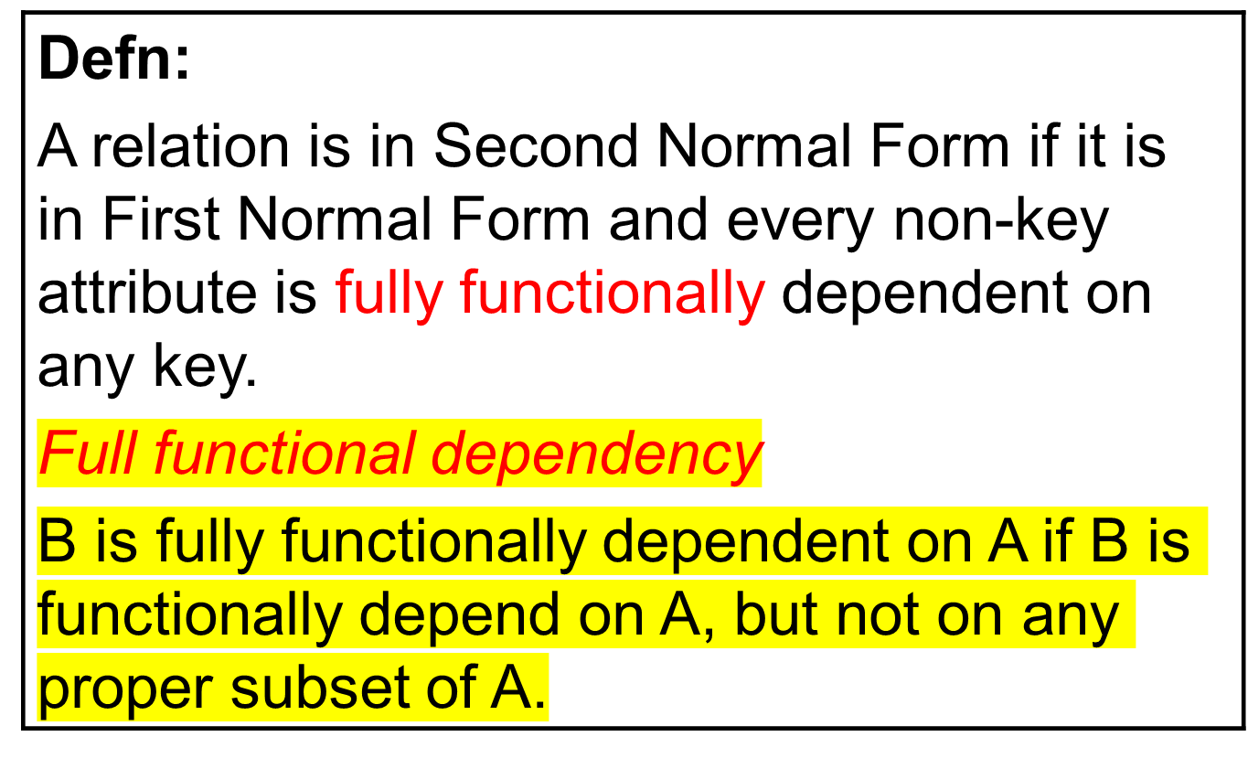
Second Normal Form

Slide 22
Second Normal Form
1NF plus every non-key attribute is fully functionally dependent on the ENTIRE primary key
  Every non-key attribute must be defined by the entire key, not by only part of the key
  No partial functional dependencies
  Therefore the student-course table is not in 2NF

Slide 23
Examine the following table
Sid | Sname | Phone | Course-id | Course-description | Credit-hours | Grade
100 | John | 487 2454 | IS380 | Database Concepts | 3 | A
100 | John | 487 2454 | IS416 | Unix Operating System | 3 | B
200 | Smith | 671 8120 | IS380 | Database Concepts | 3 | B
200 | Smith | 671 8120 | IS416 | Unix Operating System | 3 | B
200 | Smith | 671 8120 | IS420 | Data Net Work | 3 | C
300 | Russell | 871 2356 | IS417 | System Analysis | 3 | A
Notes:
The primary key determines every attribute.
For example if you know both Sid and Course-id for any student you will be able to retrieve Sname, Phone, Course-description, Credit-hours and Grade, because these attributes are dependent on the primary key.

Slide 24
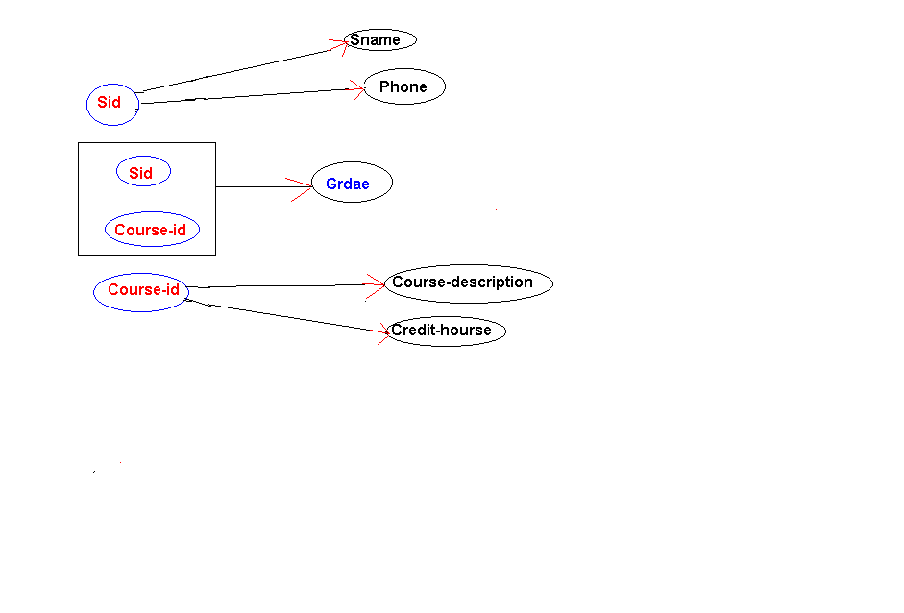

Figure below is the graphical representation of the functional dependency between the primary key and attributes of the above relation.

Slide 25
2NF
To convert Student-courses to second normal relations we have to make all non-primary attributes to be fully functionally dependent on the primary key.
To do that we need to decompose (that is we break it down to two or more relations)
Student-courses table into two or more tables.
However decomposition may cause problems.
To avoid such problems it is important to keep attributes, which are dependent on each other in the same table
From dependency diagram we see that we should divide Student-courses relation into following three relations:

Slide 26
Student (Sid:pk, Sname, Phone)
Sid | Sname | Phone
100 | John | 487 2454
200 | Smith | 671 8120
300 | Russell | 871 2356
Courses (Course-id::pk, Course-Description)
Course-id | Course-description | Credit-hours
IS380 | Database Concepts | 3
IS416 | Unix Operating System | 3
IS420 | Data Net Work | 3
IS417 | System Analysis | 3

Slide 27
Student-grade (Sid:pk1:fk:Student, Course-id::pk2:fk:Courses, Grade)
Sid | Course-id | Grade
100 | IS380 | A
100 | IS416 | B
200 | IS380 | B
200 | IS416 | B
200 | IS420 | C
300 | IS417 | A

Slide 28
Free From Anomalies
Further these three sets are free from all anomalies. Let us clarify this in more detail.
Insertion anomaly: Now a new Course with course-id IS247 and Course-description can be inserted to the table Course.
Equally we can add any new students to the database by adding their id, name and phone to Student table.
Therefore our database, which made up of these three tables does not suffer from insertion anomaly.
Update anomaly: Since redundancy of the data was eliminated no update anomaly can occur. To change the course-description for IS380 only one change is needed in table Courses.
Deletion anomaly: the deletion of student Russell from the database is achieved by deleting Russell's records from both Student and Student-grade relations and this does not have any side effect because the course IS417 untouched in the table Courses.

Slide 29
2NF, therefore, applies to a relation with a composite primary key.
Consider the following relation
Result(studentID, moduleCode, moduleTitle, mark)
Is it in 1NF?
Is it in 2NF?

Slide 30
solution
Set up a new relation for each partial key with its dependent attribute(s). Keep a relation with the original primary key and any attributes that are fully functionally dependent on it.
Result(studentID, moduleCode, moduleTitle, mark)=>
Result(studentID, moduleCode, mark) ; Module(moduleCode, moduleTitle)

Slide 31
Try to normalise the following to 2NF
Item Code Description Qty in stock Minimum Qty
Item Code Supplier Code Name Address Date of last order
Item Code Order No Order date Order qty Custno Cust Name Cust Address
assumptions:
1)order no uniquely identifies a date and a customer;
2)the order qty is the qty of an item on an order;
3)the supplier code uniquely identifies a supplier and the date of last order;

Slide 32
Item code Description Qty in stock Minimum Qty
Item code Supplier Code
Item Code Order no Order qty
Supplier Code Name Address Date of last order
Order no Order date Custno Name Address

Slide 33
Functional Dependencies in EMPLOYEE2
Dependency on entire primary key
EmpID
CourseTitle
Name
DeptName
Salary
DateCompleted
Dependency on only part of the key (Partial Dependency)
EmpID, CourseTitle ➔ DateCompleted
EmpID ➔ Name, DeptName, Salary
Therefore, NOT in 2nd Normal Form!!

Slide 34
Getting it into 2nd Normal Form
Decompose into two separate relations
Both the table are now full functionally dependent on primary key
EmpID
Name
DeptName
Salary
EmpID
CourseTitle
DateCompleted

Slide 35
Third Normal Form
Defn: A relation is in Third Normal Form if it is in Second Normal Form, and no non-key attribute is transitively dependent on any key. Transitive dependency If A B and B C, then C is transitively dependent on A (provided that A is not functionally dependent on B or C).

Slide 36
Third Normal Form
2NF PLUS no transitive dependencies (one attribute functionally determines a second, which functionally determines a third)

Slide 37
Consider the STUDENT ACTIVITY table shown below (Sid: pk, Activity, fee)
Sid | Activity | Fee
100 | Swimming | 100
200 | Tennis | 100
300 | Golf | 300
400 | Swimming | 100
Student ID (SID)----------→Activity I,e SID determine Activity
Further Activity ------------> fee that is the Activity determine the fee

Slide 38
3NF
Table STUDENT is in first normal form because all its attributes are simple.
Also STUDENT is in second normal form because all its non-primary attributes are fully functionally dependent on the primary key (Sid).
Notice that a first normal relation with non-composite (that is simple) primary key automatically will be in second normal form because all its non-primary attributes will be fully functionally dependent on the primary key.

Slide 39
3NF
Table STUDENT suffers from all 3 anomalies;
A new student can not be added to the database unless he/she takes an activity and no activity can be inserted into the database unless we get a student to take that activity.
There is redundancy in the table (see Swimming), therefore to change the fee for Swimming we must make changes in more than one place and that will cause update anomaly problem.
If student 300 is deleted from the table we also loose the fact that we had Golf activity with its fee to be 300.
To overcome these anomalies STUDENT table should be decomposed into smaller tables.

Slide 40
STUD-AVT (Sid:pk, Activity) with the following data :
STUD_ACT
Sid | Activity
100 | Swimming
200 | Tennis
300 | Golf
400 | Swimming
AVT-Fee (Activity:pk, Fee)
AVT-Fee
Activity | Fee
Swimming | 100
Tennis | 100
Golf | 300
Swimming | 100

Slide 41
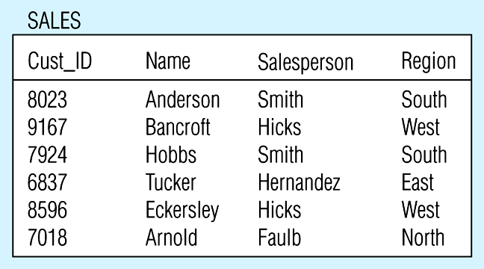
Relation with transitive dependency
(a) SALES relation with simple data

Slide 42
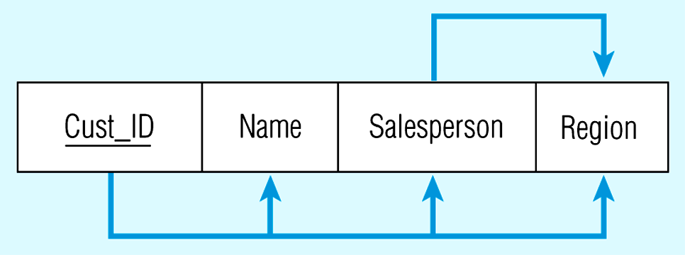
Below Figure shows Relation with transitive dependency
CustID → Name
CustID → Salesperson
CustID → Region
All this is OK
(2nd NF)
BUT
CustID → Salesperson → Region
Transitive dependency
(not 3rd NF)

Slide 43
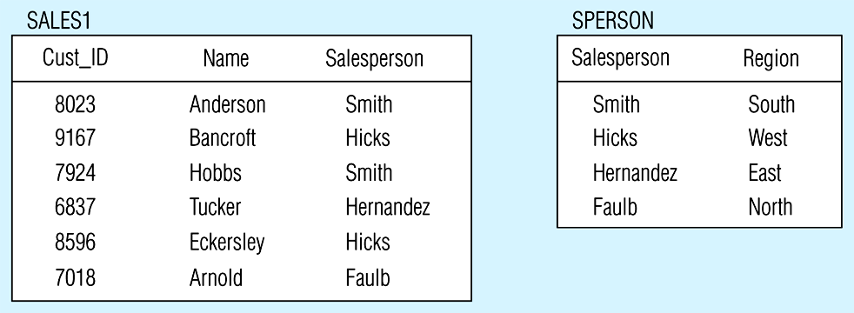
Removing a transitive dependency
(a) Decomposing the SALES relation

Slide 44
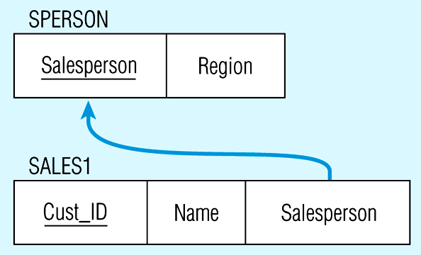
Relations in 3NF
Salesperson → Region
CustID → Name
CustID → Salesperson
Now, there are no transitive dependencies…
Both relations are in 3rd NF

Slide 45
Consider the following relation
Customer(customerID, name, address, creditCode, creditLimit)
Assume that one credit code can apply to several customers. But one customer can have only one credit code
Is it in 1NF?
Is it in 2NF?
Is it in 3NF?

Slide 46
Solution
Set up a relation that includes the nonkey attributes(s) that functionally determine(s) other nonkey attributes(s).
Customer(customerID, name, address, creditCode, creditLimit)=>
Customer(customerID, name, address, creditCode); Credit(creditCode, creditLimit)

Slide 47
Example
Example: StudentInfo(SSNo, Name, Major, Dept, DeptChair), SSNo-> Name,Major; Major -> Dept; Dept -> DeptChair
Example: R(A, B, C); FDs: A->B, B->C

Slide 48
Solutions
Example: StudentInfo(SSNo, Name, Major, Dept, DeptChair),
Solution: StudentInfo(SSNo, Name, Major), MajDept(Major, Dept), DeptInfo(Dept, DeptChair)
Example: R(A, B, C); FDs: A->B, B->C
Solution: R1(A, B); R2(B, C);

Slide 49
Summary: 1NF
A relation is in 1NF if it contains no repeating groups
To convert an unnormalised relation to 1NF either:
Flatten the table and change the primary key, or
Decompose the relation into smaller relations, one for the repeating groups and one for the non-repeating groups.
Remember to put the primary key from the original relation into both new relations.
This option is liable to give the best results.

Slide 50
Summary: 2NF
A relation is in 2NF if it contains no repeating groups and no partial key functional dependencies exists
Rule: A relation which is in 1NF having a single key field is said to be in 2NF
To convert a relation with partial functional dependencies to 2NF. create a set of new relations:
One relation for the attributes that are fully dependent upon the key.
One relation for each part of the key that has partially dependent attributes

Slide 51
Summary: 3NF
A relation is in 3NF if it contains no repeating groups, no partial functional dependencies, and no transitive functional dependencies
To convert a relation with transitive functional dependencies to 3NF, remove the attributes involved in the transitive dependency and put them in a new relation
Rule: A relation in 2NF with only one non-key attribute must be in 3NF
In a normalized relation a non-key field must provide a fact about the key, the whole key and nothing but the key.
Relations in 3NF are sufficient for most practical database design problems.
However, 3NF does not guarantee that all anomalies have been removed.

Slide 52
Boyce-Codd Normal Form
Defn: A relation is in BCNF if every determinant is a candidate key.
只要表中的主键是candidate key即可

Slide 53
Boyce-Codd Normal Form (BCNF)
BCNF is based on the concept of a determinant.
A determinant is any attribute (simple or composite) on which some other attribute is fully functionally dependent.
When a relation has more than one candidate key, anomalies may result even though the relation is in 3NF
3NF does not deal satisfactorily with the case of a relation with overlapping candidate keys
i.e. composite candidate keys with at least one attribute in common.

Slide 54
BCNF applies to a relation which has more than one candidate key, and the candidate keys are composite and overlapping.
Consider the following relation
SSL(student, subject, lecturer)

Slide 55
SSL(student, subject, lecturer)
Assume that: each teacher teach only one subject. A subject has several teachers to teach,
{student, subject} → lecturer;
lecturer → subject
Is it in bcnf?
STUDENT | SUBJECT | LECTURER
123 | PHYSICS | EINSTEIN
123 | MUSIC | MOZART
456 | BIOLOGY | DARWIN
789 | PHYSICS | BOHR
999 | PHYSICS | EINSTEIN

Slide 56
ANOMILY (不规则)
If the record for student 456 is deleted we lose not only information on student 456 but also the fact that DARWIN Lecture’s in BIOLOGY
we cannot record the fact that WATSON can Lecture on COMPUTING until we have a student who take a subject in COMPUTING to whom we can assign WATSON as an Lecturer.

Slide 57
Convert to BCNF
STUDENT,SUBJECT,LECTURER
BREAK DOWN INTO TWO TABLES
Lecture → Subject (X→ Y) (FIRST TABLE)
REMOVE Y
STUDENT, LECTURER (SECOND TABLE)

Slide 58
Convert to BCNF we have two tables:
LECTURER | SUBJECT
EINSTEIN | PHYSICS
MOZART | MUSIC
DARWIN | BIOLOGY
BOHR | PHYSICS
STUDENT | LECTURER
123 | EINSTEIN
123 | MOZART
456 | DARWIN
789 | BOHR
999 | EINSTEIN

Slide 59
BCNF
Consider the following relation and determinants.
Let R(a,b,c,d) be a relation
a,c -> b,d
a,d -> b
Here, the first determinant suggests that the primary key of R could be a,c.
If this change was done all of the non-key attributes present in R could still be determined, and therefore this change is legal.
However, the second determinant indicates that a,d determines b, but a,d could not be the key of R as a,d does not determine all of the non key attributes of R (it does not determine c). Therefore cant be candidate key.
We would say that the first determinate is a candidate key, but the second determinant is not a candidate key, and thus this relation is not in BCNF (but is in 3rd normal form).

Slide 60
Another Example:
Supplier(supplierNo, productCode, supplierName, quantity)
Where supplierNo ←→SupplierName
Is it in 1NF?
Is it in 2NF?
Is it in 3NF?
Is it in BCNF?

Slide 61
supplierNo
productCode
quantity
supplierNo
supplierName
OR
supplierName
productCode
quantity
supplierName
supplierNo

