Slide 1
Database Design
Normalization

Slide 2
What you learn:
Problems related to DB design (Anomalies) (不规则)
How to overcome (Normal Form)
How does it relate to last class( Functional Dependency and Relational DB theory )

Slide 3
The problem
Considering the relation:
{Sno,sdept,mn,courseNo,grade}
Some problem exists:
  Change the name of the manager in a dept.
  Insert new classes in a new course
  Delete the student information will cause the course information loss.
  Anomalies

Slide 4

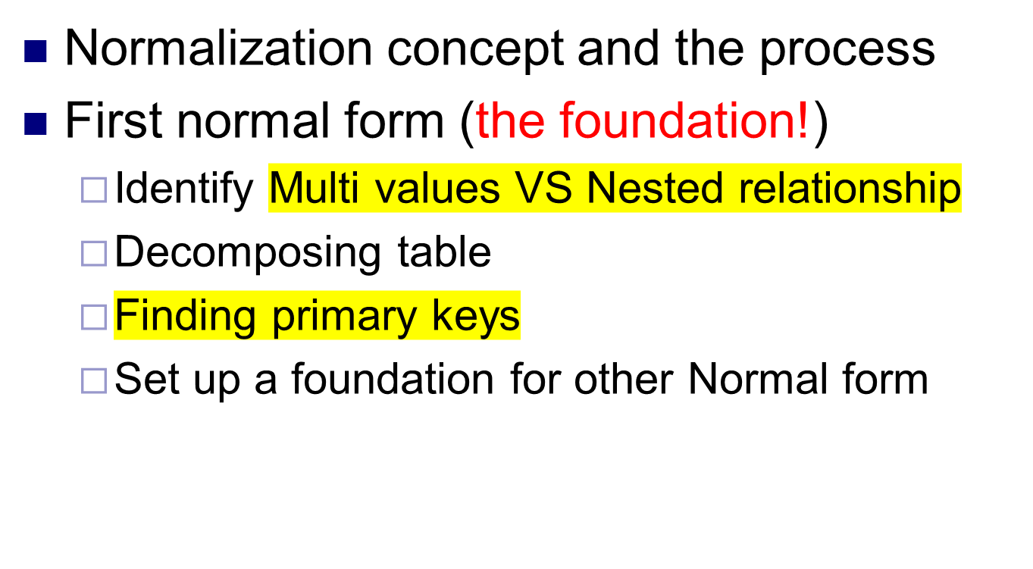
Content of this Class:
多值属性：一个属性包含多个值（如writer: A B ）

Slide 5
Normalisation
Defn: Normalisation : is a technique for producing a set of relations with desirable properties, given the data requirements of an enterprise.

Slide 6
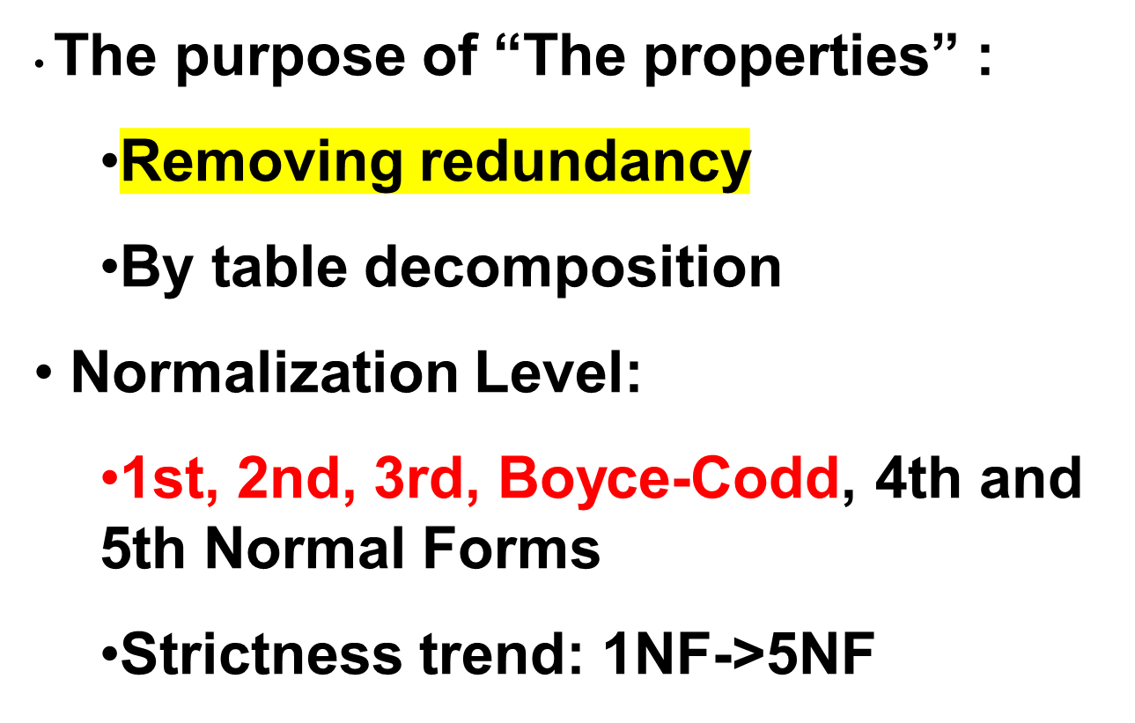

Slide 7
Data Normalization
Primarily a tool to validate and improve a logical design so that it satisfies certain constraints that avoid unnecessary duplication of data
The process of decomposing relations with anomalies to produce smaller, well-structured relations

Slide 8
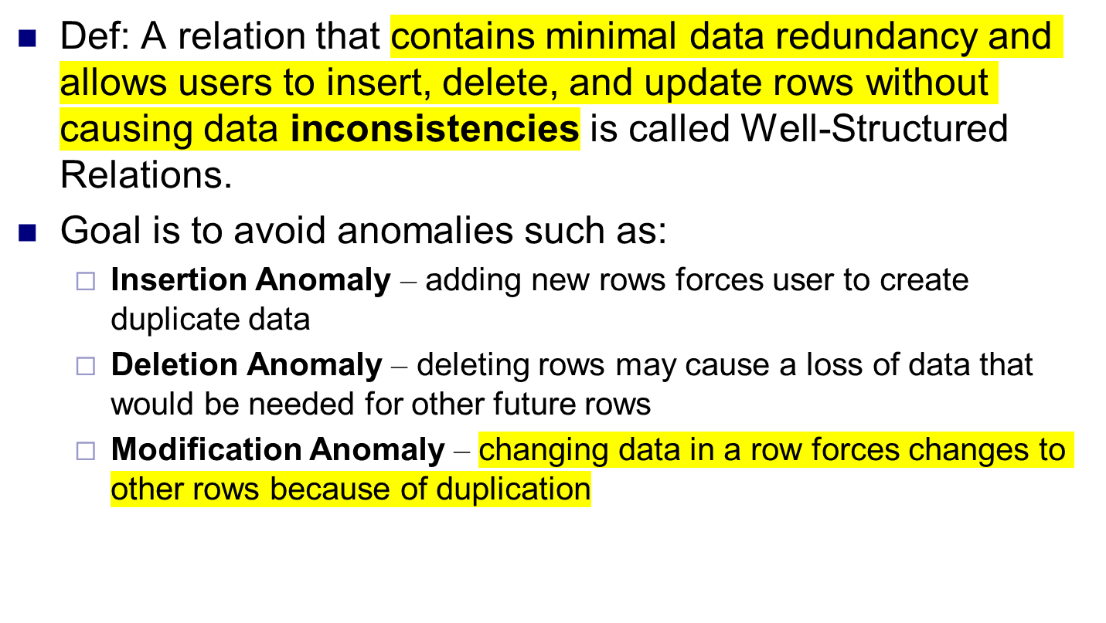
What is Well-Structured Relations?

Slide 9
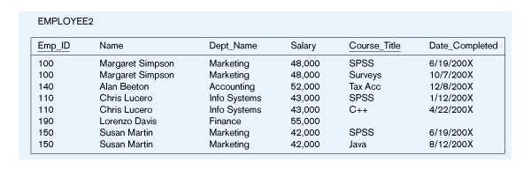
Example – Employee2
没有重复的行
Question – Is this a relation?
Answer – Yes: unique rows and no multivalued attributes
Question – What’s the primary key?
Answer – Composite: Emp_ID, Course_Title

Slide 10
Anomalies (不规则) in this Table
Insertion – can’t enter a new employee without having the employee take a class
Deletion – if we remove employee 140, we lose information about the existence of a Tax Account class
Modification – giving a salary increase to employee 100 forces us to update multiple records

Slide 11
Cont…
Why do these anomalies exist?
Because we’ve combined two themes (entity types) into one relation.
This results in duplication, and an unnecessary dependency between the entities

Slide 12
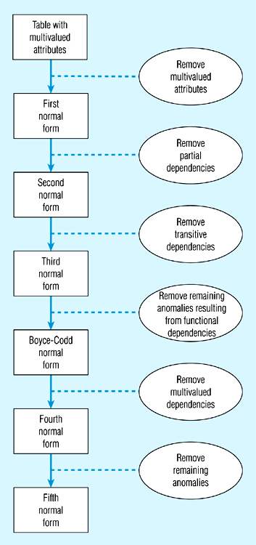
Steps in normalization

Slide 13

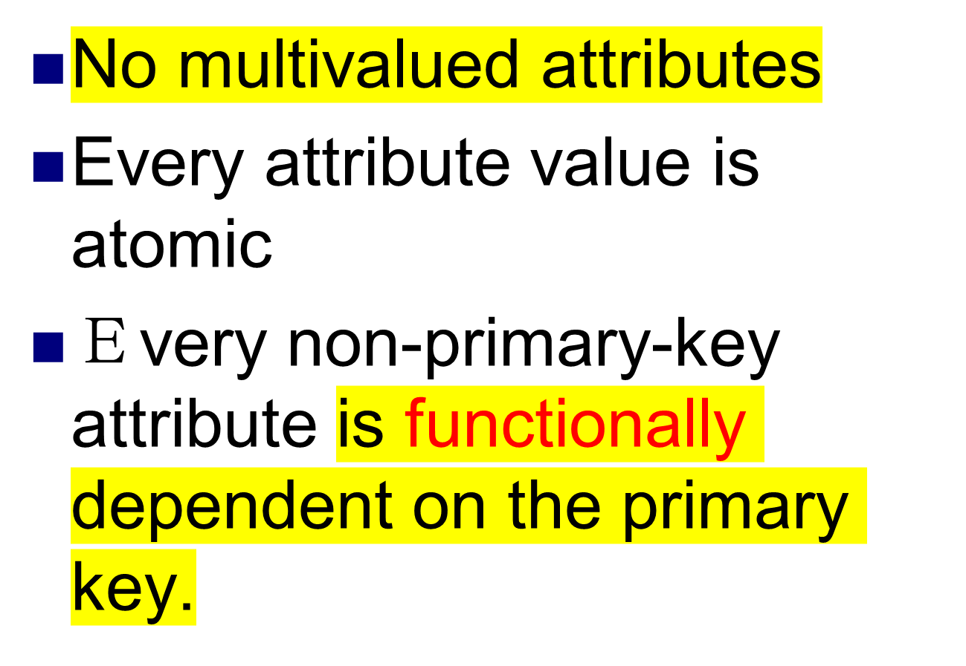

Slide 14
Analysis :
What does “functionally dependent on the primary key” mean?
  1) no multi-value cells.
  2)no Nesting Relation

Slide 15


Question:
Is the following table in 1NF?
supplierNo | supplierName | partNo
S5 | Wells | P1
S2 | Heath | P1, P4
S7 | Barron | P6
S9 | Edwards | P8, P2, P6

Slide 16
How about this one?
supplierNo | supplierName | partNo
S5 | Wells | P1
S2 | Heath | P1
S2 | Heath | P4
S7 | Barron | P6
S9 | Edwards | P8,
S9 | Edwards | P2
S9 | Edwards | P6

Slide 17
  A relation that is not in 1NF effectively embeds other relations within it.
  The previous relation can be represented as:
SupplierPart(supplierNo,
supplierName, Part(partNo))

Slide 18

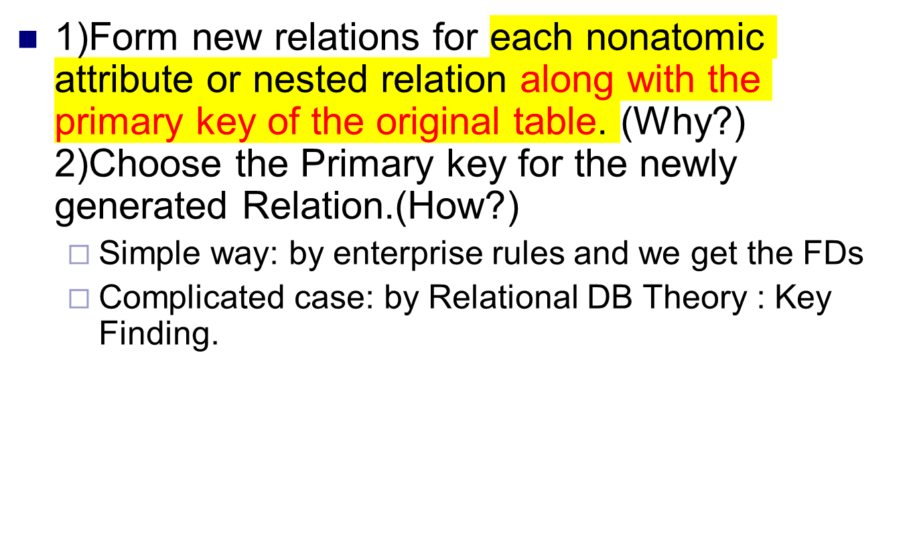
Solution:

Slide 19
Example:
SupplierPart(supplierNo,supplierName, Part(partNo)).
Solution!
SupplierPart(supplierNo,supplierName)
SupplierPart(supplierNo,partNo)

Slide 20
supplierNo | supplierName
S5 | Wells
S2 | Heath
S2 | Heath
S7 | Barron
S9 | Edwards
S9 | Edwards
S9 | Edwards
supplierNo | partNo
S5 | P1
S2 | P1
S2 | P4
S7 | P6
S9 | P8,
S9 | P2
S9 | P6

Slide 21
Any other solutions?
SupplierPart(supplierNo,supplierName, Part(partNo))
Hint!
supplierNo←→supplierName
So we can replace SupplierNo with supplierName
Solution:
  SupplierPart(supplierNo,supplierName)
  SupplierPart(supplierName,partNo)

Slide 22
Try to normalise the following to 1NF
Customer number
Customer name
Customer address
Order(
Order no
Order date
Order value
Order item(
Item code
Item quantity
Item unit price ))

Slide 23
Cust No Name Address
Order No Cust no Order date Order value
Item Code Order No Qty Unit Price

Slide 24
Examine the following table
Sid | Sname | Phone | Course-id | Course-description | Credit-hours | Grade
100 | John | 487 2454 | IS380 | Database Concepts | 3 | A
100 | John | 487 2454 | IS416 | Unix Operating System | 3 | B
200 | Smith | 671 8120 | IS380 | Database Concepts | 3 | B
200 | Smith | 671 8120 | IS416 | Unix Operating System | 3 | B
200 | Smith | 671 8120 | IS420 | Data Net Work | 3 | C
300 | Russell | 871 2356 | IS417 | System Analysis | 3 | A
Notes:
The primary key determines every attribute.
For example if you know both Sid and Course-id for any student you will be able to retrieve Sname, Phone, Course-description, Credit-hours and Grade, because these attributes are dependent on the primary key.

Slide 25
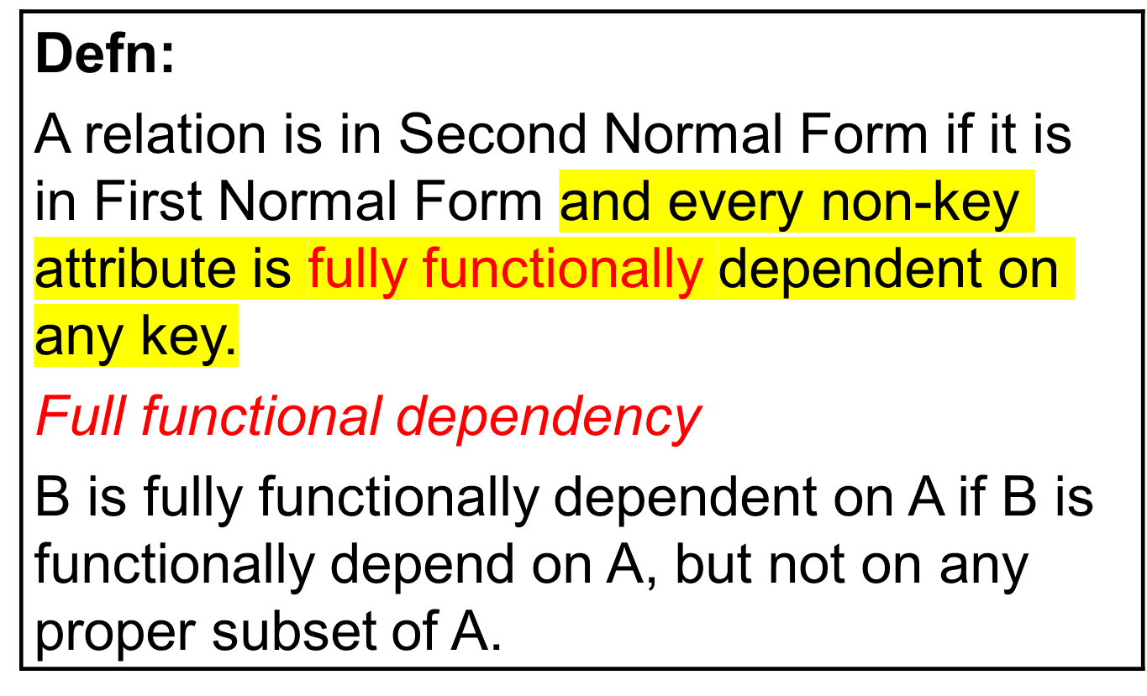
Second Normal Form
A→B且B->A

Slide 26
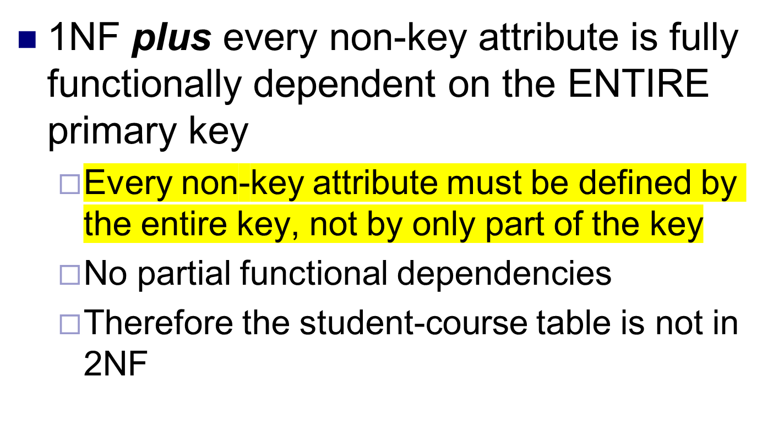
Second Normal Form

Slide 27
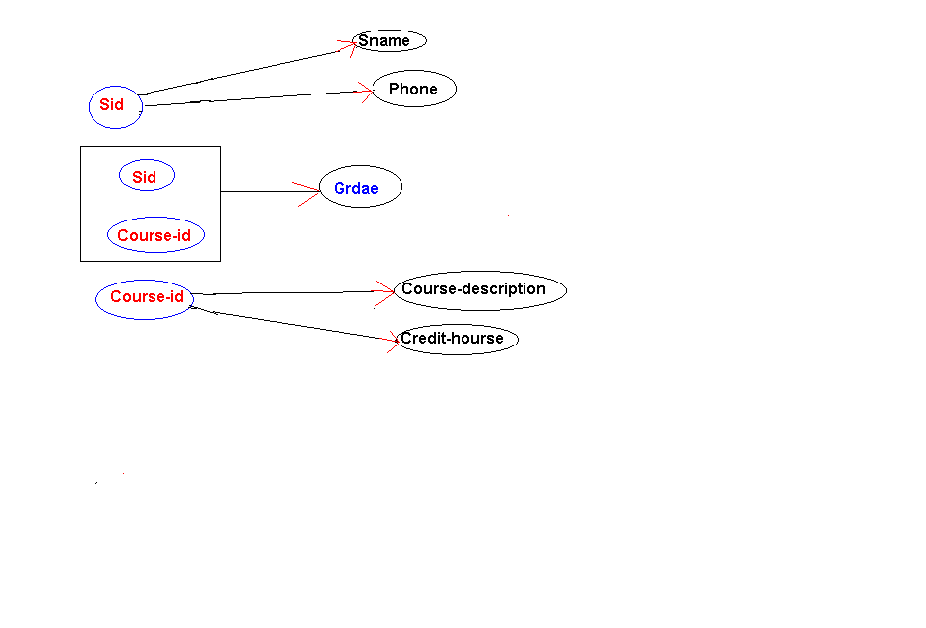

Figure below is the graphical representation of the functional dependency between the primary key and attributes of the above relation.

Slide 28
2NF
To convert Student-courses to second normal relations we have to make all non-primary attributes to be fully functionally dependent on the primary key.
To do that we need to decompose (that is we break it down to two or more relations)
Student-courses table into two or more tables.
However decomposition may cause problems.
To avoid such problems it is important to keep attributes, which are dependent on each other in the same table
From dependency diagram we see that we should divide Student-courses relation into following three relations:

Slide 29
Student (Sid:pk, Sname, Phone)
Sid | Sname | Phone
100 | John | 487 2454
200 | Smith | 671 8120
300 | Russell | 871 2356
Courses (Course-id::pk, Course-Description)
Course-id | Course-description | Credit-hours
IS380 | Database Concepts | 3
IS416 | Unix Operating System | 3
IS420 | Data Net Work | 3
IS417 | System Analysis | 3

Slide 30
Student-grade (Sid:pk1:fk:Student, Course-id::pk2:fk:Courses, Grade)
Sid | Course-id | Grade
100 | IS380 | A
100 | IS416 | B
200 | IS380 | B
200 | IS416 | B
200 | IS420 | C
300 | IS417 | A

Slide 31
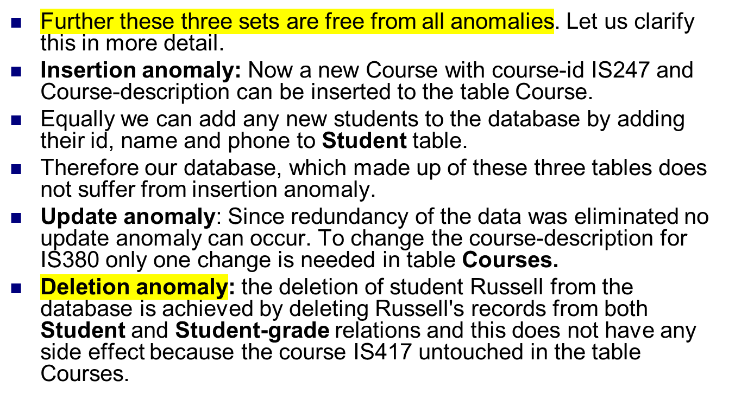
Free From Anomalies

Slide 32
2NF, therefore, applies to a relation with a composite primary key.
Consider the following relation
Result(studentID, moduleCode, moduleTitle, mark)
Is it in 1NF?
Is it in 2NF?

Slide 33
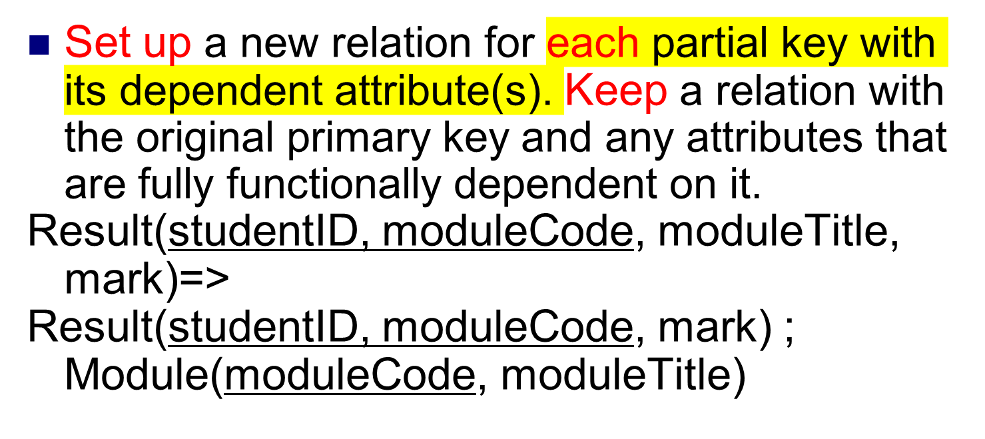
solution

Slide 34
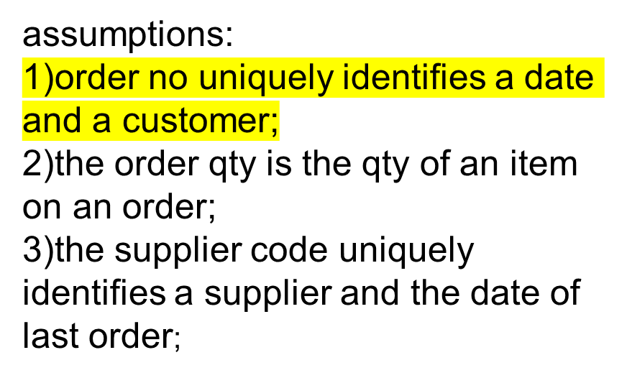
Try to normalise the following to 2NF
Item Code Description Qty in stock Minimum Qty
Item Code Supplier Code Name Address Date of last order
Item Code Order No Order date Order qty Custno Cust Name Cust Address

Slide 35
Item code Description Qty in stock Minimum Qty
Item code Supplier Code
Item Code Order no Order qty
Supplier Code Name Address Date of last order
Order no Order date Custno Name Address

Slide 36
Functional Dependencies in EMPLOYEE2
Dependency on entire primary key
EmpID
CourseTitle
Name
DeptName
Salary
DateCompleted
Dependency on only part of the key (Partial Dependency)
EmpID, CourseTitle ➔ DateCompleted
EmpID ➔ Name, DeptName, Salary
Therefore, NOT in 2nd Normal Form!!

Slide 37
Getting it into 2nd Normal Form
Decompose into two separate relations
Both the table are now full functionally dependent on primary key
EmpID
Name
DeptName
Salary
EmpID
CourseTitle
DateCompleted

Slide 38
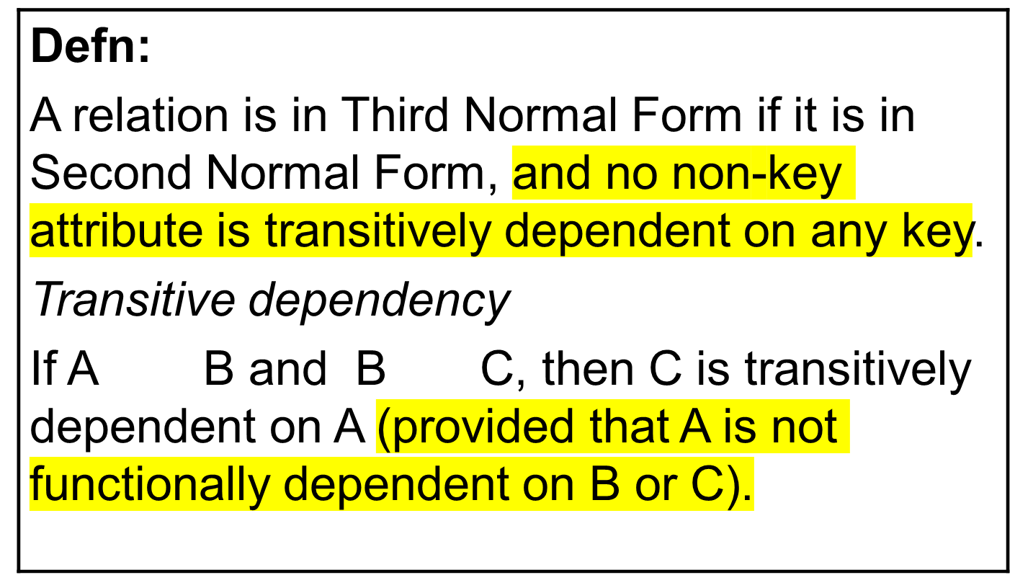
Third Normal Form

Slide 39
Third Normal Form
2NF PLUS no transitive dependencies (one attribute functionally determines a second, which functionally determines a third)

Slide 40

Consider the STUDENT ACTIVITY table shown below (Sid: pk, Activity, fee)
Sid | Activity | Fee
100 | Swimming | 100
200 | Tennis | 100
300 | Golf | 300
400 | Swimming | 100
出现传递性依赖

Slide 41
3NF
Table STUDENT is in first normal form because all its attributes are simple.
Also STUDENT is in second normal form because all its non-primary attributes are fully functionally dependent on the primary key (Sid).
Notice that a first normal relation with non-composite (that is simple) primary key automatically will be in second normal form because all its non-primary attributes will be fully functionally dependent on the primary key.

Slide 42
3NF
Table STUDENT suffers from all 3 anomalies;
A new student can not be added to the database unless he/she takes an activity and no activity can be inserted into the database unless we get a student to take that activity.
There is redundancy in the table (see Swimming), therefore to change the fee for Swimming we must make changes in more than one place and that will cause update anomaly problem.
If student 300 is deleted from the table we also loose the fact that we had Golf activity with its fee to be 300.
To overcome these anomalies STUDENT table should be decomposed into smaller tables.

Slide 43
STUD-AVT (Sid:pk, Activity) with the following data :
STUD_ACT
Sid | Activity
100 | Swimming
200 | Tennis
300 | Golf
400 | Swimming
AVT-Fee (Activity:pk, Fee)
AVT-Fee
Activity | Fee
Swimming | 100
Tennis | 100
Golf | 300
Swimming | 100

Slide 44
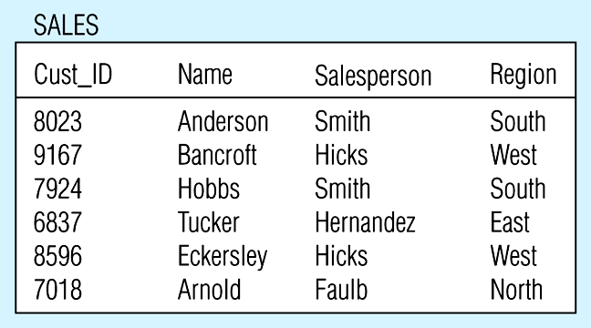
Relation with transitive dependency
(a) SALES relation with simple data

Slide 45
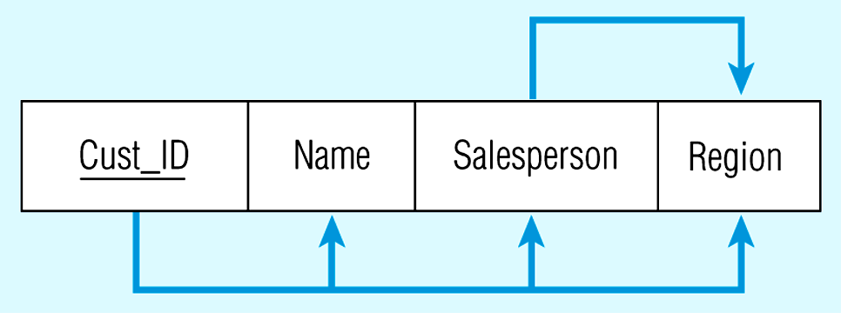
Below Figure shows Relation with transitive dependency
CustID → Name
CustID → Salesperson
CustID → Region
All this is OK
(2nd NF)
BUT
CustID → Salesperson → Region
Transitive dependency
(not 3rd NF)

Slide 46
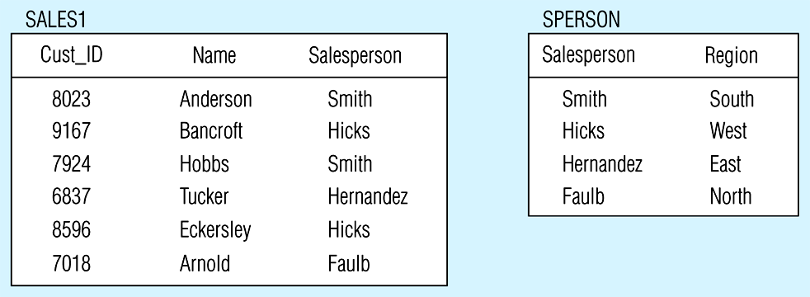
Removing a transitive dependency
(a) Decomposing the SALES relation

Slide 47
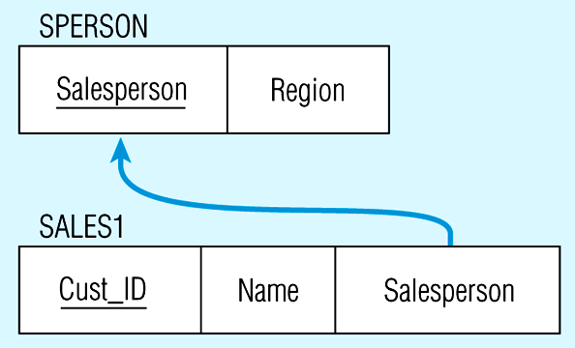
Relations in 3NF
Salesperson → Region
CustID → Name
CustID → Salesperson
Now, there are no transitive dependencies…
Both relations are in 3rd NF

Slide 48
Consider the following relation
Customer(customerID, name, address, creditCode, creditLimit)
Assume that one credit code can apply to several customers. But one customer can have only one credit code
Is it in 1NF?
Is it in 2NF?
Is it in 3NF?

Slide 49
Solution
Set up a relation that includes the nonkey attributes(s) that functionally determine(s) other nonkey attributes(s).
Customer(customerID, name, address, creditCode, creditLimit)=>
Customer(customerID, name, address, creditCode); Credit(creditCode, creditLimit)

Slide 50
Example
Example: StudentInfo(SSNo, Name, Major, Dept, DeptChair), SSNo-> Name,Major; Major -> Dept; Dept -> DeptChair
Example: R(A, B, C); FDs: A->B, B->C

Slide 51
Solutions
Example: StudentInfo(SSNo, Name, Major, Dept, DeptChair),
Solution: StudentInfo(SSNo, Name, Major), MajDept(Major, Dept), DeptInfo(Dept, DeptChair)
Example: R(A, B, C); FDs: A->B, B->C
Solution: R1(A, B); R2(B, C);

Slide 52
Summary: 1NF
A relation is in 1NF if it contains no repeating groups
To convert an unnormalised relation to 1NF either:
Flatten the table and change the primary key, or
Decompose the relation into smaller relations, one for the repeating groups and one for the non-repeating groups.
Remember to put the primary key from the original relation into both new relations.
This option is liable to give the best results.

Slide 53
Summary: 2NF
A relation is in 2NF if it contains no repeating groups and no partial key functional dependencies exists
Rule: A relation which is in 1NF having a single key field is said to be in 2NF
To convert a relation with partial functional dependencies to 2NF. create a set of new relations:
One relation for the attributes that are fully dependent upon the key.
One relation for each part of the key that has partially dependent attributes

Slide 54
Summary: 3NF
A relation is in 3NF if it contains no repeating groups, no partial functional dependencies, and no transitive functional dependencies
To convert a relation with transitive functional dependencies to 3NF, remove the attributes involved in the transitive dependency and put them in a new relation
Rule: A relation in 2NF with only one non-key attribute must be in 3NF
In a normalized relation a non-key field must provide a fact about the key, the whole key and nothing but the key.
Relations in 3NF are sufficient for most practical database design problems.
However, 3NF does not guarantee that all anomalies have been removed.

Slide 55
Other Normal Forms
Boyce-Codd NF
  All determinants are candidate keys…there is no determinant that is not a unique identifier
4th NF
  No multivalued dependencies
5th NF
  No “lossless joins”
Domain-key NF
  The “ultimate” NF…perfect elimination of all possible anomalies

Slide 56
Normal Forms (5)
Claim: 3NF relations do not have insertion and deletion anomalies.

Slide 57
Normal Forms (6)
3NF still cannot eliminate all redundancies.
Example: Consider R(City, Street, Zipcode).
F = { CS Z, Z C }
R has two candidate keys: CS, ZS.
R is in 3NF as each attribute is a prime.
C S Z Redundancy on C due to
c s1 z
c s2 z Z C
c2 s1 z1

Slide 58
Normal Forms (7)
Boyce-Codd Normal Form (BCNF): A relation schema R is in BCNF if for every FD X A, where A is a single attribute, at least one of the following is true:
(a) A ∈ X,
(b) X is a superkey.
R is in BCNF if for every non-trivial FD, the left side is a superkey.

Slide 59
Normal Forms (8)
If R is in BCNF, then R is also in 3NF.
However, R in 3NF R in BCNF.
Example: Consider R(City, Street, Zipcode).
F = { CS Z, Z C }.
R is in 3NF but not in BCNF because in
Z C, Z is not a superkey.
Claim: BCNF completely removes redundancies caused by FDs.

Slide 60
Normal Forms: Summary (1)
Relationships between different NFs.
1NF
2NF
3NF
BCNF

Slide 61
Normal Forms: Summary (2)
3NF removes all insertion anomalies and deletion anomalies, as well as most redundancies.
BCNF achieves all achieved by 3NF. In addition, BCNF removes all redundancies caused by FDs.

Slide 62
Normalization (1)
A relation schema is in good quality if it is in BCNF.
If a relation schema is not in BCNF, then decompose it into a set of schemas such that
every new schema is in BCNF;
it is a lossless-join decomposition;
it is a dependency-preserving decomposition.

Slide 63
Normalization (2)
Problem: There is no guarantee that such an ideal decomposition exists.
can guarantee: lossless-join decomposition into BCNF.
can't guarantee: dependency-preserving decomposition into BCNF.
For a given relation schema R, if there is no lossless-join and dependency-preserving decomposition into BCNF, be happy if R is in 3NF.

Slide 64
Normalization (3)
If R is not even in 3NF, decompose it into a set of schemas such that
every new schema is in 3NF;
it is a lossless-join decomposition;
it is a dependency-preserving decomposition.
Such a decomposition can always be found!

Slide 65
Normalization to BCNF (1)
Algorithm LLJD-BCNF
Input: A relation schema R, a set of FDs in R.
Output: A lossless-join decomposition D such that each new schema in D is in BCNF.

Slide 66
Normalization to BCNF (2)
D := {R};
while ∃ R_{i} ∈ D that is not in BCNF do {
find an FD X Y such that
(1) X Y makes R_{i} not in BCNF, and
(2) XY ⊆ R_{i};
replace R_{i} by (R_{i} – Y) and XY in D;
}

Slide 67
Normalization to BCNF (3)
Theorem 5: Algorithm LLJD-BCNF is correct.
Every schema in D is in BCNF because the algorithm will not stop if there is a schema in D that is not in BCNF.
D is a lossless-join decomposition because in each iteration R_{i} is decomposed into 2 smaller schemas (R_{i} – Y) and XY and they satisfy the condition:
(R_{i} – Y) ∩ XY = X (XY – (R_{i} – Y)) = Y.

Slide 68
Normalization to BCNF (4)
Example: Prod_Manu(Prod_no, Prod_name, Price, Manu_id, Manu_name, Address),
F = {Mi Mn A, P# Pn Mi}.
Note that Price is not involved in any functional dependency.
Candidate keys: P# Pr
Initialization: D = {P# Pn Pr Mi Mn A}

Slide 69
Normalization to BCNF (5)
1st iteration: R_{i} = {P# Pn Pr Mi Mn A} is not in BCNF because Mi Mn A is not a trivial FD and Mi is not a superkey.
Replace R_{i} by Mi Mn A and P# Pn Pr Mi.
Hence: D = {Mi Mn A, P# Pn Pr Mi}.
Mi Mn A is in BCNF because in Mi Mn A, Mi is a candidate key.
How about P# Pn Pr Mi? Is it in BCNF?

Slide 70
Normalization to BCNF (6)
2nd iteration: R_{i} = P# Pn Pr Mi is not in BCNF because P# Pn Mi is not a trivial FD and P# is not a superkey in P# Pn Pr Mi.
Replace P# Pn Pr Mi by P# Pn Mi and P# Pr.
Hence, D = {Mi Mn A, P# Pn Mi, P# Pr}.
P# Pn Mi is in BCNF because in P# Pn Mi, P# is a candidate key.
P# Pr is in BCNF (see theorem on next page).
Final result: D = {Mi Mn A, P# Pn Mi, P# Pr}.
Question: Is D dependency-preserving?
Answer: Yes.

Slide 71
Normalization to BCNF (7)
Theorem 6: Any relation schema with exactly two attributes is in BCNF.
The proof is not difficult.
Note: The LLJD-BCNF algorithm may produce different decompositions depending on the order in which FDs are considered. Not all decompositions make sense.
Example: Suppose for the earlier example, we apply P# Pn Mi first. The final decomposition would be D = {P# Pn Mi, P# Mn A, P# Pr}. This decomposition separates Mi and Mn A in different schemas.

Slide 72
Minimal Cover (1)
Definition: Let F and G be two sets of FDs in R. F is a cover of G if every FD in G can be derived from the FDs in F.
If F is a cover of G and G is a cover of F, then F and G are equivalent (F ≡ G).

Slide 73
Minimal Cover (2)
Example: Consider F = {B CD, AD E, B A} and G = {B CDE, B ABC, AD E}. Show that F is a cover of G.
(1) AD E in G can be derived from
AD E in F.
(2) From B CD, B A, B B and the union rule: we have B ABCD;
From B ABCD and decomposition rule:
B ABC B ABC in G can be derived from FDs in F.

Slide 74
Minimal Cover (3)
(3) From B ABCD and decomposition
rule: B AD;
From B AD, AD E and
transitivity rule: B E;
From B ABCD, B E and union
rule: B ABCDE;
From B ABCDE and decomposition
rule: B CDE.
Since every FD in G can be derived from FDs in F, F is a cover of G.

Slide 75
Minimal Cover (4)
Definition: Let F be a set of FDs. Fmin is a minimal cover of F if
Fmin is a cover of F.
Every FD in Fmin has a single attribute on the right.
No FD in Fmin is redundant. (X Y∈F is redundant if F – {X Y} ≡ F).
For any X Y ∈ Fmin, no attribute in X is extraneous (A ∈ X is extraneous if (X – {A}) Y can replace X Y).

Slide 76
Minimal Cover (5)
Example: Given F = {A BC, B C,
A B, AB C}, find Fmin.
F ≡ { A B, A C, B C, A B,
AB C }
≡ { A B, B C, AB C }
≡ { A B, B C } = Fmin

Slide 77
Minimal Cover (6)
Example: Let F = {A AC, B ABC,
D ABC}. Find Fmin.
F ≡ {A A, A C, B A, B B,
B C, D A, D B, D C}
≡ {A C, B A, B C, D A,
D B, D C}
≡ {A C, B A, D B} = Fmin

Slide 78
Normalization to 3NF (1)
Algorithm LLJD-DPD-3NF
Input: A relation schema R, a set of FDs F in R.
Output: A lossless-join and dependency-preserving decomposition D such that each schema in D is in 3NF.

Slide 79
Normalization to 3NF (2)
(1) Find all candidate keys.
(2) Compute Fmin.
(3) Let X A_{i}, i=1,...,m, be all FDs in Fmin that have the same left hand side X. Create a relation schema X∪ A₁ ∪ . . . ∪ A_{m} in D if it is not a subschema of an existing relation schema.
(4) If none of the relation schemas contain a candidate key of R, use a candidate key to form another relation schema.

Slide 80
Normalization to 3NF (3)
Example: Given
R(Instructor, Class_no, Classroom, Text),
F = {Class_no Classroom Text}.
Candidate keys: Instructor Class_no.
Fmin = {Class_no Classroom,
Class_no Text}.
D = {Class_no Classroom Text,
Instructor Class_no}

Slide 81
Normalization to 3NF (4)
Example: R = CTHRSG, F = {C T, CS G, HR C, HS R, HT R }
Candidate keys: HS.
Fmin = F,
D = {CT, CSG, HRC, HSR, HTR}
HSR contains the candidate key.

Slide 82
Normalization Summary (1)
Given: R – A relation schema
F – A set of FDs in R
Find all candidate keys C of R using F
R, F, C
Is R in BCNF?
yes
done
no

Slide 83
Apply Algorithm LLJD-BCNF to
obtain a decomposition in BCNF
Is the decomposition
dependency-preserving?
yes
done
no
Roll back the decomposition

Slide 84
yes
Is R in 3NF?
done
no
Apply Algorithm LLJD-DPD-3NF
to obtain a decomposition in 3NF
done

Slide 86

Boyce-Codd Normal Form
Defn: A relation is in BCNF if every determinant is a candidate key.

Slide 87
Boyce-Codd Normal Form (BCNF)
BCNF is based on the concept of a determinant.
A determinant is any attribute (simple or composite) on which some other attribute is fully functionally dependent.
When a relation has more than one candidate key, anomalies may result even though the relation is in 3NF
3NF does not deal satisfactorily with the case of a relation with overlapping candidate keys
i.e. composite candidate keys with at least one attribute in common.

Slide 88
BCNF
Consider the following relation and determinants.
Let R(a,b,c,d) be a relation
a,c -> b,d
a,d -> b
Here, the first determinant suggests that the primary key of R could be changed from a,b to a,c.
If this change was done all of the non-key attributes present in R could still be determined, and therefore this change is legal.
However, the second determinant indicates that a,d determines b, but a,d could not be the key of R as a,d does not determine all of the non key attributes of R (it does not determine c). Therefore cant be candidate key.
We would say that the first determinate is a candidate key, but the second determinant is not a candidate key, and thus this relation is not in BCNF (but is in 3rd normal form).

Slide 89
BCNF applies to a relation which has more than one candidate key, and the candidate keys are composite and overlapping.
Consider the following relation
SSL(student, subject, lecturer)

Slide 90
SSL(student, subject, lecturer)
Assume that: each teacher teach only one subject. A subject has several teachers to teach,
{student, subject} → lecturer;
lecturer → subject
Is it in bcnf?
STUDENT | SUBJECT | LECTURER
123 | PHYSICS | EINSTEIN
123 | MUSIC | MOZART
456 | BIOLOGY | DARWIN
789 | PHYSICS | BOHR
999 | PHYSICS | EINSTEIN

Slide 91
ANOMILY (不规则)
If the record for student 456 is deleted we lose not only information on student 456 but also the fact that DARWIN Lecture’s in BIOLOGY
we cannot record the fact that WATSON can Lecture on COMPUTING until we have a student who take a subject in COMPUTING to whom we can assign WATSON as an Lecturer.

Slide 92
Convert to BCNF
STUDENT,SUBJECT,LECTURER
BREAK DOWN INTO TWO TABLES
Lecture → Subject (X→ Y) (FIRST TABLE)
REMOVE Y
STUDENT, LECTURER (SECOND TABLE)

Slide 93
Convert to BCNF we have two tables:
LECTURER | SUBJECT
EINSTEIN | PHYSICS
MOZART | MUSIC
DARWIN | BIOLOGY
BOHR | PHYSICS
STUDENT | LECTURER
123 | EINSTEIN
123 | MOZART
456 | DARWIN
789 | BOHR
999 | EINSTEIN

Slide 94
Another Example:
Supplier(supplierNo, productCode, supplierName, quantity)
Where supplierNo ←→SupplierName
Is it in 1NF?
Is it in 2NF?
Is it in 3NF?
Is it in BCNF?

Slide 95
supplierNo
productCode
quantity
supplierNo
supplierName
OR
supplierName
productCode
quantity
supplierName
supplierNo

