Slide 1
Introduction to PHP
(Server side Programming)
Notes:
This talk introduces the JavaScript language.
© Netskills, University of Newcastle
Copyright in the whole and every part of this Courseware whether in the form of a written manual,document, software program, service or otherwise belongs to the University of Newcastle upon Tyne ("the Owner") and may not be used, sold, licensed, transferred, copied or reproduced in whole or in part in any manner or form or in or on any media to any person other than in accordance with the terms of the Owner's Licence Agreement or otherwise without the prior written consent of the Owner.
All use of this material is governed by the Owner's Standard Licence Agreement together with the appropriate Schedule. The following are available:
A Standard Licence Schedule to cover all use including all for-profit use by any type of organisation and all use by non-educational establishments
An Educational Licence Schedule for not-for-profit internal use only by a recognised educational establishment
The Netskills logo and this copyright notice must be included in any copy or adaptation.
Netskills is a trademark of Netskills, University of Newcastle

Slide 2
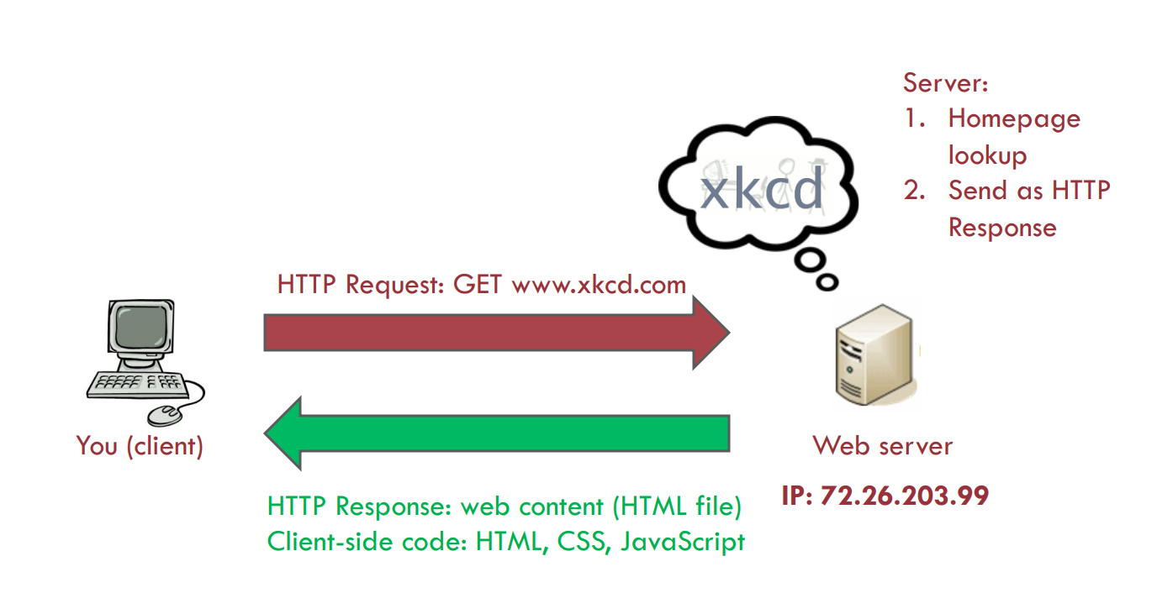
Request to a Static Site
Notes:
This talk aims to give an overview of JavaScript - introducing the concepts and explaining the potential and possible uses.
The talk moves on to describe the basics behind the language, how and where it operates and how it is included in a web page.
A number of real examples of JavaScript are provided to demonstrate some of the features and syntax of the language, and to identify key concepts. As part of this, a quick refresher on the HTML form tags is given as this is crucial to many of the exercises in the accompanying hands-on document.
A comparison with Java is given to clear up any confusion surrounding the connection between the two languages.

Slide 3
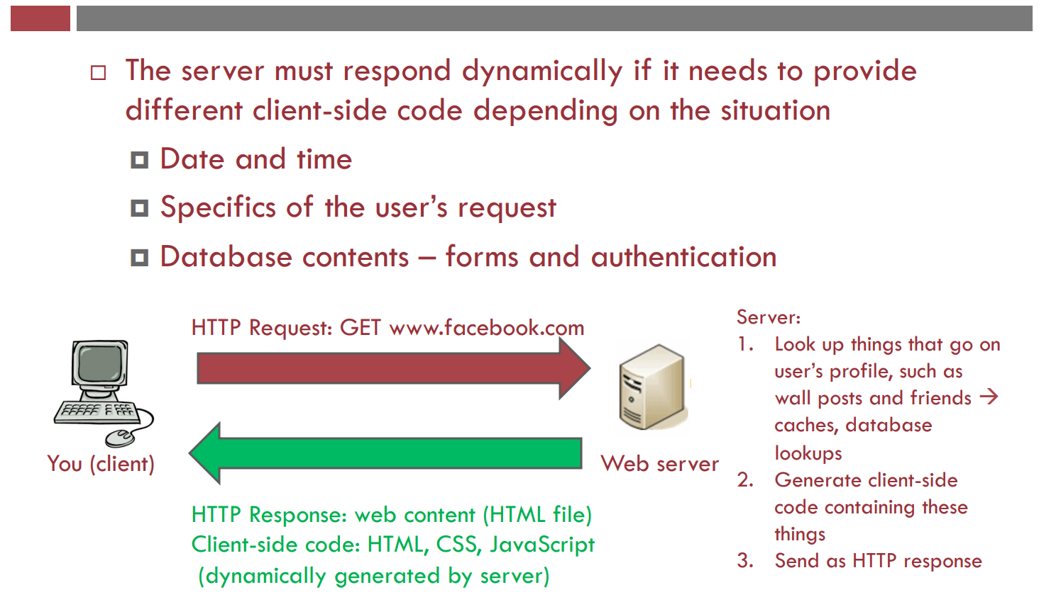
Request to a Dynamic Site
Notes:
This talk aims to give an overview of JavaScript - introducing the concepts and explaining the potential and possible uses.
The talk moves on to describe the basics behind the language, how and where it operates and how it is included in a web page.
A number of real examples of JavaScript are provided to demonstrate some of the features and syntax of the language, and to identify key concepts. As part of this, a quick refresher on the HTML form tags is given as this is crucial to many of the exercises in the accompanying hands-on document.
A comparison with Java is given to clear up any confusion surrounding the connection between the two languages.

Slide 4
What is PHP?
PHP = PHP: Hypertext Preprocessor
Server-side scripting language that may be embedded into HTML
Ultimate goal is to get PHP files to generate client side code
  must end up with HTML, CSS, JavaScript, other client side code！
Notes:
When the web was conceived, browsers were limited to text and image - later tables and frames. The extent to which they provided interactivity with the user was very limited. JavaScript was developed by Netscape as a simple programming language (often referred to as a scripting language). It is easy to learn and small sections of JavaScript can be added to a web page rather than needing to develop complicated programs. It was specially designed for web page interaction and manipulating the web browser and page elements. It is often used to respond to user actions such as mouse clicks.
Although developed by Netscape, and other variants exist, such as Jscript from Microsoft, a standard has been developed by the European Computer Manufacturers Association. It is known as ECMAScript, using the standard ECMA262, which can be found fully documented at the address on the slide.

Slide 5
Side by Side
PHP File:
html>
<head>
<title> PHP Introduction </title>
</head>
<body>
This is HTML! <br />
<?php
echo 'This is PHP! <br />';
?>
</body>
</html>
Output: resulting HTML
<html>
<head>
<title> PHP Introduction </title>
</head>
<body>
This is HTML! <br />
This is PHP! <br /></body>
</html>
Notes:
When the web was conceived, browsers were limited to text and image - later tables and frames. The extent to which they provided interactivity with the user was very limited. JavaScript was developed by Netscape as a simple programming language (often referred to as a scripting language). It is easy to learn and small sections of JavaScript can be added to a web page rather than needing to develop complicated programs. It was specially designed for web page interaction and manipulating the web browser and page elements. It is often used to respond to user actions such as mouse clicks.
Although developed by Netscape, and other variants exist, such as Jscript from Microsoft, a standard has been developed by the European Computer Manufacturers Association. It is known as ECMAScript, using the standard ECMA262, which can be found fully documented at the address on the slide.

Slide 6
A closer look
<html>
<head>
<title> PHP Introduction </title>
</head>
<body>
This is HTML! <br />
<?php
echo 'This is PHP! <br />'; // prints to screen
/*
Here's a longer
comment
that spans multiple
lines.
*/
?>
</body>
</html>
PHP tags: <?php and ?>
The echo command
Single line comment ( // )
Multiple line comment (/* and */)
Notes:
JavaScript can be contained either in the header section of an HTML page or in the body. This JavaScript statement is shown as a pure JavaScript statement within SCRIPT tags.
Notice that there is no HTML in the body of this page at all. (Demonstrate what this JavaScript looks like in a web browser).
This statement writes a line of text on a web page.
The command document.write is a standard function in JavaScript to write text to the page. The following is a more technical explanation for background information only:
document.write is derived from the JavaScript object model (not covered in detail here). It works on the principle that all document and browser elements have an object name (document, window, image etc) and can each has various properties that can be manipulated. The object hierarchy means that individual elements can be uniquely identified i.e. document.myform.mytext would refer to the text entry named mytext within the form called myform within the current page (document).
The arrow symbol '→' is used in these slides and in the workbook to indicate where a JavaScript statement should be typed on one line without a break. A line break in the wrong place will stop JavaScript from working.e.g.
document.write('This is my first →
JavaScript Page');
should actually be typed:
document.write('This is my first JavaScript Page');

Slide 7
Viewing PHP files
PHP files executed on the web server
Save .php files in subdirectory of web server
  /var/www/ on many Linux configurations
Make call to web server via domain name (google.com), IP address (72.26.203.99), or localhost if on your own computer
Notes:
Some tips for debugging and clarity to make it easier for you (the trainer) as well as for the audience. Follow the conventions we have used for capitalisation which will make it easier to read / find mistakes.
References:An alternative site with ready made scripts for download:
http://builder.com.com/
Follow links to Web Development and then JavaScript to see a number of good examples.

Slide 8

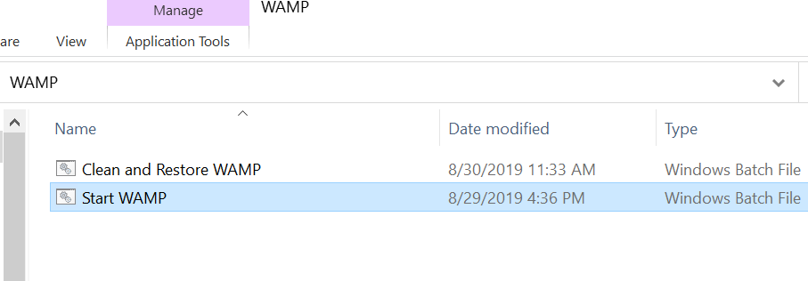
WampServer
Open this!
Then Start Wamp!

Slide 9
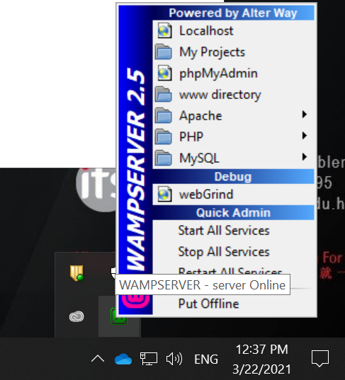

WampServer
On the Bottom right of the window, Click this!
Start All Services!

Slide 10
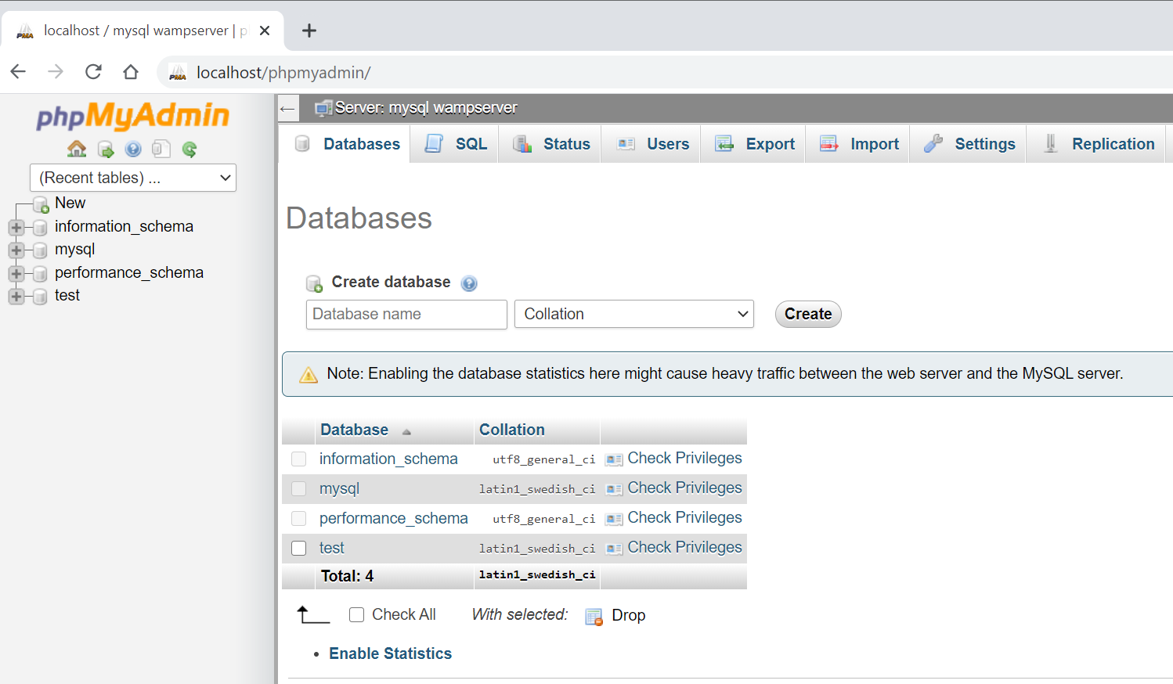
phpmyadmin
Create Database test

Slide 11
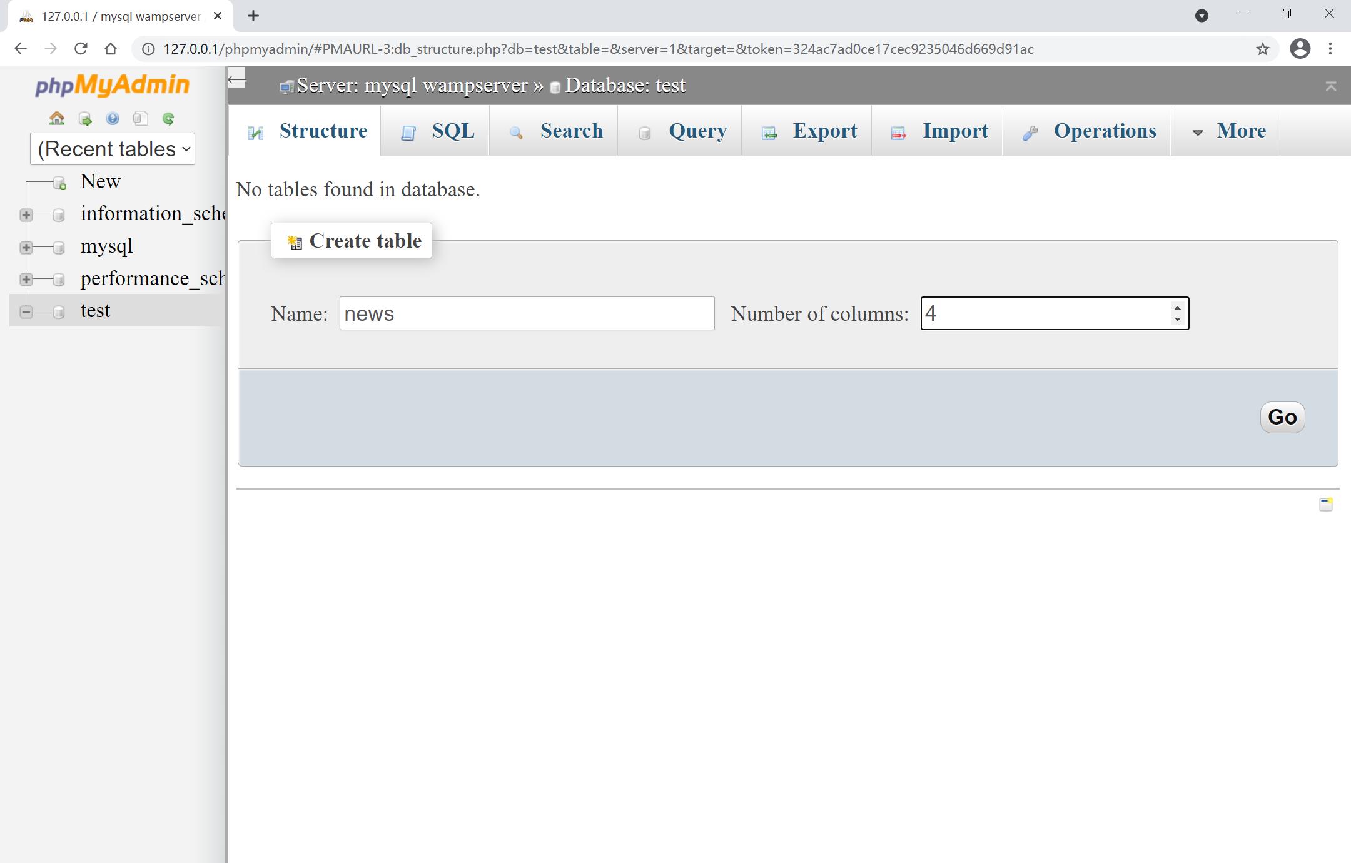
Mysql
Create table news

Slide 12
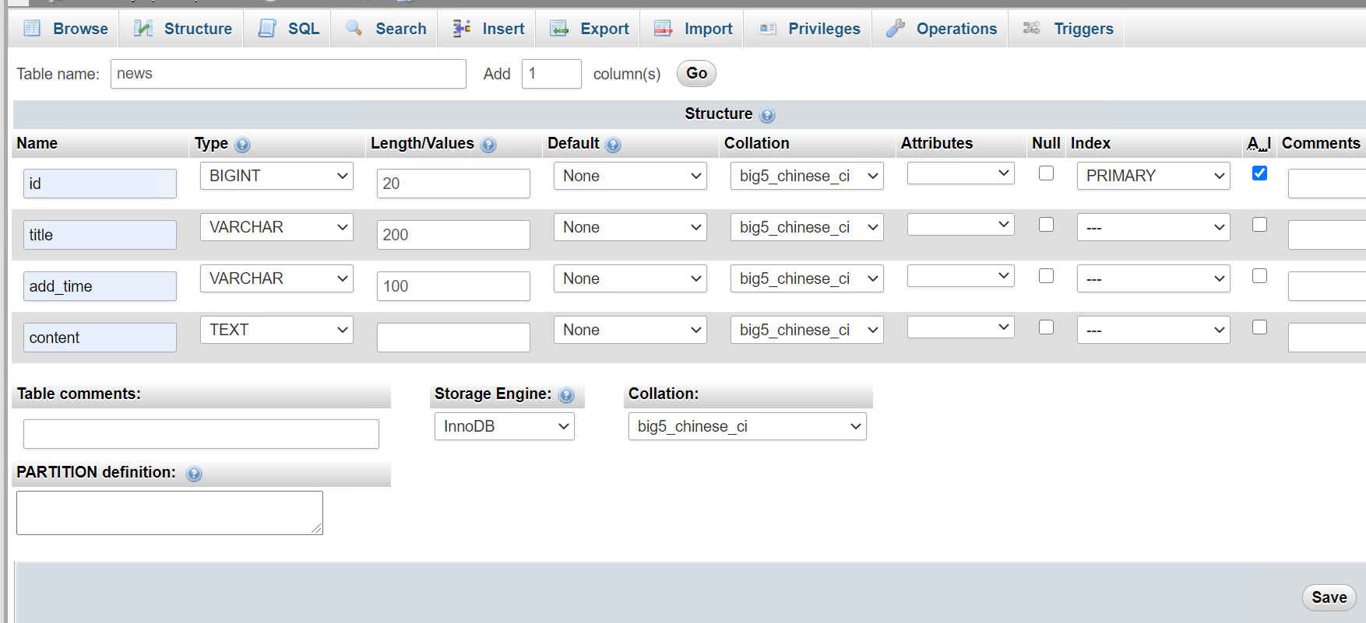
Mysql
Auto increasing

Slide 13
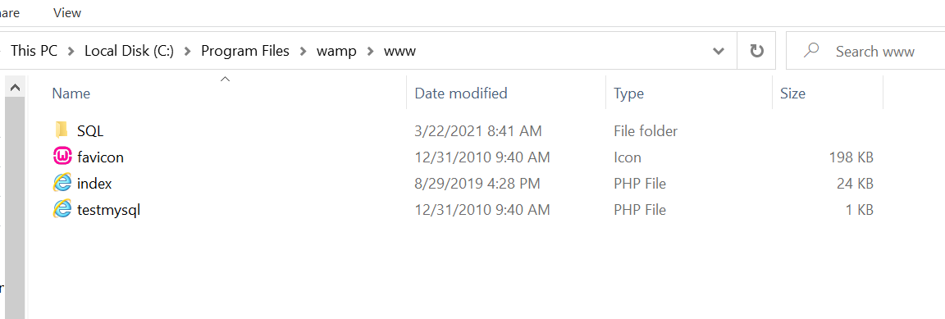
Your folder
Notes:
JavaScript can be contained either in the header section of an HTML page or in the body. This JavaScript statement is shown as a pure JavaScript statement within SCRIPT tags.
Notice that there is no HTML in the body of this page at all. (Demonstrate what this JavaScript looks like in a web browser).
This statement writes a line of text on a web page.
The command document.write is a standard function in JavaScript to write text to the page. The following is a more technical explanation for background information only:
document.write is derived from the JavaScript object model (not covered in detail here). It works on the principle that all document and browser elements have an object name (document, window, image etc) and can each has various properties that can be manipulated. The object hierarchy means that individual elements can be uniquely identified i.e. document.myform.mytext would refer to the text entry named mytext within the form called myform within the current page (document).
The arrow symbol '→' is used in these slides and in the workbook to indicate where a JavaScript statement should be typed on one line without a break. A line break in the wrong place will stop JavaScript from working.e.g.
document.write('This is my first →
JavaScript Page');
should actually be typed:
document.write('This is my first JavaScript Page');

Slide 14
Add_news.php
<!DOCTYPE html PUBLIC "-//W3C//DTD XHTML 1.0 Transitional//EN" "http://www.w3.org/TR/xhtml1/DTD/xhtml1-transitional.dtd">
<html xmlns="http://www.w3.org/1999/xhtml"> <head>
<meta http-equiv="Content-Type" content="text/html; charset=gb2312" />
<title>input news</title>
<style>
form{
padding:0px;
margin:0px;
}
</style>
</head>
<body>
<table width="70%" height="30" border="0" align="center" cellpadding="0" cellspacing="0">
<tr>
<td align="center">Fill in the information</td>
</tr>
</table>
<form action="save_news.php" method="post">
<table width="70%" border="0" align="center" cellpadding="0" cellspacing="0">
<tr>
<td width="30%" align="right">News Title</td>
<td width="70%" align="left"><input type="text" name="title" size="30"/></td>
</tr>
<tr>
<td align="right">New Content</td>
<td align="left"><textarea name="content" cols="30" rows="5"></textarea></td>
</tr>
</table>
<table width="70%" height="30" border="0" align="center" cellpadding="0" cellspacing="0">
<tr>
<td align="center"><input type="submit" name="submit1" value="Confirm to add"/></td>
</tr>
</table>
</form>
</body>
</html>
Notes:
JavaScript can be contained either in the header section of an HTML page or in the body. This JavaScript statement is shown as a pure JavaScript statement within SCRIPT tags.
Notice that there is no HTML in the body of this page at all. (Demonstrate what this JavaScript looks like in a web browser).
This statement writes a line of text on a web page.
The command document.write is a standard function in JavaScript to write text to the page. The following is a more technical explanation for background information only:
document.write is derived from the JavaScript object model (not covered in detail here). It works on the principle that all document and browser elements have an object name (document, window, image etc) and can each has various properties that can be manipulated. The object hierarchy means that individual elements can be uniquely identified i.e. document.myform.mytext would refer to the text entry named mytext within the form called myform within the current page (document).
The arrow symbol '→' is used in these slides and in the workbook to indicate where a JavaScript statement should be typed on one line without a break. A line break in the wrong place will stop JavaScript from working.e.g.
document.write('This is my first →
JavaScript Page');
should actually be typed:
document.write('This is my first JavaScript Page');

Slide 15
Save_news.php
<?php
$hostname = "localhost"; //local hist
$database = "test"; //database name
$username = ""; //user
$password = ""; //password
$con = mysqli_connect($hostname, $username, $password, $database);
if (mysqli_connect_errno())
{
echo "Failed to connect to MySQL: " . mysqli_connect_error();
exit();
}
?>
<?php
$title=$_POST["title"];
$content=$_POST["content"];
if(function_exists('date_default_timezone_set'))
{
date_default_timezone_set('Hongkong');
}
$add_time=date("Y-m-d");
$sql = "INSERT INTO news (title,content,add_time) VALUES ('$title','$content','$add_time')";
echo $sql;
$result = @mysqli_query($con,$sql);
if($result)
{
echo "Add successfully,<a href='add_news.php'>return to continue</a>";
}
else
{
echo "Fail to add,<a href='add_news.php'>please return</a>";
}
?>
Notes:
JavaScript can be contained either in the header section of an HTML page or in the body. This JavaScript statement is shown as a pure JavaScript statement within SCRIPT tags.
Notice that there is no HTML in the body of this page at all. (Demonstrate what this JavaScript looks like in a web browser).
This statement writes a line of text on a web page.
The command document.write is a standard function in JavaScript to write text to the page. The following is a more technical explanation for background information only:
document.write is derived from the JavaScript object model (not covered in detail here). It works on the principle that all document and browser elements have an object name (document, window, image etc) and can each has various properties that can be manipulated. The object hierarchy means that individual elements can be uniquely identified i.e. document.myform.mytext would refer to the text entry named mytext within the form called myform within the current page (document).
The arrow symbol '→' is used in these slides and in the workbook to indicate where a JavaScript statement should be typed on one line without a break. A line break in the wrong place will stop JavaScript from working.e.g.
document.write('This is my first →
JavaScript Page');
should actually be typed:
document.write('This is my first JavaScript Page');

Slide 16
read.php
<?php
$hostname = "localhost"; //local hist
$database = "test"; //database name
$username = ""; //user
$password = ""; //password
$con = mysqli_connect($hostname, $username, $password, $database);
if (mysqli_connect_errno())
{
echo "Failed to connect to MySQL: " . mysqli_connect_error();
exit();
}
?>
<?php
$sql = "select * from news where id = 1";
$res = @mysqli_query($con,$sql);
$row = @mysqli_fetch_array($res, MYSQLI_ASSOC);
if($row)
{
//$dbrow=@mysqli_fetch_array($res, MYSQLI_ASSOC);
$id=$row['id'];
$title=$row['title'];
$content=$row['content'];
$add_time=$row['add_time'];
echo "ID:". $id . "<br>";
echo "Title:". $title."<br>";
echo "Timestamp:". $add_time;
echo "<br>";
}
else
{
echo "no data";
}
?>
Notes:
JavaScript can be contained either in the header section of an HTML page or in the body. This JavaScript statement is shown as a pure JavaScript statement within SCRIPT tags.
Notice that there is no HTML in the body of this page at all. (Demonstrate what this JavaScript looks like in a web browser).
This statement writes a line of text on a web page.
The command document.write is a standard function in JavaScript to write text to the page. The following is a more technical explanation for background information only:
document.write is derived from the JavaScript object model (not covered in detail here). It works on the principle that all document and browser elements have an object name (document, window, image etc) and can each has various properties that can be manipulated. The object hierarchy means that individual elements can be uniquely identified i.e. document.myform.mytext would refer to the text entry named mytext within the form called myform within the current page (document).
The arrow symbol '→' is used in these slides and in the workbook to indicate where a JavaScript statement should be typed on one line without a break. A line break in the wrong place will stop JavaScript from working.e.g.
document.write('This is my first →
JavaScript Page');
should actually be typed:
document.write('This is my first JavaScript Page');

