Slide 1
Introduction to PHP
(Server side Programming)

Slide 2
List all the news for delete- news2.php
<?php include "conn.php" ?>
<?php
echo "all news are listed below.<br>";
echo "----------------------------------.<br>";
$sql = "select * from news";
$res = @mysqli_query($con,$sql);
if (mysqli_num_rows($res) > 0)
{
while ($dbrow = mysqli_fetch_assoc($res))
{
$id=$dbrow['id'];
$title=$dbrow['title'];
//$content=$dbrow['content'];
$add_time=$dbrow['add_time'];
//$content = str_replace("\r", "<br>", $content);
//$content= str_replace(" ", "&nbsp; ", $content);
echo "ID:". $id;
echo " ";
echo "$title";
echo " ";
echo "<a href='del_news.php?id=$id'><font color='red'>delete</font></a>";
echo "<br>";
}
}
else
{
echo "no data";
}
mysqli_close($con);
?>

Slide 3
Delete the selected news
-Del_news.php
<?php include "conn.php" ?>
<?php
$id=$_GET["id"];
$sql = "delete from news where id=$id";
$res = @mysqli_query($con,$sql);
if($res)
{
?>
<script language=javascript>window.alert('delete successfully!');history.back(1);</script>
<?php
}
?>

Slide 4
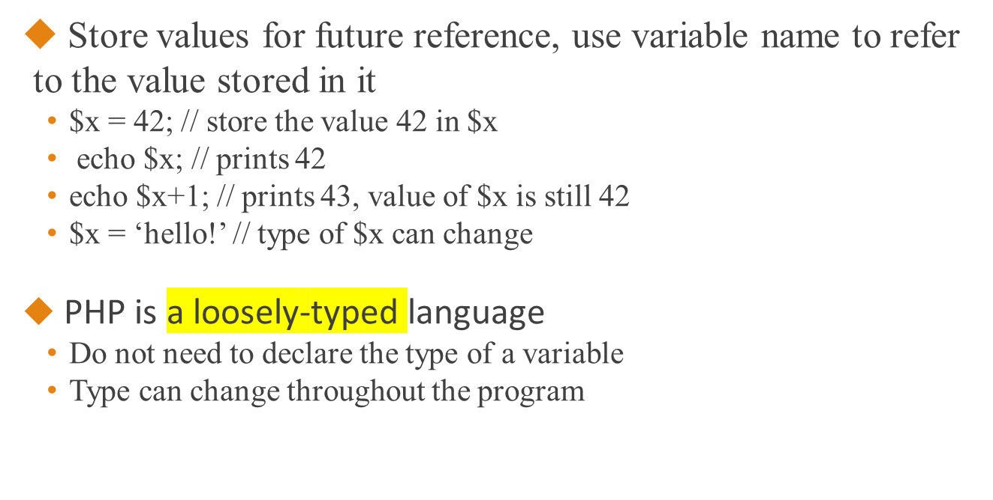
Basic Grammar of PHP
- Variables

Slide 5
Basic Grammar of PHP
- Operators
Arithmetic operators
  ! +, -, *, /, % (modulus – remainder after division)
Logical AND (&&), OR (||), NOT (!)
Assignment operators (=)
Shorthand for assignment operators:
    ! $x += $y equivalent to $x = $x + $y
    Also works with subtraction, multiplication, division, modulus, and string concatenation

Slide 6
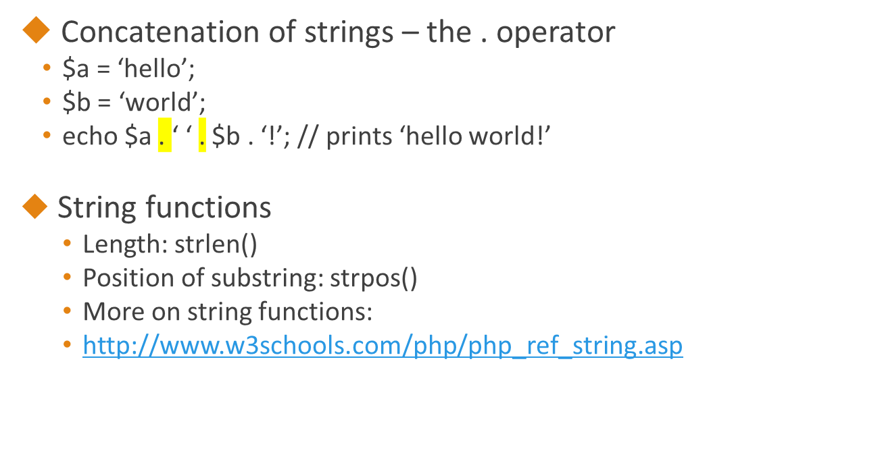
Basic Grammar of PHP
- Strings

Slide 7
Basic Grammar of PHP
- Conditional Statements
if (condition / boolean expression)
{ statements }
else if (another condition)
{ statements }
// there may be more than one else if block
else
{ statements }
------------------------------------
Example:
$x = 5;
if ($x == 5)
{ echo ‘The variable x has value 5!’; }

Slide 8
Basic Grammar of PHP
- Loop
$x = 2;
while ($x < 1000) {
echo $x . “\n”; // \n is newline character
$x = $x * $x; }
do { echo $x . “\n”;
$x = $x * $x; }
while ($x < 1000); // note the semicolon
for ($i = 1; $i <= 10; $i++)
{ echo $i . “:” . ($i * $i) . “\n”; }

Slide 9
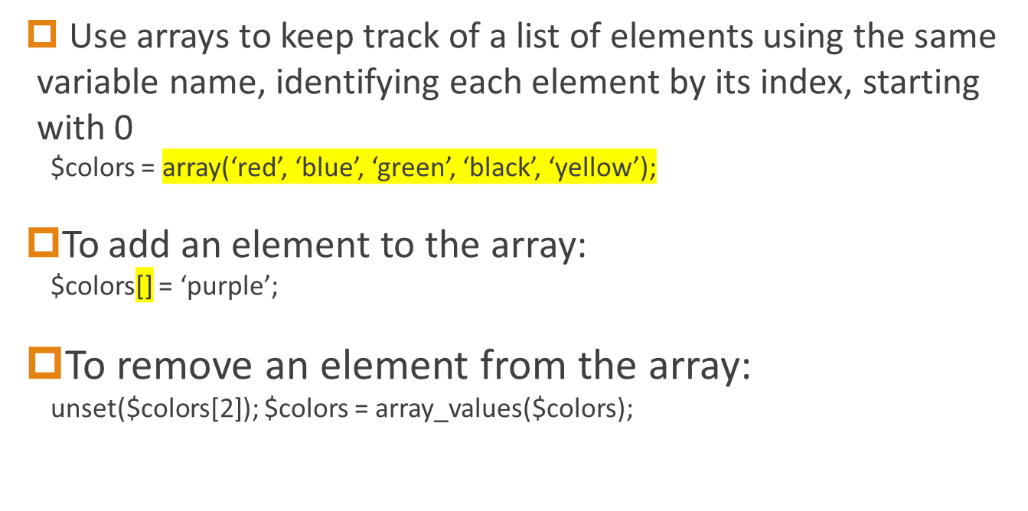
Basic Grammar of PHP
- Arrays as a list of elements

Slide 10
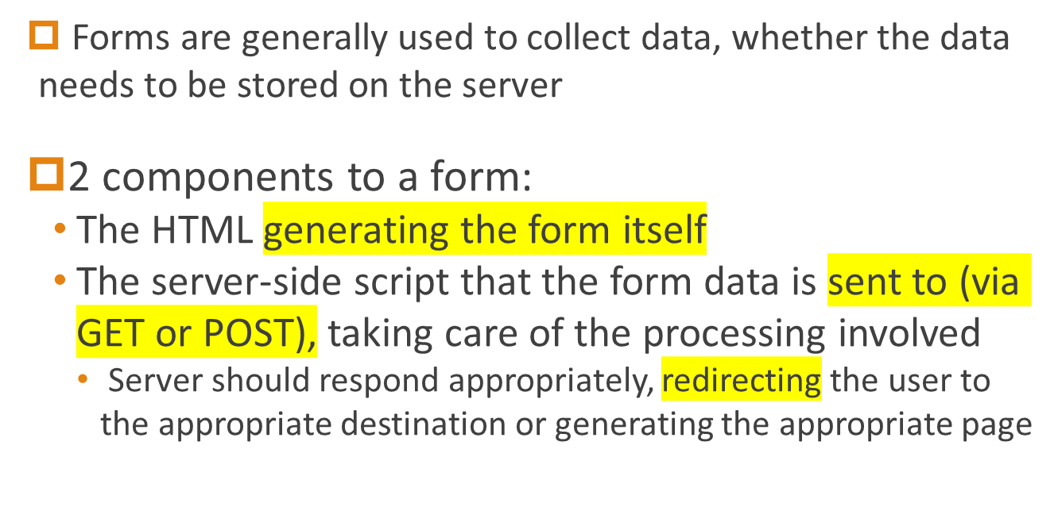
Basic Grammar of PHP
- Dealing with forms

Slide 11
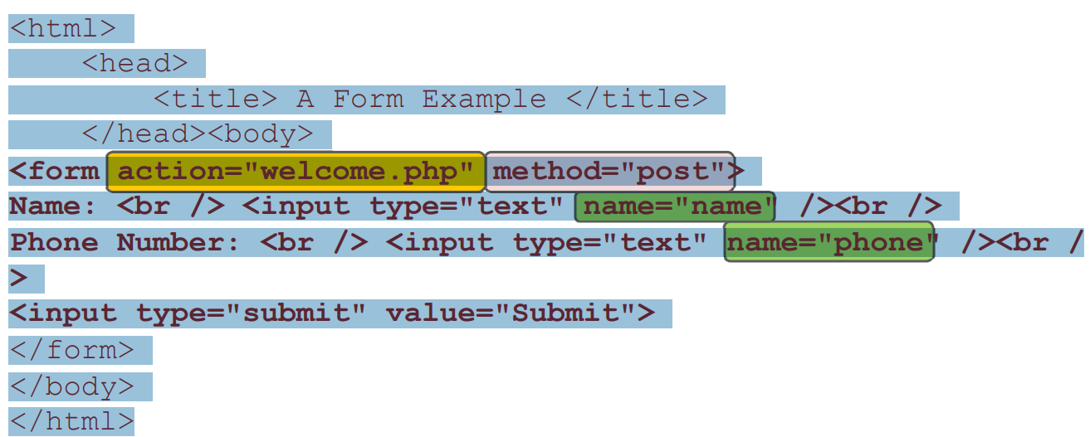
Basic Grammar of PHP
- forms-client side
form action – where to send the form data
method – how to send the data (GET or POST)
Name attributes become the keys used to access the corresponding fields
in the $_GET or $_POST arrays

Slide 12
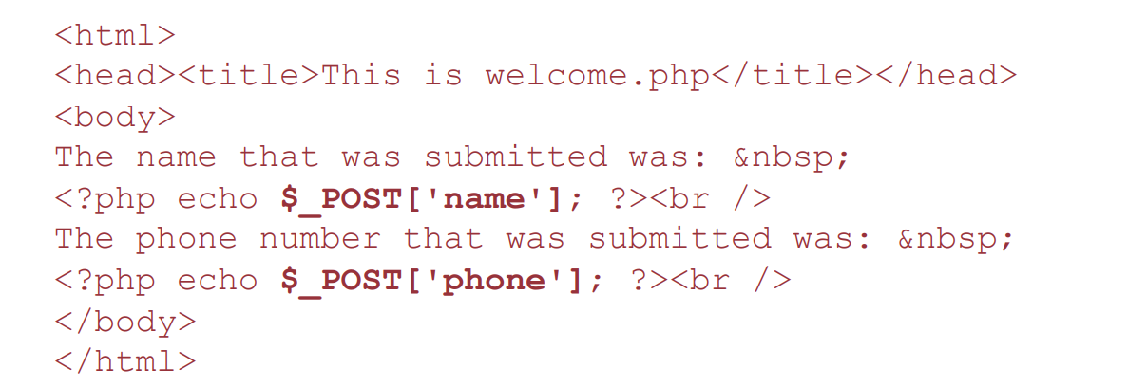
Basic Grammar of PHP
- forms-Server Side
A simple PHP file that displays what was entered into the form
  Can do many other things server-side depending on the situation

