Slide 1

EARTHQUAKE MAGNITUDE ESTIMATION
Earth Science Department
Master’s degree in Exploration and Applied Geophysics
Professor:
Francesco Grigoli
Student:
Diego Eustachio Farchione
Student number: 628186
AY 2021/2022

Slide 2
PROCESSING STEPS AND AIM OF THE PROJECT
Loading the catalogue, reading the seismic traces and calculating the most relevant statistical parameters
Merge the dataset obtained from the parameters of the seismic trace with the catalogue, after formatting the datetime data type
Feature selection and scaling on the merged dataset
Splitting the dataset
Fitting different models on the train dataset
Evaluate the models on the validation dataset
Evaluate the model with the least error on the test dataset
Objective : estimate the magnitude of the earthquakes given some features extracted from the seismic catalogue and the seismic traces.

Slide 3
THE CATALOGUE
The original catalogue (in .csv format) has 588 rows and 29 columns with the following features:
['origtime', 'latitude', 'longitude', 'depth', 'magnitude', 'rms', 'relocated', 'startRms', 'locChange', 'depthChange', 'timeChange', 'numNeighbours', 'neigh_meanDistToCentroid', 'neigh_centroidToEventDist', 'neigh_meanDepthDistToCentroid', 'neigh_centroidToEventDepthDist', 'ph_usedP', 'ph_usedS', 'ph_stationDistMin', 'ph_stationDistMedian', 'ph_stationDistMax', 'ddObs_numTTp', 'ddObs_numTTs', 'ddObs_numCCp', 'ddObs_numCCs', 'ddObs_startResidualMedian', 'ddObs_startResidualMAD', 'ddObs_finalResidualMedian', 'ddObs_finalResidualMAD’]
In addition to the catalogue, a folder containing the waveforms for each event was given and the traces for every single event were read.
Then, a csv file with all the stations and the respective latitude, longitude and station code was also provided.

Slide 4
THE CATALOGUE
The catalogue that I used was obtained merging the data from the original catalogue with the features extracted from the seismic traces.
So, firstly some statistical parameters ( like maximum amplitude, standard deviation of the amplitudes, mean amplitudes etc, latitude and longitude of the stations etc…) were calculated for each seismic trace and for the 2 channels (‘N’ and ‘E’). The different parameters were concatenated, obtaining a dataframe.
Then, the data extracted from the seismic traces and the data of the catalogue were merged, considering the origin time as a common column. I used the datetime library to modify the datetime data type in order to apply an inner join between the two datasets.

Slide 5
THE CATALOGUE
The final dataset has 573 rows and 60 columns.
In addition to the columns already present in the catalogue, 34 features were extracted.
The features extracted are the following:
['station_x','station_y','station','Amaxmax_x','Amaxmax_y'
,'Amaxmax','Ameanmax_x','Ameanmax_y','Ameanmax'
,'mean_std1','mean_mean1','mean_median1','mean_std2'
,'mean_mean2','mean_median2','mean_std','mean_mean'
,'mean_median','std1_Amax','mean1_Amax','median1_Amax',
'std2_Amax','mean2_Amax','median2_Amax','lat_Amax1'
,'long_Amax1','lat_Amax2','long_Amax2','std_Amax'
,'mean_Amax','median_Amax',
'lat_Amax','long_Amax’,’distance’]

Slide 6
LIBRARIES
import obspy.io.mseed
import os
import matplotlib.pyplot as plt
import numpy as np
from obspy.core import read,UTCDateTime
import pandas as pd
from datetime import datetime
from sklearn.ensemble import RandomForestRegressor,GradientBoostingRegressor,AdaBoostRegressor
from sklearn.ensemble import ExtraTreesRegressor
from sklearn.preprocessing import PolynomialFeatures
from sklearn.linear_model import LinearRegression
from sklearn.pipeline import Pipeline
from sklearn.tree import DecisionTreeRegressor
from sklearn import linear_model, svm
from sklearn.metrics import mean_squared_error,mean_absolute_error,mean_absolute_percentage_error,r2_score
from sklearn.model_selection import GridSearchCV, RandomizedSearchCV
import pickle
from obspy.geodetics import degrees2kilometers, locations2degrees
from tensorflow import keras
import tensorflow as tf
from tensorflow.keras import layers

Slide 7
FEATURE SELECTION
The features were extracted using the SelectKBest function:
fs = SelectKBest(score_func=f_regression, k=11)
X_selected_PHIF = fs.fit_transform(final_data.iloc[:,final_data.columns !='magnitude'],final_data.iloc[:,4])
filter = fs.get_support()
indexes_best_PHIF=final_data.iloc[:,final_data.columns !='magnitude'].columns[filter]
Out : ['rms', 'ph_usedP', 'ddObs_numCCp', 'Ameanmax_x', 'Ameanmax_y’, 'Ameanmax', 'mean_std1', 'mean_std2', 'mean_std','std2_Amax', 'median2_Amax']

Slide 8
FEATURE SELECTION
magnitude 1.000000
ph_usedP 0.600647
mean_std 0.480952
mean_std1 0.477862
mean_std2 0.466811
ddObs_numCCp 0.429659
Ameanmax_x 0.393792
Ameanmax_y 0.389920
Ameanmax 0.371795
std2_Amax 0.288400
std_Amax 0.269209
ddObs_numTTp 0.263046
mean2_Amax 0.253727
std1_Amax 0.240164
Amaxmax 0.197000
Amaxmax_x 0.184579
Amaxmax_y 0.184048
long_Amax1 0.181711
ph_stationDistMax 0.181549
long_Amax 0.171940
timeChange 0.154579
Unnamed: 0 0.123934
ph_stationDistMedian 0.109363
mean_mean2 0.106660
mean_Amax 0.098166
numNeighbours 0.082698
distance 0.082336
ddObs_finalResidualMedian 0.067387
mean1_Amax 0.057671
neigh_centroidToEventDepthDist 0.056724
lat_Amax2 0.054666
ddObs_startResidualMedian 0.040786
mean_median2 0.025500
ddObs_numCCs 0.016339
long_Amax2 0.010312
mean_median 0.002617
mean_median1 -0.013299
neigh_centroidToEventDist -0.039468
ph_usedS -0.044091
latitude -0.044149
mean_mean -0.044211
depthChange -0.045563
neigh_meanDistToCentroid -0.057102
neigh_meanDepthDistToCentroid -0.066440
longitude -0.066712
ddObs_finalResidualMAD -0.073325
ddObs_numTTs -0.084252
ddObs_startResidualMAD -0.085705
median1_Amax -0.090183
ph_stationDistMin -0.102060
locChange -0.114886
lat_Amax -0.121910
startRms -0.122040
depth -0.128279
mean_mean1 -0.132801
lat_Amax1 -0.137641
median_Amax -0.156497
rms -0.317903
median2_Amax -0.318394
relocated NaN

Slide 9
FITTING ON TRAIN DATASET
param_grid={"max_depth" : [3],
"min_samples_leaf":[1],
"min_weight_fraction_leaf":[0.0],
"max_features":["auto"],
"max_leaf_nodes":[460],
'n_estimators':[180]}
grid = RandomizedSearchCV(estimator=model,
param_distributions=param_grid, #GridSearchCV() scoring=['neg_mean_squared_error'],cv=5,n_iter=1,refit='neg_mean_squared_error')
model.fit(X_train, y_train)
y_pred_train=model.predict(X_train)

Slide 10
FITTING THE ANN ON THE TRAIN DATASET
opt = keras.optimizers.Adam(lr=0.000018,beta_1=0.8,beta_2=0.994,epsilon=1e-7)
model=keras.models.Sequential(,
#keras.layers.BatchNormalization(),
#keras.layers.Dropout(rate=0.08),
keras.layers.Dense(2600,activation='selu'
,kernel_initializer='lecun_normal'
#,kernel_regularizer=keras.regularizers.l2(0.1)
),
keras.layers.BatchNormalization(),
#keras.layers.Dropout(rate=0.05),
keras.layers.Dense(25,activation='selu'
,kernel_initializer='lecun_normal'
#,kernel_regularizer=keras.regularizers.l2(0.1)
),
keras.layers.BatchNormalization(),
keras.layers.Dense(1,activation='linear')])
model.compile(loss='mean_squared_error', optimizer=opt, metrics=[tf.keras.metrics.MeanSquaredError()])
checkpoint_cb=keras.callbacks.ModelCheckpoint('my_keras_model_2_layers_700_30.h5',save_best_only=True)
early_stopping_cb=keras.callbacks.EarlyStopping(patience=200,restore_best_weights=True)
history=model.fit(np.array(X_train),np.array(y_train),
epochs=4500,validation_data=(X_val,y_val),
callbacks=[checkpoint_cb,early_stopping_cb])

Slide 11
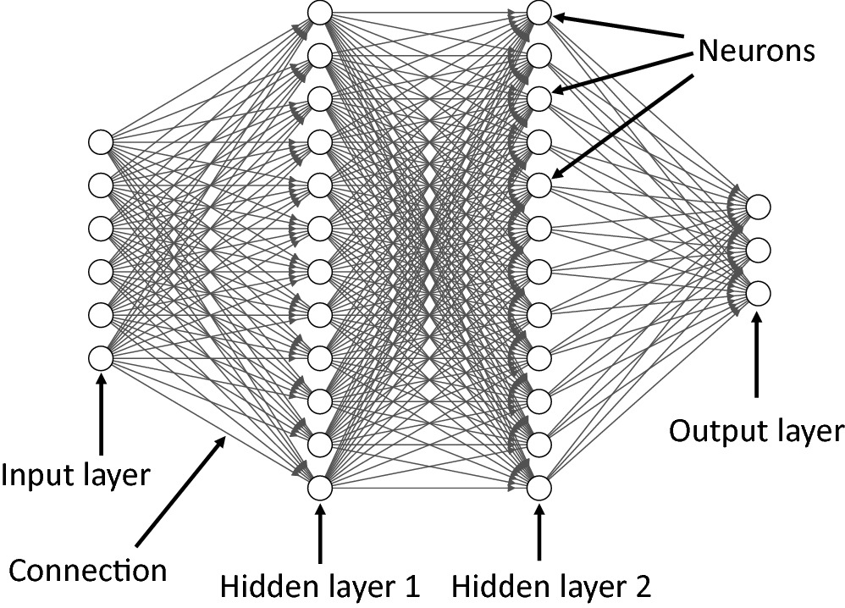
THE STRUCTURE OF THE NEURAL NETWORK

Slide 12
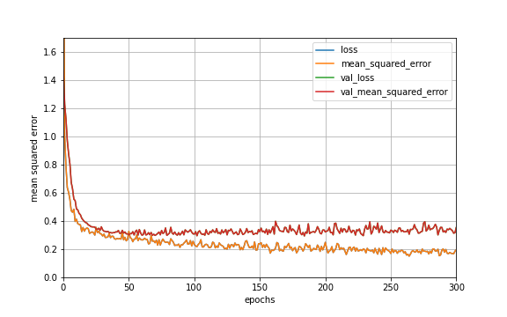
TRAINING CURVE
Validation error
Train error

Slide 13
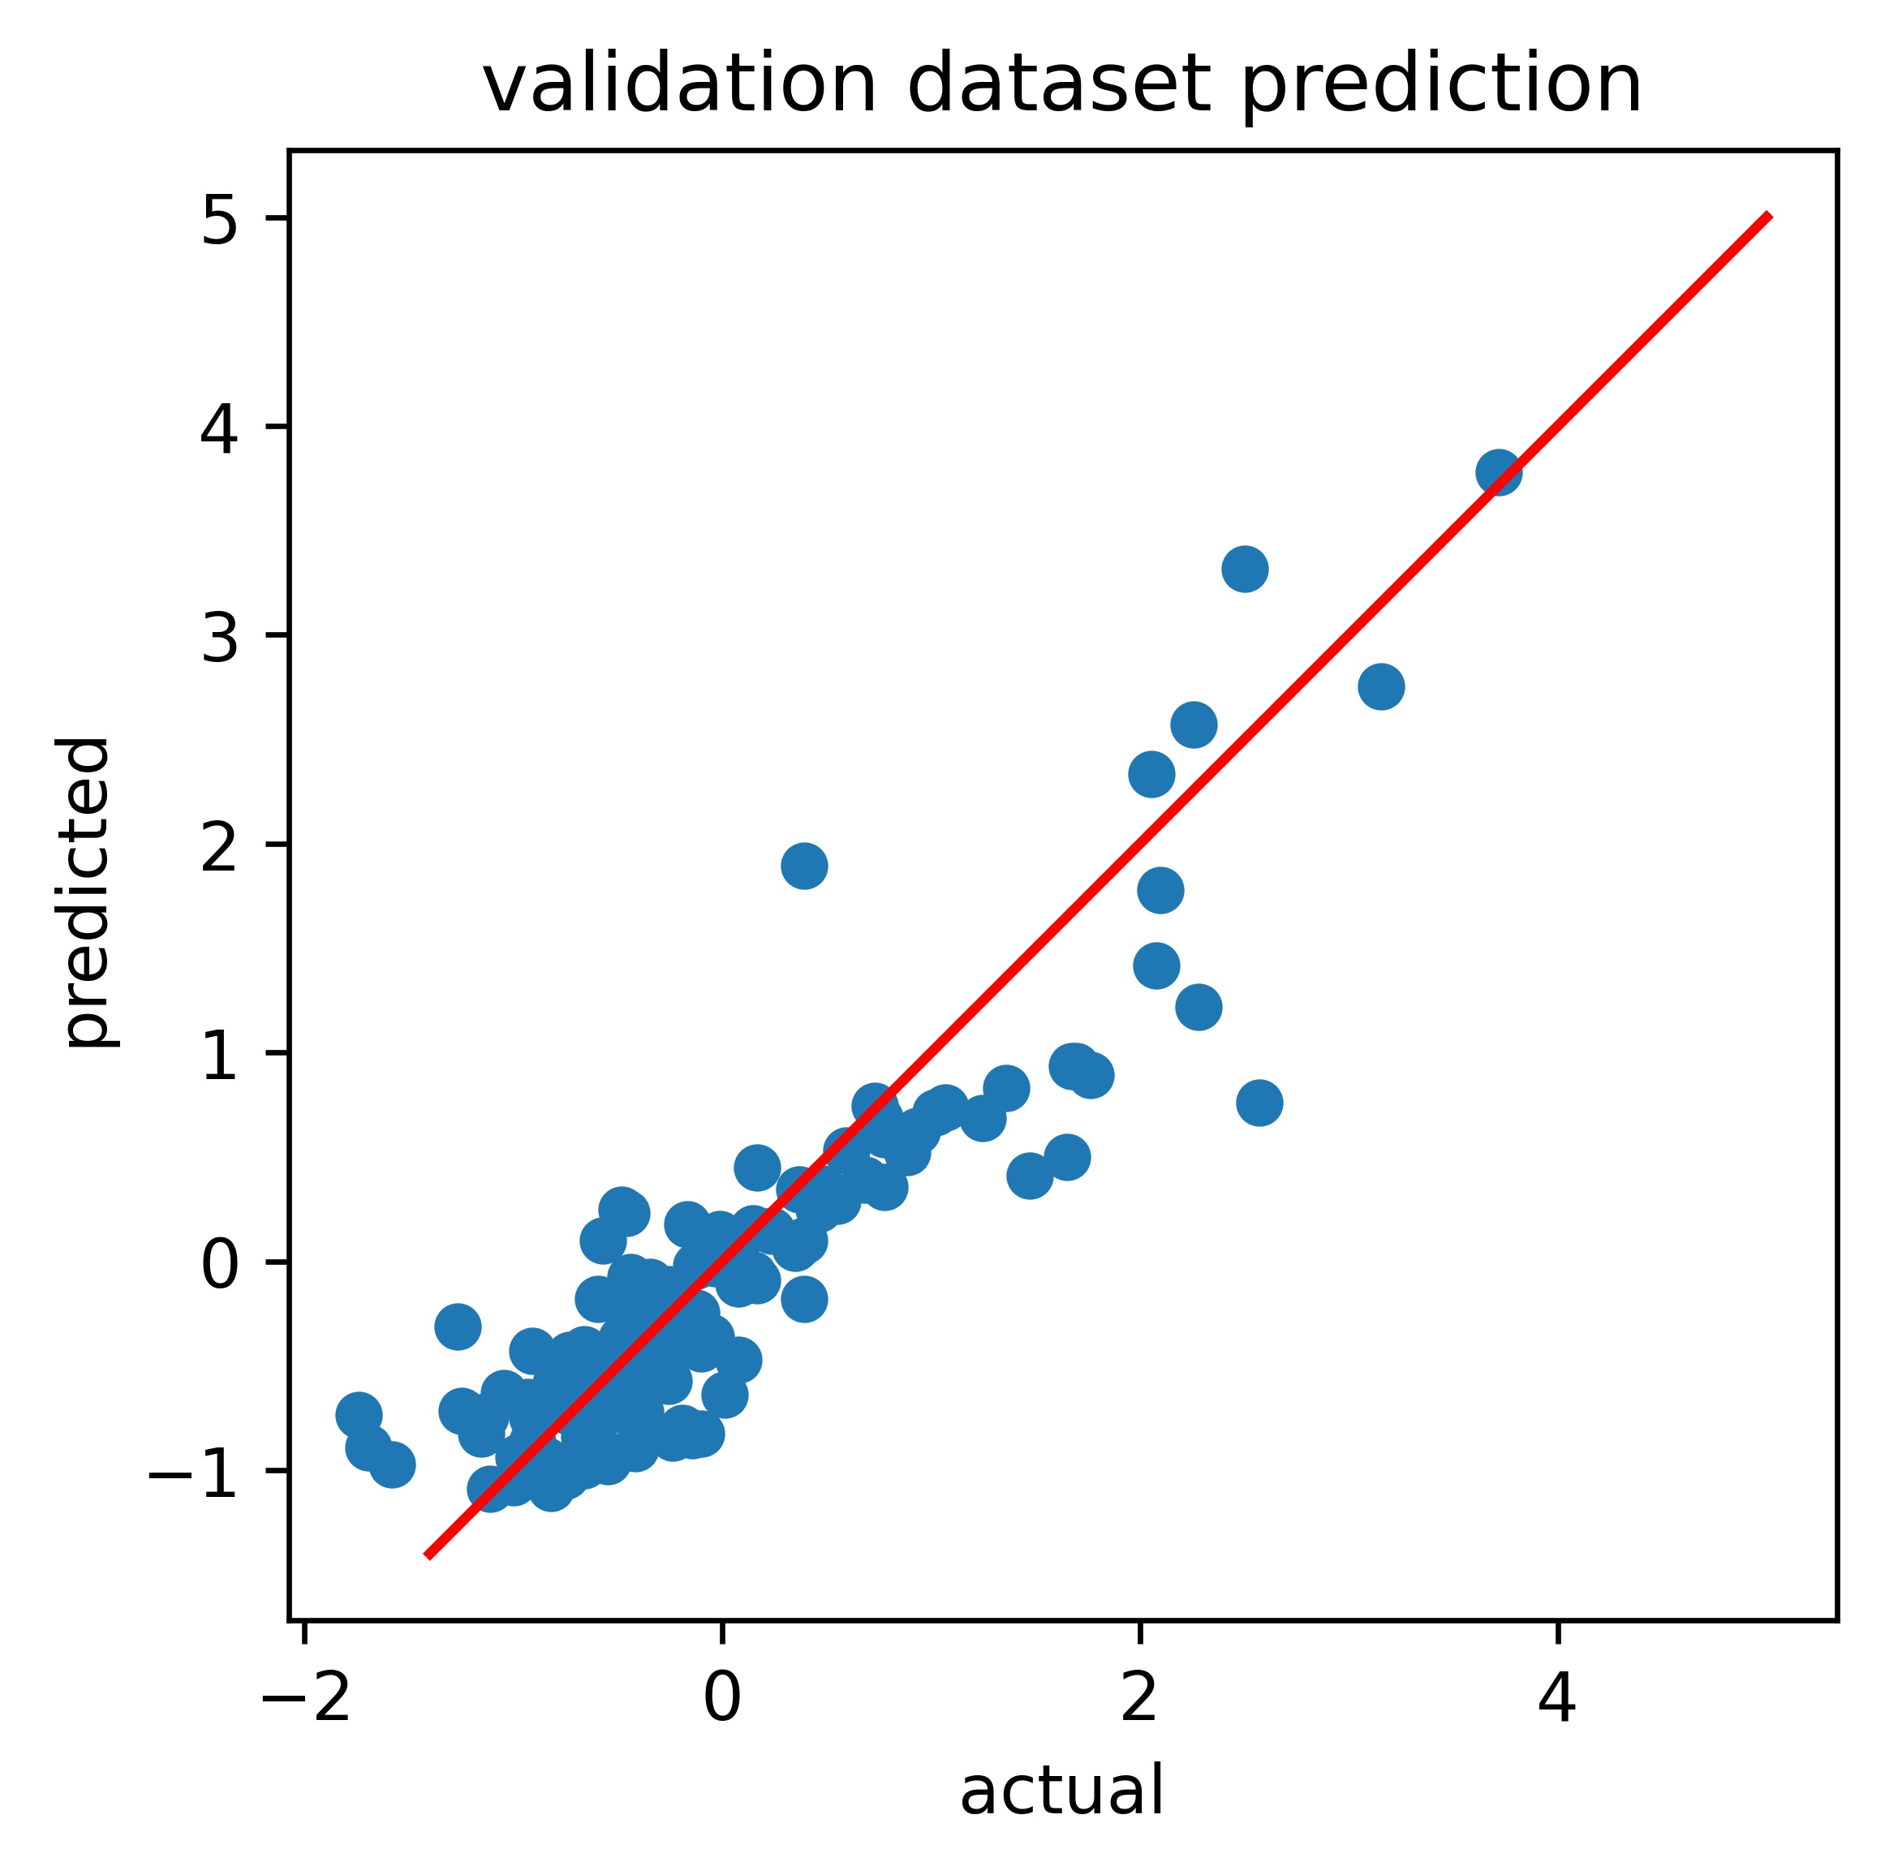
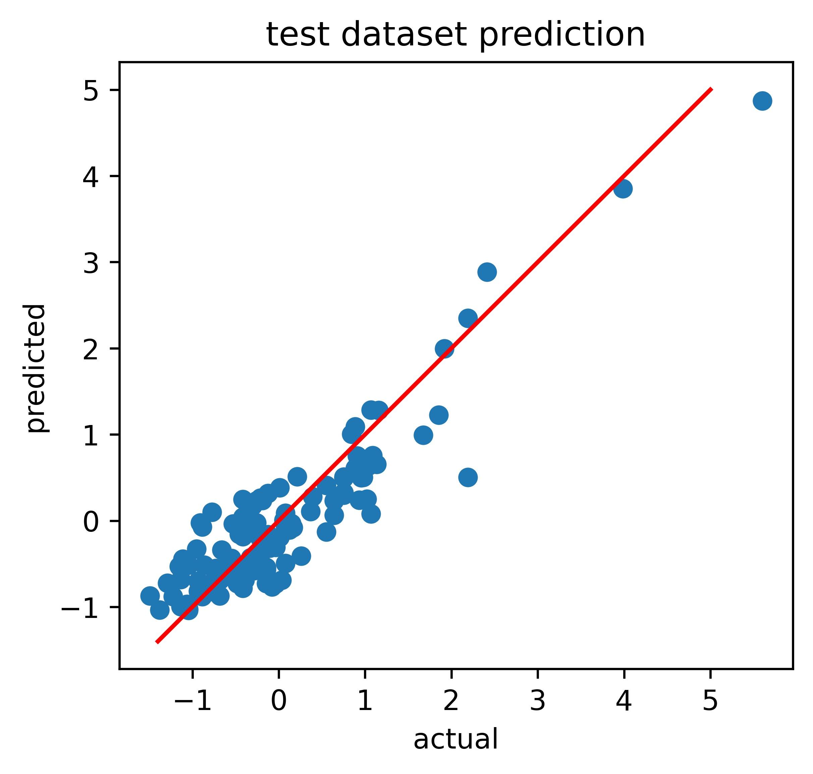
VALIDATION AND TEST DATASETS PREDICTION
rmse:0.4682974873094415
r2:0.787758594244337
mae:0.3412472098261595
mape:1.4385847502364602
rmse:0.43062023977200553 r2:0.8292674240053359 mae:0.34011389198597936 mape:1.6911960636435472¶

Slide 14
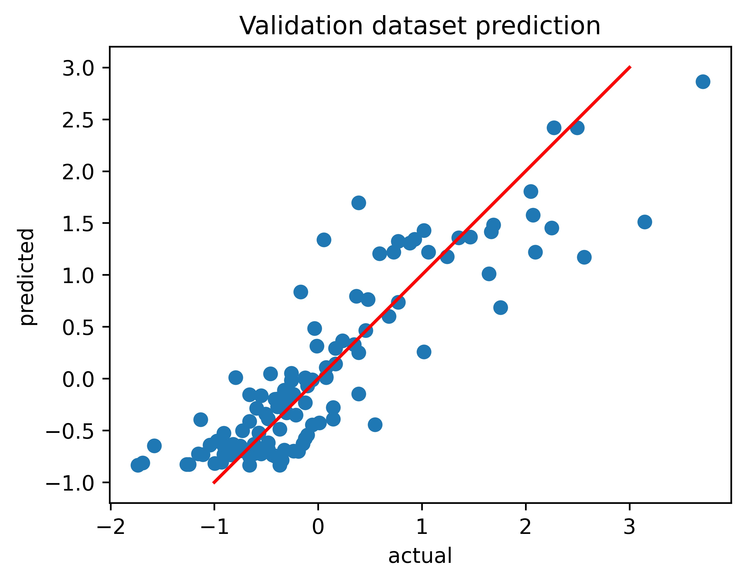
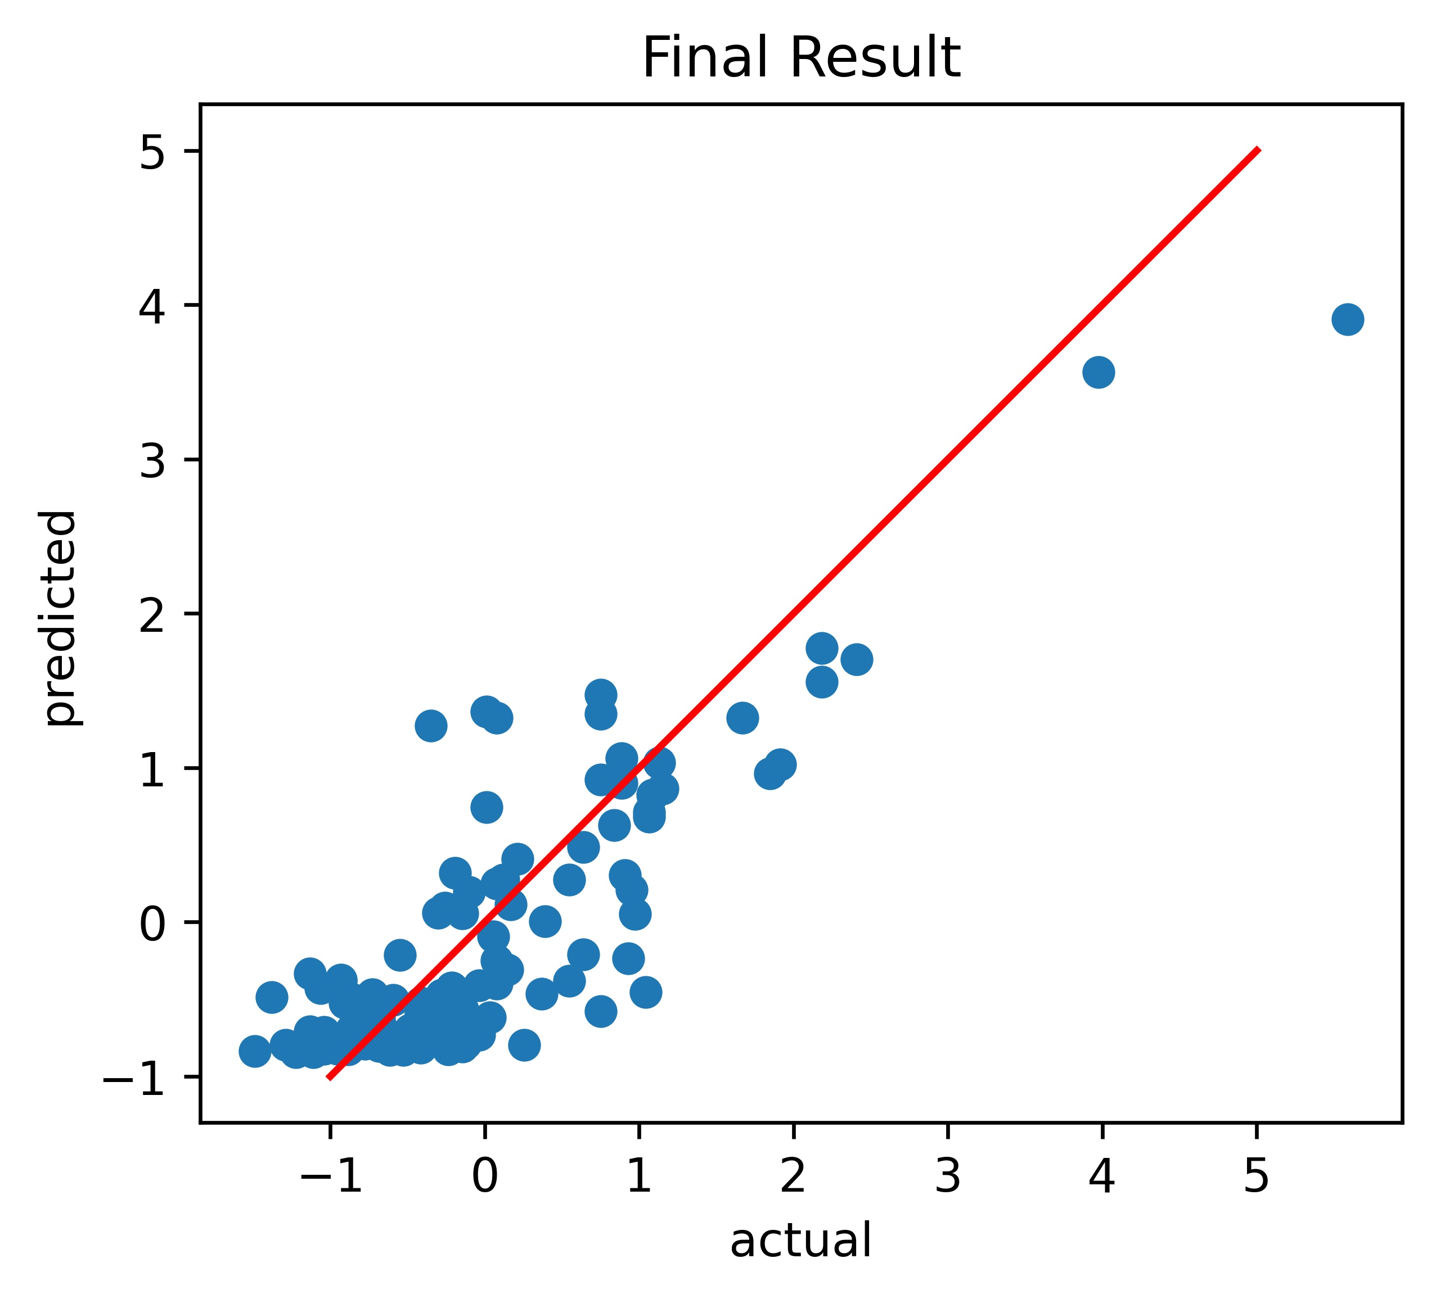
VALIDATION AND TEST DATASETS PREDICTION (ONLY ONE STATION)
rmse:0.48101761678925814 r2:0.7767606542671457 mae:0.3568588342965572 mape:1.6975885313626764
rmse:0.5640885714888886 r2:0.7058078969832094 mae:0.44675370687078253 mape:3.3646880381338766

Slide 15
CONCLUSIONS
The neural network was the model with the lowest error on the validation dataset and the test dataset
The other models like the ensemble methods, SVM and linear regression, were not able to correctly predict the result, especially on the test dataset and they overfit the model (in particular, when hyperparameter tuning was performed). The r2 coefficient was even negative for the models that were trained.
Considering only one station, the result were slightly worse (even because less features were extracted) but they required less tuning and good results were obtained with the trained ensemble methods (AdaBoost, ExtraTrees, Random Forest, Gradient Boosting).
If the rows are randomly shuffled, the error on test data can vary a lot. In particular, using the ensemble methods, SVM and linear regression, the error decreases.

Slide 16
FOR FURTHER EXPLORATION…
Try to extract other features from the waveforms
Feature selection with other methods
Consider more events and more stations
Select a range distance and select features in this range distance
Spending even more time tuning the model (using a more powerful GPU or a GPU cluster )
Apply other kinds of crossvalidation or nested crossvalidation
Determine anomalous data points

