Slide 1

Robot Website Design
Team members：Junrui Xu Bingshuai Fu Chengwei Zhang

Slide 2

Mission Requirements
MMiiirements
Database Management and Web Visualisation
• Design the database and create a web application that has the following functions: 1. allow users to login and check their accounts (1 account for 1 robot);
2. add/delete/modify information about robot (e.g. name, picture, etc.)
3. visualise records of explorations (e.g. average maze exploration time, statistics of treasures, etc.);
• Possible advanced functions: 1. display the real-time map, pictures and
other information from the robot,
2. self-designed other functions

Slide 3
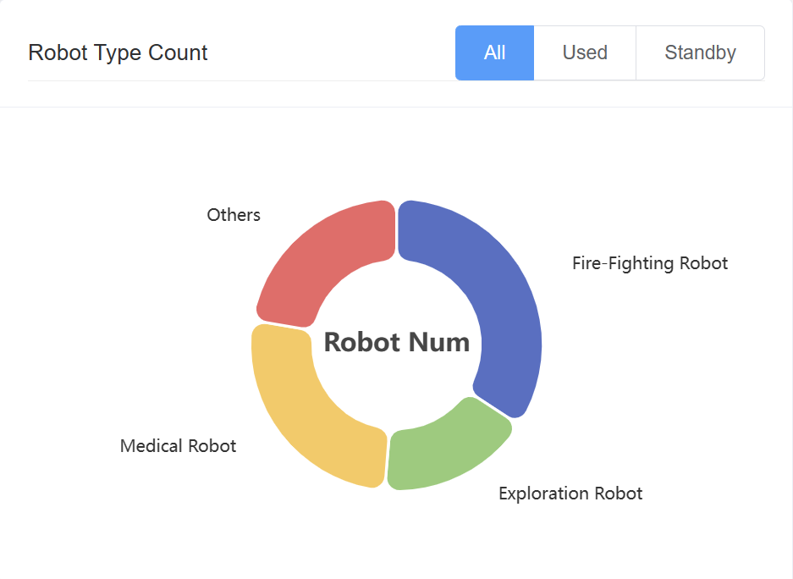
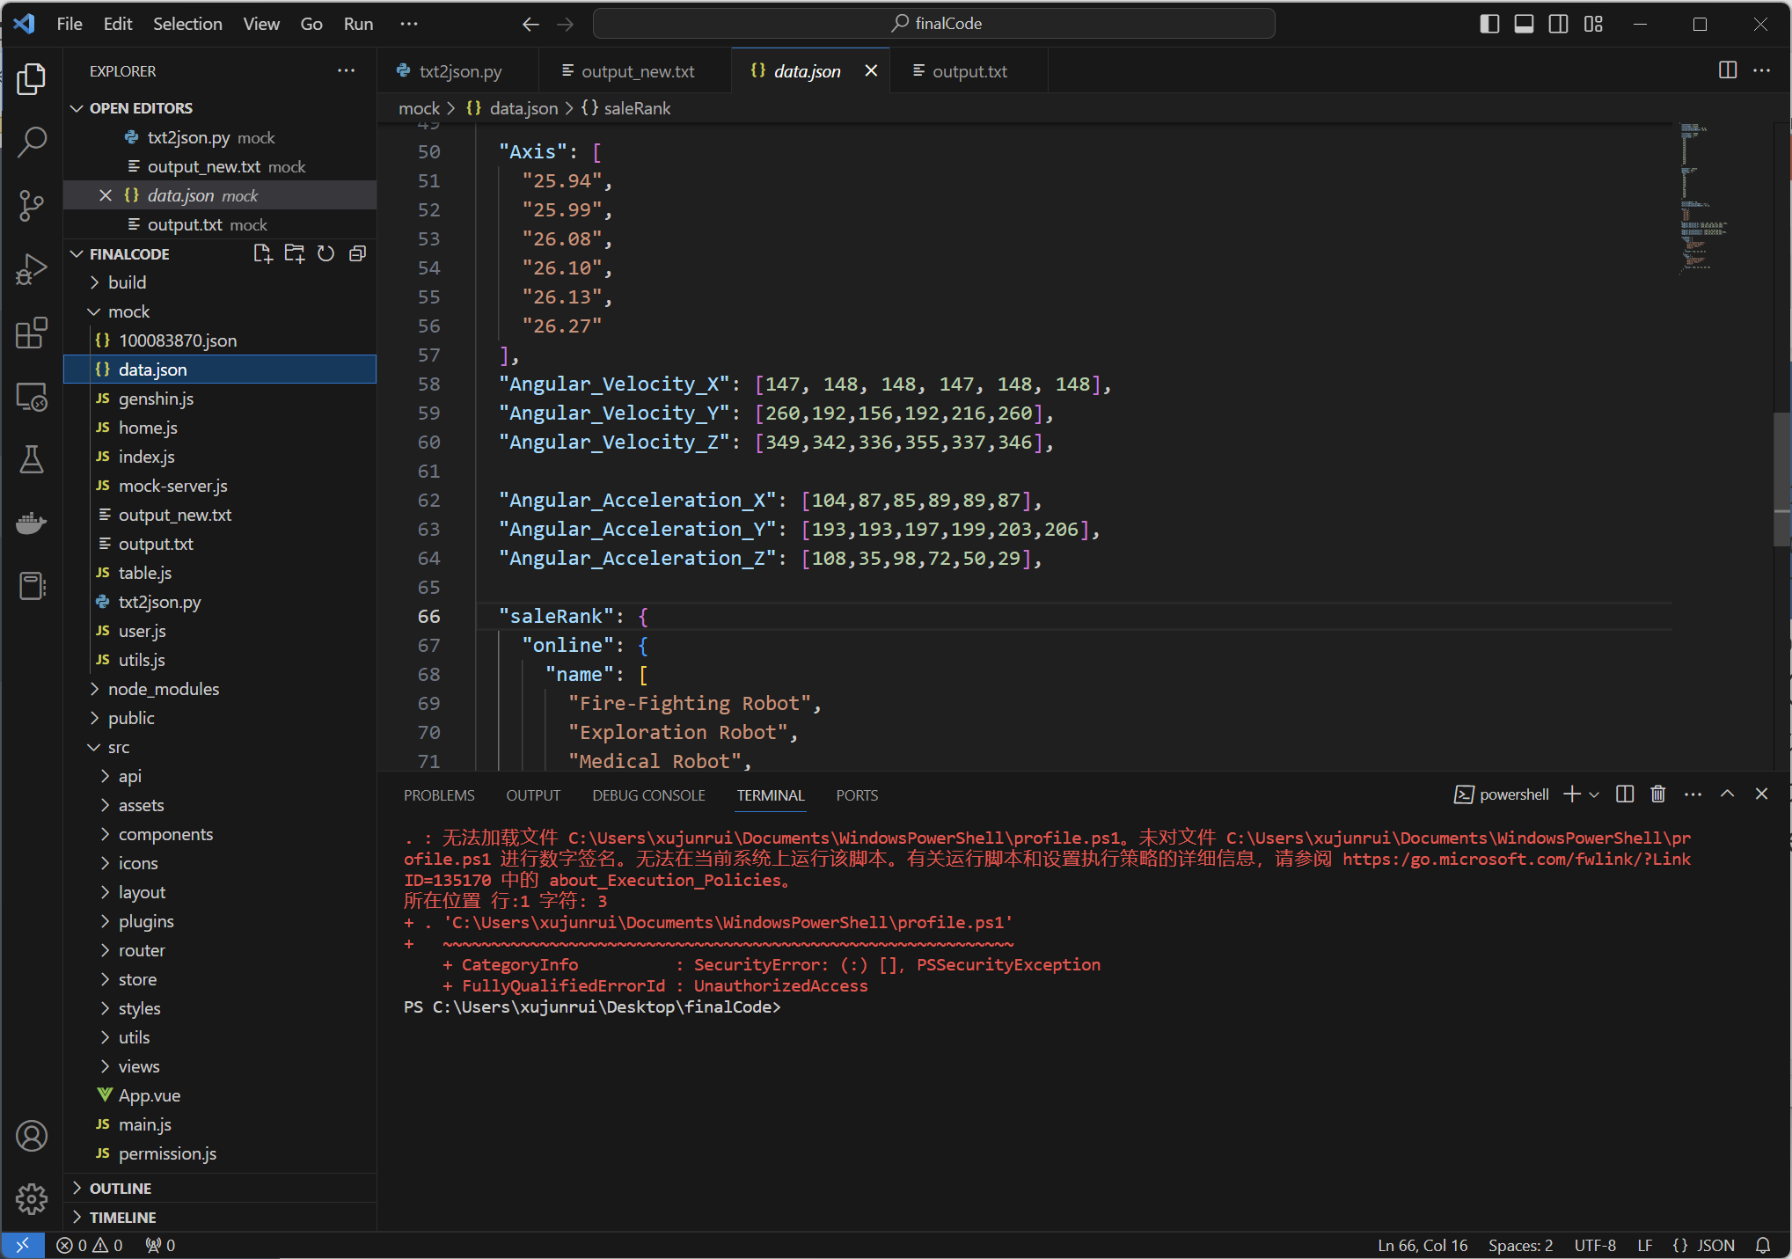
Basic Functions
Login and User Management
add/delete/modify information about robot
visualise records of explorations (e.g. average maze exploration time, statistics of treasures, etc.)
Useful and Beautiful Website

Slide 4

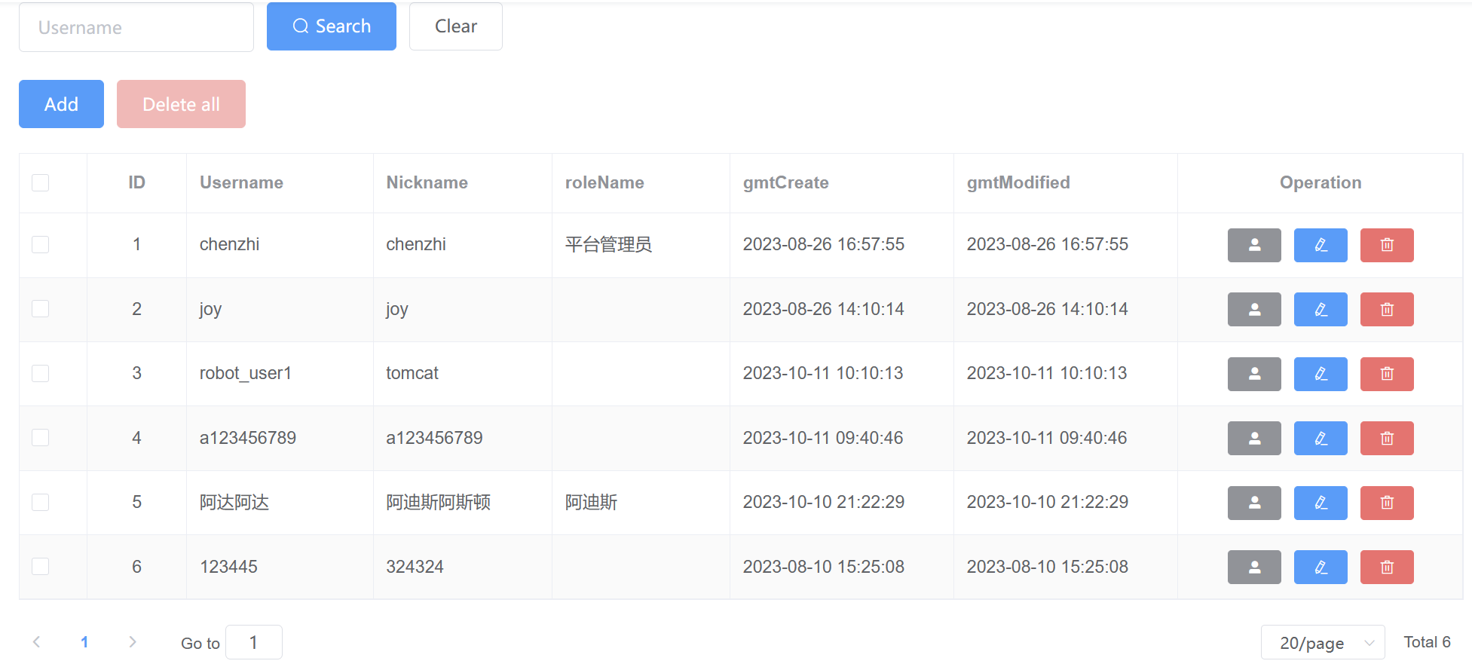
Innovation 1: Authority Management
Assign roles for each user
Enable various user operation
Data read and edits from the
following url(backend DB): http://gmall-h5-api.atguigu.cn

Slide 5
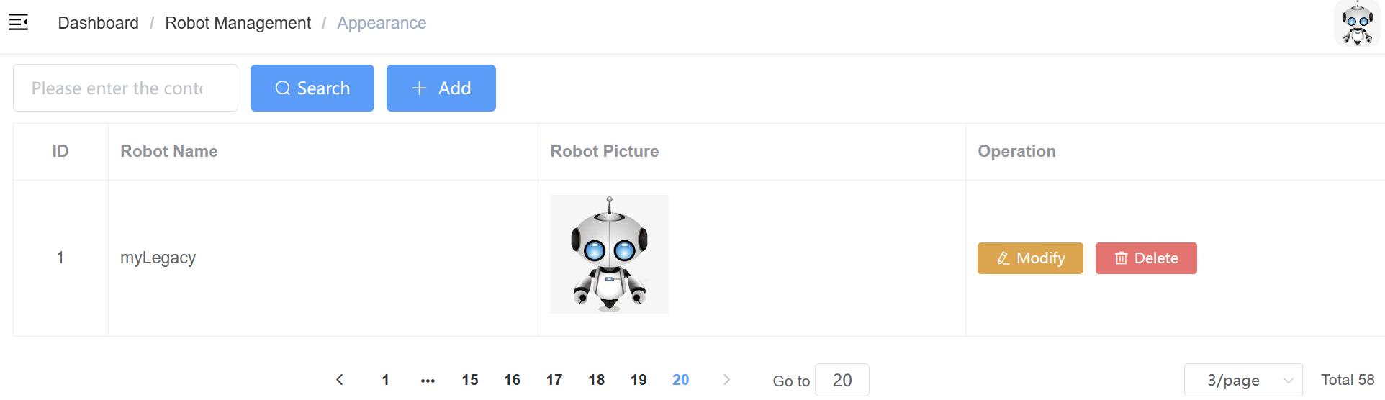
Innovation 2: Robot Appearance and Attribute Management
Manage the name and appearance for the robot.
Manage the attribute for each robot.

Slide 6
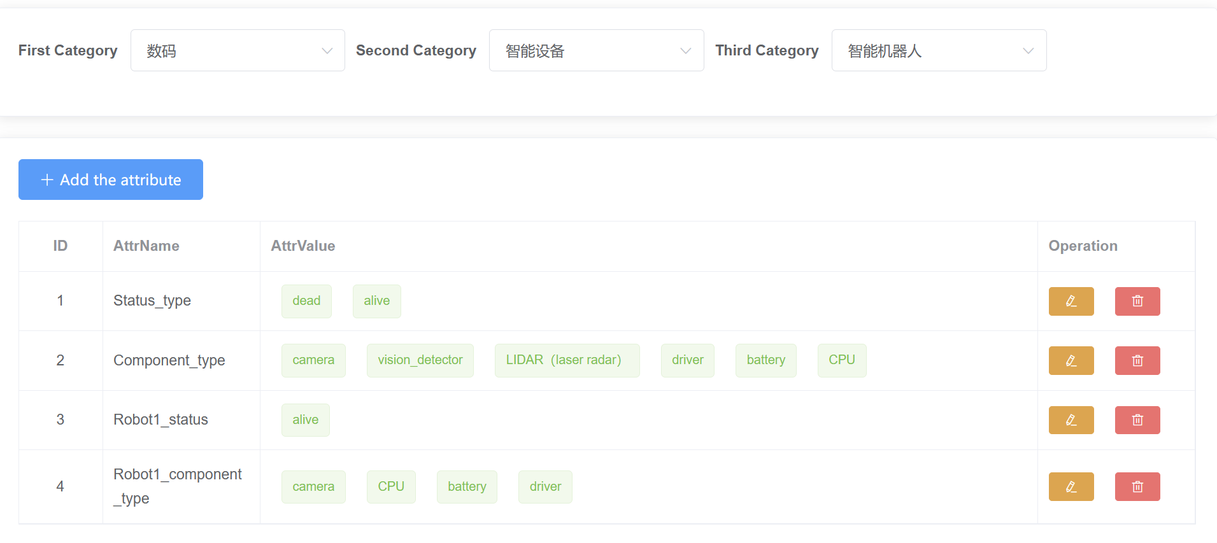
Innovation 2: Robot Appearance and Attribute Management
Manage the name and appearance for the robot.
Manage the attribute for each robot.

Slide 7
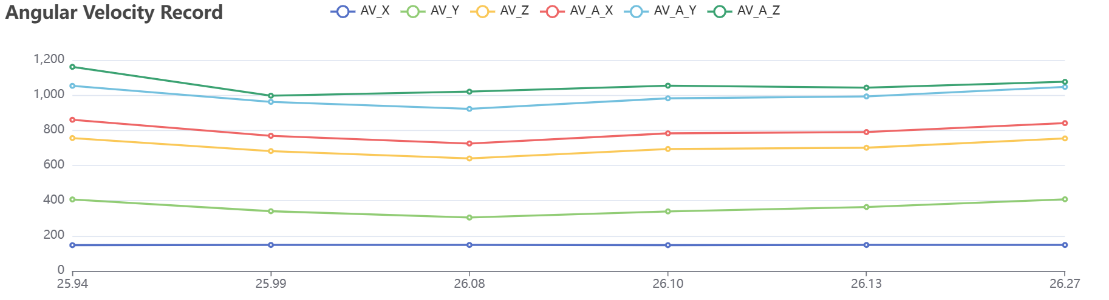
Innovation 3: Robot Data visualization
Read data from txt and convert it into json.
Visualized as pie chart and curve.

Slide 8
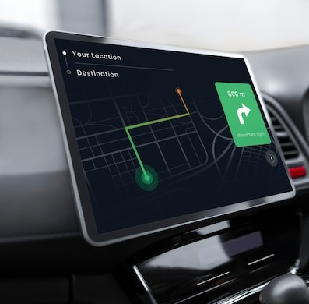
Technical principles
Thanks
For
Watching
Team members： Junrui Xu Bingshuai Fu Chengwei Zhang

