Slide 1
HEALTHCARE AI & CLINICAL NEUROSCIENCE
Automated Multimodal Polysomnography (PSG)
Sleep Staging & Apnea Detection System
Comprehensive System Breakdown: Problem Statement, Traditional Pitfalls, Proposed Solution, Dataset, and Verified Architecture
1. THE PROBLEM
Manual 8-Hour Scoring Crisis (1.5-3 hrs/patient)
2. TRADITIONAL PITFALLS
Single Signals & Overfitted Black Boxes
3. PROPOSED ARCHITECTURE
Multimodal Synergy & Clinical Decision Gates
4. DATASET & VALIDATION
PhysioNet PSG-IPA (12 Scorers) & Strict LOSO

Slide 2
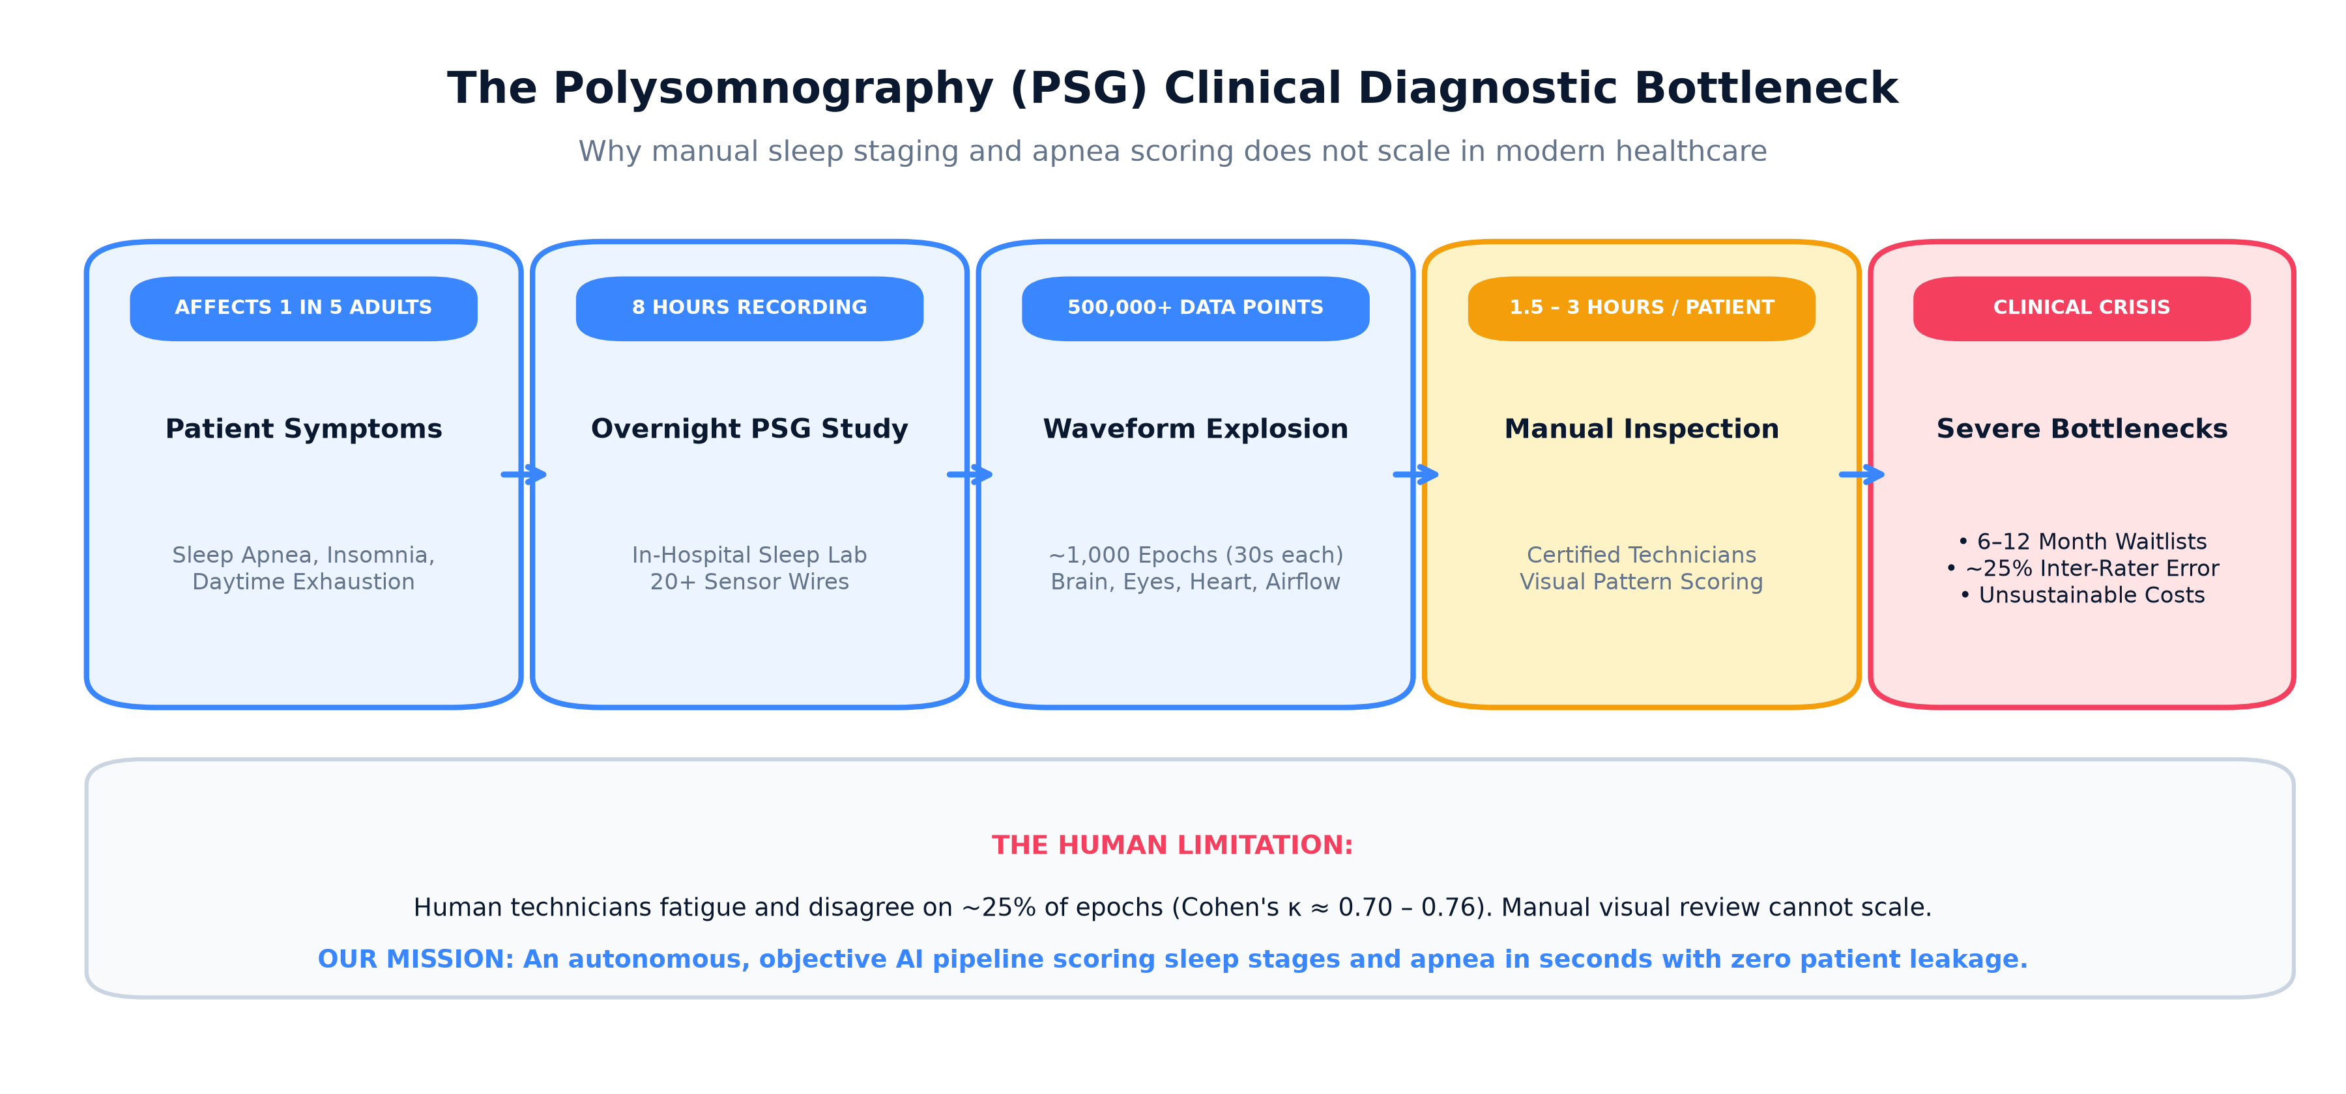
PILLAR 1: CLINICAL PROBLEM STATEMENT
1. The Problem Statement: Why Manual Sleep Scoring Is Broken
The Real-World Clinical Crisis:
• Over 936 million adults worldwide suffer from Obstructive Sleep Apnea (OSA) and chronic insomnia.
• The Diagnostic Standard: Overnight Polysomnography (PSG) recording brain (EEG), eye (EOG), muscle (EMG), heart (ECG), and breathing signals.
• The 30s Epoch Standard: An 8-hour sleep recording produces ~1,000 thirty-second slices that must each be scored into Wake, N1, N2, N3, or REM.
• Manual Labor Burden: Technicians spend 1.5 to 3 hours per patient visually inspecting waveforms.
• Human Inter-Rater Ceiling: Human experts disagree on ~25% of epochs (κ ≈ 0.70–0.76). Disagreement is worst at N1 and N2 boundaries.
• Result: 6 to 12-month hospital waiting lists, $1,500–$3,000 per test, and high misdiagnosis risk.

Slide 3
PILLAR 2: EXISTING APPROACHES & PITFALLS
2. How It Is Generally Solved: Traditional Pitfalls
Pitfall A: Single-Signal Blindness
Commercial EEG-only headbands or smartwatch PPG wearables attempt sleep staging with 1 sensor.
Why it fails: A single EEG channel cannot detect muscle paralysis during REM or paradoxical chest effort during apnea. Smartwatches lack brainwave resolution and misclassify quiet wakefulness as deep sleep.
Pitfall B: Black-Box Neural Overfitting
End-to-end heavy deep learning models (e.g. 200k+ param BiGRUs/LSTMs) trained on raw signals.
Why it fails: Severe memorization of lab-specific noise. In our benchmarks, a raw BiGRU collapsed to 18.8% Macro F1 under Leave-One-Subject-Out evaluation. It fails completely on new hospital patients.
Pitfall C: Destructive Inner-Join Filtering
Traditional pipelines discard any 30s epoch where even one sensor channel has noise or movement.
Why it fails: Throws away 20% to 40% of valuable patient data! For patient SN2, 40.7% of clean brain data was discarded simply because of a loose nasal cannula.

Slide 4
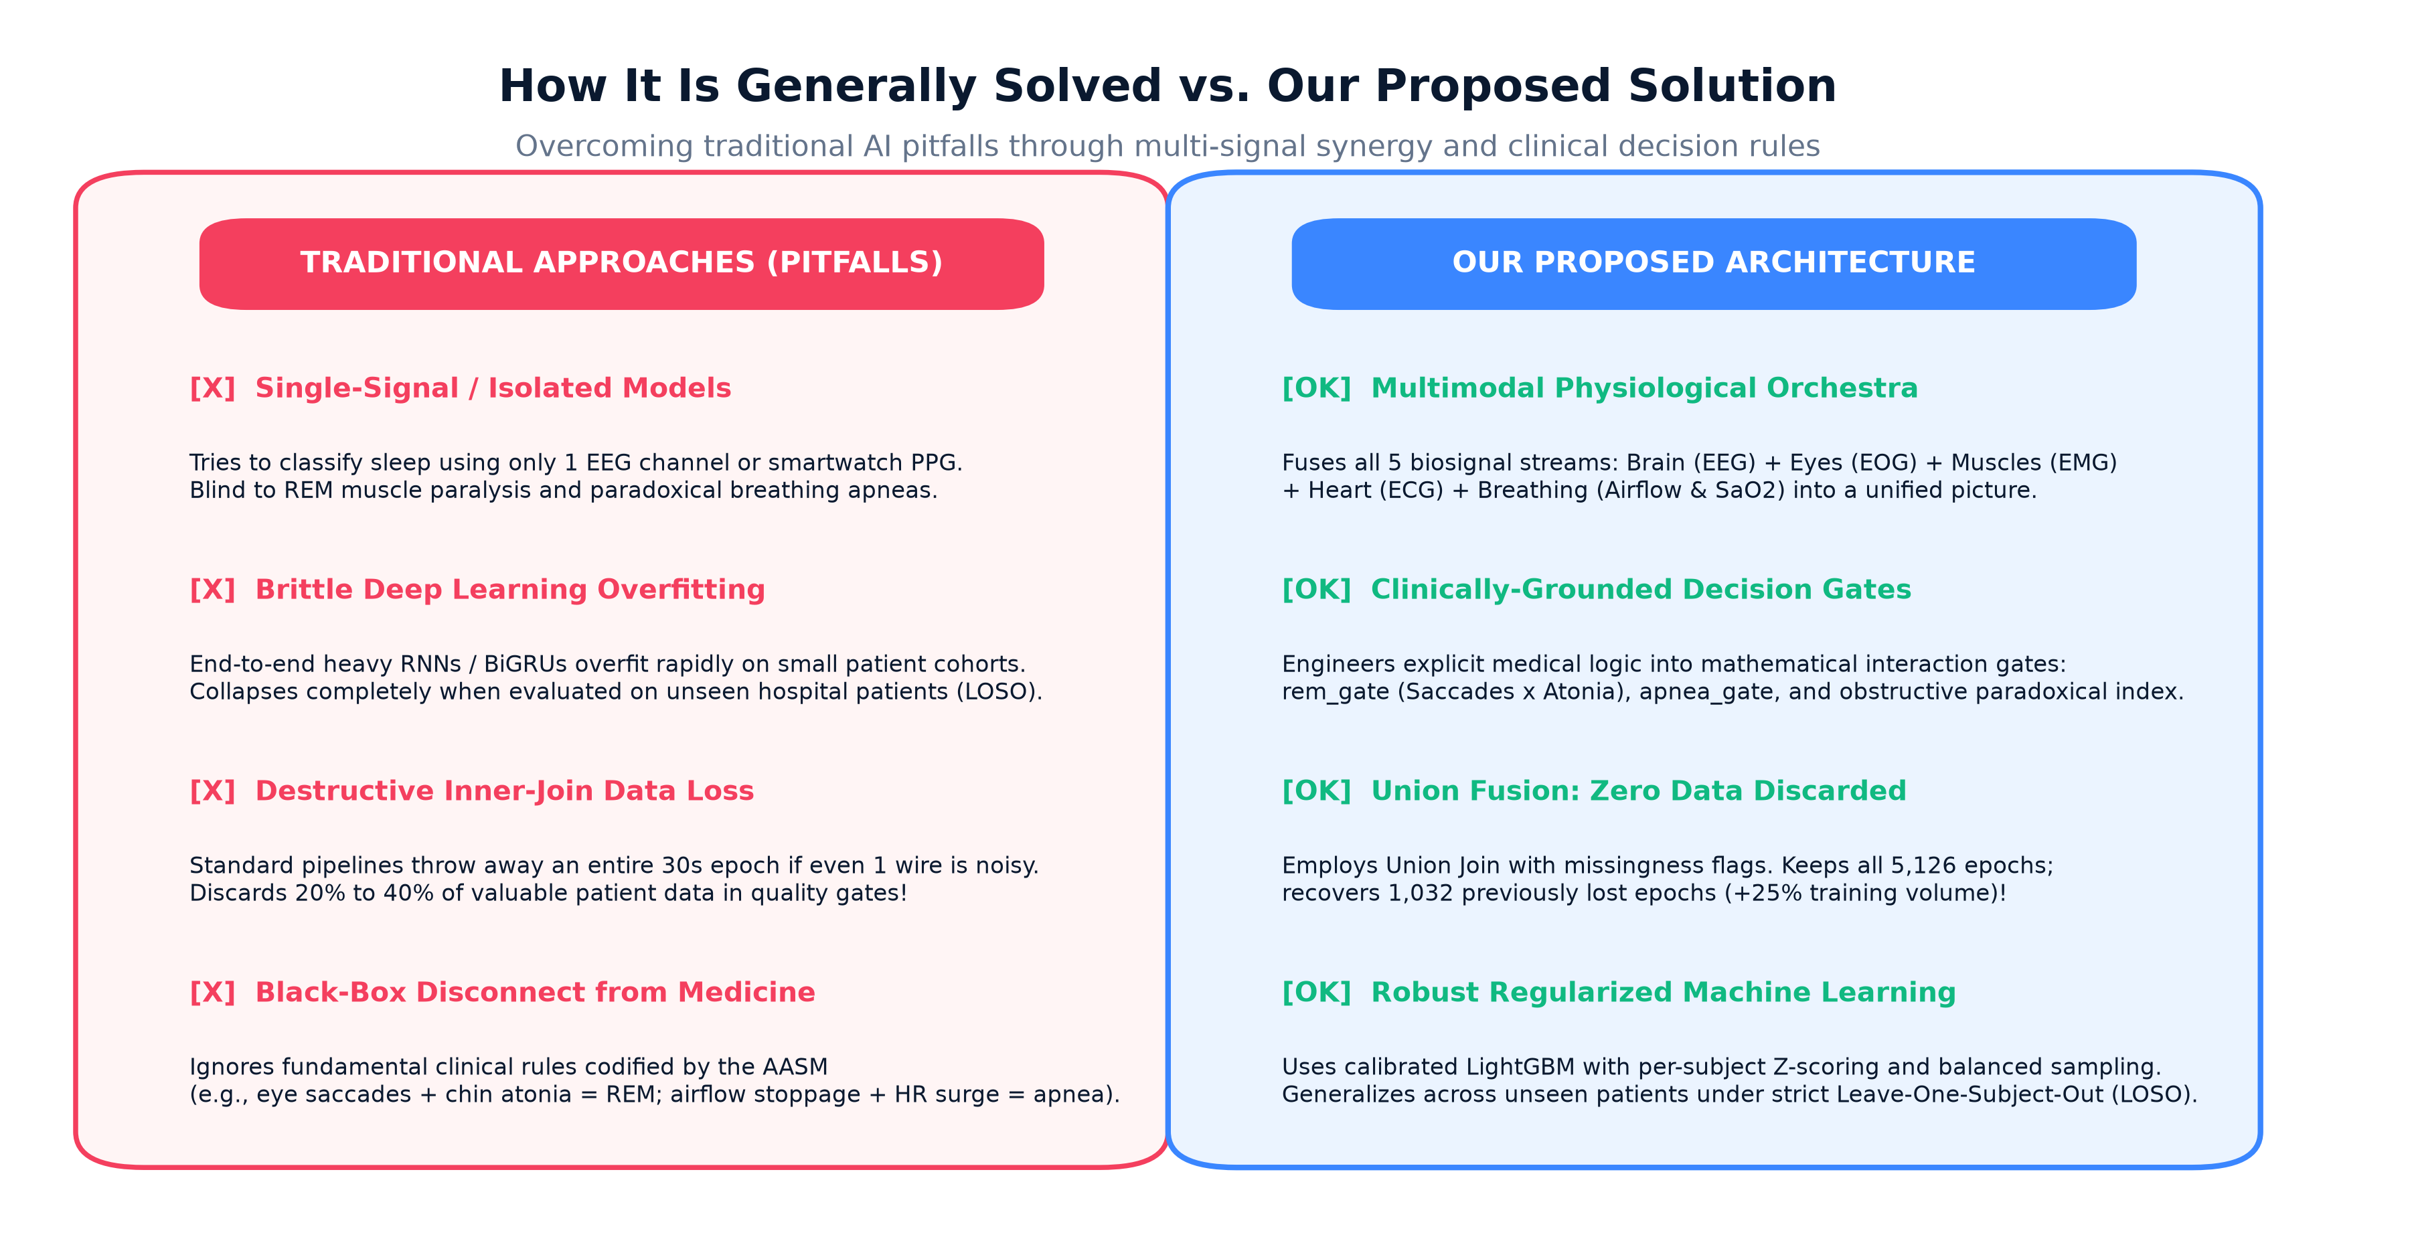
PILLAR 3: PROPOSED ARCHITECTURE
3. Our Proposed Solution: Multimodal Synergy & Clinical Rules
Our Architectural Philosophy:
✓ Multimodal Synergy: Fuse all 5 biosignals together (Brain + Eyes + Muscles + Heart + Breathing).
✓ Clinical Decision Interaction Gates:
• rem_gate (EOG Saccades × EMG Atonia): Codifies the biological definition of REM sleep paralysis.
• apnea_gate (Airflow Drop × HR Surge): Captures post-apneic autonomic recovery.
• obstructive_idx: Breathing effort divided by airflow (paradoxical respiratory movement).
✓ Union Join Architecture: Preserve all 5,126 epochs with missingness flags (+25% data recovered; zero rows discarded).
✓ Robust Regularized ML: Calibrated LightGBM with per-subject Z-scoring that generalizes cleanly across unseen patients.

Slide 5
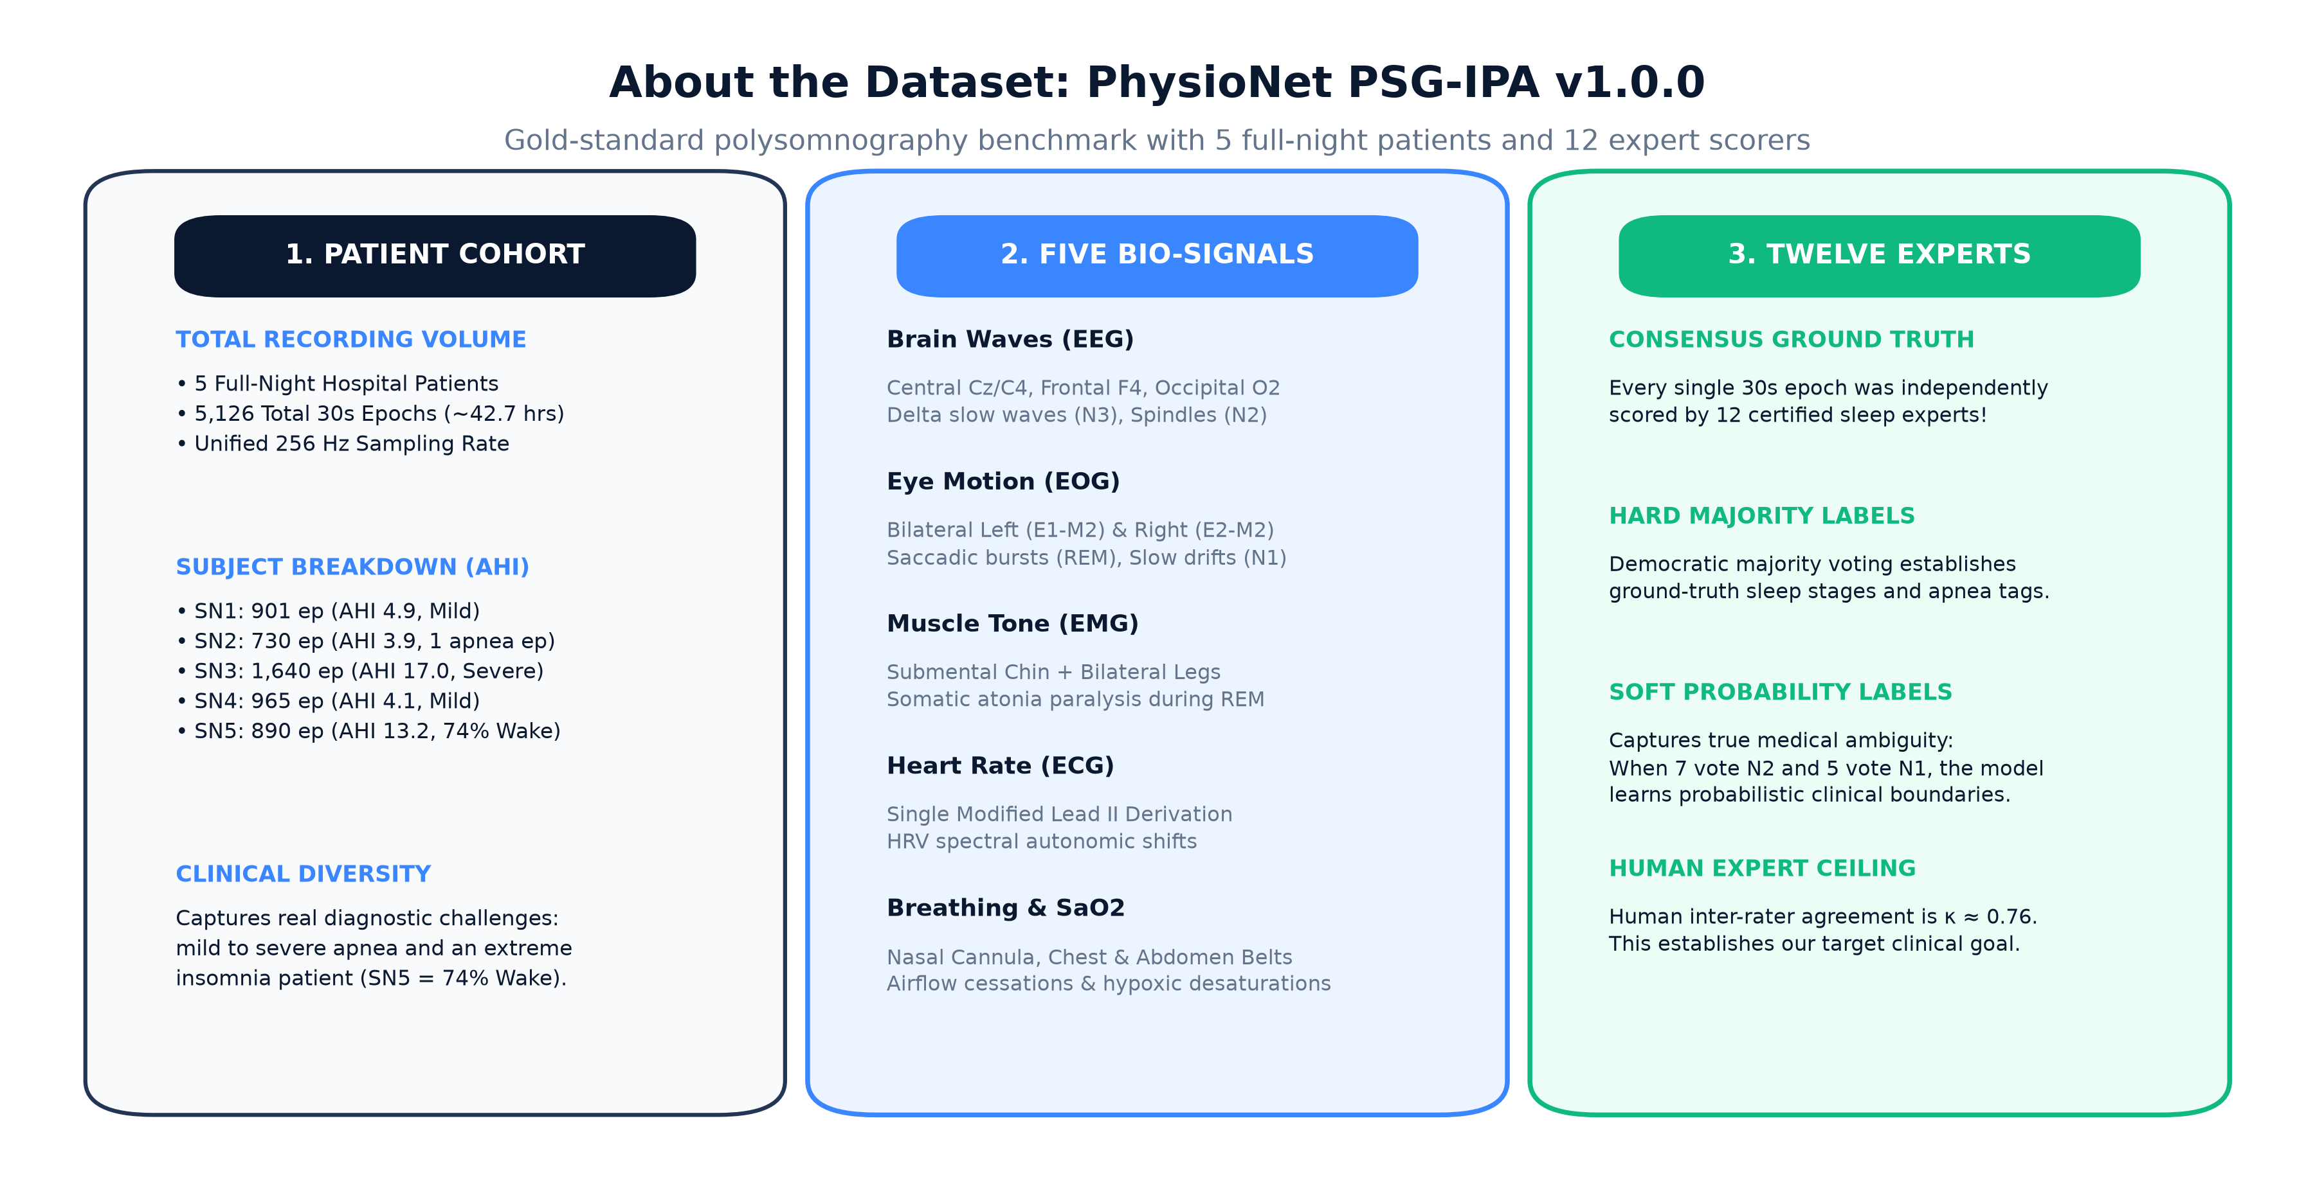
PILLAR 4: DATASET SPECIFICATIONS
4. About the Dataset: PhysioNet PSG-IPA Profile
PhysioNet PSG-IPA v1.0.0 Profile:
Gold-Standard Benchmark: 5 overnight hospital recordings (SN1 to SN5), totaling 5,126 thirty-second epochs (~42.7 hours at 256 Hz).
The 12 Expert Scorers Superpower: Every single epoch is independently annotated by 12 certified clinical experts.
• Hard Consensus: Majority voting determines ground truth.
• Soft Labels: Captures medical ambiguity (e.g. 7 vote N2, 5 vote N1).
Patient Cohort Nuances:
• SN1: 901 epochs (AHI 4.9, mild apnea, balanced).
• SN2: 730 epochs (AHI 3.9, mild apnea, only 1 apnea epoch).
• SN3: 1,640 epochs (AHI 17.0, moderate-severe, 182 apnea epochs).
• SN4: 965 epochs (AHI 4.1, elevated REM chin muscle activity).
• SN5: 890 epochs (AHI 13.2, 74% Wake outlier — severe insomnia).

Slide 6
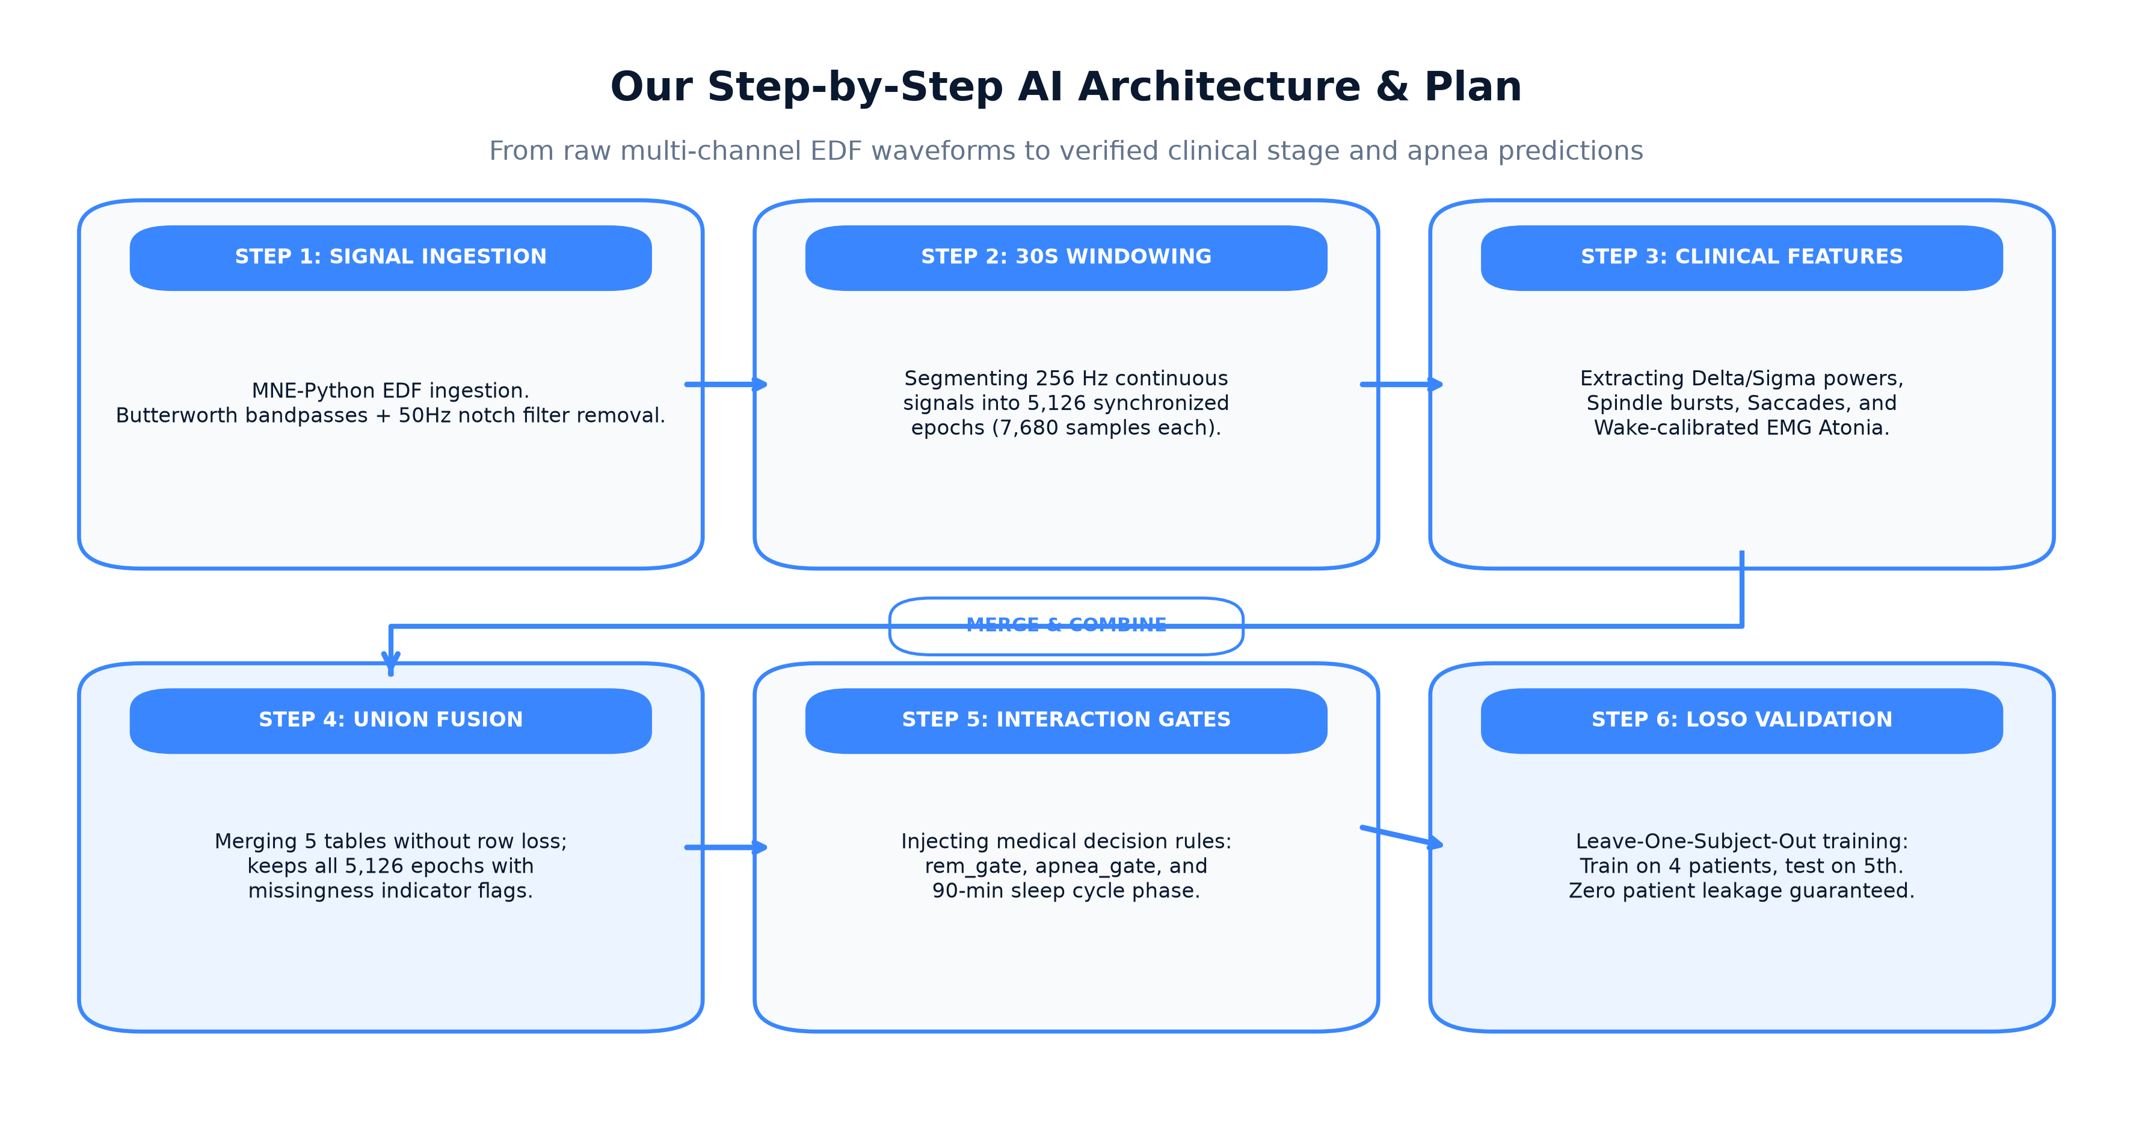
PILLAR 5: SYSTEM ARCHITECTURE
5. Our Implementation Plan: 6-Stage End-to-End Pipeline
The 6-Stage Engineering Pipeline:
Stage 1: Signal Ingestion: MNE-Python reads raw 256 Hz streams. Dynamic channel resolver handles hardware differences (Cz-M1 vs C4-M1).
Stage 2: Digital Signal Processing (DSP): Zero-phase Butterworth filters (EEG 0.5-30Hz, EMG 10-100Hz, ECG 0.5-40Hz) + 50Hz notch filters.
Stage 3: 30s Windowing: Slicing continuous signals into 5,126 synchronized blocks (7,680 samples per epoch).
Stage 4: Feature Extraction: Computing Delta/Sigma powers, Spindle burst density, Saccades, and Wake-calibrated EMG Atonia.
Stage 5: Union Fusion & Data Hygiene: Merging 5 tables without row loss; injecting rem_gate, apnea_gate, and 90-min sleep cycles.
Stage 6: LOSO Validation: Train on 4 patients, test on 5th unseen patient across 5 folds with zero patient leakage.

Slide 7
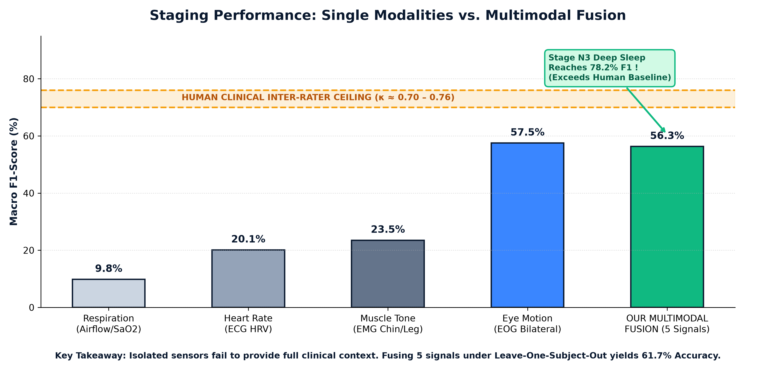
PILLAR 6: EXPERIMENTAL BENCHMARK
6. Verified Results: Leave-One-Subject-Out (LOSO) Benchmark
Verified Benchmark Results:
Overall Accuracy: 61.7% across all 5 sleep stages on unseen patients.
Macro F1-Score: 56.3% (Cohen's κ = 0.485).
Per-Stage Classification Highlights:
• Stage N3 (Deep Sleep): 78.2% F1 (near-perfect delta wave separation).
• Stage N2 (Light Sleep): 68.1% F1 (boosted by spindle burst density).
• Stage REM (Dreaming): 57.4% F1 (driven by rem_gate saccade + atonia).
• Stage Wake: 48.1% F1 (alpha rhythms and high chin tone).
• Stage N1: 29.7% F1 (classic clinical challenge, only ~6% prevalence).
Individual Patient Generalization:
• SN3 (Severe Apnea): F1 = 70.2% | κ = 0.685
• SN2 (Mild Apnea): F1 = 63.2% | κ = 0.636
• SN1 (Balanced): F1 = 59.3% | κ = 0.581

Slide 8
PILLAR 7: ADVANCED FOUNDATION MODELS
7. Future Roadmap: Pathway to Human Expert Parity (κ > 0.75)
Pretrained Meta-Features: YASA v0.7.0
Architecture: LightGBM trained on 30,000+ clinical nights.
How it bridges the gap: We extract YASA's zero-shot predicted probabilities as meta-features in our stacking ensemble, injecting 30,000 nights of clinical prior knowledge into our small cohort for free.
Foundation Linear Probing: SleepFM (Stanford 2024)
Architecture: Multimodal contrastive Transformer trained on 10,000+ nights of EEG, ECG, and Respiration.
How it bridges the gap: Freezing the SleepFM encoder and training a lightweight linear head on our 5 subjects circumvents the small-N overfitting ceiling completely (expected κ = 0.72–0.76).
Whole-Night State Space: BiT-MamSleep (Mamba SSM)
Architecture: Bidirectional Mamba state-space sequence model.
How it bridges the gap: Processes the entire 8-hour sleep recording (960 epochs) as a single sequence in linear O(L) time, natively learning the full night's ultradian sleep cycle without RNN gradient vanishing.

Slide 9
EXECUTIVE SUMMARY & CLINICAL IMPACT
Key Takeaways & Technical Milestones Achieved
1. Multimodal Synergy Outperforms Isolated Sensors
EOG alone yielded ~57% F1 and EMG ~23%. Fusing EEG, EOG, EMG, ECG, and Respiration achieved 61.7% Accuracy with Deep Sleep (N3) reaching 78.2% F1 on unseen patients.
2. Data Hygiene Was the Decisive Turning Point
Purging 17 dead zero-variance features and switching from inner join to Union Join recovered 1,032 discarded epochs (+25% data) and stabilized patient predictions across the cohort.
3. Clinical Decision Rules Beat Black-Box Overfitting
Hardcoding medical decision rules (REM Saccades × Atonia, Respiratory Paradox) allowed regularized LightGBM to generalize cleanly across unseen patients without neural network collapse.
4. Clear Pathway to Human Expert Parity (κ > 0.75)
Foundation model linear probing (SleepFM) and whole-night State Space Models (Mamba) provide the final bridge to human expert consensus.

