Slide 1
QueueLess
Implementation output
Screenshots of the browser application and JavaFX staff console
20 October 2026
Notes:
QueueLess implementation screenshot presentation. Existing project screenshots document recorded application states, rather than a live walkthrough. Browser captures span 11–18 October 2026. JavaFX captures are from the isolated test workflow on 18 October. Sources: C:/Users/Rishit/Documents/ChatGPT/Queueless/.local/evidence and C:/Users/Rishit/Documents/ChatGPT/Queueless/queueless-desktop/target/fx-smoke.

Slide 2
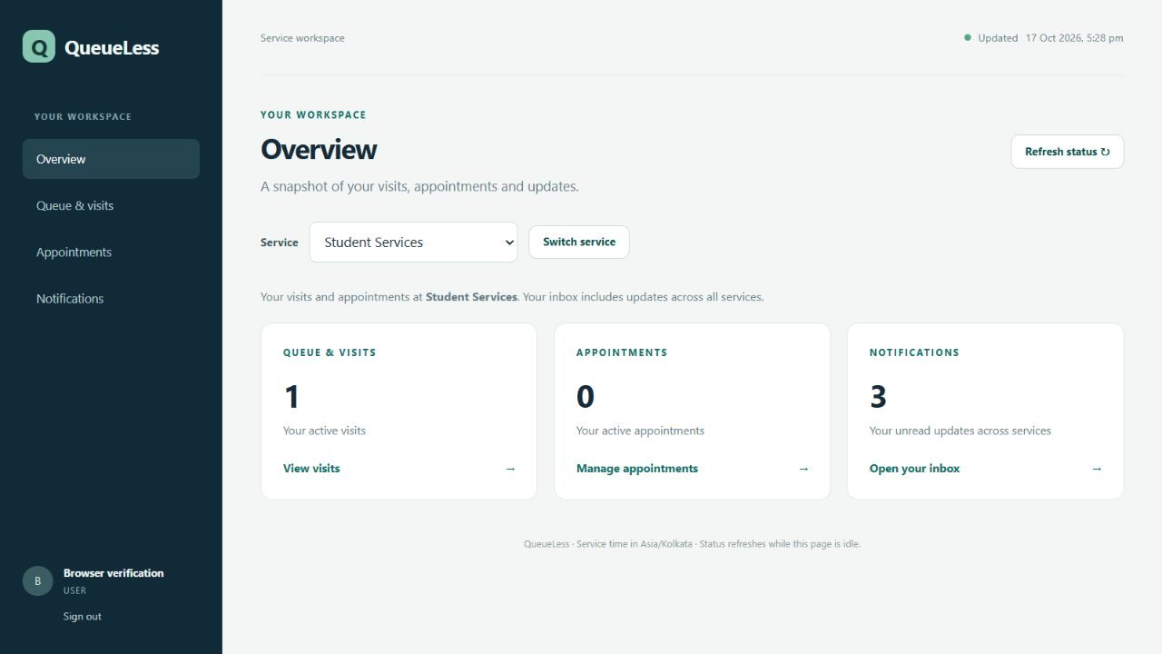
Customer overview
A summary of visits, appointments and unread updates
02
Notes:
Source screenshot: C:/Users/Rishit/Documents/ChatGPT/Queueless/.local/evidence/overview-focused.png
Recorded browser state, 17 October 2026. Counts reflect this capture only.

Slide 3
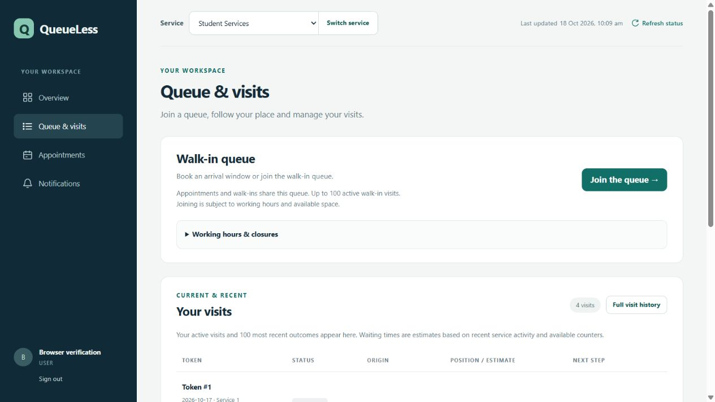
Queue and visits
Service selection, queue admission and recent visits
03
Notes:
Source screenshot: C:/Users/Rishit/Documents/ChatGPT/Queueless/.local/evidence/ux-visits.png
Recorded browser state, 18 October 2026. The selected service is Student Services.

Slide 4
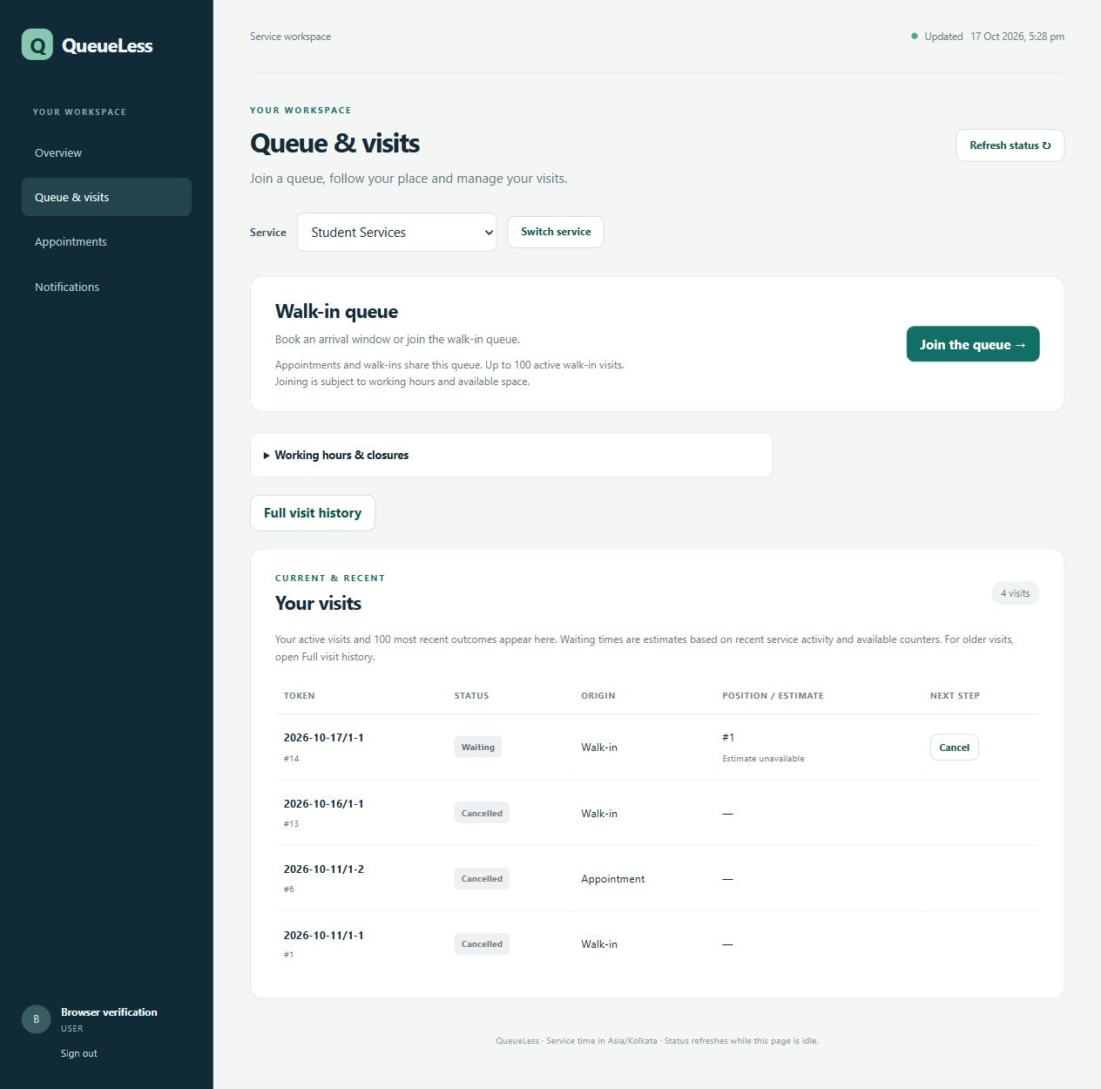
Visit status and history
Waiting position, visit origin and available actions
04
Notes:
Source screenshot: C:/Users/Rishit/Documents/ChatGPT/Queueless/.local/evidence/visits-focused.png
Recorded 17 October 2026. This slide shows a detail crop of the lower visit table. The screenshot preserves the original captured state and labels.

Slide 5
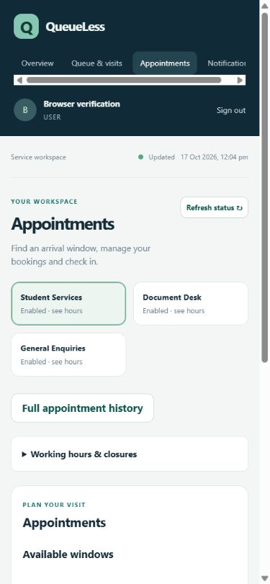
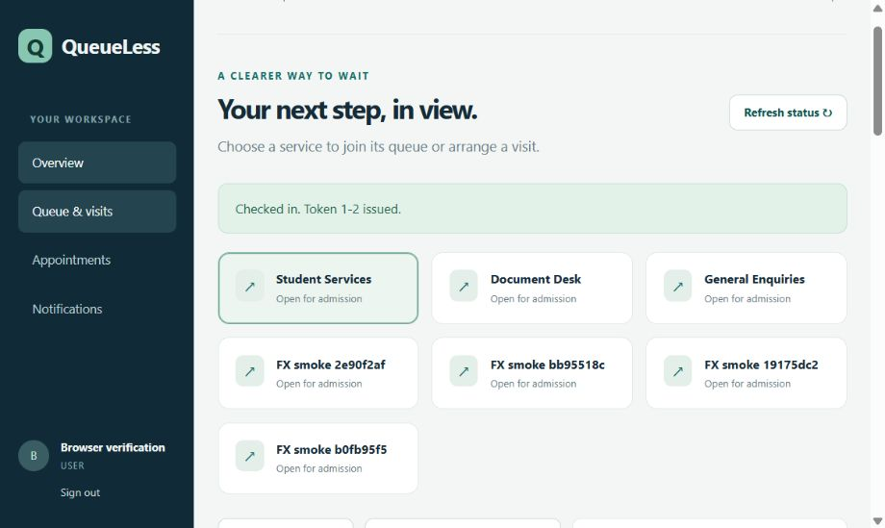
Appointments and check-in
The appointment page on mobile and a recorded check-in confirmation
Check-in confirmation
Earlier test capture, 11 October 2026
05
Notes:
Sources: C:/Users/Rishit/Documents/ChatGPT/Queueless/.local/evidence/separate-appointments-mobile.png (17 October 2026); C:/Users/Rishit/Documents/ChatGPT/Queueless/.local/evidence/browser-appointment-checkin.jpg (11 October 2026).
The earlier desktop capture predates the separate workspace pages and test-fixture cleanup. Its success banner reads "Checked in. Token 1-2 issued." It documents the recorded result, not the current page layout. See docs/verification.md and docs/demonstration.md.

Slide 6
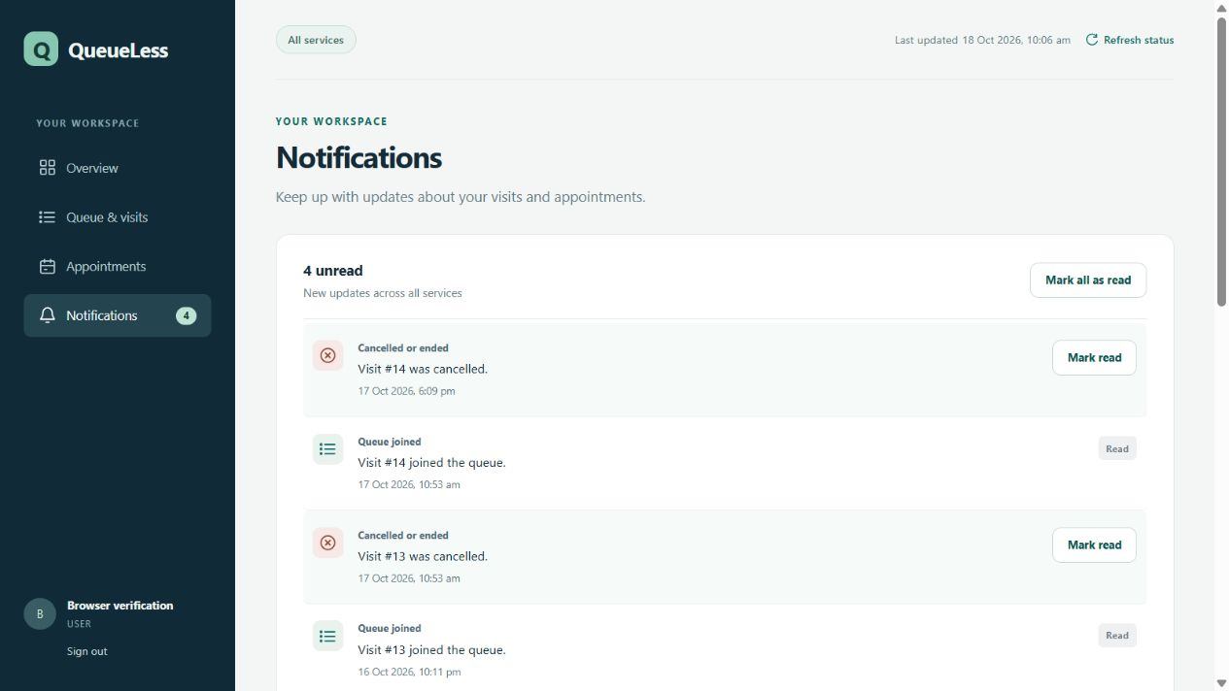
Notifications
Unread counts and controls to mark individual or visible updates as read
06
Notes:
Source screenshot: C:/Users/Rishit/Documents/ChatGPT/Queueless/.local/evidence/ux-notifications.png
Recorded 18 October 2026. This is an internal application inbox. It does not represent email or SMS delivery.

Slide 7
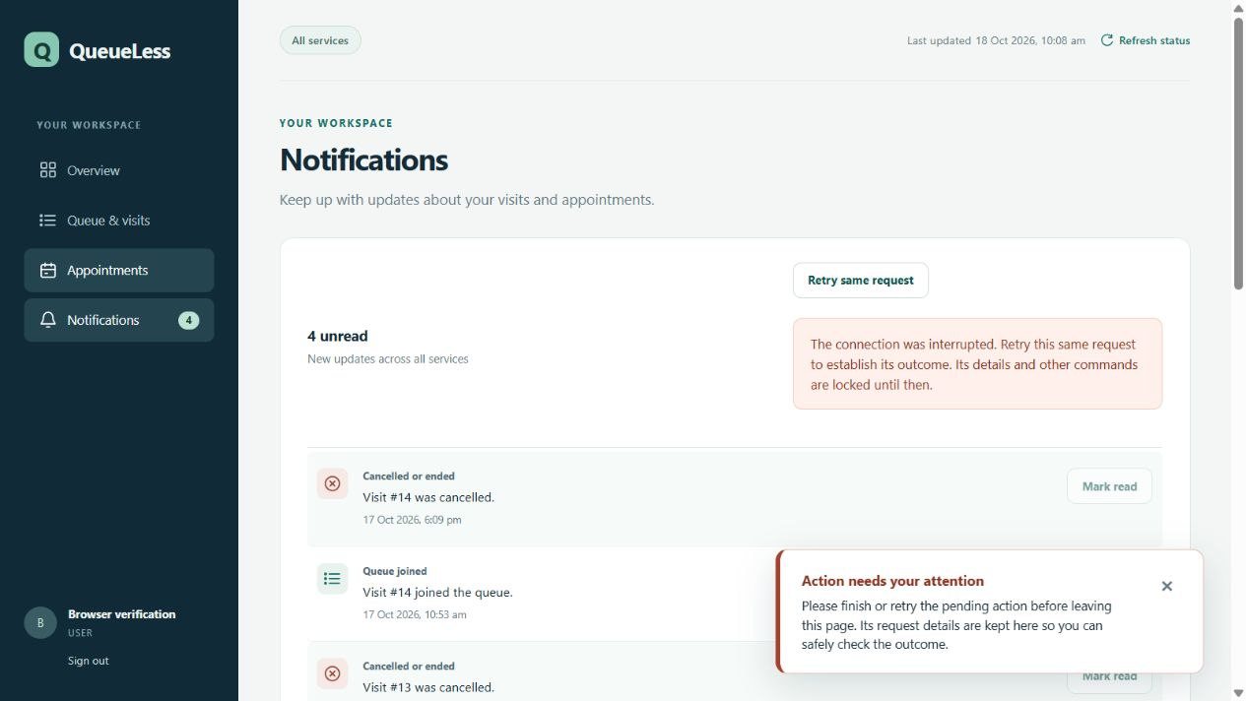
Interrupted request recovery
The page preserves the pending action and offers Retry same request
07
Notes:
Source screenshot: C:/Users/Rishit/Documents/ChatGPT/Queueless/.local/evidence/ux-pending-refresh-protected.png
Recorded 18 October 2026 during an intentional lost-response check. The visible warning blocks other commands until the existing request outcome is resolved. See docs/verification.md.

Slide 8
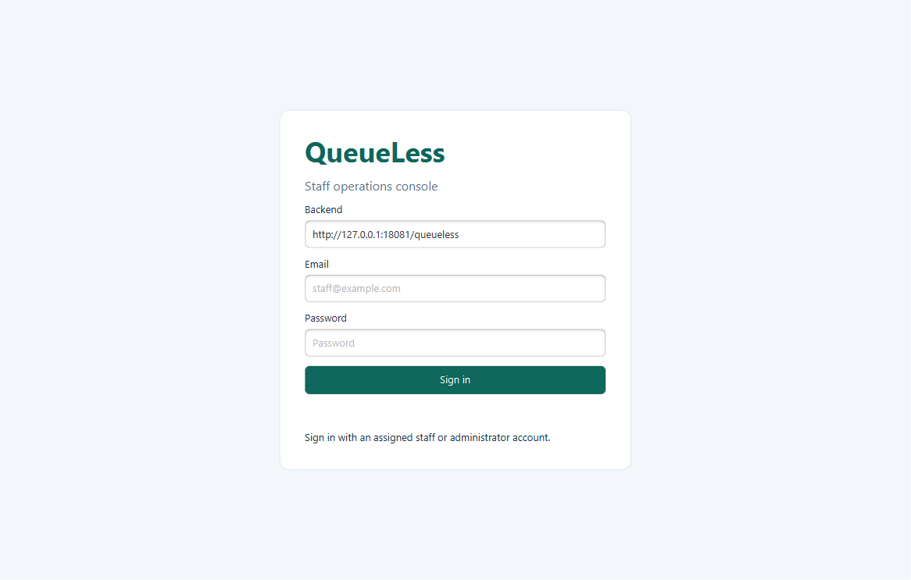
Staff console sign-in
The JavaFX client connects staff to the shared backend
Backend address and staff credentials open the operations console.
08
Notes:
Source screenshot: C:/Users/Rishit/Documents/ChatGPT/Queueless/queueless-desktop/target/fx-smoke/desktop-login.png
Captured 18 October 2026 during isolated JavaFX integration testing. Test fixtures use a separate backend on port 18081 and the dedicated test database.
Source: C:/Users/Rishit/Documents/ChatGPT/Queueless/docs/verification.md
Backend address and staff credentials open the operations console.

Slide 9
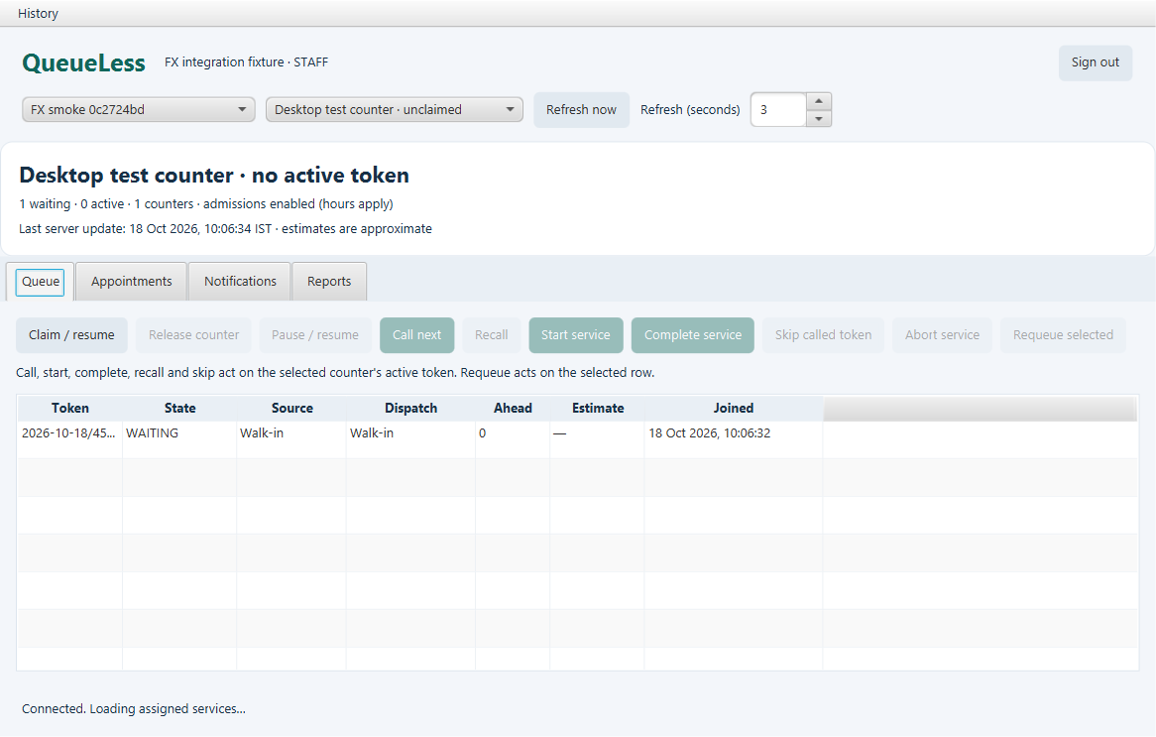
Staff queue before dispatch
JavaFX test console with a waiting visit and an unclaimed counter
One visit is waiting. The counter has no active token.
09
Notes:
Source screenshot: C:/Users/Rishit/Documents/ChatGPT/Queueless/queueless-desktop/target/fx-smoke/desktop-waiting.png
Captured 18 October 2026 during isolated JavaFX integration testing. Test fixtures use a separate backend on port 18081 and the dedicated test database.
Source: C:/Users/Rishit/Documents/ChatGPT/Queueless/docs/verification.md
One visit is waiting. The counter has no active token.

Slide 10
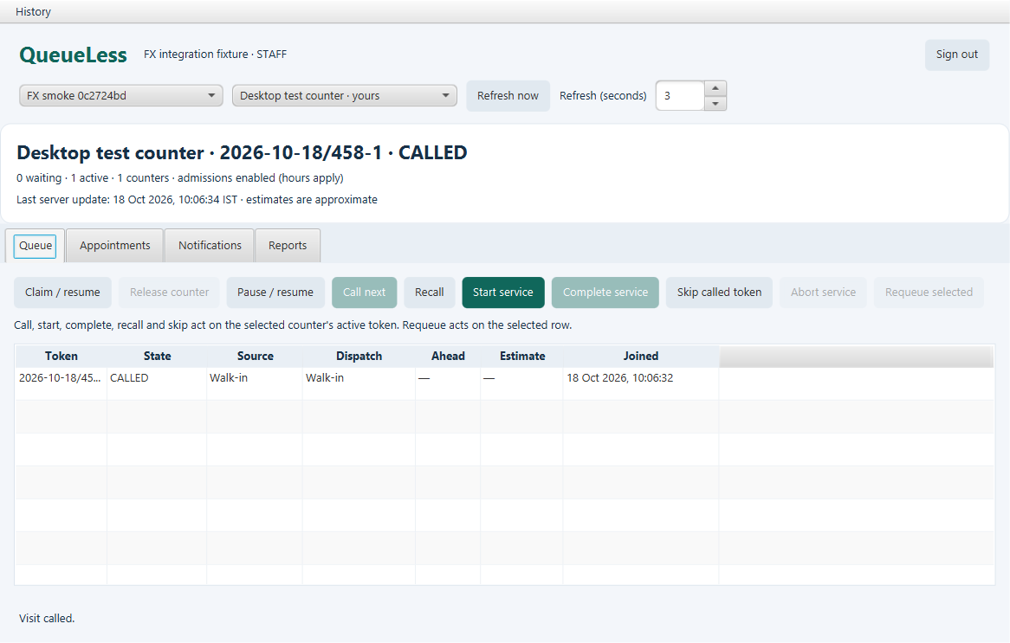
Called visit
JavaFX test console after Call next
The visit is CALLED. Start service is available for the claimed counter.
10
Notes:
Source screenshot: C:/Users/Rishit/Documents/ChatGPT/Queueless/queueless-desktop/target/fx-smoke/desktop-called.png
Captured 18 October 2026 during isolated JavaFX integration testing. Test fixtures use a separate backend on port 18081 and the dedicated test database.
Source: C:/Users/Rishit/Documents/ChatGPT/Queueless/docs/verification.md
The visit is CALLED. Start service is available for the claimed counter.

Slide 11
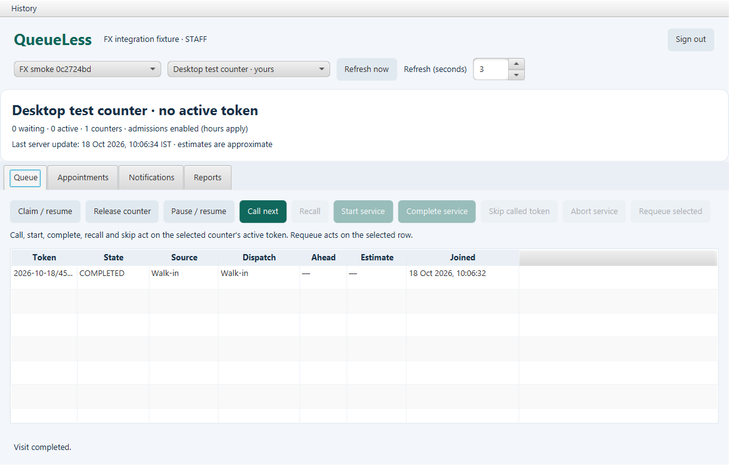
Completed visit
JavaFX test console after service completion
The row shows COMPLETED. The counter has no active token.
11
Notes:
Source screenshot: C:/Users/Rishit/Documents/ChatGPT/Queueless/queueless-desktop/target/fx-smoke/desktop-completed.png
Captured 18 October 2026 during isolated JavaFX integration testing. Test fixtures use a separate backend on port 18081 and the dedicated test database.
Source: C:/Users/Rishit/Documents/ChatGPT/Queueless/docs/verification.md
The row shows COMPLETED. The counter has no active token.

