Slide 1
TCO Case Study:
Credit Card (CC) Transaction for a Bank
Ferri Marco 0299859

Slide 2
UC environment and TPS description
In this Use Case the Conceptual Transaction requires:
Validation:
Check the CC
Check the POS
Check money amount:
For single transaction
For other limits such as monthly or daily
Security:
Check if transaction is suspect
Check if the POS type require a second identification step
At the End:
Check complete successfully
Issue OK or abort storing the attempt
Assumptions:
In this Case Study let’s assume that:
An x86 core is able to perform 20 TPS of the Conceptual Transactions
A LinuxONE core is able to perform 200 TPS of the Conceptual Transactions

Slide 3
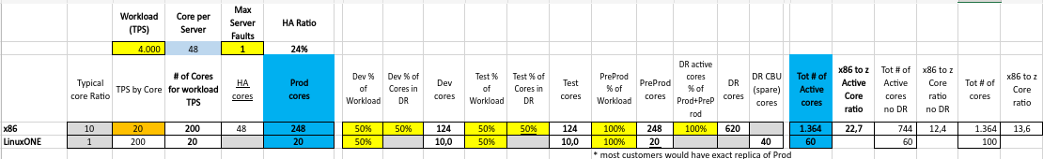
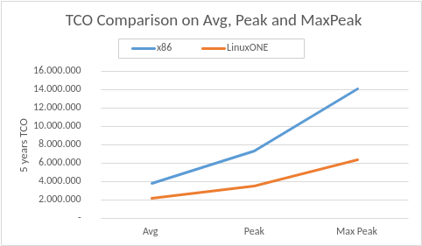
Sizing
Workload considered is the Max Peak. Avg (1000 TPS) doesn’t handle any peak, Peak (2000 TPS) works fine for 90% of time but Max Peak (4000 TPS) works always fine although it costs much. Furthermore Max Peak is required to be handled and stressing Test at Max Peak is required for any new Release.Considering MaxPeak there is an overprovisioning, but we can assume to use Statistical Multiplexing in order to maximize utilization . The original file has been modified in order to select the amount of cores of Test and Dev Environments for DR as reported in NFR-3 and rates are calculated from full Prod size (Prod cores, NFR-4 ) . Pre-Production has the same size of the Production Environment
Notice how prices grow using Avg, Peak and Max Peak.
In particular for x86 the prices are always higher than for LinuxONE.

Slide 4
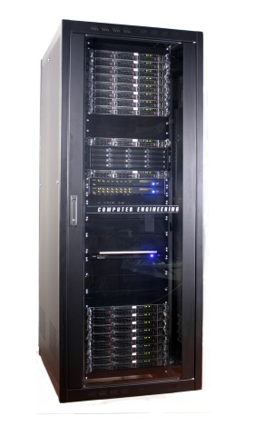

Technical Architecture
SITE 1
SITE 2
x86:
Site 2 is used only for DR.
As reported in NFR-3 DR must ensure 100% Prod, 100% PreProd, 50% Test and 50% Dev. In total DR has 620 extra cores.
Prod PreProd Test Dev
248 cores 248 cores 124 cores 124 cores
DR
620 cores
LinuxONE:
This architecture ensure NFR-3 optimizing cores better than x86 architecture. In case of disaster SITE 2 can use Spare CBU for Production Env and half of Test’s cores for Dev (needed at 50%). Without disasters each site has also 20 Spare CBU.
Prod Dev Spare
20 cores 10 cores 20 CBU
PreProd Test Spare
20 cores 10 cores 20 CBU

Slide 5
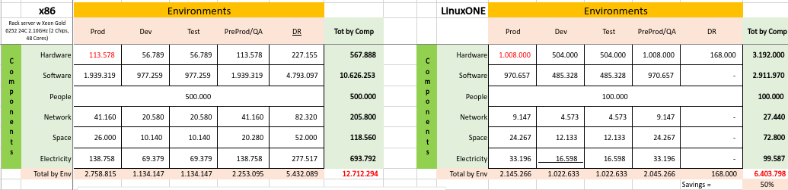
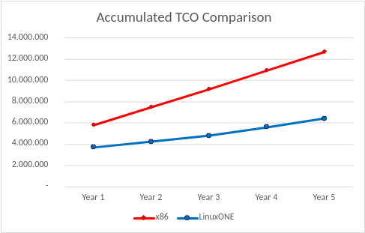
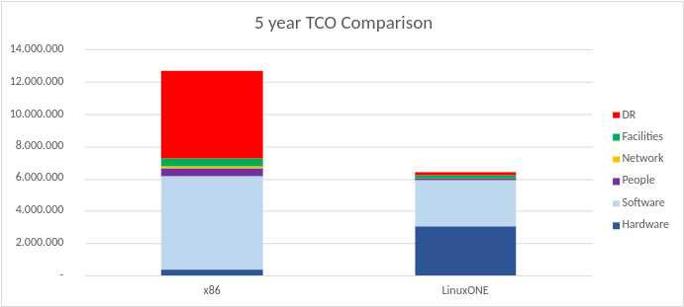
TCO Comparison on 5 years
The above TCO summary schema shows that adopting LinuxONE platform we save 50% than the x86 platform. In particular the below diagram shows that from Year 1 to Year 5 LinuxONE platform costs always less than the equivalent x86 platform. This suggest us that LinuxONE platform could be better also for Enterprise systems designed to work for a few years.
Impacting costs:
Most impacting costs for LinuxONE are Software and Hardware while for x86 are DR and Software, but x86 Software is about x5 LinuxONE Software. The biggest difference is in DR cost.

Slide 6
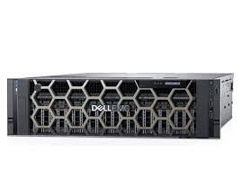
x86 TCO Assumption
Hardware:
Rack server w Xeon Gold 6252 24C 2.10GHz(2 Chips, 48 Cores)
Acquisition cost: 21K€-37% discount including 3 years Support
Support for following years is 20% of acquisition cost
Network:
7K€ per Server -30% discount. Maint 10% of purchase price from year 2
People:
One FTE covers 30 servers
Average yearly costs=100K€
Space:
Fully loaded cost of Sq.meter=2.600€
Electricity:
Cost per kWh=0.48€
Software:
OS: subscription 2K€ /year -20%disc per socket
VM: license 5K€ /socket -20% disc maint 20% of purchase price from year 2
Application Server (Web Sphere): license 47€/PVU -75% disc (100 PVU per core) maint 20% of purchase price from year 2
DB (Microsoft SQL): license 11.626€ for 2 cores -75% disc maint 20% purchase price from year 1
Data Replication Tools: subscription 3K€/year -75% disc per core
Monitoring Tools: license 5K€/server -40% disc maint 20 % of purchase price from year 2
Security Tools: license 5K€/server -40% disc maint 20% of purchase price from year 2

Slide 7
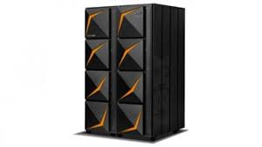
LinuxONE TCO Assumption
Hardware:
LinuxONE servers 1900K€-30% discMaint 10% of purchase price from year 4
Network:
14K€ per LinuxONE Server -30% disc
Maint 10% of purchase price from year 4
People:
One FTE covers 10 servers
Average yearly costs=100K€
Space:
Fully loaded cost of Sq.meter=2.800€
Electricity:
Cost per kWh=0.48€
Software:
OS: subscription 6K€ /year -20%disc per socket
VM: included in HW
Application Server (Web Sphere): license 47€/PVU -50% disc (120 PVU per core) maint 20% of purchase price from year 2
DB (Microsoft SQL): license 11.626€ per cores -50% disc maint 20% purchase price from year 1
Data Replication Tools: subscription 3K€/year -50% disc per core
Monitoring Tools: license 5K€/server -40% disc maint 20 % of purchase price from year 2
Security Tools: license 5K€/server -40% disc maint 20% of purchase price from year 2

Slide 8
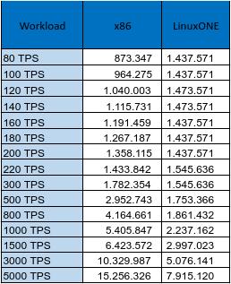
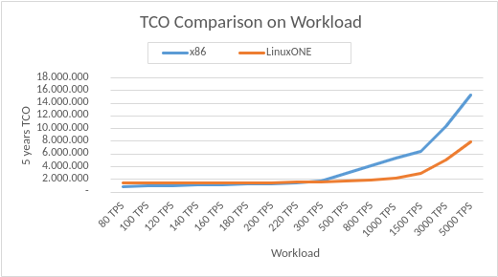
TCO & Workload
As the above table shows for a workload equal to about 220 TPS the two platforms have similar costs.
For all workloads less than 220 TPS the x86 platform results always more convenient than LinuxONE while for workloads greater than 220 TPS the more convenient is the LinuxONE platform. Notice how LinuxONE TCO is constant for every value up to 220 TPS. This because a LinuxONE server is bigger than x86 server and the constant TCO is referred to a single LinuxONE server that can handle up to a workload of 220 TPS.
However the important assumption is that this is the designing of an Enterprise-level solution and all workloads where x86 is better than LinuxONE often don’t characterize this kind of solution because they are too low.

Slide 9
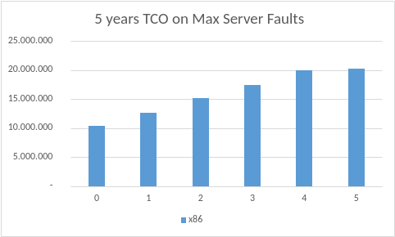
HA and conclusions
Workload 4000 TPS | Max Server Faults | x86 | HA ratio
 | 0 | 10.405.715 | 0%
 | 1 | 12.712.294 | 24%
 | 2 | 15.165.398 | 48%
 | 3 | 17.484.977 | 72%
 | 4 | 19.938.082 | 96%
 | 5 | 20.256.193 | 100%
In order to ensure a good HA level for a x86 are needed extra servers. As shown above the costs increase seems regular and at the end the difference is negligible.
LinuxONE instead provide Spare CBU in order to ensure HA so it doesn’t need extra servers.
Conclusions: in this kind of case study is very important to consider all costs because no one is negligible. From an initial intuition seems that x86 solution is more convenient than LinuxONE but the study told us that this is not true. This because LinuxONE Hardware costs much more than x86 platform but all other costs are much lower than x86. For an Enterprise level solution is required a 24/7 support and also its cost is important in addition to acquisition cost.

