Slide 1
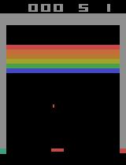
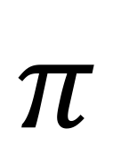
Action | Probability
Move Left | 0.5
Move Right | 0.3
Do Nothing | 0.2
$$π$$

Slide 2
Start
End

Slide 3
 |  |  | -9 | -10 | -11
 | -10 | -9 | -8 |  | -12 | -13
-12 | -11 |  | -7 | -6 |  | -14
 | -12 | -13 |  | -5 |  | -15
 | -13 |  |  | -4 | -3
-15 | -14 |  | -18 |  | -2 | -1
 | -15 | -16 | -17 | -18
Start
End

Slide 4
v(s) = medium
v(s) = high
a_{t}
M(s_{t}, a_{t})
v(s) = high
s_{t}
s_{t+1}

Slide 5
r = 3
Publish Code
Netflix
r = -2
Wake Up
Code & Debug
Deploy
r = 0
r = -3
r = 10
Nap
r = 1

