Slide 1

Basic Details of the Team and Problem Statement
Problem Statement Title: Elimination of Printed Receipts from Parking Like Malls, Supermarkets, etc.
Theme Name: Smart Automation
Team Name: Tech Titans
Team Leader Name: Aadithya S Nair
School Code:830092
School Name: Delhi Public School Bangalore North

Slide 2
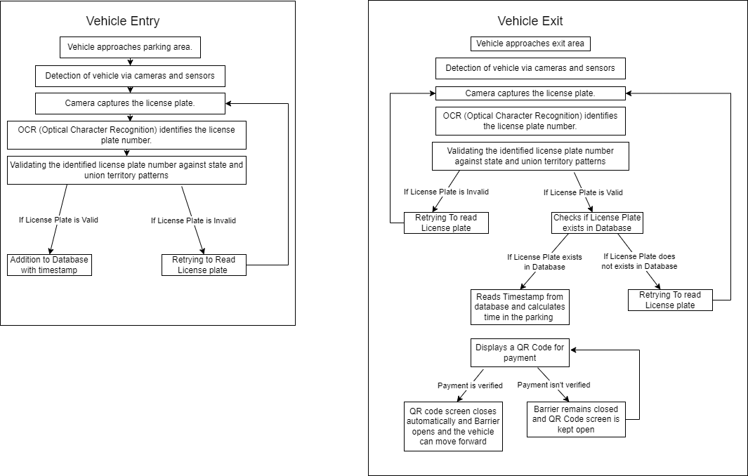
Idea/Approach Details
Idea/Solution
Our System is a groundbreaking advancement in parking solutions. This system leverages cutting-edge technology to provide a unmanned system for collection of parking fees, completely transforming the parking experience. By harnessing the power of computer vision and sophisticated data services, it offers immediate access to crucial information about available parking spaces. With a primary focus on environmental sustainability, this technology-driven solution seeks to elevate the efficiency and convenience of parking facilities, promising a more seamless and eco-conscious experience for users.
Process flow chart
Describe your Technology stack here:
Frontend:(User Interface): HTML5, CSS3, JavaScript (ES6+)
Backend:
  Server-Side Language: Python
  Web Framework: Flask
Database:
  Relational Database: MySQL
Additional Packages Used:
  Computer vision(cv2)
  Pytesseract
  QR code Generator
OCR recognition Engine
  Tesseract OCR

Slide 3
Idea/Approach Details
Describe your Use Cases here
Describe your Dependencies / Show stopper here
Shopping Malls: EazePark can be implemented in shopping malls to streamline the parking process for visitors. It provides real-time information on available parking spaces, reducing the time spent searching for a spot.
Supermarkets: Supermarkets often have high traffic in their parking areas. EazePark helps customers quickly find available spots and provides an efficient way to pay for parking.
Airports: Airports can utilize EazePark to enhance the parking experience for travelers. Real-time tracking and payment options improve efficiency, especially during busy travel times.
Event Venues (Stadiums, Arenas, Concert Halls): During events, parking areas can become congested. EazePark helps attendees locate available spots and pay for parking seamlessly, enhancing the overall event experience.
Dependencies
Hardware Reliability :Ensuring selected hardware (cameras, servers) is compatible and reliable.
Payment System Integration :Establishing seamless integration with external payment systems.
Show Stopper
Data Security: Protecting sensitive information from breaches or unauthorized access.
Scalability Concerns: Ensuring the system can handle increased usage without performance issues.

Slide 4
Team Member Details
Team Leader Name: Aadithya S Nair
Class: 12th Stream: Science Age :17 Gender (M/F): M
Team Member 1 Name: Harry R
Class: 12th Stream: Science Age : 17 Gender (M/F): M
Team Member 2 Name: Niyati Reddy E
Class: 12th Stream: Science Age : 18 Gender (M/F): F
Team Mentor 1 Name: Varsha Vijay
Category :Academic Expertise (AI/ML/Blockchain etc.): AI Domain Experience (in years):9.5

