Slide 1
Analysis of State Spending Differences on Infrastructure
Yuxuan Liu, W. Grant Hayward, Matthew Burns

Slide 2

Abstract
This paper dives into the potential variables that could affect how much a specific state spends on infrastructure in a given year. We estimate in regards to what we believed would be four of the main indicators of state infrastructure spending.These variables include average personal income in the state, average precipitation in a given year for a state, the population density of the state, as well as where the state lies politically. Income is the only variable that had significant results when regressed individually. However, when the variables are regressed altogether, our results are the most significant, meaning that these variables all give us a better estimate of how much a state will spend on infrastructure in a given year.

Slide 3
Why we do the Analysis of State Spending Differences on Infrastructure?
It is essential for every state to address the needs of essential physical and organizational structures in order to keep the state operational and convenient for its citizens. State spending on infrastructure, however, varies drastically from state to state - despite the core goal of every state. These differences exist for any number of reasons, but qualities of states that aren’t directly related to how much a state spends on infrastructure (such as total government revenue) can be analyzed to find a relationship.

Slide 4
State Infrastructure Spending Variable
Because not all states are the same size, we cannot regress our selected variables in terms of total spending on infrastructure.
Our selected variables were regressed in terms of per capita state infrastructure spending averaged throughout the years 2015- 2020.
The variable “TotalCapitalOutlays” in our data refers to the total amount spent on infrastructure by state and local governments per capita, or per person.

Slide 5
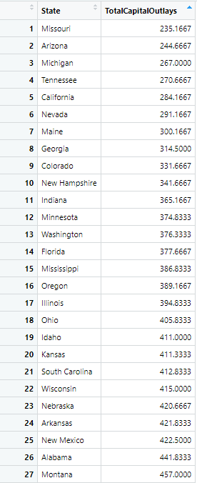
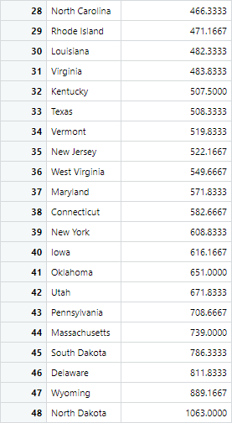

Slide 6
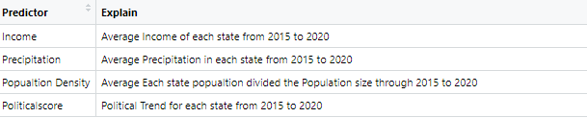
The variables we used

Slide 7
Political Score Variable Explained
((legdemy1 + legdemy2 + legdemy3 + legdemy4)/4)/2+(govy1+ govy2 + govy3 + govy4)/4)/2 = y4Politicalscore
State Political Control
Time to Enact Policies
The Nebraska Problem

Slide 8



Slide 9
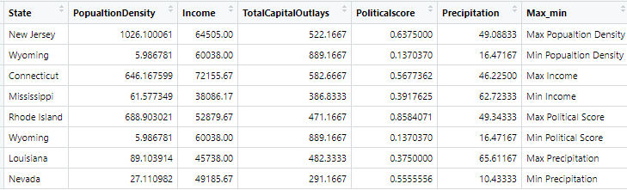
The Max and Min value on each variable

Slide 10
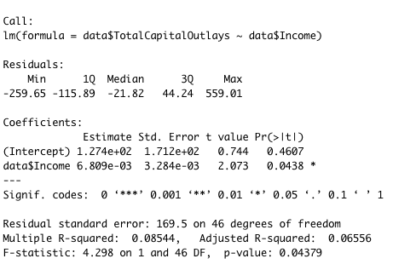
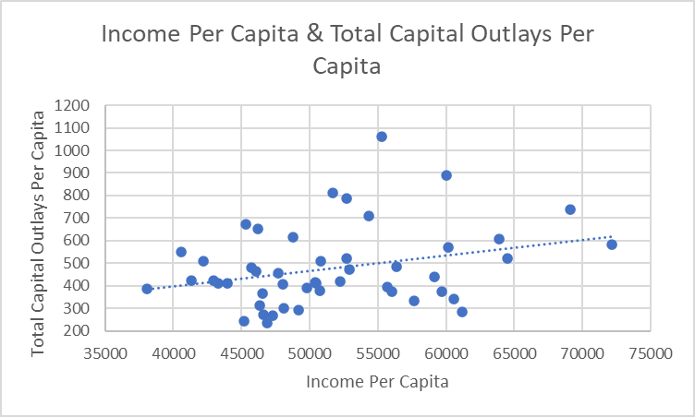
Income Regression
Outliers: Connecticut

Slide 11
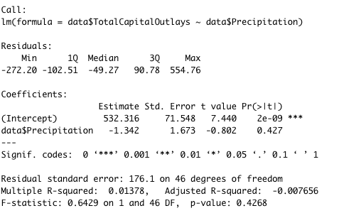
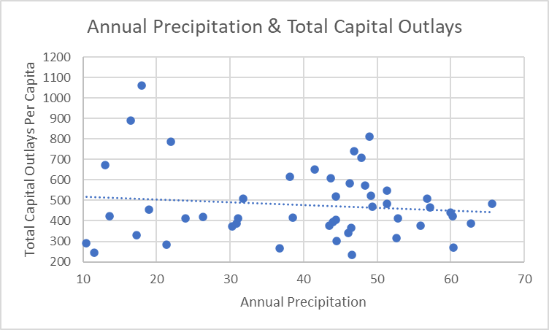
Precipitation Regression
Outliers: North Dakota, Wyoming, Utah, South Dakota

Slide 12
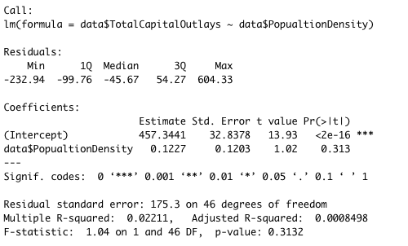
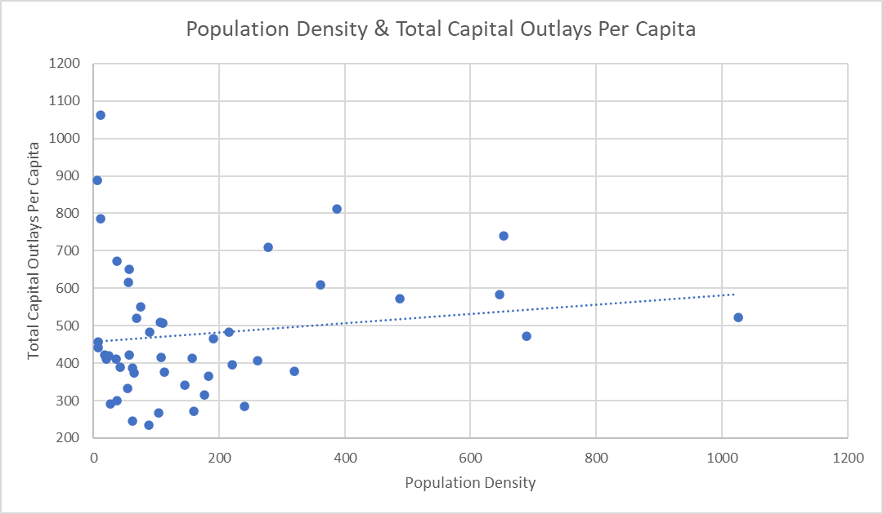
Population Density Regression
Outliers: North Dakota, New Jersey, Wyoming

Slide 13
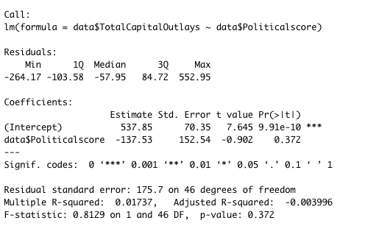
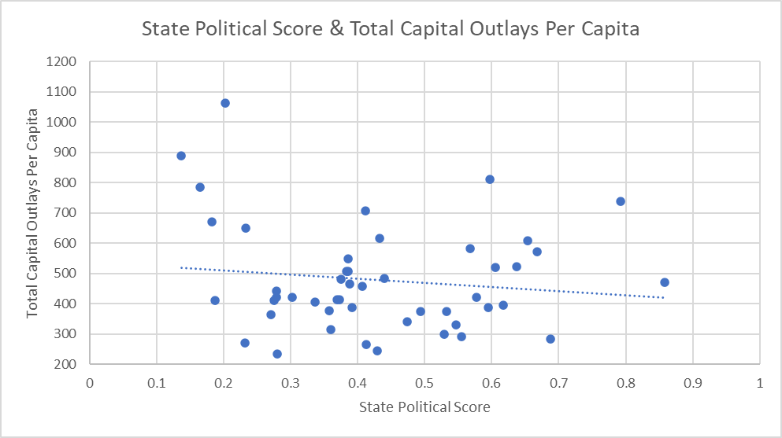
Political Score Regression
Outliers: Wyoming, North Dakota, Rhode Island

Slide 14
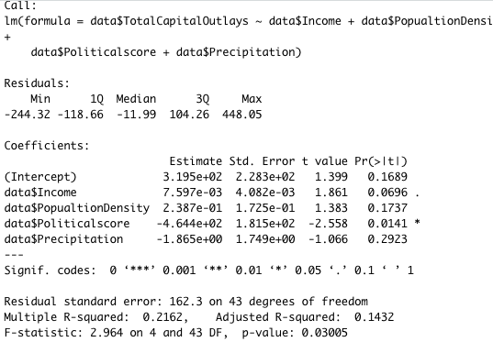
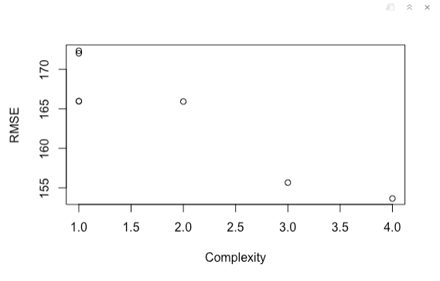
Multiple Regression

Slide 15
Potential Error in the Analysis
The political score variable is a combination of a binary variable and a continuous variable. That could be part of the reason why the variable runs strangely in the regression.
Our precipitation variable weighed snow and rain the same, even though an inch of rain is not the equivalent of an inch of snow. We intended to put a heavier emphasis on the states that receive more snow.

Slide 16
Potential Variable Changes
Wyoming and North Dakota were frequently outliers for our chosen data. We would be curious to run the same regressions excluding these states and seeing if the results become more significant.
Doing snow precipitation data separately from total precipitation might give us a better idea of how winter weather affects infrastructure spending.
Using political score as one binary variable could give more significant results.

Slide 17
Thank You!!
Questions?

