Slide 1

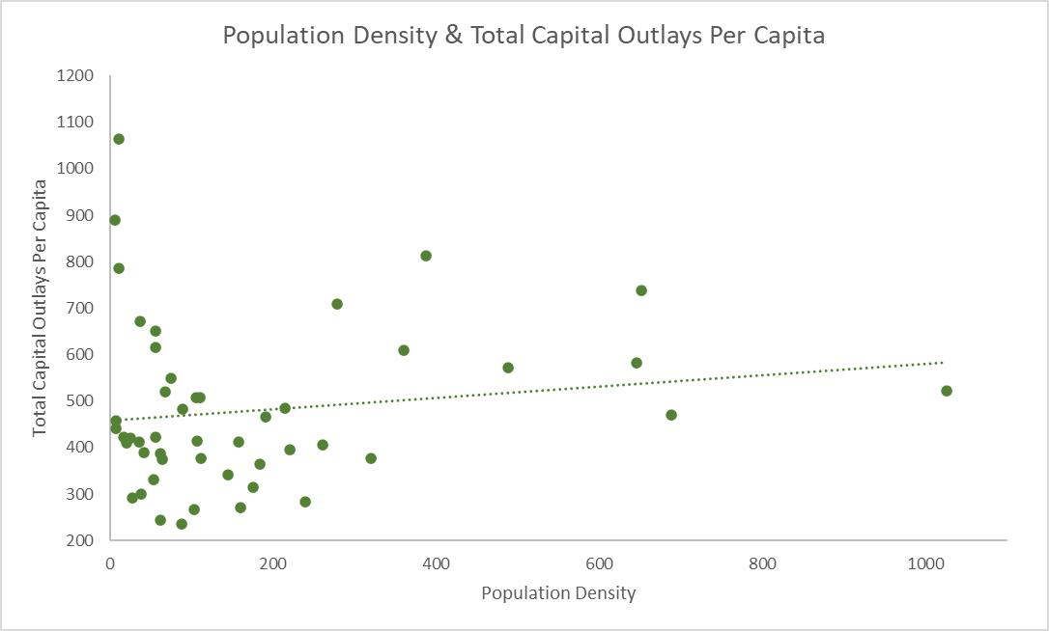
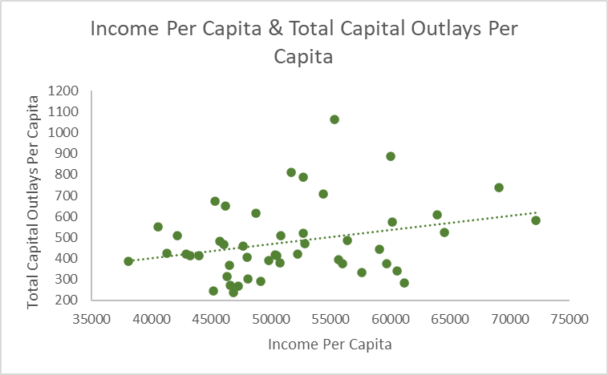
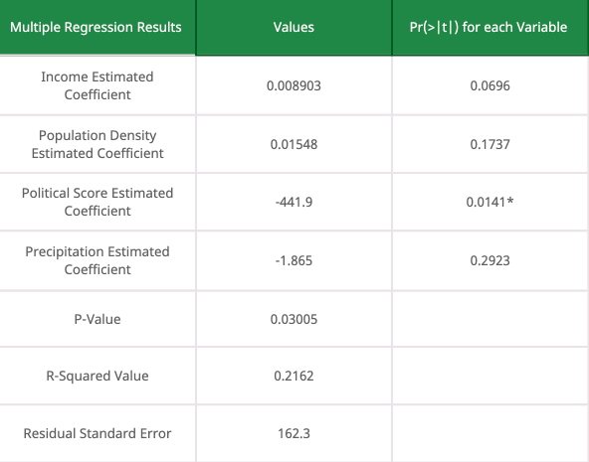
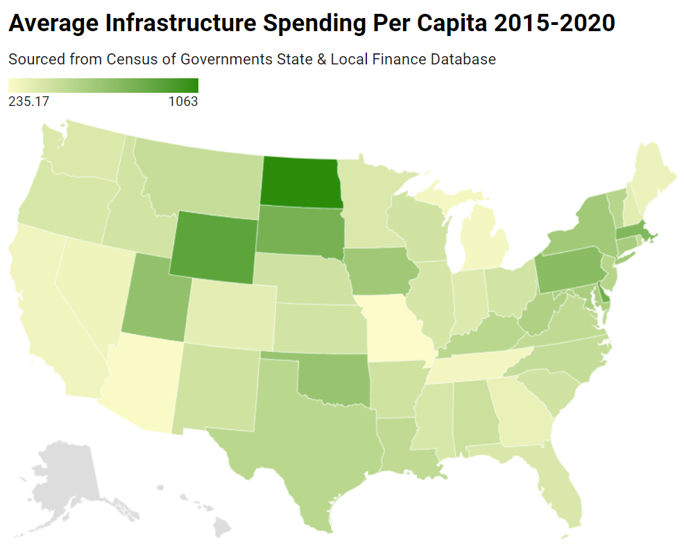
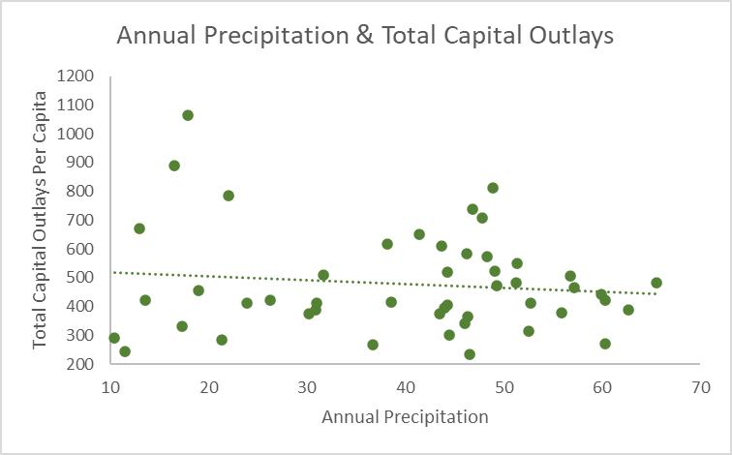
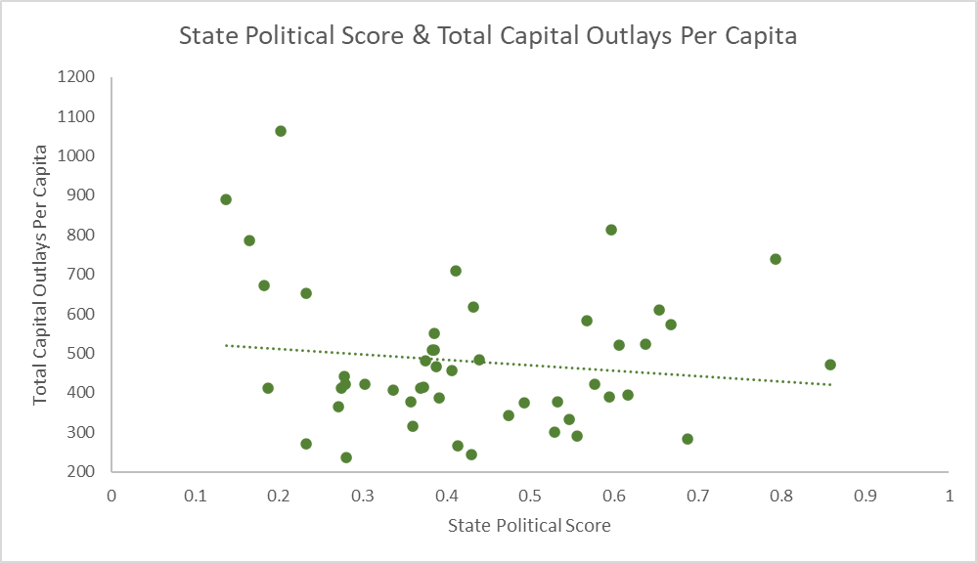
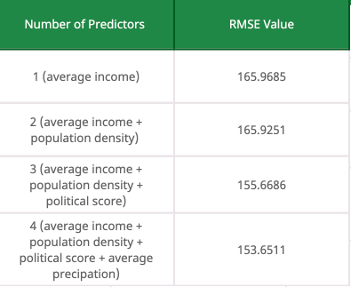
Analysis of State Spending Differences on Infrastructure 2015-2020
Yuxuan Liu, W. Grant Hayward, Matthew Burns
EC 499 - Professor Ronald Fisher
Research Question
How do the variables of Precipitation, Average Personal Income, Population Density, and State Political Score impact State Total Capital Outlays from 2015-2020.
All calculations and regressions run in R-Studio
Population Density
Average Personal Income
Multiple Regression Results
Estimated Coefficient: 0.1227 R-Squared: 0.02211 P-Value: 0.3132
Outliers: North Dakota, New Jersey, Wyoming
Estimated Coefficient: 0.006809 R-Squared: 0.08544 P-Value: 0.04379
Outliers: Connecticut
State Infrastructure Spending (per capita) = 0.007597 * (average income) + 0.2837 * (population density) - 464.4 * (political score) - 1.865 * (average precipitation)+319.5
Precipitation
State Political Score
Data Sources
Average Personal Income - US Bureau of Economic Analysis
Population Density - US Census Bureau, & Iowa State University
Precipitation - The National Centers for Environmental Information
State Political Score - National Conference of State Legislatures, and National Governors Association
Estimated Coefficient: -1.342 R-Squared: 0.01378 P-Value: 0.4268
Outliers: North Dakota, South Dakota, Utah, Wyoming
Estimated Coefficient: -137.53
R-Squared: 0.01737 P-Value: 0.372
Outliers: Wyoming, North Dakota, Rhode Island
Equation: ((legdemy1 + legdemy2 + legdemy3 + legdemy4)/4)/2+(govy1+ govy2 + govy3 + govy4)/4)/2 = y4Politicalscore
legdemy1 = % of the state legislature that the Democratic party controls in year 1
govy1 = binary variable in year 1; 0 if member of Republican party, 1 if member of Democratic party
Conclusion
Our variables regressed together accounted for 21.62% of State Total Capital Outlays per capita from 2015-2020

