Slide 1
the difference of each state’s expenidture of infrastructure
Yuxuan Liu

Slide 2


Abstract
This is a research about what variable will influence the expenidture of infrastructure of each state

Slide 3
Abstract
I believed would be four of the main indicators of state infrastructure spending. These variables include average personal income in the state, average precipitation in a given year for a state, the population density of the state, and the Political Score.

Slide 4
The data I choose
In order to make sure the predict result is accurate enough,I choose the data from 2015 to 2020
the Predictor we use to predict the spending of Infrastructure should be the non-correlation variable with other indenpendent variable

Slide 5
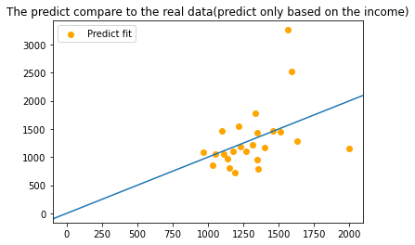
the regression model based on income
R squared =
0.16667385145402647

Slide 6
Regression1
is the predict capitaloutlay based on the average income of each state,but from the plot ,we can’t clearly find that the relationship between capitaloutlay and Income .But the R suared is 0.17,that prove the income is a important variable for Capital Outlay

Slide 7
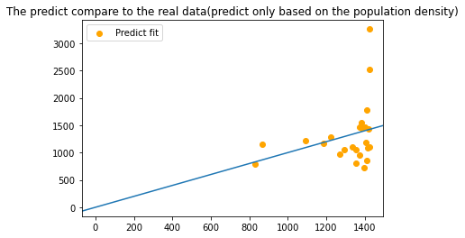
Simple regression based on Populatoin Density
R squared =
0.04658621879020297

Slide 8
Regression2
is the predict capitaloutlay based on the Population Density,the scatter is far away between the idel model(The line),But we got a r_quared is 0.08,that means the population density have some small effect on the capital outlay

Slide 9
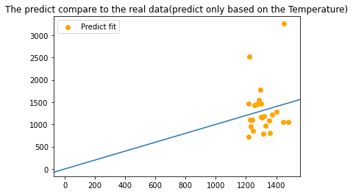
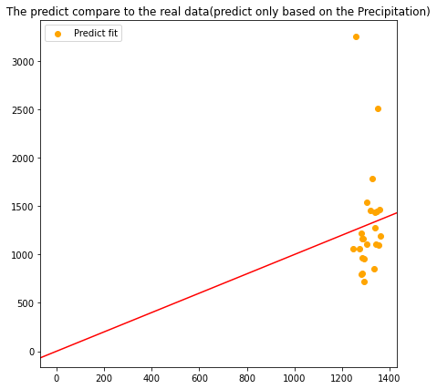
Varibale compare through regression
R squared=2.4522081430999876e-06
R squared =
0.02220514609609181

Slide 10
these 2 regression is based on the different variables ,the First is Temperature and r squared is 0.00002the second is Precipitation(water level by the rain and snow) and r squared is 0.02,is bigger than temperature one
so Precipitationis a better variable than Temperature to represent Weather

Slide 11
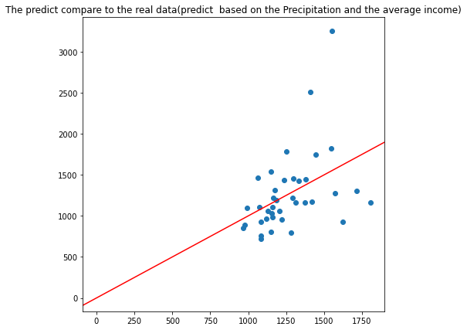
Simple regression 4
R
R squared = 0.1787683627998019

Slide 12
In this regression, we put the Income with Precipitation into the function,then the r squared is about 0.2,but the shape of the scatter is not very close the idel line plot

Slide 13
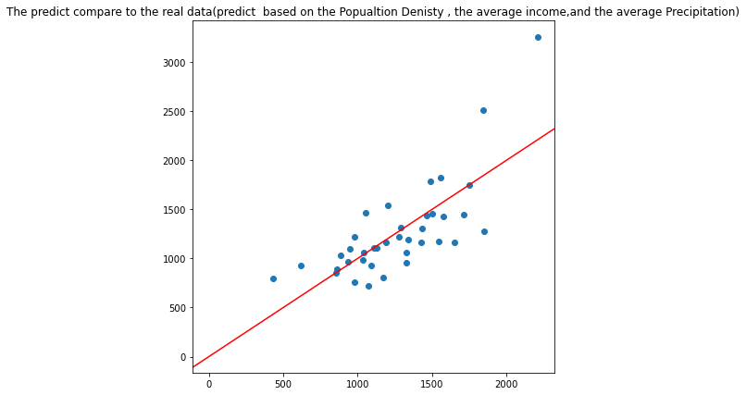
Simple regression 5
R squared = 0.5635816910768189

Slide 14
In this regression,I use the popualtion density(population/size),the income and temperature
the R squared is 0.56 ,is very strong,we can clearly find that the plot have obvisoulsy trend and similar to the idel line

Slide 15
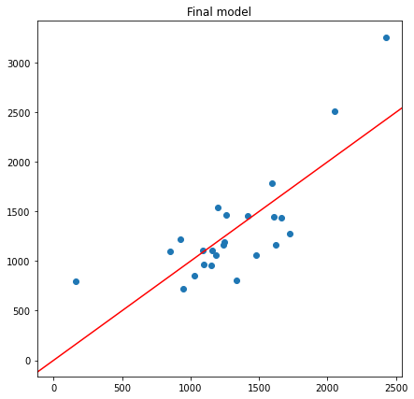
final model
r squared =0.5519590704744184

Slide 16
In this regression,I add the Political score as a new variable in regression,the r squared is 0.5519590704744184

Slide 17
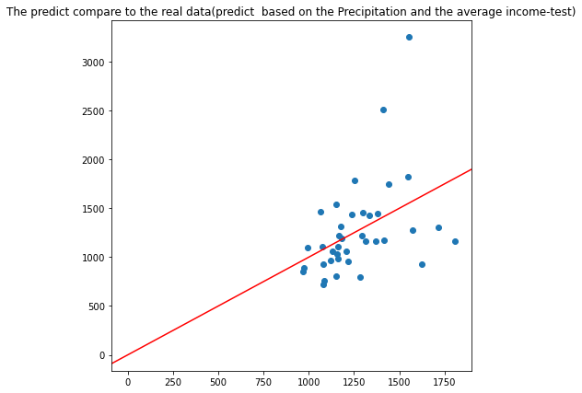
Test Regression
R squared = -0.06521943906510286

Slide 18
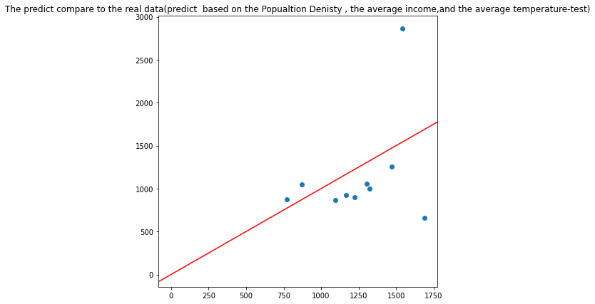
R suqared =
0.06356640654083567

Slide 19
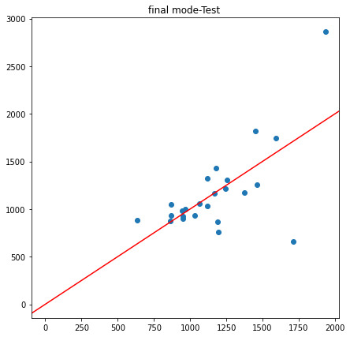
R squared =
0.23970698294275372

Slide 20
from the test regression we can find ,that the test R _squared is not as big as the train one ,I think this is because we don’t have enough data to train the model, if we increase the train number,the r squared of test should increase

Slide 21
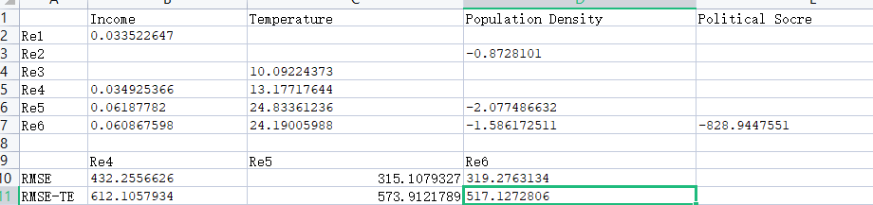
Second table show the RMSE of test data and train data, we can find that the RMSE prove that as the predictor increase the model is better fit to the idel line
this table show the parameter of each variable in train data frame and test data frame.The weired thing is in train data the temperature is positive with capitaloutlay,but in test data it become negaitve.

Slide 22
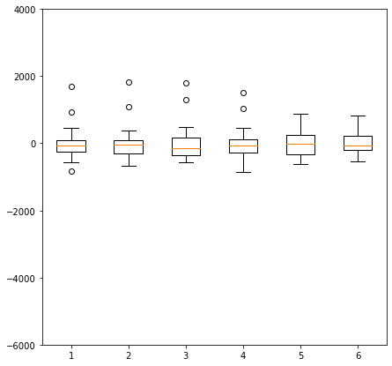

Slide 23
this is the boxplot show the residual of train data,as we can see that as the increase of the predictor number ,the residula’s range decrease and the outliner is disappear,that mean our model can explain more about the exact data of capital outlay

Slide 24
Problems
the test and train r squared have big difference ,may cause by not enough data in the train dataset
the parameter of temperature is changed from positive to negative
So i think the data may have some problem or the code I used to split the train data and test data have problem.

Slide 25
Result
Through the several model, we can find a conclusion that the Expenidture on Infrastructure is been influenced by Population density,Temperature,Income and Political Score.But there are more variable that may influence it.

