Slide 1



Master of Science Music and Acoustic Engineering
Computer Music – Languages and Systems
Homework 1:
Musical Genre Classification
GROUP 16
Zaccaria Carrettoni
Lorenzo Lellini
Luca Sorini
Alessandro Zullo

Slide 2
MUSIC GENRE CLASSIFICATION
2
Dataset of audio files
Genre classification
Blues
Reggae
High-level features of music
Low-level features of frequency and time domain
Hip-Hop
Metal
POLITECNICO DI MILANO HW1 CMLS – Group 16

Slide 3

RELATIONSHIP BETWEEN LOW-LEVEL AND HIGH-LEVEL FEATURES
2
Support Vector Machine (SVM) model to fill the semantic gap between the low-level features of frequency and time domain and the high-level features of music
Genre annotations
Training
Dataset of audio files
Low-level features
SVM
Learned parameters
Audio signal
Testing
Low-level features
SVM
POLITECNICO DI MILANO HW1 CMLS – Group 16

Slide 4

FEATURE DESCRIPTION AND MFCCs COMPUTATION
4
Our auditory system is non linear
The best technique to be used as a features vector representation of human hearing is that of the Mel Frequency Cepstrum Coefficient (MFCCs)
allow us a non linear representation of the frequency spectrum in a logarithmic scale called Mel scale
$$Mel_{freq}=1127.0148\log\left(1+\frac{f\left[\text{Hz}\right]}{700}\right)$$
POLITECNICO DI MILANO HW1 CMLS – Group 16

Slide 5
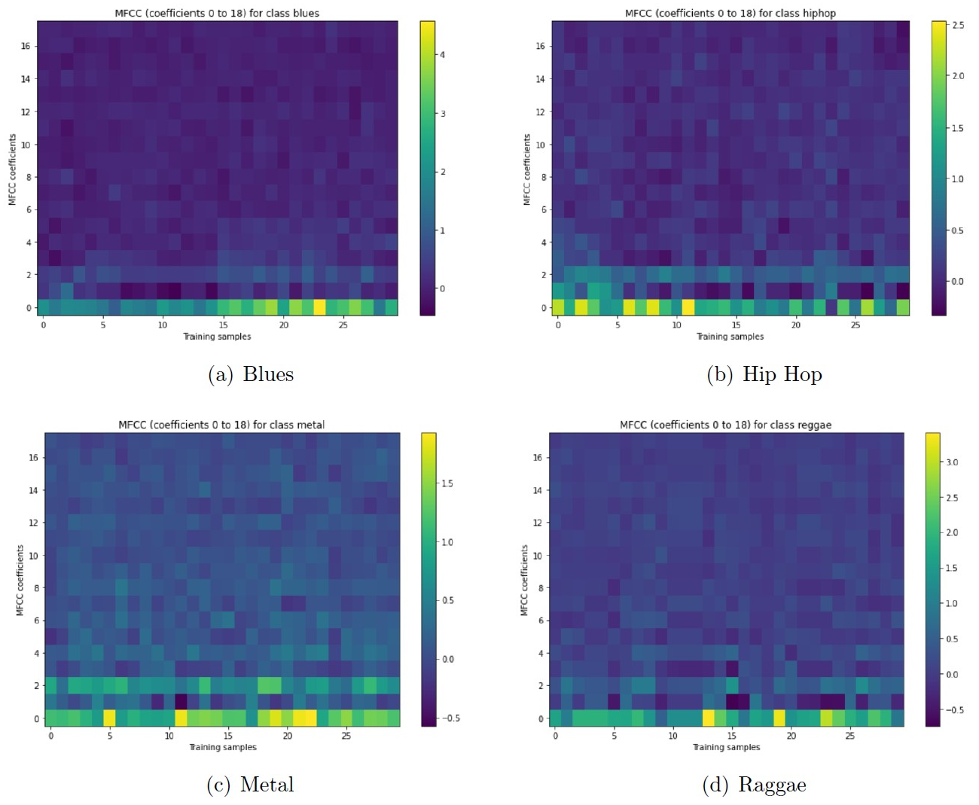
FEATURE VISUALISATION
4
Algorithm implemented to have a viewable feedback from the calculator
Helpful to the user, not to the machine
The code plots the distribution of the cepstrum for each sample
POLITECNICO DI MILANO HW1 CMLS – Group 16

Slide 6
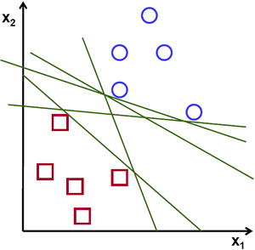
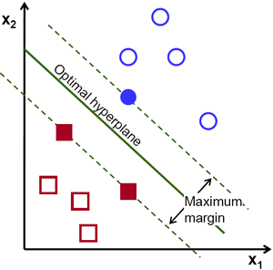
SUPPORT VECTOR MACHINE
5
The objective of the SVM algorithm is to find a hyperplane in a N-dimensional space, where N is the number of features, that distinctly classifies the data points
To separate two classes of data points, there are many hyperplanes that could be chosen
The objective is to find a plane that has the maximum margin, i.e. the maximum distance between data points of both classes
POLITECNICO DI MILANO HW1 CMLS – Group 16

Slide 7
MAJORITY VOTING
6
Blues
Hip-Hop
Metal
Reggae
Training
SVM
SVM
SVM
SVM
SVM
SVM
Blues/Hip-Hop
Blues/Metal
Blues/Reggae
Hip-Hop/Metal
Hip-Hop/Reggae
Metal/Reggae
Audio signal
Testing
SVM
SVM
SVM
SVM
SVM
SVM
Voting
POLITECNICO DI MILANO HW1 CMLS – Group 16

Slide 8
CONFUSION MATRIX AND EVALUATION OF THE RESULTS
3
Confusion matrix to understand the performance of the model
How many times each class is classified as one of the considered classes
 | Blues | Hip-Hop | Metal | Reggae
Blues | 15 | 4 | 1 | 10
Hip-Hop | 1 | 24 | 1 | 4
Metal | 1 | 10 | 15 | 4
Reggae | 3 | 17 | 4 | 6
Accuracy
50 %
80 %
50 %
20 %
The evaluation of the results is not as simple as it seems
Similarities in the typical instrument used or in their musical origins
Subjective nature of genre classification
Sometimes artists merge two or multiple known genres
POLITECNICO DI MILANO HW1 CMLS – Group 16

Slide 9
Master of Science Music and Acoustic Engineering
Computer Music – Languages and Systems
Thanks for your attention!

