Slide 1
BSCS Methods of Research
Final Defense
List of Group Members:
Project Manager : Accad, Glenn Marco B.
Programmer Specialist : Tayag, Jose Mari Christian V.
System Analyst Specialist : Mamauag, Jefferson G.
Quality Assurance Specialist : Gallano, Adrian V.

Slide 2
SANDEE: AN EDUCATIONAL 2D OPEN WORLD SURVIVAL CRAFTING GAME FOR LUA AND PYTHON

Slide 3
Introduction
The demand for Lua developers has grown, particularly in the gaming industry (Crudu, 2024), and Python continues to gain popularity for its easy-to-learn syntax.
Many companies turn to these languages for its superior performance and ease of use.
To address this, the study proposes SandEE, An Educational 2D Open World Survival Crafting Game for Lua and Python designed as an educational tool for learning Lua and Python. The game introduces programming concepts through interactive gameplay, where players write and run code that directly affects the game environment. Embedded interpreters for both languages provide realistic, visual feedback, while a mission system guides learners through progressive challenges, rewarding them as they advance their programming skills.

Slide 4
Background of the Problem
The rapid advancement of technology has significantly transformed educational methodologies. The traditional curriculum for programming languages such as Lua and Python, which often emphasizes theoretical concepts and static exercises, struggles to fully engage students or prepare them for real-world problem-solving.
In contrast, educational games have emerged as an innovative approach to learning. The proponents have conducted a survey with the Grade 11 and Grade 12 ICT and STEM students of Yverdon De Pestallozi School Inc. The results shows that out of 104 students, over 70% are not familiar with Lua. However, the results also show that over 70% of the students are also interested in learning both Lua and Python.

Slide 5
General Problem
How to develop a game to supplement the high interest in learning Lua and Python through a game?

Slide 6
Specific Problem
How to develop a game that enhances programming skills by providing hands-on learning where concepts are learned through experience?
How to develop a game that provides direct visual feedback as players learn and apply programming concepts?
How to develop a game that realistically responds to player errors by embedding Lua and Python interpreters within the system?
How to develop a game that introduces the programming structure and syntax of Lua and Python?

Slide 7
Objectives of the Study
General Objectives
To develop a game to supplement the high interest in learning Lua and Python through a game.
STI College San Jose Del Monte

Slide 8
Specific Objectives
To develop a game that enhances programming skills by providing hands-on learning where concepts are learned through experience.
To develop a game that provides direct visual feedback as players learn and apply programming.
To develop a game that realistically responds to player errors by embedding Lua and Python interpreters within the system.
To develop a game that introduces the programming structure and syntax of Lua and Python.
STI College San Jose Del Monte

Slide 9
Scope and Limitations of the Study
Main Menu
  Start Game
    This will redirect the user to the saves menu to select their desired save or start a new save.
  Settings
    This will redirect the user to the settings panel to adjust the game’s sound volume.
  Quit
    This will close the game.
STI College San Jose Del Monte

Slide 10
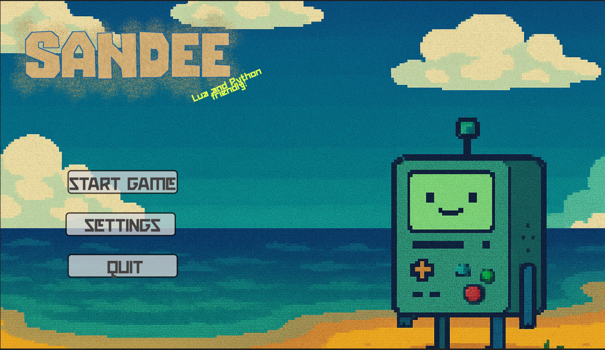
Scope and Limitations of the Study
Main Menu
STI College San Jose Del Monte

Slide 11
Scope and Limitations of the Study
Settings Panel
  Volume Sliders
    BGM Volume
      Adjusts the volume for the background music of the game.
    Effects Volume
      Adjust the volume for the sound effects of the game.
STI College San Jose Del Monte

Slide 12
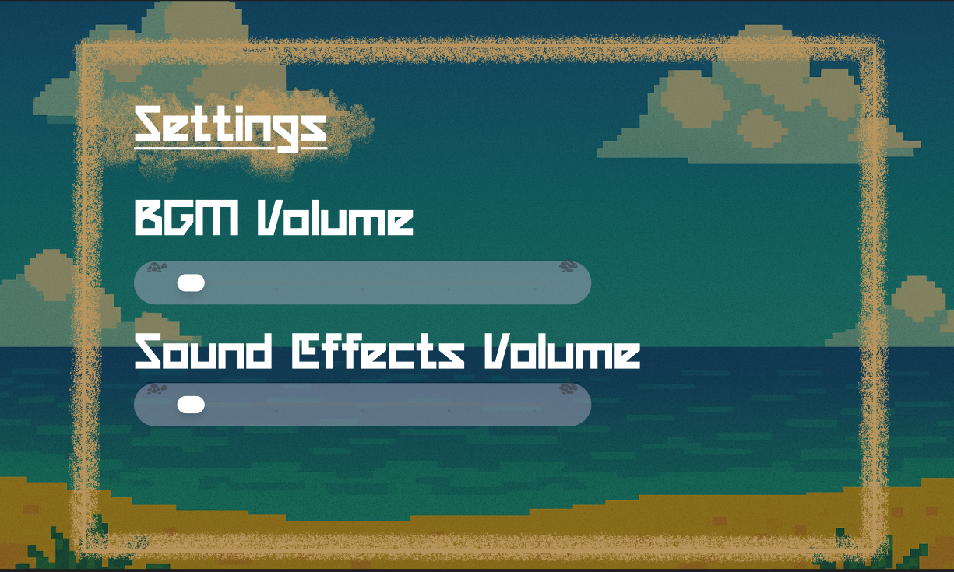
Scope and Limitations of the Study
Settings Panel
STI College San Jose Del Monte

Slide 13
Scope and Limitations of the Study
Saves Menu
  Save Slots
    This allows the user to manage their save states.
Save Slot
  Continue
    Loads the chosen save file to continue its progress.
  Delete
    Deletes the chosen save file.
STI College San Jose Del Monte

Slide 14
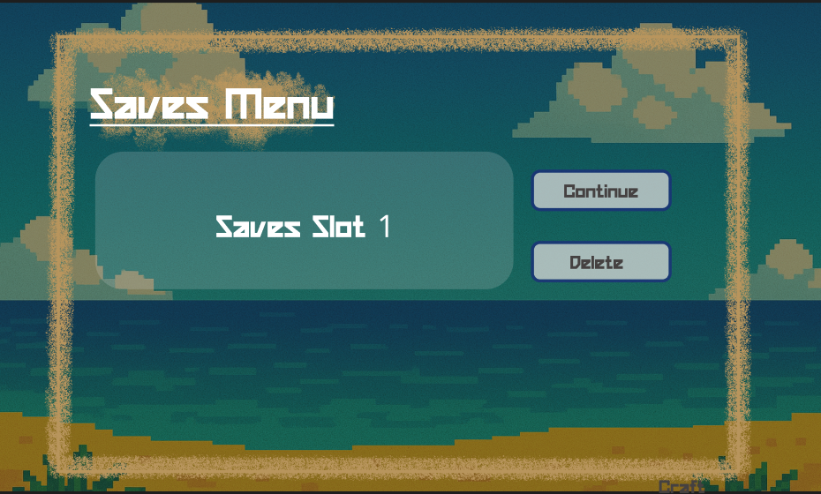
Scope and Limitations of the Study
Saves Menu
STI College San Jose Del Monte

Slide 15
Scope and Limitations of the Study
Game Mechanics
  Missions
    A list of objectives will be shown to help track the user’s progress.
  Crafting
    The user will be crafting various items that improve their current state or progress the missions provided.
  Challenge Areas
    Unlockable areas that serve to give major progress for the user, challenging their skills in Lua or Python programming to unlock more mechanics.
  Automatica
    Robot-like craftables that allow the user to automate certain processes by programming it through Lua, unlockable through the Lua-focused challenge areas.
STI College San Jose Del Monte

Slide 16
Scope and Limitations of the Study
  Algorithmica
    Allows the user to imbue regular items with automation by programming it through Python, unlockable through the Python-focused challenge areas.
  LUA (Live Unit Application)
    An advanced Automatica non-player character that introduces the user in the first few areas helps out the user during the Lua-focused challenge areas.
  Py-san
    An advanced Algorithmica non-player character that introduces the user in the first few areas helps out the user during the Python-focused challenge areas.
  Autosave
    The game will automatically save the player’s progress during important parts of the game, as well as when the player quits.
STI College San Jose Del Monte

Slide 17
Scope and Limitations of the Study
Desktop Application
  HUD (Heads-Up Display)
    Pause
      Allows the user to temporarily pause the game, showing the Pause Menu Panel.
    Pause Menu Panel
      Resume
        Resumes the current game.
      Settings
        Shows the settings panel.
      Quit
        Saves the game and directs the user to the Start Page.
STI College San Jose Del Monte

Slide 18
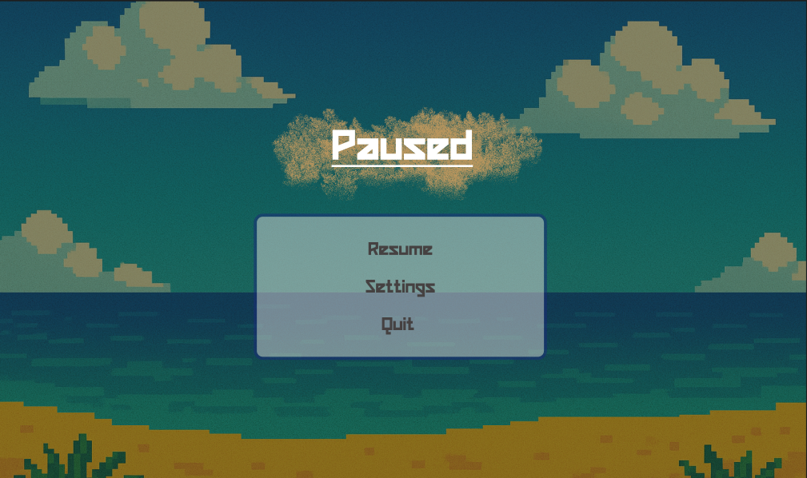
Scope and Limitations of the Study
Pause Menu Panel
STI College San Jose Del Monte

Slide 19
Scope and Limitations of the Study
    Missions Panel
      Shows the user the current missions they can do to progress.
    Health Bar
      Shows the user their current health.
    Hotbar
      Shows the user their current held items.
    Inventory
      Shows the user their extra space and a smaller crafting area.
    Code Editor Panel
      A panel that prompts the user to code in Lua or Python to either progress in a challenge area or customize their Automatica and Algorithmica.
    Crafting Panel
      A panel for more advanced crafting, unlockable when the user crafts the crafting bench.
STI College San Jose Del Monte

Slide 20
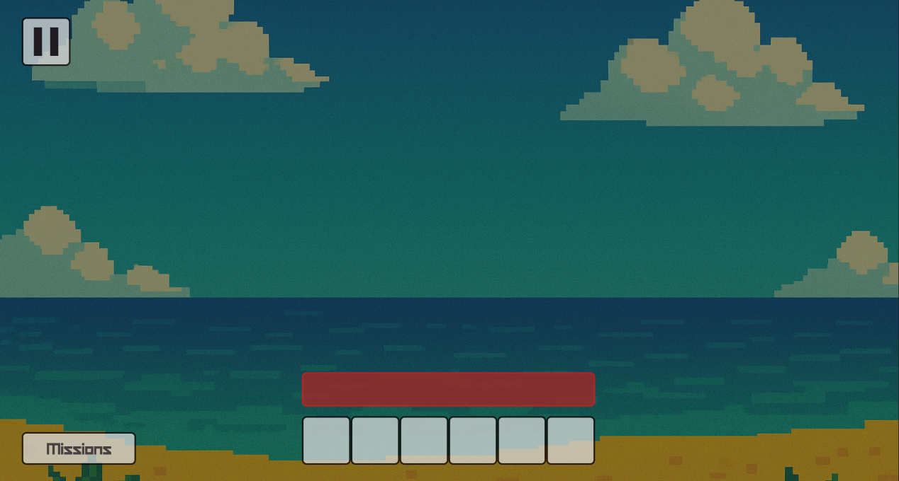
Scope and Limitations of the Study
Desktop HUD
STI College San Jose Del Monte

Slide 21
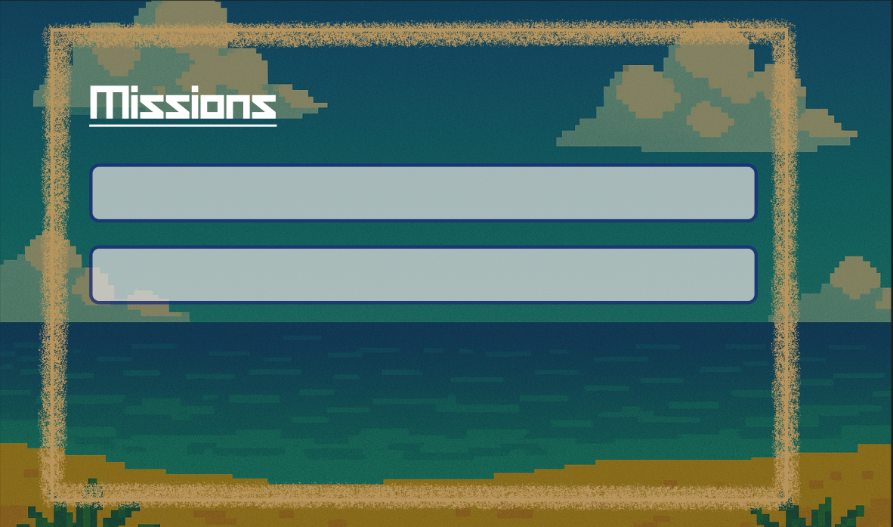
Scope and Limitations of the Study
Missions Panel
STI College San Jose Del Monte

Slide 22
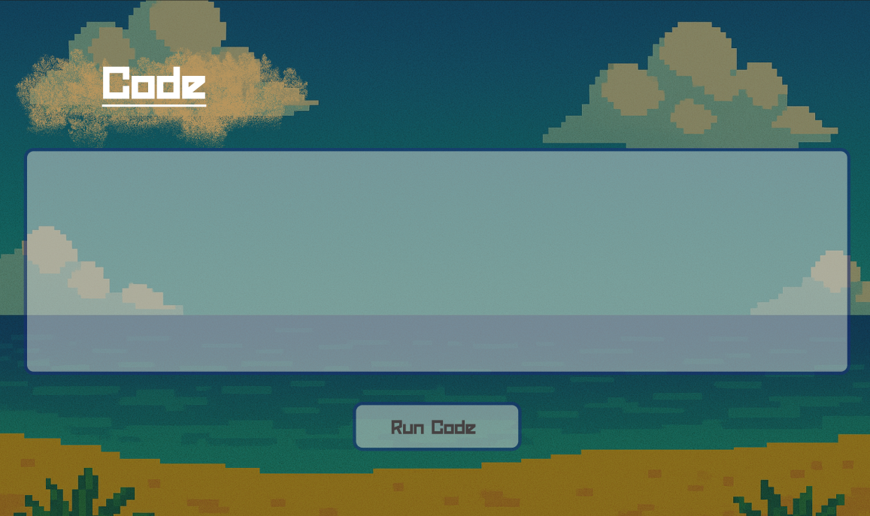
Scope and Limitations of the Study
Code Editor Panel
STI College San Jose Del Monte

Slide 23
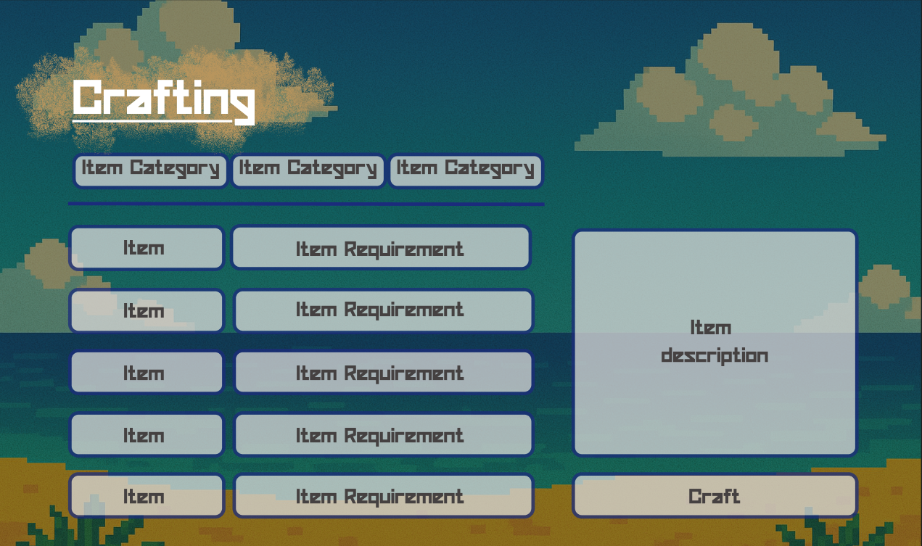
Scope and Limitations of the Study
Crafting Panel
STI College San Jose Del Monte

Slide 24
Scope and Limitations of the Study
Mobile Application
  HUD (Heads-Up Display)
    Pause
      Allows the user to temporarily pause the game, showing the Pause Menu Panel.
    Pause Menu Panel
      Resume
        Resumes the current game.
      Settings
        Shows the settings panel.
      Quit
        Saves the game and directs the user to the Start Page.
    Missions Panel
      Shows the user the current missions they can do to progress.
STI College San Jose Del Monte

Slide 25
Scope and Limitations of the Study
Pause Menu Panel
STI College San Jose Del Monte

Slide 26
Scope and Limitations of the Study
Missions Panel
STI College San Jose Del Monte

Slide 27
Scope and Limitations of the Study
    Health Bar
      Shows the user their current health.
    Hotbar
      Shows the user their current held items.
    Inventory
      Shows the user their extra space and a smaller crafting area.
    Code Editor Panel
      A panel that prompts the user to code in Lua or Python to either progress in a challenge area or customize their Automatica and Algorithmica.
    Crafting Panel
      A panel for more advanced crafting, unlockable when the user crafts the crafting bench.
    On-screen Joystick
      Allows movement for mobile users.
    Interact Button
      A general button that changes depending on the items near the player character.
STI College San Jose Del Monte

Slide 28
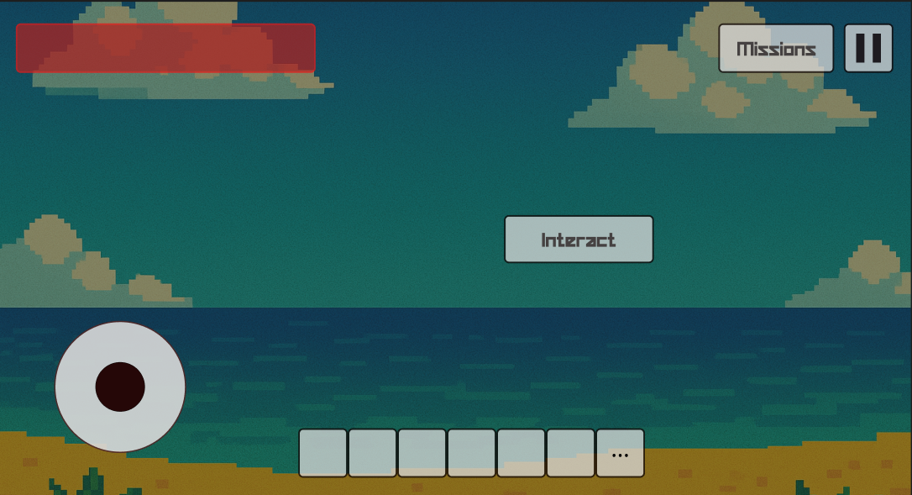
Scope and Limitations of the Study
Mobile HUD
STI College San Jose Del Monte

Slide 29
Scope and Limitations of the Study
Code Editor Panel
STI College San Jose Del Monte

Slide 30
Scope and Limitations of the Study
Crafting Panel
STI College San Jose Del Monte

Slide 31
Scope and Limitations of the Study
Limitations
The game only runs on Windows 10 – 11 and Android 8.0 and above.
The game only supports Lua and Python for its languages.
The game only supports single player.
STI College San Jose Del Monte

Slide 37
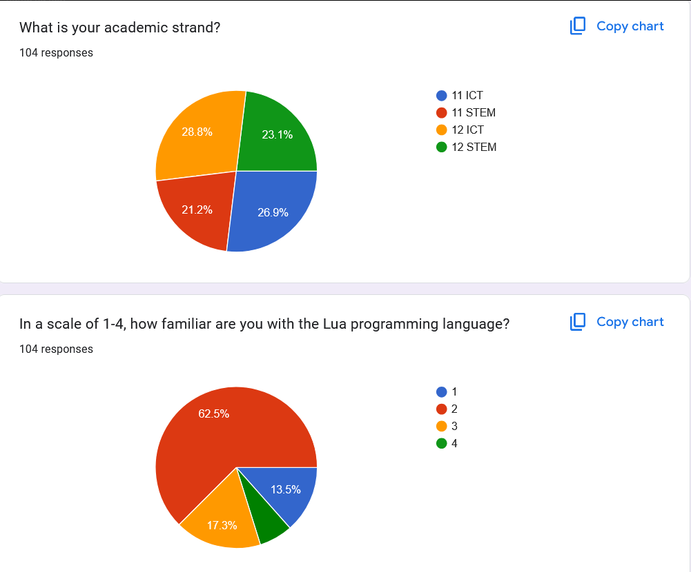
Transcript of Records

Slide 38
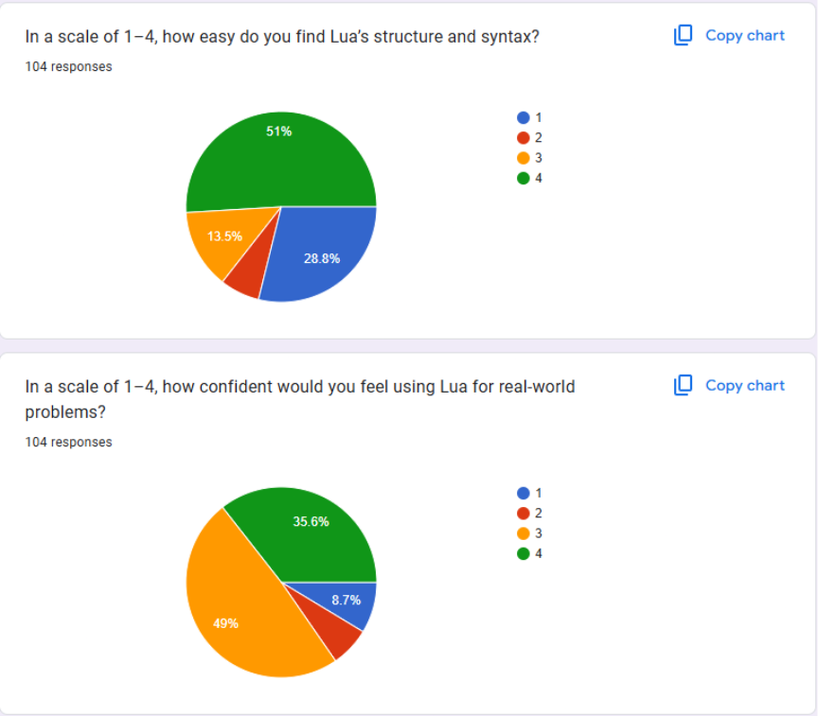
Transcript of Records

Slide 39
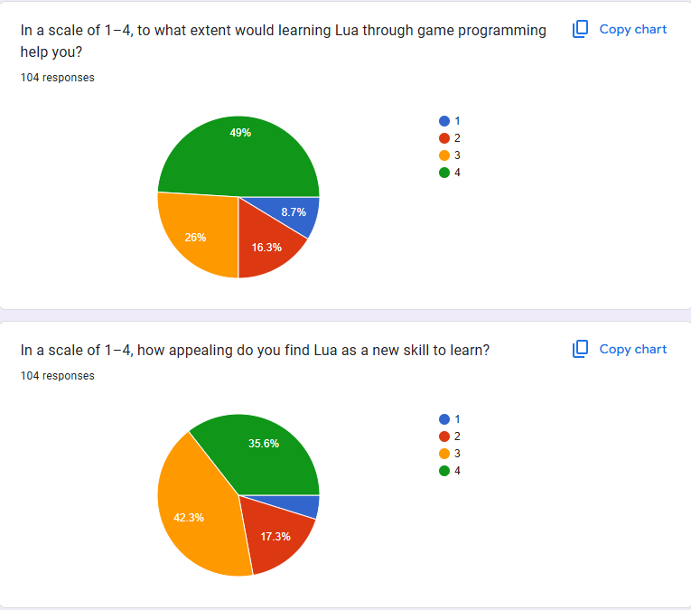
Transcript of Records

Slide 40
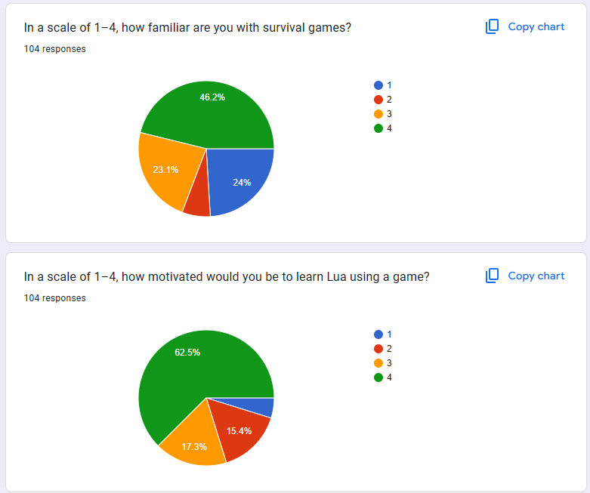
Transcript of Records

Slide 41
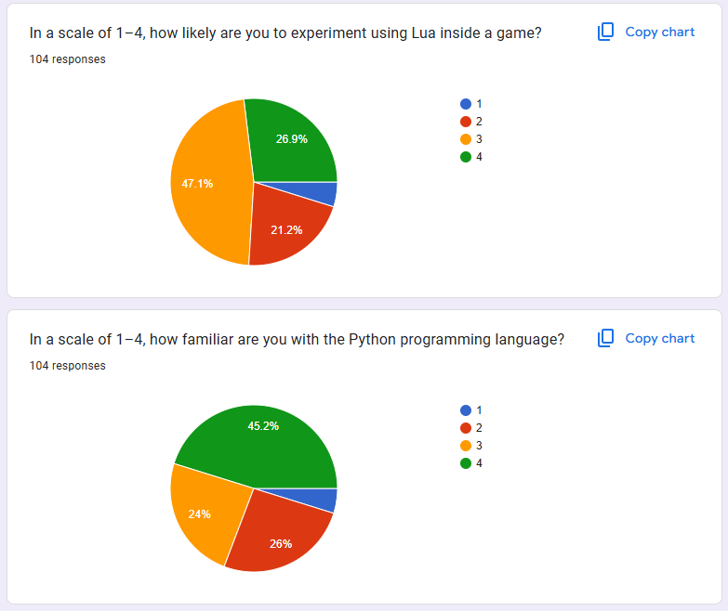
Transcript of Records

Slide 42
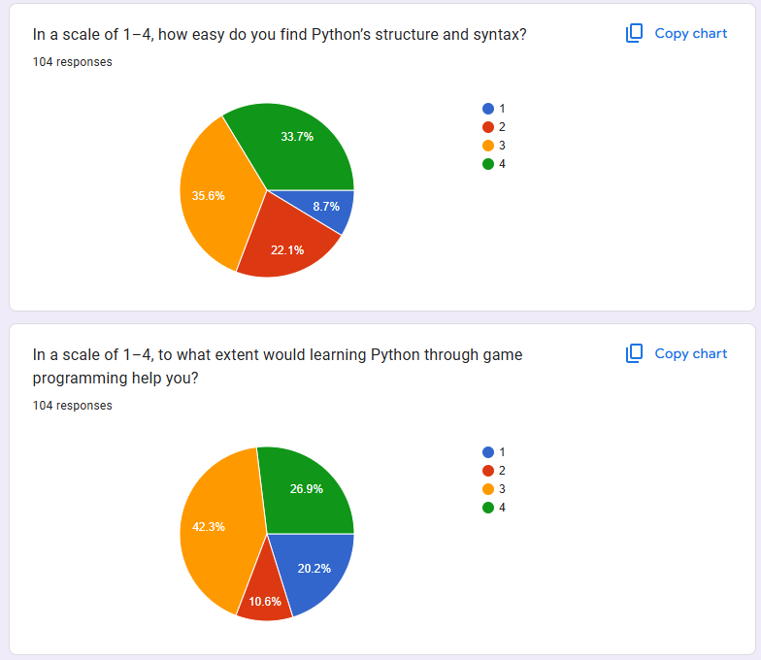
Transcript of Records

Slide 43
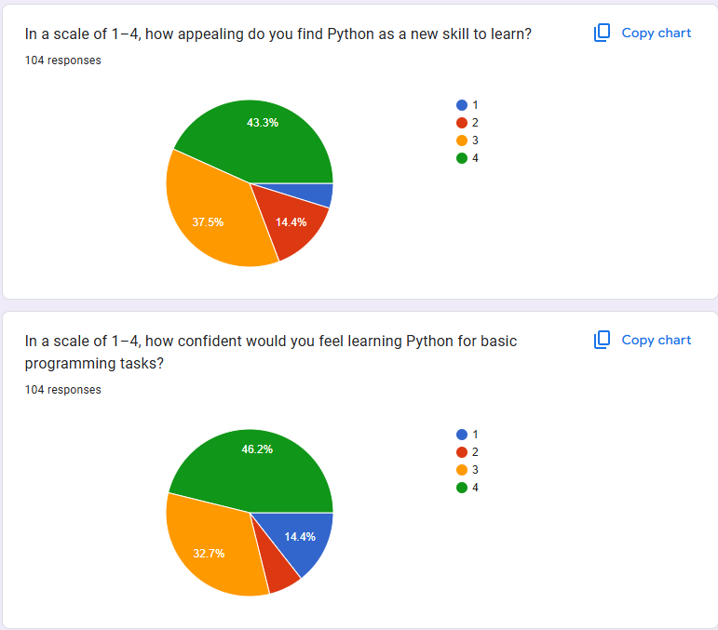
Transcript of Records

Slide 44
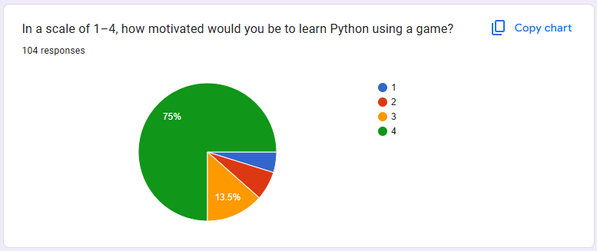
Transcript of Records

