Slide 1
Airline loyalty programme
A proposal for leaving clients
Egbe
Guilherme
Jesús
Robert

Slide 2
Index
Purpose
Data overview, cleaning and selection
SQL insights and analysis
Visualization and insights
Conclusion and business challenge
Major obstacles
Visit our repository https://github.com/Ironhack-DA-Course/proj-sql-data-insight

Slide 3
Objectives of the project
“leavers have accumulated low miles while in the programme and they were a significant cost to the company.”
Understanding the requirements.
Selecting the data.
Defining a hypothesis.
Creation of tools to track progress and cooperation:
Github repo
Trello file
ERD(understanding the data design and flow)

Slide 4
Data overview, cleaning and selection
Revising the data dictionary
Creation of the Entity-Relational-Diagram (ERD)
Reviewing the data (null and empty data)
Selecting the values needed to prove or disprove the hypothesis
Getting more data insight using the flights activity and history
Defining the best visualization way

Slide 5
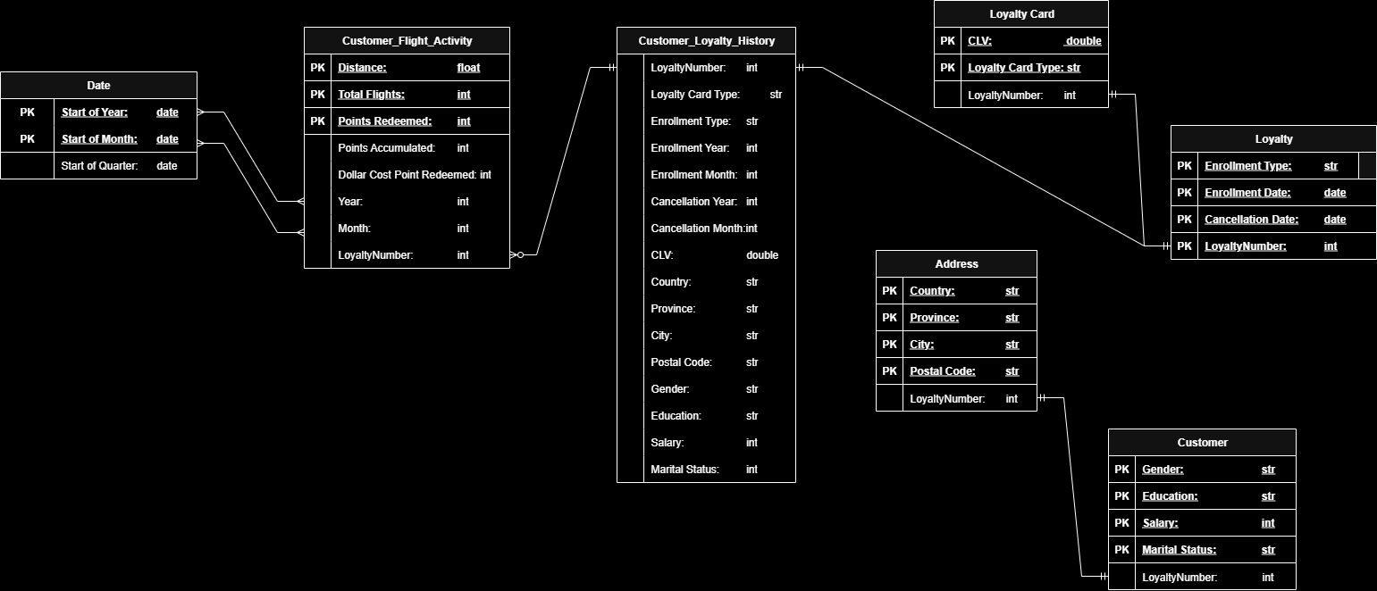
Entity Relationship Diagram

Slide 6
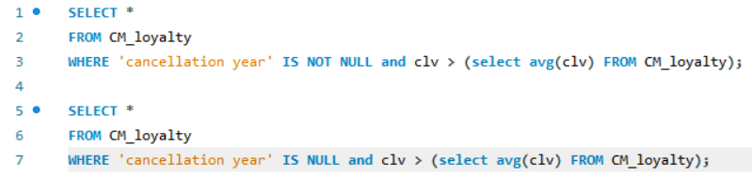
SQL insights and analysis
Remembering the hypothesis: leavers have accumulated low miles while in the programme and they were a significant cost to the company.
Tables creation using filters to isolate desired data.
Design visuals in python using the created tables to prove or disprove the hypothesis using pie charts, bar plot, strip plot, box plot and hist plot.

Slide 7
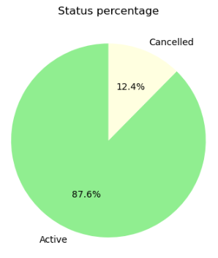
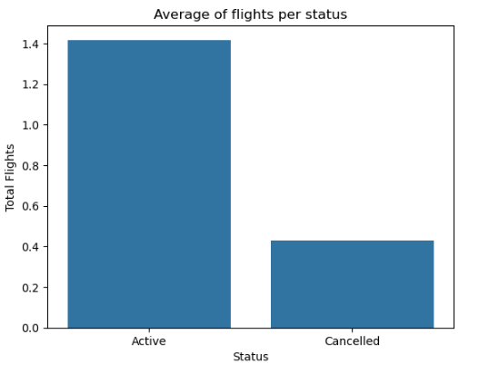
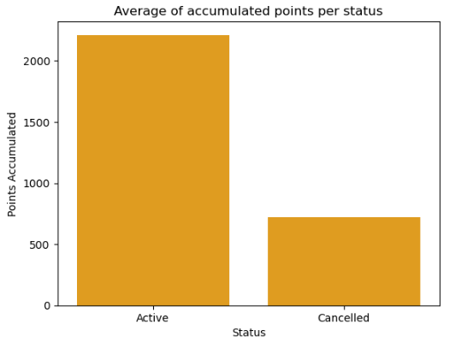
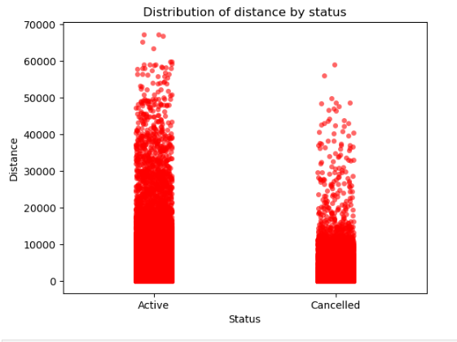
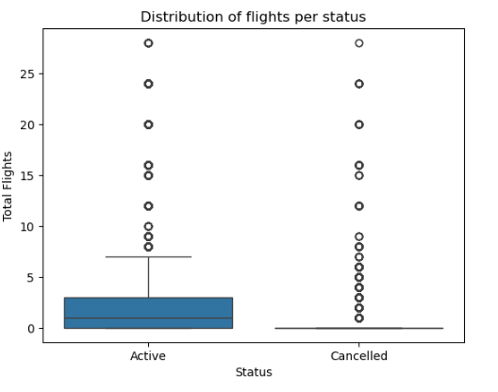
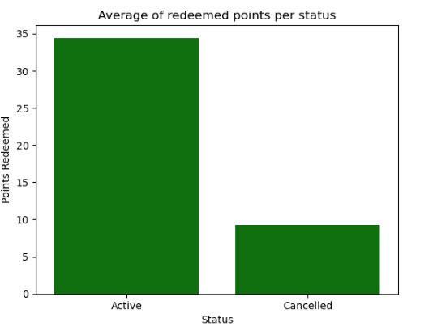
Visualization and insights

Slide 8
Conclusion and business challenge
Creation of new tier “Explorer” for returning and new members.
New low cost incentives based on activity (flights and miles).
Attractive cost-shared incentives travel related.
$20 voucher for Booking.com $20 voucher for Avis.com Free priority boarding 10% discount on additional luggage 10% discount on selected flights
Nova
Star
Aurora
Explorer

Slide 9
Major obstacles and advantages
Data was to heavy to load on SQL Workbench.
linking loyalty data with customer and flight activity in ERM.
Data was encoded
The data was clean, easy to use and well explained.
Demonstrates how data storytelling can turn flight activity into strategic customer retention and possible profits.

Slide 10
Thank you!
We are now open for questions!

