Slide 1

Portada
Notes:
shape
No alt text provided.
textbox
No alt text provided.
textbox
No alt text provided.

Slide 2
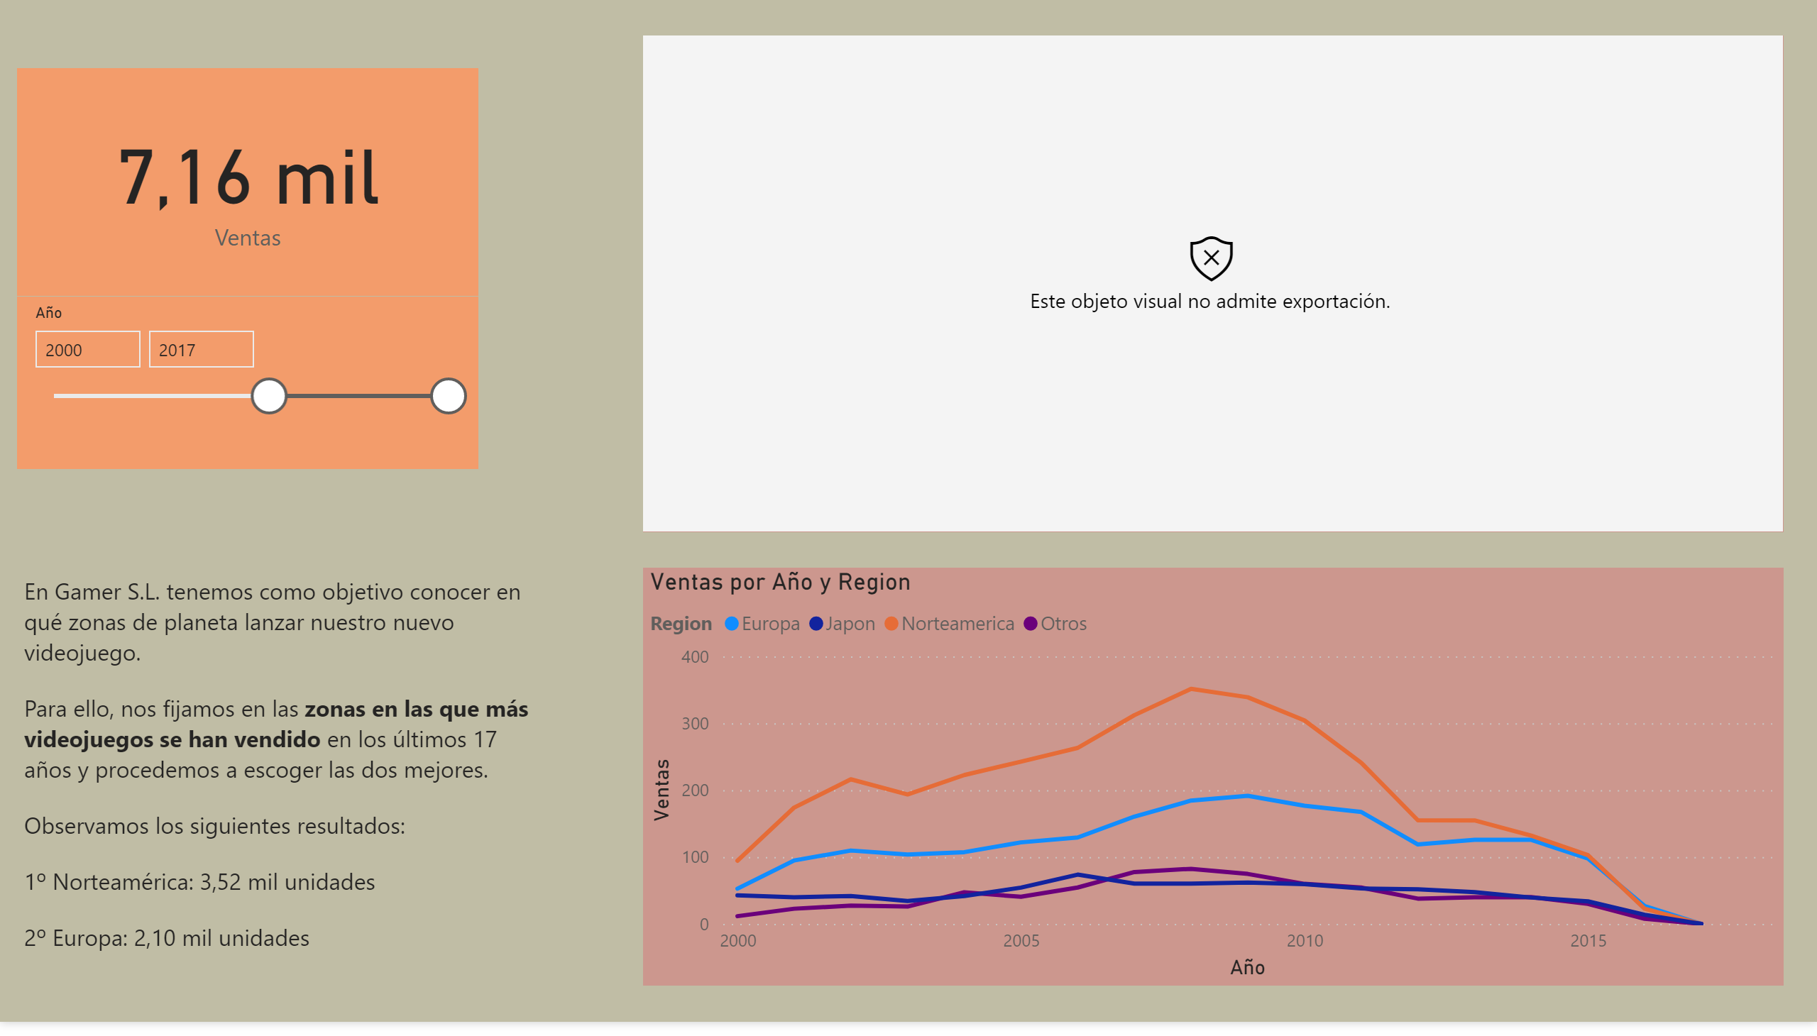
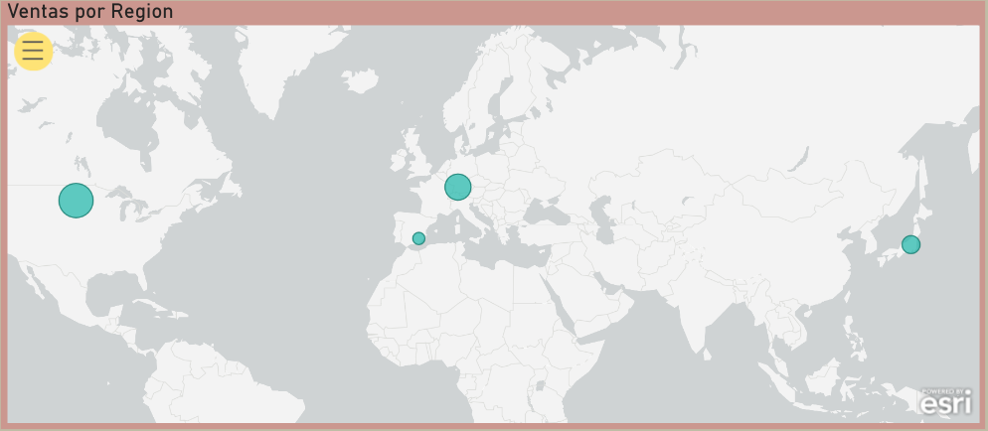
Zona
Notes:
textbox
No alt text provided.
esriVisual
No alt text provided.
slicer
No alt text provided.
card
No alt text provided.
lineChart
No alt text provided.

Slide 3
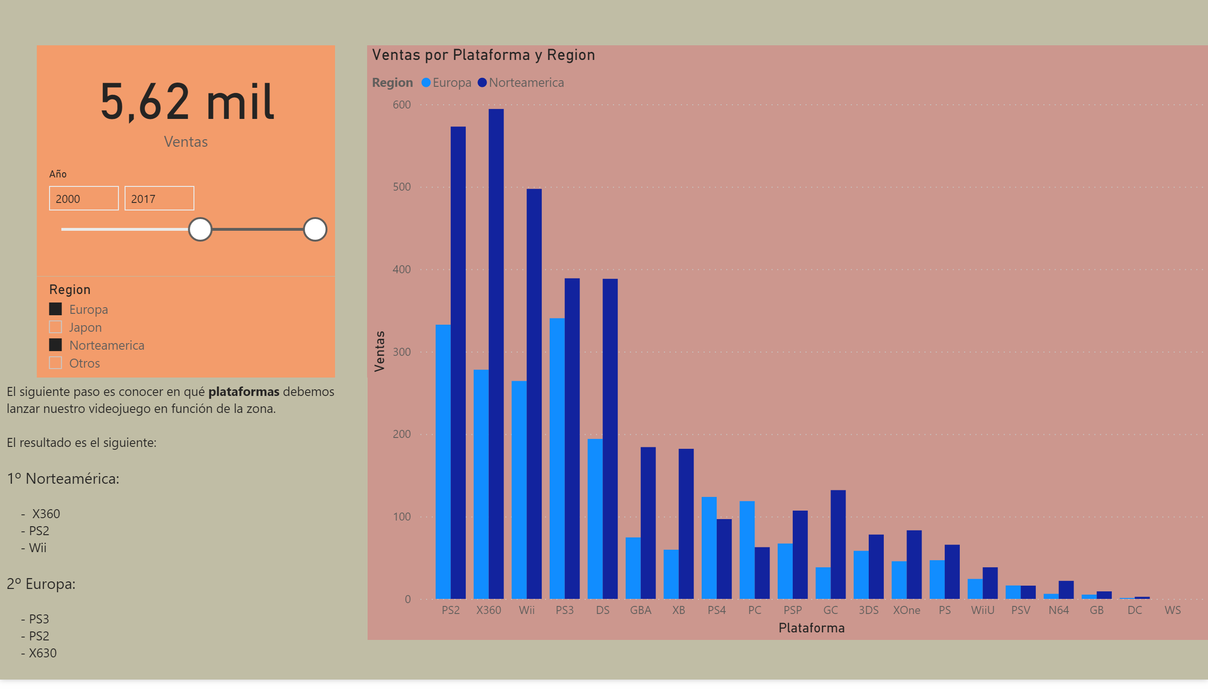
Plat
Notes:
slicer
No alt text provided.
card
No alt text provided.
slicer
No alt text provided.
clusteredColumnChart
No alt text provided.
textbox
No alt text provided.

Slide 4
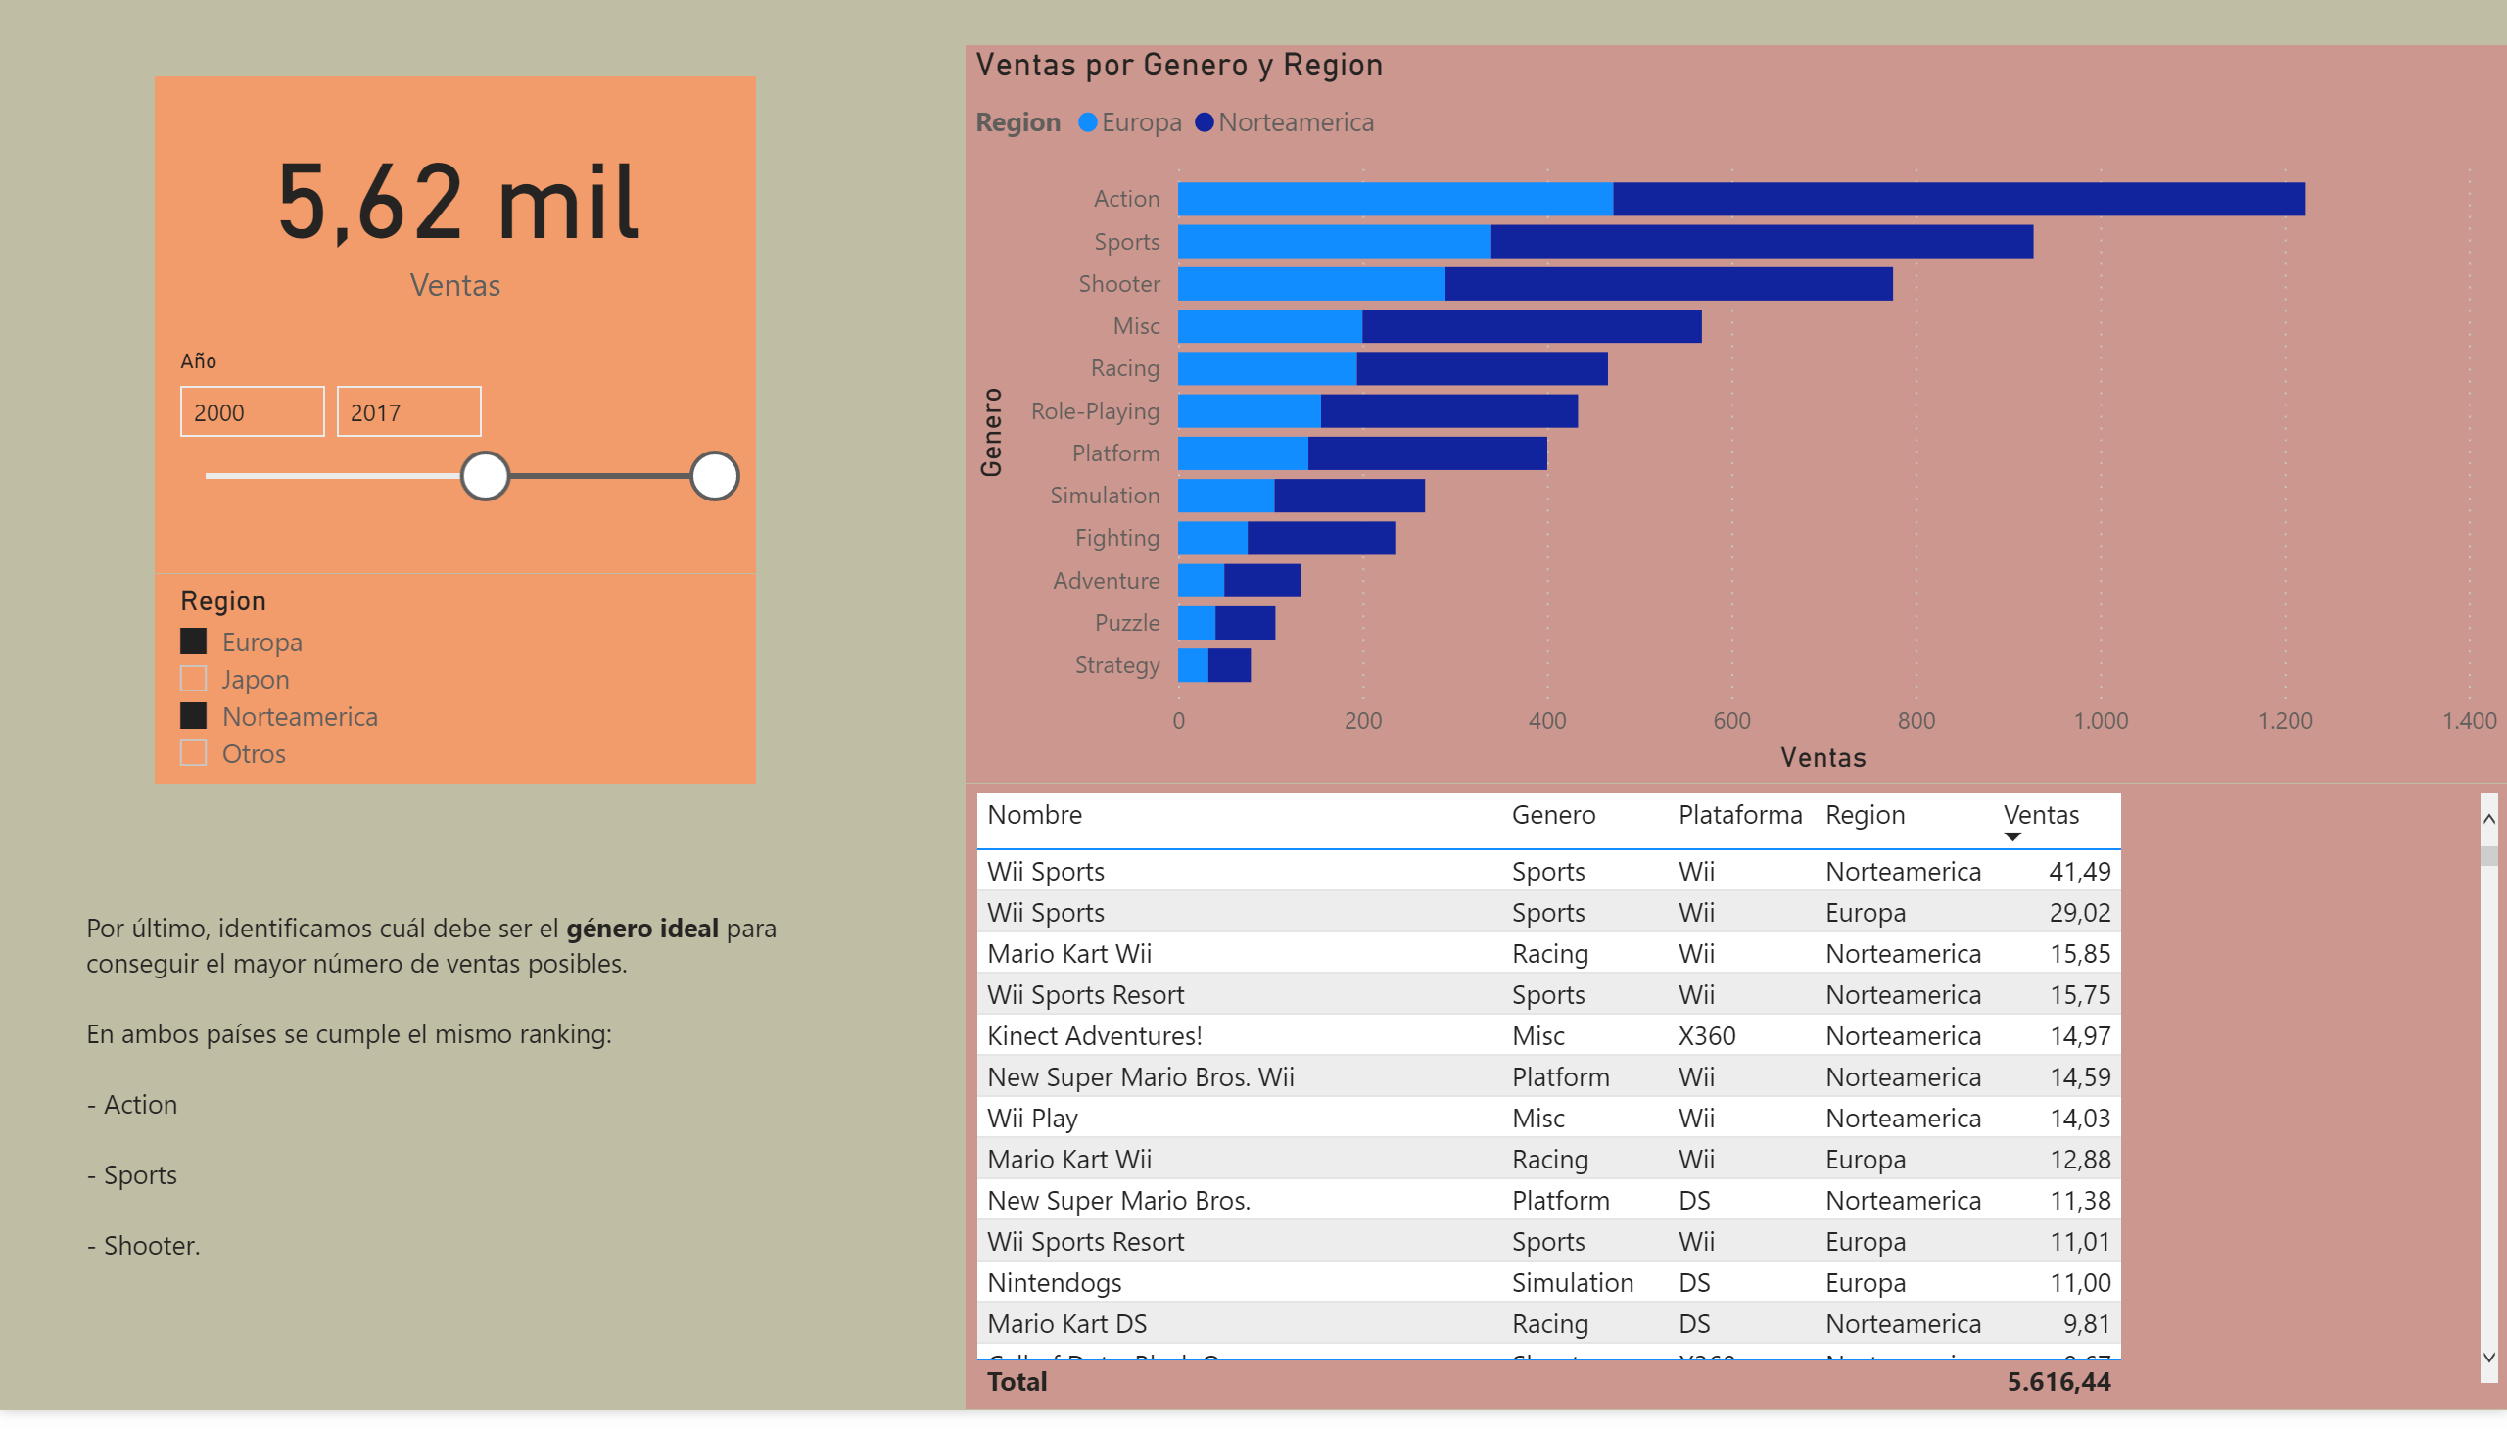
Gen
Notes:
slicer
No alt text provided.
card
No alt text provided.
textbox
No alt text provided.
slicer
No alt text provided.
barChart
No alt text provided.
tableEx
No alt text provided.

