Slide 1

Salary Predictor
Irene Aguerri

Slide 2
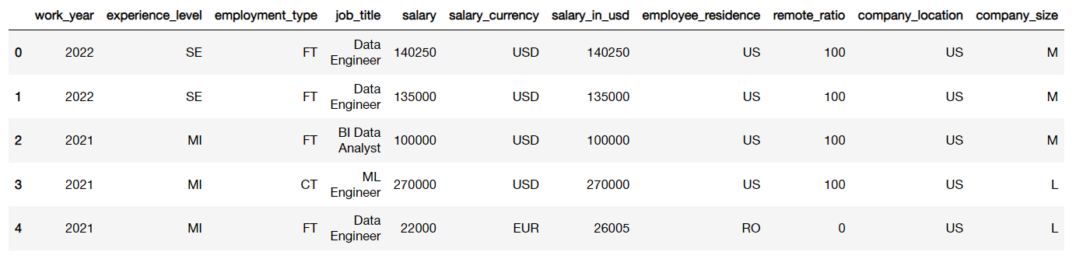
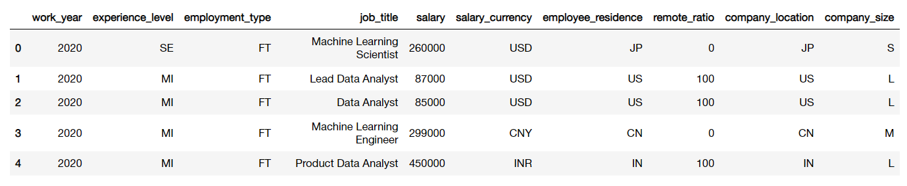
Feature Analysis
Salaries Data
Test Data

Slide 3
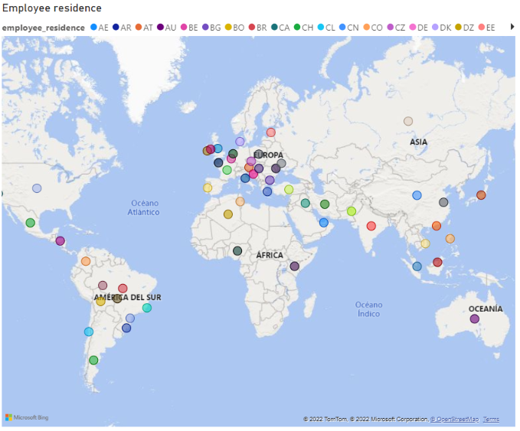
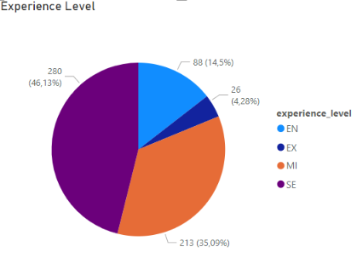
Objective
Predict the salary for Data Science positions according to data from period 2020-2022

Slide 4
Raw Data
Cleaning and preprocessing
Training and testing
Drop duplicates
Categorical to numerical variables
XGBR
Random Forest
Validation
GBM

Slide 5
Cleaning and preprocessing
5 cols erased
Label encoder custom
Label encoder random
Employment Type
remote_ratio
salary
company_location
salary_currency
work_year
Company Size
Experience level
Job title
Employee residence
Join DF to transform data

Slide 6
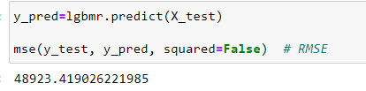
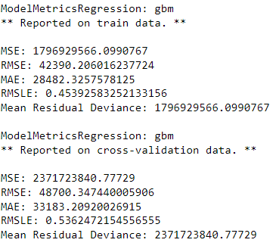
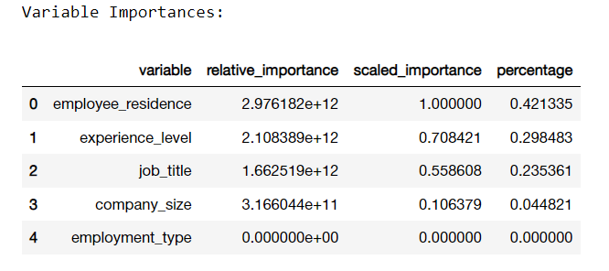
Training and Testing
Test with all models:
Best results with Light Gradient Boosted Machine (LGBM)
Train Salaries data
Choose Model
Predict Test data
RMSE → 48923,41 $
Model: GBM
H20

Slide 7

Validation
RMSE → 48700,3 $

Slide 8
Thanks!

