Slide 1
Django AllAuth

Slide 2
What is allauth and why we use it
It is a package which enables Django application to use third party authentication via services like Github, Google, Facebook, Twitter, etc.

Slide 3
Features
It supports multiple authentication schemes like login by username, or by e-mail.
It provides verification feature methods like email verification.
It Uses access tokens to authenticate user.

Slide 4
Some Settings of AllAuth
ACCOUNT_AUTHENTICATION_METHOD(”username” | “email”)
Used to define which value will bu used for authentication.
ACCOUNT_EMAIL_VERIFICATION (=”optional”)
Determines the e-mail verification method during signup – choose one of mandatory, optional, or none.
ACCOUNT_EMAIL_CONFIRMATION_EXPIRE_DAYS (no of days)
Determines the expiration date of the email confirmation mail.
ACCOUNT_LOGIN_ATTEMPTS_LIMIT (=5)
Number of failed login attempts. When this number is exceeded, the user is prohibited from logging in for the specified seconds.

Slide 5
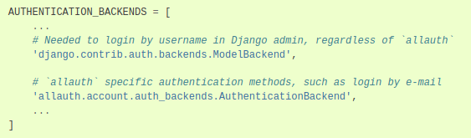
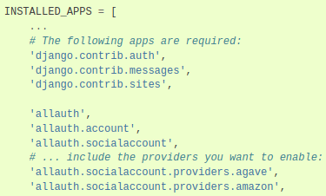
Settings.py after pip install django-allauth

Slide 6
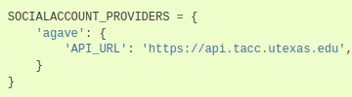
Social Account Providers
For every authentication we need to provide the api_url for authentication provider.

Slide 7
Some URLs provided by AllAuth
LoginView with /accounts/login/ URL.
SignupView with /accounts/signup/ URL.
LogoutView with /accounts/logout/ URL.
PasswordResetView with /accounts/password/reset/ URL.

Slide 8
References
https://learndjango.com/tutorials/django-allauth-tutorial
https://django-allauth.readthedocs.io/en/latest/overview.html

Slide 9

Thank You

Slide 10
ANY QUESTIONS?

