Slide 1
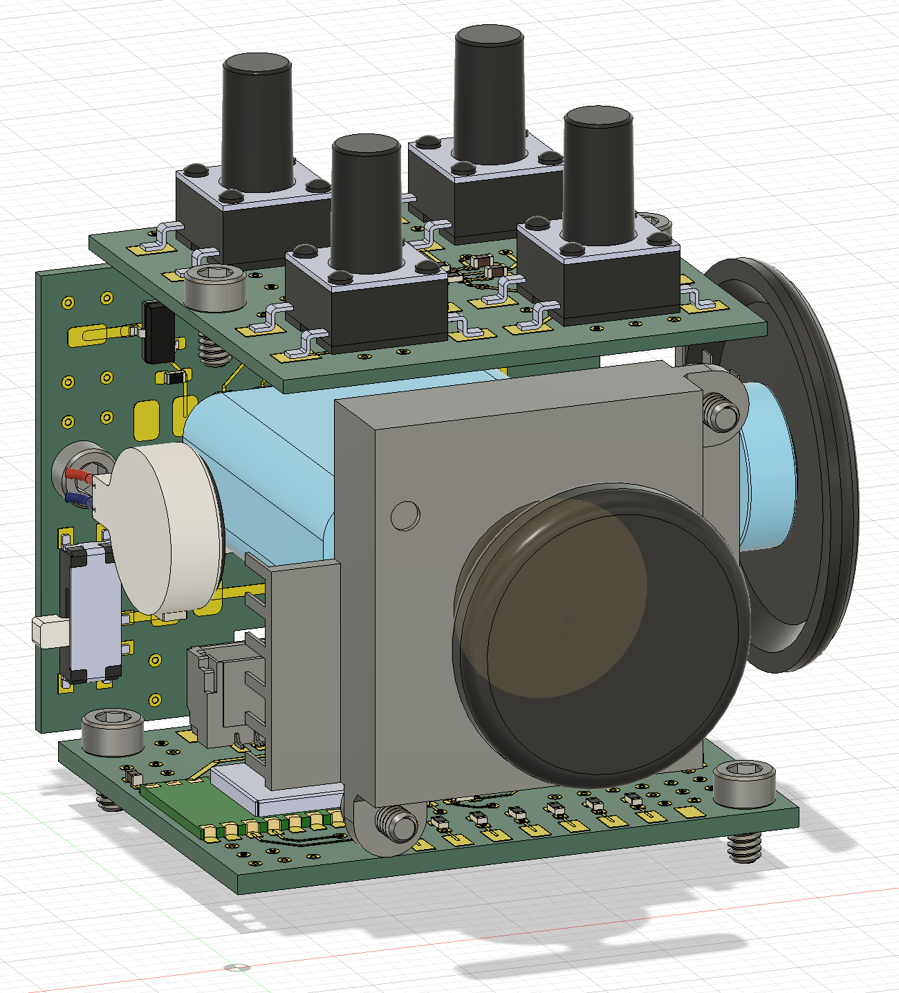
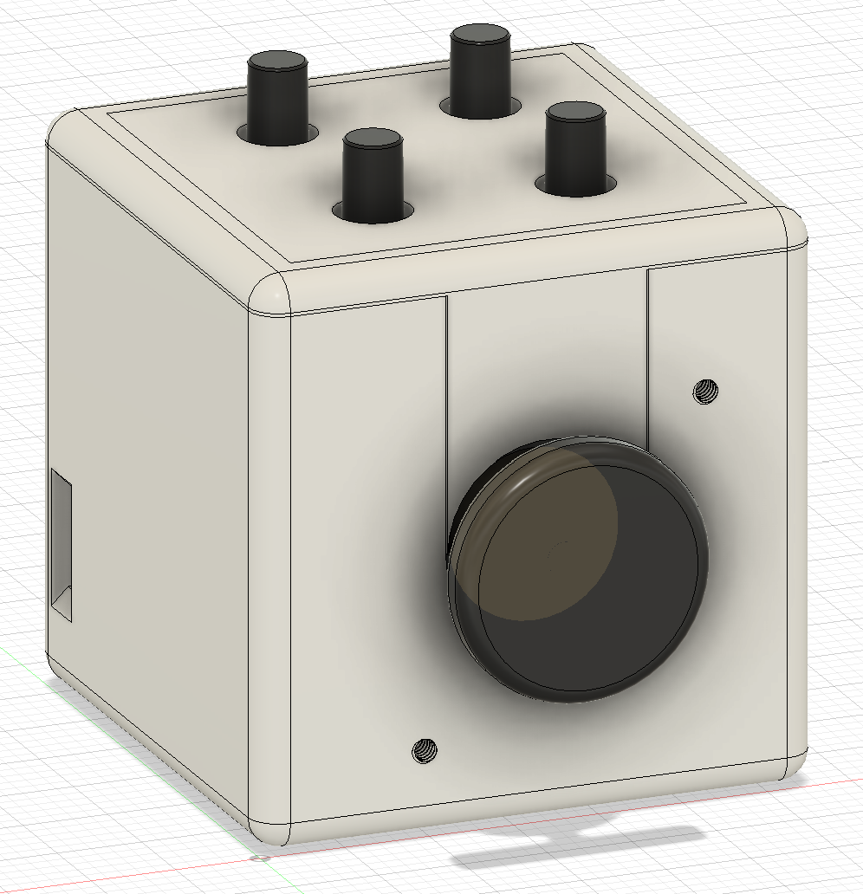
Tactile switch board
Connector board
Ball bearing
100mAh Li-Po
Mouse encoder
Linear vibration motor
Joystick
33mm
Main control board
33mm
33mm

Slide 2
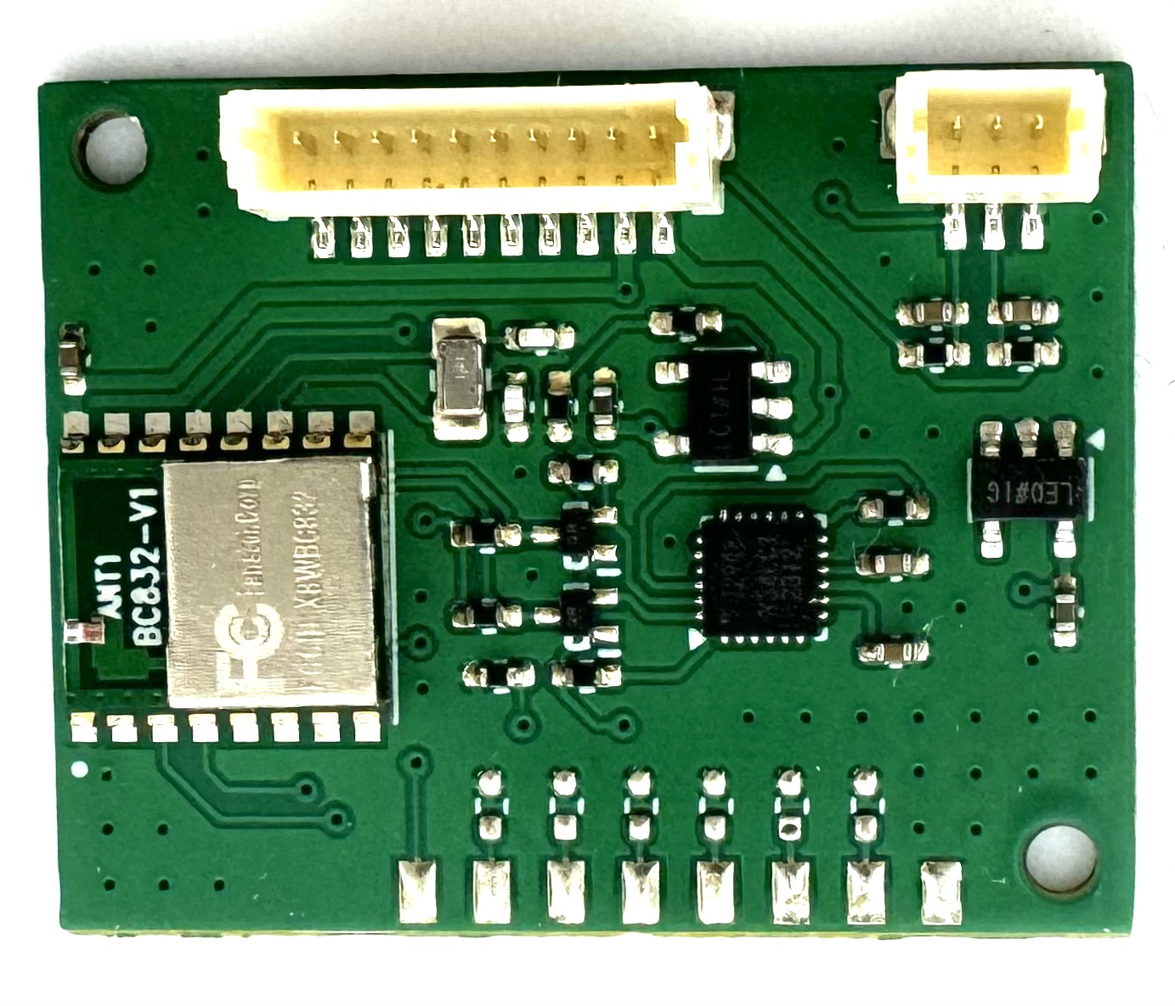
Connector for the connector board
TTC encoder connector
ICM20948
BC832 BLE SoC
Joystick connector

Slide 3
