Slide 1
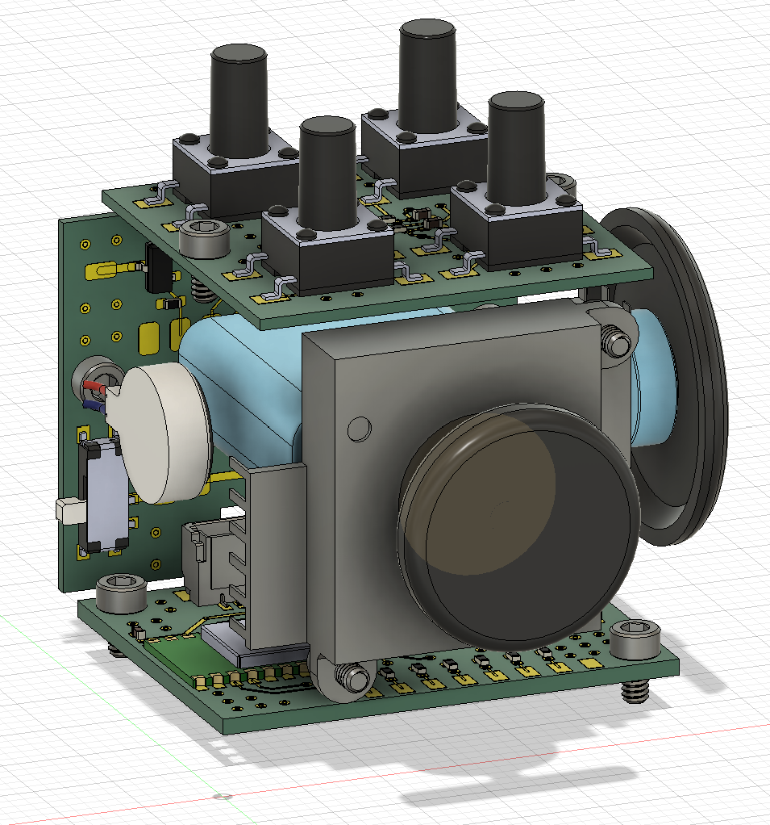
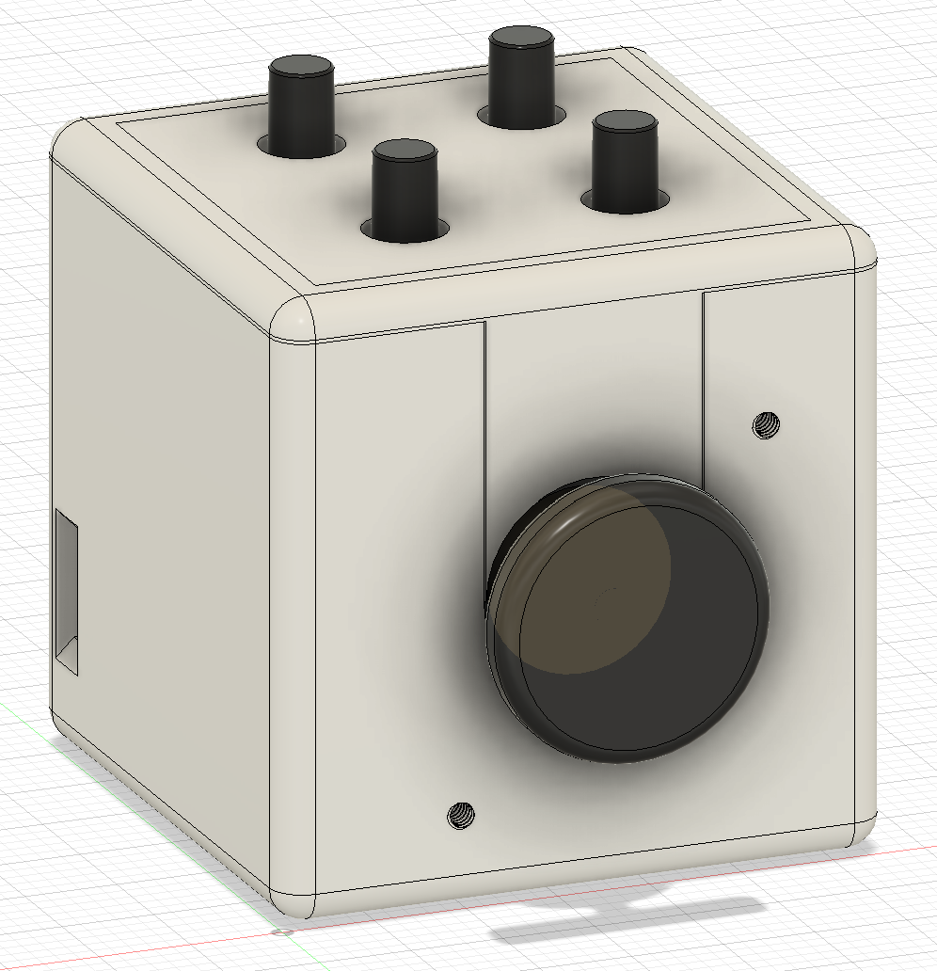
Tactile switch board
Connector board
100mAh Li-Po
Ball bearing
Encoder
Linear vibration motor
Joystick
33mm
Main control board
33mm
33mm

