Slide 1
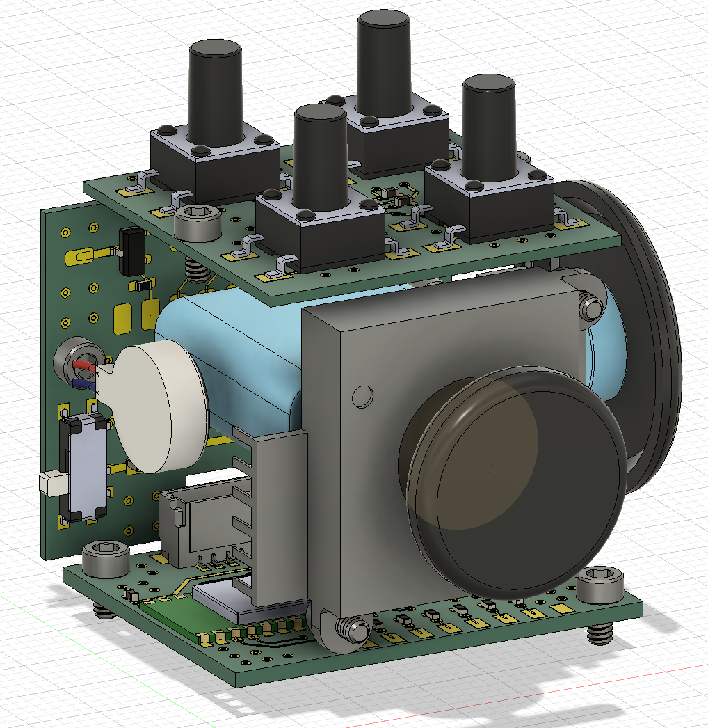
Tactile switch board
Connector board
100mAh Li-Po
Encoder
Linear vibration motor
Joystick
Main control board

