Slide 1
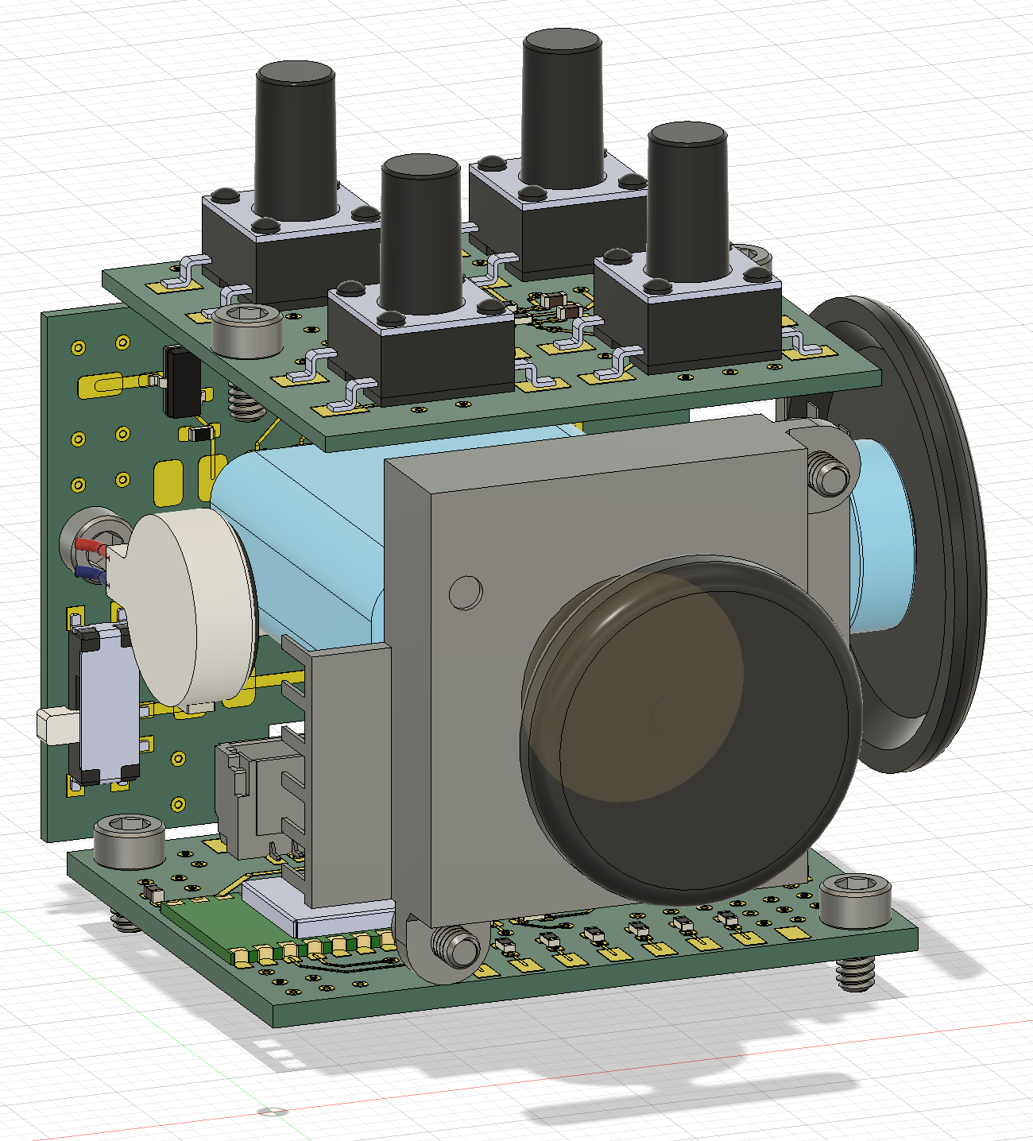
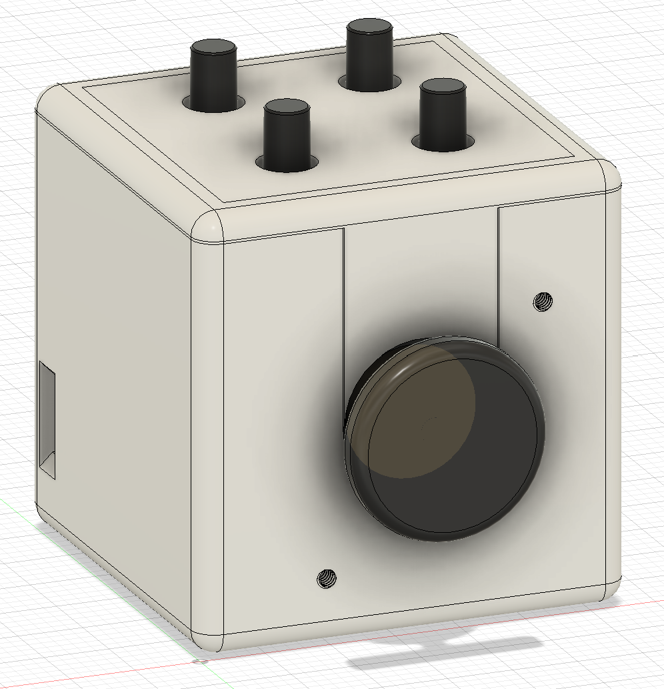
Tactile switch board
Connector board
Ball bearing
100mAh Li-Po
Mouse encoder
Linear vibration motor
Joystick
33mm
Main control board
33mm
33mm

