Slide 1
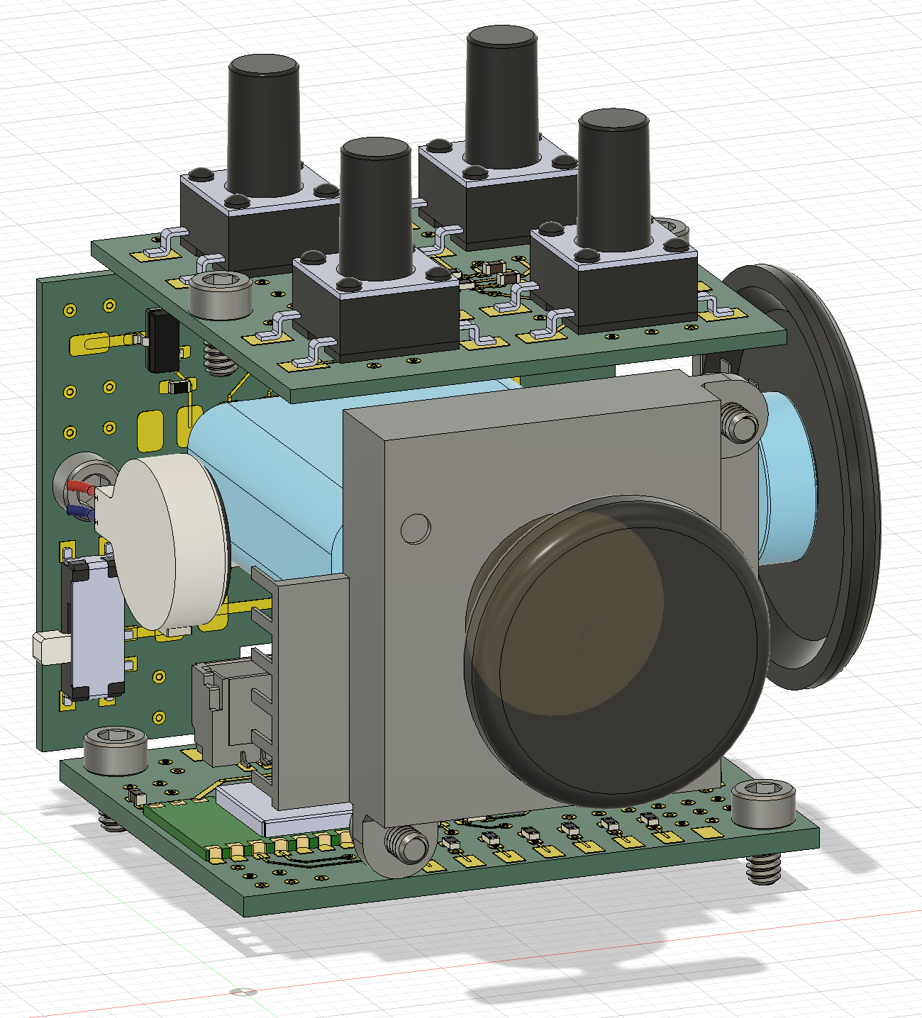
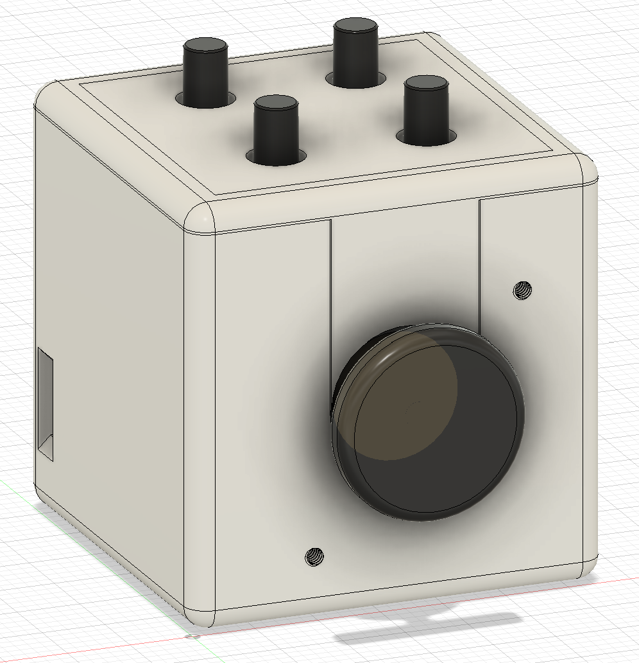
Button board
Connector board
Ball bearing
100mAh Li-Po
TTC encoder
Linear vibration motor
Joystick
33mm
Main control board
33mm
33mm

Slide 2
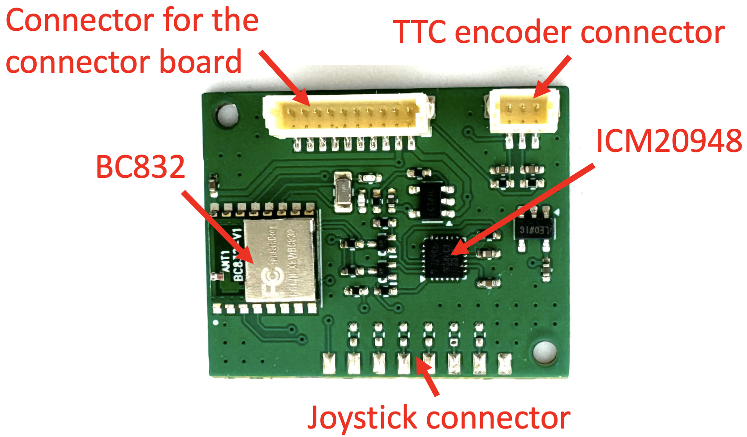
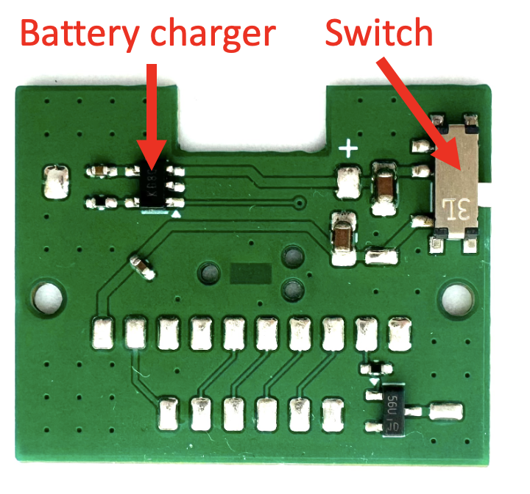
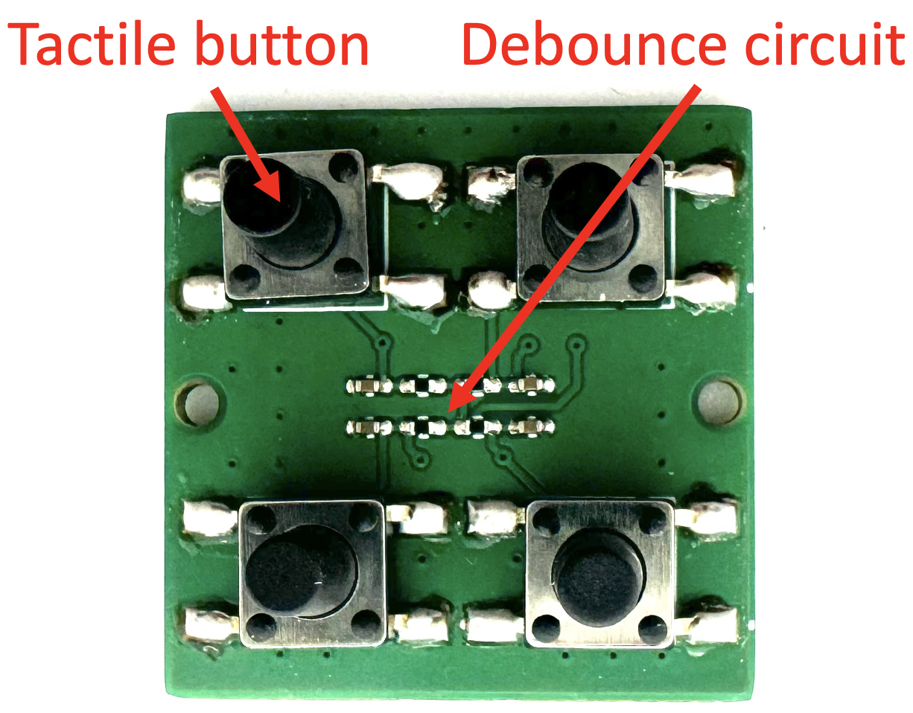
Main control board
Button board
Connector board

Slide 3
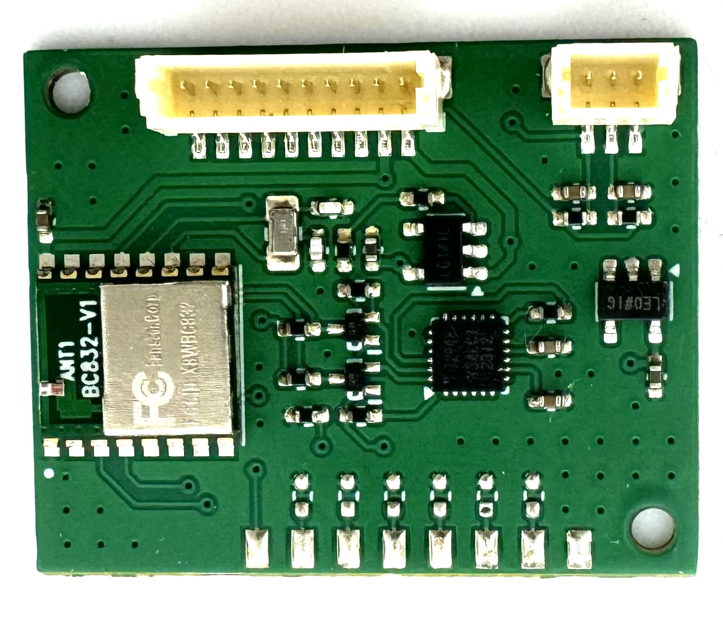
Connector for the connector board
TTC encoder connector
ICM20948
BC832
Joystick connector

Slide 4
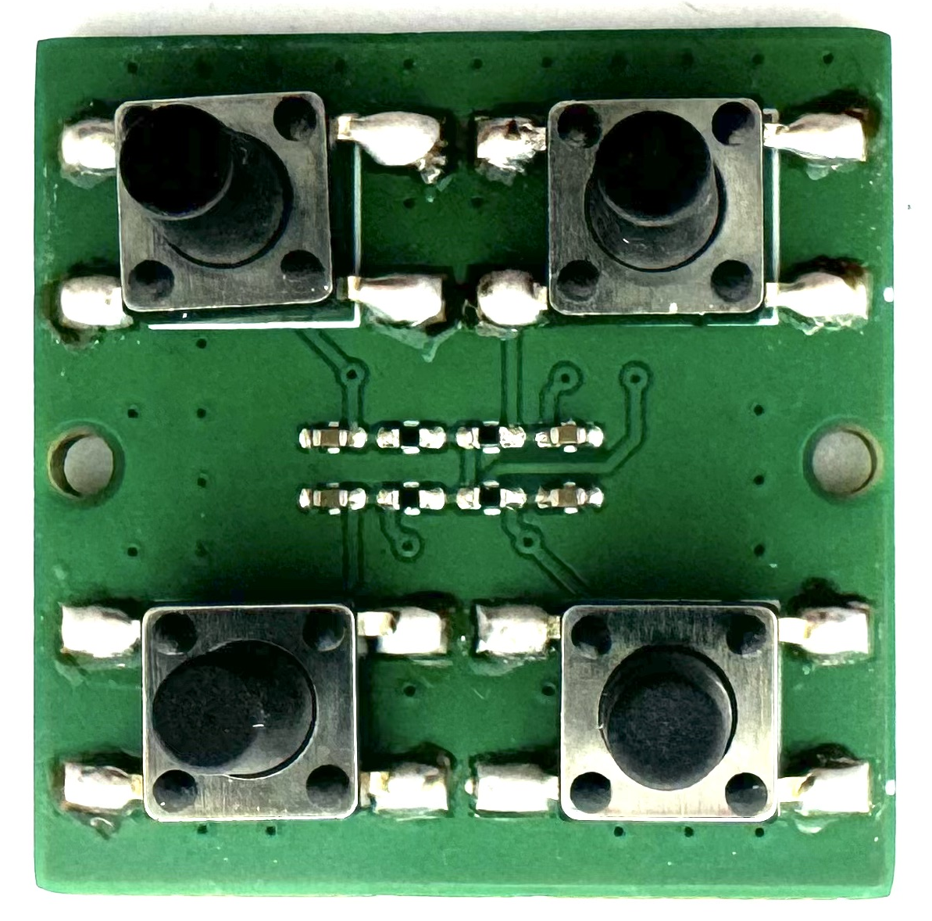
Tactile button
Debounce circuit

Slide 5
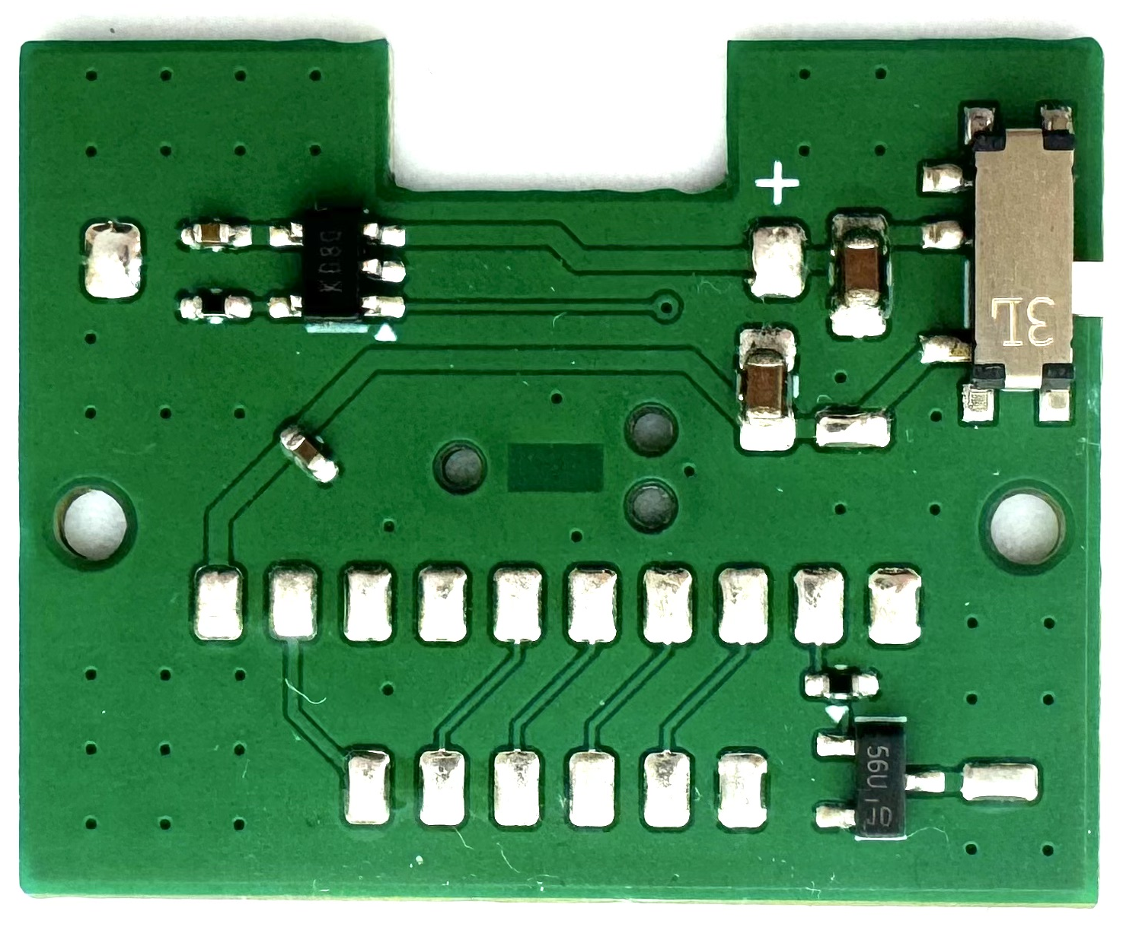
Battery charger
Switch

Slide 6
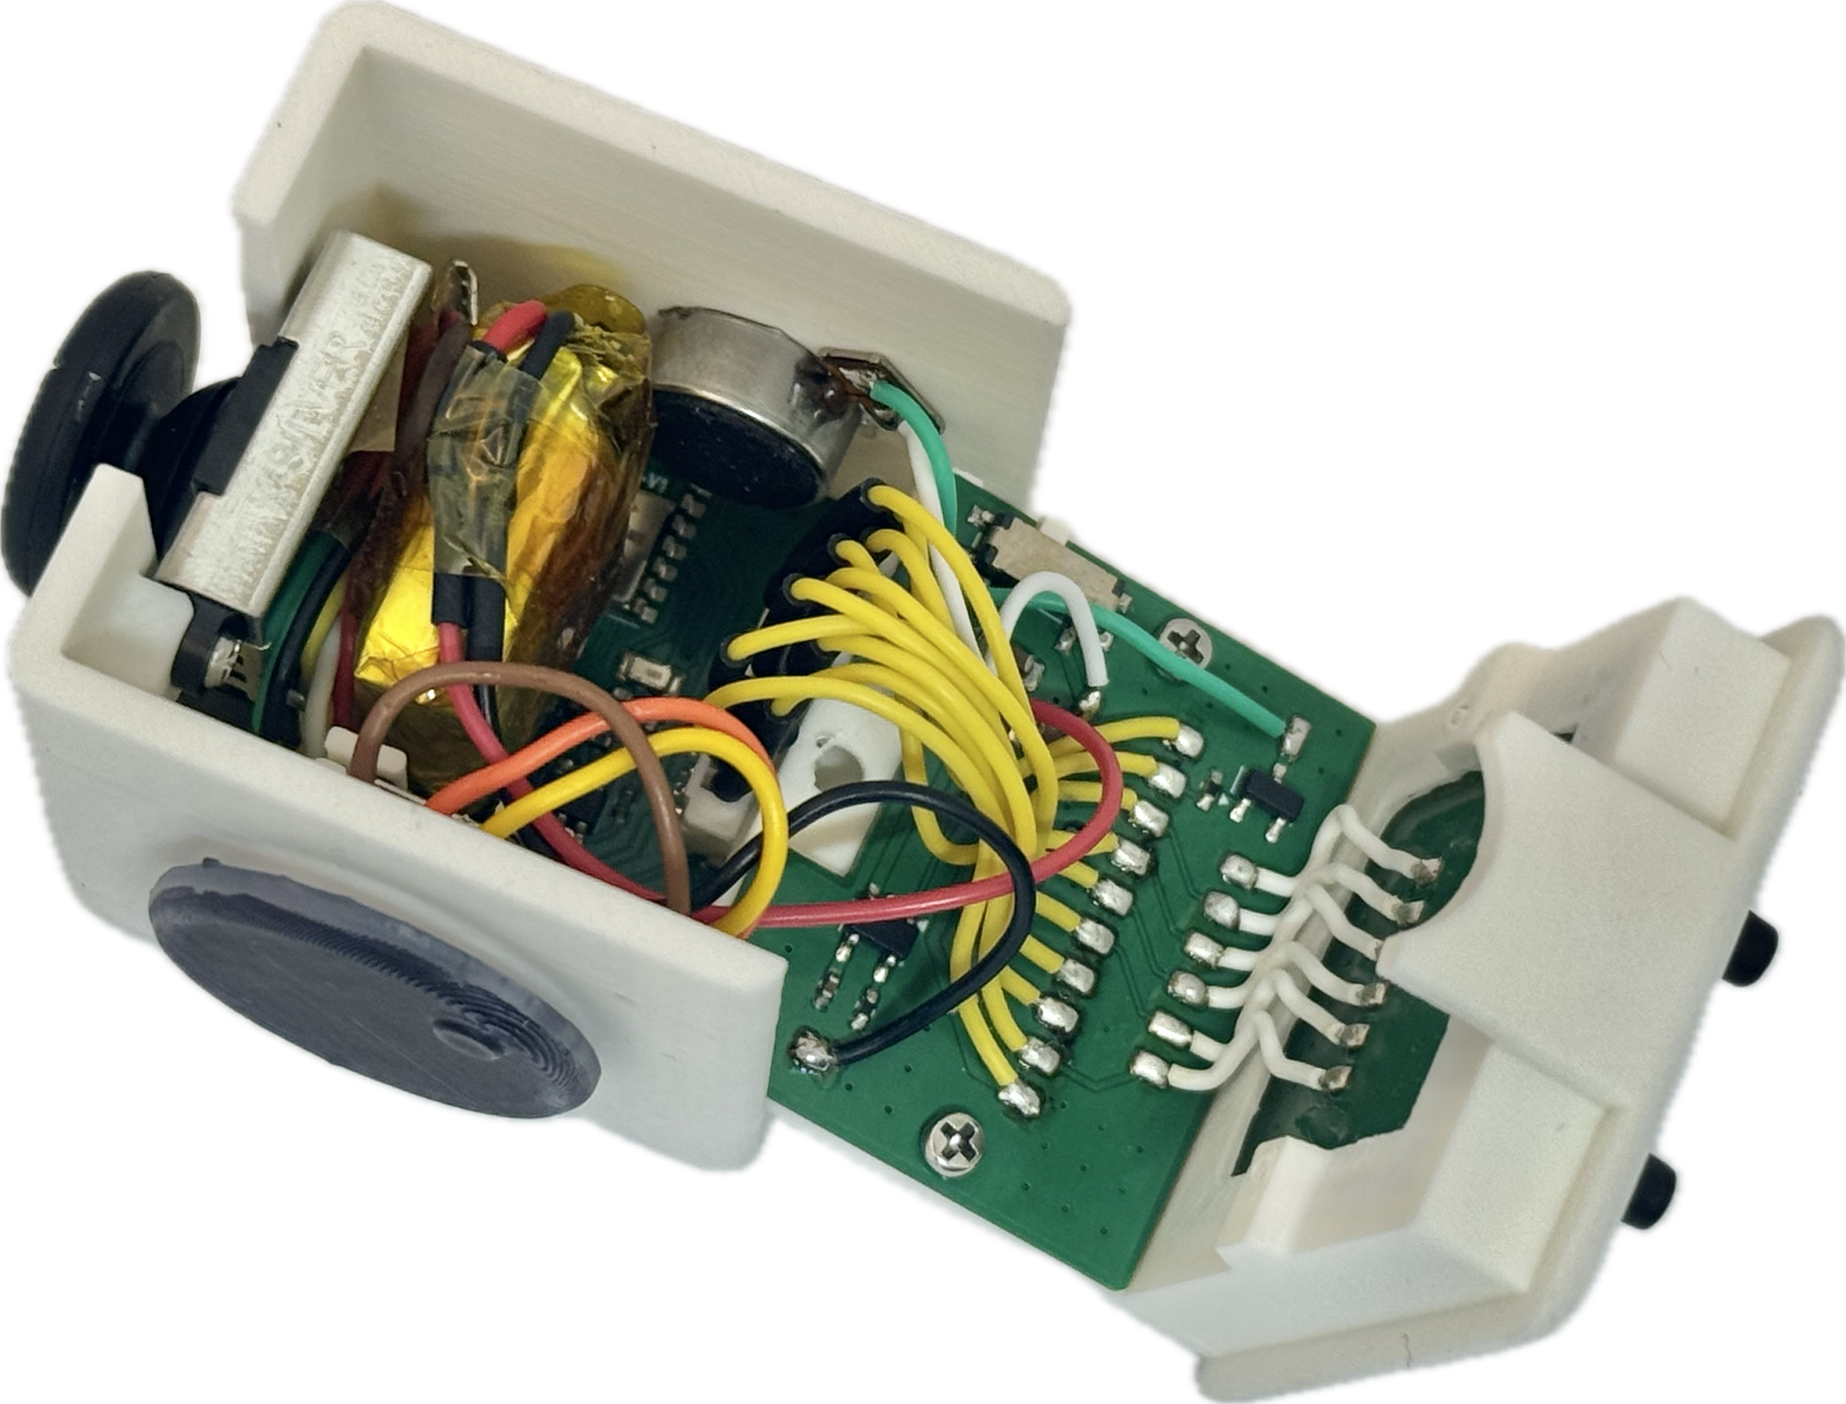
Main control board
Linear vibration motor
Joystick
Connector board
Button board
100mAh LiPo
TTC encoder

Slide 7
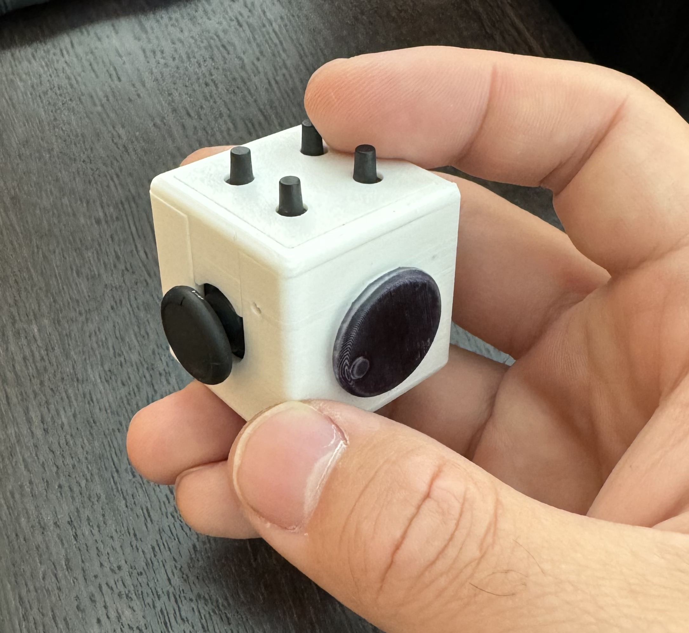

Slide 8
33mm
33mm
33mm

Slide 9
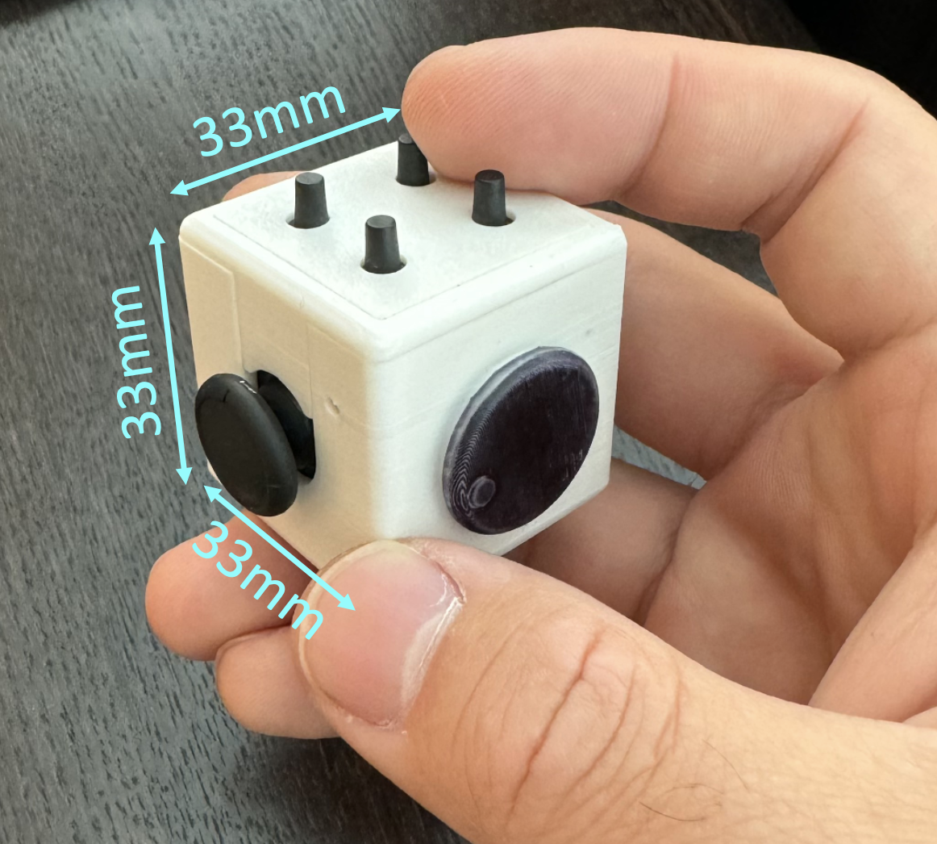
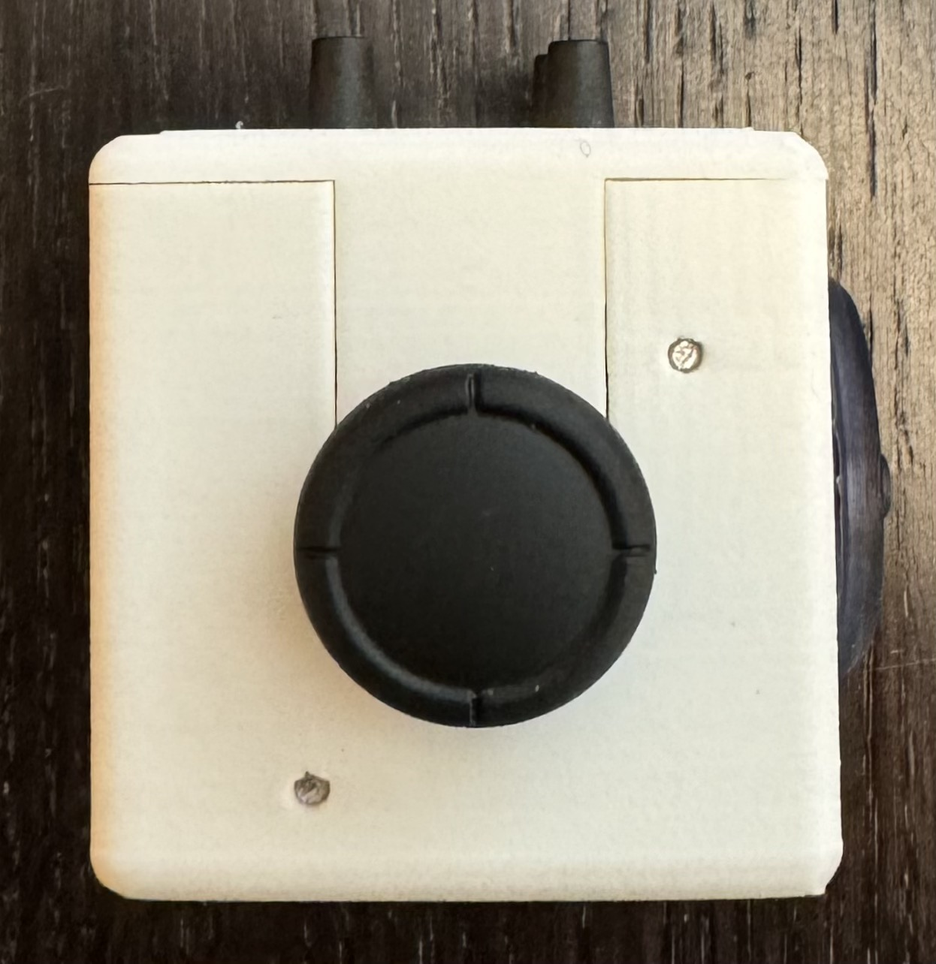
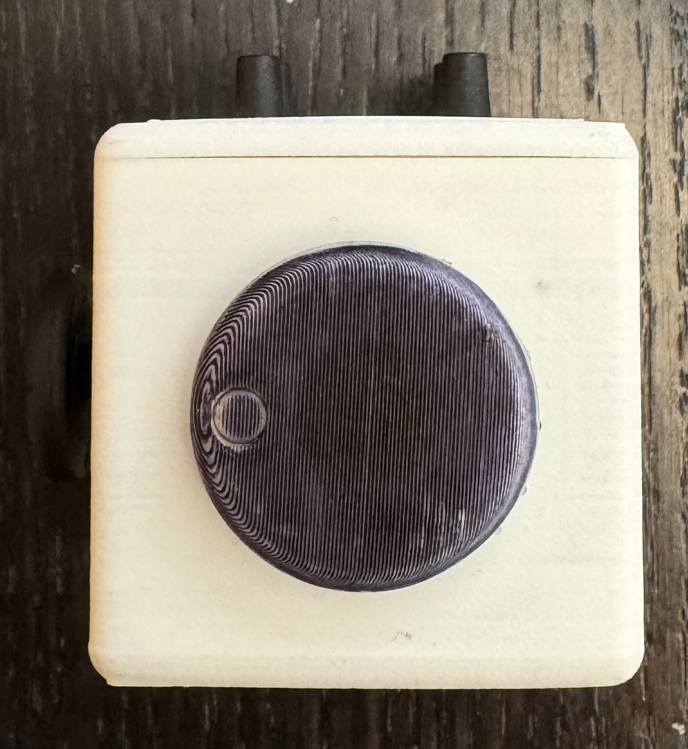
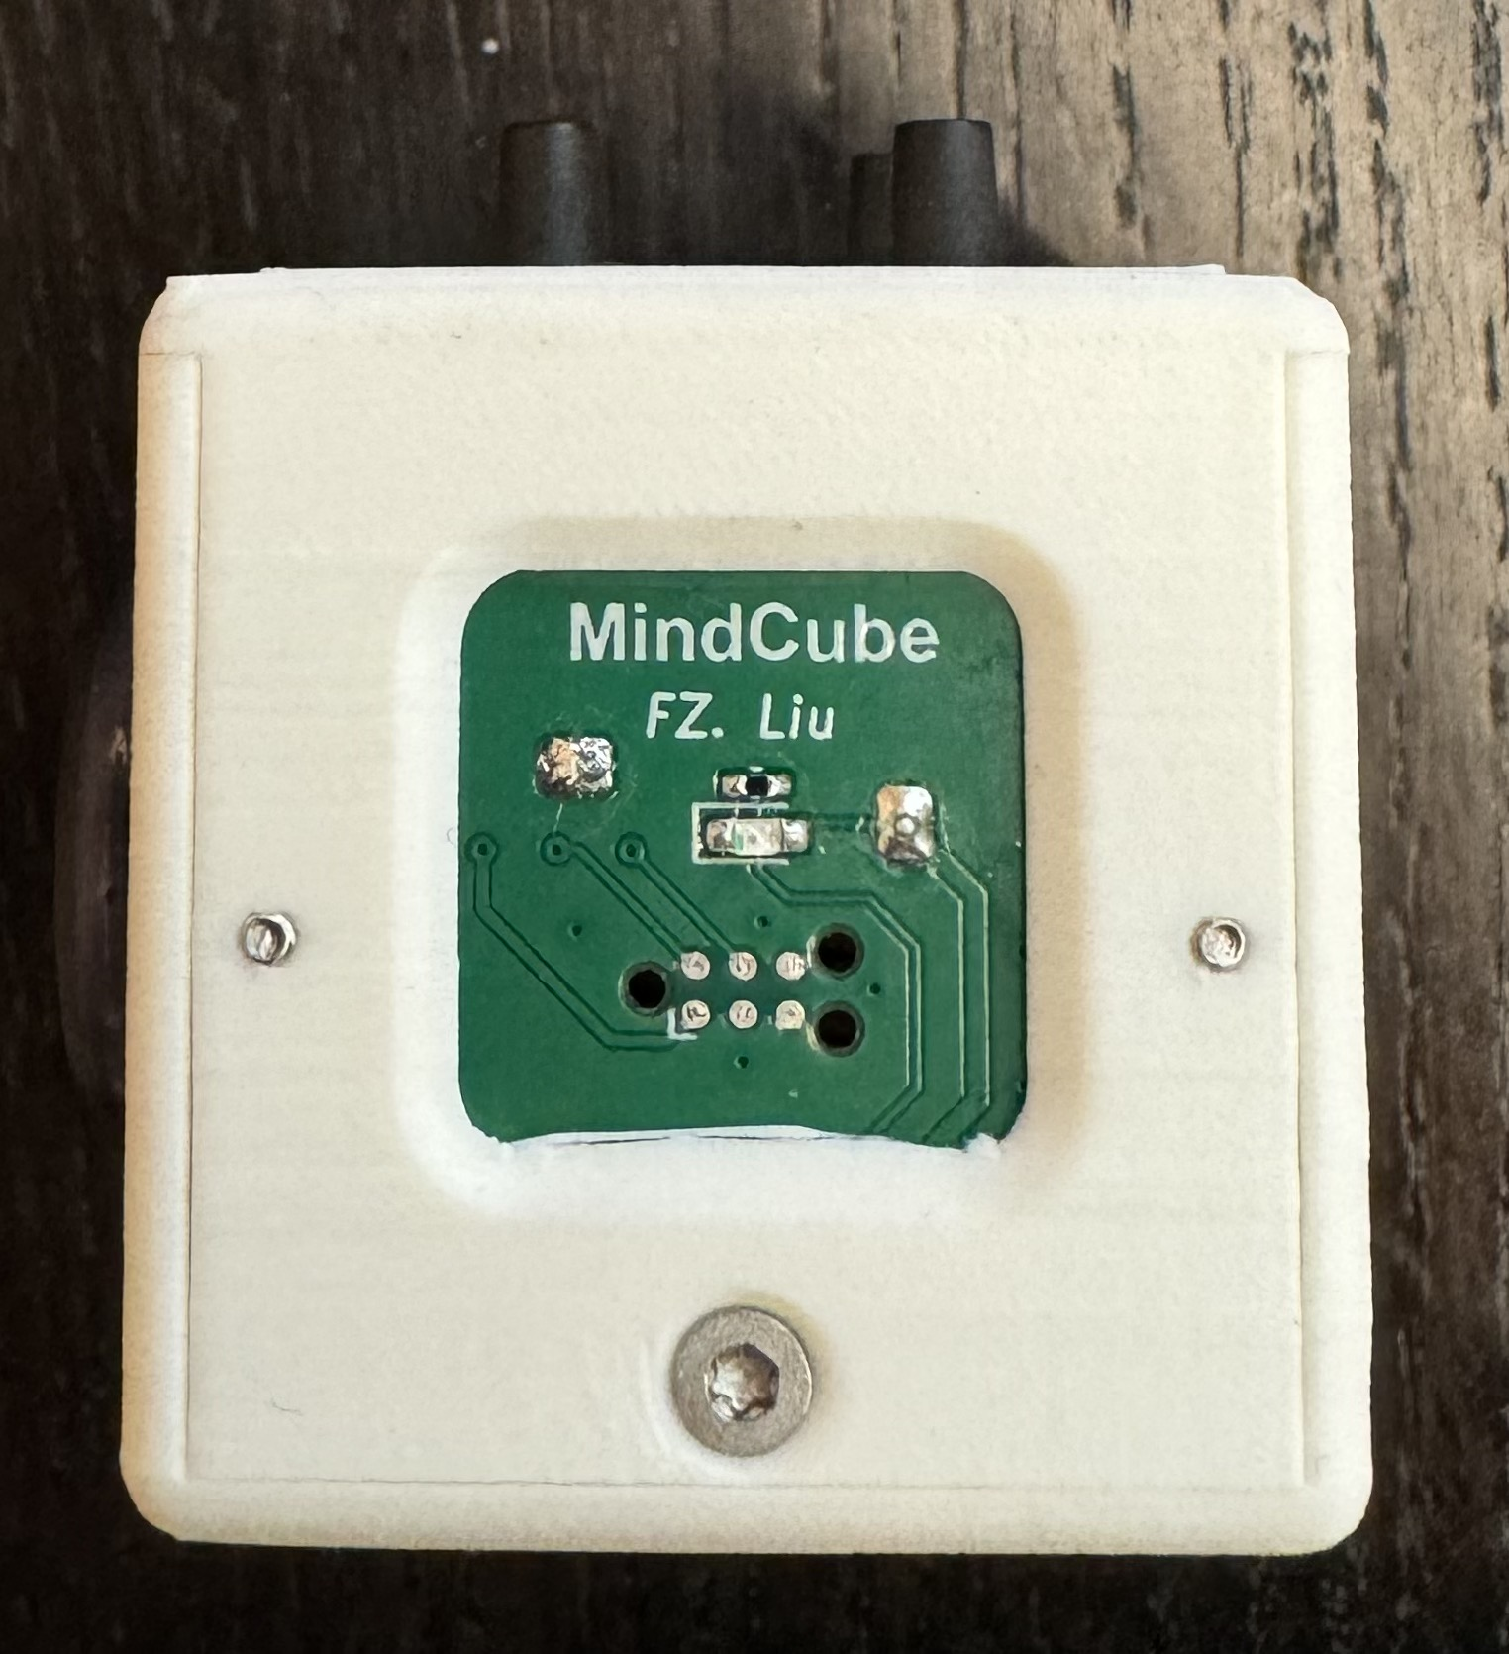
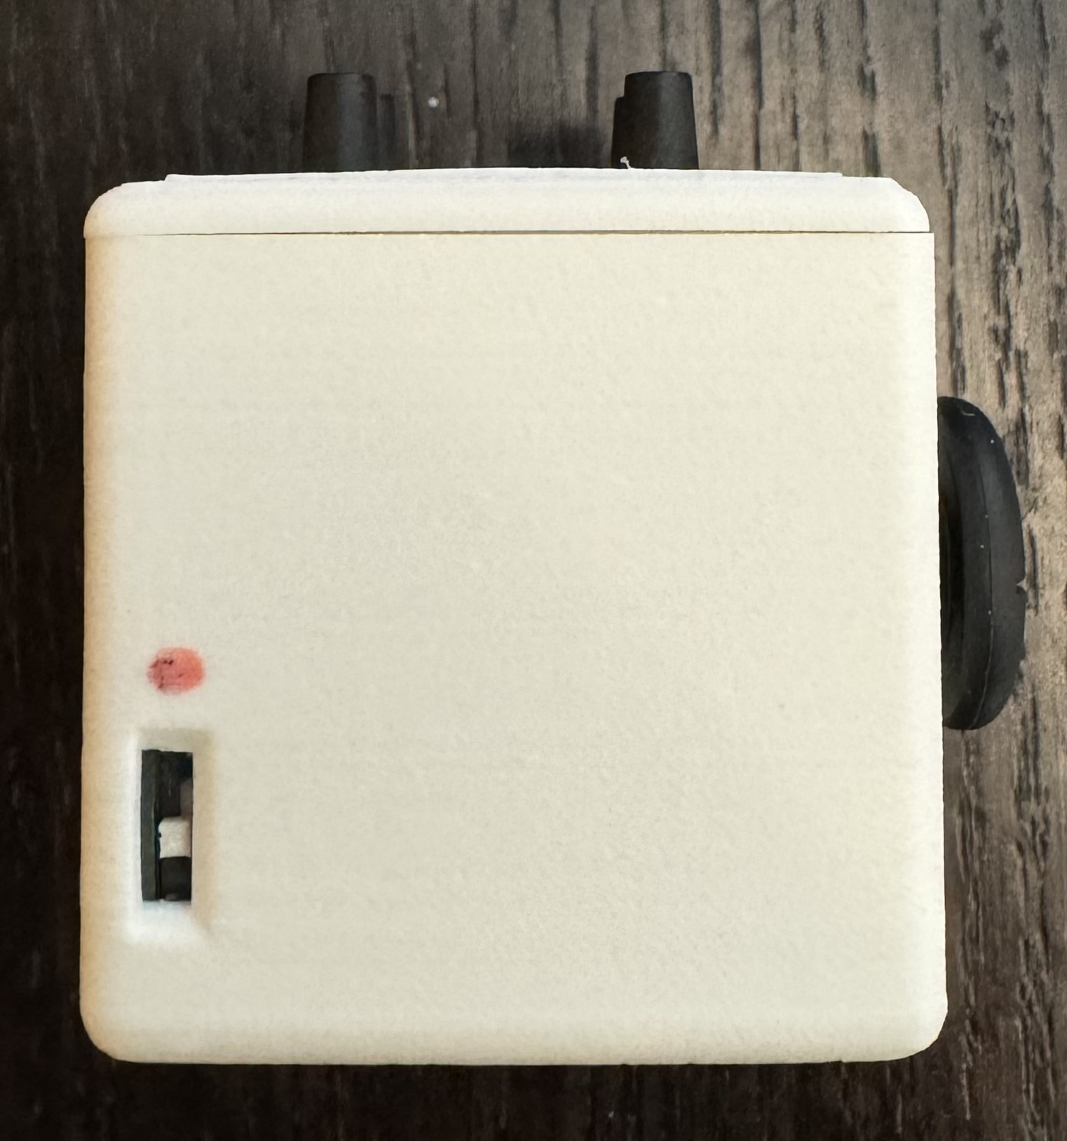
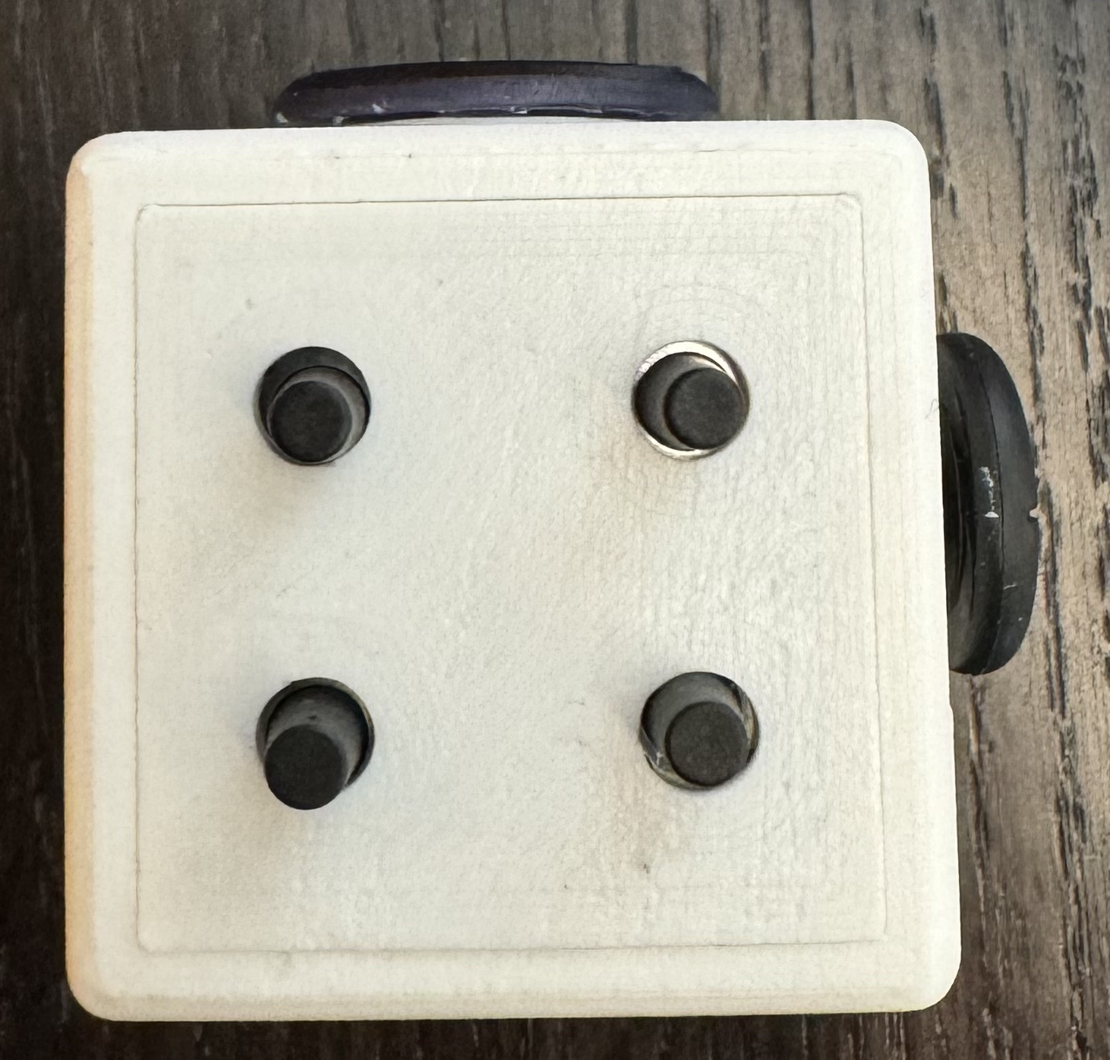
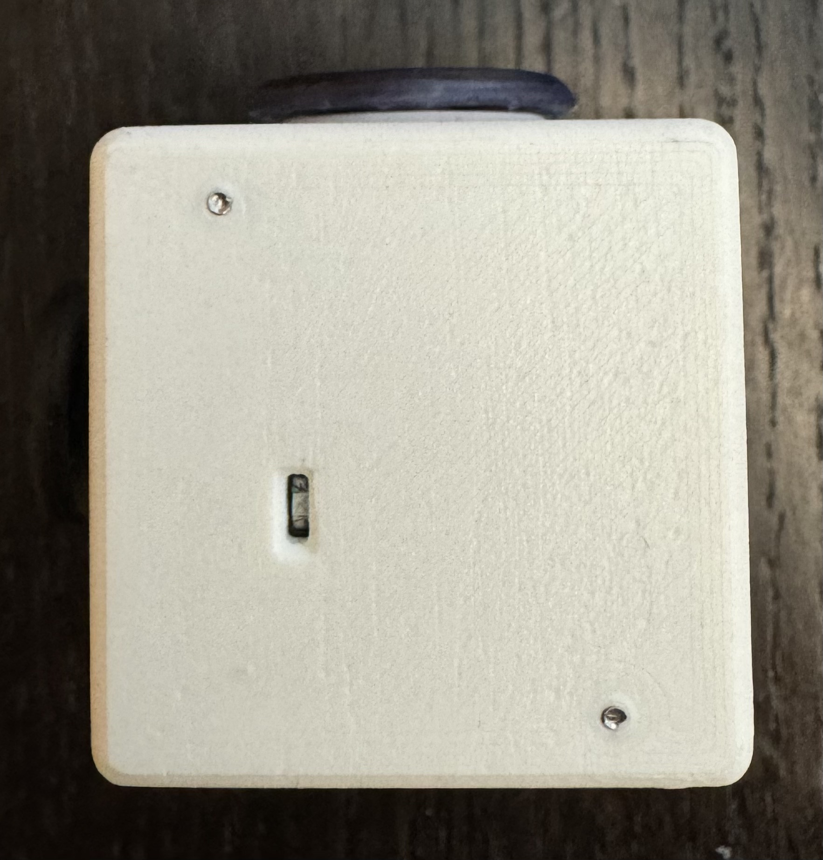
b
c
d
a
e
f
g

Slide 10
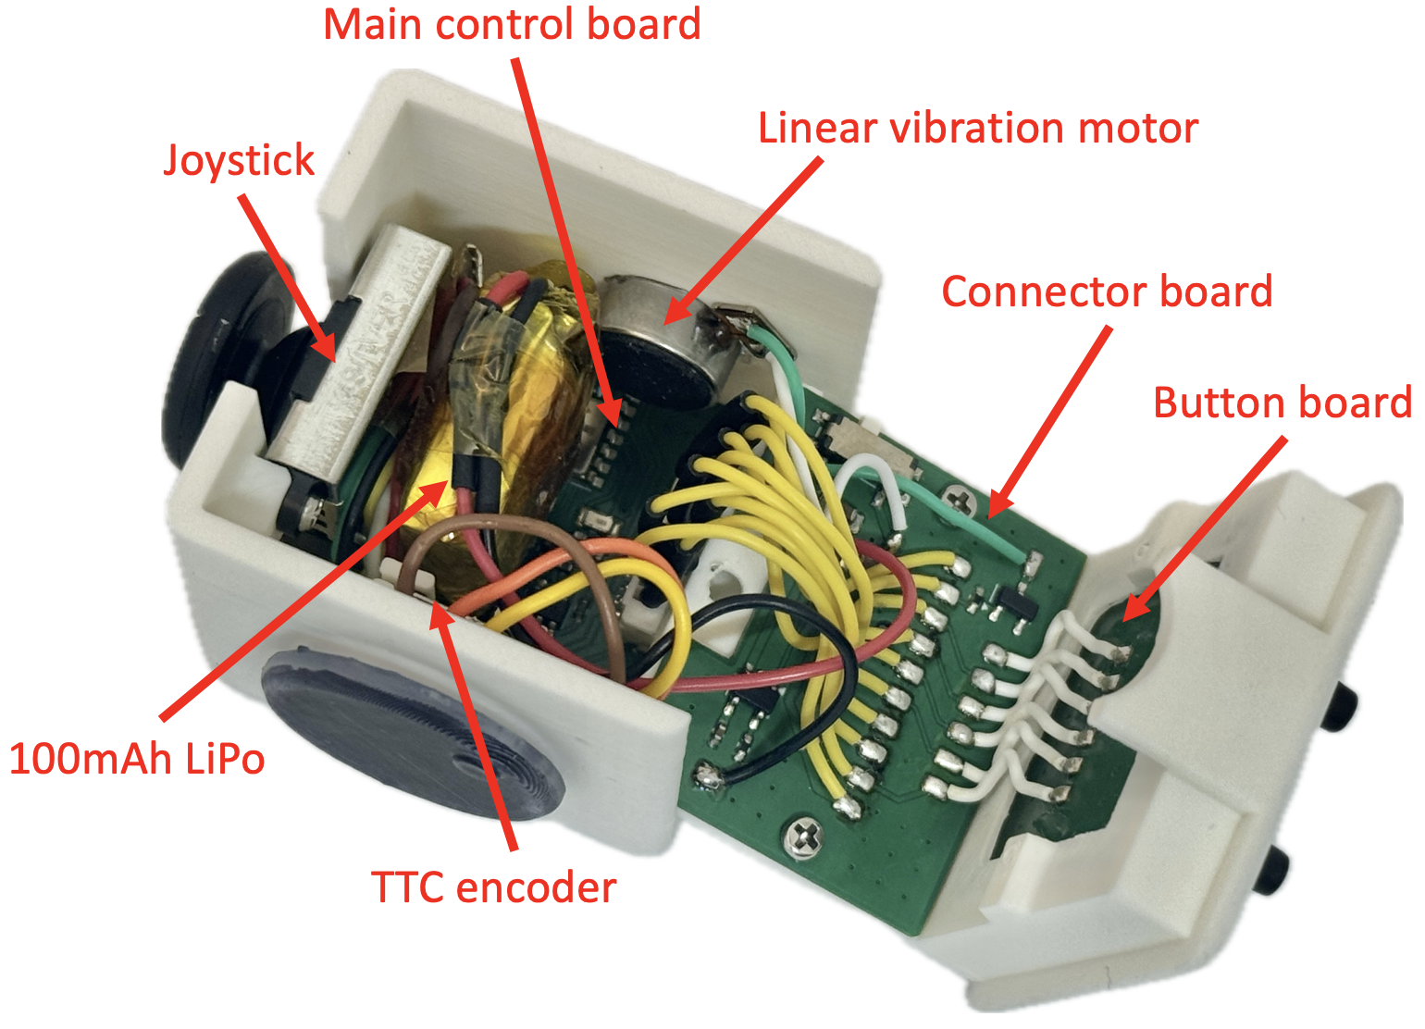


Slide 11
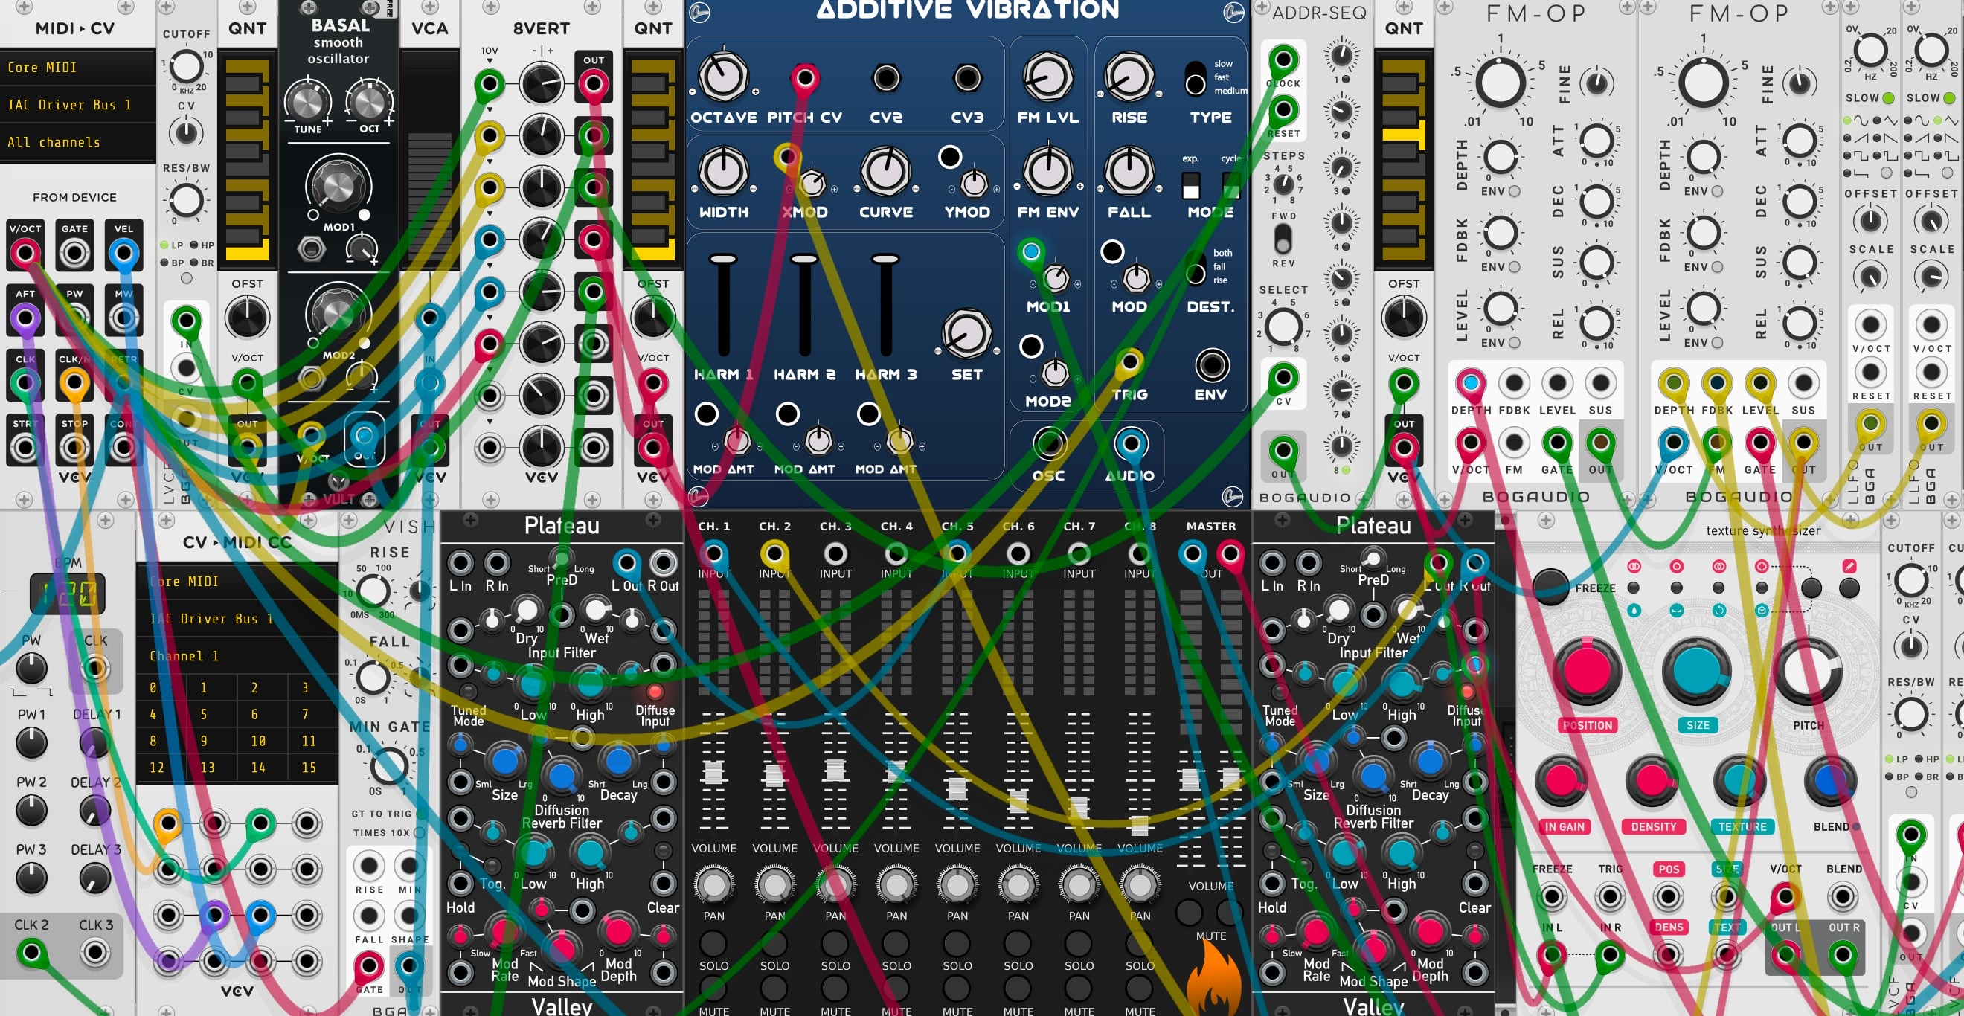
Mapping
MIDI
Music

Slide 12
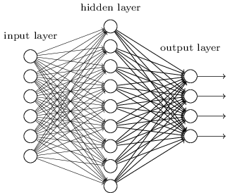
Neural Network
Focused?
Sensors data
Distracted?
Stressed?
Calm?
…

Slide 13
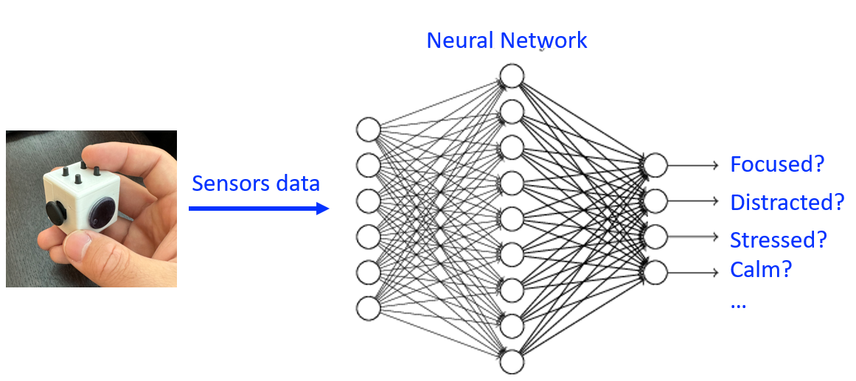
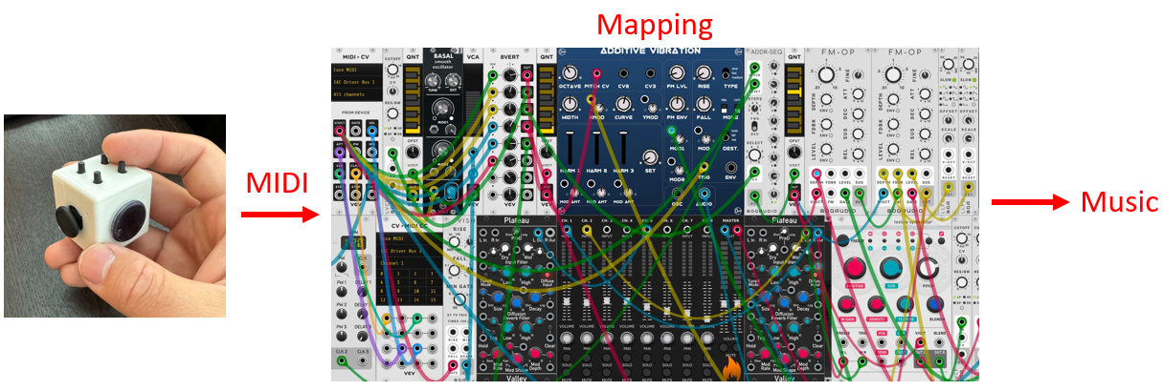

Slide 14
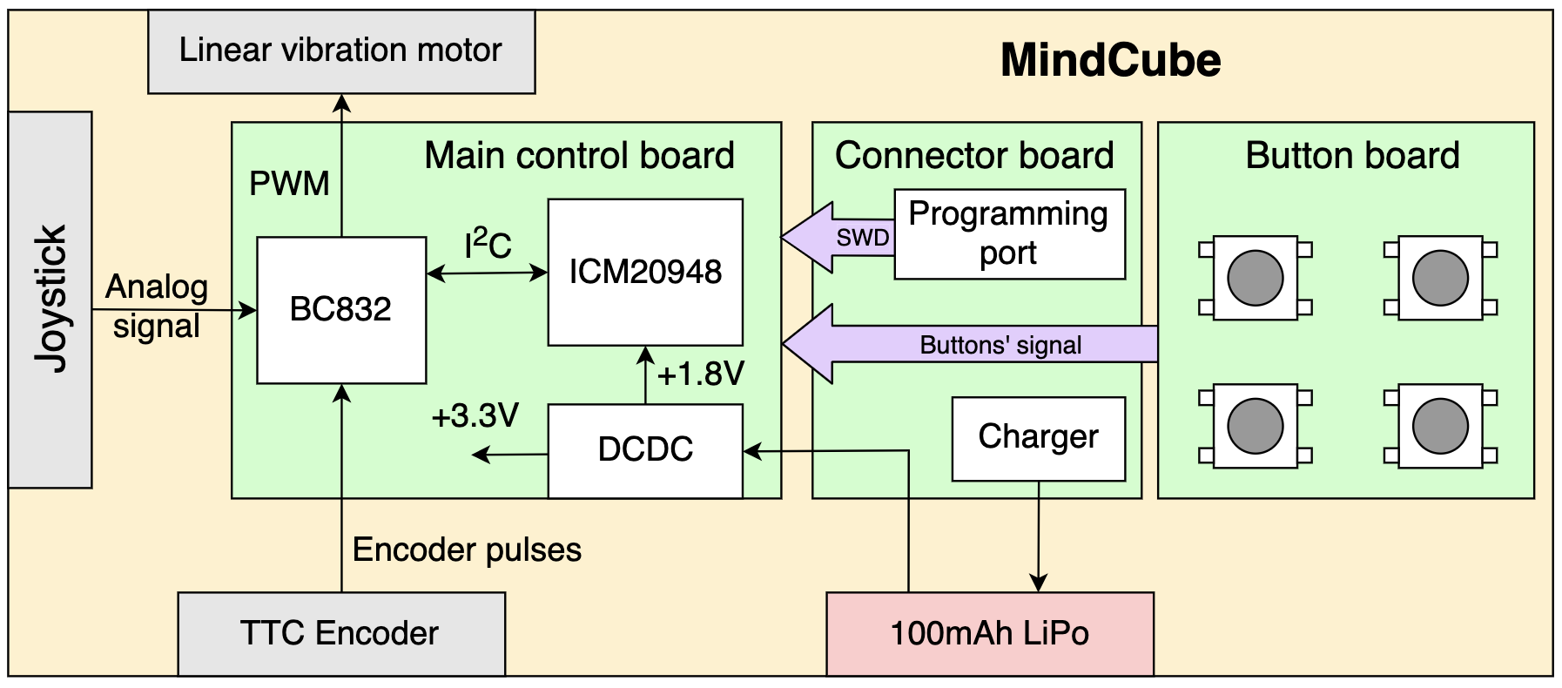

Slide 15
