Slide 1
MAS 836 Sensor Systems for Interactive Environments
Recitation #1 Feb 8th 2010

Slide 2
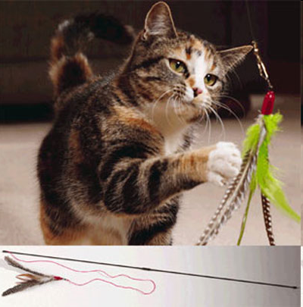

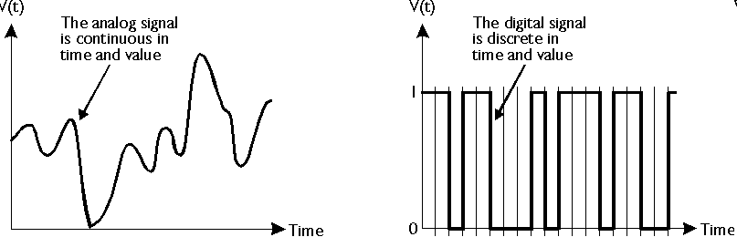
So… exactly what are we going to learn from the sensors class?
Input
Output
THE Black Box!!!
Da Bird cat teaser
Sensors
Active: sonar, FSR…
Passive: photodiodes, piezo microphone
Electronics
Output devices
Analog / Digital electronics
Leds / speakers / displays
/computer ….
A sensor is a device that receives a
stimulus and responds with an electrical
signal. -- J. Fraden
http://www-scm.tees.ac.uk/users/a.clements/DSP/ADintro.htm

Slide 3
THE Black Box!!!
we’ll start with what’s inside the black box….
then introduce different sensors..
and you’ll have to figure out your final projects..

Slide 4


Okay.. tell me what’s in the black box then…
Resistors
  Ohm’s Law
  Resistor in parallel / series
  Voltage divider
  Wheatstone bridge
Capacitors
  Gauss’s Law
  Capacitor in parallel / series
Inductors
Diodes
  Zener diodes
Transistors
Op Amps
  Ideal model
  Comparator / Schmidt trigger
  Voltage follower
  Non-inverting Amp / Inverting Amp
  Summing / Differential Amplifier
and more!
THE Black Box!!!

Slide 5
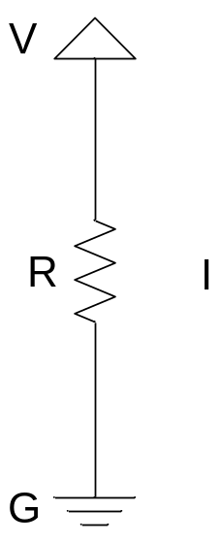
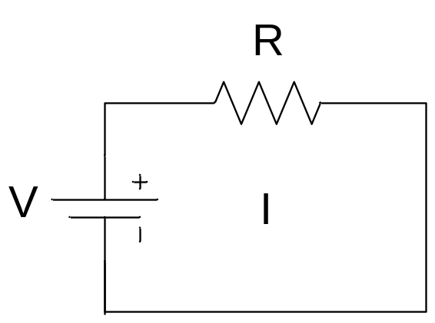
Resistors
Ohm's Law : The voltage drop across a resistor is proportional to the current owing through it and is modeled by “Ohm's Law.”
V : “Voltage” is the potential the electrons drop across the circuit
I : “Electric Current” is the flux of electrons per unit time (Amperes)
R : “Resistance” relates voltage to current
=
V = I × R

Slide 6
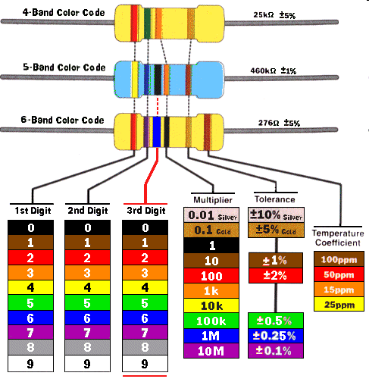
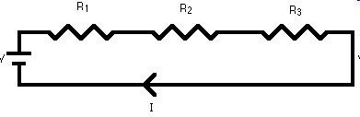
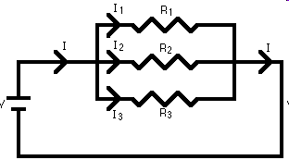
Resistors
Resistors in Series :
Resistor chart
Rtotal = R1 + R2 + R3 +….
Resistors in Parallel :
1/Rtotal = 1/R1 + 1/R2 + 1/R3 +….
http://www.pyrouniverse.com/gallery2/data/500/resistors.gif
See more examples on http://physics.bu.edu/py106/notes/Circuits.html

Slide 7
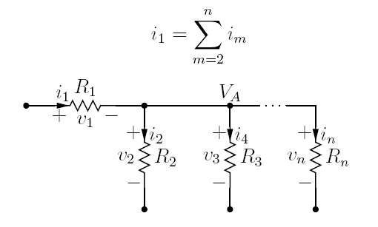
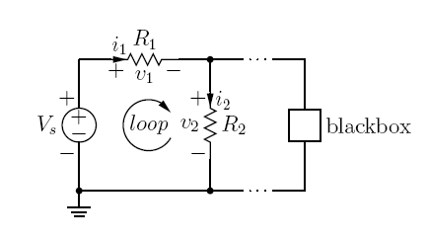
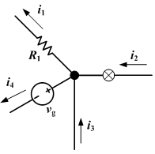
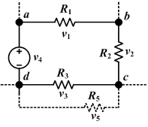
Resistors
Kirchhoff's Current Law :
To satisfy the conservation of charge
(think flow of electrons), all currents owing
into a node must sum to zero,
Kirchhoff's Voltage Law :
The sum of all voltages around a loop of
circuit elements is zero.
i₁ = i₂+ i₄+… i_{n}
i₁ + i₄ = i₂+ i₃
v₁ + v₂ + v₃ + v₄ = 0
There can be many many loops in the same circuit

Slide 8
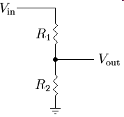
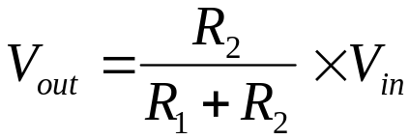
Resistors
Voltage divider :
a simple linear circuit that produces an output voltage (V_{out}) that is a fraction of its input voltage (V_{in}).
Rtotal = R1 + R2
V1
itotal = i1 = i2
I_{total}
Vin = i1 × R1 + i2 × R2 = itotal (R1 + R2)
Vout = V₂ = i × R₂
V2
Resistive Divider
Applications : reference voltage, voltage source…

Slide 9
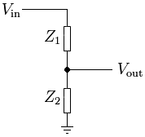
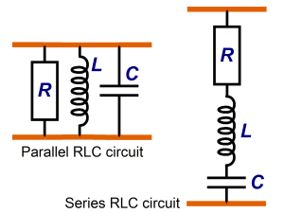

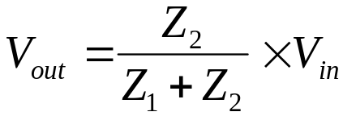
Impedance (Z)
Electrical impedance, or simply impedance, describes a measure of opposition to alternating current (AC). Electrical impedance extends the concept of resistance to AC circuits, describing not only the relative amplitudes of the voltage and current, but also the relative phases. I am impressed that you are still reading this. Impedance is defined as the frequency domain ratio of the voltage to the current
In short, things get complicated when capacitors and inductors are involved. Stuff might change with time. It’s easier if we can do the math in the frequency domain…
For example – voltage divider
V1
C
Z
R
I_{total}
L
V2
To sum up, some guy decided to put all the crazy math into a bucket and call it “Z”…
The input voltage is applied across the series impedances Z₁ and Z₂ and the output is the voltage across Z₂.
Z₁ and Z₂ may be composed of any combination of elements such as resistors, inductors and capacitors.
http://en.wikipedia.org/wiki/Impedence
http://www.calctool.org/CALC/eng/electronics/RLC_circuit

Slide 10
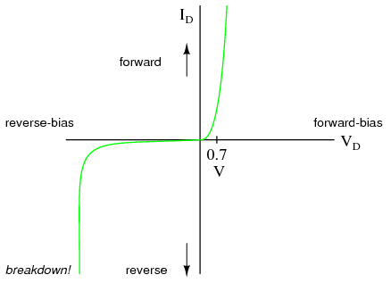


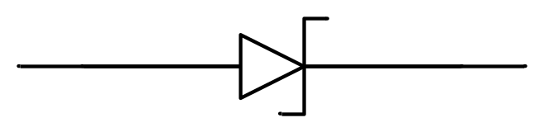
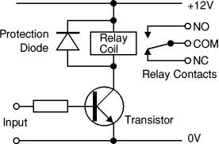

Diodes
Diodes allow electricity to flow in only one direction.
Diode
Forward bias (0.6~0.7V)
Reverse bias
(very large voltage,
normally destroy the diode )
Applications : relay protection, rectifier,
Zener regulator… we’ll see a lot of examples in the lab
Zener
Diode
Forward bias (0.6~0.7V)
Reverse bias
4.7V for example (4V7)
http://www.kpsec.freeuk.com/components/diode.htm
http://www.allaboutcircuits.com/vol_3/chpt_3/1.html
http://hyperphysics.phy-astr.gsu.edu/hbase/electronic/diodecon.html#c2

Slide 11
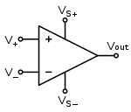
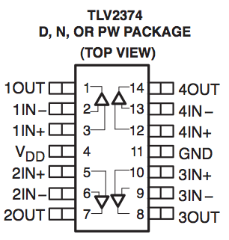
Op Amps
Circuit diagram symbol for an op-amp
V₊: non-inverting input
V₋: inverting input
V_{out}: output
V_{s+}: positive power supply
V_{s-}: negative power supply
The 4 channel Op Amp we use in this class

Slide 12
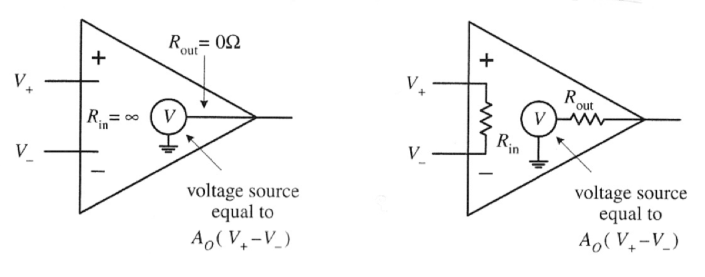
Op Amps
op amps Figures are from Practical electronics for inventors 2nd edition, Scherz
  Ideal model
  Real model
Rule 1: for ideal Op Amp A_{o} =∞, in real life, A_{o} = 10⁴-10⁶
Rule 2: for ideal Op Amp R_{in} = ∞, in real life, R_{in} = 10⁶-10¹²Ω
R_{out}= 0 R_{out}=10 - 1000Ω
Rule 3: input terminals draw no current, in real life it’s almost true..
(within picoamps)
Rule 4: When negative feedback, current flows through feedback
resistor to make V+ equal to V-

Slide 13
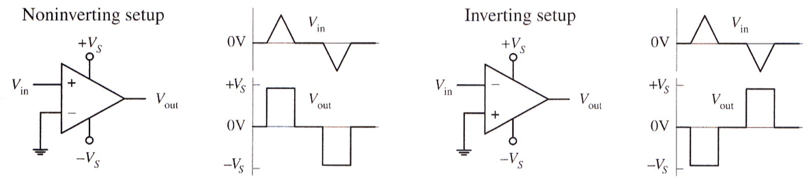
Without feeback loops,
Vo = Ao (V+ - V-)
Ao can be very big! But even though Op Amps
can do magic, the output can’t be bigger than
Vs+ or smaller than Vs-.
Therefore, Vout will saturate if it’s out of range
Using Op Amps as comparator

Slide 14
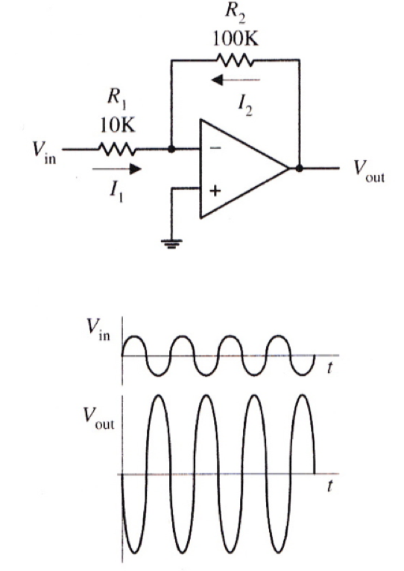
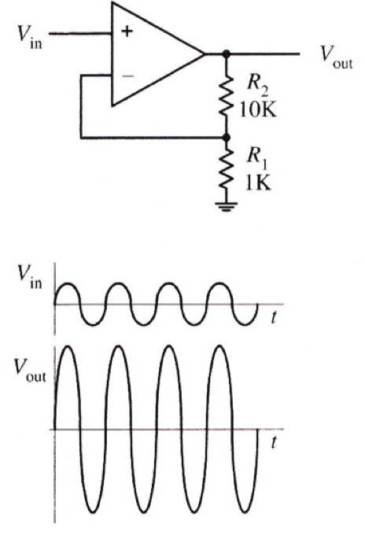
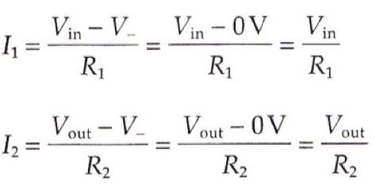
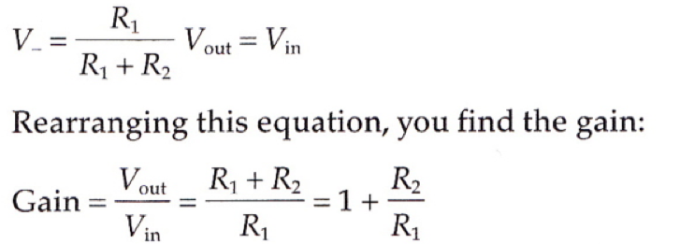
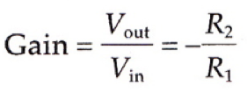
Op Amps
  Inverting Amplifiers
  Non-Inverting Amplifiers

Slide 15
Op Amps
  Inverting Amplifiers
Op Amp Rule 4
Current from negative feedback
will try to keep V+ = V-
V+ = 0V, therefore, V- = 0V
Kirchhoff Current’s Law:
all currents flowing into a node must sum to zero

Slide 16
Op Amps
  Non-Inverting Amplifiers
Iout
Voltage divider
Op Amp Rule 4
Current from negative feedback
will try to keep V+ = V-
Application: Voltage-to-Current Converter
Iout = V_{out} / R₁+R₂ = Vin / R2

Slide 17
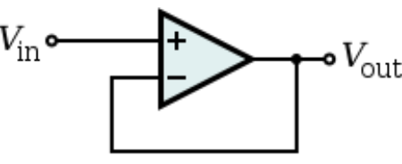
Op Amps
  Unit Gain Amplifiers (buffer)
Rule 2: for ideal Op Amp R_{in} = ∞ → very high impedance
R_{out}= 0 → very low impedance
Remember “Z”?
BB1
Z
BB2
z

Slide 18
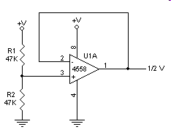
Op Amps
Example application
An opamp can also be used as a bias generator (or reference) for providing 1/2 the power
supply voltage for other opamps on the same board using a single ended (uni-polar) power supply.
To turn this circuit into a power regulator,
replace R2 with a zener and R1 with an appropriate value,
and the output of the opamp will provide a buffered regulated voltage source.
Voltage divider
buffer
http://www.pic101.com/op_amp.htm

Slide 19
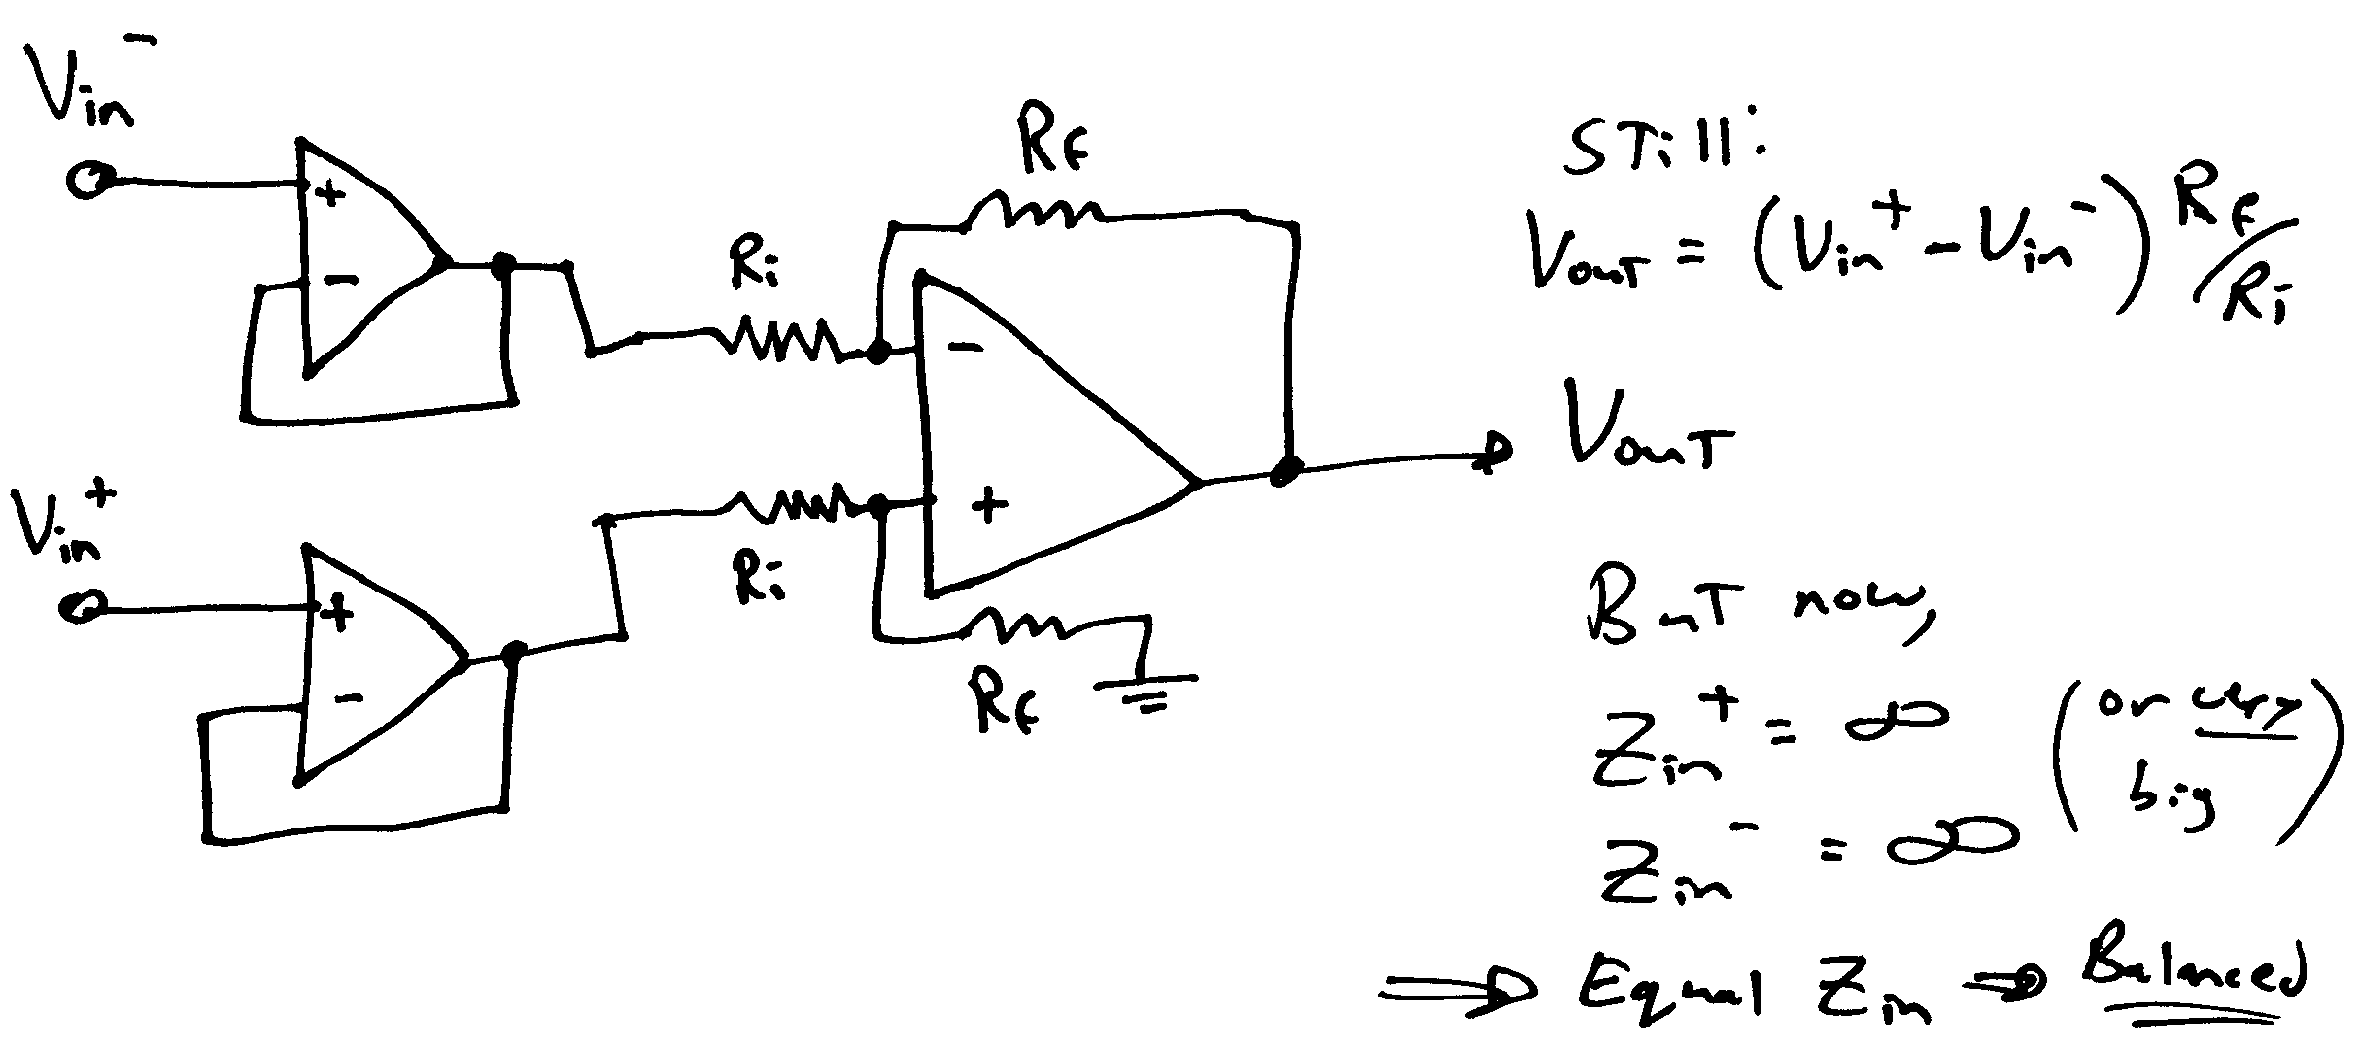
The Basic Instrumentation Amplifier
Buffer each leg of the differential amplifier by a voltage follower
  Impedance is now extremely high at both inputs
  Impedance can be set by a shunt resistor across inputs
  This is a balanced “instrumentation” amplifier
I hope this makes more sense now…

