Slide 1
MID-PROJECT TECHNICAL REVIEW
UrbanEye
Data Engineering → ML Pipeline → Initial Evaluation
A reproducible, auditable pipeline that turns municipal 311 service-request data into ML-ready datasets — and an honest first evaluation of three prediction tasks against strong baselines.
1,900,000 incidents
3 cities ingested
22/22 pipeline stages
90 automated tests
3 ML tasks trained
Generated from repository reports · 15 September 2026
Notes:
WHAT THIS SLIDE SHOWS
Title slide. Five headline facts: 1,900,000 incidents, 3 cities ingested, 22/22 pipeline stages, 90 automated tests, 3 ML tasks trained.
TAKEAWAY
This is an engineering review of a working, reproducible system — not a demo.
HOW TO EXPLAIN IT
"UrbanEye turns municipal 311 service-request data into ML-ready datasets and models. In this review I will cover the data foundation, the validation infrastructure, the three tasks we trained, and an honest comparison against baselines. Some of those comparisons are unfavourable, and I will present those as carefully as the favourable ones — they are the most useful results we have."
LIKELY QUESTIONS
Q: Is this real data or synthetic?
A: Real public 311 data from Chicago, New York City and San Francisco, downloaded from each city's open-data portal. Nothing is synthetic and no labels are fabricated.
Q: Can you reproduce this?
A: Yes. One command rebuilds all 18 tables from raw in 606.93 seconds and the rebuild is content-identical.

Slide 2
01 PROBLEM
Why civic 311 data resists direct machine learning
The operational problem
Cities receive hundreds of thousands of civic service requests a year — potholes, streetlight faults, graffiti, drainage. Crews are finite. Deciding what to send where, and warning when a case is about to miss its deadline, is currently reactive.
Why 311 data is useful
311 systems record what was reported, where, when, by which channel, which department owned it and when it closed. That is a large, public, longitudinal record of how a city actually responds to its own citizens.
Why it cannot be modelled directly
Every city uses a different schema, vocabulary and timestamp convention. Closure timestamps do not always mean service completed. Random splits leak the future into the past. Naive use produces confident, wrong models.
What UrbanEye sets out to do
Build the data foundation first: ingest heterogeneous municipal 311 feeds, normalise them into one audited schema, engineer leakage-safe features, and only then train models — each measured against a baseline strong enough to be worth beating.
This review reports the state of that foundation and the first models built on it. The models are experimental; the pipeline is not.
WHAT THIS REVIEW COVERS
01
Data foundation
sources, schema, generated datasets
02
Assurance
quality, provenance, leakage, audits
03
Methodology
task design and chronological splitting
04
Results
three models against strong baselines
05
Next phase
limitations and proposed work
UrbanEye · Mid-Project Technical Review
2
Notes:
WHAT THIS SLIDE SHOWS
The motivation in three parts — the operational problem, why 311 data is suited to it, and why the data cannot be modelled naively — then the project's response.
TAKEAWAY
The hard part of this project is the data, not the model. That is a deliberate scoping decision, not an excuse.
HOW TO EXPLAIN IT
"Cities are already collecting the record of how they respond to citizens. The obstacle is that three cities means three schemas, three vocabularies and three timestamp conventions, and that closure timestamps do not always mean the work was done. If you skip that and go straight to modelling, you get a confident model of clerical behaviour. We built the foundation first and we can show that it is validated."
LIKELY QUESTIONS
Q: Why not just use one city and start modelling immediately?
A: We could have, and we would have had results sooner. But a single-city model tells you nothing about whether the approach transfers, and cross-city generalisation is the interesting research question. Slide 13 lists it as an explicitly untested area, which is only meaningful because the pipeline is multi-city.
Q: Isn't 311 data quite clean already?
A: No. Slide 5 shows a concrete example: 173,346 records close in under a minute, and in Chicago 18,279 of them at exactly 7 seconds. That is a database write, not field work, and it was 8.2 % of our regression target.

Slide 3
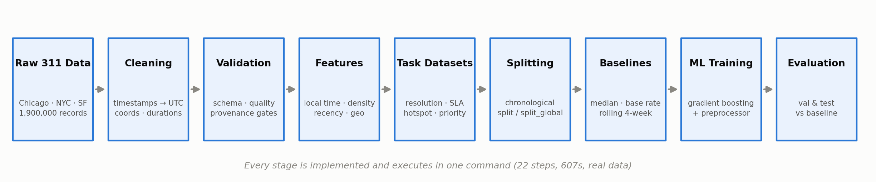
02 SYSTEM
End-to-end pipeline — what runs today
All 22 stages execute in one command and rebuild every dataset from raw in 607 s.
IMPLEMENTED AND VALIDATED
Ingestion · schema normalisation · cleaning · provenance and leakage validation · time, density and recency features · task datasets · chronological splitting · baselines · training framework · evaluation and reporting.
STAGES PER PHASE, AS EXECUTED
verify 2 preprocess 3 incidents 1 features 2 priority 1 ml 5 validate 8
Slowest stage build_duplicate_pairs at 98 s; every stage returned OK.
PROPOSED — NOT YET BUILT
Model optimisation · cross-city generalisation · richer spatial and workload features · interpretability · inference API · drift monitoring · automated retraining · dashboard integration.
WHY THE BOUNDARY SITS HERE
Deployment work is gated on evidence, not on schedule: two of the three models do not yet beat their baseline on both folds, and serving a model in that state would be worse than serving none.
UrbanEye · Mid-Project Technical Review
3
Notes:
WHAT THIS SLIDE SHOWS
The pipeline architecture: 22 stages grouped into phases — verify, preprocess, incidents, features, priority, ML, validate — followed by what is implemented versus what is proposed.
TAKEAWAY
The entire chain from raw download to evaluated model runs as one orchestrated command in 606.93 seconds, with all 22 stages reporting OK.
HOW TO EXPLAIN IT
Trace one path with your finger: raw files → schema normalisation → cleaning with provenance rules → the unified incident table → feature engineering → the three task datasets → training → evaluation reports. Then say: "Every box on the left half of the lower panel is implemented and validated. Every box on the right is proposed and not built. We are explicit about that boundary throughout this deck."
LIKELY QUESTIONS
Q: What does 'reproducible' mean concretely here?
A: Fixed random seed (20260915), configuration-driven rather than hard-coded, no manual edits to generated parquet files, and a full rebuild that produces content-identical outputs. The repository tracks the code and config; the generated datasets are deliberately untracked.
Q: How long does the whole thing take?
A: 606.93 seconds end-to-end for 1.9 million incidents, on a laptop.
Q: What is the 'priority' phase if you are not modelling priority?
A: It computes a deterministic rule-based priority score from a configuration file for operational use. We explicitly do not train a model on it — see slide 6 — because a supervised model would just relearn the YAML.

Slide 4
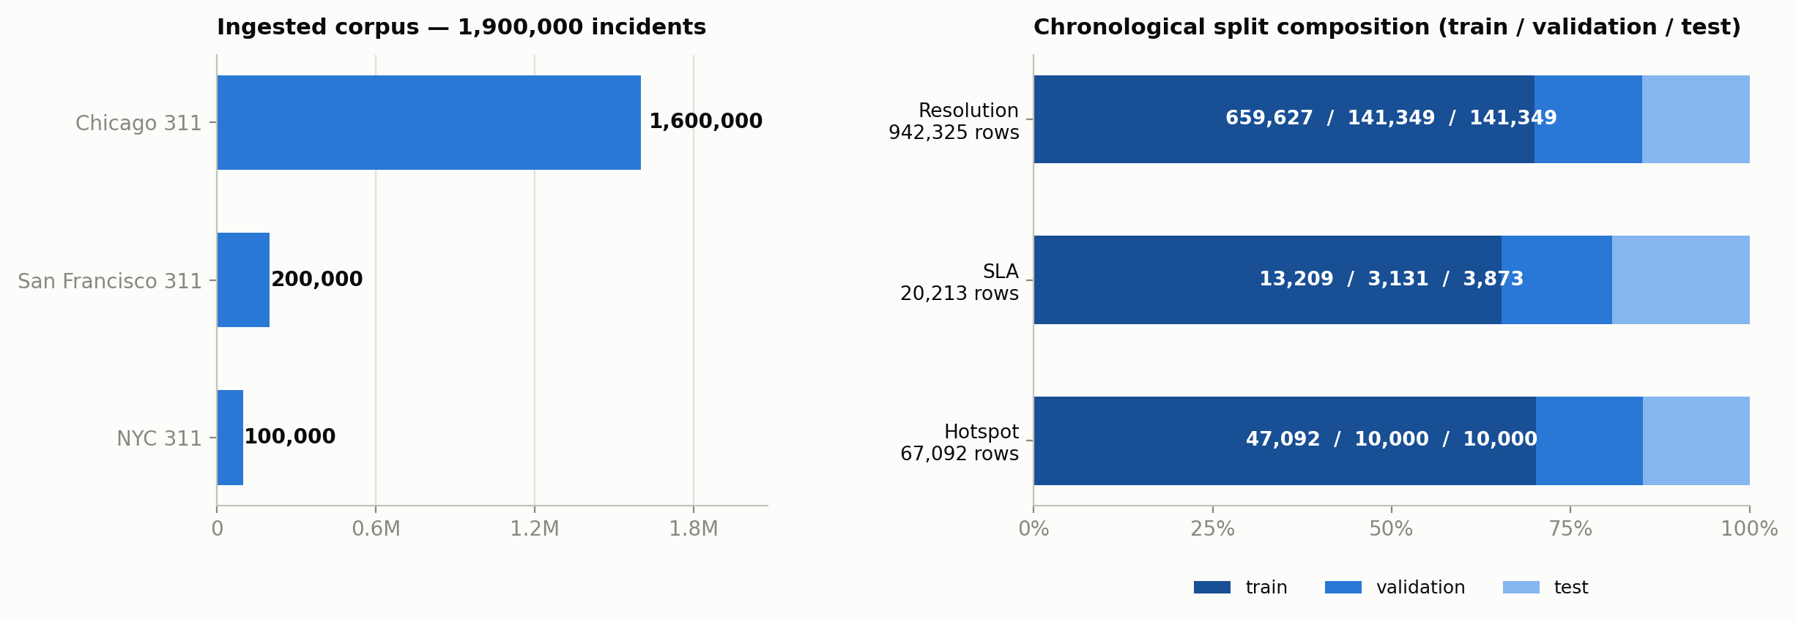
03 DATA
Data foundation
Three municipal 311 sources normalised into one audited schema; Boston is configured and licence-cleared but not yet downloaded.
Generated dataset | Rows | Cols | Purpose
all_incidents | 1,900,000 | 41 | Unified cleaned incident record
resolution_ml | 942,325 | 27 | Resolution-time regression
hotspot_ml | 67,092 | 20 | Zone x category x week count panel
sla_ml | 20,213 | 26 | SLA-breach classification
priority_features | 1,900,000 | 60 | Policy features — no supervised target
duplicate_ml | 455,460 | 11 | Duplicate pairs — labels ready, evaluation set is not
Raw and generated datasets are deliberately untracked in Git; the repository carries the code and configuration that regenerate them. A full rebuild reproduced all 18 tables content-identical.
UrbanEye · Mid-Project Technical Review
4
Notes:
WHAT THIS SLIDE SHOWS
The data foundation: source volumes and the generated dataset table with exact row and column counts.
TAKEAWAY
1,900,000 incidents across three cities in one audited 41-column schema, from which six downstream datasets are derived.
HOW TO EXPLAIN IT
"Chicago contributes 1.6 million records covering July 2018 to August 2020, San Francisco 200,000 covering January to May 2018, and New York City 100,000 covering January to March 2010. Those windows are disjoint, and that fact drives the splitting decision on slide 7. Boston is configured and its licence has been cleared — PDDL — but it has not been downloaded, so it contributes nothing to any result in this deck."
Point out the two rows that are deliberately not model inputs: priority_features has no supervised target, and duplicate_ml has labels but no usable evaluation set.
LIKELY QUESTIONS
Q: Why is NYC only three months and from 2010?
A: It is the extract we obtained for that source. It is a real limitation and it constrains the SLA task, which is NYC-only — slide 9 states that explicitly.
Q: Is the class imbalance between cities a problem?
A: Chicago is 84 % of the corpus, so a pooled model is largely a Chicago model. That is exactly why 'cross-city generalisation untested' appears on the weaknesses slide.
Q: Why is resolution_ml 942,325 rows when all_incidents is 1.9 million?
A: A resolution-time row requires an observed, plausible duration. Records still open, records with negative or absurd durations, and the sub-minute artefacts on slide 5 have no observable target, so they are excluded from that task only. They remain in the incident table.

Slide 5
04 ASSURANCE
Validation infrastructure
The pipeline is tested before its outputs are trusted. These gates run on every execution.
Gate | Result | What it checks
Full pipeline | 22/22 stages | End-to-end rebuild from raw in 607 s
Automated tests | 90 passed | Unit and integration tests across pipeline and training
Data quality | 11/11 | Integrity assertions on the incident table
Provenance | 11/11 | Includes deliberate fabrication attempts that must be rejected
Leakage | 11/11 | Backward-window features re-derived independently
Output validation | 15/15 | Shape and content of every ML-ready table
Pipeline audit | 56/56 | Stage-by-stage audit of the whole chain
Task & leakage audit | 78/80 | 12 leakage routes per task (2 not applicable)
The statistical audit is reported, not suppressed
40 findings classified needs-preprocessing, 2 policy decision, 1 dangerous. The dangerous finding is a documented regime change inside the evaluation window — recorded so results are read correctly, not removed to make a chart look better.
UrbanEye · Mid-Project Technical Review
5
Notes:
WHAT THIS SLIDE SHOWS
The validation gates, with pass counts read from the repository's own report files at build time, and the statistical audit reported honestly.
TAKEAWAY
The pipeline is tested before its outputs are trusted, and failures are surfaced rather than suppressed.
HOW TO EXPLAIN IT
"Three of these deserve emphasis. The provenance suite includes deliberate fabrication attempts — we try to write a value into a NULL-provenance field and the guard must raise ProvenanceViolation. The leakage suite re-derives the backward-looking window features independently and compares; if a feature had used a forward window it would fail. The task and leakage audit checks twelve distinct leakage routes per task, 78 passing and 2 not applicable."
On the amber box: "The statistical audit found 43 issues. We report the distribution rather than the headline. One is classified dangerous — a documented regime change inside the evaluation window. We did not delete it, because deleting it would make the charts look better and the conclusions worse."
LIKELY QUESTIONS
Q: What exactly is the 'dangerous' statistical finding?
A: A distributional regime change within the evaluation period — the operating conditions differ between the training window and part of the evaluation window. It is flagged so that a performance drop between validation and test is read as a period effect rather than as pure model failure. That matters directly for the resolution result on slide 8.
Q: 90 tests sounds like a lot for a data pipeline. What do they cover?
A: Unit tests on the cleaning and feature functions, integration tests on the split logic and baselines, and regression tests that pin specific known behaviours — for instance a test that fails if the report claims the hotspot model beat its baseline when the measured numbers say otherwise.
Q: Are these gates run automatically?
A: Yes, they are stages within the 22-stage pipeline run — they are not a manual afterthought.

Slide 6
05 DATA-QUALITY FINDING
Sub-minute closures: an artefact, not service time
Discovered during validation of the resolution target.
Evidence
Chicago closes 18,279 cases at exactly 7 seconds, 18,125 at 6 seconds and 14,578 at 5 seconds — a transactional write, not field work.
In NYC the sub-minute population is 7,645 cases, of which 7,640 sit at exactly 0 seconds and only 5 fall anywhere between 1 and 60 seconds.
One minute is also the coarsest timestamp granularity in the sources, so a sub-minute duration is below what the data can express.
Rule applied
cleaning.resolution_time.min_observable_seconds = 60
No row is deleted. status, closed_at and a resolution_instant_closure flag are all retained; only the duration becomes NULL, because it is not reliably observable.
173,346 durations were made unobserved — the same treatment negative and absurd durations already received.
 | Before | After
all_incidents rows | 1,900,000 | 1,900,000
resolution_ml rows | 1,026,596 | 942,325
Target p10 | 0.03 h | 1.32 h
Target p25 | 8.87 h | 20.20 h
Target median | 82.99 h | 116.04 h
Share under 1 minute | 8.21 % | 0.00 %
Why this matters for the review
The artefact was 8.2 % of the regression target. Left in place, a model would have learned clerical behaviour and reported it as service-time prediction.
Caveat we state openly: the 60-second threshold is corpus-specific and justified by these sources' timestamp granularity. A publisher with sub-second timestamps would need its own value.
UrbanEye · Mid-Project Technical Review
6
Notes:
WHAT THIS SLIDE SHOWS
A concrete data-quality defect found during validation, the evidence for it, the rule applied, and the measured effect on the target distribution.
TAKEAWAY
8.21 % of the resolution-time target was an administrative artefact, not service time. It is now 0.00 %.
HOW TO EXPLAIN IT
"The evidence is the giveaway. If these were genuinely fast repairs, the durations would be smoothly distributed. Instead Chicago has 18,279 cases at exactly 7 seconds and 18,125 at exactly 6. New York has 7,645 sub-minute cases of which 7,640 are exactly zero — only five fall anywhere in between. That is a system writing a row, not a crew fixing a pothole."
"Our response is conservative. We delete nothing. The status, the closure timestamp and an explicit flag are all retained. Only the duration becomes NULL, because it is not reliably observable — the same treatment negative durations already received. The effect is visible in the table: the 10th percentile moves from 0.03 hours to 1.32 hours and the median from 83 hours to 116 hours."
LIKELY QUESTIONS
Q: How do you know these aren't genuine instant resolutions?
A: Three independent arguments. The point-mass structure at exact second values. The fact that one minute is the coarsest timestamp granularity in these sources, so a sub-minute duration is below what the data can express. And the volume — 173,346 genuine same-second field resolutions is not operationally plausible.
Q: Isn't 60 seconds an arbitrary threshold?
A: It is corpus-specific and we say so on the slide. It is justified by the timestamp granularity of these three sources. A publisher with sub-second timestamps would need its own value, which is why it lives in configuration — cleaning.resolution_time.min_observable_seconds — rather than in code.
Q: Doesn't nulling 173,346 targets bias your dataset?
A: It biases it towards cases where resolution time is actually observable, which is the population the task is defined on. The alternative — training on them — biases the model towards predicting clerical behaviour. We judged the first bias to be the honest one, and we flag it on the weaknesses slide because the target may still contain administrative closures above 60 seconds.
Q: Could you model the artefact instead?
A: Predicting whether a case will be instantly closed administratively is a legitimate separate task. It is not resolution-time prediction, and we did not want to conflate them.

Slide 7
06 TASKS
Three supervised tasks — and two deliberately excluded
 | Resolution time | SLA breach | Hotspot
Question | How long until this request is resolved? | Will this request miss its due date? | How many incidents next week in this zone and category?
Target | resolution_time_hours | sla_breach | future_incident_count
Type | Regression (hours) | Binary classification | Count regression
Dataset | resolution_ml 942,325 rows | sla_ml 20,213 rows | hotspot_ml 67,092 rows
Split used | split_global | split | split_global
Features | 20 | 17 | 13
Headline metric | MAE + median AE | PR-AUC | MAE vs rolling mean
Status | Mixed — partial success | Most promising | Not yet better than baseline
Two tasks are deliberately not modelled
Priority — no public 311 dataset records an operational priority, and the existing priority_baseline is a deterministic function of a configuration file; training on it would reproduce the YAML. Duplicate detection — the labels are genuine, but in the realistic candidate population the test fold contains 23,480 positives and zero negatives, so no metric on it would mean anything.
UrbanEye · Mid-Project Technical Review
7
Notes:
WHAT THIS SLIDE SHOWS
The three supervised tasks side by side — question, target, type, dataset, split column, feature count, headline metric and current status — plus the two tasks we deliberately do not model.
TAKEAWAY
Task design is explicit and per-task, not one generic table fed to three models.
HOW TO EXPLAIN IT
"Each task has its own dataset, its own manifest of allowed predictors, and its own baseline. The manifest matters: features are selected by explicit declaration, never by 'all columns except the target'. That is what prevents an identifier or a post-outcome field from silently becoming a predictor."
On the exclusions: "We were asked to build a priority model. We are not going to, and the reason is that no public 311 dataset records an operational priority. The priority_baseline field in our repository is a deterministic function of a configuration file. A supervised model trained on it would achieve near-perfect accuracy and would have learned the YAML. That would be a fabricated result. Duplicate detection is different — the labels are genuine — but in the realistic candidate population the test fold contains 23,480 positives and zero negatives, so precision is trivially 1.0 and no metric on it would mean anything."
LIKELY QUESTIONS
Q: Why is the SLA dataset only 20,213 rows when the others are much larger?
A: SLA breach is only defined where the source publishes a due date. That is NYC-only and only for complaint types carrying a Due Date field. We would rather have a small honest population than a large invented one.
Q: Why does SLA use a different split column from the other two?
A: Slide 7 covers this. sla_ml is single-source, so a global chronological cut would place every row in train and leave validation and test empty. The pipeline detects single-source tables and uses the per-source split. That selection rule is itself covered by tests.
Q: Can you not construct priority labels from the data?
A: Only by inventing a rule and then predicting it, which is circular. A legitimate route would be operational labels from a city — dispatch priority, escalation records. That is on the next-phase slide as 'product data needed', not something we can synthesise.

Slide 8
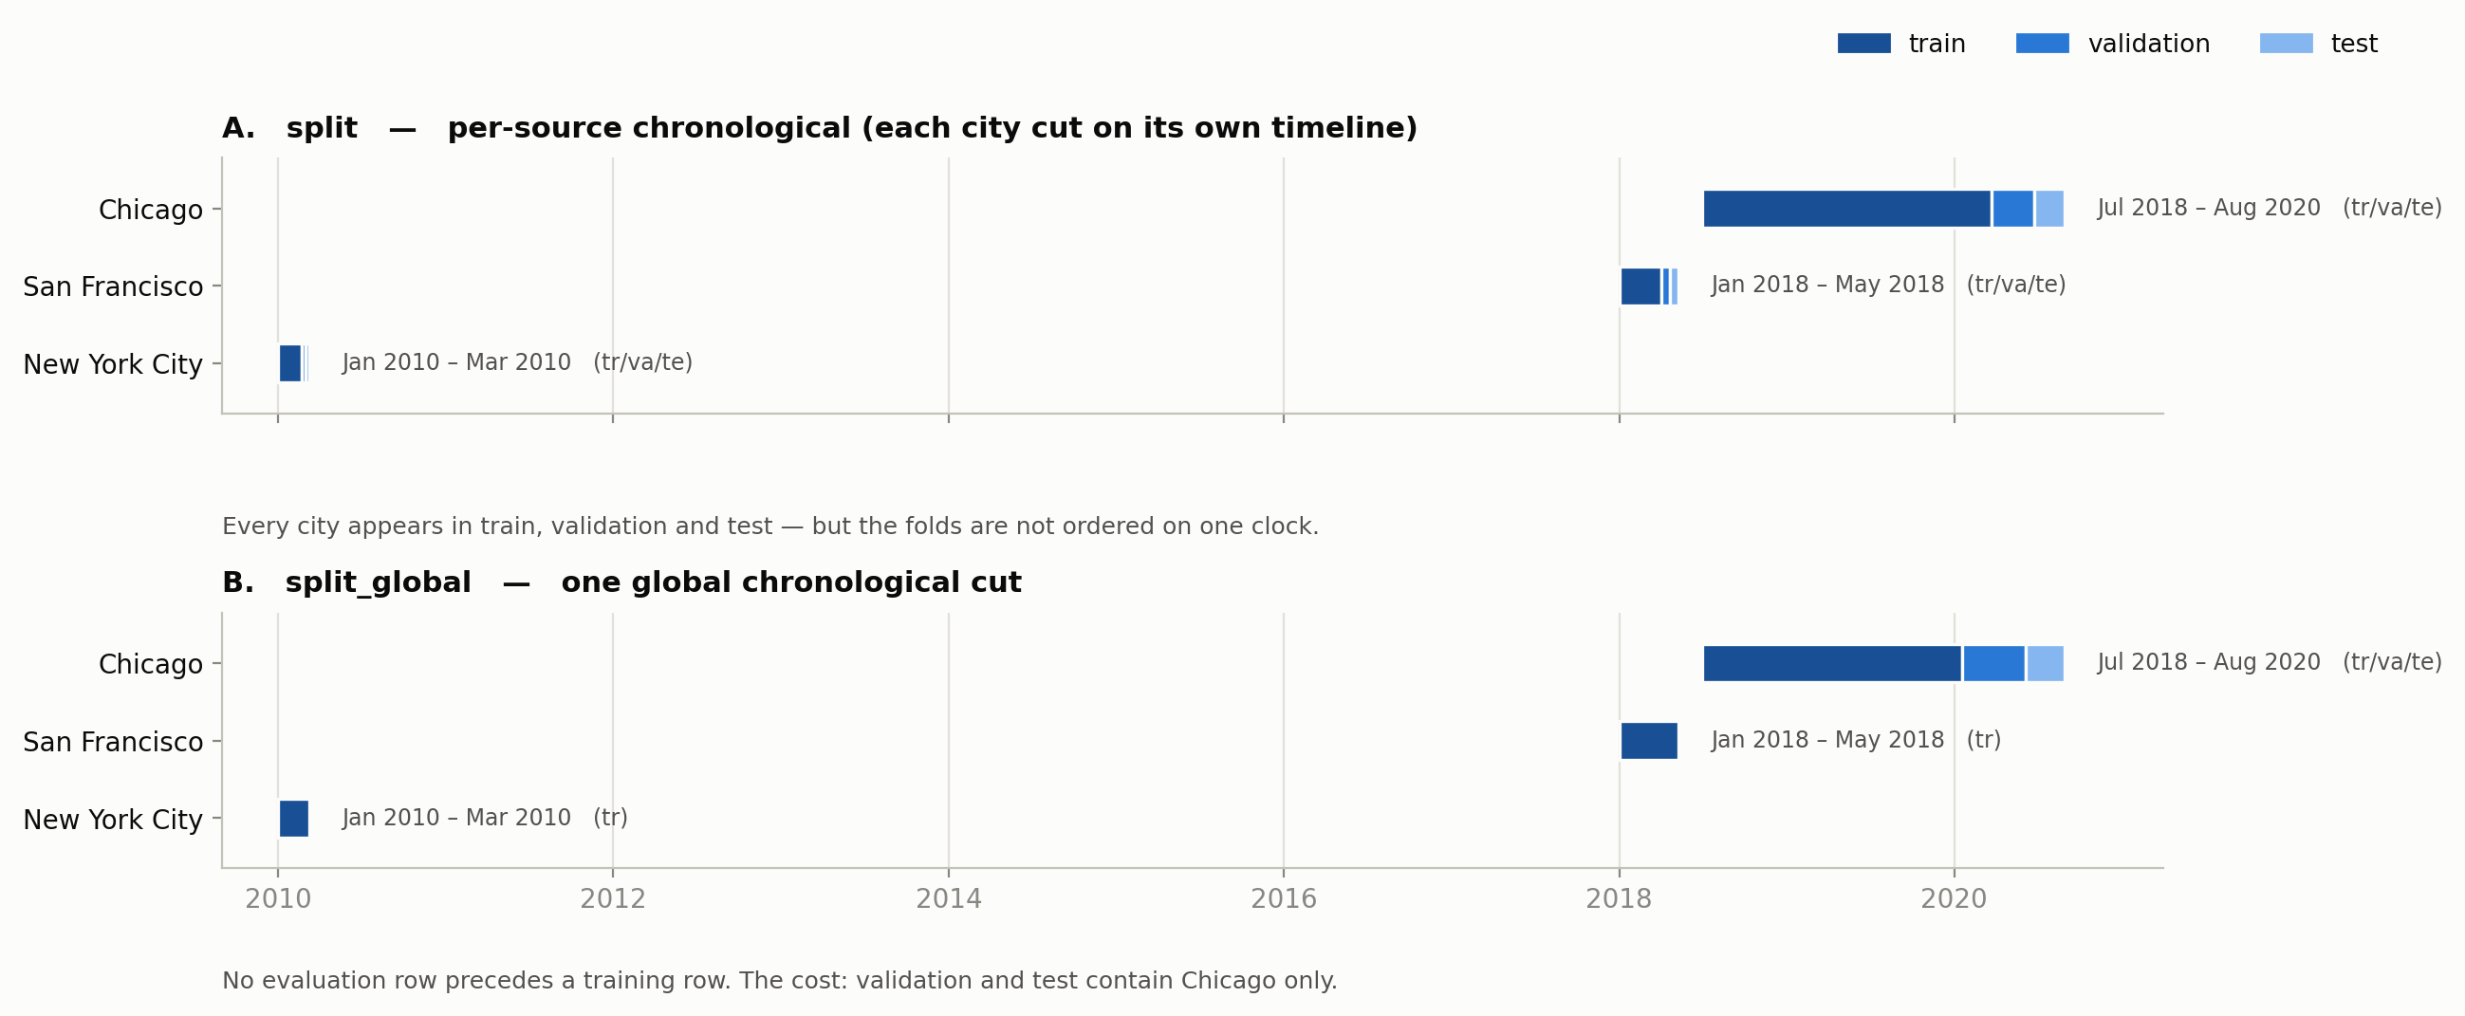
07 METHODOLOGY
Chronological splitting — two strategies, stated openly
Random splitting would leak the future into the past. There is no single correct chronological cut, so the pipeline publishes both.
How the column is chosen
split_global for multi-city tables — one wall clock, so no evaluation row precedes a training row.
split for single-source tables — sla_ml is NYC-only, and a global cut would put every row in train.
The trade-off we accept
Because the three cities occupy disjoint windows, split_global leaves validation and test Chicago-only. Per-source split keeps all cities in every fold but is not globally ordered.
Neither is free. The pipeline exposes both rather than silently choosing, and each task manifest records which column was used and why.
What keeps the folds honest
Density and recency windows are strictly backward and half-open (reported_at < t), so no feature can see its own outcome. The leakage suite re-derives every window independently and compares — 11/11 checks pass, and the task audit tests 12 leakage routes per task. Predictors come from a declared manifest per task, never 'all columns except the target'.
UrbanEye · Mid-Project Technical Review
8
Notes:
WHAT THIS SLIDE SHOWS
The two chronological split strategies drawn on the corpus's real date ranges, with the fold composition visible for each city under each strategy.
TAKEAWAY
Random splitting would leak the future into the past. There is no single correct chronological cut here, so the pipeline publishes both and records which one each task used.
HOW TO EXPLAIN IT
"Look at panel B. Under a single global clock, San Francisco and New York are marked 'train' only — they are labelled '(tr)' — while Chicago carries '(tr/va/te)'. That is not a bug; it is the arithmetic consequence of three disjoint date windows. Under a global cut, everything before the cut date is training, and the two earlier cities fall entirely before it. So global splitting buys you strict temporal ordering and costs you city diversity in evaluation."
"Panel A is the alternative: cut each city on its own timeline. Every city appears in every fold, but the folds are no longer ordered on one clock — a Chicago validation row can precede an NYC training row in real time."
"Neither is free. We expose both rather than silently choosing one, and each task manifest records the column used and the reason."
LIKELY QUESTIONS
Q: Why not just use random splitting with a time-based feature?
A: Because the density and recency features are computed over backward-looking windows. A random split places rows from the same window on both sides of the split, so the model sees neighbouring events at training time that it would not have at prediction time. The measured performance would be optimistic and would not survive deployment.
Q: Doesn't Chicago-only evaluation make your results Chicago results?
A: For the two tasks using split_global, yes — and we say so on the weaknesses slide. That is precisely the argument for the leave-one-city-out evaluation proposed for the next phase.
Q: How are the cut points chosen?
A: By target proportions on the time axis rather than by hand-picked dates, so the same rule applies to every table and is reproducible.
Q: What stops a feature from looking forward?
A: The windows are half-open and strictly backward — reported_at < t, never <= t and never beyond. The leakage suite re-derives each of them independently and compares against what the pipeline wrote; 11 of 11 checks pass.

Slide 9
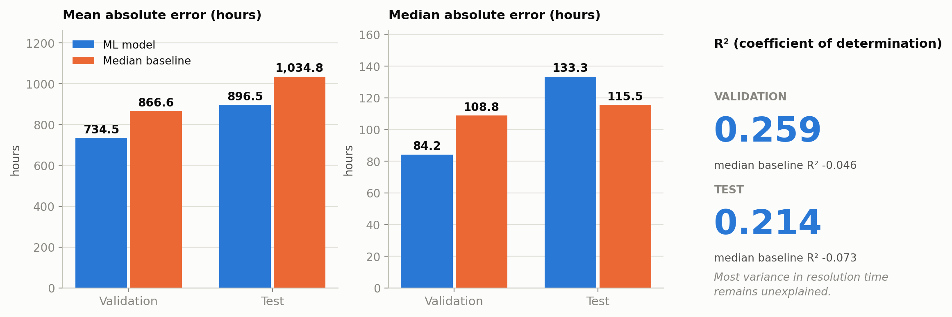
08 RESULT
Resolution time — improves MAE, loses on median error
HistGradientBoostingRegressor on log1p(target) · 20 features · split_global · 659,627 train / 141,349 validation / 141,349 test
Why this is only a partial success
The model wins on the long tail and loses in the middle of the distribution, which is where most operational decisions sit.
On validation it beat the baseline on both metrics — 84.2 h against 108.8 h median error. The reversal appears only on test, so neither fold alone describes this model.
Test metric | Model | Median baseline | Verdict
MAE (hours) | 896.5 | 1,034.8 | improves 13.4%
Median AE (hours) | 133.3 | 115.5 | worse by 15.5%
R squared | 0.214 | -0.073 | most variance unexplained
Verdict recorded in the results file
Beats the median baseline on MAE but LOSES on median absolute error — it wins on the tail and loses in the middle
Selection used validation only. The test fold was scored once, with the already-chosen configuration. Per-city numbers are reported, not used to select.
SELECTED CONFIGURATION · read from the saved model metadata
HistGradientBoostingRegressor · variant C_log1p_deeper · selected on validation MAE · target transform log1p
loss=squared_error, max_iter=500, learning_rate=0.06, max_leaf_nodes=63, min_samples_leaf=20, l2_regularization=1.0
seed 20260915 · scikit-learn 1.6.1 · preprocessing fitted on the training fold only (rare levels folded to the train top-250)
UrbanEye · Mid-Project Technical Review
9
Notes:
WHAT THIS SLIDE SHOWS
Resolution-time results. Validation and test are shown separately, alongside the train-median baseline. The chart is generated from the results JSON, not typed.
TAKEAWAY
A partial success. The model improves mean absolute error by 13.4 % on test but is 15.5 % worse than the baseline on median absolute error — and median error is what matters for typical cases.
HOW TO EXPLAIN IT
"I want to be precise about this result because it is easy to misreport. On test, MAE improves from 1,034.8 hours to 896.5 hours. That is real. But median absolute error moves the wrong way: 133.3 hours against the baseline's 115.5. The model is winning on the long tail — the extreme, slow cases — and losing in the middle of the distribution, which is where most operational decisions actually sit."
"There is a second complication I will not hide. On validation the model beat the baseline on both metrics: 84.2 hours median error against 108.8. The reversal appears only on test. That is consistent with the regime change the statistical audit flagged as dangerous. So neither fold alone describes this model, and we report both."
"Our conclusion: useful today for flagging tail risk, not a general-purpose resolution-time predictor."
LIKELY QUESTIONS
Q: Why is R-squared only 0.214?
A: Because most of the variance in municipal resolution time is driven by things this dataset does not contain — crew availability, backlog, parts, weather, whether a case bounced between departments. The baseline's R-squared is negative (-0.073), so the model does explain more than a constant, but the honest reading is that most variance is unexplained and the missing information is operational.
Q: Isn't MAE of 896 hours — over a month — useless in practice?
A: As a point prediction, largely yes, and we do not claim otherwise. The distribution is extremely heavy-tailed; the median case resolves in about 116 hours while the mean is dragged up by cases open for months. That is why we report median absolute error alongside MAE rather than leading with MAE.
Q: Why train on log1p of the target?
A: The target spans several orders of magnitude. Squared error on the raw scale is dominated by the extreme tail. The log1p transform is applied to the target only, fitted decisions are train-only, and predictions are inverted before any metric is computed — so every number on this slide is in hours, not log-hours.
Q: Did you tune hyper-parameters?
A: Yes, on validation only, and the selected configuration is saved with the model. This one is C_log1p_deeper: max_iter 500, learning_rate 0.06, max_leaf_nodes 63, min_samples_leaf 20, l2_regularization 1.0. Test was touched once, for the final numbers on this slide.
Q: Would a neural network do better?
A: On tabular data of this size and shape, gradient boosting is a strong and appropriate default, and our own diagnosis says the ceiling here is missing operational features rather than model capacity. Adding capacity before adding signal would be the wrong order.

Slide 10
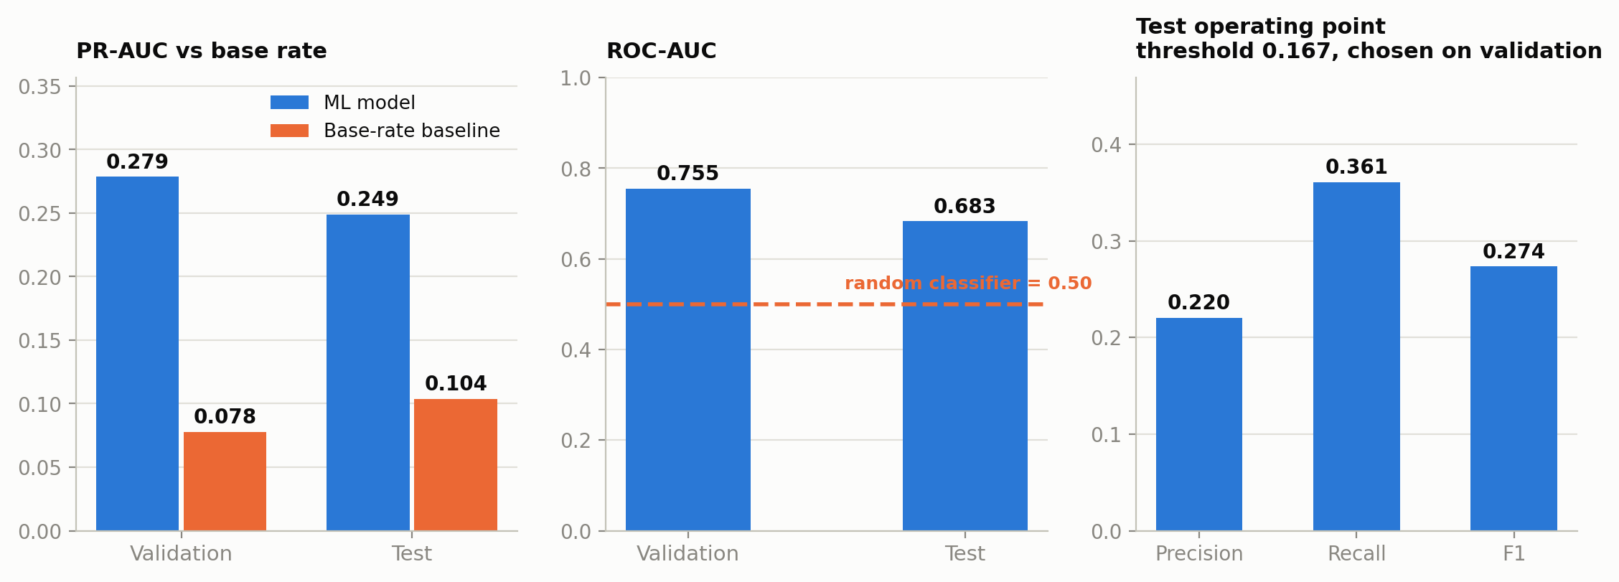
09 RESULT
SLA breach — strongest current result
HistGradientBoostingClassifier · 17 features · split · 13,209 train / 3,131 validation / 3,873 test · decision threshold 0.167, chosen on validation
Promising — and narrow
A 2.4x lift over prevalence is real signal, and it holds on both folds.
Accuracy is deliberately not reported: at a ~10 % positive rate, always predicting 'no breach' scores ~90 % accuracy and catches nothing.
Population caveat
NYC only, January-March 2010, and only the complaint types that carry a Due Date. This is a research model for that slice, not a general SLA-risk model, and must never be presented as one.
Accuracy is NOT reported as a headline. With a ~10% positive rate, always predicting 'no breach' scores ~90% accuracy and catches nothing. PR-AUC against the base rate is the number that means something.
Test metric | Value | Test metric | Value
PR-AUC | 0.249 | ROC-AUC | 0.683
Base rate (prevalence) | 0.104 | Precision / Recall / F1 | 0.220 / 0.361 / 0.274
Lift over base rate | x2.40 | Confusion tn/fp/fn/tp | 2,958 / 513 / 257 / 145
SELECTED CONFIGURATION · read from the saved model metadata
HistGradientBoostingClassifier · variant A_default · selected on validation PR_AUC
max_iter=200, learning_rate=0.1, max_leaf_nodes=31, min_samples_leaf=20, l2_regularization=0.0
seed 20260915 · scikit-learn 1.6.1 · preprocessing fitted on the training fold only (rare levels folded to the train top-250) · threshold frozen on validation
UrbanEye · Mid-Project Technical Review
10
Notes:
WHAT THIS SLIDE SHOWS
SLA-breach classification. PR-AUC against the base rate, ROC-AUC, precision/recall/F1 at the chosen threshold, and the confusion matrix.
TAKEAWAY
The strongest current result: PR-AUC of 0.249 against a base rate of 0.104 — a 2.4x lift over prevalence, on both folds.
HOW TO EXPLAIN IT
"For a rare-event problem, PR-AUC against the base rate is the honest metric, so that is what we lead with. The positive rate on test is 10.4 %, and the model's PR-AUC is 0.249 — roughly two and a half times what random ranking would achieve. Validation agrees: 0.279 against a base rate of 7.8 %. It clears its baseline on both folds and on every metric we report."
"I want to point out what is deliberately absent: accuracy. At a 10 % positive rate, a model that always predicts 'no breach' scores about 90 % accuracy and catches nothing. Reporting it would be misleading, so we do not."
"The decision threshold is 0.167, selected on validation and then applied unchanged to test. At that threshold we catch 145 of 402 actual breaches at 22 % precision. That is a triage tool, not an automated decision-maker."
"The constraint here is the population, not the model: 20,213 rows, New York City only, January to March 2010, and only complaint types that publish a due date. This is not a general cross-city SLA predictor and I will not present it as one."
LIKELY QUESTIONS
Q: 22 % precision sounds poor. Is this usable?
A: It depends on the cost asymmetry. If the intervention is cheap — flagging a case for a supervisor to glance at — then finding 36 % of breaches in a queue where 1 in 4.5 flags is real is operationally valuable. If the intervention is expensive, you raise the threshold and trade recall for precision. The threshold is a deployment parameter, and the PR curve on the slide is what you would use to choose it.
Q: Why is test PR-AUC lower than validation?
A: 0.249 against 0.279, with ROC-AUC dropping more sharply from 0.755 to 0.683. The base rate also differs between folds — 7.8 % on validation, 10.4 % on test — so the underlying period is not identical. We report the drop rather than leading with the better number.
Q: Is the model calibrated?
A: Brier score and a calibration assessment are computed and stored in the results. Explicit probability calibration is listed as proposed next-phase work, because the threshold-based use here depends on ranking quality more than on absolute probability values.
Q: Only three months of one city — how much can you conclude?
A: About this population, a real signal exists and is measurable. About cities generally, nothing. That is stated on the weaknesses slide and it is the first thing we would fix given more data.
Q: Which features drive it?
A: Seventeen declared features: category and subcategory, department, zone, report channel, time-of-day and calendar features, the backward-looking density and recency counts, and the SLA target hours itself. Formal feature-importance and interpretability work is next-phase, not done.

Slide 11
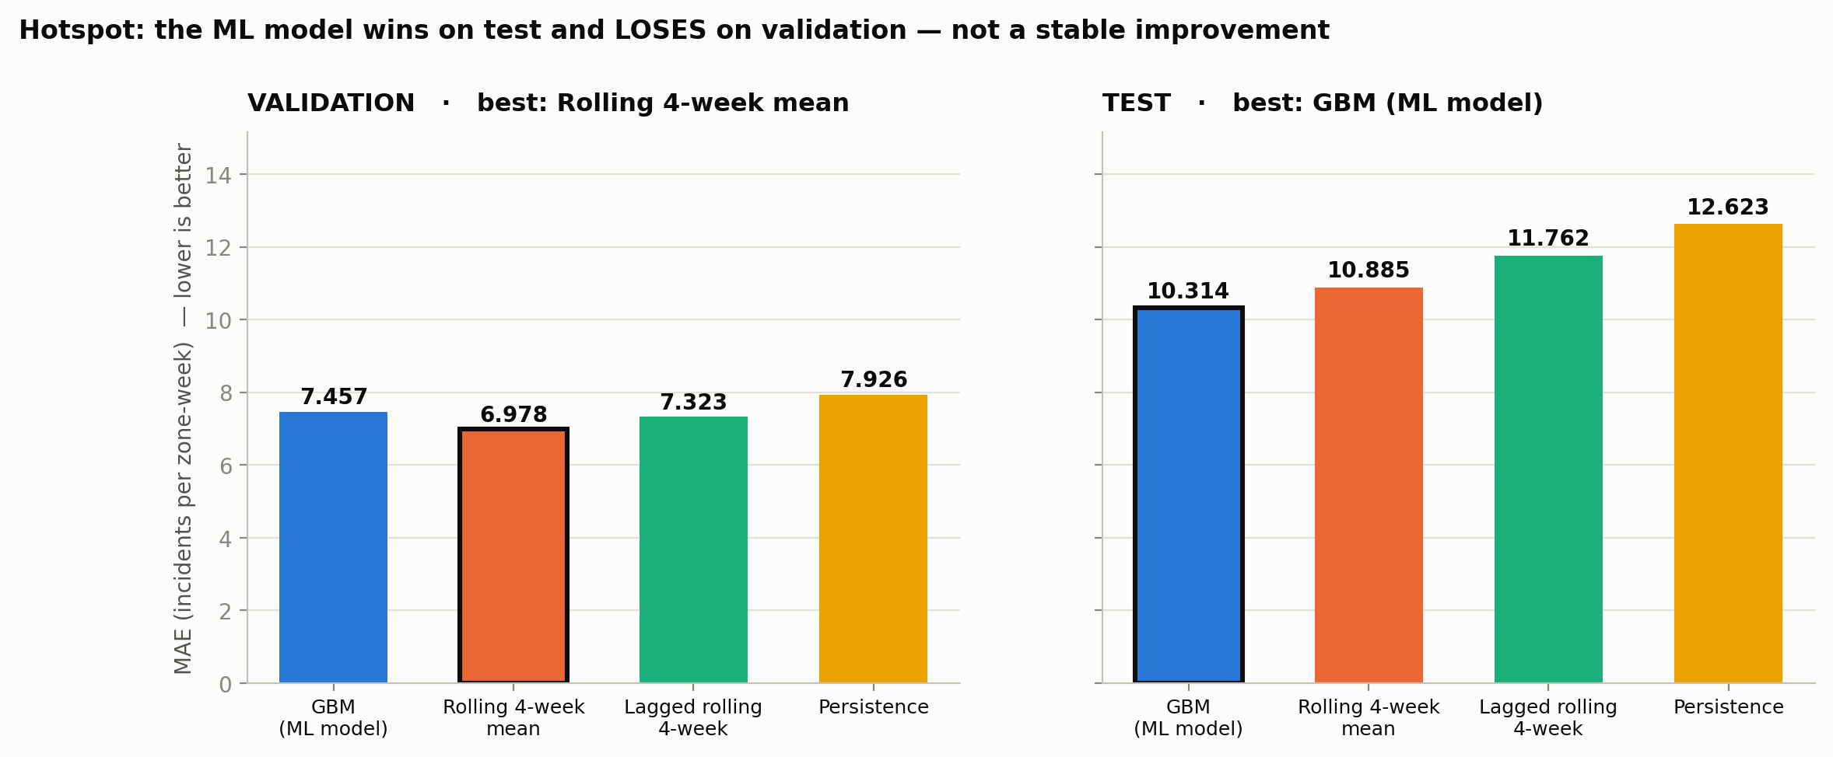
10 RESULT
Hotspot — the baseline still wins on validation
HistGradientBoostingRegressor on log1p(count) · 13 features · split_global · 47,092 train / 10,000 validation / 10,000 test · benchmark: rolling 4-week mean
Test improvement is not stable
The model beats the rolling 4-week mean on test by 5.2% and loses to it on validation by 6.9%. A win on one fold and a loss on the other is not evidence of superiority.
Current recommendation
Ship the rolling 4-week mean; the model has not demonstrated a real edge
This verdict is derived in code from the measured numbers, and an automated test prevents the report from claiming a win it did not earn.
SELECTED CONFIGURATION · read from the saved model metadata
HistGradientBoostingRegressor · variant C_log1p_squared · selected on validation MAE · target transform log1p
loss=squared_error, max_iter=300, learning_rate=0.1, max_leaf_nodes=31, min_samples_leaf=20, l2_regularization=0.0
seed 20260915 · scikit-learn 1.6.1 · preprocessing fitted on the training fold only (rare levels folded to the train top-250)
UrbanEye · Mid-Project Technical Review
11
Notes:
WHAT THIS SLIDE SHOWS
Hotspot forecasting against four baselines — train median, persistence, rolling 4-week mean, and a lagged rolling mean — on both validation and test.
TAKEAWAY
The model does not yet beat the rolling 4-week mean on validation. We therefore report it as unproven and recommend operating the baseline.
HOW TO EXPLAIN IT
"This is the negative result, and I think it is the most useful slide in the deck. On test the model's MAE is 10.31 against the rolling 4-week mean's 10.89 — a 5.2 % improvement. If we showed only that, this would look like a win. On validation the same model scores 7.46 against the baseline's 6.98 — it is 6.9 % worse. A win on one fold and a loss on the other is not evidence of superiority."
"So our recommendation is the unglamorous one: operate the rolling 4-week mean. It is simpler, it has no training cost, and on the evidence we have it is at least as good."
"I would add that this verdict is computed in code from the measured numbers, and there is an automated test that fails the build if the report claims a win the numbers do not support. We wanted the honesty to be structural rather than a matter of discipline."
LIKELY QUESTIONS
Q: Why is a rolling mean such a hard baseline to beat?
A: Because incident counts per zone and category are strongly autocorrelated. Last month's count is genuinely most of the information. A learned model has to add something beyond persistence — spatial spillover, seasonality, interactions — and our current 13 features do not yet supply enough of it.
Q: Did you try a count-appropriate loss?
A: The selected configuration is C_log1p_squared — squared error on log1p of the count, not a Poisson objective. Poisson deviance is computed and reported as a diagnostic. Trying a Poisson objective directly is reasonable next-phase work and is listed on the proposals slide under count forecasting.
Q: Is the panel complete, or only weeks where something happened?
A: Complete. The panel is reindexed to a full calendar-week grid of zone x category x week, so weeks with zero incidents are present as zeros — about 20 % of rows. Without that the target would be conditioned on the outcome and the task would be ill-posed.
Q: Would more data fix it?
A: Possibly, but our diagnosis is features first. The model has no spatial lag — no notion of what happened in adjacent zones — and no long-horizon seasonality. Those are the first things to add.
Q: Why present a negative result at all?
A: Because it is a finding. It says the marginal value of learning over persistence is currently negative for this task, and it tells us where to spend the next engineering effort. Suppressing it would leave us optimising something we had no evidence was working.

Slide 12
11 EVIDENCE
Consolidated model vs baseline
Validation and test reported separately throughout. Improvement is stated against the appropriate baseline for each task, including where it is negative.
Task | Metric | Validation | Test | Baseline (test) | Improvement | Conclusion
Resolution | MAE (h) | 734.5 | 896.5 | median 1,034.8 | +13.4% | Improves the tail
Resolution | Median AE (h) | 84.2 | 133.3 | median 115.5 | -15.5% | Worse for typical cases
SLA | PR-AUC | 0.279 | 0.249 | base rate 0.104 | x2.40 | Most promising
Hotspot | MAE (per zone-week) | 7.457 | 10.314 | rolling 4w 10.885 | -6.9% val / +5.2% test | Unproven
SLA — promising
Clears its baseline on both folds and on every reported metric. Limited by population, not by the model.
To extend it: more cities and years, improved due-date coverage, explicit probability calibration.
Resolution — mixed
Clears one metric and fails another. Useful today for tail-risk flagging, not for point prediction.
To fix it: quantile and robust objectives, plus the operational features the data does not yet carry.
Hotspot — unproven
Clears the benchmark on one fold and fails on the other. The simple baseline remains the defensible choice.
To prove it: beat the rolling 4-week mean on validation and test together, with spatial and seasonal features.
One of three tasks currently has a defensible predictive advantage over a trivial baseline. That is the honest reading of this table.
UrbanEye · Mid-Project Technical Review
12
Notes:
WHAT THIS SLIDE SHOWS
The consolidated model-versus-baseline table, with validation and test reported separately and improvement signed — including where it is negative.
TAKEAWAY
One of three tasks currently has a defensible predictive advantage over a trivial baseline. That is the honest reading.
HOW TO EXPLAIN IT
"Read the improvement column. SLA is a 2.4x lift over the base rate and it holds on both folds. Resolution is plus 13.4 % on MAE and minus 15.5 % on median error — one metric each way. Hotspot is minus 6.9 % on validation and plus 5.2 % on test — one fold each way."
"So: one clear result, one mixed, one unproven. I would rather present that than three green ticks, because this table is what tells us where to work next."
LIKELY QUESTIONS
Q: Are these baselines strong enough to be meaningful?
A: They are chosen per task to be the thing a practitioner would actually do. For resolution it is the training-set median — the correct trivial predictor for MAE. For SLA it is the base rate, because accuracy is meaningless at 10 % prevalence. For hotspot it is the rolling 4-week mean, which is what a planner would use, and it is substantially stronger than persistence (6.98 versus 7.93 on validation). We deliberately did not pick a weak baseline.
Q: Why not report a single headline number per task?
A: Because in two of three cases a single number would be wrong. Reporting only resolution MAE would hide the median-error regression; reporting only hotspot test would hide the validation loss.
Q: What would change your verdict on hotspot?
A: Beating the rolling 4-week mean on validation and test simultaneously, with the margin larger than the fold-to-fold variation. We have not set an arbitrary threshold, but a consistent sign on both folds is the minimum.
Q: Is the SLA result at risk of overfitting on 13,209 training rows?
A: It is a small training set and that is a legitimate concern. The mitigation is that the threshold was chosen on validation and applied unchanged to test, and both folds show the same direction. More data is the real answer and it is in the proposals.

Slide 13
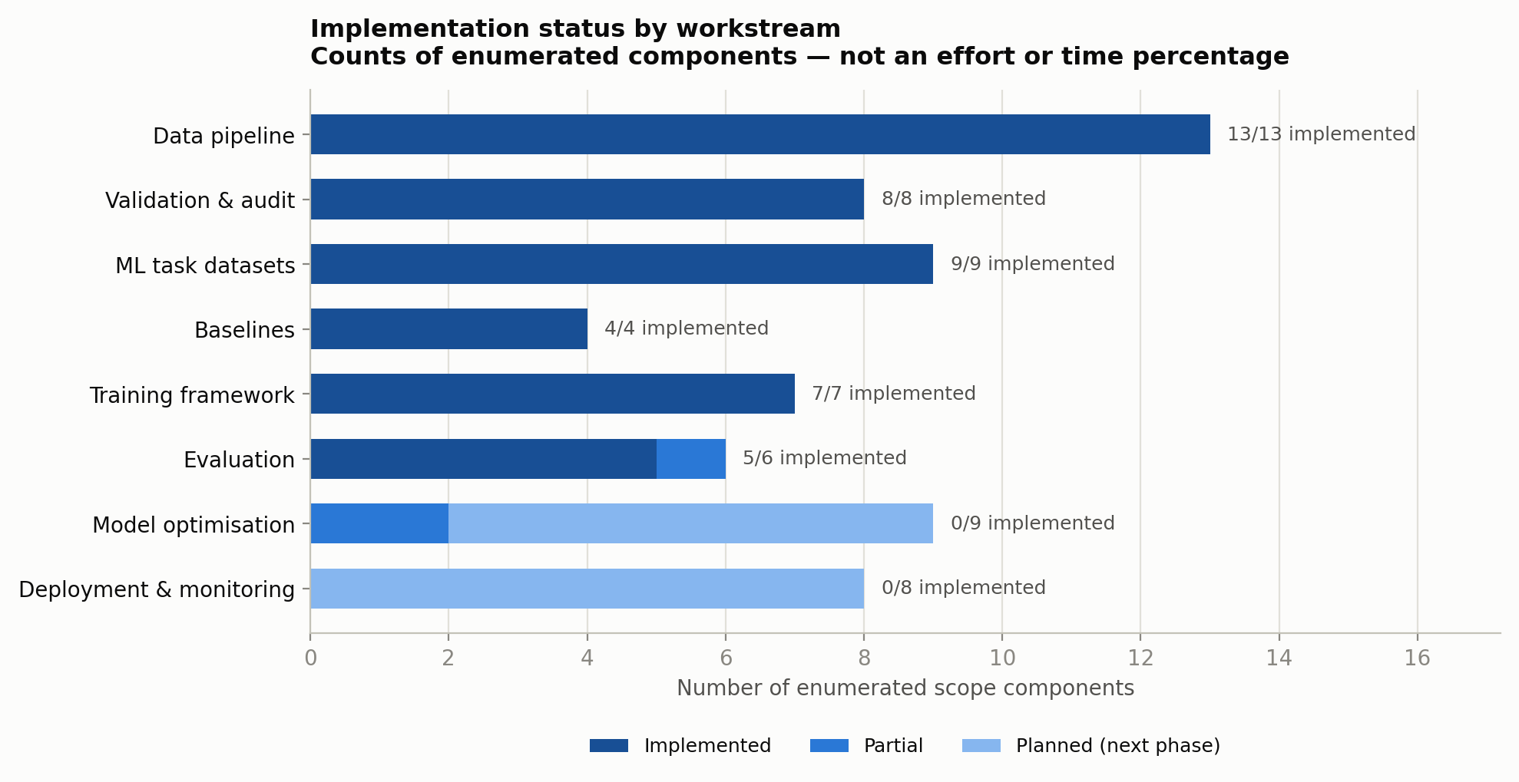
12 PROGRESS
What has been implemented
Substantial interim implementation covering the data, validation, dataset, baseline, training and evaluation layers.
Delivered and validated
• Multi-source ingestion and schema normalisation
• Cleaning, provenance and quality gates
• Time, density and recency feature engineering
• Task dataset construction with manifests
• Leakage validation by independent re-derivation
• Two chronological split strategies
• Baselines computed on the same folds as models
• Reproducible training framework and saved artifacts
• Automated evaluation and reporting
On the question of percentage complete
We report counts of enumerated scope components rather than a percentage. The repository contains no approved scope document from which a percentage could be derived, so stating one would be invention.
UrbanEye · Mid-Project Technical Review
13
Notes:
WHAT THIS SLIDE SHOWS
Implementation status across the layers of the system, with delivered components enumerated.
TAKEAWAY
Substantial interim implementation spanning data, validation, dataset construction, baselines, training and evaluation.
HOW TO EXPLAIN IT
Walk the list. Then address the percentage question before it is asked: "We were asked whether this is 50 % complete. We report counts of enumerated scope components rather than a percentage, because the repository contains no approved scope document from which a percentage could be derived. Stating one would be an invention, and we have applied the same rule to every number in this deck."
LIKELY QUESTIONS
Q: So are you on schedule?
A: Against the plan for this phase — build and validate the data foundation, then train initial models — yes, both are done. The next phase is model quality and generalisation, which slide 14 enumerates.
Q: What is the single largest piece of remaining work?
A: Feature expansion, because it is the common root cause under two of the three weak results. Resolution is missing operational load; hotspot is missing spatial context.
Q: How much of this is code you wrote versus library use?
A: The models are scikit-learn HistGradientBoosting. The pipeline, the provenance and leakage guards, the manifest-driven feature selection, the dual split logic, the baselines and the evaluation framework are project code, and that is where the majority of the effort went.

Slide 14
13 LIMITATIONS
Current weaknesses — stated without mitigation language
Problem | Evidence in the repository | Impact
Resolution target semantics | 173,346 sub-minute closures were artefacts; the 60 s threshold is corpus-specific | Target may still contain administrative closures
Resolution model quality | Test median AE 133.3 h vs baseline 115.5 h; R² 0.214 | Not usable for typical-case point prediction
Hotspot not proven | Validation MAE 7.457 vs rolling 4-week 6.978 | Simple baseline remains preferable
SLA population is narrow | 20,213 rows, NYC only, Jan–Mar 2010, Due-Date types only | No cross-city or multi-year evidence
City generalisation untested | Sources differ in schema, vocabulary and operational policy; split_global folds are Chicago-only | Pooled model may not transfer
Temporal robustness untested | Single chronological cut per task; one regime change flagged as dangerous | Performance across future windows unknown
Operational features missing | No workload, backlog, crew-capacity or weather features exist | Key drivers of service time are unobserved
Deployment not addressed | No inference API, monitoring, drift detection or retraining | None of the three models is production-ready
UrbanEye · Mid-Project Technical Review
14
Notes:
WHAT THIS SLIDE SHOWS
Current weaknesses with repository evidence and impact, stated without mitigation language.
TAKEAWAY
We can name our own failure modes precisely and back each with a number from the repository.
HOW TO EXPLAIN IT
"There is no 'however' column on this slide, deliberately. Each row is a problem, the evidence for it, and what it costs us. The last row is the one to note: none of the three models is production-ready, and we are not going to claim otherwise on the strength of these numbers."
LIKELY QUESTIONS
Q: Which of these worries you most?
A: Cross-city generalisation, because it is untested rather than merely imperfect. Under split_global, validation and test are Chicago-only, so we have no measurement of transfer at all. A leave-one-city-out evaluation would give us that number, and it might be unfavourable.
Q: You said the instant-closure issue was fixed. Why is it still listed?
A: Because the fix is a threshold, and a threshold only removes what falls below it. Administrative closures above 60 seconds are still in the target and we have no way to detect them from timestamps alone. Separating administrative from genuine closure needs status-transition events, which is the first proposal on the next slide.
Q: Isn't 'no deployment work' just an admission you did not finish?
A: It is a sequencing decision. Deploying a model that loses to a rolling mean on validation would be worse than not deploying. Deployment work is gated on the models clearing their baselines consistently, and we state that gate explicitly on the proposals slide.
Q: What would a hostile reviewer attack first?
A: The resolution target semantics, and they would be right to. It is the weakness we have the least complete answer to.

Slide 15
14 NEXT PHASE
Proposed solutions
PROPOSED WORK — none of the following is implemented.
Weakness | Proposed solution | Expected benefit
Resolution target semantics | Source-specific timestamp analysis; status-transition events; separate administrative closure from genuine resolution | A target that measures service time rather than data entry
Typical-case error | Quantile regression and robust/Huber objectives; survival analysis for censored cases; prediction intervals | Better middle-of-distribution accuracy and honest uncertainty
Weak operational signal | Workload and backlog features; seasonality; category interactions; city/source indicators | Represent the drivers of service time that are currently unobserved
Hotspot not proven | Spatial lag and neighbourhood history; longer windows; classical count forecasting; multi-horizon evaluation | A model that clears the rolling baseline on both folds
Narrow SLA population | More cities and years; improved Due-Date coverage; probability calibration; per-service-type models | Evidence that SLA risk generalises beyond NYC 2010
City generalisation | City-aware and hierarchical models; leave-one-city-out holdout | Quantified transfer loss between municipal regimes
Temporal robustness | Rolling-origin evaluation across multiple future windows; bootstrap confidence intervals | Performance claims with stated uncertainty
Deployment readiness | Inference API, versioning, prediction logging, drift and performance monitoring, retraining | Only after models consistently beat strong baselines
UrbanEye · Mid-Project Technical Review
15
Notes:
WHAT THIS SLIDE SHOWS
Proposed next-phase work, mapped one-to-one onto the weaknesses from the previous slide. Nothing here is implemented.
TAKEAWAY
The next phase is determined by the measured failures, not by a wish list.
HOW TO EXPLAIN IT
"Every row on this slide answers a row on the previous one, in the same order. That is intentional — the mixed results are diagnostic, and they tell us precisely where the effort goes."
"Three priorities if I had to rank them. First, target quality: separate administrative closure from genuine resolution using status-transition events, because it is upstream of everything. Second, features: workload, backlog and spatial context, because that is the common cause under both weak results. Third, evaluation: rolling-origin validation across multiple windows, so that a performance claim comes with a stated uncertainty rather than a single fold."
"Deployment is last and it is conditional. We will not build an inference API for a model that does not beat a rolling mean."
LIKELY QUESTIONS
Q: Why quantile regression for resolution time?
A: Because our failure is in the middle of the distribution while our loss function optimises the mean. Median regression — quantile at 0.5 — optimises the metric we are losing on. It also produces prediction intervals, which are more honest than a point estimate for a target this dispersed.
Q: What is survival analysis doing in a resolution-time task?
A: Cases still open at the data cut-off are right-censored. We currently exclude them, which biases the sample towards cases that closed quickly. Survival methods use them rather than discarding them.
Q: Will more cities actually help, given the schema differences?
A: It helps the SLA task most directly, since that population is currently one city and one quarter. For the pooled models it also makes city transfer measurable rather than assumed. The normalisation layer to absorb new schemas already exists — Boston is configured and licence-cleared, and adding it is a download away.
Q: How would you know the next phase succeeded?
A: Three concrete criteria: hotspot beats the rolling 4-week mean on both folds; resolution beats the median baseline on median absolute error, not only MAE; and a leave-one-city-out evaluation produces a quantified transfer loss rather than an unknown.

Slide 16
15 CONCLUSION
Current status, and the objective for the next review
IMPLEMENTED
• Data pipeline — 22 stages, reproducible from raw
• Validation — quality, provenance, leakage, audits
• ML datasets with declared manifests
• Baselines for every task
• Initial models for three tasks
• Honest evaluation and reporting
NEXT PHASE
• Target-quality investigation
• Feature expansion — workload, spatial, seasonal
• Model optimisation — quantile, survival, forecasting
• Cross-city and rolling-origin generalisation
• Interpretability and error analysis
• Deployment, monitoring and dashboard integration
1. The foundation works and is reproducible
22 pipeline stages, 90 automated tests, 56/56 audit checks; a full rebuild reproduces every dataset content-identical.
2. The models give measurable but mixed improvements
SLA clears its baseline; resolution clears one metric and fails another; hotspot does not yet clear its benchmark on both folds.
3. The next phase is target quality, features and generalisation
The mixed results are diagnostic — they point precisely at where the next engineering effort belongs.
Objective for the next review: move from a validated ML pipeline to models that consistently outperform strong baselines.
UrbanEye · Mid-Project Technical Review
16
Notes:
WHAT THIS SLIDE SHOWS
Status summary — implemented versus next phase — the three closing messages, and the objective for the next review.
TAKEAWAY
The foundation is validated and reproducible; the models are experimental and mixed; the next phase is determined by the evidence.
HOW TO EXPLAIN IT
Close on the three messages in order, then the objective line:
"One: the foundation works and is reproducible — 22 stages, 90 tests, 56 of 56 audit checks, and a rebuild that reproduces every dataset content-identical."
"Two: the models give measurable but mixed improvements. SLA clears its baseline on both folds. Resolution clears one metric and fails another. Hotspot does not yet clear its benchmark on both folds."
"Three: those mixed results are the most useful output of this phase. They point precisely at target quality, feature expansion and generalisation."
"The objective for the next review is to move from a validated pipeline to models that consistently outperform strong baselines. I would rather bring you that in six weeks than bring you three green ticks today that I could not defend."
LIKELY QUESTIONS
Q: If you had to defend one thing as the project's contribution so far, what is it?
A: A reproducible, leakage-audited multi-city 311 ML pipeline with per-task datasets, declared feature manifests and baselines computed on the same folds as the models. The negative results are only trustworthy because that infrastructure exists — without it, we could not distinguish a weak model from a broken dataset.
Q: What is the biggest risk to the next phase?
A: That the missing signal is genuinely not in 311 data. If crew capacity and backlog are what determine resolution time, no amount of modelling on published fields will recover it, and the answer becomes operational data from a city partner. We would find that out early, from the feature-expansion work.
Q: Would you make the same architectural decisions again?
A: Yes on the pipeline-first ordering and on publishing both split strategies. The decision I would revisit is starting with three cities of very different sizes and disjoint date ranges — that disjointness is the root of the split trade-off on slide 7 and it constrains evaluation throughout.

