Slide 1


the people at
present to you

Slide 2
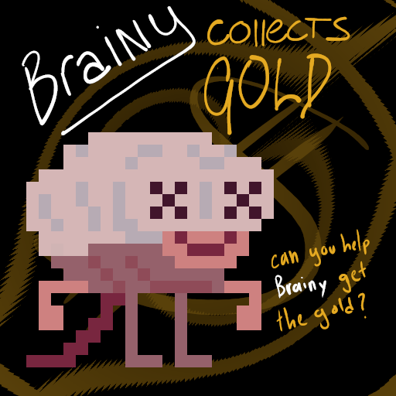
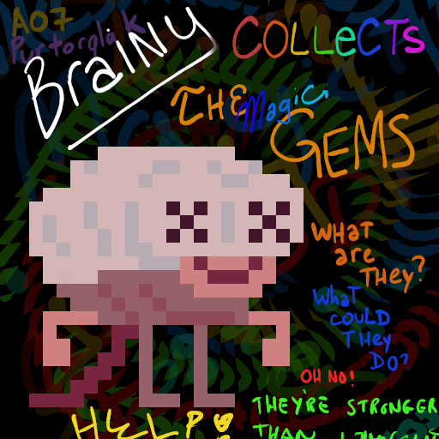
unmodded
&
modded
brainy collects series

Slide 3
how is it different?
placement of the gems
0
1
2
3
4
gold is now rainbow gems
glyphs
order of collection

Slide 4
unique floor space covered
experience goals
more evenly spaced gem collection

Slide 5
operationalization
/
percentage of floorspace covered
variation of gem times

Slide 6
tracking
variation
the database records the time at which each gem piece is picked up. the difference between each pickup time was averaged in excel and the value represents the variation per player. the goal was to reduce this number.
instrumentation
unique spaces
an array was created the same size as the map. for each location, a player landed on, the value at the corresponding location was changed in the array. upon victory or shutdown, the total number of unique squares a player had stepped on was counted. the goal was to increase this number.
average player
all collected data was then averaged from each six players to get the average player.

Slide 7
hypothesis
looking for:
increase in floorspace percentage
decrease in time variation between gem pieces

Slide 8
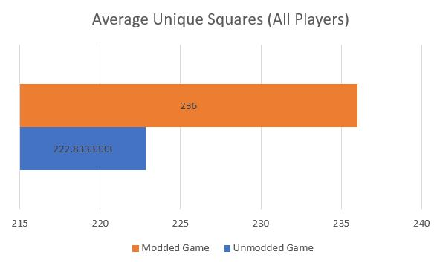
of twelve data points for each version of the game:
results
In the base game, players averaged 222.8 unique squares traveled.
In the modded game, players averaged 236 unique squares traveled
Unique squares

Slide 9
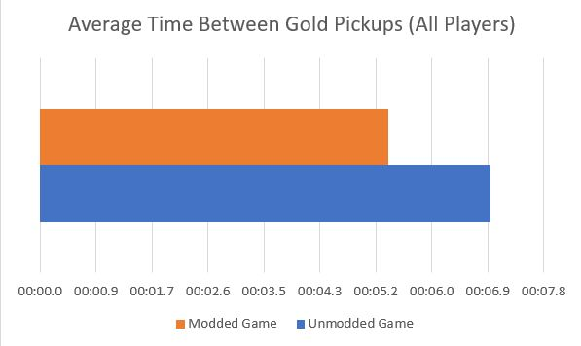
of twelve data points for each version of the game:
results
In the base game, players averaged 7.0s variation between gem pick ups
In the modded game, players averaged 7.4s variation between gem pick ups
Variation

Slide 10
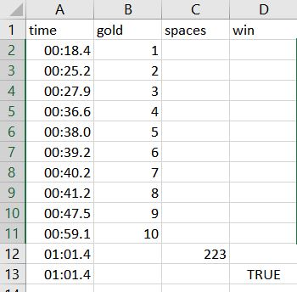
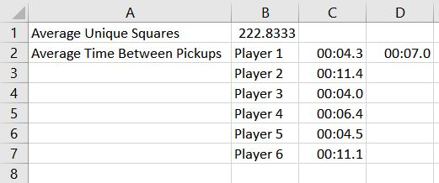
An example of the data gathered from each player and calculations completed:
results
Single Player
For each version of the game, we first averaged the unique squares each player traveled through and got one number representing the unique squares for that version.
We then found the average variation each player had between pickups, averaged those values again, and found one number representing the variation in gem pickup for that version.

Slide 11
final thoughts
For our first goal, we were successful
For our second, we were successful,
although less so

