Slide 1
COMP390/3/4/5 && COMP593
Final Year Projects
Demonstration & Dissertation
Irina Biktasheva
https://cgi.csc.liv.ac.uk/~comp39x/2018-19/

Slide 2

Submission Deadlines
Specification & Design documentation (20%) Thu 15.11.18 noon
Interim Report: Fri 15.02.19
Demonstration (15%):
-Slides Submission by Thu 21.03.19 noon
-Demonstrations Mon 25.03.19 –
Fri 29.03.19
Dissertation (65%): Thu 9.05.19 noon
You should make yourself available during this weeks for the project demonstration

Slide 3

Project Stages
You should by now have a project allocated; otherwise, talk to me after the lecture
Three assessment phases
Phase 1: Specification (3.5 weeks) & Design (4.5 weeks)
Phase 2: Implementation, Testing & Demonstration (11 weeks)
Phase 3: Dissertation (3 weeks)
Specification & design
Documentation (20%)
specification
document
design
document
 | w1 | w2 | w3 | w4 | w5 | w6 | w7 | w8 | w9 | w10 | w11 | w12
Sem 1
Sem 2
interim report
Demonstration (15%)
Dissertation (65%)
*to be assessed

Slide 4

Demonstration (15% of total mark)
Purpose
  To give a demonstration / to talk through your software
Demonstration: Week 9 (25 Mar – 29 Mar)
  You must make yourself available during the week
Arranged by the marker (2nd supervisor)
Assessed by | Supervisor | marker
Demonstration

Slide 5
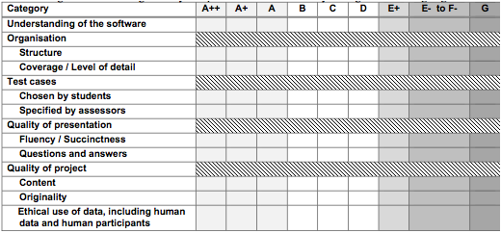
Demonstration Assessment Form
brief reminder of what project is; functionalities; may consider showing code of main methods
demonstrate main functions via various test cases

Slide 6
Dissertation (65% of total mark)
To provide a complete record of all the work
Submission: Thursday 9 May (noon)
  pdf file to submit to E-project
  + zip file with code, etc.
Dissertation: self-contained, complete record
  recommend: 10,000 words (max 15,000)
  template for cover page downloaded from website https://cgi.csc.liv.ac.uk/~comp39x/2018-19/guides/COMP39X_CoverTemplate_18-19.docx
Assessed by | Supervisor | marker
Dissertation

Slide 7
Dissertation Structure
One-page summary of project as a whole
Abstract
Introduction
Background
Data Required
Design
Realisation
Evaluation
Learning Points
Professional Issues
Bibliography
Appendices
Brief overview:
What problem is addressed?
What are the aims and objectives?
What are the challenges?
What is the solution produced?
How effective is the solution / how successful has the project been?

Slide 8

Dissertation Structure
To include:
Background of problem to be solved
Existing solutions/approaches, and a comparison with the solution produced in project
Reading and research done to
  understand existing approaches
  acquire necessary information
  acquire required skills
A clear statement of the project requirements
References are expected
Abstract
Introduction
Background
Data Required
Design
Realisation
Evaluation
Learning Points
Professional Issues
Bibliography
Appendices

Slide 9
Dissertation Structure
To include:
What data were needed for the project and
Where the data was obtained from;
Ethical use of data, including
  ethical use of human data
  ethical use of human participants
See for full detail projects website:
http://cgi.csc.liv.ac.uk/~comp39x/2018-19/guides/report.html
Abstract
Introduction
Background
Data Required
Design
Realisation
Evaluation
Learning Points
Professional Issues
Bibliography
Appendices

Slide 10
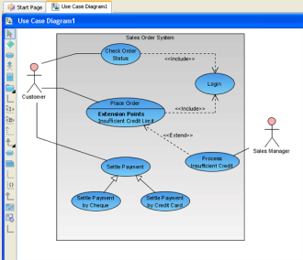
Dissertation Structure
Description of design
organisation should be same as design documentation
full details are required
exact content depends on design methodology adopted and type of project
  OO or traditional design
  empirical experiments
  devising new algorithms
If design has been revised, give revised design & justify changes made
Abstract
Introduction
Background
Data Required
Design
Realisation
Evaluation
Learning Points
Professional Issues
Bibliography
Appendices

Slide 11

Dissertation Structure
How design was implemented & testing of implementation
implementation of each stage and each component
problems encountered and solutions
changes made to design and justification (if design.org isn't revised)
various testing of each stage and each component
  test cases used, expected results, and actual results
snapshot of code & screen shot
  full code listing, detail screen shots in appendices
Abstract
Introduction
Background
Data Required
Design
Realisation
Evaluation
Learning Points
Professional Issues
Bibliography
Appendices

Slide 12

Dissertation Structure
To include
how project is evaluated?
  What criteria are used?
  How to assess criteria?
  Who is involved?
Your evaluation of results/outcomes.
Your evaluation of project strength & weakness
Where appropriate, 3rd party evaluation/
customer feedback
see for full detail projects website: http://cgi.csc.liv.ac.uk/~comp39x/2018-19/guides/report.html
Abstract
Introduction
Background
Data Required
Design
Realisation
Evaluation
Learning Points
Professional Issues
Bibliography
Appendices
At least one-page of learning points

Slide 13

Dissertation Structure
At least one-page of how your project is related to
Code of practice
Code of conduct
issued by British Computer Society
Abstract
Introduction
Background
Data Required
Design
Realisation
Evaluation
Learning Points
Professional Issues
Bibliography
Appendices
Properly cited list of books, articles, and other materials

Slide 14
Dissertation Structure
1) Detailed material, required for completeness, e.g.
  code listing
  detail of test data
  screen shot of sample runs
  user guide
  full design diagrams
2) Zip file in the E-project system for archive
Abstract
Introduction
Background
Data Required
Design
Realisation
Evaluation
Learning Points
Professional Issues
Bibliography
Appendices

Slide 15

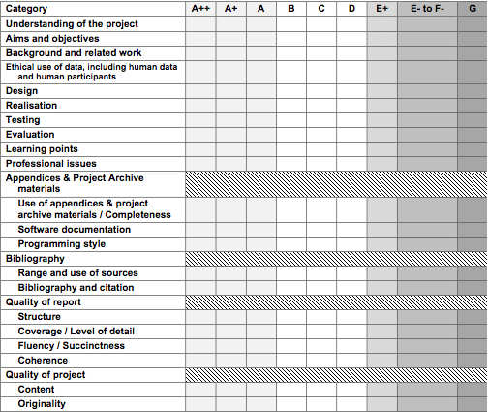
Dissertation Assessment Form

Slide 16

Late Submission
According to University standard penalties
5 marks deducted for each calendar day of lateness for the electronic submission
Up to a maximum of 5 calendar days
Work received after 5 calendar days will receive a mark of 0
For any mitigating circumstances, submit the form with evidence to the Student Office asap and contact your first supervisor

Slide 17
Submission Deadlines
Specification & Design documentation (20%) Thu 15.11.18 noon
Interim Report: Fri 15.02.19
Demonstration (15%):
-Slides Submission by ---> Thu 21.03.19 noon
-Demonstrations ---> Mon 25.03.19 –
Fri 29.03.19
Dissertation (65%): Thu 9.05.19 noon
You should make yourself available during this weeks for the project demonstration

