Slide 1
Executive Threat Intelligence Report
By Monica
Ransomware Campaign Investigation – Healthcare Sector
Suricata IDS Validation & Threat Intelligence Integration

Slide 2
Executive Summary
This project focused on investigating a ransomware campaign targeting the healthcare sector through structured malware analysis and threat intelligence collection.
  50 file hashes analyzed using VirusTotal API
  1 high-confidence malicious sample identified
  Associated with LockBit Ransomware Loader & MedusaLocker
  37 security vendor detections confirmed

Slide 3
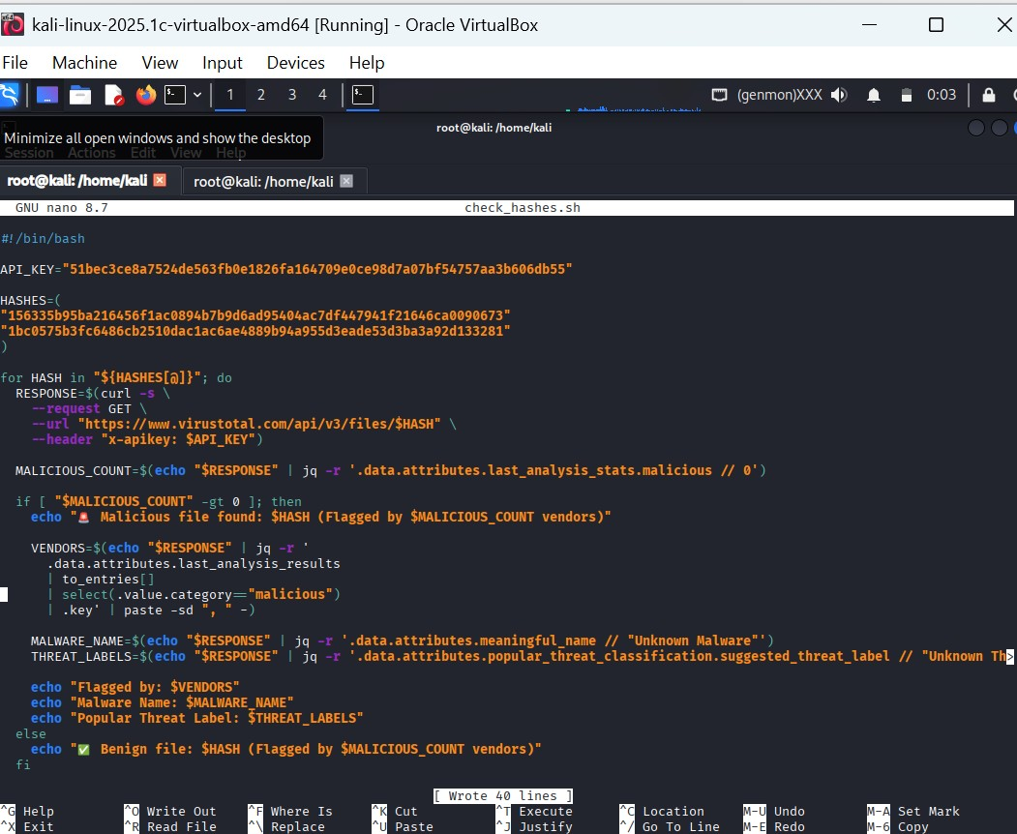
Malware Hash Analysis – VirusTotal API Integration
During hash analysis, one file was identified as malicious and associated with:
MedusaLocker Ransomware

Slide 4
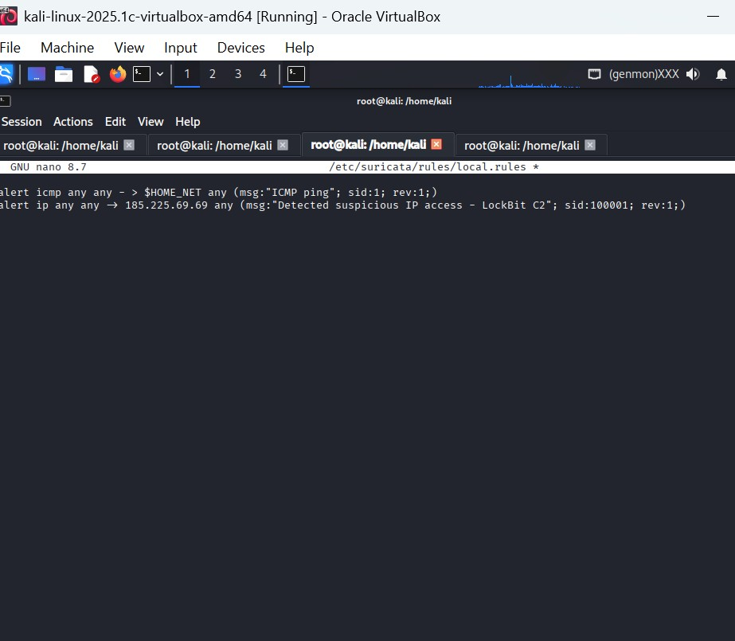
Suricata IDS Rule Configuration
A custom Suricata detection rule was configured to:
Monitor known ransomware Command-and-Control (C2) indicators
Detect suspicious outbound traffic
Trigger alerts based on malicious IP communication

Slide 5
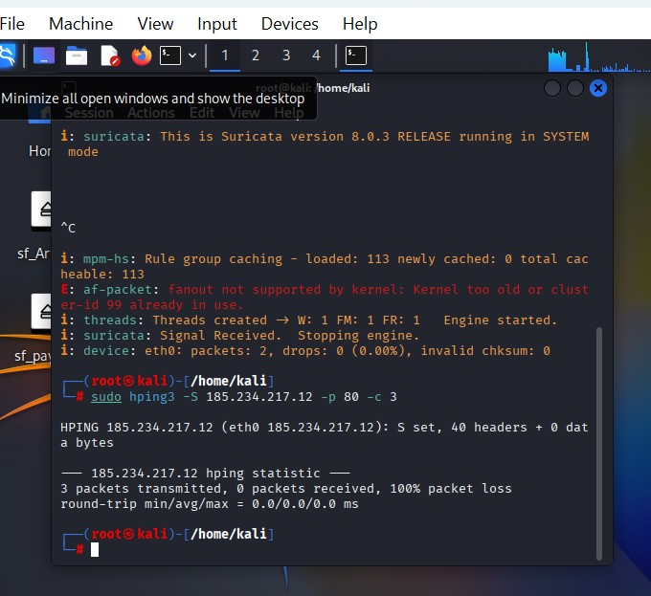
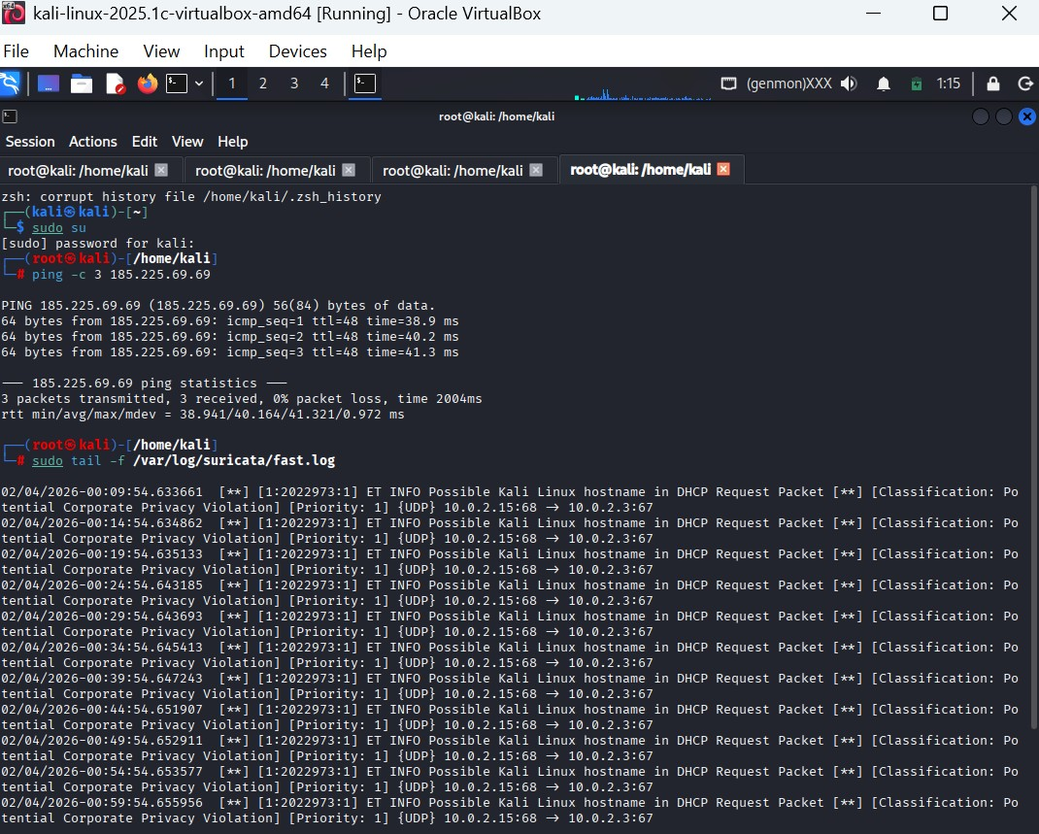
Controlled Network Traffic Simulation – hping3

Slide 6
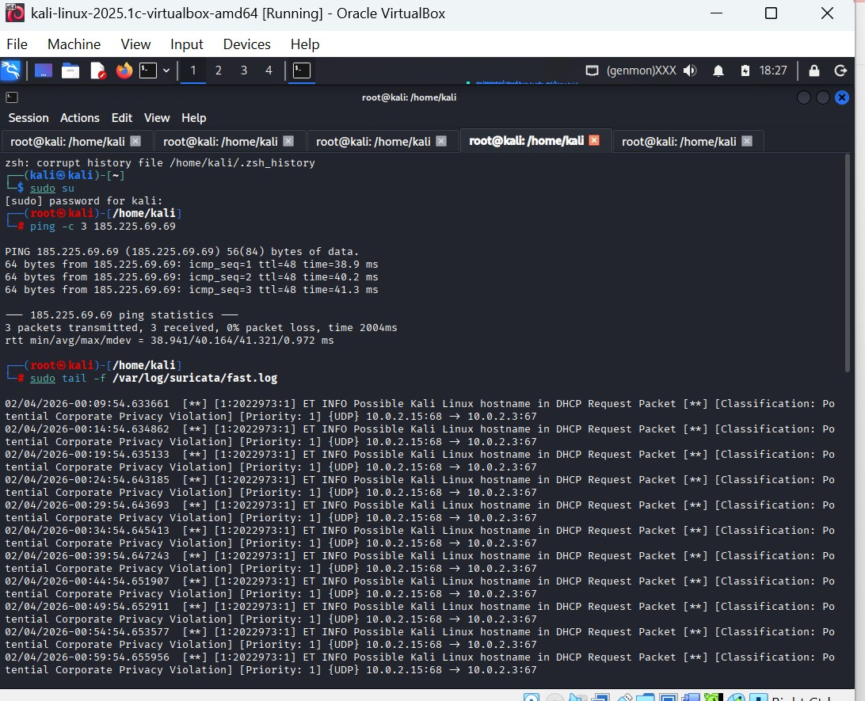
Network Traffic Test
Controlled network traffic was generated to simulate communication with a suspicious IP address.
Purpose:
Validate Suricata detection capabilities
Confirm alert reliability
Test rule effectiveness

Slide 7
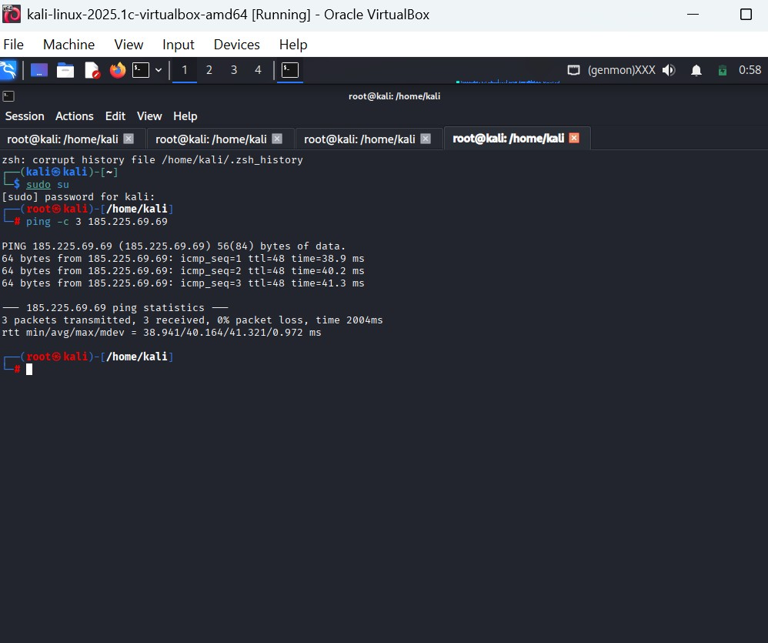
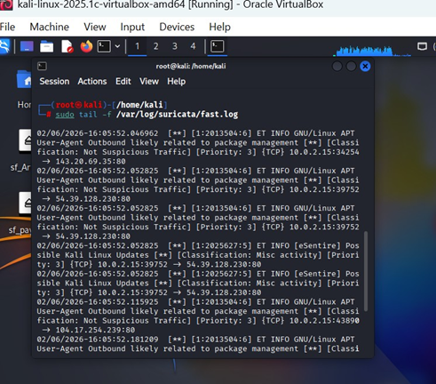
Additional IDS Alert Logs
Repeated alert triggers confirmed:
Detection consistency
Rule stability
Reliability of the implemented IDS configuration

Slide 8
Healthcare Security Impact Analysis
Operational disruption to clinical systems
  Exposure of Protected Health Information (PHI)
  Financial extortion and regulatory risk
  Double extortion tactics (encryption + data exfiltration)
  Critical need for proactive detection & monitoring

Slide 9
Strategic Conclusion
Threat intelligence enhances ransomware detection
  IoC-based Suricata rules effectively detect C2 communication
  Controlled validation confirms IDS reliability
  Layered defense strengthens healthcare cybersecurity posture

