Slide 1
PORTFOLIO PROJECT
UPI Digital Payment
Fraud Detection &
Transaction Risk Analytics
₹
UPI
Power BI Data Analytics & Business Intelligence Project
Analyzing transaction patterns, payment performance and fraud risk across 250K UPI transactions
2024 • JAN—DEC
Notes:
Portfolio project built from the supplied UPI transaction analytics brief and dashboard screenshots.

Slide 2
Project Overview
An interactive view of payment performance and observed fraud activity
UPI data offers a detailed view of how payment behavior changes across time, payment types and technology.
Analyze transaction behavior, payment performance and fraudulent activity.
Transform transaction records into an interactive Power BI dashboard.
Focus on volume, value, success and failure performance, plus fraud risk.
Analytics workflow
250,000
Raw transaction
data
›
Clean &
transform
›
Model &
measure
›
Power BI
dashboard
›
Business
insights
transactions
Notes:
Dataset scale: 250,000 transactions. Project objective and workflow are from the user-provided brief.

Slide 3
Dataset & Key Attributes
250,000 transaction records spanning January–December 2024
TRANSACTION
FRAUD & CUSTOMER
BANK & TECHNOLOGY
Transaction ID
Fraud flag
Sender bank
Timestamp
Sender age group
Receiver bank
Transaction status
Receiver age group
Device type
Transaction type
Sender state
Network type
Transaction amount
Day of week
Weekend indicator
JANUARY—DECEMBER 2024
Fields grouped by analytical role
Notes:
Dataset fields and transaction period are provided in the project brief.

Slide 4
Data Preparation & Data Model
Validation, transformation and measures supporting the dashboard
Raw data
›
Power Query
›
Clean data
›
Data model
›
DAX measures
›
Dashboard
Data quality checks
250,000
Unique
100%
0%
transaction records
Transaction ID verified
valid values in checks
errors or empty values
Preparation steps
Type and timestamp validation
Missing, empty and error checks
Duplicate ID and category checks
Calendar table + relationship
DAX KPIs and fraud measures
Notes:
Data preparation, validation outcomes, Calendar table, relationship, Power Query and DAX are stated in the project brief.

Slide 5
Overall Transaction Performance
Payment volume, value and completion across 2024
250,000
₹81.98T
₹1,311.76
Total transactions
Total transaction value
Average transaction value
238K
12K
95.0%
Successful transactions
Failed transactions
Success rate
95% of transactions completed successfully
Notes:
KPI values supplied in the brief and Page 1 screenshot. Successful and failed transaction counts are shown as rounded values from the brief.

Slide 6
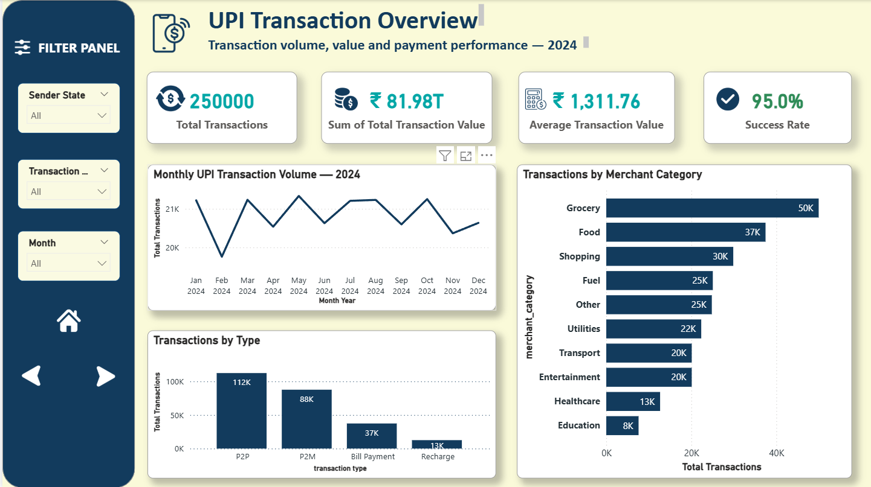
Power BI Dashboard — UPI Transaction Overview
Actual dashboard page supplied as the visual reference
Notes:
Source: Page1.png supplied by the user. Dashboard screenshot embedded unchanged.

Slide 7
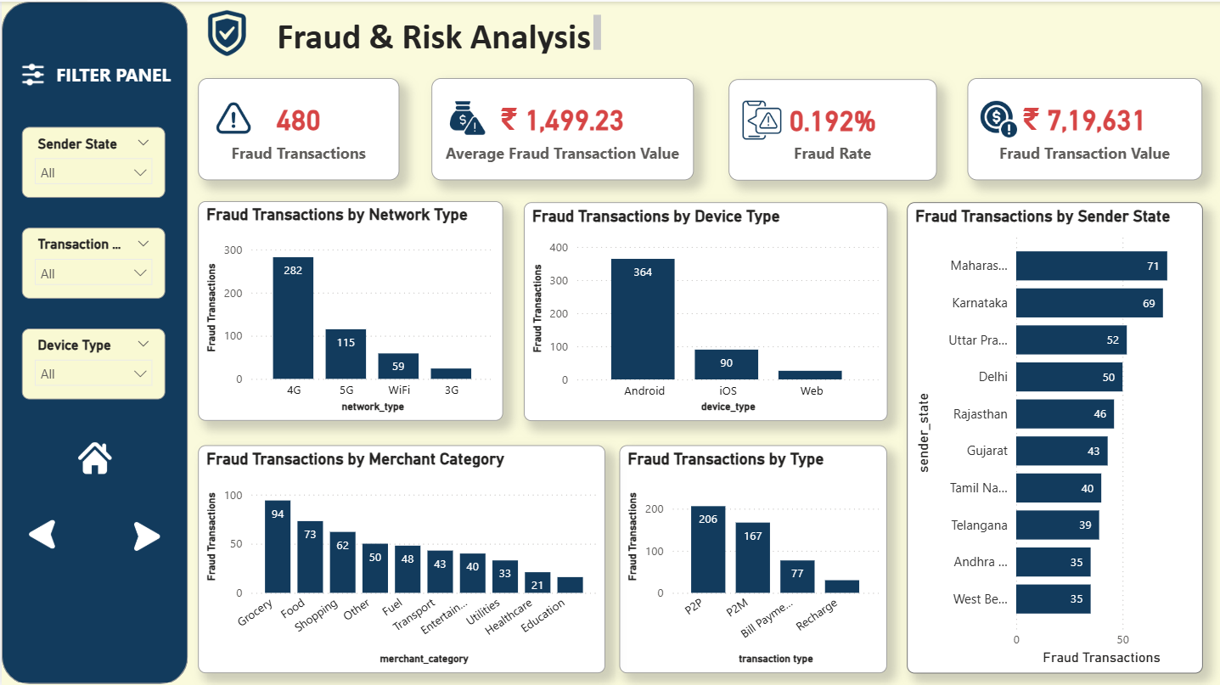
Power BI Dashboard — Fraud & Risk Analysis
Observed fraud volume, value and distribution across transaction dimensions
Notes:
Source: Page2.png supplied by the user. Dashboard screenshot embedded unchanged.

Slide 8
Key Business Insights
Observed patterns describe where fraud counts are highest; they do not establish cause
480
0.192%
₹7.20 lakh
₹1,499.23
Fraud transactions
Fraud rate
Fraud transaction value
Avg. fraud transaction value
Transaction type
Device type
Network type
Fraud amount rate: 0.219%
Highest observed merchant counts
Grocery 94 · Food 73 · Shopping 62
Highest observed state counts
Maharashtra 71 · Karnataka 69 · Uttar Pradesh 52
Notes:
Verified findings from the user-provided brief and Page 2 screenshot. Fraud amount rate: 0.219%. Merchant categories: Grocery 94, Food 73, Shopping 62, Other 50, Fuel 48, Transport 43, Entertainment 40, Utilities 33, Healthcare 21, Education 16. Sender state: Maharashtra 71, Karnataka 69, Uttar Pradesh 52, Delhi 50, Rajasthan 46, Gujarat 43, Tamil Nadu 40, Telangana 39, Andhra Pradesh 35, West Bengal 35.

Slide 9
Recommendations & Conclusion
Use observed concentrations to guide monitoring priorities
Monitoring priorities
Conclusion
Review P2P and P2M activity with additional risk checks for suspicious patterns.
The dashboard brings UPI transaction performance and fraud risk into one view.
Monitor Grocery, Food and Shopping alongside other high-volume categories.
Strengthen device and network monitoring, especially Android and 4G activity.
Power Query, a Calendar model and DAX measures turn transaction records into business intelligence for monitoring and investigation.
Track states with higher observed counts and review risk patterns periodically.
Use ongoing dashboard reviews to support fraud investigation and monitoring.
From transaction data to actionable risk insights.
Notes:
Recommendations are framed as monitoring priorities based on observed counts, not causal claims. Conclusion reflects the project brief.

