Slide 1

WELCOME
To The Presentation

Slide 2
HOSPITAL MANAGEMENT SYSTEM
Presented by:
Amrita P
Mohd. Irshad
Priyanka I
Rajani H

Slide 3
Contents
Problem statement
Short Description
Application modules
Design
Technologies used
Results

Slide 4
Problem Statement
Healthcare especially in the developed world is characterized by rapidly increasing use of information technology in patient care, increasing documentation, billing, and management. This helps to increase the efficiency of health service delivery, reducing medical errors, improving quality of care and providing better information for patients and physicians.
The purpose is to automate the process of day to-day activities like Admission of Patient, Assign a Doctor, Prescribe the medicine and ﬁnally compute the bill etc.

Slide 5
Description
HMS is powerful, ﬂexible, and easy to use and is designed and developed to deliver Real conceivable beneﬁts to hospitals. More importantly it is backed by reliable and dependable support.
The project ‘Hospital Management System’ is based on the database, Object Oriented Programming. There are many areas where we keep the records in database, hence the database is vital.

Slide 6
Application Modules
Register
Admin
Doctor
Pharmacist
Receptionist
To Register or to create a new account.
Handles all the users.
Treats the patient and prescribe medicine.
Handles the Medicine.
Books an appointment for patient and makes bill.

Slide 7
Hospital Management System
User
INTERNET
User Interface
Register
Server
Data
Base
Login
Doctor
Pharmacist
Backend Process
Receptionist

Slide 8
Technologies Used
Front End :
HTML
CSS
JSP

Slide 9
Technologies Used
2. Back end:
Spring boot
Java
Build tool - Maven
Data Base: MySQL

Slide 10
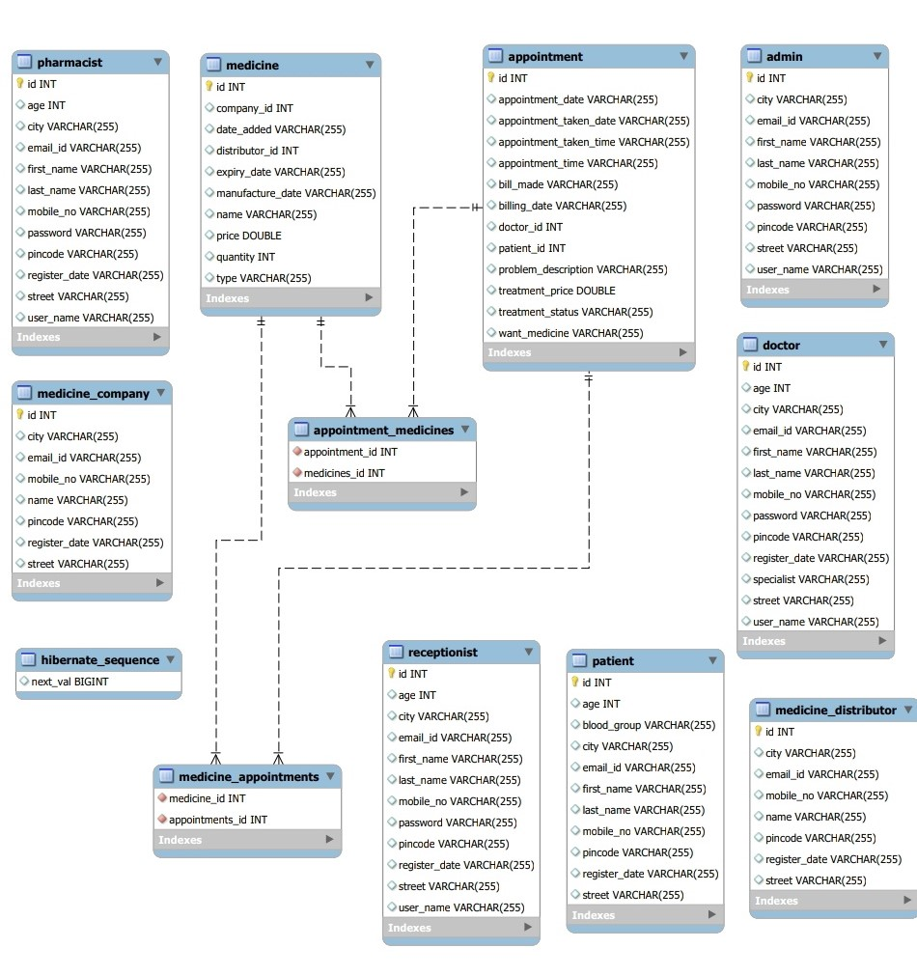
Database

Slide 11
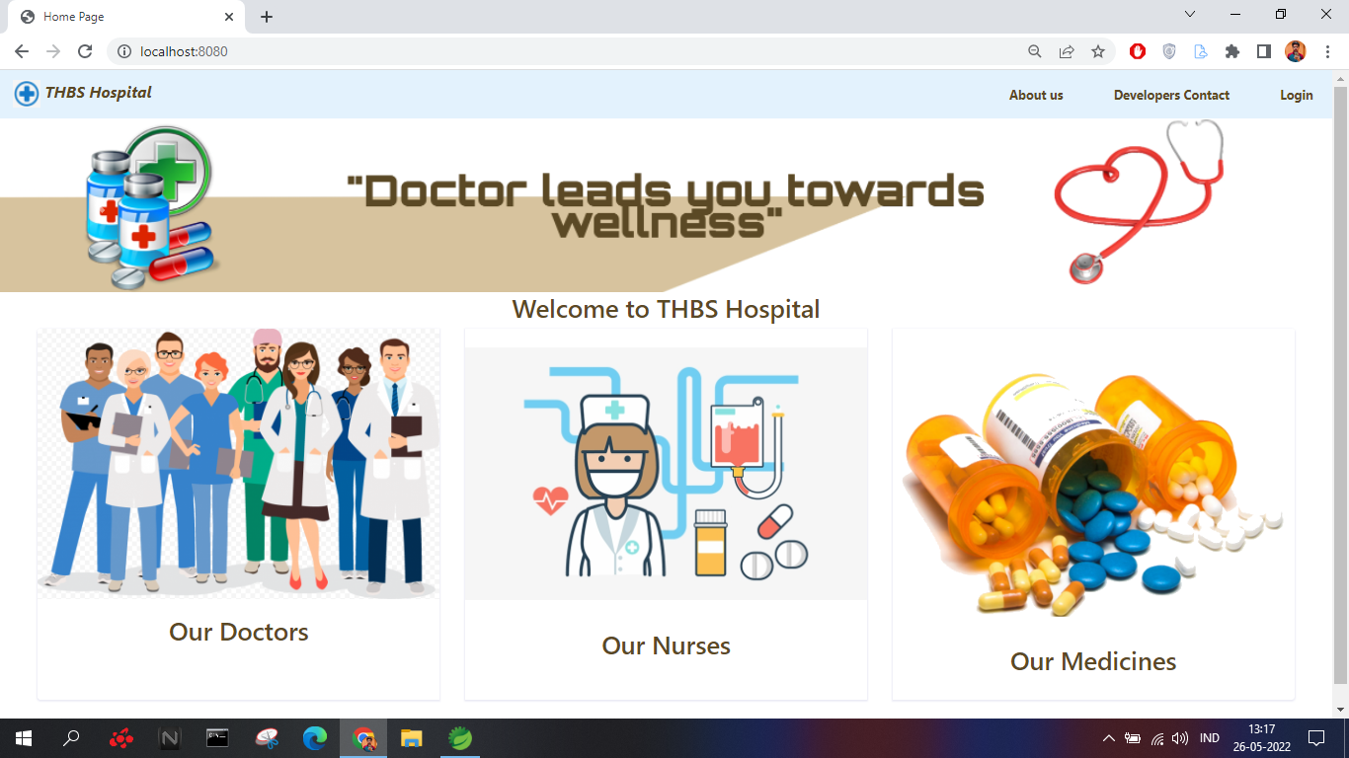
Home Page

Slide 12
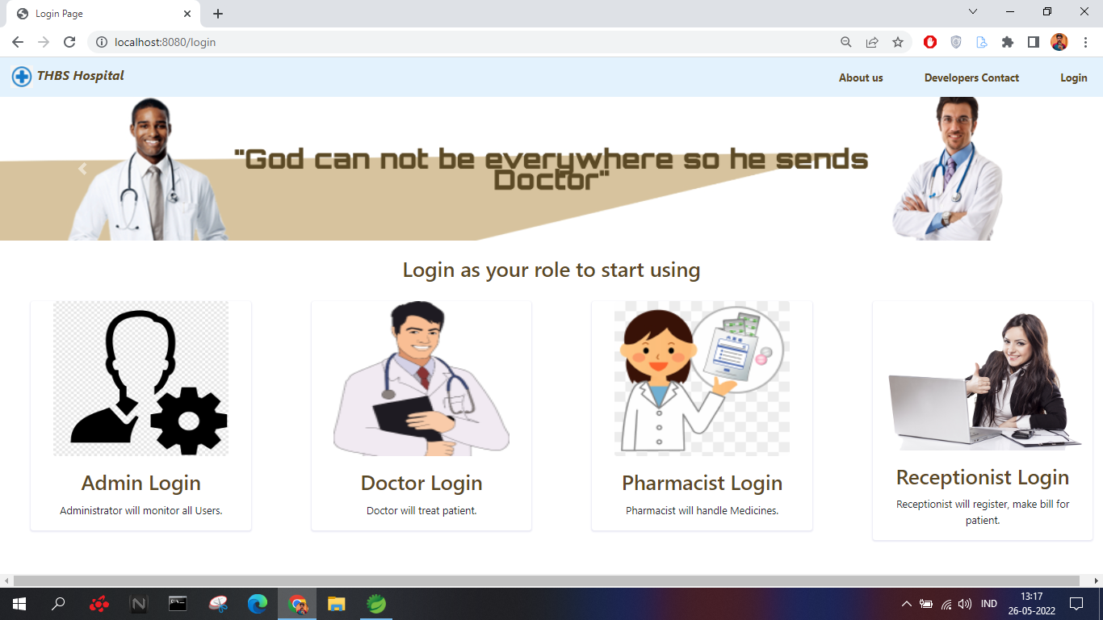
Login Page

Slide 13
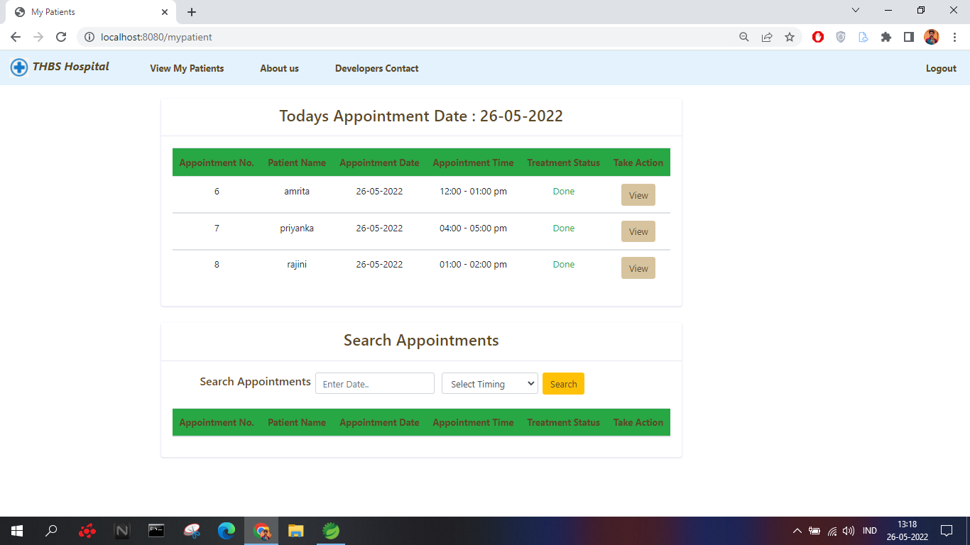
Doctor

Slide 14
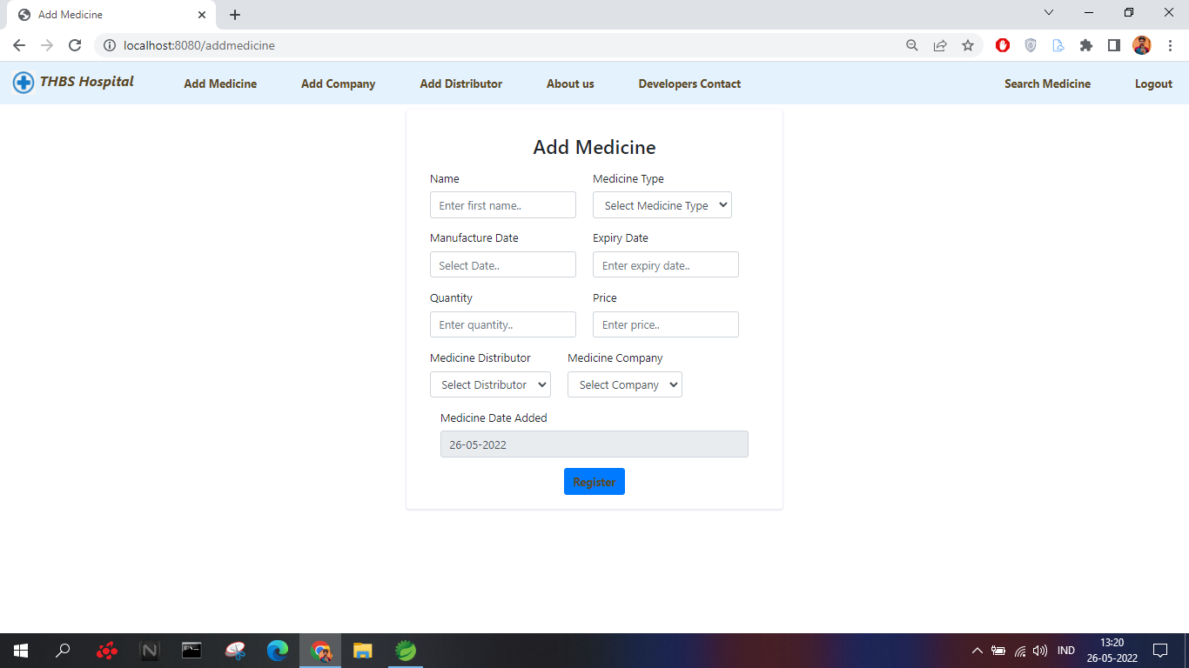
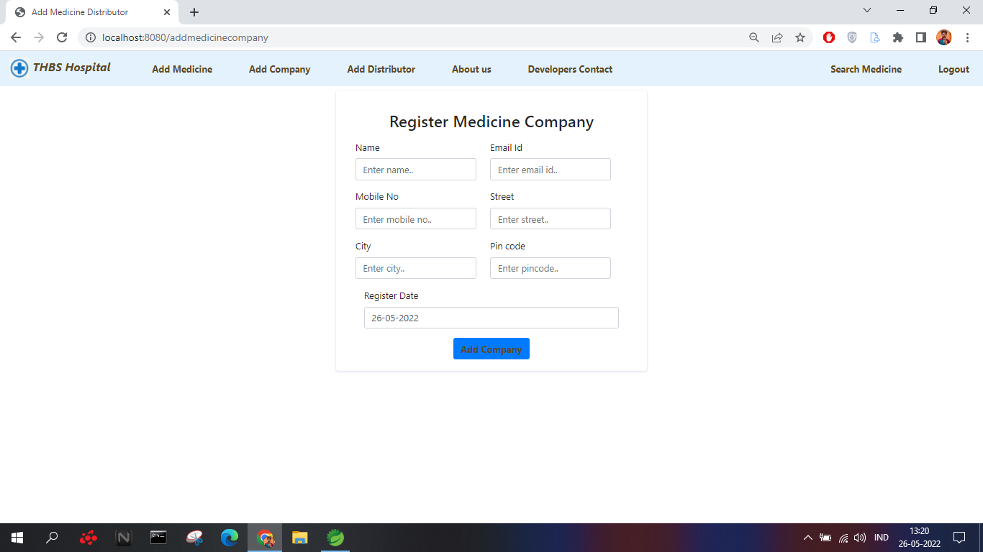
Pharmacist

Slide 15
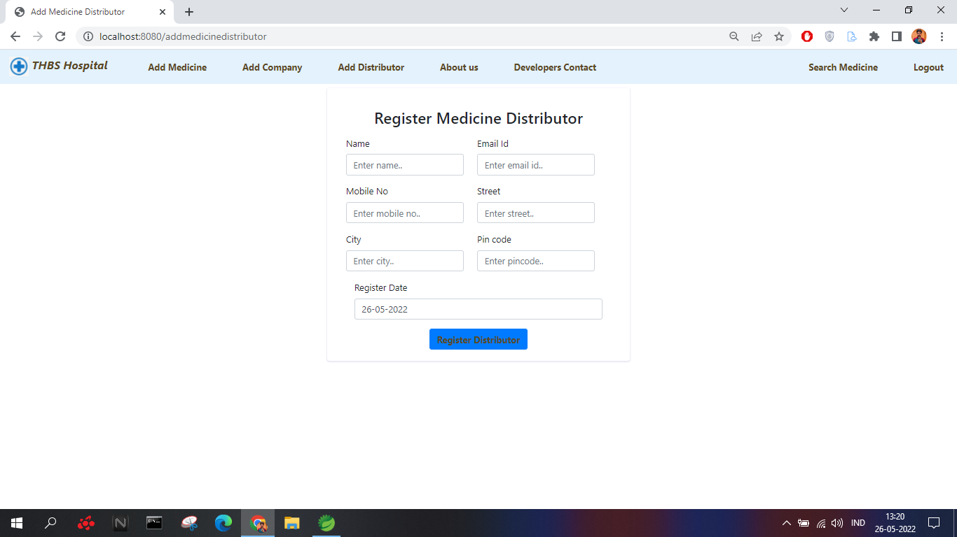
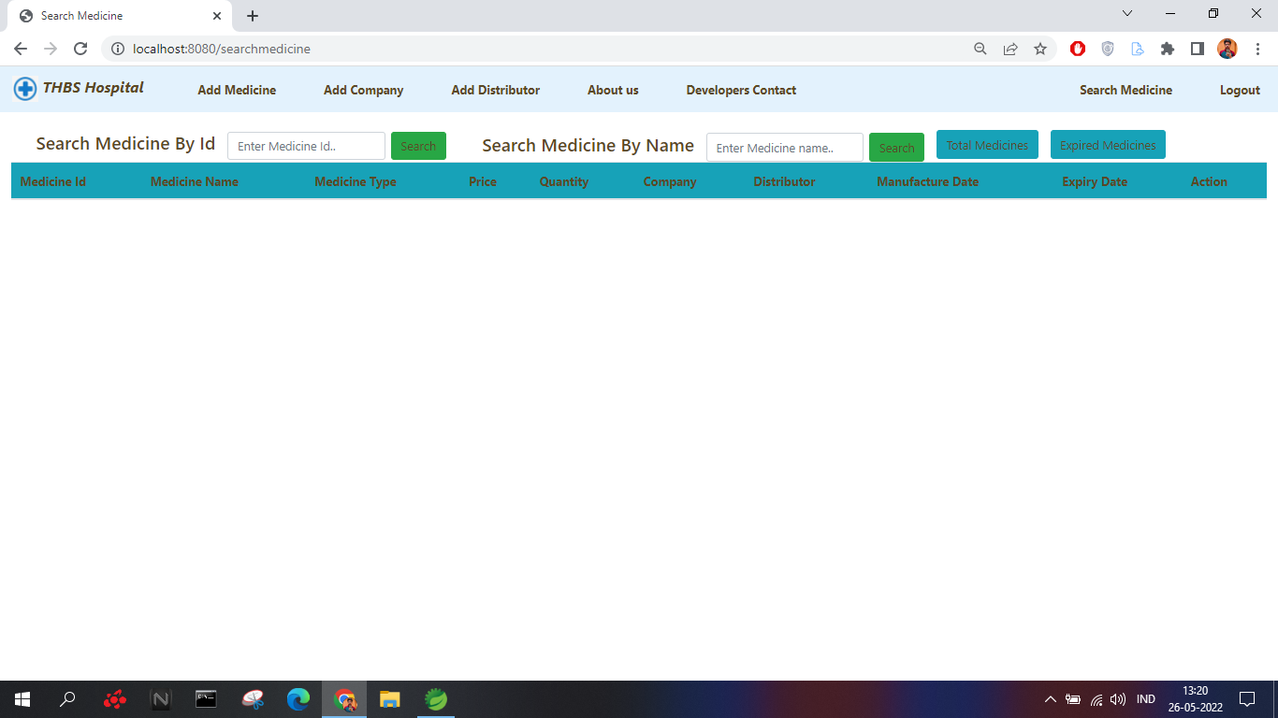

Slide 16
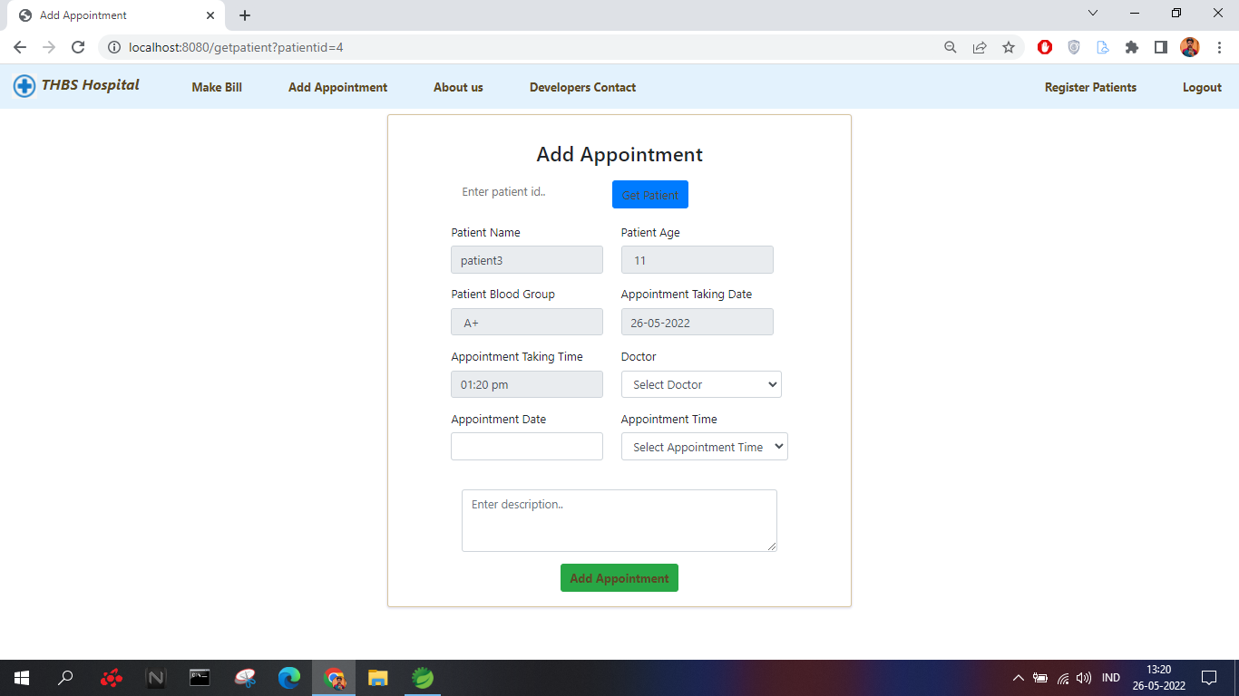
Receptionist

Slide 17
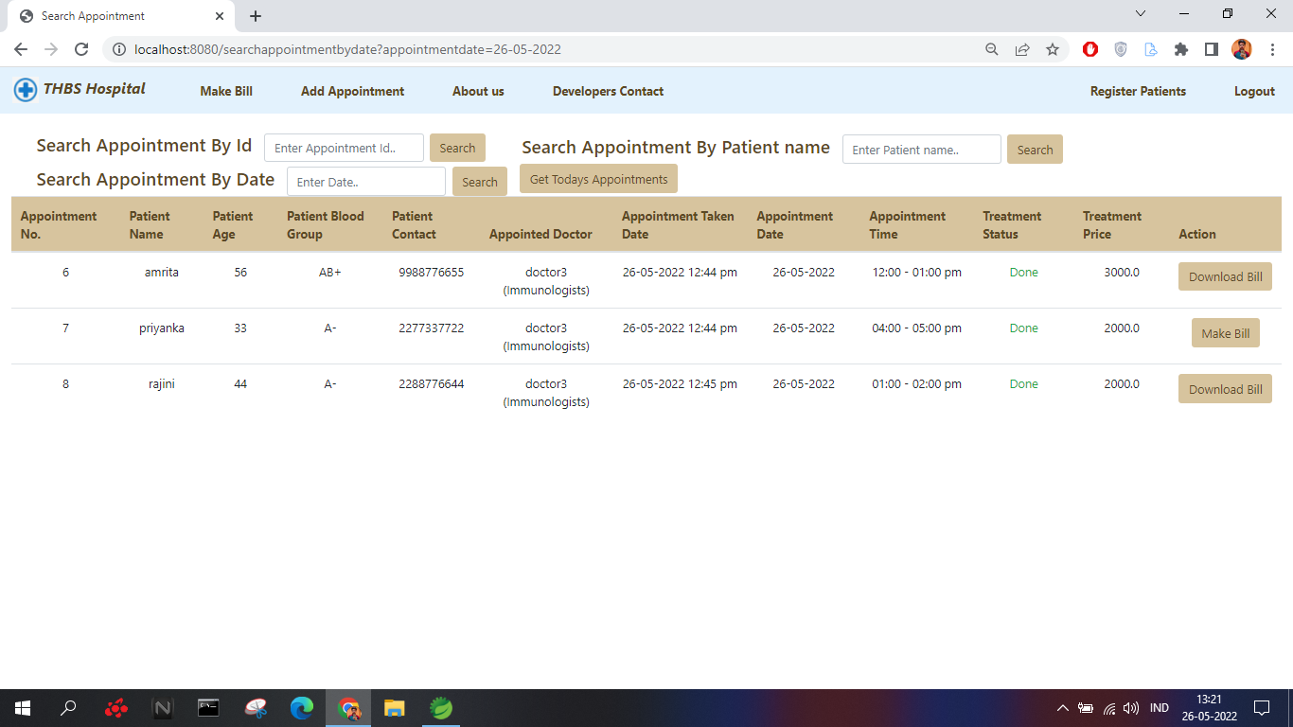

Slide 18

Thank you

