Slide 1

Exploratory Data Analysis Case Study
Exploring Patterns in Lending Club Loan Data

Slide 2
Your best quote that reflects your approach… “It’s one small step for man, one giant leap for mankind.”
- Neil Armstrong

Slide 3
Data Cleaning

Slide 4
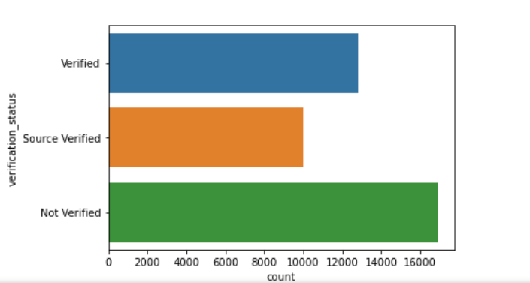
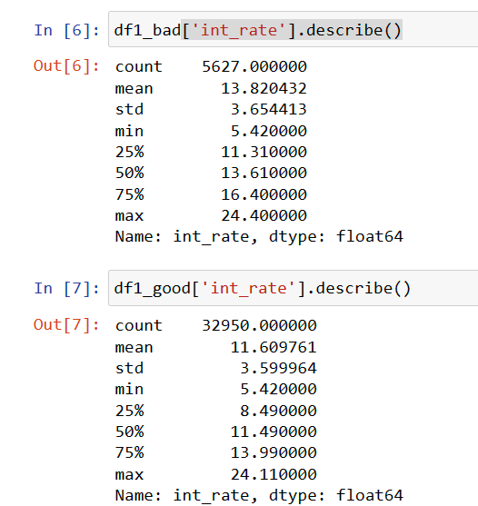
Univariate Analysis
Not verified people are more in number for whom loan
Is approved this is critical issue
Defaulter tends to accept more interest rate on the other
Hand. The people who genuinely wanted to fully pay will accept
Less interest rate.
This can be proven by first second and third quartile comparison

Slide 6
Bivariate Analysis

Slide 7
Segmentation

Slide 8
Multivariate Analysis

Slide 9
Conclusion

