Slide 1

PFEPL
Industries
Inventory Management System
A Flask + MySQL based Web Application
Prepared by:
Irshad Shaikh
Guided by:
Fahad Sir
https://pioneerfoundationengineers.com/

Slide 2

PFEPL
Industries
Inventory Management System
Introduction
Built with Flask, MySQL, HTML/CSS/JS
Manages products, categories, transactions
Includes approval workflows, transfer progress, and reporting
A Flask + MySQL based Web Application
https://pioneerfoundationengineers.com/

Slide 3
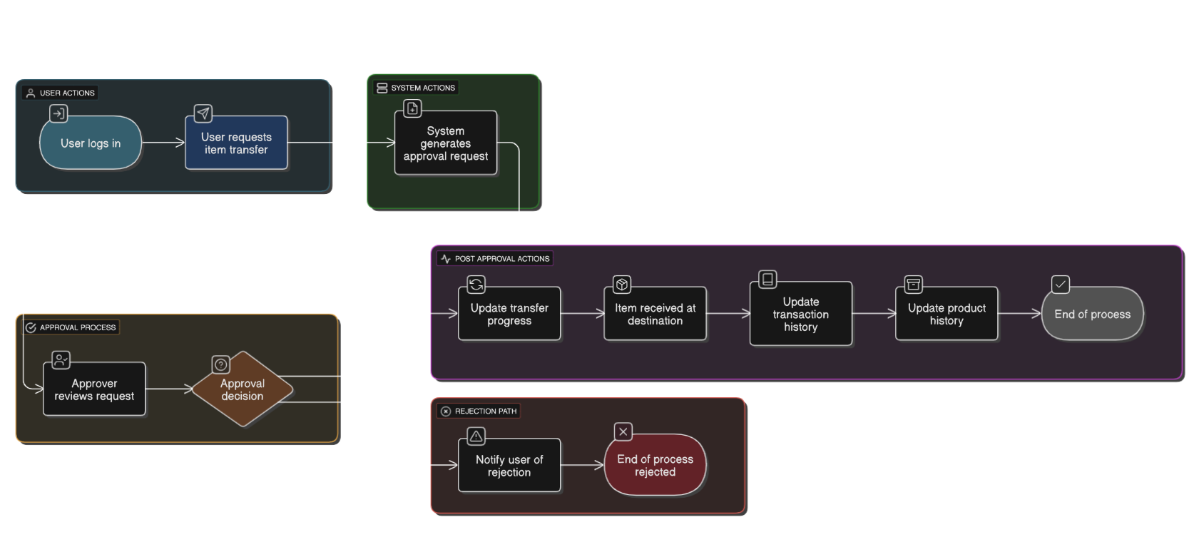
PFEPL
Industries
Workflow Flowchart: Item Transfer & Approval
Outlines the step-by-step process for an item transfer.
Key steps:
User login
Transfer request submitted
Approval required
Approved → transfer completed & history updated
Rejected → notify user
Keeps process simple and high-level.
https://pioneerfoundationengineers.com/

Slide 4
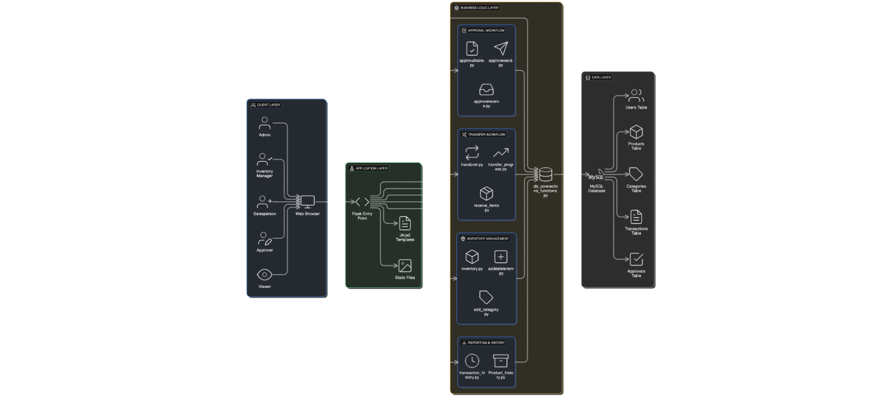
PFEPL
Industries
System Architecture
A 4-layer design:
Users (Client Layer) – Access via browser (roles: Admin, Inventory Manager, Salesperson, Approver, Viewer)
Flask Application Layer – Handles routing, templates, and requests
Business Logic Layer – Functions for approvals, transfers, inventory, history
Database Layer (MySQL) – Stores all entities and transactions
Shows high-level data flow between layers.
https://pioneerfoundationengineers.com/

Slide 5
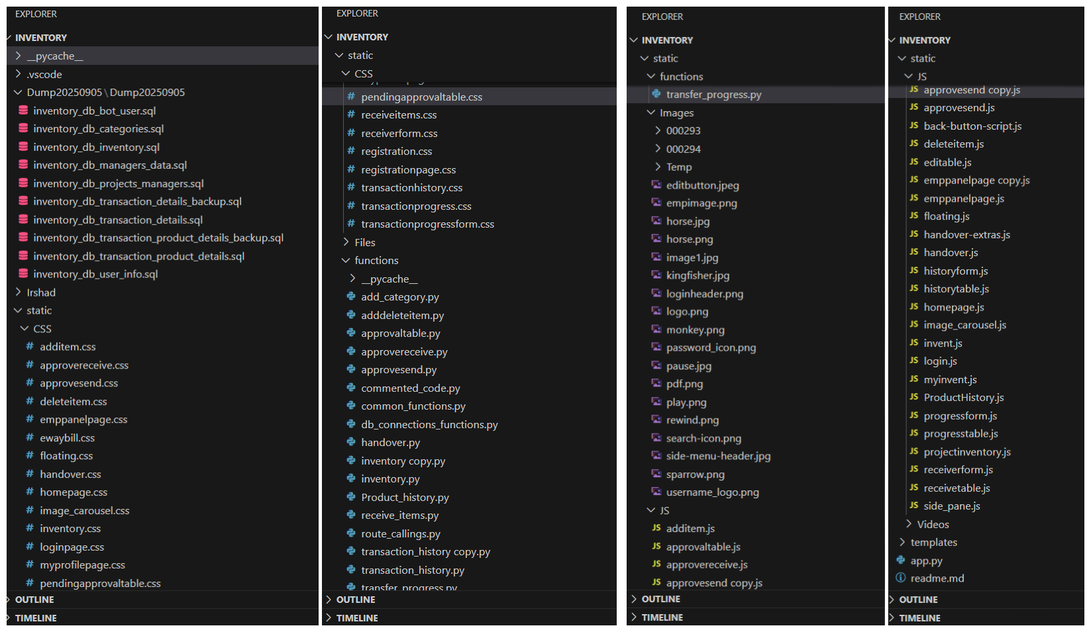
Project Directory Structure
PFEPL
Industries
Provides an overview of the project’s organization in VS Code.
Separates code into Flask entry point, functions, templates, static resources, and SQL dumps.
Helps understand how the project is structured for maintainability and scalability.
https://pioneerfoundationengineers.com/

Slide 6
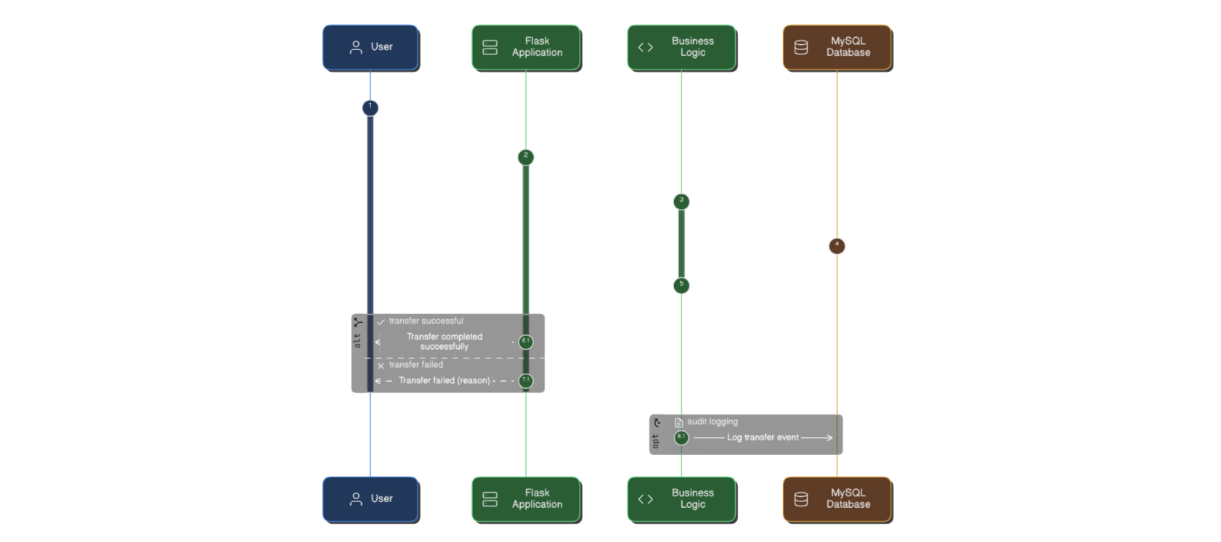
PFEPL
Industries
Sequence Diagram: Item Transfer Workflow
Shows the interaction between the User, Flask App, Business Logic, and Database during an item transfer.
Captures the synchronous flow of request, processing, and response.
Highlights how approvals and database updates are coordinated.
https://pioneerfoundationengineers.com/

Slide 7
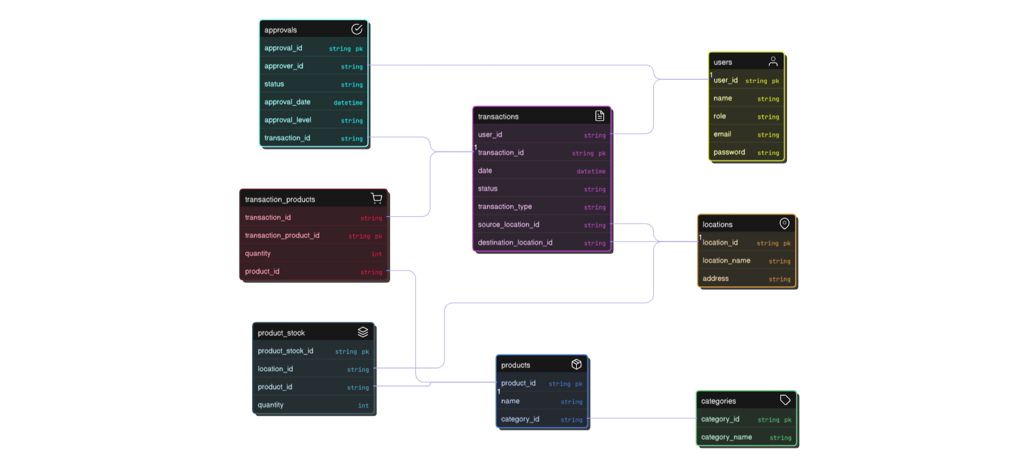
PFEPL
Industries
Entity Relationship Diagram (ERD)
Defines the core entities in the system: Users, Products, Categories, Transactions, and Approvals.
Shows relationships:
Users initiate transactions
Products belong to categories
Transactions require approvals
Ensures data consistency and traceability for inventory operations.
https://pioneerfoundationengineers.com/

Slide 8
PFEPL
Industries
Conclusion
The system streamlines inventory & transfer management
Provides role-based approvals
Ensures full transaction & product history tracking
Extensible and modular code structure
https://pioneerfoundationengineers.com/

Slide 9
PFEPL
Industries
Thank You
https://pioneerfoundationengineers.com/

