Slide 1
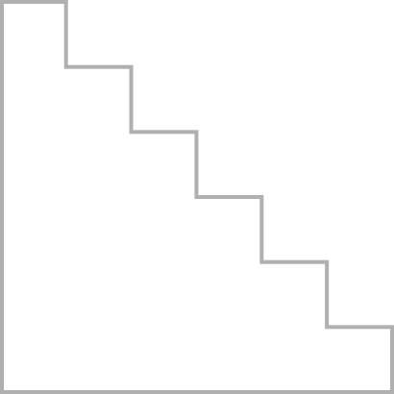





TELEGRAM TASK MANAGEMENT BOT
PROJECT STUDY
PREPARED BY:
Irshad Shaikh
GUIDED BY:
Fahad Sir
DATE:
1-9-25

Slide 2
INTRODUCTION
Purpose: Studied the codebase and functionality of the bot.
Deliverables: Architecture, workflows, ER model, and documentation.
Objective: Understand how the bot manages tasks, users, and database.

Slide 3
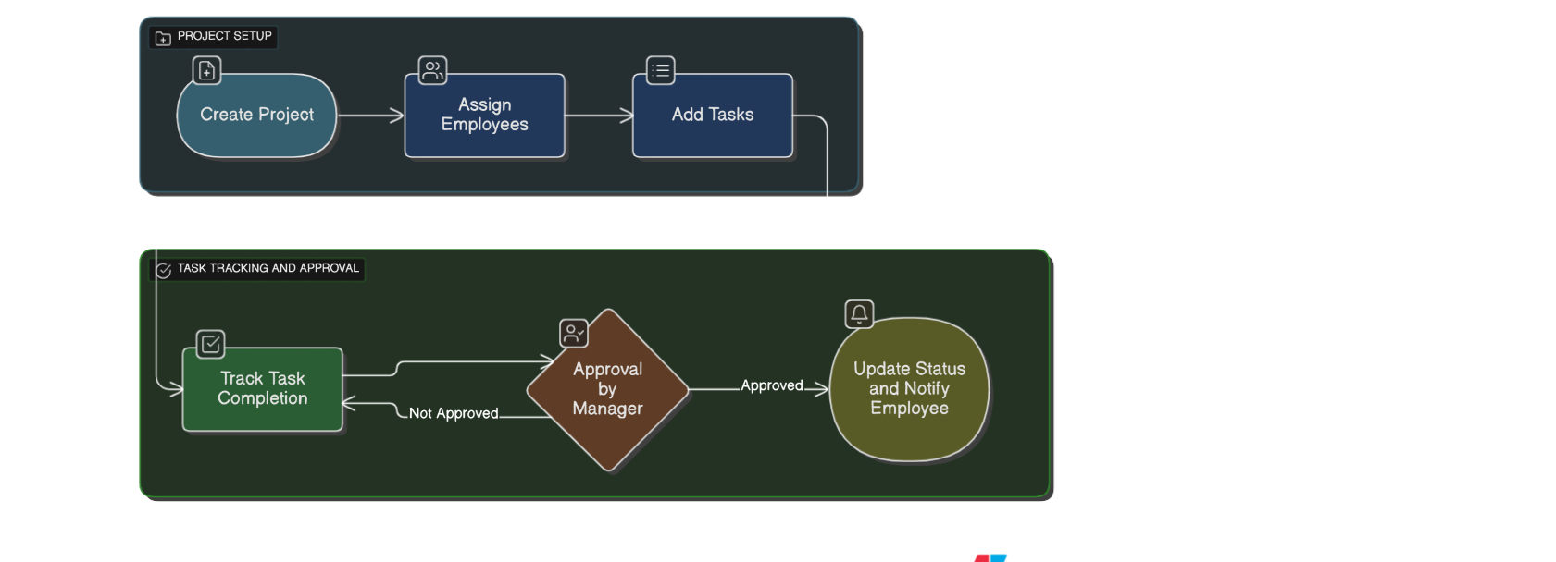
PROJECT OVERVIEW (DIAGRAM 1)
Fig: Project Structure and Component:
Shows the bot’s high-level purpose.
Key features: Task creation, project organization, database linkage.
End users: Individuals/teams managing tasks via Telegram.

Slide 4
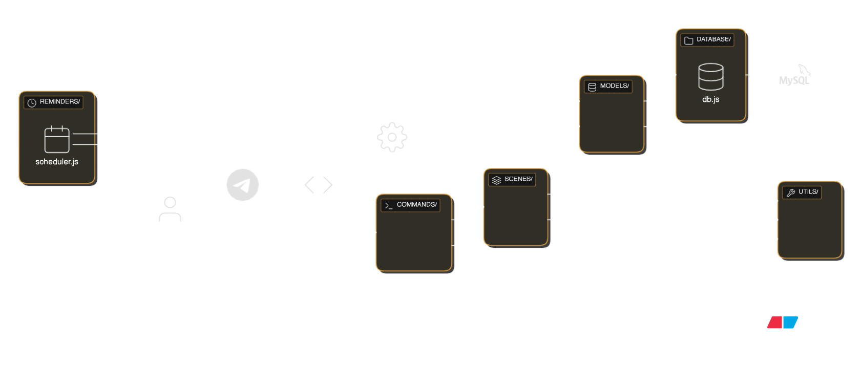
ARCHITECTURE (DIAGRAM 2)
Fig:Architecture:
Bot connects with Telegram API and Database.
Config & command handlers manage functionality.
Database layer ensures task persistence.

Slide 5
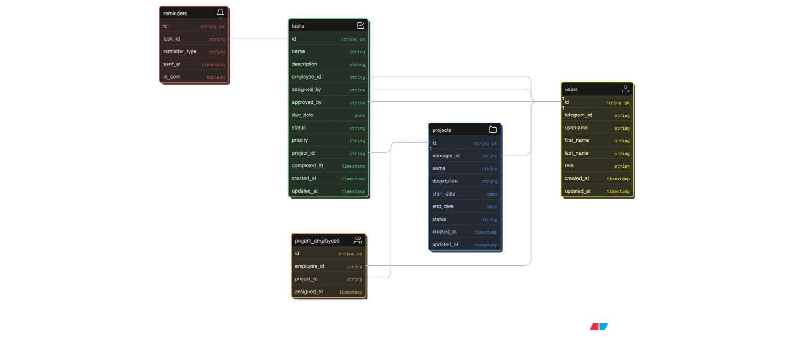
DATABASE MODEL (DIAGRAM 3)
Fig:Entity Relationship:
Entities: Users, Tasks, Projects, Reminders, and Project_employees.
Relationships: Users manage projects, assign tasks, and are on project teams. Projects contain tasks. Tasks have reminders.
Purpose: This model streamlines task and project management for users.

Slide 6
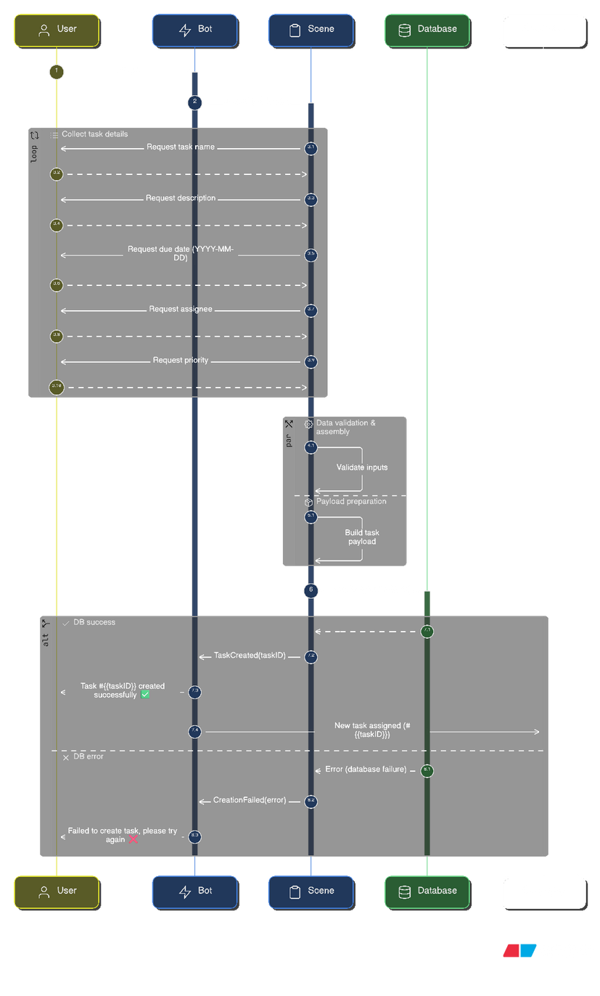
WORKFLOW (DIAGRAM 4)
Fig:UML Sequence:
Task Initiation: A User sends a "Task" command to the Bot.
Data Collection: The Bot interacts with a Scene to prompt the user for task details (name, description, due date, assignee, priority) in a loop.
Validation & Payload: The Scene performs data validation and prepares the task data into a payload.
Database Interaction: The Scene attempts to create the new task in the Database.
Success/Error Handling:
On Success: The Database responds with the new task ID. The Scene notifies the Bot, which confirms success to the User and sends a notification to the assigned Employee.
On Error: The Database sends an error. The Scene informs the Bot, which then sends a failure message back to the User.

Slide 7
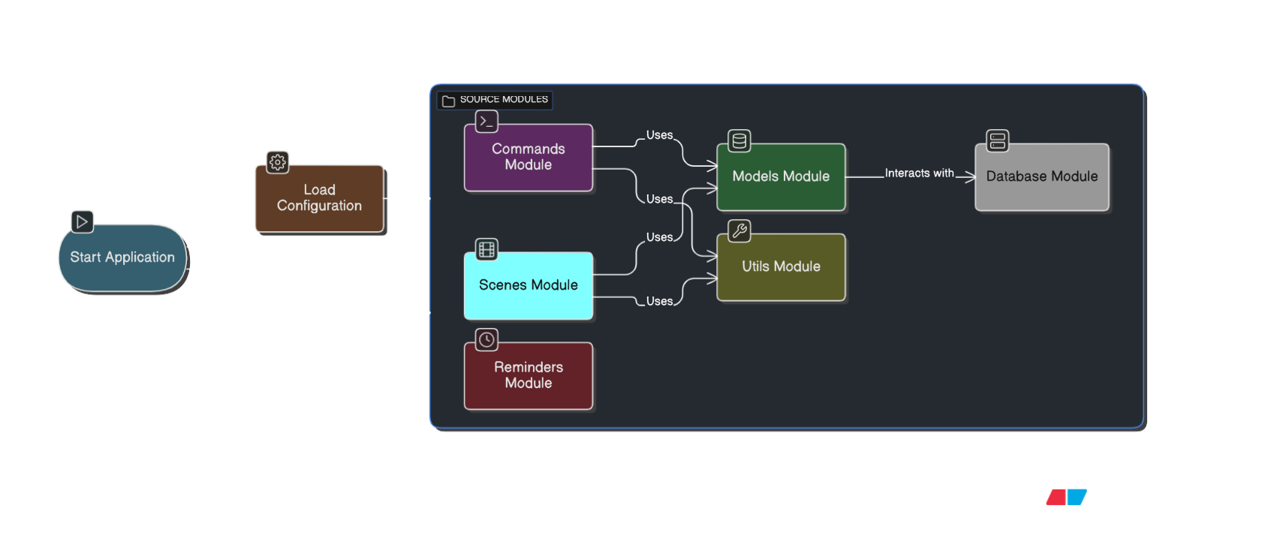
PROJECT STRUCTURE (DIAGRAM 5)
Fig:Task and Project Overview:
Main entry file: app.js (starts bot).
commands/ folder → handles user inputs.
database/ → manages data persistence.
config.js → environment variables.

Slide 8
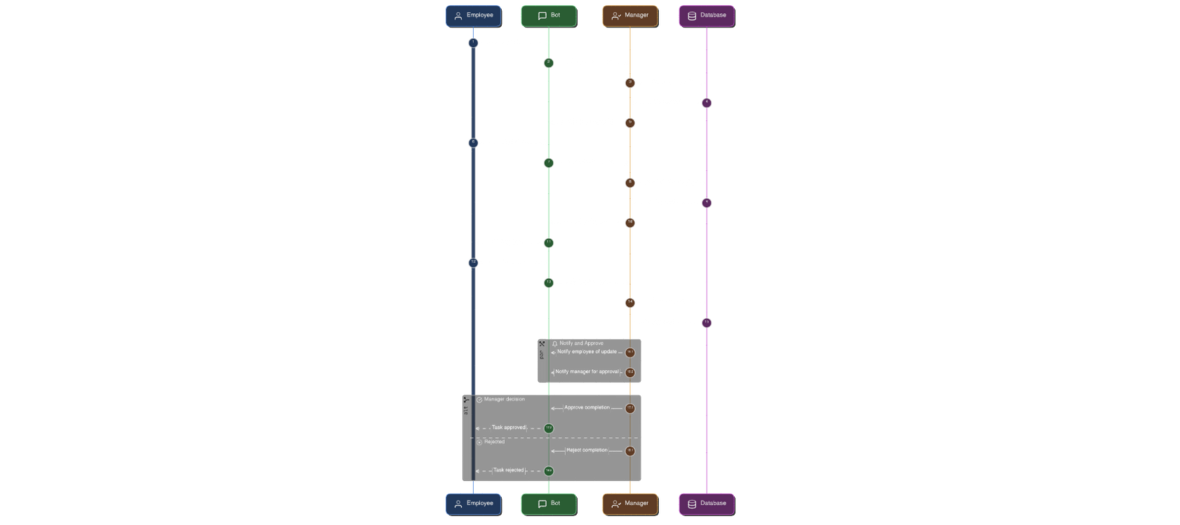
USER FLOW (DIAGRAM 6)
Fig:User Flow Sequence:
Employee initiates a task by logging in and then completing it.
The Bot acts as an intermediary, updating task statuses in the database and notifying the manager.
The Manager reviews and approves the completed task.
The Database stores and updates all the task information, including status and approvals.
Provides complete cycle from user action to system response.

Slide 9
CONCLUSION & LEARNINGS
Completed study of the Telegram Task Management Bot.
Understood architecture, workflows, and database structure.
Created diagrams to document findings.
✅ Task successfully completed.

Slide 10
THANK YOU

