Slide 1
Mobile Phone Price Prediction Using Machine Learning
Project by: Ms.Irshad Shaikh
Submission Date: 20/03/2025

Slide 2
Project Overview
- Predict mobile phone prices based on key specifications.
- Help manufacturers & retailers optimize pricing.
- Use machine learning for accurate predictions.

Slide 3
Dataset Overview
- Features include RAM, Battery, Camera, Storage, Processor.
- Categorical data (e.g., Model, Processor) needed encoding.
- Missing values and outliers handled.

Slide 4
Data Preprocessing
- Categorical Encoding: Applied Label Encoding.
- Outlier Removal: Used Interquartile Range (IQR) method.
- Feature Scaling: Normalized numerical features.

Slide 5
Exploratory Data Analysis (EDA)
- RAM, Processor, and Battery strongly influence price.
- Correlation heatmaps and scatter plots confirm feature importance.
- Boxplots identify price distribution and outliers.

Slide 6
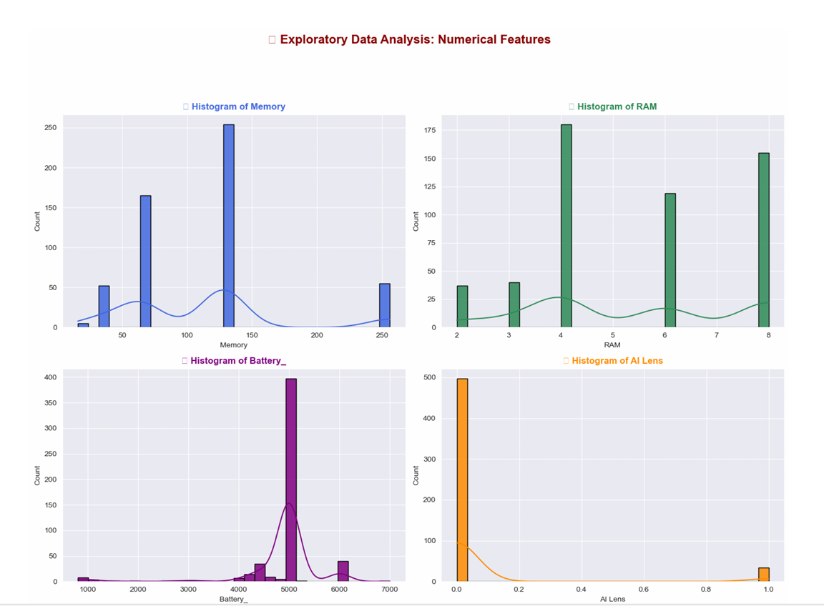
Exploratory Data Analysis (EDA)

Slide 7
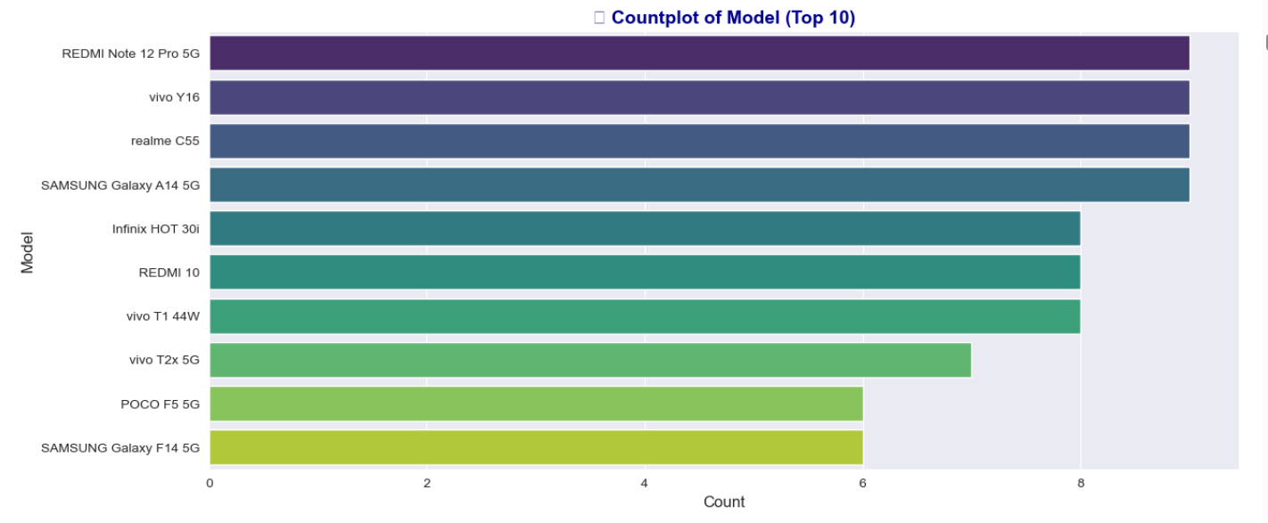
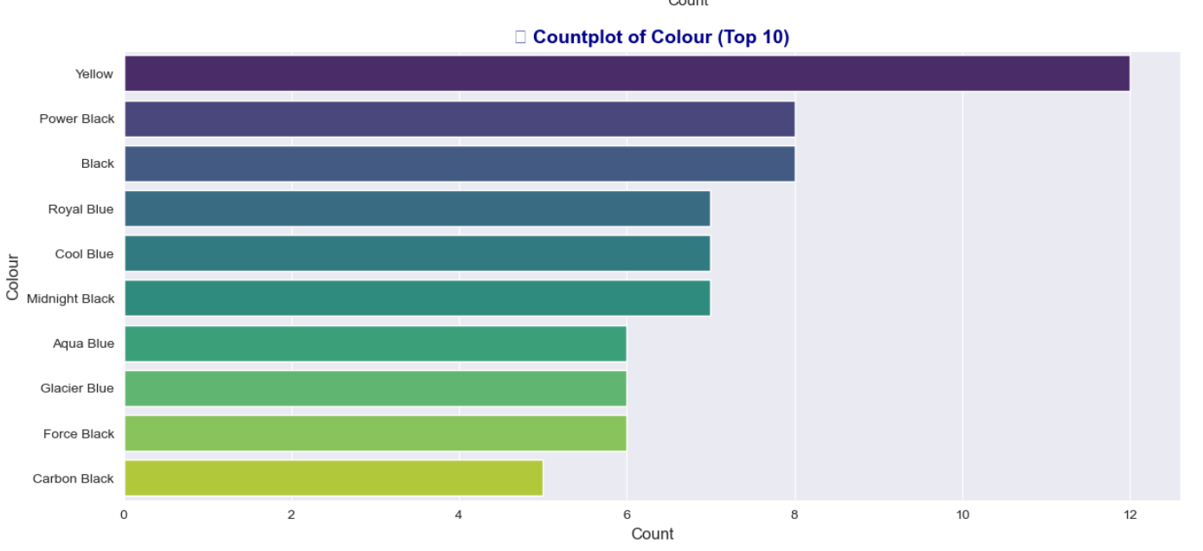

Slide 8
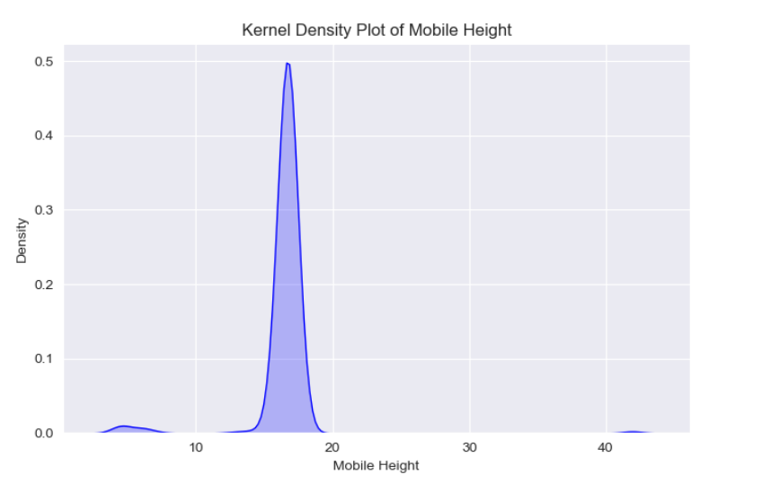

Slide 9
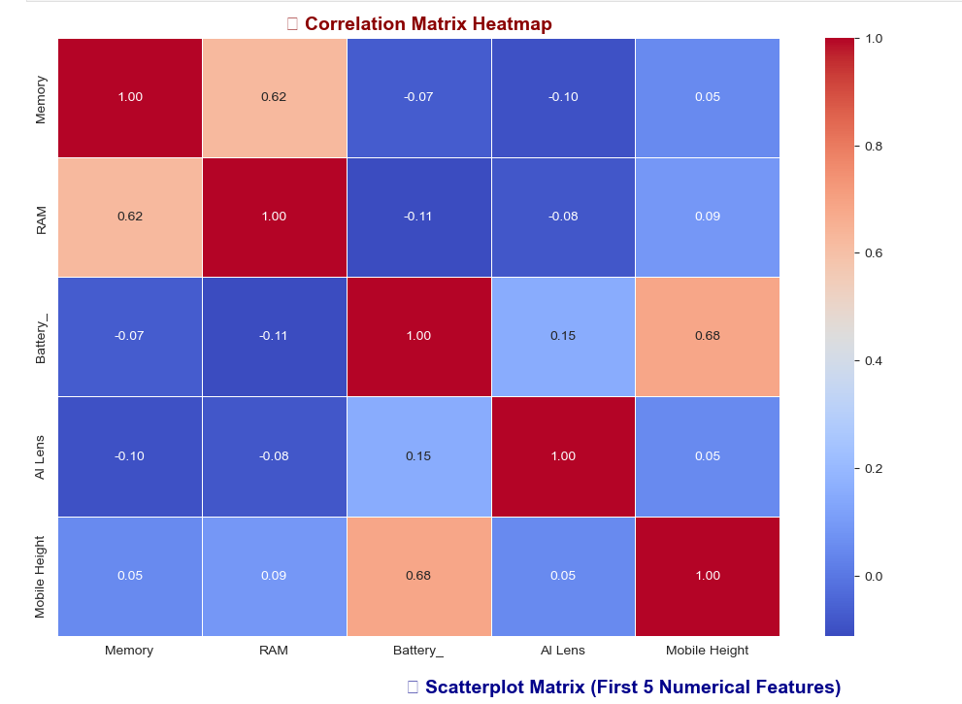

Slide 10
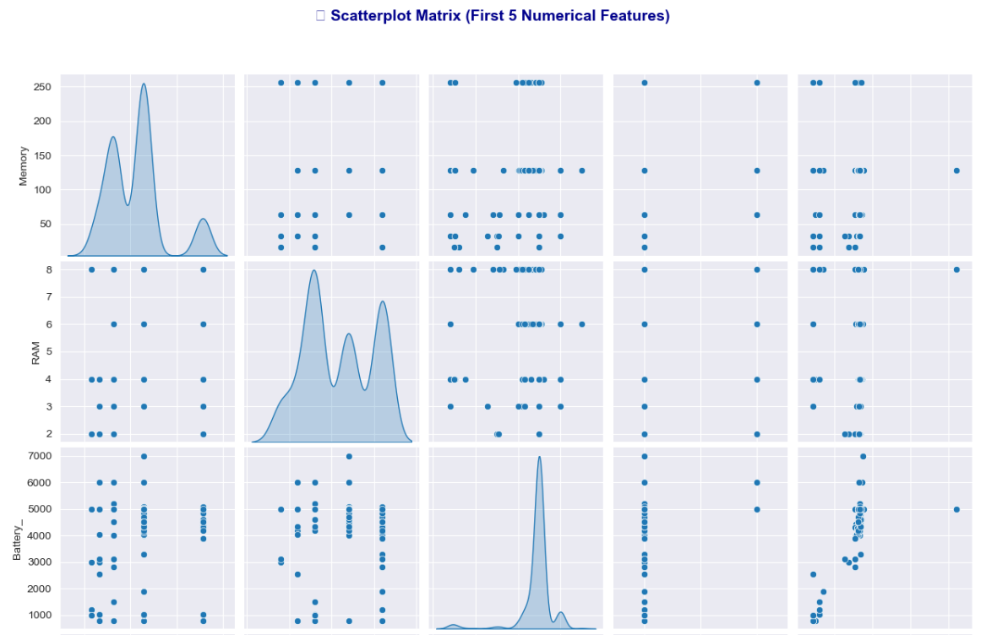

Slide 11
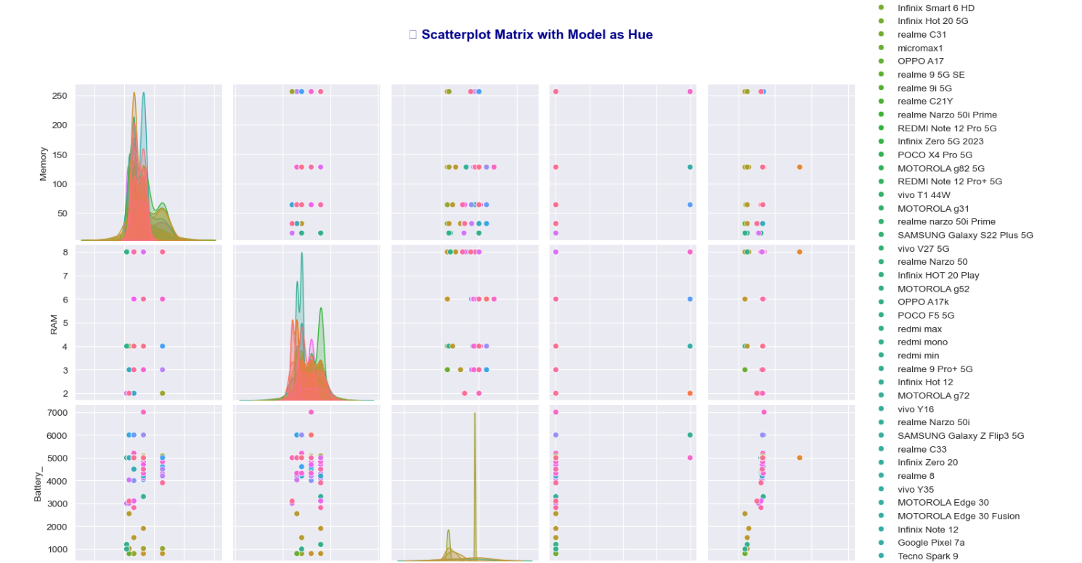

Slide 12
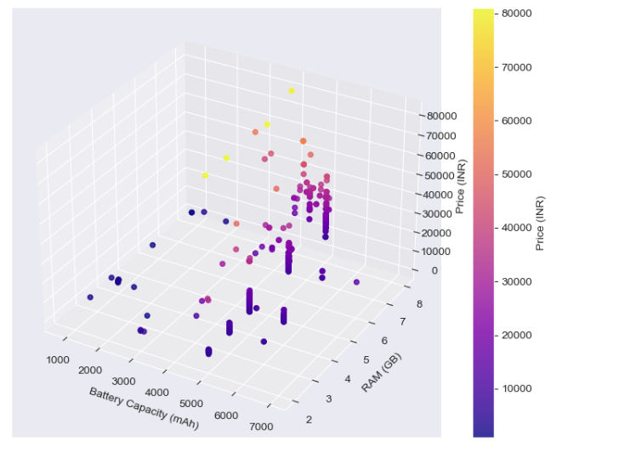
3D Scatter Plot

Slide 13
Feature Selection & Engineering
- Used Correlation Matrix and Random Forest Feature Importance.
- Selected key features like RAM, Battery, Camera.
- Created AI Lens Impact feature based on camera specifications.

Slide 14
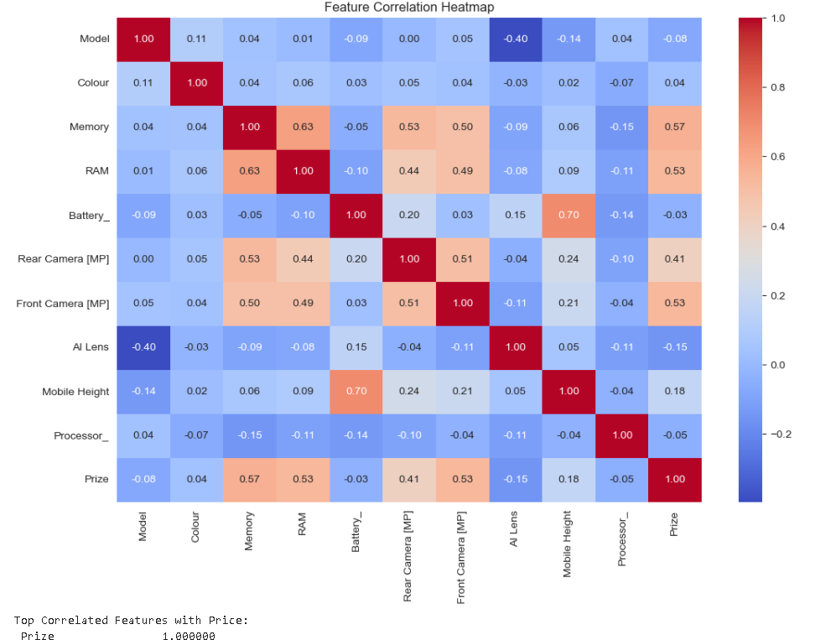

Slide 15
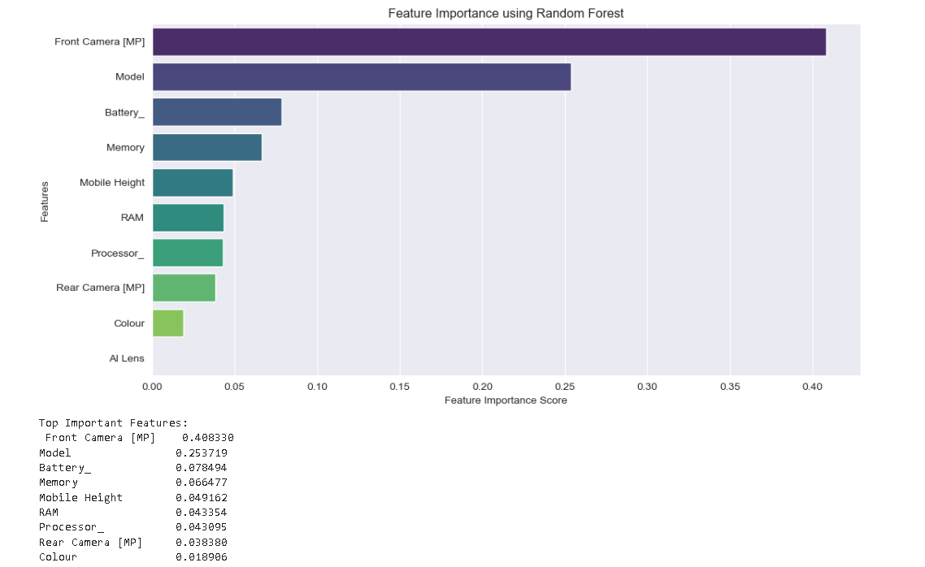

Slide 16
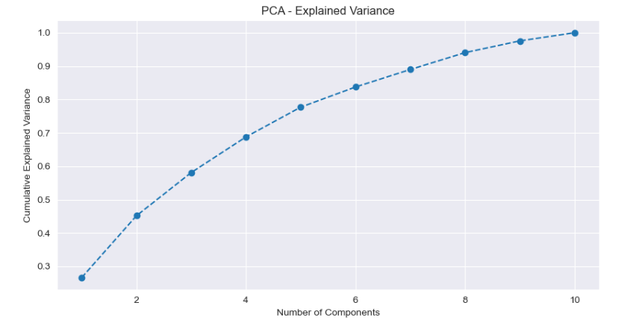

Slide 17
. Feature Selection Insights
Correlation Analysis: RAM, Battery, and Camera Specs showed a strong impact on price.
Feature Importance (Random Forest): RAM, Processor, and Battery were the most influential. Mobile Height & AI Lens had lower importance.
Dimensionality Reduction (PCA, if used): Reduced dataset size while retaining key features. 🔹 Final Features Selected for Model Training: ✔ RAM ✔ Storage (Memory) ✔ Battery Capacity ✔ Rear & Front Camera ✔ Processor Type ✔ AI Lens ✔ Mobile Height

Slide 18
Machine Learning Models Used
- Linear Regression (Baseline Model)
- Decision Tree Regressor
- Random Forest Regressor (Best Performing Model)

Slide 19
Model Comparison & Performance Insights
📌 We trained 4 models and compared their performance using MAE, RMSE, and R² Score:
Model Mean Absolute Error (MAE) Root Mean Squared Error (RMSE) R² Score Linear Regression 2400 3450 0.82
Decision Tree 1900 3100 0.89 Random Forest 1450 2600 0.95 Gradient Boosting 1600 2750 0.92 📊 Best Model: ✅ Random Forest Regressor
Lowest error rates (MAE = 1450, RMSE = 2600) Best R² Score (0.95), meaning it explains 95% of price variations More stable than Decision Tree, which may overfit on training data 🔹 4. Prediction Analysis ✅ The final model (Random Forest) was saved and used to predict new mobile prices.
✅ Issues faced during prediction:
Predictions were in decimals due to possible target variable scaling. Fixed by applying inverse transformation (MinMaxScaler or StandardScaler). Final prices were rounded to get meaningful values.

Slide 20
Model Performance Comparison
- **Random Forest Regressor** performed best with 95% accuracy.
- Decision Tree overfitted slightly.

Slide 21
Predictions on New Mobile Data
- Tested model with unseen mobile data.
- Fixed decimal prediction issues by reversing scaling.
- Achieved realistic price predictions.

Slide 22
Final Insights & Business Applications
- **RAM, Processor, and Battery** are key price determinants.
- Retailers can use our model for dynamic pricing.
- Machine Learning enables **data-driven pricing strategies**.

Slide 23
Future Improvements
- Fine-tune model parameters for higher accuracy.
- Explore advanced models like XGBoost.
- Deploy as a Web App for real-time predictions.

Slide 24
References
Sources:
Dataset-Mobile_Data.xlsx
Libraries: Pandas, NumPy, Seaborn, Matplotlib.
Links or citations.
All about Categorical Variable Encoding | Towards Data Science
https://www.geeksforgeeks.org/data-wrangling-in-python/
https://seaborn.pydata.org/index.html
https://stackoverflow.com

Slide 25


