Slide 1
Pharmaceutical Store Sales Forecasting
Using Machine Learning and Deep Learning
Presented by: Irshad Shaikh

Slide 2
Problem Statement
- Forecast daily sales for pharmaceutical stores
- Handle promotions, holidays, and store-specific behavior
- Deploy a working ML/DL dashboard

Slide 3
Dataset Overview
- train.csv, test.csv, store.csv
- ~1 million rows, 17+ features
- Key columns: Date, Store, Sales, Promo, StateHoliday

Slide 4
Preprocessing Steps
- Merged train/test with store data
- Handled missing values
- Feature engineering: Year, Month, Day, IsWeekend
- Saved merged CSV files

Slide 5
Exploratory Data Analysis (EDA)
- Analyzed sales over time
- Compared sales with promo and store type
- Visualized trends, outliers

Slide 6
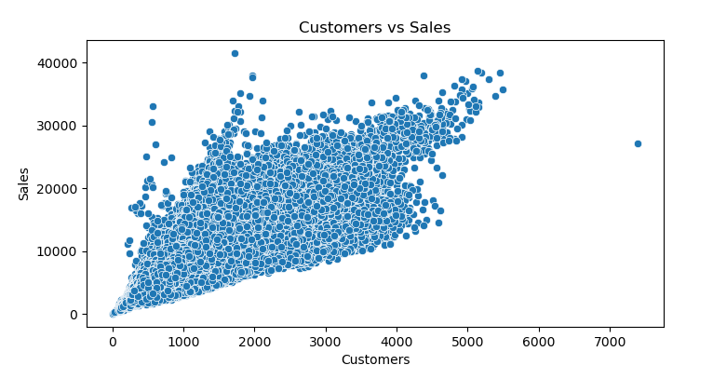
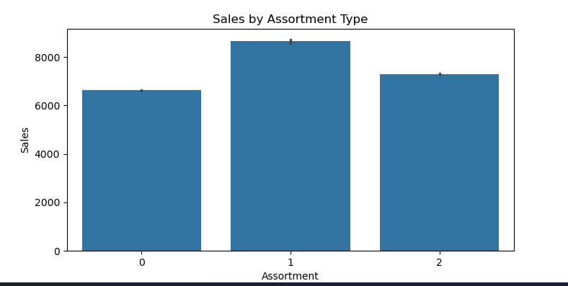
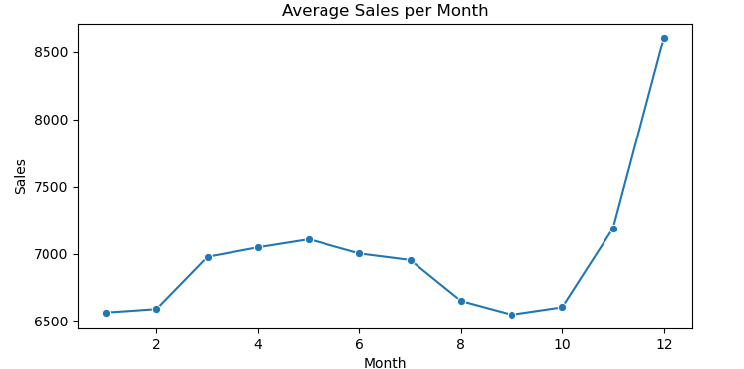
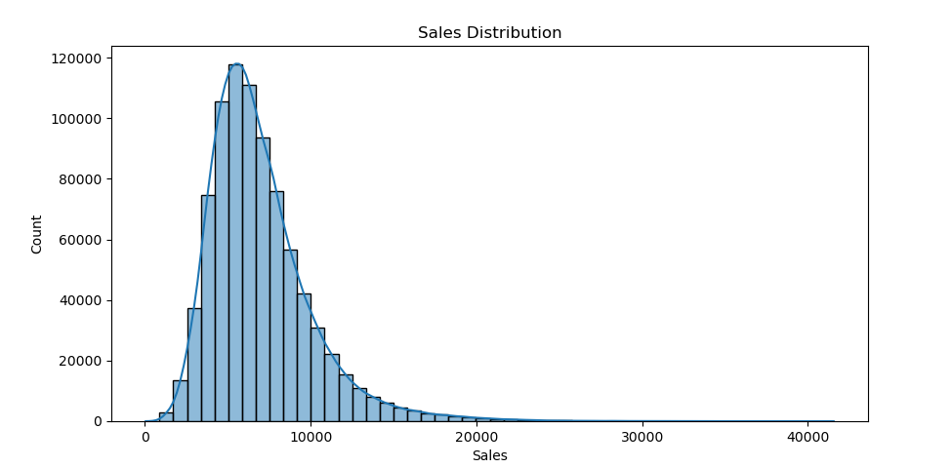

Slide 7
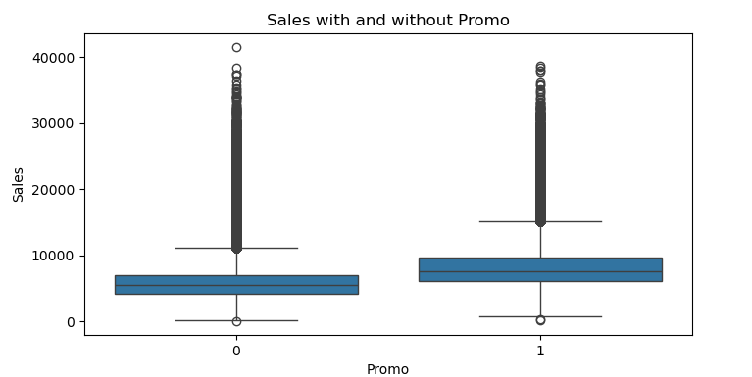
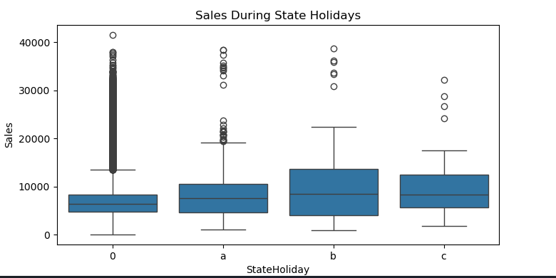

Slide 8
Machine Learning Model (RandomForest)
- Chose RandomForest for accuracy and speed
- Trained on top features
- Saved as rf_model.pkl

Slide 9
Deep Learning Model (LSTM)
- Used for Store 1 sales forecasting
- Sliding window approach (30 days)
- Normalized with MinMaxScaler
- Saved as lstm_model.h5

Slide 10
LSTM Prediction Output
- Predicted vs Actual Sales plotted
- Good alignment on trends
- Model loaded and tested in Jupyter/Colab

Slide 11
Deployment Strategy
- Used Streamlit/Gradio for dashboard
- Upload test file → Predict → Show plot → Download CSV
- Local errors avoided by deploying in Colab

Slide 12
Challenges Faced
- TensorFlow errors on Windows
- Model serialization issues
- Switched to Gradio for easier UI

Slide 13
Learnings
- Built complete ML & DL pipeline
- Model deployment techniques
- End-to-end automation of predictions

Slide 14
Thank You

