Slide 1
User Analytics in the Telecommunication Industry
Project Submission by : IRSHAD SHAIKH
Date: 24/04/2025

Slide 2
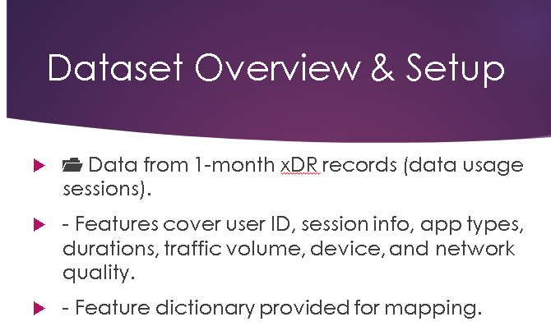
Situational Overview (Business Need)
The investor is analyzing TellCo, a mobile provider in Pefkakia.
- No prior user-level analysis done.
- Data analysis role: To perform full customer behavior analytics using xDR data.

Slide 3
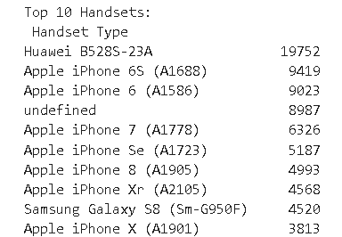
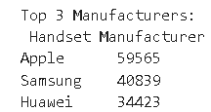
Task 1: User Overview Analysis
📱 To Identify top 10 most used handsets.
- Top 3 Manufacturers: Samsung, Huawei, Apple
- Recommended marketing segmentation based on device trends.

Slide 4
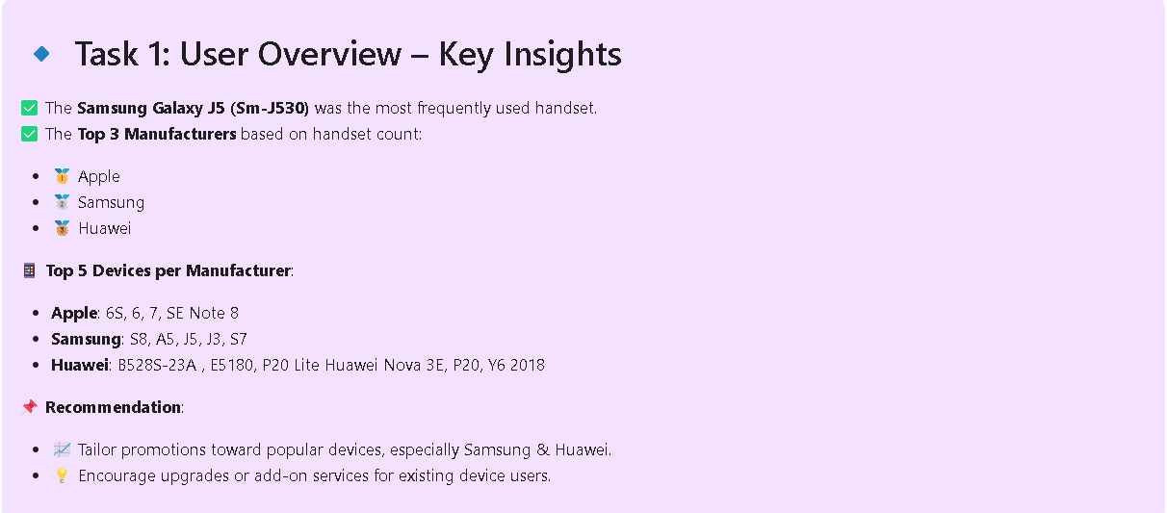
Task 1: User Overview Analysis

Slide 5
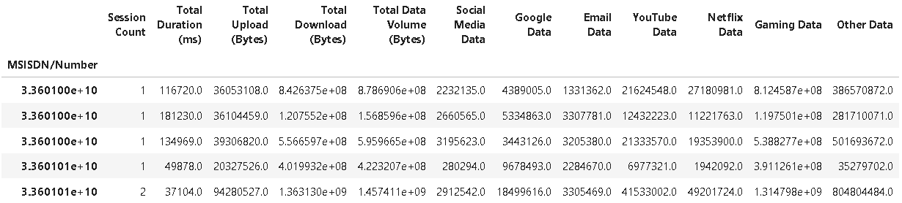
Task 1.1: Aggregate App Usage
📊 For each user, calculated:
- Total xDR sessions
- Session duration
- Upload/Download traffic per app

Slide 6

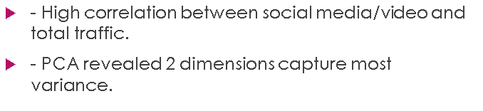
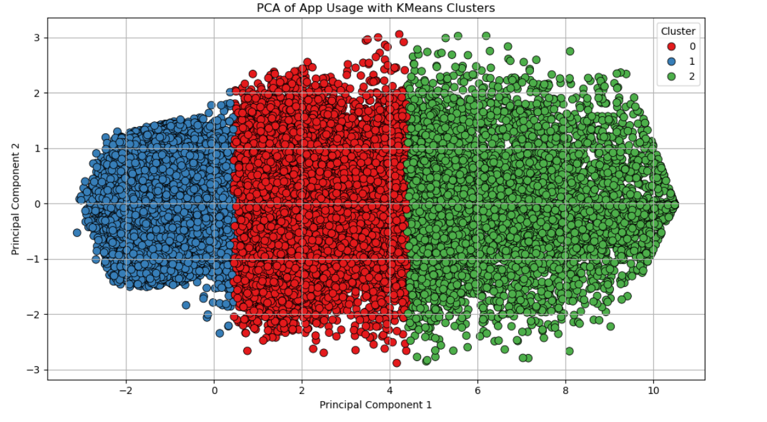
Task 1.2: EDA & Initial Insights

Slide 7
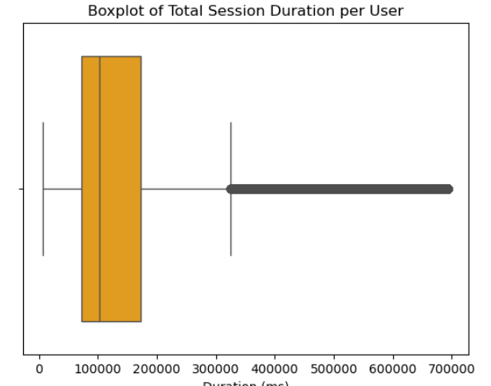
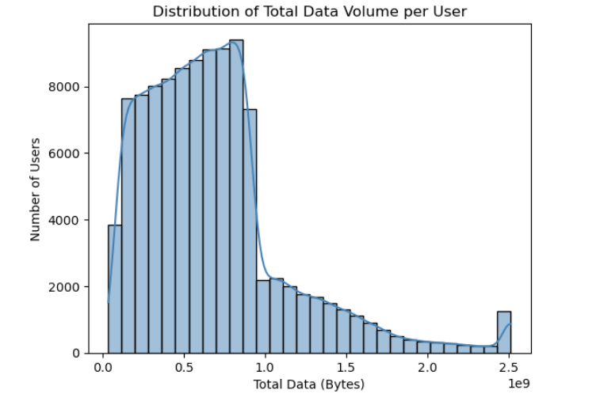
Task 1.2: EDA & Initial Insights

Slide 8
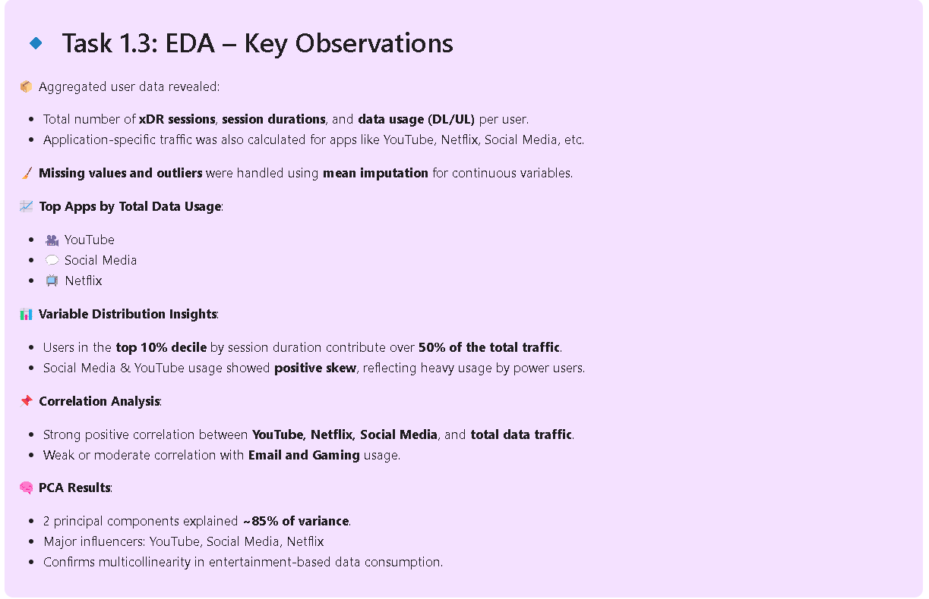
Task 1.2: EDA & Initial Insights

Slide 9
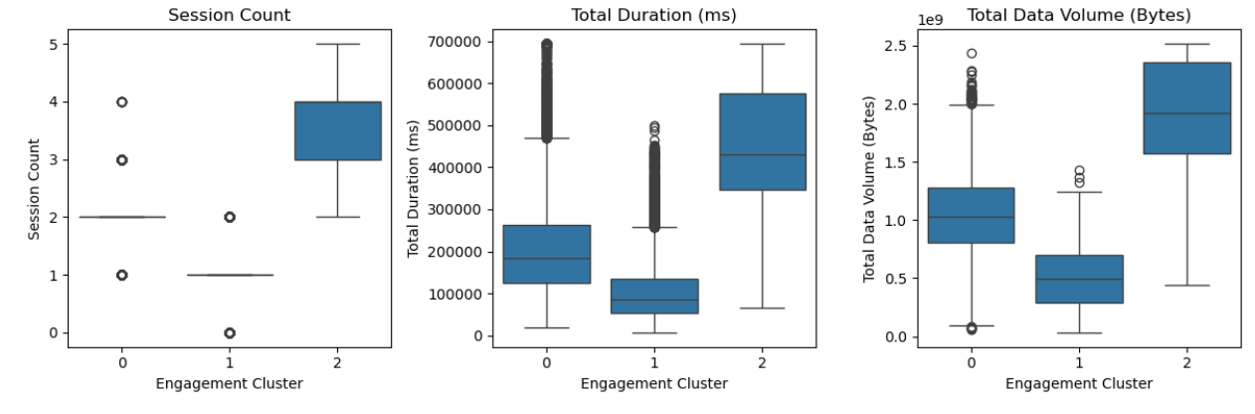
Task 2: User Engagement Analysis
📊 Tracked per-user session count, duration, and traffic.
- Clustered users into 3 groups (High, Medium, Low Engagement).
- App-wise usage revealed YouTube and Netflix are top traffic drivers.

Slide 10
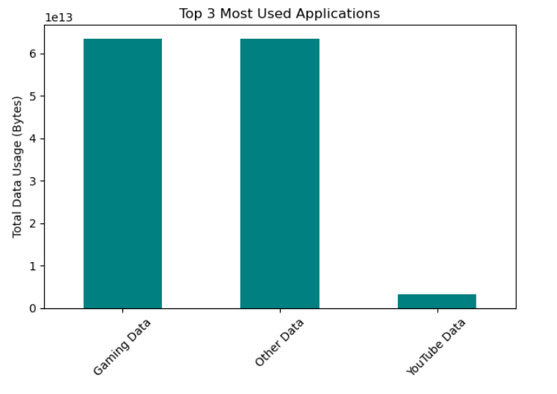
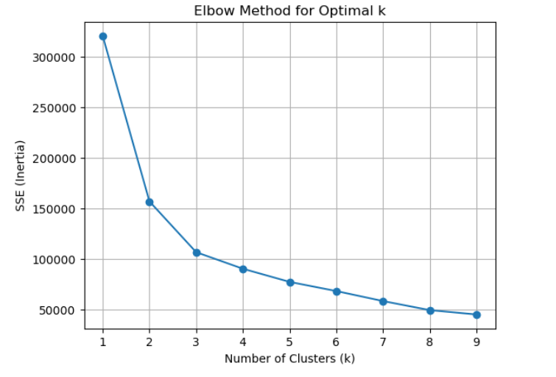
Task 2: User Engagement Analysis

Slide 11
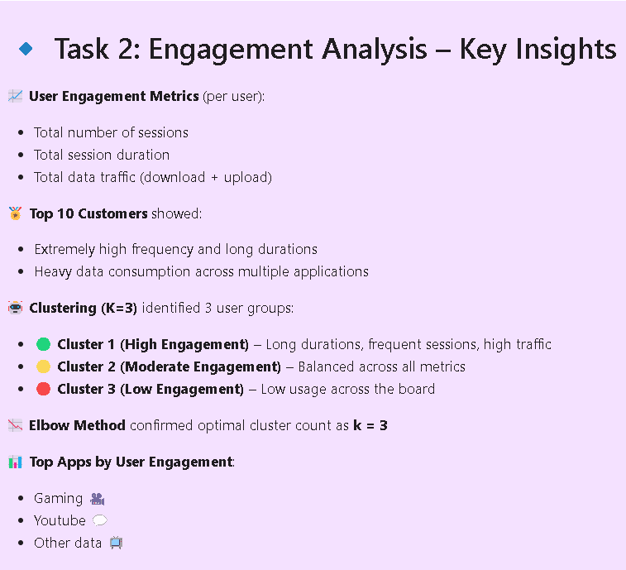
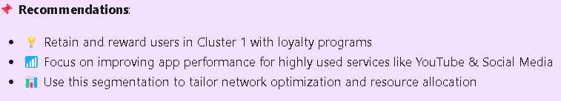
Task 2: User Engagement Analysis

Slide 12
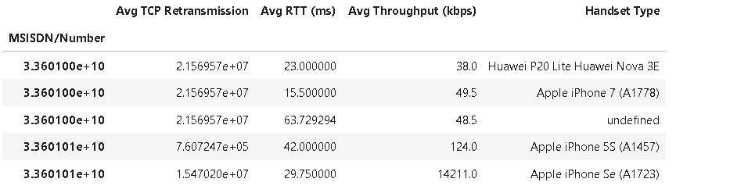
Task 3.1: Network Metrics Aggregation
📡 Aggregated per-user:
- Avg. TCP retransmission, RTT, throughput, handset type
- Handled missing/outliers using mean/mode.

Slide 13
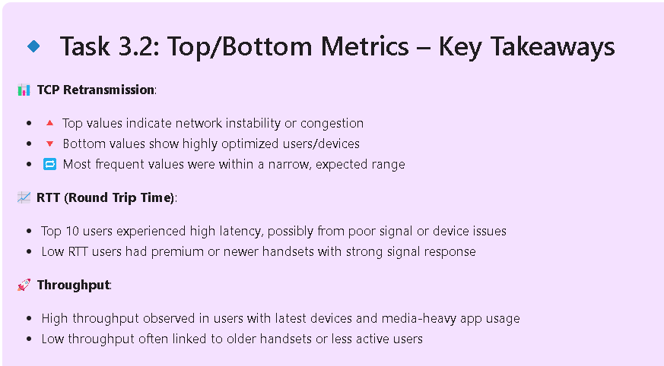
Task 3.2: Top/Bottom/Frequent Metric Values
📉 Identified extreme values for TCP, RTT, throughput.
- Flagged devices/users with potential QoS issues.

Slide 14
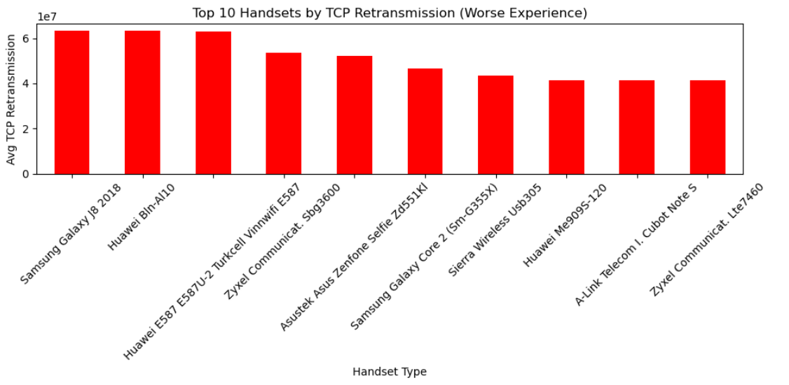
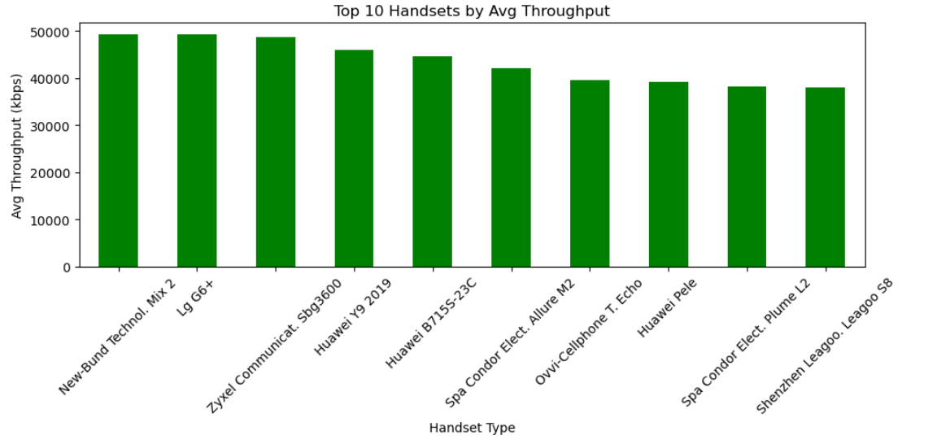
Task 3.3: Distribution by Handset
📶 Analyzed throughput and TCP retransmission by handset type.
- Newer premium phones showed better performance.

Slide 15
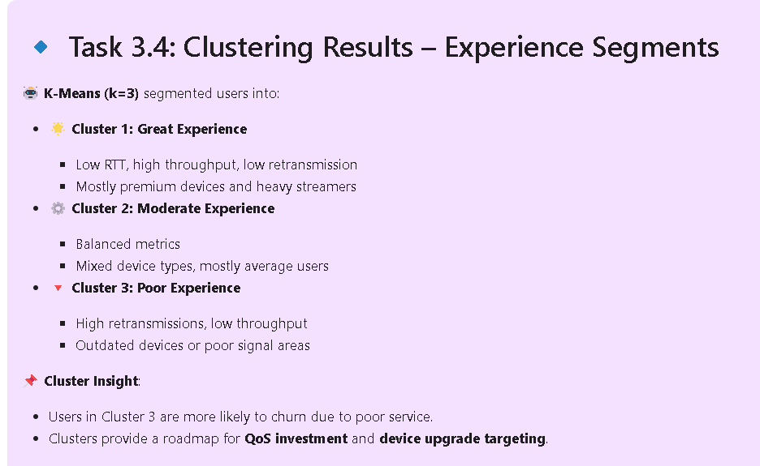
Task 3.4: Experience Clustering
🤖 K-Means (k=3) clustered users:
- Cluster 1: High QoS
- Cluster 2: Average
- Cluster 3: Poor QoS → prioritize for improvement.

Slide 16
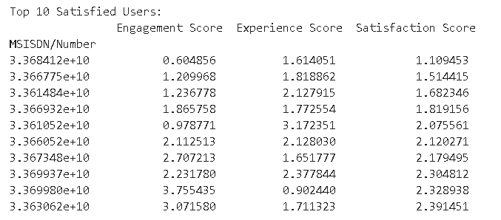
Task 4.1 & 4.2: User Scores
🧮 Computed engagement & experience scores using Euclidean distance.
- Satisfaction = average of both.
- Identified top 10 satisfied users.

Slide 17
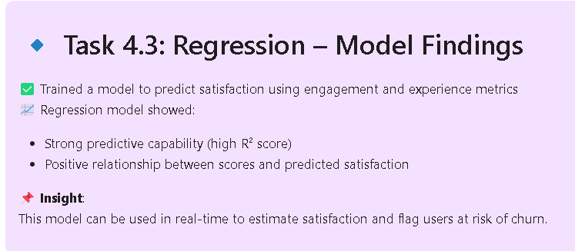
Task 4.3: Predict Satisfaction
📈 Trained regression model using engagement and experience scores.
- High R² value confirms predictive reliability.
- Model helps in forecasting future satisfaction.

Slide 18
Task 4.4 & 4.5: Cluster Users by Satisfaction Task 4.6: Export Scores to SQL
📊 Final K-Means (k=2):
- Cluster A: High satisfaction
- Cluster B: Low satisfaction
- Used averages to define strategies per group.
🗄️ Saved final table to MySQL.
- Included user ID, all scores
- Ran SELECT queries for validation.

Slide 19
Executive Summary & Recommendations
📌 Focus on:
- Retaining high-scoring users
- Upgrading low-performing devices
- Enhancing QoS for poor experience clusters

Slide 20
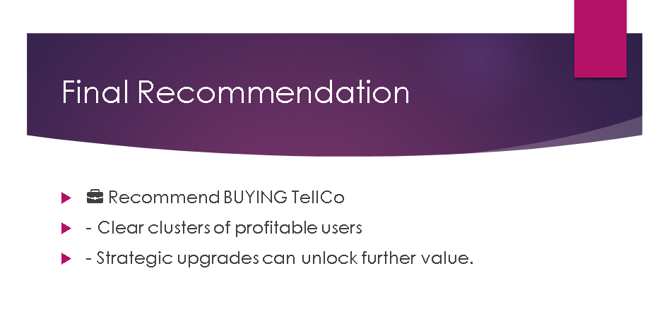
Limitations of the Analysis
⚠️ Challenges faced:
- Single month data
- Some devices undefined
- No location data for signal mapping

Slide 21


