Slide 1


Unlocking Insights: Amazon Sales Data Analysis
Amazon sales data analysis provides a wealth of insights that can drive business growth. In this presentation, we'll explore the techniques and tools needed to unlock those insights.
MI
by MD IRSHAD ANWAR

Slide 3
The Importance of Sales Data Analysis
By analyzing your Amazon sales data, you can gain valuable insights into customer behavior, identify trends, and pinpoint areas of your business that need improvement. Used correctly, this data can inform your business strategy and help you drive growth.
What Can Sales Data Analysis Do?
The Pitfalls of Not Analyzing Your Data
Using the Right Tools and Techniques
Unlock trends and insights to turbocharge your business growth, by understanding customer behaviors, internal trends, and external market forces.
Lack of data then leads to unoptimized pricing strategy, missed opportunities to capitalize on potential growth, and overall reduced company efficiency.
Cleaning and structuring your data is essential to gain accurate insights. Learn how to use Excel or Python for data cleaning and formatting.

Slide 4

Advanced E-Commerce Business Intelligence on Amazon Sales Data
Our project will focus on using advanced business intelligence techniques to analyze Amazon sales data. We will use Jupyter Notebook, Tableau, Ms Excel, and Python to uncover insights into customer behavior and optimize our E-Commerce domain name. This project is of advanced difficulty level.

Slide 5
PROBLEM STATEMENT
• sales management has gained importance to meet increasing condition and the need for improved methods of distribution to reduce cost and to increase profits. Sales management today is the most important function in a commercial and business enterprise.
DATASET INFORMATION
This is a sales related data set that contains information like sales ,Amt., Cost Amt., Sales Prices, List Prices, Sales Margins, Sales Quantities, etc.

Slide 6
Data Analysis Techniques for Amazon Sales Data
Data visualization and predictive analytics are essential techniques for analyzing Amazon sales data. By using dynamic and visually stunning graphs, dashboards, and reports.
1
Data Visualization
Learn about different data visualization techniques that will help you unlock key insights that might otherwise go unnoticed.
2
Predictive Analytics
Use predictive analytics to make more informed business decisions and understand what is driving current trends in the market.
3
Segmentation
Divide your customers into different groups to understand what each customer group specifically needs, allowing you to apply different marketing strategies and make accurate business decisions on behalf of your company.

Slide 7

Key Performance Indicators (KPIs) for Amazon Sales
KPIs help you simplify complex data sets and understand how well your business is performing. Identifying and tracking the right KPIs is essential for evaluating business effectiveness and making informed decisions. Images>
Sales Growth
Analyze the growth rate of your business and understand customer behavior to gain insights into your business strategy and customer satisfaction levels.
Return on Investment (ROI)
Analyze your marketing campaigns and understand how much you're investing per customer to validate the customer acquisition cost against your Average Order Value (AOV).
Customer Satisfaction
Identify customer pain points, since dissatisfaction can be a great way to identify things you need to fix about your products or services.
Conversion Rate
Analyze site stability, web design, and retargeting for search term optimization. Increases in conversion rate means more customers add items to their cart and eventually finalize the purchase.

Slide 8
Examples of Insights Gained from Amazon Sales Data Analysis using Tableau
Tableau may be your best friend when analyzing sales data. It is intuitive, easy to use, and quickly yields some robust data visualizations and insights. By incorporating features like descriptive statistics, regression models, and multi-level filtering into your visualizations, Tableau provides powerful insights that have a real impact on your business.
1
Market Basket Analysis
See which products are often sold together, providing insights into your customers' buying behavior, suggesting promotions, and creating one-time deals.
Product Sales Breakdown
2
Understand which products are driving your sales and identify new products or niche areas which could diversify your company.
3
Customer Analysis
Understand higher vs. lower-end customer lifetime values in terms of total revenue, marketing cost ramifications, local control, and loyalty campaigns.

Slide 9
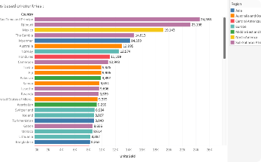
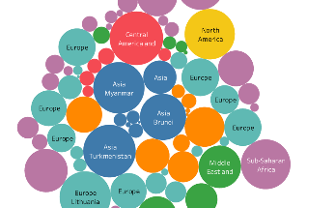
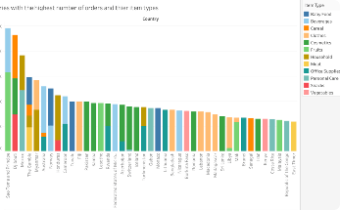
Using Insights to Inform Business Decisions and Drive Growth
By leveraging insights gained from Amazon sales data analysis, you can inform your business decisions and drive growth. From improving marketing strategies to optimizing pricing, and identifying emerging opportunities, insights gained from data analysis can supercharge your business growth.
Implementing Insights
Assessing Business Performance
Efficiency & Productivity
Brainstorm with your team, present data-driven insights and work on an action plan to include potential areas of change.
Track changes regularly, to evaluate the impact of changes adopted post-insight generation.
Data analysis should help optimize your business processes or workflows, making them more efficient, eliminating any bottlenecks, and reducing inefficiencies.

Slide 10
Conclusion and Key Takeaways
By analyzing your Amazon sales data, you can gain valuable insights that will help you make informed decisions that drive growth. Use the techniques and tools discussed to uncover valuable insights.
Start Small
Get Help When Needed
Monitor Changes Over Time
Don't just dive into complex analytics straight away. Begin with simple reports and dashboards and scale up to more complex models as you get comfortable with the process.
The data analysis process is complex, so it's essential to reach out to experts when needed.
It is crucial to track your KPIs and metrics over time to gain insights into how your business is evolving.

Slide 11
THANKYOU

