Slide 1


All India Research Scholar Summit-2024
ORAL PRESENTATION
PARTICIPATION ID: BOP002
Presentation Title : Investigating the Generalization Performance of Machine Learning Model for Diabetes Prediction across Diverse Population Demographics
Author Details :
Author 1 – MD Irshad Anwar
Author 2- MD Tahseen Equbal

Slide 2
Introduction
Brief Description of the Project: The healthcare project aims to leverage machine learning and predictive analytics to enhance the management and care of diabetic patients. By analyzing a comprehensive dataset containing key medical predictor variables, the project seeks to develop models that can accurately predict the likelihood of diabetes in patients. The focus is on proactive intervention, personalized treatment plans, and improved healthcare outcomes for individuals at risk or already diagnosed with diabetes.
Objectives:
Develop a Comprehensive Understanding, Exploring and pre-processing the data.
Exploratory Data Analysis
Feature Engineering and Selection
Address Class Imbalance
Apply Machine Learning Algorithms
Develop Insights and Recommendations

Slide 3
Research Gap
While many studies have explored using different algorithms separately to predict diabetes, there's a lack of research that combines these algorithms together in a smart way. We still don't know how effective it is to blend Logistic Regression, KNN, Decision Tree, and Random Forest into a single predictive model for diabetes.
Additionally, while we know that things like cross-validation (checking if our model works well on different data) and hyperparameter tuning (fine-tuning our model settings) are important for making reliable predictions, we haven't seen much research on how to do this best for diabetes prediction specifically.
Lastly, there's room to improve how we choose and use the features (like age, weight, blood sugar levels) that go into our model. We need more research on which features are most helpful for predicting diabetes and how to make the most of them in our models.
our research aims to fill these gaps by creating a smarter, more reliable predictive model for diabetes that combines different algorithms effectively, ensures its accuracy through rigorous testing, and makes the most of the information available to us through careful feature selection and engineering.

Slide 4
Problem Statement
In healthcare, timely identification and management of chronic conditions like diabetes are essential for effective treatment.
However, the absence of efficient predictive models hampers early diagnosis, limiting proactive intervention strategies.
This project aims to address this gap by leveraging Python and machine learning algorithms (Logistic Regression, KNN, Decision Tree, and Random Forest).
Objective: Develop a robust and accurate predictive model.
Aim: Empower healthcare professionals with a tool for early detection and proactive intervention in individuals at risk of developing diabetes.

Slide 5
Proposed solution
Algorithmic Ensemble:
Implement an ensemble approach using Logistic Regression, KNN, Decision Tree, and Random Forest to capitalize on the strengths of each algorithm.
2. Cross-Validation:
Apply cross-validation techniques to ensure the model's robustness and mitigate overfitting.
3. Hyperparameter Tuning:
Conduct rigorous hyperparameter tuning for each algorithm to optimize their individual performances.
4. Feature Engineering:
Explore additional feature engineering methods to enhance the predictive power of the model.

Slide 6
Project Methodology
The venture strategy includes a efficient and iterative handle outlined to create precise prescient models for diabetes in patients. The key steps include:
Information Collection and Understanding: Accumulate and comprehend the healthcare dataset containing restorative indicator factors related to diabetic patients. Pick up experiences into the nature and structure of the data.
Information Preprocessing: Cleanse and preprocess the dataset by tending to lost values, exceptions, and guaranteeing information quality. This step lays the basis for significant analysis.
Exploratory Information Examination (EDA): Conduct broad EDA to reveal designs, dispersions, and connections inside the dataset. Utilize univariate, bivariate, and multivariate investigations to illuminate include engineering.
Include Designing and Choice: Investigate progressed highlight designing strategies to improve the prescient control of the models. Select important highlights for show advancement.

Slide 7
Technology Used
Software:
1. Python:
Utilized Python as the primary programming language for data preprocessing, exploratory data analysis, and implementation of machine learning algorithms. Python's extensive libraries, such as Pandas, NumPy, and Scikit-Learn, facilitated efficient data manipulation and model development.
2. Jupyter Notebooks:
Employed Jupyter Notebooks for an interactive and collaborative coding environment. Jupyter Notebooks provided a seamless platform for code execution, visualization, and documentation.

Slide 8
Conclusion
Conclusion: Healthcare Prediction Accuracy
In summary, our project has revealed notable accuracy metrics for the employed machine learning algorithms in predicting diabetes:
Logistic Regression: 77%
K-Nearest Neighbours (KNN): 72%
Decision Tree: 71%
Random Forest: 76%
These accuracy scores highlight the diverse strengths of each algorithm. Notably, ensemble learning, as demonstrated by Random Forest, showcased enhanced predictive accuracy. While the achieved accuracies are promising, ongoing refinement and exploration of additional features remain crucial for future improvements. The practical application of these models in healthcare underscores their potential to contribute significantly to early intervention and improved patient outcomes.

Slide 9
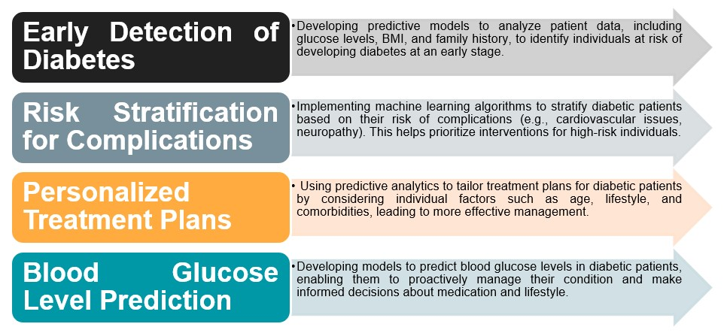
Industry Use Case

Slide 10
THANK YOU

