Slide 1

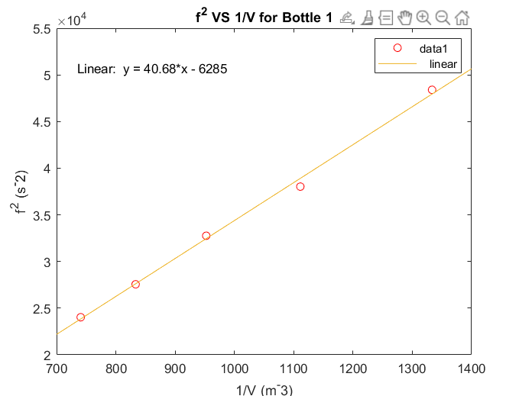
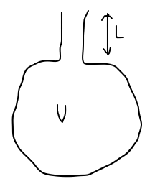
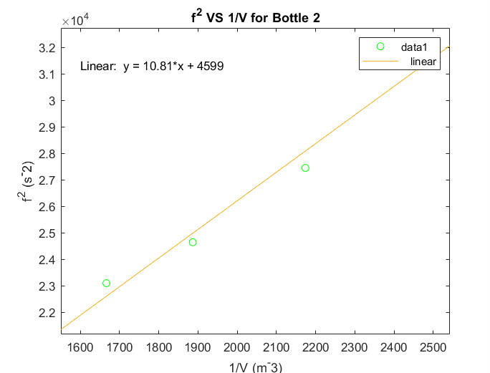
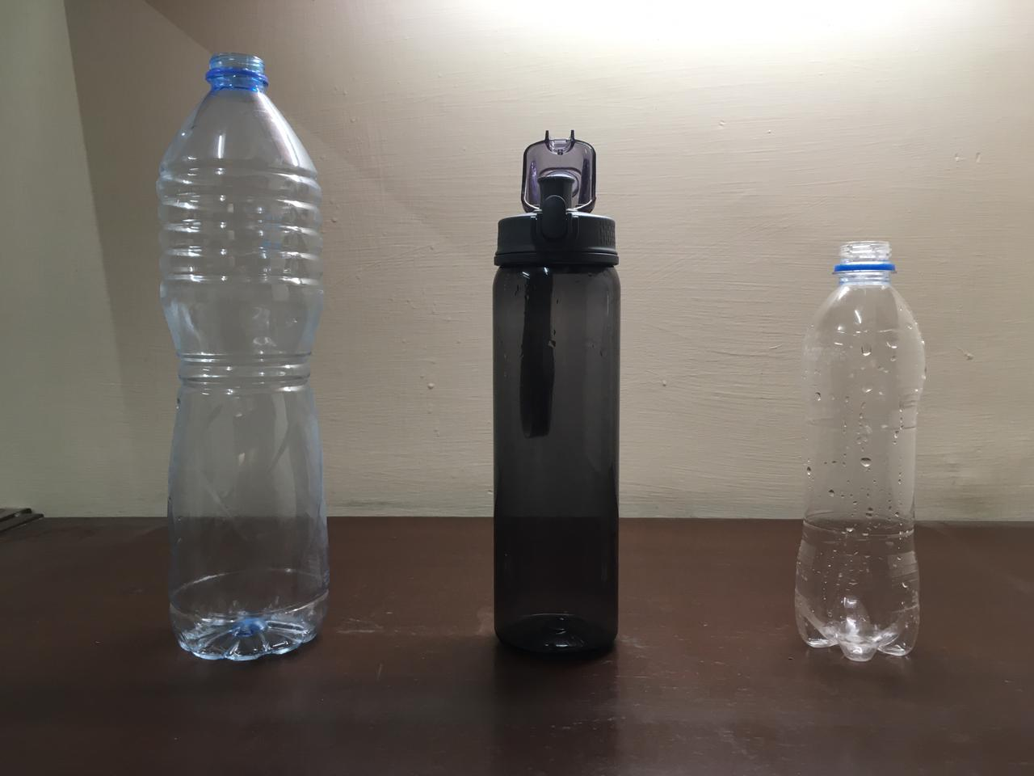
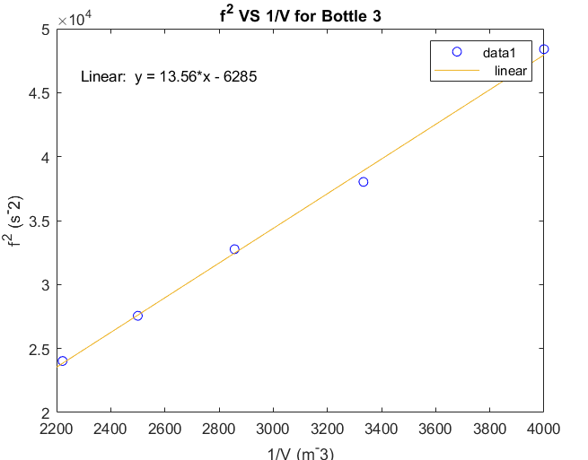


Experimental Procedure
Take a water bottle and fill it with some amount of water. Measure the amount of air in it by subtracting the volume of the water from the maximum capacity of the bottle (which can be measured using a measuring cylinder). This volume is V.
Record the length L and cross sectional area A of the bottle’s neck using a ruler. A can be determined by recording the diameter of the bottle’s neck and then using the formula for a circle’s area.
Blow air into the bottle. Use the PhyPhox application to measure the frequency of the sound produced. Repeat the process and measure 3 frequency values f1, f2 and f3 for the same amount of volume. Determine the average frequency f for a specific V.
Repeat Step 3 for 5 different values of V for the same water bottle. V can be easily altered by removing water from the bottle.
Tabulate the following quantities for the water bottle, alongside their overall uncertainties:
V
1/V
f1
f2
f3
f
f^2
Repeat all of the above steps for two additional water bottles.
For each bottle, plot a graph of 1/V on the x-axis and f^2 on the y-axis using MATLAB.
Determine the gradient m of the plot for each bottle. Calculate v using this gradient for each bottle.

Slide 2
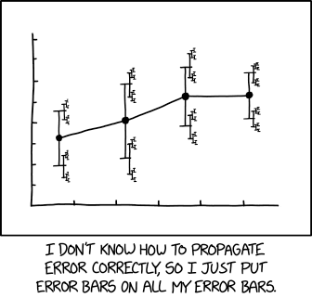
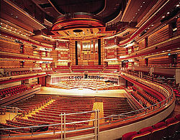
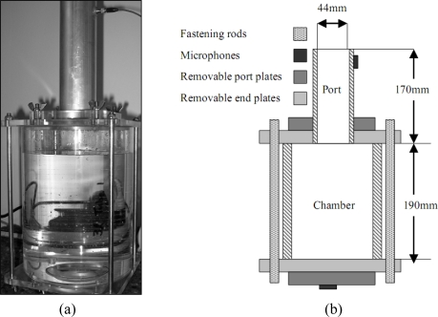
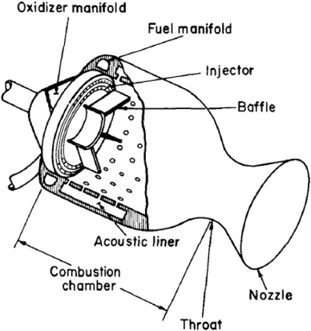
Interpretation of
Results
Sources of Error
Possible Improvements
External noise
Meniscus in measuring cylinder.
Shapes of the bottlenecks
Physical distance between the microphone and bottle.
Cross-sectional area might not remain constant.
PhyPhox Application.
Perform the experiment in a quiet area
Take a larger number of frequency measurements
Dry water from the bottle.
Use bottles with comparatively smaller volumes.
Use a decibel meter for frequency measurements.
Use calipers to measure L and determine A.
Use bottles with similar dimensions.
Theoretically, plots should have passed through the origin, but they didn’t.
Experimental errors contributed to the actual results not reflecting theoretical predictions.
Applications of Helmholtz
Resonance
Theatrical Acoustics
Determining the volume of a liquid
Rocket engines.

