Slide 1

IRTAZA
THE DATA INITIATIVE ​ week 7th project
Power BI Basic

Slide 2
Agenda
1
2
3
4
5
Introduction
Analysis base on customer
Analysis base on Geo location
Analysis base on Dates
Conclusion

Slide 3
Introduction
Here is a dataset from a brand that sells various clothing items. As a data analyst, my role was to analyze this data to extract valuable insights. I focused on examining the data based on geographic location, sales, customer behavior, and monthly sales trends. This analysis aims to help the brand optimize their production for specific months and locations to achieve maximum outcomes.

Slide 4
Analysis base on Customer
Base on Gender
I analyzed the gender distribution of our customers and found that there are 300 more male customers than female customers. However, this difference is relatively small, and many men also purchase products for women. Therefore, we do not need to make any business changes based on gender.
Base on Martial status
I also analyzed the data based on marital status and found a difference of 6,000 customers between married and single individuals. Married people show more interest in our products. Out of 600,400 customers, 33,273 are married. Therefore, we should focus on products targeted at married customers.

Slide 5
Education analysis
During the analysis of customer education and profession, I found that out of 600,400 customers, 5,356 have a bachelor's degree, 5,064 have some college education, and over 3,000 are high school graduates. This means that more than 50% of our customers have an education level higher than high school. Additionally, 5,520 customers are professionals, 4,500 are skilled manual workers, and over 3,000 are in management. This indicates that we should focus more on products targeted at high school graduates and working professionals.

Slide 6
Assets analysis
During the analysis of assets, I found that customers who own at least one house show greater interest in our products, accounting for 67.64% of our customer base. Regarding car ownership, customers with 0, 1, or 2 cars are more interested in our products, making up 79% of the customer base. However, customers with more than 2 cars are less interested. Additionally, customers with 0 or 1 child account for 67% of our customer base. Therefore, we should also focus on customers with more children.

Slide 7
Income analysis
During the income analysis, I realized that customers with a yearly income between $40,000 and $70,000 show a strong interest in our products and purchase frequently, generating more revenue than other income groups. Therefore, we should focus on attracting other income groups while strengthening our hold on this key segment.

Slide 8
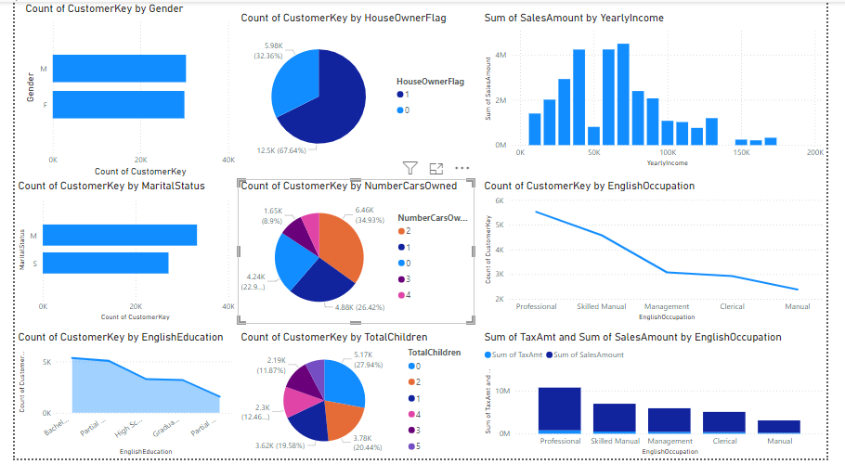
Customer analysis

Slide 9
Sales from different countries
North America
9,386,789$
Tax: 751,183$
Australia
9,061,000$
Tax: 724,880$
United kingdom
3,391,721$
Tax: 271,336$
Germany
2,893,312$
Tax:231,544$
France, Canada
2,644,017$ and
1,877,844$

Slide 10
Areas of focus
States
California, England and Washington DC
Because this state give more revenue and have more number of customer we don’t afford to loose them
Countries suggestion
New Zealand, Ireland, south America
We also need to focus the countries which are near to our most revenue countries because there is little change between their demography and we easily step in that market with little change in product and marketing

Slide 11
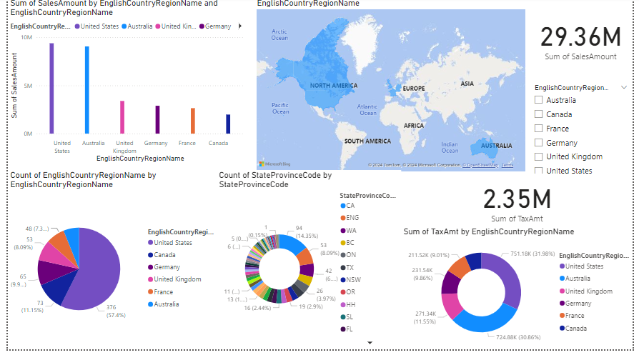
Geo location chart​
Envision multimedia-based expertise and cross-media growth strategies​ Visualize quality intellectual capital​ Engage worldwide methodologies with web-enabled technologies​ ​
Pursue scalable customer service through sustainable strategies​ Engage top-line web services with cutting-edge deliverables​
Cultivate one-to-one customer service with robust ideas​ Maximize timely deliverables for real-time schemas

Slide 12
Dates Analysis
During the analysis, I discovered that we have a higher number of customers at the start of summer vacation, as most of our products are related to summer, and also in December due to Christmas. Therefore, we need to increase our production in April, March, and November. There are also significant orders in April and March, though not as many as in May and June. Out of our total revenue of $29 million, over $9 million comes from May, June, and December. To meet market demand, we should ramp up production before these months and add more products related to summer vacation and Christmas to attract more customers.

Slide 13
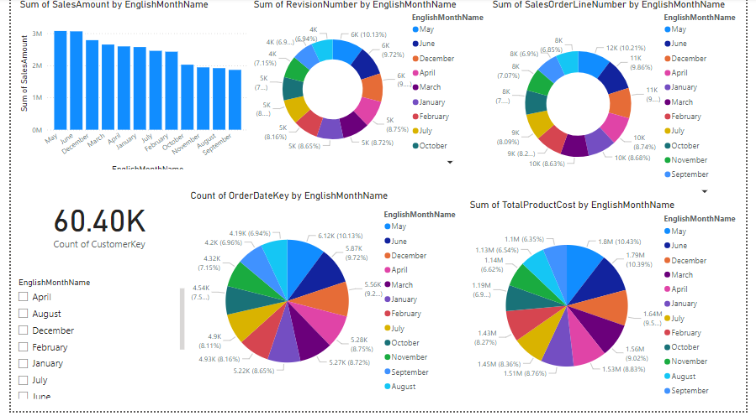
Date Analysis chart

Slide 14

Thank you
Irtaza
irtazasheikh402@gmail.com

