Slide 1
Umubyeyi
A bilingual first-time-mother emotional-well-being assistant
Raissa Irutingabo • Mission Capstone Defense • 2026

Slide 2
Outline
Introduction
Problem and intended user
Literature synthesis and gap
Objectives and strict scope
Data
Dataset and target
Methodology
Model selection and full-model results
Practical guided check-in
Current system architecture
Training and Testing Evidence
Functional and testing evidence
What was trained—and what was not
Results and Discussion
Results, limitations and real-world validity
Conclusions
Recommendations and impact

Slide 3
1. Problem and intended user
The first months after childbirth can involve sadness, anxiety, guilt, isolation and exhaustion.
Kinyarwanda-speaking mothers have limited access to culturally reviewed digital support.
The assistant must support the mother while refusing diagnosis, emergency care and unrelated requests.
Mission: accessible bilingual support with transparent evidence and human referral boundaries.

Slide 4
2. Literature synthesis and gap
Maternal chatbots mostly emphasize pregnancy, clinical tracking, or English-speaking populations.
African-language performance and reviewed Kinyarwanda resources remain limited.
Generative flexibility creates risk when health responses are unsupported.
Gap: bilingual postpartum emotional support combining screening research, evidence grounding and deterministic safety.

Slide 5
3. Objectives and strict scope
Train and compare seven classifiers on licensed postpartum participant data.
Build a practical reduced-input, non-diagnostic guided check-in.
Support reformulated English and Kinyarwanda emotional messages through retrieval by similarity.
Place crisis, acute-health, baby-care and unrelated-topic rules before generation.
Evaluate with held-out metrics, automated tests, benchmarks and transparent limitations.

Slide 6
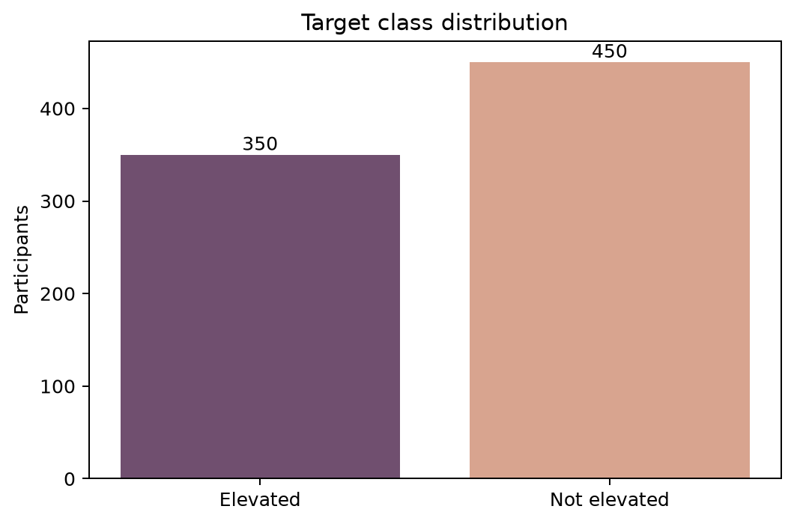
4. Dataset and target
800 postpartum participants from Bangladesh • 70 source columns • CC BY 4.0.
Target: EPDS High = elevated; Low/Medium = not elevated (350 vs 450).
Concurrent EPDS/PHQ questions, totals and derived labels excluded to prevent leakage.
46 retained predictors • stratified 560/120/120 split • seed 42.
Limitation: not Rwanda-specific, not first-time-only, and up to 24 months postpartum.

Slide 7
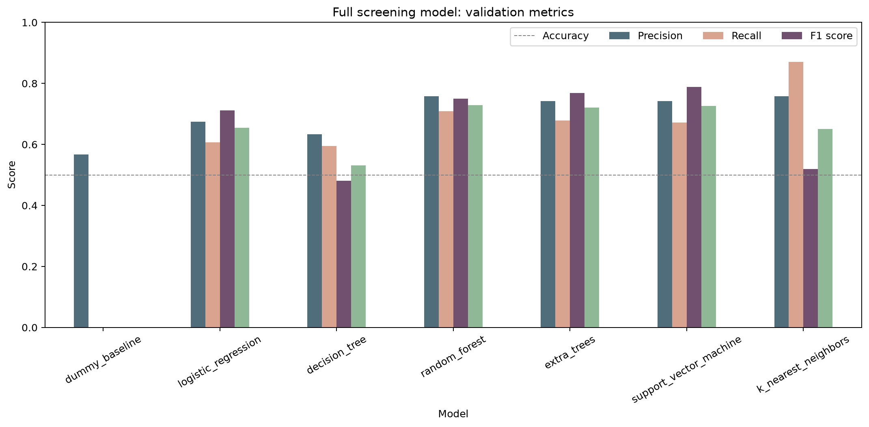
5. Methodology and model selection
Numeric: median imputation + standardisation.
Categorical: most-frequent imputation + one-hot encoding.
Seven candidates: Dummy, LR, Tree, RF, Extra Trees, SVM and KNN.
Winner selected using validation F1 for the elevated class.
Only the selected configuration evaluated on untouched test data.

Slide 8
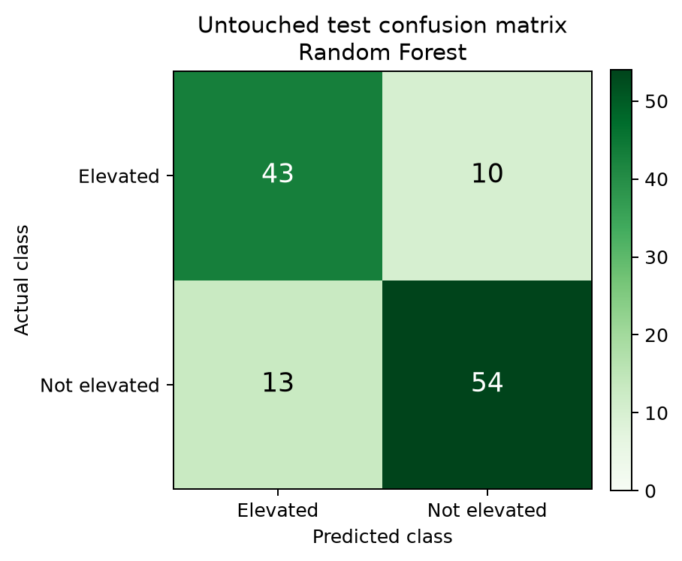
6. Full-model results
Random Forest selected • 46 predictors.
Accuracy 0.8083 • Precision 0.7679.
Recall 0.8113 • F1 0.7890.
43/53 elevated cases detected; 10 missed; 13 false alerts.
Held-out performance is screening research, not diagnosis.

Slide 9
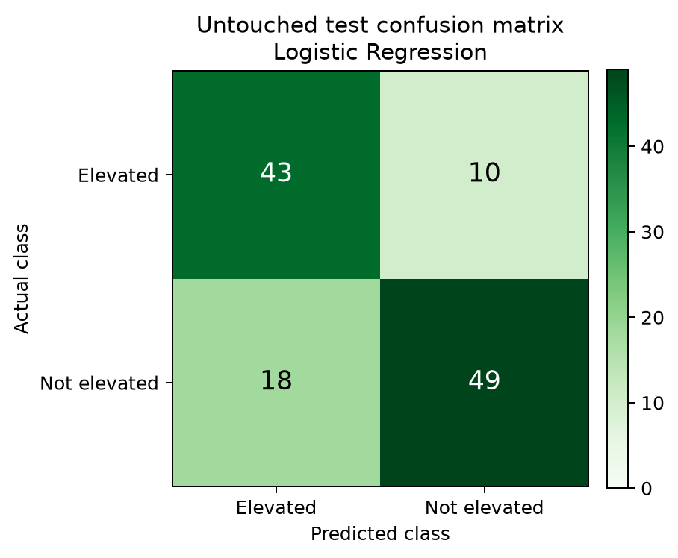
7. Practical guided check-in
Same seven algorithm families compared using 15 understandable inputs.
Logistic Regression selected by validation F1.
Accuracy 0.7667 • Precision 0.7049.
Recall 0.8113 • F1 0.7544.
Same recall as the full model, with more false alerts but much lower input burden.

Slide 10
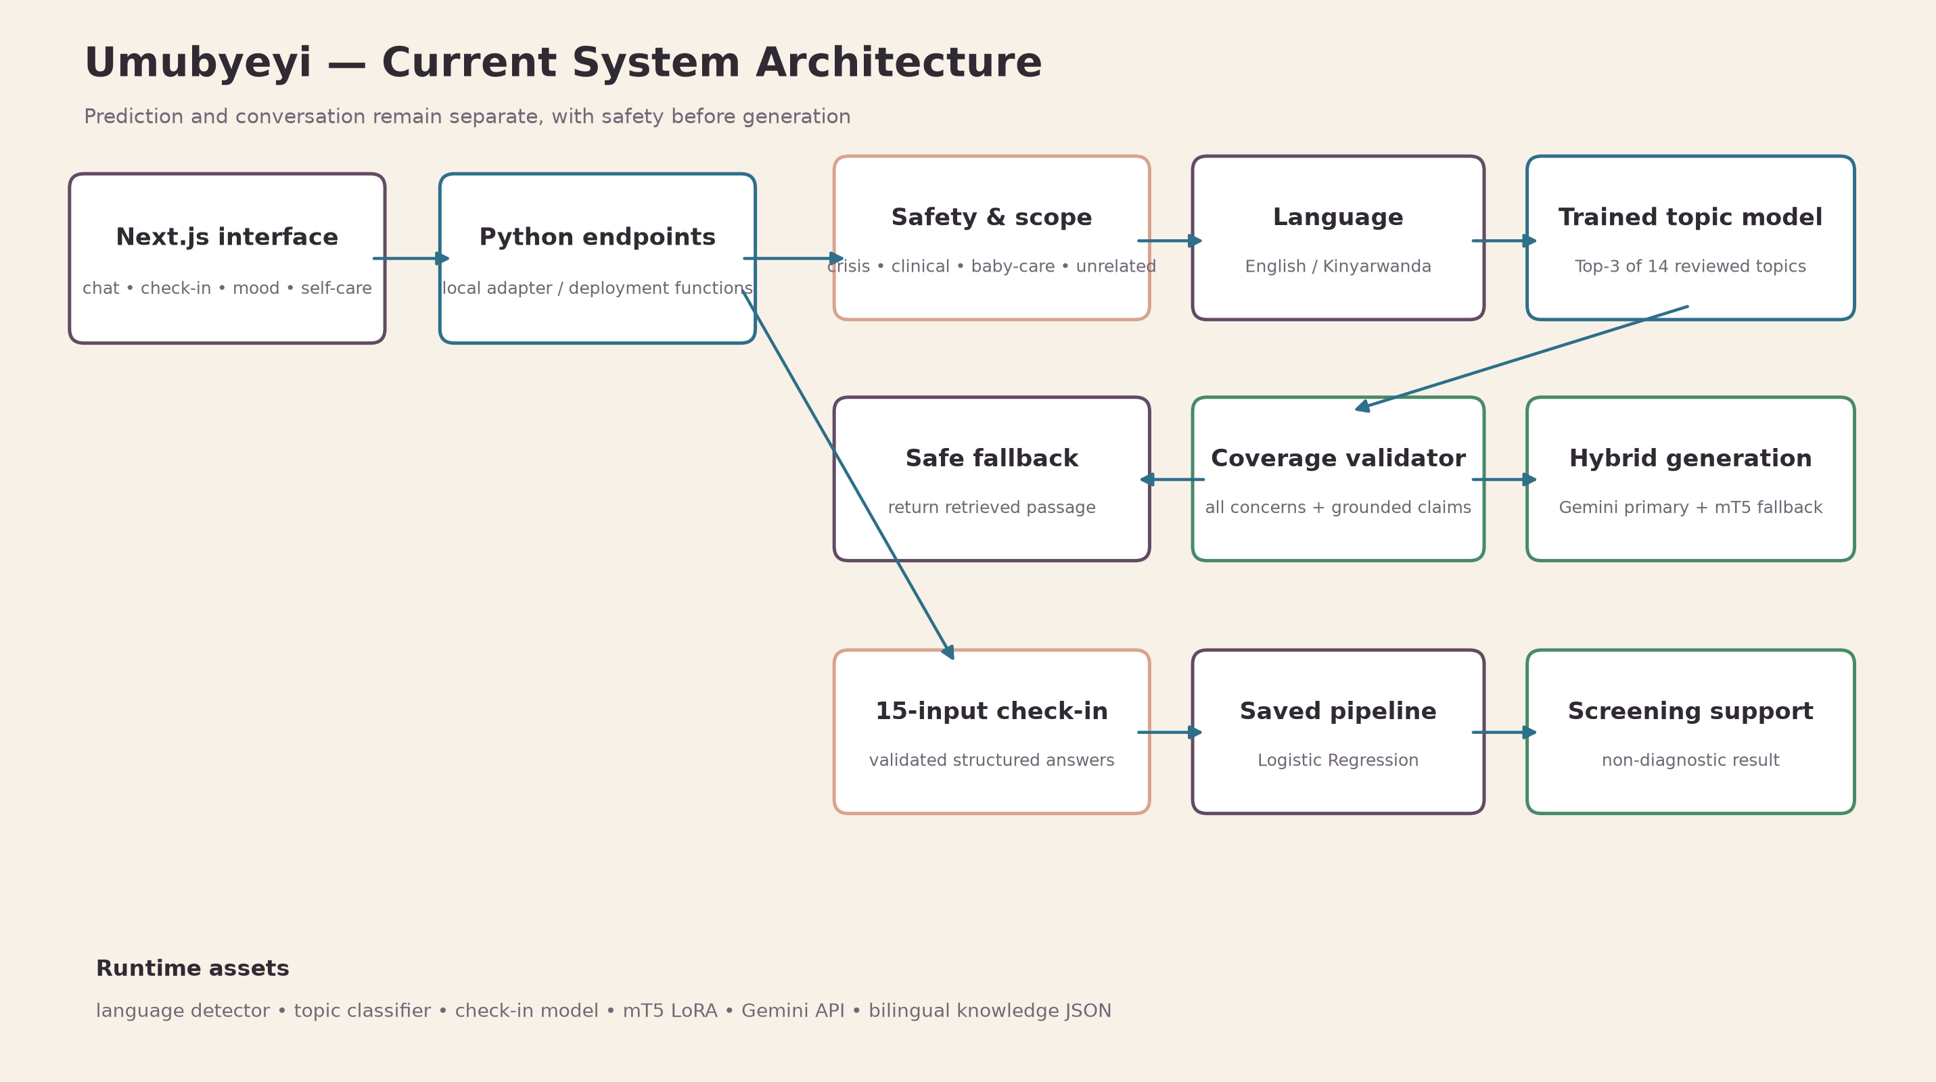
8. Current system architecture

Slide 11
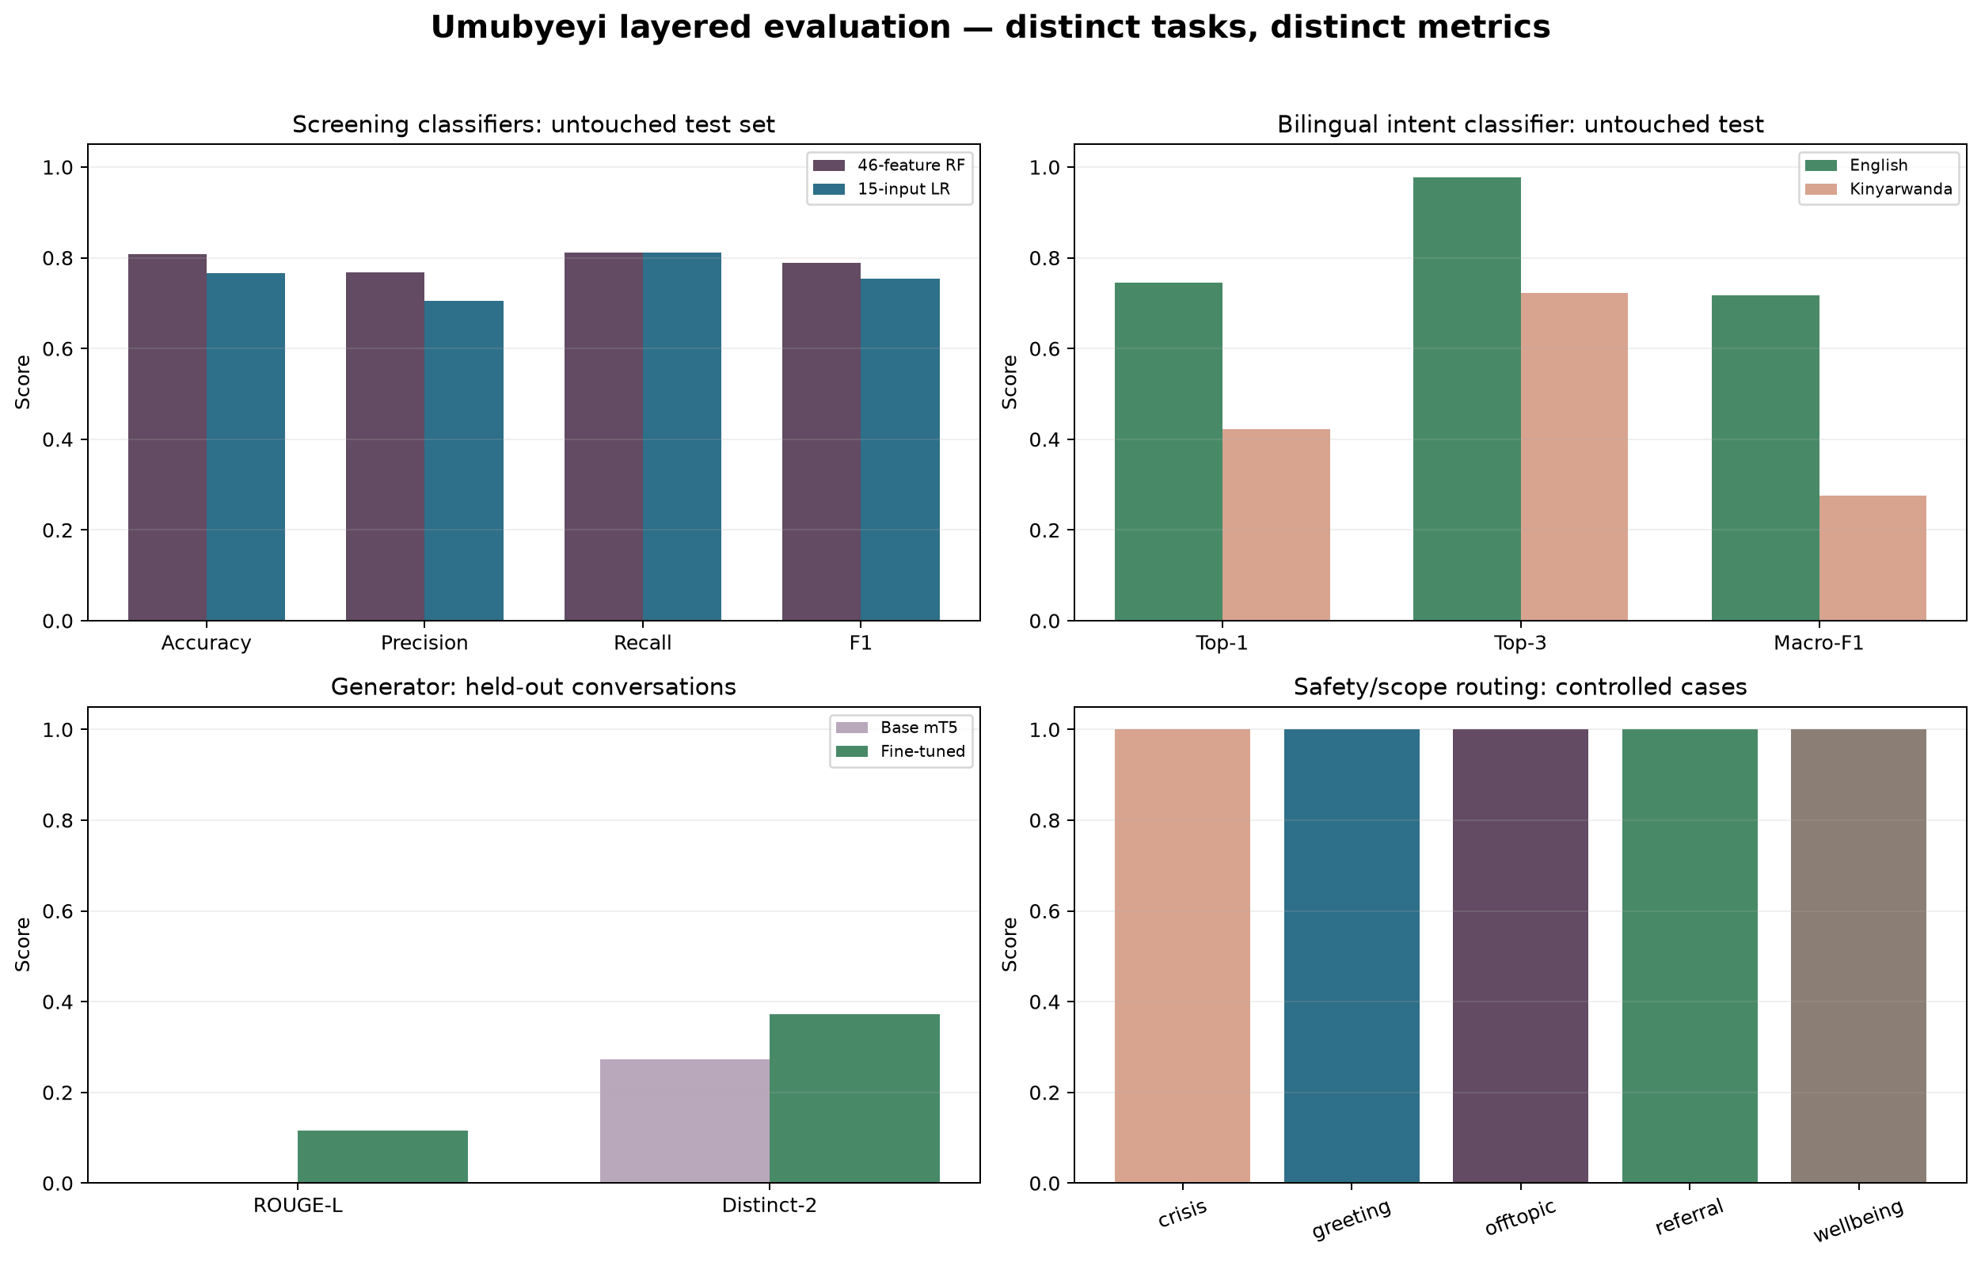
9. Functional and testing evidence
67 automated tests: unit, boundary, invalid-input, offline, HTTP, safety and evaluation integrity.
Layered results: classifiers, question matching, generation quality, safety routing and latency.
Trained six-class bilingual intent classifier: English Top-1 74.44%, Top-3 97.78%; Kinyarwanda Top-1 42.22%, Top-3 72.22% (90 controlled cases per language).
English retrieval: Top-1 64.29%, Top-3 92.86% on 14 controlled paraphrases.
Controlled RW retrieval and safety routing reached 100%; neither is real-user validation.
Production Next.js build passes.
All cases and metrics are retained as JSON for audit and reproduction.

Slide 12
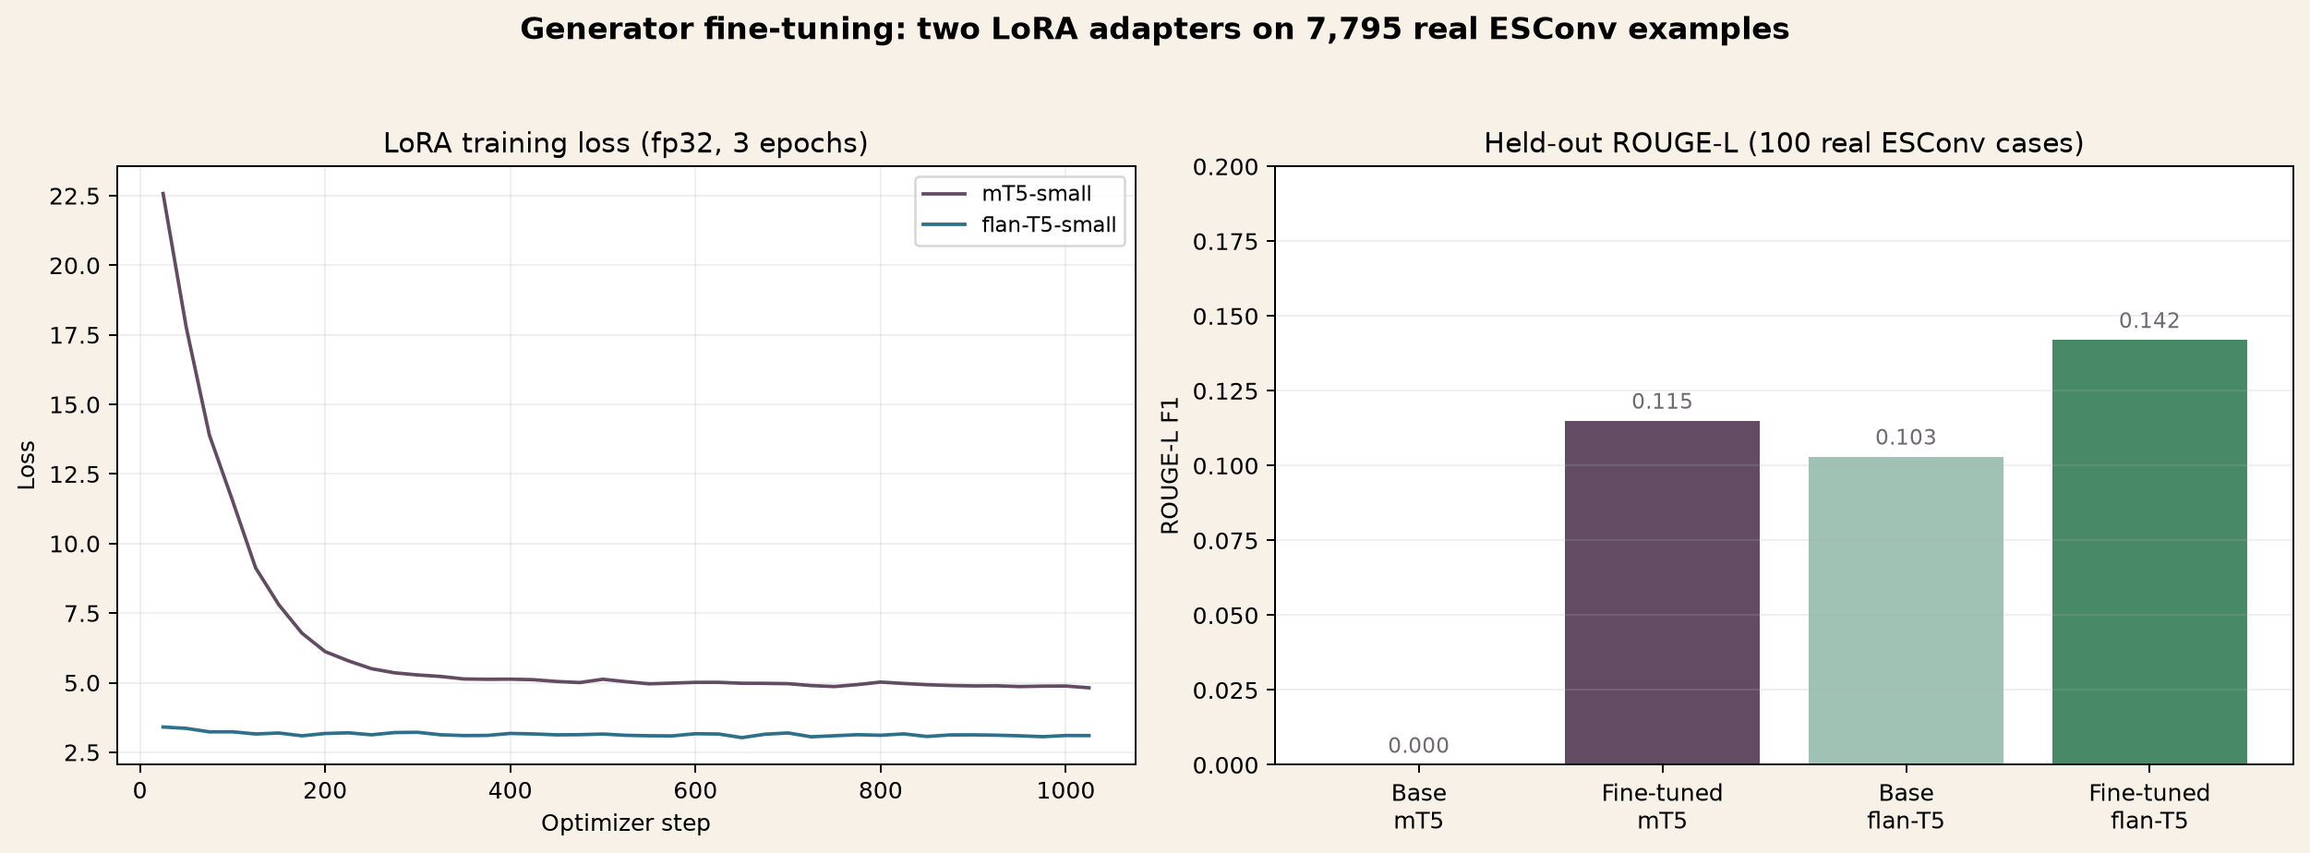
10. What was trained—and what was not
Trained here: two screening experiments, bilingual intent classification, and two LoRA generators.
Built here: preprocessing, retrieval, safety policy, grounded Gemini integration, OOP services and interface.
mT5-small LoRA (deployed): 344,064 parameters updated; validation loss 4.36 to 4.18 over 3 epochs.
flan-T5-small LoRA (comparison only, not deployed): same LoRA config; validation loss 2.95 to 2.92.
Held-out ESConv cases (100): ROUGE-L 0.000 to 0.115 (mT5-small), 0.103 to 0.142 (flan-T5-small).
7,795 real ESConv conversation examples used; AMOD returned 0 rows this run (HF gated-license fetch).
Gemini is externally hosted and not claimed as project fine-tuning.

Slide 13
11. Results, limitations and real-world validity
Technically functioning prototype with held-out model evaluation and reproducible evidence.
No clinical diagnosis, calibration or validation for Rwanda is claimed.
Both fine-tuned generators are English-only; Kinyarwanda always routes to grounded Gemini or retrieval.
If Gemini is absent, times out or fails validation, the RW source passage is returned.
Intent Top-1 74.44% (English) still exposes ambiguity; Top-3 reaches 97.78%.
No formal field study with postpartum mothers has yet been completed.
Safety rules and retrieval reduce risk but do not replace professional support.

Slide 14
12. Recommendations and impact
Collect Rwanda-specific data through an ethically approved study.
Conduct native-speaker, health-professional and usability review.
Compare multilingual semantic embeddings with character TF-IDF.
Evaluate calibration, fairness, false-negative risk and resource usage.
Create a larger reviewed bilingual corpus for a stronger second fine-tuning experiment.
Impact: a transparent foundation for safe, locally operated maternal-support research.

Slide 15
Thank you — questions
Umubyeyi • support the mother • stay within evidence • refer when uncertain
Core distinction: screening prediction and emotional-support conversation are separate tasks.
Key result: strong recall with transparent limitations and safe referral boundaries.
Live demonstration: trained topic selection • grounded Gemini • mT5 fallback • check-in • safety.

